Slide 1
JFF & SBCTC
Collaborative Projects
PRESENTED BY
Holly Siino and Jodi Novotny, JFF

Slide 2
Our mission
JFF is building a future that works—for everyone. We transform U.S. education and workforce systems to drive economic success for people, businesses, and communities.
BUILDING A FUTURE THAT WORKS—FOR EVERYONE.

Slide 3
Our vision & North Star
BUILDING A FUTURE THAT WORKS—FOR EVERYONE.
By 2033, 75 million Americans facing barriers to economic advancement will have quality jobs.

Slide 4
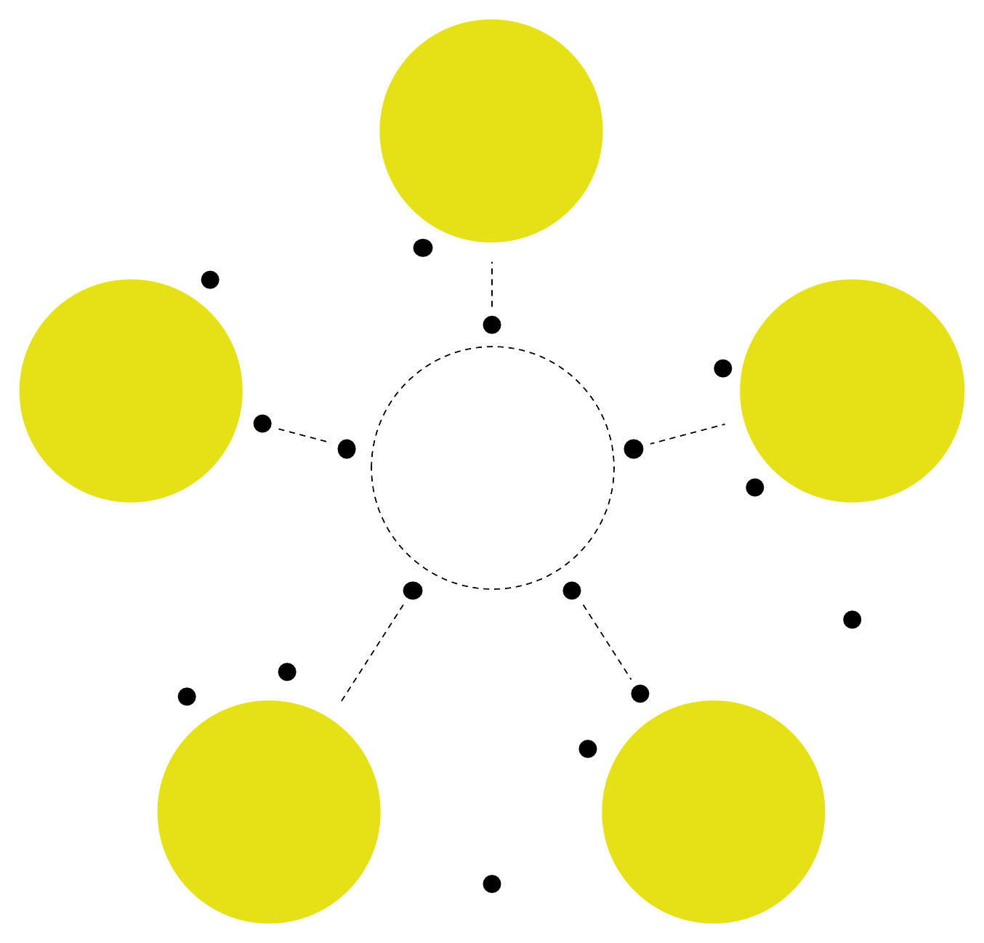
OUR PARTNERS
JFF
works with:
Policymakers
& government
BUILDING A FUTURE THAT WORKS—FOR EVERYONE.
Education & workforce development
providers
Employers
Philanthropies & nonprofits
Investors & entrepreneurs

Slide 5
JFF is supporting the State Board through two distinct, but complementary projects aimed at advancing student success and equity.
BUILDING A FUTURE THAT WORKS – FOR EVERYONE
Guided Pathways Planning Project
Early Adopter Advising Technology Project
Focused on strengthening Guided Pathways implementation by supporting colleges with strategies and tools to accelerate progress and address equity gaps.
Aided by a new advising platform, this project aims to enhance student advising and support by identifying and scaling effective practices that help students navigate their educational journeys.
Both projects seek to align and connect student success initiatives across the system, creating more coherent and sustainable structures to support implementation.

Slide 6
JFF/WA Projects
ECMC Student Advising
Ascendium State Impact Strategies
Year One |  |  |  |  |  |  |  |  |  |  |  | Year Two
2024 |  | 2025 |  |  |  |  |  |  |  |  |  |  |  | 2026
Nov | Dec | Jan | Feb | Mar | Apr | May | June | July | Aug | Sep | Oct | Nov | Dec | Jan | Feb | Mar | Apr | May | June | July | Aug | Sep | Oct
Pre-Launch: Planning, outreach, and data collection |  |  |  |  |  |  | Advising Scan: In-person convening, stakeholder engagement.
 |  |  |  |  |  |  |  |  |  |  |  |  |  |  |  |  |  |  |  |  | Learning & Sustainability: Convenings, webinar, field-facing blog.
 |  |  |  |  |  |  |  |  |  |  |  | Design to Implementation: Customization of advising tool, implementation begins.
 |  |  |  | Project Design & Engagement: Institutional selection, advising audits begin
 |  |  |  |  |  |  |  |  | Strategy Maps: Policy review, infrastructure planning.
 |  |  |  |  |  |  |  |  |  |  |  |  |  |  |  |  |  | Testing & Process Evaluation: Full rollout/testing, coaching support.
Discovery Phase: Desk Research |  |  | Develop Guided Pathways Guide: Develop content for planning guide
 |  | Mobilize Stakeholders: Collaboration with GPAC to develop content for Guide |  |  |  |  |  |  | Pilot Guide within the System Professional development and learning

Slide 7
From Planning to Impact:
How Guided Pathways Implementation Bridges Leading and Lagging Indicators
Inputs
New Student Advising Platform Provides data and structure to support student decision making on Pathways
Outcome
Impact
Process
Improved Pathways Design through GP plans: Advising & Equity Focus
Maximize impact on
student outcomes and center student experiences
Guided Pathways Work through 2024:
Leading
Indicators (2024 Report)
Increased completion, transfer, and equity (Measured in 2029 Report)
Guided Pathways Planning and institutional Adoption
Increased Guided Pathways capacity through planning and feedback from system stakeholders , toolkit development, dissemination, and training
7

Slide 8
An Agile Approach
Ascendium Scope Review
Centering continuous improvement
Adapting policies and practices in response to student data
Connecting policy and practice reforms
Marrying policy and practice into interconnected feedback cycles
Prioritizing student outcomes
Prioritizing intentional student outcomes in program design
8

Slide 9
Our goals
Guided Pathways
Update Guided Pathways strategy that centers KPIs, performance targets, and data and action reporting cycles in advance of the 2026 planning cycle
Ascendium Scope Review
Washington
Build capacity for Guided Pathways Planning through resources and tools (i.e. a new planning toolkit)
Implement a statewide student advising platform, building on the colleges’ recent adoption of a common Enterprise Resource Planning system (ERP), ctcLink
https://silhouettegarden.com/download/north-carolina-silhouette/#terms; https://silhouettegarden.com/download/washington-silh

Slide 10
Guidebook- Key Components
Guided Pathways “Ideal State”
Institutional Assessment
Planning Strategies and Exemplars
Data Guidance
Action Planning Template
BUILDING A FUTURE THAT WORKS – FOR EVERYONE

Slide 11
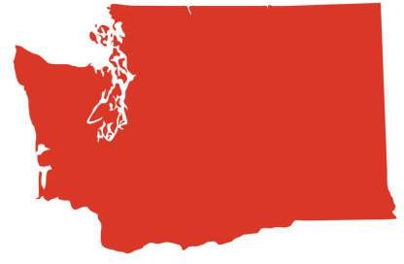
JFF will collaborate with the State Board to work with five early adopter institutions to...
EARLY ADOPTER ADVISING TECHNOLOGY PROJECT
Conduct a local advising scan and define the future state
Engage students meaningfully in advising reform efforts
Implement a new advising platform based on local needs
Share ideas and problem solve with peers in a community of practice through the fall of 2026
Disseminate learnings more broadly to other WA CTCs and nationally

Slide 12
Application Process
EARLY ADOPTER ADVISING TECHNOLOGY PROJECT
Application launched on April 1
Informational webinars were held on April 8 and May 7
Application closed on May 15
Colleges were notified on May 28th
Selection Committee members used a rubric to evaluate how applicants planned for key areas aligned to the project's goals. These included:
Criteria for Success
Establishing and sustaining a cross-functional implementation team
Developing a phased and actionable implementation timeline
Demonstrating commitment to advising improvements and equitable student outcomes
Utilizing a data-informed strategy to guide advising redesign
Engaging students meaningfully in advising reform efforts
Sharing promising practices and collaborating with peer institutions

Slide 13
Institutions Selected for the Early Adopter
Advising Implementation Project
BUILDING A FUTURE THAT WORKS – FOR EVERYONE
Bates Technical College
Edmonds College
Pierce College
Spokane Falls Community College
Whatcom Community College

Slide 14
Questions?
Contact Us
Jodi Novotny, Director
jnovotny@jff.org
Holly Siino, Senior Manager
hsiino@jff.org

