Slide 1
SBCTC Updates
Fall WSSSC Meeting 2024
Jamie Traugott, Director of Student Services & K12 Alignment

Slide 3
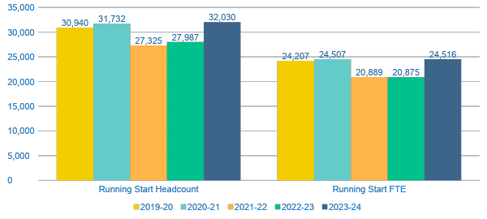
HEADCOUNT AND ANNUAL FTE: RUNNING START
Notes:
This is the same information as slide 3; however, it includes only Running Start, depending on whether you want to display the programs side by side or separately.
Enrollment in both programs dipped during the pandemic. CiHS enrollment declined in 2020-21, whereas Running Start enrollment declined in 2021-22, a year later.
CiHS enrollment surged in 2023-24 following investment by the legislature.
In 2023-24, CiHS headcount increased 53% over 2022-23.
In 2023-24 CiHS FTE increased 64% over 2022-23.
Compared to 2019-20:
In 2023-24 Running Start headcount increased 4%.
In 2023-24 Running Start FTE increased 1%. (This excludes FTE that RS students enroll in that are not covered by the Running Start program.)
Compared to Pandemic Lows:
RS headcount and FTE both increased 17% in 2023-24
CiHS headcount and FTE increased 104% in 2023-24

Slide 4
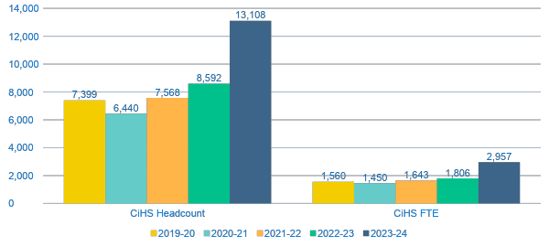
HEADCOUNT AND ANNUAL FTE: COLLEGE IN THE HIGH SCHOOL
Notes:
This is the same information as slide 3; however, it includes only CiHS, depending on whether you want to display the programs side by side or separately.
Enrollment in both programs dipped during the pandemic and have since rebounded. CiHS enrollment softened in 2020-21, whereas Running Start enrollment softened a year later, in 2021-22. Both programs reached all-time high enrollments in 2023-24.
CiHS enrollment surged in 2023-24 following investment by the legislature.
In 2023-24, CiHS headcount increased 53% over 2022-23.
In 2023-24 CiHS FTE increased 64% over 2022-23.
Compared to 2019-20:
In 2023-24 Running Start headcount increased 4%.
In 2023-24 Running Start FTE increased 1%. (*Running Start FTE includes FTE funded by the program and does not include state-supported FTE that students may enroll in outside of Running Start. Students may have split enrollment as state-supported students not reflected in these figures.)
Compared to Pandemic Lows:
RS headcount and FTE both increased 17% in 2023-24
CiHS headcount and FTE increased 104% in 2023-24

Slide 5
Basic Needs Survey
The WA Basic Needs Survey 2024 is legislatively mandated by the Postsecondary Basic Needs Act (2SHB 1559 2023). The survey, which is administered biannually to all students enrolled in public higher education institutions in Washington State, provides institutions, systems, and the legislature with data about the current level of unmet basic needs experienced by Washingtons higher education students.
WWU will administer the survey from 10/28/2024 until 11/22/2024. The survey will be distributed via email to current students enrolled in credit-bearing, apprenticeship program and adult basic education courses at all of the SBCTC system colleges. WSAC and SBCTC are working on preparing guidance for colleges on additional marketing and communication strategies to maximize the response rate.

Slide 6
FAFSA Update
The Department of Education announced this summer that the opening of the FAFSA form will be released on December 1st, 2024. This delay is set to allow for beta testing of the application functionality throughout the fall term. The intention is to have a fully functional application to reduce the risk of technical errors and delays for students and families.
College Aid Services (CAS) conducted a thorough evaluation of the PeopleSoft (ctcLink) Financial Aid module, examining system functionality, the skills of support staff, and policy resources and guidance/direction within SBCTC’s Education Division. The assessment highlighted optimizations already implemented and identified areas for further improvement, providing valuable insights for SBCTC and college financial aid offices.

Slide 7
Title II Regulations
In a landmark ruling this spring, the Department of Justice updated regulations for Title II of the Americans with Disabilities Act to include web and mobile accessibility requirements. The regulations use WCAG 2.11AA as its technical standard for compliance, and you can learn more at the ADA Fact Sheet.

Slide 8
Dual credit updates
College in the High School (CiHS) 2023-2024 Review cycle has been completed. Any additional evidence needed for approval for continued program implementation is due October 15, 2024 to The Standards Review Report and Process Committee.
SBCTC staff is submitting the 2023-2024 CiHS report on course enrollment to the Office of Financial Management this fall. Colleges should expect to receive their reimbursement in the January 2025 allocation.
Dual Credit Reports
The first College in the High School Legislative Report in response to 2SSB 5048 is available now.
Running Start and College in the High School: Assessing Transferability-State Auditor Office
2024 ERDC Annual Dual Credit Report

Slide 9
Dual Credit updates
Fall 2024 Dual Credit Webinar
In collaboration with OSPI, SBCTC will offer a Dual Credit Webinar open to all for systemwide dual credit updates.
10/23 9:30-11am https://us02web.zoom.us/j/81497951056
Running Start Virtual Series
Each session has included updates from SBCTC/OSPI and space for Running Start college staff to come together and connect. The presentation portion of each session is recorded and posted to the SBCTC Dual Credit YouTube playlist.

Slide 10
Gainful Employment & Ability to Benefit
The deadline for Gainful Employment/Financial Value Transparency (GE/FVT) Reporting has been pushed back to January 15, 2025.
College Resources:
Reports for those unable to access the National Student Clearinghouse service.
Queries colleges can use to extract and upload data not provided by NSC.
Identification of programs that may be impacted by the metrics, and by changes to the 150% rule if it is re-enacted.
The U.S. Department of Education has released new regulatory information on Eligible Career Pathway Programs (ECPPs) for institutions offering Ability to Benefit. SBCTC will release further guidance and resources in November 2024.

Slide 11
Student trainings, Education, & Awareness
ESSSB 5227 Diversity, Equity, Inclusion, and Antiracism Training and Assessments
Implementation Timeline: Fall term 2024
Provide a program on diversity, inclusion, and antiracism to students.
Sample Rubric for Student Diversity Training
HB 2112 Opioid Education and Awareness
Provide opioid and fentanyl prevention education and awareness information.
Make fentanyl test strips and naloxone available.
Train staff working in residence halls how to administer naloxone.

Slide 12
Student Financial Responsibility Agreement
This student Financial Responsibility Agreement is designed to comply with the following laws:
RCW 28B.10.293: Permitting educational institution to impose reasonable financing and late charges, as well as debt collection charges, but only if so provided for in an agreement signed by the student debtor.
RCW 43.17.240: Requiring state agencies and institutions to impose a financing charge of 1% a month on unpaid accounts starting on the date the unpaid account becomes past due.
RCW 19.16.500: Authorizing state agencies and institutions to refer delinquent accounts to a collection agency and to require the debtor to pay reasonable collection agency fees and costs.
U.S. Bankruptcy code, 523(a)(8): Student educational debts are generally non-dischargeable in bankruptcy without a court order based on undue hardship, but may garden-variety student debts (bookstore purchases, for example) remain dischargeable in bankruptcy unless the student signs a promissory note or other agreement to pay the debt. This Financial Responsibility Agreement makes all student account charges non-dischargeable in bankruptcy.

Slide 13
STUDENT SUCCESS SOFTWARE RFP UPDATE
Event | Date
RFP issued | September 30, 2024
Optional Letter of Intent Due | October 8, 2024
Vendor Pre-Proposal Teleconference | October 8, 2024
Demo Accounts Active Date | October 10, 2024
Response to Pre-Proposal Conference Questions Posted | October 10, 2024
Final Vendor questions, comments, and complaints due | October 21, 2024
Written responses to final Vendor questions, comments, and complaints | October 23, 2024
Vendor Responses and Client References due | October 29, 2024
Evaluation of Responses & Conclusion of Demo use of Vendor Solutions | October 30- November 8, 2024
Optional Vendor Demonstrations & Presentations | (TBD) November 12-14, 2024
Notification of Apparent Successful Vendor | November 19, 2024
Vendor requests for debriefing due (Optional) | November 22, 2024, 2024
Optional Vendor debriefings | December 3-5, 2024
Contract Approval & Signature | TBD
RFP is published!
Next step: identifying evaluation committee members
Invites for evaluation will be sent by the end of October

Slide 14
Evaluation committee members
Student
Student Services
Academic Advising
Accessibility
Registrar
Institutional Research
President
Business Advisory Committee (BAC)
Information Technology (IT)/Security
Academic Affairs
Equity (DEOC)
Basic Education
State Board
Representative
Faculty

Slide 15
Early Adopter COMMUNITY OF PRACTICE
Participating institutions will receive:
Funding: Up to $50,000 to support the technical and professional development needs of early adopter colleges
Technical assistance: Jobs for the Future (JFF) will provide technical assistance to equip colleges with the tools and strategies to support students from recruitment to graduation.
Peer support: Connect with peers across the state and develop a strong network of support. The CoP will share promising practices, troubleshoot challenges, and gain valuable insights from across the state.

Slide 16
Jamie Traugott, Director of Student Services & K12 Alignment
Dawn Draus, Policy Associate for Math Pathways & Placement
Math Placement Project Grant
Summer 2024 Instruction Commission
August 1, 2024

Slide 17
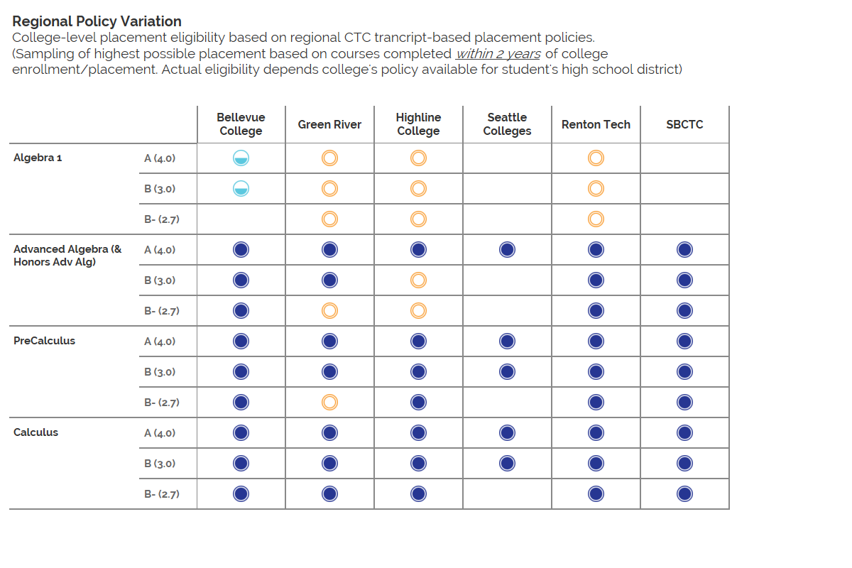
Placement Eligibility:
Precollege
College with Co-Reqs
College Level

Slide 18
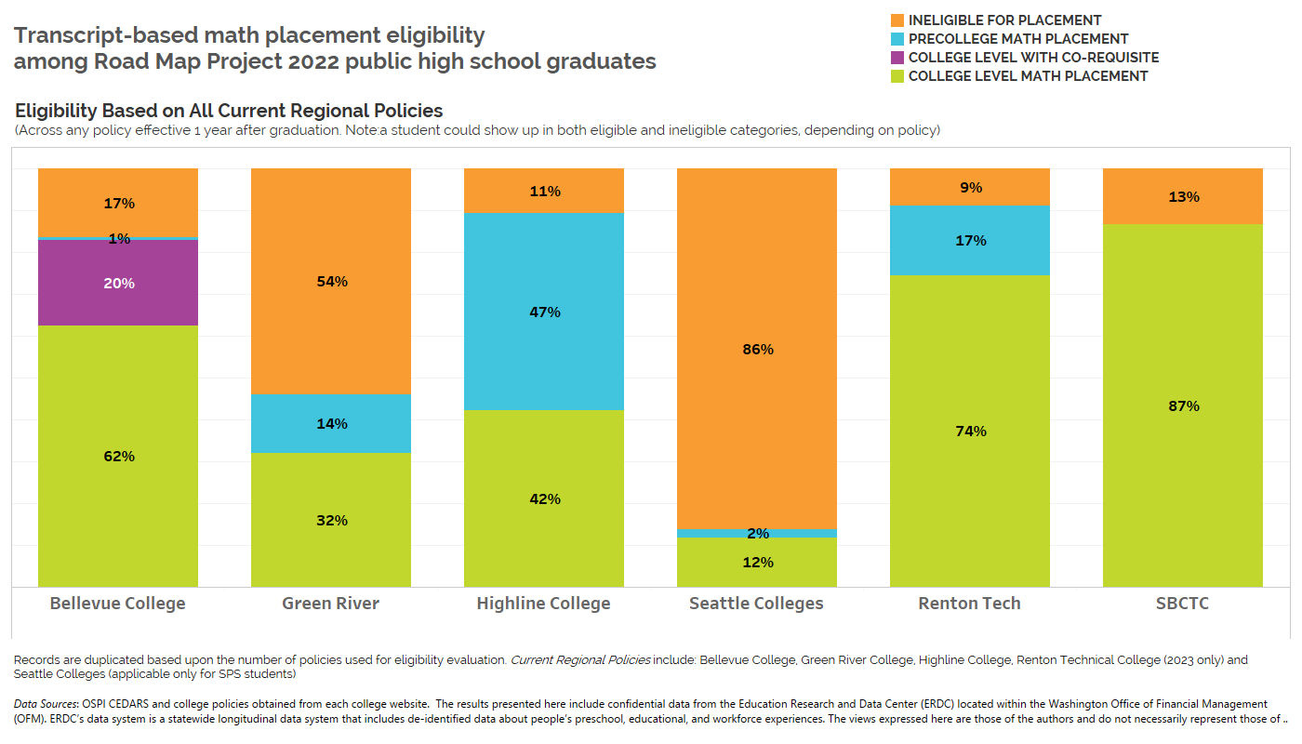

Slide 19
MATH PLACEMENT PROJECT GRANT
The Math Placement Project Grant is managed by SBCTC and generously funded by College Spark Washington.
Key Focus includes moving away from standardized testing and focusing on high school transcripts evaluation and implementing guided self-placement models designed for students to reflect on prior experiences with reading, writing and math.
The purpose of this project is to create a cohort of colleges who are willing to share and learn from each other as they invest in examining and revising their current practices to ensure that all students who are currently eligible for placement into college level courses are being enrolled into those courses.
Pilot colleges agree to use the GRID for placement and enter data into ctcLink.

Slide 20
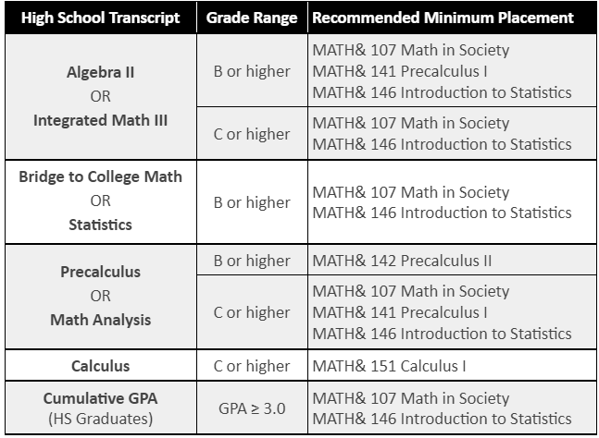
MATH PLACEMENT PROJECT - PILOT COLLEGES
Cascadia College
Everett Community College
Lower Columbia College
Renton Technical College
Shoreline Community College
Tacoma Community College

Slide 21
Placement Eligibility:
Precollege
College with Co-Reqs
College Level

Slide 23
MATH PLACEMENT PROJECT GRANT: CONSIDERATIONS AND CONVERSATIONS
Placement Reciprocity
What is the purpose of Placement Reciprocity?
Is Placement Reciprocity working?
Notes:
https://www.sbctc.edu/resources/documents/colleges-staff/programs-services/transfer/placement-reciprocity-policy-and-procedure-spring2013.pdf

Slide 24
2013 Placement Reciprocity
For all entering students at any Washington community and technical college, system policy provides that:
A student who qualifies for a specific level of pre-college math, English, or reading, either through course completion or local placement determination*, will have that course placement level honored at another Washington CTC if the student so requests, even if the courses may not be exact equivalents.
A student who qualifies for entry into college-level math, English, or reading, either through course completion or local skills placement determination, will be considered to have met the entry college-level standard at every community and technical college.
Students requesting reciprocity must initiate the process within one year of their initial placement assessment.
Notes:
https://www.sbctc.edu/resources/documents/colleges-staff/programs-services/transfer/placement-reciprocity-policy-and-procedure-spring2013.pdf

Slide 25
What’s Next?
Math Placement Summit
Exploring Statewide GSP for Math
Creating a GRID for English
Mainstream processes utilizing ctcLink

Slide 26
QUESTIONS
Jamie Traugott jtraugott@sbctc.edu
Dawn Draus ddraus@sbctc.edu
Stephanie Rock srock@sbctc.edu
sbctc.edu/colleges-staff/grants/math-placement
WAMathPathways.org

