Slide 1
WSSSC Meeting
2025 Legislative Priorities
Arlen Harris, Legislative Director Sam Herriot, Government Relations Liaison October 2024

Slide 2
Capital budget request
The State Board is required to develop a single, prioritized list of project for the community & technical college system. In 2022, the legislature further directed the State Board to prepare its capital budget requests by prioritizing minor works requests above major projects and with all the funding needed for design and construction included in a single biennium.
The system has approximately $68M in infrastructure that will be beyond its expected life at the end of the 25-27 biennium. These assets have been prioritized for replacement within the approximately $45.5M funding target.
In April, WACTC voted to approve recommendations as follows:
Prioritizes minor projects before major projects
$1M for Grays Harbor College Lake Swano Dam planning assistance
Prioritizes major projects in the priority order that they were added to pipeline
Targets an estimated request level of approximately $625M
Includes major projects that fall beyond funding target in future biennia of 10 year capital plan
Has State Board staff work with colleges to update cost estimates re: inflation, fee rates, laws, requirements and current sales tax rates

Slide 3
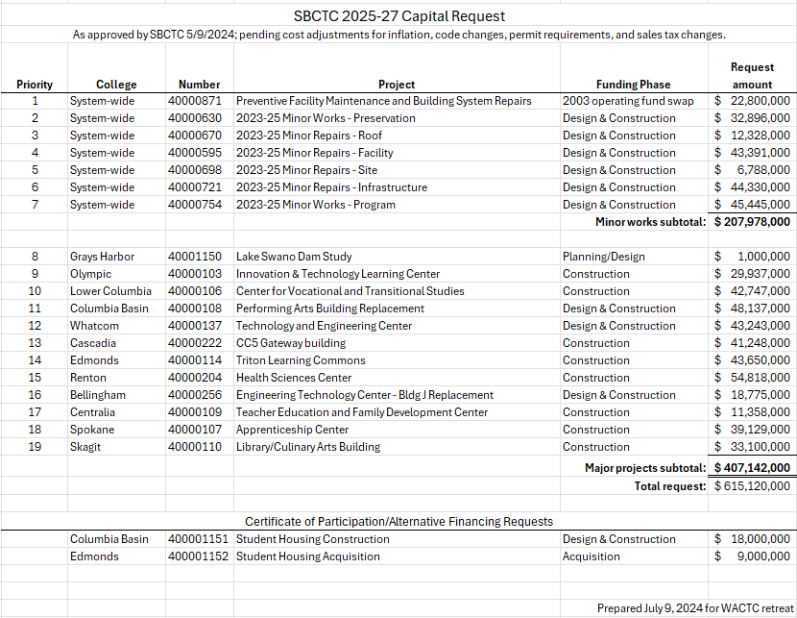

Slide 4
Capital policy proposals
Minor works limit
Increase minor works from $2 mil to $5 mil

Slide 5
Operating budget requests
The State Board approved the following priorities for the 2025 Legislative Session requests at their June meeting:
Competitive Compensation—Increase salaries for all employee groups, supported with 100% state funding. Colleges are struggling to recruit and retain faculty and staff in several areas. Recent salary increases from the legislature created equity gaps as some groups received significantly larger increases than others. These challenges cannot be address unless our college system received compensation funding to help keep pace with industry and K-12.
Increase General Purpose Funding—With the rising cost of doing business throughout all areas of campus operations, colleges are stretched to meet demand using existing resources. While individual campus needs may differ, all colleges are squeezed by cost increases, restricted funding and structural barriers that limit colleges’ ability to respond to student and college operating needs.
Expand Capacity of Job Skills Programs—Since 1983, Washington has invested in partnerships between colleges and employers to provide incumbent workers skills training through the JSP. Last biennium the program enables 17 colleges to provide 1200 customized skills courses to 8200 working learners across 118 JSP grants. Demand exceeds available funding, and expansion would provide opportunity to expand college participation to meet current demands and increase number of small, rural, diversly owned businesses supported with training grants.

Slide 6
Policy bills in development
Dual Credit:
In collaboration with OSPI and other stakeholders, a proposal will ensure book and fees are fully covered for Running Start students.
A separate proposal will fix College in the High School funding, so colleges receive the $5K per class like the regional universities.

Slide 7
Policy bills in development
Financial Aid Navigator Expansion:
Building on the work from 2022 in HB 1835, State Board staff are collaborating with Graduate Tacoma Foundation for Students, COP, and others to expand the Financial Aid Navigator pilot program state-wide.
Creates a new, optional financial aid training program for secondary school teachers and counselors, higher education staff, and community partners.

Slide 8
Policy bills in development
Tribal-affiliated students:
Automatic qualification for all ATNI students for the WA College Grant.
Lower age from 60 to 55 for the Tribal elder tuition waiver.

Slide 9
Policy bills in development
Basic Education for Adults:
Expand College Bound scholarship eligibility to include High School Equivalency (HSE) passers.
Remove age restriction (currently 19 years and older) from eligibility waiver for all or portion of tuition fees and services and activity fees for students eligible for resident tuition.
Add “person enrolled in HS completion program at CTCs” to resident student definition.

Slide 10
Policy bills in development
Mental Health Counselor expansion
SB 5194 was passed in 2021 and established a pilot program to increase student access to mental health counseling and services.
A bill proposal for the 2025 legislative session would expand this program statewide.

Slide 11
State economics
Revenue forecasts are beginning to slow down
Election results could impact our state and national economy
Ballot initiatives could carve holes in the state operating budget
Capital Gains repeal
Climate Commitment Act repeal
Legislators should double down on the solution
Continue to make investments in CTCs

Slide 12
Important dates
November 5: General Election
December 10 – 13: Legislative Assembly Days
Week of December 16: Governor’s Budget Released
January 13: First day of 2025 legislative session
January 28 (not confirmed): Regents & Trustees Day
January 30: WEA/AFT hill climb & WACTCSA day
March 28: CTC Showcase – Columbia Room
*Colleges will make two trips to Olympia during session
** More dates will be added as session approaches

