Slide 1
Opioid
Overdose
Response
Acting Dir. Of Safety & Security Greg Cranson

Slide 2
OVERVIEW
HB 2112 (2023-24)
Opioids
Naloxone
Identifying Opioid Overdose
How to Administer Naloxone
Campus Opioid Overdose Response
Campus Security Training and Response
Washington State ‘Good Samaritan Law’
How to Contact
Naloxone and Fentanyl Test Strips Around Campus
Questions

Slide 3
HB 2112 (2023-24)
Requires that naloxone and fentanyl test strips must be made available across campus
Suggested locations are health centers, student union buildings, & residence halls
Suggested some be available past 5PM and on weekends
Requires education and training on administering naloxone for staff working in residence halls
Requires opioid and fentanyl prevention education and awareness for all students. May be in person or online and must include ‘Good Samaritan’ statute training. Must be posted on public college website for students, parents, and guardians.
Students and non-uniformed Safety & Security personnel are not required by the college to assist during an overdose and are therefore covered under the Good Samaritan Law. The college prefers that if you suspect someone is overdosing on opioids, immediately contact Campus Security and 9-1-1 rather than intervening yourself.

Slide 4
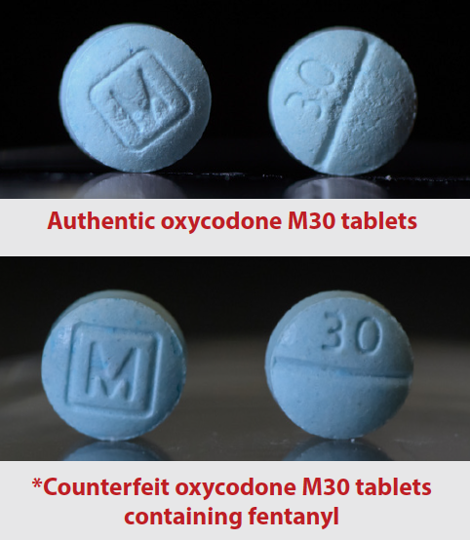
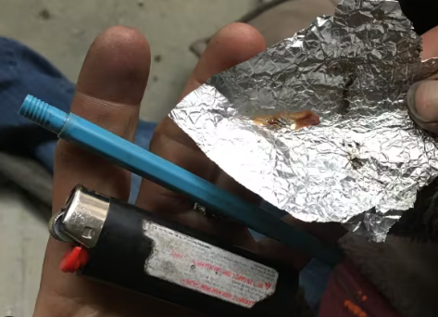
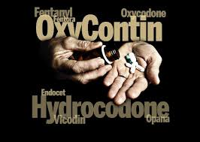
Opioids
Opioids are a type of drugs in both legal (prescription medications such as oxycodone, hydrocodone, morphine, fentanyl) and illegal(heroin) forms.
Opioids are natural or synthetic substances that act on the brain
Opioids dull pain and relieve anxiety.
People may misuse opioids because they are in pain (physical and emotional) and opioids produce a relaxed feeling.
Opioids can be inhaled, ingested, or injected

Slide 5
Naloxone
Naloxone works by reversing effects of an overdose
The only purpose is to reverse overdose; there is no abuse potential, and this medication cannot produce a “high”
Naloxone is safe. It is as nontoxic as water and has no potential for addiction. If a person has not taken opioids, naloxone will not hurt them.
Onset of action is about 2-3 minute
Duration of action is 30-120 minutes depending on method of administration
It will not reverse an overdose caused by other drugs, only opioids
May be used in children and pregnant women
Pay attention to the expiration date for any naloxone product. Most have an expiration date of about 12-18 months.
Also known by the name brand product NARCAN
Narcan is to naloxone as Advil is to ibuprofen or Tylenol is to acetaminophen or Kleenex is to facial tissues

Slide 6
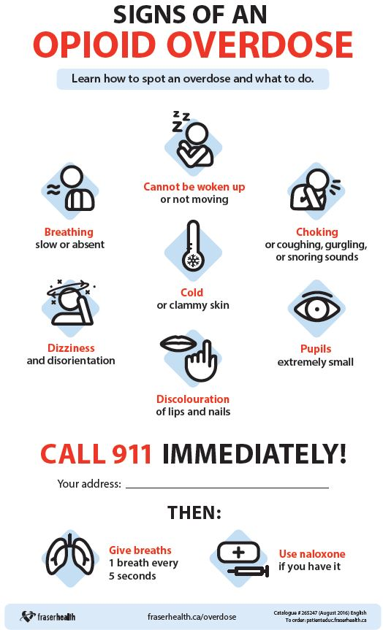
Identifying an Overdose
REALLY HIGH | OVERDOSE
Muscles becomes relaxed | Pale, clammy skin
Speech is slowed or slurred | Breathing is infrequent or has stopped
Sleepy looking | Deep snoring or gurgling
Responsive to sternal rub, shouting, earlobe pinch | Unresponsive to any stimuli
Normal heart rate and/or pulse | Slow or no heart rate/pulse
Normal skin tone | Blue lips and/or face

Slide 7
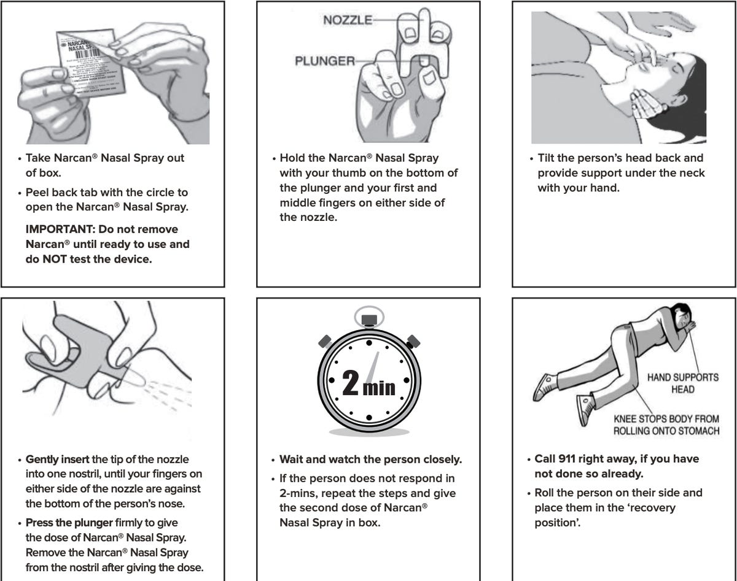
How to Administer Naloxone

Slide 8
Shoreline Community College Opioid Overdose Response
Identify suspected opioid overdose
Contact Campus Security and 9-1-1 immediately
Recruit assistance if possible
Follow all directions of Campus Security, 9-1-1 dispatch, and emergency responders
If you touched the person, items, or surfaces in the vicinity of the overdose, thoroughly wash your hands as soon as reasonable
Provide all information that you have; do not omit anything and do not guess

Slide 9
Campus Security Training and Response
Uniformed Campus Security personnel undergo annual training with a Shoreline Fire and King County Medic One Medical Services Officer
Trained in administering NARCAN and how to conduct rescue breathing with a Bag Valve Mask
Every situation will offer unique circumstances
NARCAN is 20x as potent as the naloxone administered by medical personnel
Patients can become violently ill or aggressive and hostile after administration of naloxone
Naloxone was a shorter half-life than opioids; allowing a patient to refuse medical attention, become secluded and resume overdosing
Potential of additional unknown hazards if administering to an unknown overdosing patient

Slide 10
Washington State
Good Samaritan Law
In WA State, anyone trying to help in a medical emergency is generally protected from civil liabilities by RCW 4.24.300. WA State’s 911 Good Samaritan Overdose Law RCW 69.50.315 gives additional, specific protections against drug possession charges:
If you seek medical assistance in a drug-related overdose, you cannot be prosecuted for drug possession.
The overdose victim is also protected from drug possession charges.
Anyone in WA State who might have or witness an opioid overdose is allowed to carry and administer naloxone. (RCW 69.41.095)

Slide 11
How to Contact
Campus Security for Emergencies:
- 206-235-5860
- Emergency Call boxes
Emergency Services (Police, Fire, Rescue):
9-1-1 (know your location), campus address is:
16101 Greenwood Avenue North, Shoreline, WA
Campus Security for Administrative Services:
Office Phone 206-546-4633
Department Email safetyandsecurity@shoreline.edu
Additional Information:
https://www.shoreline.edu/safetyandsecurity/emergency-preparedness/opioid-response.aspx
https://stopoverdose.org/
Center for Disease Control Website
King County Department of Health Website

Slide 13
Questions?

