Slide 1
VICE PRESIDENT ORIENTATION:
GUIDED PATHWAYS 101
Student Success Center
Washington State Board for Community and Technical Colleges

Slide 2
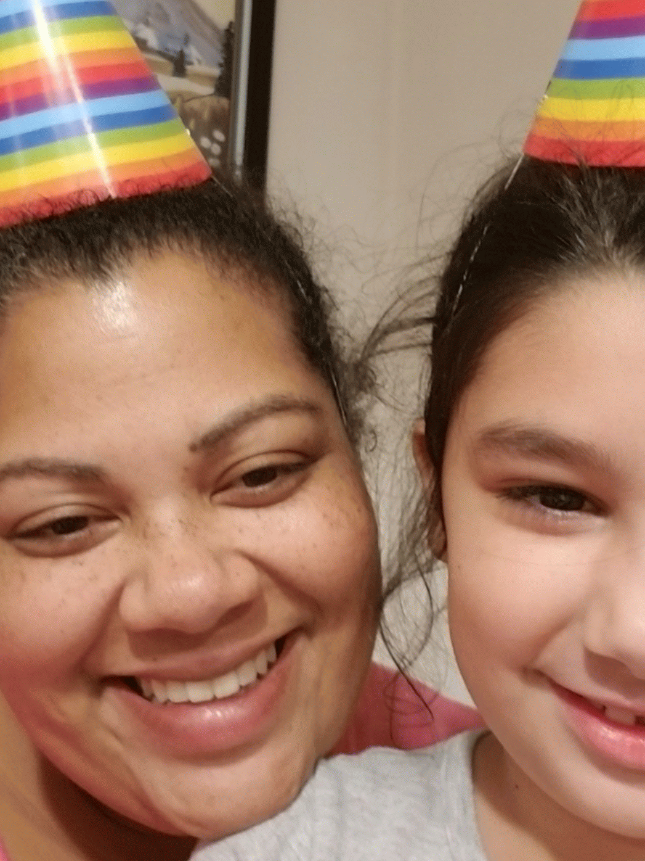
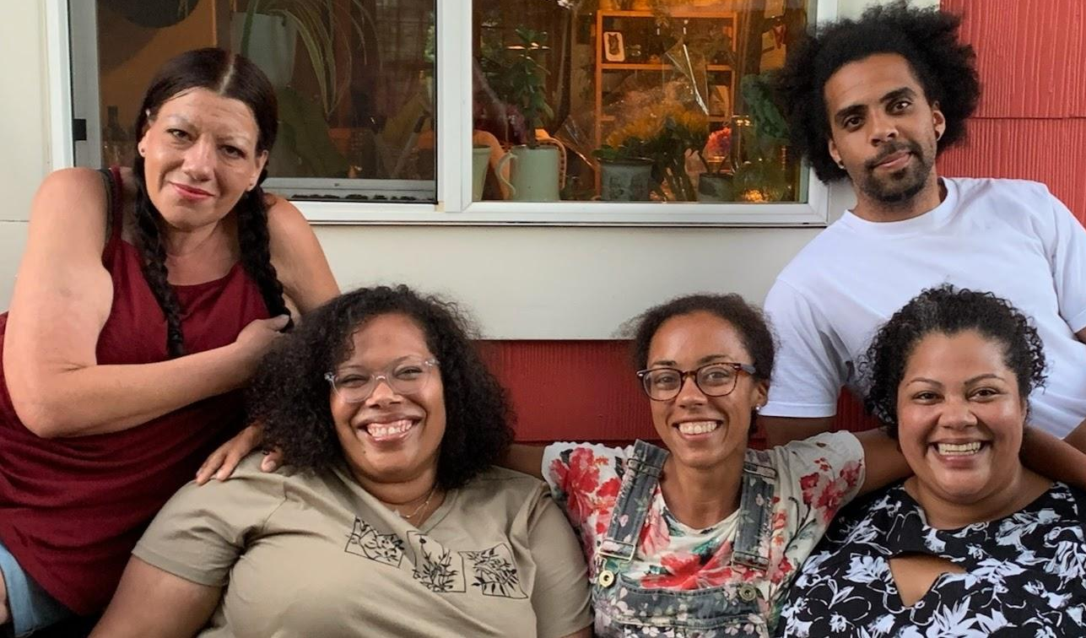
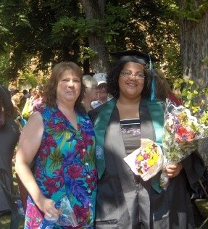
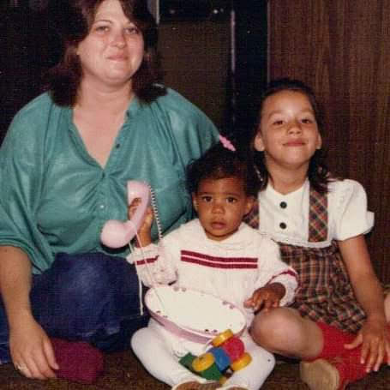
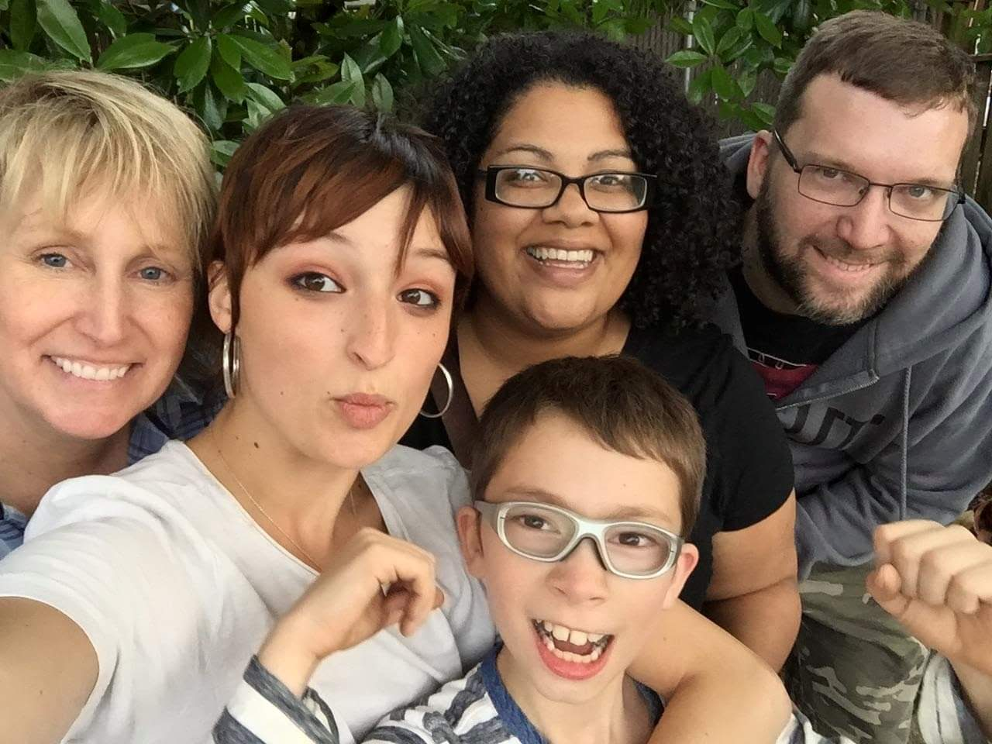
Monica Introduction
PNW born and raised
Mixed and blended families
#AUNTIEGANG
Garden nerd
First Generation Graduate
Community College educated
Survived DVED Math/English
Self-Advised
10 years to bachelors degree
Notes:
At the end of the day, this work is very personal to me.

Slide 3
Student success center team
Monica Wilson
Director
Amunoo Tembo
Policy Associate
Pathway Navigation
Guava Jordan
Policy Associate
Faculty Development
Ensured Learning
Dawn Draus
Policy Associate
Math Pathways
Placement
Student Services Liaison
System Engagement
Strategic Initiatives
Brook Bane
Program Specialist
Professional Development
Coaching
Vacant
Administrative Assistant
Professional Development
IDEAL Fellowship

Slide 4
Guided Pathways Vision & Mission
A system that advances racial, social, and economic justice by achieving equitable student aspiration, access, economic progress, and educational and career attainment.
Create an equitable system that prepares all learners to engage in a diverse society and workforce, achieve economic mobility through educational attainment and contribute to a socially just society.

Slide 5
Guiding Principles
Principle #1 Urgent, radical, equity-minded, transformational organizational change.
Principle #2 Culturally responsive commitment to racial and social equity by dismantling systemic policies and practices that perpetuate inequities.
Principle #3 The voices of students, faculty, staff and community members are essential to fully engage in adaptive problem focused inquiry processes leading to meaningful action and sustained systemic change.
Principle #4 Intentional collaborative learning through partnerships, professional and resource development
Principle #5 Focus on learning and outcomes aligned with community values and industry needs.

Slide 6
Guided pathways priorities
Completion
Learning
Research
Equity
Increasing meaningful credential completion rates of all students.
Closing the equity gap for underserved communities.
Build capacity for implementing framework.
Deepened understanding of effective practice

Slide 7
What is guided pathways?
Guided Pathways is a research-based framework that simplifies choices for students.
Courses are grouped together to form clear paths through college and into careers, whether students enter those careers directly after graduation or transfer to a university for more study in their chosen fields.

Slide 8
Pathway Design
Pathway Development
Program Maps
Pathway Entry
Intake
Entry Advising
Pathway Navigation
Progress Monitoring
Teaching & Learning
Engagement
Scheduling
Completion Support
Degree Math and English in One Year
Effectiveness
Improvement
Inclusion
Alignment
Educational Planning
Financial Planning
Math Pathways
Guided pathways framework
Equity Minded Leadership and Management

Slide 9
Guided Pathways in Washington
Funding and Implementation Timelines

Slide 10
Washington State Scaling Investments
American Association of Community Colleges
2015: Three colleges selected to receive technical assistance and professional development
College Spark Washington
2016: First cohort of five colleges received 100,000 per year for five years
2018: Second cohort of five colleges received 100,000 per year for five years
Washington State Legislature
2019: Workforce Education Investment Act, HB 2158

Slide 11
GP Implementation Timeline
2015
AACC Launches Guided Pathways (GP)
(4 CTCs)
2017-18 & 2018-19
Washington State Legislature funds Early Adopter Colleges
(12 CTCs)
2019 - Present
Workforce Education Investment Act for all CTCs to implement GP
(34 CTCs)
2016
WA Student Success Center & College
Spark Washington (CSW) launch Cohort 1
(5 CTCs – 2 AACC)
2018
CWS begins funding for GP cohort 2
(5 CTCs)
2020
COVID BEGINS
12 Early Adopter Colleges
Clark, Clover Park, Everett, Lower Columbia, Peninsula, Pierce District, Renton Tech, Skagit Valley, South Puget Sound, South Seattle, Spokane Falls, Tacoma
Notes:
Cohort 3= 22 colleges

Slide 12
Workforce Education Investment Act
At a minimum, Guided Pathways Implementation mut include:
Comprehensive mapping of student educational pathways with student end goals in mind;
Dedicated advising and career counseling that helps students make informed program choices and develop completion plans;
Data analysis of student learning as well as program and service outcomes. Data must be used to inform program development, the creation and further refinement of student pathways, and to provide opportunities for early intervention to help students succeed; and
A student success support infrastructure effective in closing equity gaps among historically underserved student populations and improve completion rates:
Equity competent academic advising services;
Equity competent career development programming;
Clear information regarding financial aid and financial literacy; and
Inclusive curriculum and teaching practices.

Slide 13
Guided Pathways Accountability
Washington Institute for Public Policy preliminary report released March 2023—Baseline Evaluation
Final Evaluation due December 2029
Guided Pathways implementation, including timeline, alignment with legislative requirements, challenges, and ongoing needs
Trends in outcomes between 2012-2019
Compares retention, course completion, credit accumulation, and Grade Point Average
No statistical analysis to evaluate the impact of Guided Pathways

Slide 14
Guided Pathways Metrics
Preliminary Report
Final Report
Student retention and persistence
College level English and math within the first year
Graduation and transfer rates
Degree completion
Time to degree, transfer to four-year institutions
Employment and earnings
Notes:
DASHBOARD

Slide 15
Scaling Guided Pathways in Washington

Slide 16
Work plan Overview
Large Scale Change
Pathway Entry & Navigation
Pathway and Program Design
Equity informed project and change management infrastructure
Comprehensive mapping of student educational pathways with student end goals in mind
Students make informed program choices and develop completion plans
Success Support Infrastructure
High impact practices in teaching and learning
Auto populated with data
Aligned with legislative requirements from the Workforce Education and Investment Act
Redesign cohorts
Inform statewide PD, coaching, and technical assistance.
Released March 11, 2024 Due June 28, 2024

Slide 17
Pathway design and mapping
Accomplishments
Growth Areas
90% of WA CTCs have scaled meta-majors wherein programs of study are organized by interest area, but only half track information for individual students by meta-major
Just over half CTCs have scaled program maps for CTE and/or transfer, with CTE more common than transfer.
Almost 75% of CTCs report scaling math pathways on some level
Limited evidence that student-level data on program and meta-major is collected or systematically leveraged by institutions to support broader reform goals

Slide 18
Pathway entry & Navigation
Accomplishments
Growth Areas
Over 60% of WA CTCs have scaled the practice of advising students to take at least one program-specific course in their first term
The majority of colleges have scaled entry advisement with exposure to program-specific courses
About 75% of WA CTCs have scaled case load advising, which assigns an advisor to each student based on interest area or meta-major.
Scaling Career Assessments with entry advisement
Educational plans and online plans for student progress monitoring
Onboarding activities contextualized with meta-major-related content
Less than 30% of colleges have scaled mandatory ongoing advising
Less than 10% of colleges have scaled data utilization about students’ meta-majors and program plans to develop course schedules aligned with completion goals

Slide 19
Teaching and learning
Accomplishments
Growth Areas
65% of colleges offer at least one corequisite math course.
75% of those offering corequisite courses also provide a prerequisite alternative for students.
Multiple Measures and Directed Self-Placement
Equity Focus
Strengthening transfer pathways
Experiential and career connected learning

Slide 20
Assessment Teaching and Learning Conference
Connect and Build: Nurturing growth of community and excellence in teaching and learning
Thursday and Friday, May 2-3, 2024 @ Yakima Convention and Event Center
$75.00
Support your faculty to attend
Registration is open now

Slide 21
Current Student Success Center Engagements
Guided Pathways Career Convenings
Rural and Technical College Convenings
Quarterly Math Faculty Retreats
Student Affairs Assessment Cycle series
Project Management series
Assessment, Teaching, and Learning Conference
Multi-college Placement Initiative
In Development:
First Year Experience Repository and Learning Community
On-Demand New Faculty Institute
On-Demand Guided Pathways Orientation
Professional Development badging
Cohort Convenings
Retreats and Institutes
Communities of Practice:
Faculty Development
Building a Thinking Classroom
Data Science
Social Justice in MATH& 107
Corequisites with Kathleen Almy
Antiracist Curriculum and Assessment Practices

Slide 22
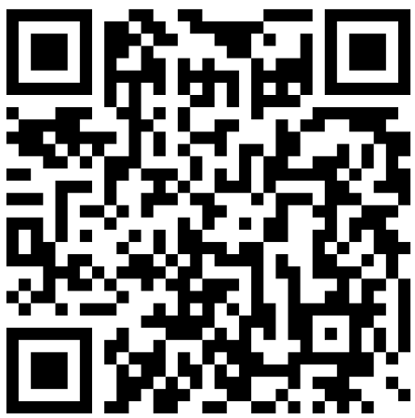
Thank You!
Questions? Comments? Feedback? Collaboration?
Monica Wilson mwilson@sbctc.edu Schedule a meeting 360-704-1022

Slide 23
Guided Pathways Resources
Guided Pathways Legislative Report
Community College Research Center Reports
Lessons From Two Major Evaluations of Guided Pathways
Whole-College Guided Pathways Reform: Scale of Adoption by Community Colleges in Three States
Revised Code of Washington 28B.50.925: Guided Pathways Implementation and Reports
Peer and Professional Learning Calendar
2024-2026 Guided Pathways Work Plan
First Time Enrolled in College Dashboard

