Slide 1
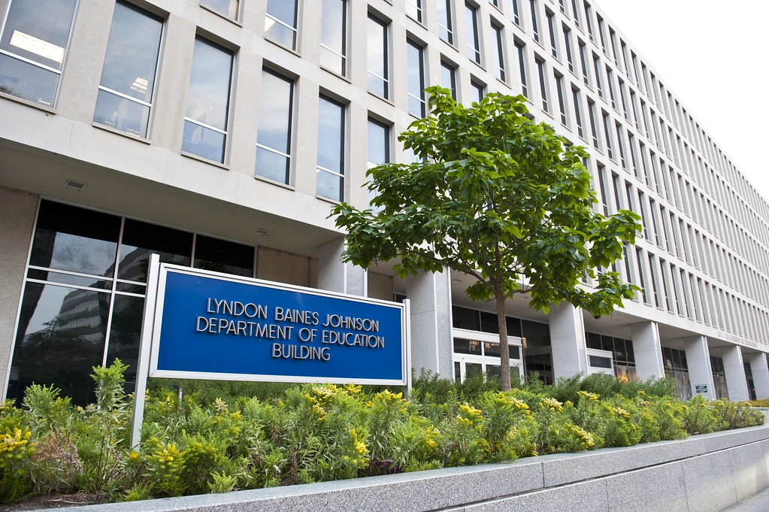
Financial value Transparency and Gainful Employment final rule & key pending regulations October 13, 2023
This Photo by Unknown Author is licensed under CC BY-NC

Slide 2
Congressional landscape
House in Turmoil – Shutdown in November seems likely given turmoil over speakership
CR keeping government open until Nov. 17
Zero chance full year funding bills will be enacted by then
Very unlikely new speaker will take same tact as McCarthy – pass new CR with Democratic (and Republican) support
House had been considering FY ‘24 appropriations bills with funding levels well below those agreed to in debt ceiling legislation
Progress in Senate also slowed by small number of Republicans
12 appropriations bills all passed out of committee with overwhelming, bipartisan support

Slide 3
Congressional landscape
Some Activity (Mostly Behind the Scenes) on Other AACC Priorities
Ongoing, bipartisan negotiations in House on short-term Pell, WIOA
Both Education and Workforce Committee leads have expressed strong interest in passing both bills, but nothing on paper yet
Tax-Free Pell Grant Act introduced in both House and Senate on bipartisan basis – field support needed
Work continues on Farm Bill
AACC advocating for new CC program, better SNAP access for students

Slide 4
Gainful employment History
June 2011: Obama administration publishes first gainful employment (GE) rule; had not been regulated previously
July 2012: GE rule struck down by U.S. District Court over “repayment rate” metric
October 2014: New GE regulations upheld in subsequent lawsuits
October 2017: Trump administration stops GE implementation and rescinds in 2019
January 2022: Biden administration begins broad negotiated rulemaking, including GE — AACC represented by two negotiators
October 10, 2023 – Final GE Rule Published in Federal Register
AACC analysis of Final Rule

Slide 5
GE/Transparency -- Big picture
For community colleges, GE programs are Title IV eligible certificate and other non-degree programs
Regulation represents Biden Administration’s most important “accountability” initiative
GE impacts for-profit institutions most intensively by far, but also impacts community colleges
Rule decried by Congressional Republicans
Transparency data component potential game changer
Substantial institutional reporting burdens

Slide 6
GE metrics -- Debt to earnings
Annual debt-to-earnings is the ratio of a program’s annual loan payment amount to completers’ median annual earnings
Discretionary debt-to-earnings is the percentage of a program’s annual loan payments compared to completers’ discretionary earnings (Median Earnings – 150% of Federal Poverty Guideline)
Program fails if annual D/E rate is above 8% and discretionary D/E rate is above 20%
If it isn’t possible to calculate D/E rates for an award year, the program remains in the same status as the previous award year for up to four years

Slide 7
Ge Metrics -- Earnings premium
Compares median annual earnings of completers to an earnings threshold -- Program passes if completers’ earnings exceeds threshold
Threshold is the median annual earnings for adults aged 25 to 34 with only a high school diploma in the state where the college is located (or nationally if fewer than 50% of students are in that state)
Earnings threshold will vary by state but is about $25,000 nationally
If earnings premium can’t be calculated for an award year, the program remains in the same status as previous award year for up to four years
AACC strongly opposed earnings premium in negotiations and formal comments; ED rejected proposed AACC alternative to accommodate regional wage variations

Slide 8
Consequences of failing a metric
Programs that fail either or both metrics in a single year must provide a warning to students that the program may lose federal aid eligibility; other programmatic information required
If program fails the same measure for two out of three consecutive years, it loses Title IV eligibility
Three years must pass before program can re-seek eligibility
Institutions can only appeal a program eligibility termination action on the basis that ED miscalculated the D/E rates or earnings premium

Slide 9
Predicted outcomes--ED
Most community colleges do not have certificate programs that would fail either the D/E or earnings metrics
94% of two-year public institutions have zero enrollment in programs that would fail GE metrics
Metrics cannot be calculated for most programs
Only 4.8% of public undergraduate certificate programs will have sufficient program completers to produce D/E rates and earnings premiums, but that encompasses 21.4% of enrollees
ED wants to capture greatest percentage of enrollment, not greatest number of programs
The 3,937 GE programs across all sectors that will have metrics calculated constitute 64.0% of all students enrolled in GE programs

Slide 10
Predicted Outcomes (Continued)
ED projects nearly 700,000 students in 1,709 failing GE programs
The NRPM indicates 193 public GE programs (representing 38,000 students), 73 private, non-profit degree programs (representing 32,600 students), and 1,440 proprietary GE programs (representing 620,800 students) would fail at least one of the D/E rate or earnings premium tests
Of the 1,440 proprietary GE programs that fail one of the two tests, 873 (61%) are undergraduate certificate programs that fail only the earnings premium test
The highest rate of failure is in Personal and Culinary Services, where 73 percent of enrolled students are in programs that would have failing metrics
88 Fed. Reg. 32420

Slide 11
Financial value transparency
Provides information to stakeholders about the “financial value” of programs along with other program details
ED will create a program information website that includes outcomes data about each program at a college
Same data and metrics as used for GE regulations, but applies to nearly all non-GE Title IV higher education undergraduate and graduate programs
Some overlap with College Scorecard data

Slide 12
Financial value transparency (continued)
Colleges will be required to provide current and prospective students with information about how to access the website
For non-GE programs labeled high-debt-burden:
Students will have to acknowledge that they’ve seen the information about the program through the disclosure website
Students cannot receive Title IV funds until they provide the acknowledgement
Undergraduate degrees excepted

Slide 13
Reporting requirements
Data will have to be submitted to ED for both GE and non-GE programs
Institutions will have to report program-level data and student-level data annually
Student-level data only includes Title IV recipients except in reports about program data. THIS EXCLUDES MORE THAN HALF OF ALL COMMUNITY COLLEGE STUDENTS!
Considerable retroactive data reporting will be necessary – as many as seven award years prior by July 31, 2024, though colleges can opt for two-year window.

Slide 14
Reporting - Cohort Periods
ED will use either a two-year or four-year cohort period to calculate D/E rates and earnings premium
Four-year cohort will be used if <30 completers in two-year cohort
Colleges won’t always know up front if a program will hit these thresholds
Two-year cohort will consist of third and fourth award years prior to the year for which the most recent data are available
Four-year cohort will consist of third, fourth, fifth, and sixth award years prior to the year for which the most recent data are available
Initially, colleges may report cohorts for two award years most recently completed before July 31. For 7/31/24 reporting, award years 22-23 and 23-24 could be used

Slide 15
Estimated cost and burden
ED’s cost and burden estimates are likely far lower than what the actual cost and burden will be
Last GE was tremendously costly, though aggregate sectoral impact could not be determined. [N.B.: Campus estimates are welcome!]
ED’s time estimation (for the first year):
95.75 hours per college + 7.75 hours per GE program at the college
A total of 1.3 million hours across all public two-year institutions
ED estimates it will cost all public two-year institutions a total of $60.8 million to implement GE in the first year and $17.3 million annually in subsequent years

Slide 16
AACC’s perspective
Longstanding support for broad transparency for all higher education programs
Supports debt-oriented GE metric, which reinforces community college financing structure (low tuition and low debt)
Rejects earnings premium metric because it does not make a fair comparison to the wages of high school graduates and is ultimately arbitrary; doesn’t reflect labor market realities
Limiting data to Title IV-aided students is a tremendous flaw

Slide 17
FLSA Overtime rules - background
Fair Labor Standards Act (FLSA)
Establishes federal minimum wage and overtime pay standards
Generally, employers must track employees’ hours worked and pay an “overtime rate” for all hours in excess of 40 hours per week
FLSA includes some exemptions to these overtime pay requirements
This rulemaking specifically addresses the exemptions for executive, administrative and professional (EAP) employees, also known as “white collar” employees

Slide 18
Flsa overtime rules - background
Employees must meet three criteria to be classified as white collar employees and exempt from overtime pay requirements
Paid on a salaried basis
Earn at least as much the minimum salary level
Have primary duties that are executive, administrative, or professional in nature
The Department of Labor is proposing a regulatory change to the salary threshold

Slide 19
Flsa overtime rules - background
In 2016, the Obama administration issued a final rule that increased the salary threshold from $23,660 to $47,476
Previously, the salary threshold hadn’t been updated since 2004
Also created automatic increases every three years
Was ultimately overturned by a federal court in 2017
The Trump administration issued a new final rule in 2019 that increased the threshold to $35,568
Went into effect on January 1, 2020 and is the current minimum salary level
Did not include automatic increases

Slide 20
Flsa overtime rules – 2023 proposed rulemaking
Sets minimum salary level to 35th percentile of weekly earnings of full-time salaried workers in the lowest-wage Census Region (currently the South)
At least $55,068 annually ($1,059 a week), but final rule will reflect most recent wage data, which is projected to be $60,209 annually ($1,158 a week)
Would automatically update salary level every three years based on the same formula
Would also increase the highly compensated employee salary threshold to $143,988 annually
Notes:
- DOL found that 3.4 million salaried white collar employees earn above the current level but below the proposed salary limit
- Applies to full time and part time employees
- Automatic updates will be in Fed Register at least 150 days before going into effect
- DOL can temporarily delay the automatic update through an NPRM
- A large increase in a historically short time frame (prior to 1975, updates ranged from every 5 to every 15 years)

Slide 21
flsa overtime rules - potential impact
Employees most likely to be impacted on college campuses may be:
Academic advisors and counselors, student admissions counselors, administrative specialists and coordinators, student success professionals, and student financial aid counselors*
Does not affect faculty
To comply with the proposed change, colleges will have to either reclassify EAP employees to hourly or increase their compensation
Stark personnel and financial decisions will be necessary
May impact remote work
May lead to a ripple effect/wage compression
*Based on an analysis conducted by CUPA-HR of salary data and the proposed salary level

Slide 22
Flsa Overtime rules – what’s next
Comment period on the NPRM ends on November 7
AACC joined other higher education associations in requesting an extension, was not granted
A final implementation date has not been provided, but it could be as early as 60 days after the final rule is published
The proposed rule is expected to face legal challenges
AACC will be submitting comments outlining sector’s concerns
Please reach out to OGR if you have a sense of the potential impact on your campus
Feel free to submit comments directly to DOL

Slide 23
ADA, Title II - Web accessibility
The Department of Justice is proposing regulatory changes to Title II of the Americans with Disabilities Act (ADA), which states that public entities’ services, programs, and activities must be accessible to people with disabilities
This includes services, programs, and activities that are offered through websites or mobile apps
As public entities, community colleges will have to comply with the proposed changes

Slide 24
Proposed web accessibility changes
Adopt a technical standard for websites and mobile apps that public entities would need to follow
Web Content Accessibility Guidelines (WCAG) Version 2.1, Level AA
Provides guidelines for how text, sound, images, controls, and animations should appear in public-facing digital content to be accessible
Would be DOJ’s first adoption of specific technical requirements
Mandate public entities’ compliance with the technical standard
Rules include some proposed exceptions and limits to those exceptions
Most relevant to colleges, this includes an exception for password-protected course content unless a student with a disability who needs accessible content is enrolled in the course

Slide 25
Web accessibility compliance deadline
Compliance dates will be three years after the final rule is published for public entities with a population <50,000 and two years for those with a population >50,000
To determine the size of a public IHE, DOJ proposes using population data “associated with the entity the… university belongs to, like a county or State”
From the NPRM: “Though a specific county school may create and maintain web content or a mobile app, the county, as the legal entity governed by title II, is also responsible for what happens in the individual school. The Department expects that the specific school benefits from the resources made available or allocated by the county.”

Slide 26
Potential challenges
Short time frame to comply with regulations
WCAG 2.1 Level AA has a total of 50 success criteria
Complexity of digital ecosystems at colleges
Mixed oversight of websites, learning management systems, and mobile apps
Increased financial burden
Community colleges estimated by DOL to incur a total of $635 million in initial testing, website remediation, PDF remediation, and video and audio captioning costs
Mean annual operation and maintenance costs calculated at about $55,000
Staff capacity

Slide 27
Web accessibility - Comments and final rule
Joined ACE and other higher education associations in submitting comments to DOJ
Affirmed importance of providing web access to students with disabilities and asked for a final rule that allows for colleges to have the time and resources to comply
Unclear when final rule will be published
DOJ received about 400 comments on the NPRM

Slide 28
Student loan debt relief committee
ED convened the first session of the Student Loan Debt Relief Committee – the negotiated rulemaking table considering broad student debt relief under the Higher Education Act.
The issue paper asks negotiators to consider debt relief measures with a particular emphasis on borrowers who:
Have loan balances greater than the amount they originally borrowed;
Are eligible for forgiveness under income-driven repayment plans but who have not applied;
Took out loans to attend programs that provided low financial value relative to the loan amount;
Entered repayment on loans taken out before more generous repayment terms were offered;
Experience financial hardship.
ED could be considering changes to the previously proposed debt relief policy to provide more targeted relief.
The Committee will reconvene in November and December.

Slide 29
Other loan issues
Debt cancellation through existing avenues remains a top Biden Administration priority
ED has led an aggressive education and outreach campaign encouraging borrowers to enroll in the new SAVE IDR plan and to avail themselves of existing options for forgiveness
So far, ED has cancelled more than $127 billion in federal student loans:
$42B – SAVE retroactive forgiveness and fixing IDR errors
$51B – Public Service Loan Forgiveness
$11.7B – Discharge for borrowers who have a total and permanent disability
$22.5B – Borrower Defense to Repayment

Slide 30
Borrower Defense
Over the past few months, colleges across sectors have reported receiving a higher than usual volume of borrower defense claim notifications
Borrower defense to repayment provides a process for borrowers who have been defrauded or misled by their college to have their loans forgiven.
The increase in claims may be due to a few factors:
Backlog of claims – ED waited to release claims under the Sweet v. Cardona settlement was reached in June
End of the repayment pause
Borrowers initiate the process by filling out an application with FSA. ED then sends the claims to colleges to give them an opportunity to respond before ED adjudicates the claims.
To be approved, applications must be materially complete, but colleges are reporting that many of the claims they are receiving lack required information.

Slide 31
Borrower defense (cont.)
Colleges should consider working with legal counsel to determine whether to respond to claims based on material completeness, merit, and institutional capacity
Two different sets of regulations apply to BDR claims:
Loans dispersed before November 15, 2022: claim will be adjudicated under the 2016 BDR rules. Non-response from the institution is not viewed as favorable to the borrower’s claim
Loans dispersed after November 15, 2022: claim would fall under the 2023 BDR rules, which do see non-response as favorable to the borrower. As those rules are currently blocked under a national injunction, colleges are not obligated to respond.
The higher education community has asked ED to offer additional clarity on institutions’ responsibilities in borrower defense to repayment

Slide 32
Questions?

Slide 33
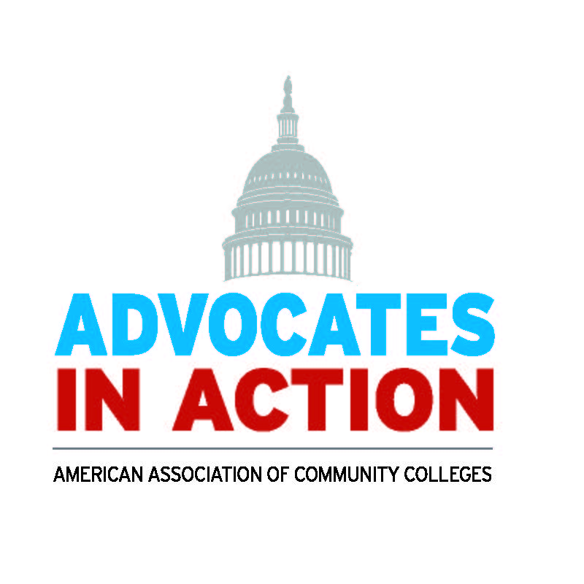
Save the date!
ADVOCATES IN ACTION
SEPT. 16 -17, 2024!

Slide 34
AACC Points of Contact
David Baime, Senior VP, Government Relations: dbaime@aacc.nche.edu
Jim Hermes, Associate VP, Government Relations: jhermes@aacc.nche.edu
Kathryn Gimborys, Government Relations Manager: kgimborys@aacc.nche.edu
Alexis Gravely, Legislative Analyst, Government Relations: agravely@aacc.nche.edu

