Slide 1
Financial Aid Basics & simplification updates
Fall 2023
October 13th, 2023
Yokiko Hayashi-Saguil, Student Services Policy Associate

Slide 2
Agenda
Context
Financial Aid Overview
FAFSA/WASFA Updates
Resources

Slide 3

Nearly Half of WA Seniors Didn’t Complete a FAFSA
WA Public HS Seniors FAFSA Completion 2022-23
Submitted with Errors 2.3%
Processed Successfully – 49.8%
No FAFSA – 47.9%
wsac.wa.gov/fafsa-completion

Slide 4
Financial Aid Overview
Grants
Scholarships
Loans
Income-Based, Federal, State, & Institutional
Merit & income based, from public, private and nonprofit sources.
Income-based, federal, and private
Work Study
Income based, federal, state and institutional

Slide 5
Sources of Financial Aid
Federal
State
College
Organizations
Typically can be used at most schools in most states.
Typically for residents to attend most colleges in the state.
Offered by a specific school to attend that school.
Offered by non-profits, business, churches, etc.
Notes:
Financial aid can come from several sources: Federal: This is from the US Department of Education and can be used at most colleges in the US. They have to be able to receive financial aid. Students can take to another state. State: For example, Washington state financial aid is for residents to attend colleges in WA. They do not necessarily have to be public colleges, but they have to be able to receive state financial aid. There are currently over 60. College: Every college will have their own scholarships, etc that they offer to students who are going to their school. Organizations: These tend to be scholarships (organizations) or private loans (banks). We will talk about applications for these specific forms of aid later.

Slide 6
Grants
A grant is gift aid that often based on financial need and does not need to be repaid (unless, for example, the student withdraws from school and owes a refund).
Washington College Grant
Pell Grant
Notes:
For more information about the Washington College Grant and other state financial aid please go to https://wsac.wa.gov/wcg
For more information about Federal Pell Grants https://studentaid.gov/understand-aid/types/grants/pell

Slide 7
Work-Study
Work-Study
Tutoring
Fitness Center
Library
Computer Lab
Student Life
Outreach
Work-Study provides part-time jobs for students with financial need, allowing them to earn money to help pay education expenses. These jobs are typically on campus.
Notes:
Work Study is an income-based program provided by both the federal and state. A student must select they are interested in Work Study on their financial aid application in order to be considered for this program.

Slide 8
Loans
Interest is paid by while the student enrolled at least half time in college.
Subsidized Student Loans
Unsubsidized Student Loans
Interest begins accruing as soon as the loan is disbursed, including while the student is enrolled in school.
Notes:
For more information about federal student loans, go to https://studentaid.gov/understand-aid/types/loans
You can find resources on student loans at our student loan advocacy site at https://wsac.wa.gov/loan-advocacy and https://www.studentloaned.wa.gov/

Slide 9
FAFSA/WASFA: Rule of One
FAFSA
Free Application for Federal Student Aid
FAFSA.gov
WASFA
Washington Application for State Financial Aid
wsac.wa.gov/WASFA
OR
Notes:
Speaking of FAFSA and WASFA… Students should only complete one application. Fill out the FAFSA if you are eligible for federal aid (i.e. US citizen/permanent resident) and this will also be used to determine state aid eligibility If you are ineligible for federal aid due to immigration status but you are eligible for a state financial aid program (i.e. for undocumented students) complete the WASFA. Some colleges may also use WASFA in replace of a FAFSA when calculating institutional aid There are resources to help you complete these applications and determine which one to file at https://wsac.wa.gov/WASFA
Note to presenter: You should not ask students which application they should file or their status. Let them self-identify.

Slide 10

Examples of Federal Financial Aid Programs
Pell Grant
Federal Work-Study
Unsubsidized/Subsidized Student Loans
Parent Loans
Notes:
There are several types of federal financial aid. Students need to be U.S. citizens or eligible non-citizens (i.e. permanent residents with a Green Card as an example) to apply. Pell Grant: The largest income-based grant. You may be familiar with this grant as it is a long-standing program. There have been some changes over the years, so make sure you investigate current Pell Grant requirements such as maximum award amounts use during the summer. Work-study: Students can work on campus and their salary is paid from the Dept of Education on-campus employer—>student. Not all on campus jobs require a student to be part of the work-study program. Loans: Both these are in the student’s name. The difference is that with Unsubsidized student loans the student will ultimately pay the interest accrued once they graduate and/or leave college. Subsidized student loans – the government pays, or subsidizes the interest. Parent loans: Would be taken out by the parent to pay for the student’s expenses. There are additional requirements, such as a credit check. There is not limit on the loan amount for parent loans. If offered any/all of these loans from the government, students/families can accept none, partial, or all that they want to utilize. There are also private loans from banks but they typically have higher interest rates and more limited repayment options that federal loans. Students apply for these programs using the Free Application for Federal Student Aid (FAFSA). Students who are not eligible to apply for these programs due to immigration status would not be eligible for these programs, such as federal student loans.

Slide 11


Examples of State Financial Aid
Washington College Grant (also known as the WA Grant)
College Bound Scholarship
State Work-Study
Passport to Careers
Opportunity Grant
Notes:
Learn more about Washington’s state financial aid programs, collectively known as opportunity pathways go to https://wsac.wa.gov/sfa-overview
These are examples of state financial aid programs that WA residents who are eligible can use in WA at eligible colleges – you may see them referred to as Washington Opportunity Pathways. Washington College Grant (formerly the State Need Grant) largest, income based grant. The amount depends on what type of school (out of the over 60) you attend. College Bound Scholarship: This is an early commitment of state financial aid to cover certain college costs. Students must have signed up in middle school. We’ll talk more later. State Work-Study: Similar to the federal program but the funding comes from Washington State versus the federal government. Passport to Careers: program that provides additional resources for both former foster youth and unaccompanied homeless youth (https://www.wsac.wa.gov/sites/default/files/Passport.Student.FAQs.pdf) Opportunity Grant: to attend a 2 year community or technical college 5 Students who can complete the FAFSA (U.S. citizens and permanent residents) are also applying for state aid programs when the complete the FAFSA. Undocumented students who meet program and state residency requirements can apply using the Washington Application for State Financial Aid (WASFA).

Slide 12

Washington College Grant
Washington State has made a groundbreaking commitment to financial aid for low- and middle-income people of all ages with the Washington College Grant (WA Grant). This grant gives eligible people more money for more types of education like certificate programs, job training, apprenticeships, or college.

Slide 13



Washington College Grant Provides a Unique Opportunity
With the Washington College Grant (WCG), more families are eligible for financial aid than ever before.
Family Size | Full Award | Partial Award
 | Income $38,000 or less | Income Up to $58,500
 | $73,000 or less | Up to $112,500
Award amounts vary based on income, family size, and the school or program attended.
Notes:
Learn more about WCG eligibility and awards at https://wsac.wa.gov/wcg-awards complete MFI chart can be found at https://wsac.wa.gov/sites/default/files/2023-24.WCG.MFIChart.pdf

Slide 14
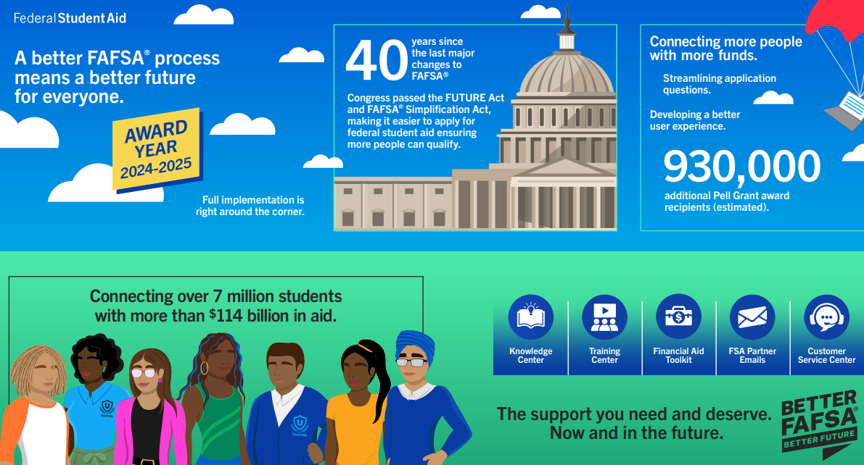
Better FAFSA Better Future
Better FAFSA Better Future is the communication campaign to increase knowledge about the changes to the FAFSA enacted by the FAFSA Simplification Act.
Notes:
Christina

Slide 15

FAFSA Simplification Act
The FAFSA Simplification Act represents a significant overhaul of federal student aid, including the Free Application for Federal Student Aid form, need analysis, and many policies and procedures for schools that participate in federal student aid programs.
Notes:
Christina

Slide 16
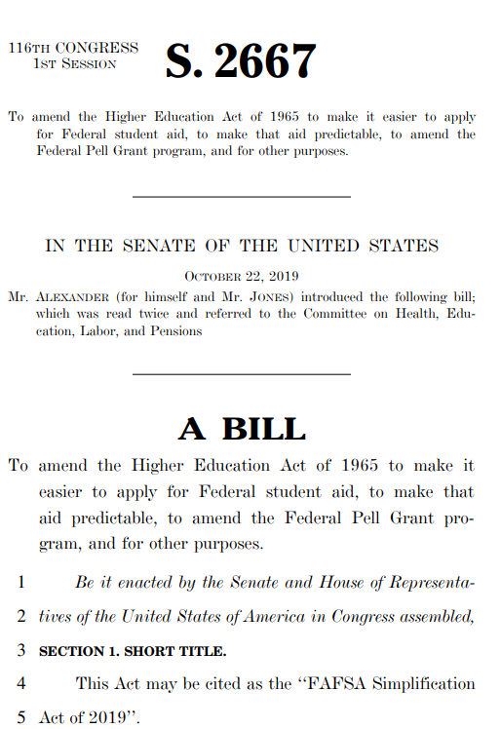
FAFSA Simplification Act
Two pieces of federal legislation were passed that enabled the coming changes:
Future Act: Expands access to federal student aid, and mandates Federal Student Aid to use data directly from the IRS-Passed December 2019
FAFSA Simplification Act included with the Consolidated Appropriations Act – Passed December 2020 Was to have started this year but an amendment moved to next FAFSA cycle
Notes:
Christina

Slide 17
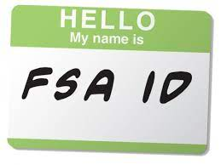
Changes to the 24-25 FAFSA
FSA ID Changes
Two-Step Verification
Back-Up Codes
FSA ID Now Required for Applicants and Contributors (Parents)
FSA ID for Those Without SSN
Notes:
Sam

Slide 18
FSA ID Now Required
Everyone will need an FSA ID in order to log into the studentaid.gov website to access the FAFSA.
FSA ID’s must be verified before starting the FAFSA and this can take 1-3 days.
Students and contributors (parents) will not be able to access the FAFSA using personally identifying information.
The 24-25 FAFSA will no longer have a signature page.
Notes:
Sam

Slide 19
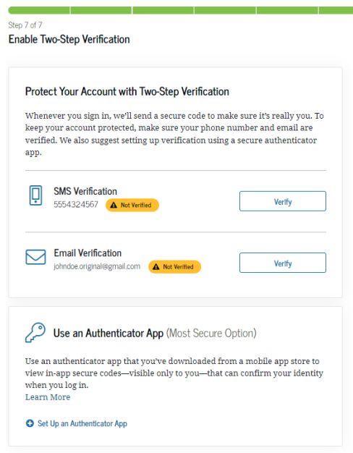
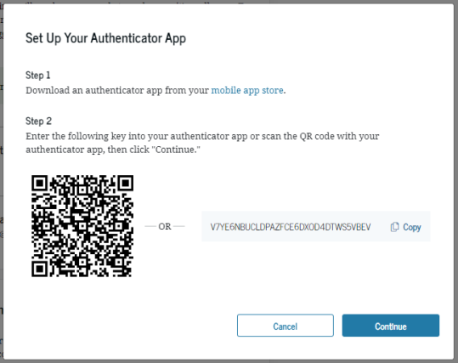
FSA ID Changes - Multi-Factor Authentication (MFA)
Setting up an Authenticator App is optional but strongly recommended by Federal Student Aid
Notes:
Sam

Slide 20
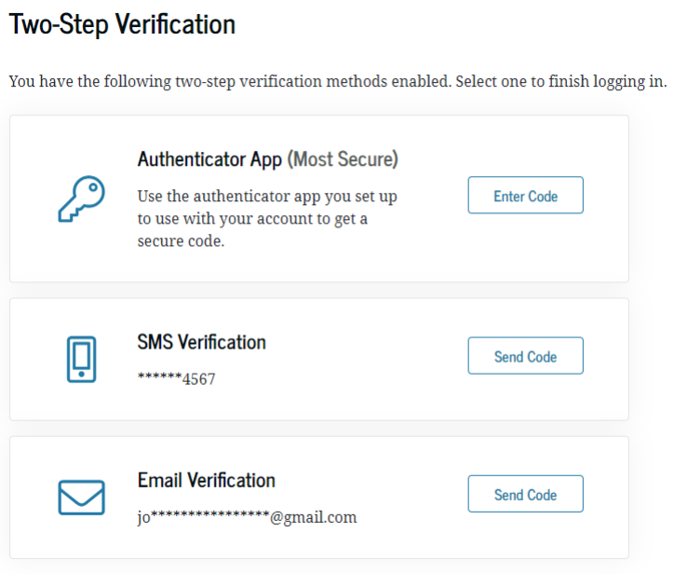
FSA ID Changes - Multi-Factor Authentication (MFA)
Every person who has an FSA ID and attempts to log into studentaid.gov for any reason will be subjected to the MFA process each time.
Notes:
Sam

Slide 21
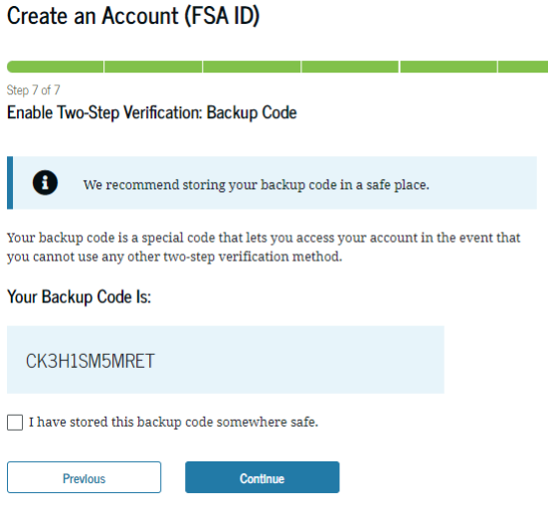
FSA ID Changes - Back-Up Codes
A two-step verification backup code lets a student or parent access their account if their unable to complete two-step verification using one of their other verified methods.

Slide 22
FSA ID Changes - FSA ID for Those Without SSN
FSA is developing a process for people who do not have a social security number to be able to set up an FSA ID
At this point FSA has not shared updated timeline or specifics about what the process will look like or what type of information will be required to verify their identity and establish the FSA ID.
We know the process will look like TransUnion’s identity verification.
There is no wait to verify the FSA ID of a contributor using this process.
Notes:
Sam

Slide 23

Changes to the 24-25 FAFSA
FAFSA Form Changes
Income Information Exchange
Student Aid Index
Who is the Parent
Contributor (Parents) Information
Number in College
Assets
December Release Date (24-25 Only)
Role Based Information Entry
Family Size
FAFSA Onboarding
Notes:
Christina

Slide 24
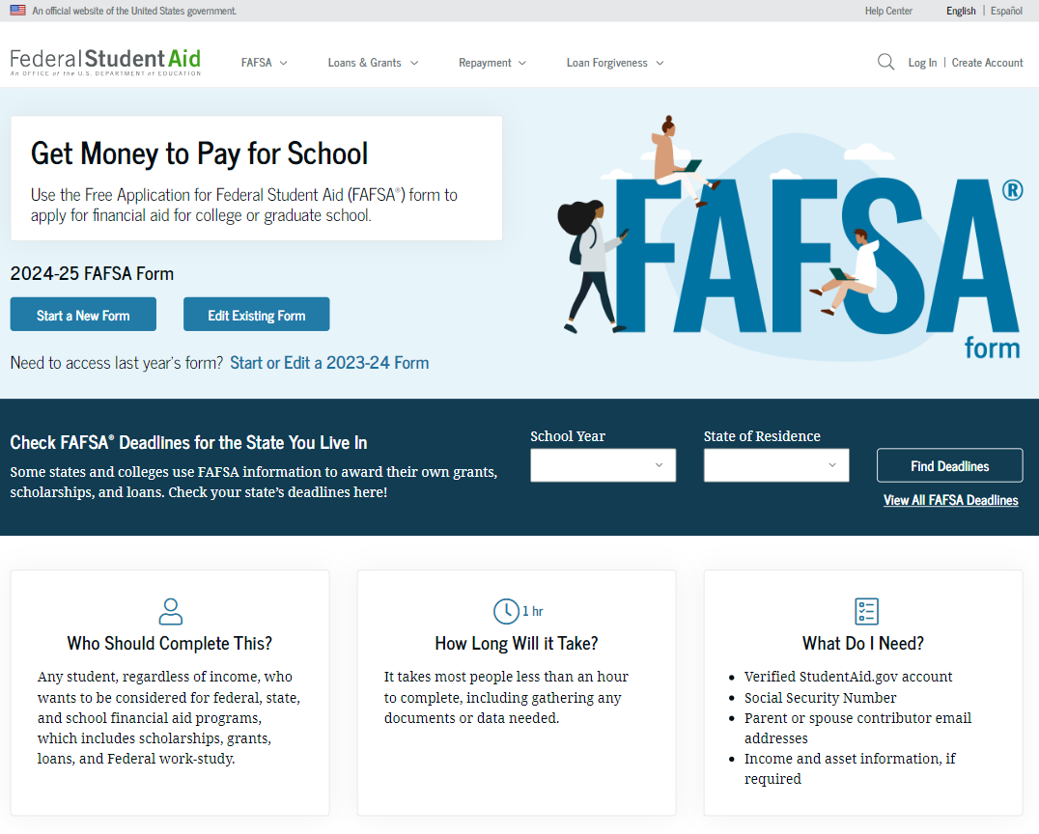
FAFSA Form Landing Page
Notes:
Christina

Slide 25
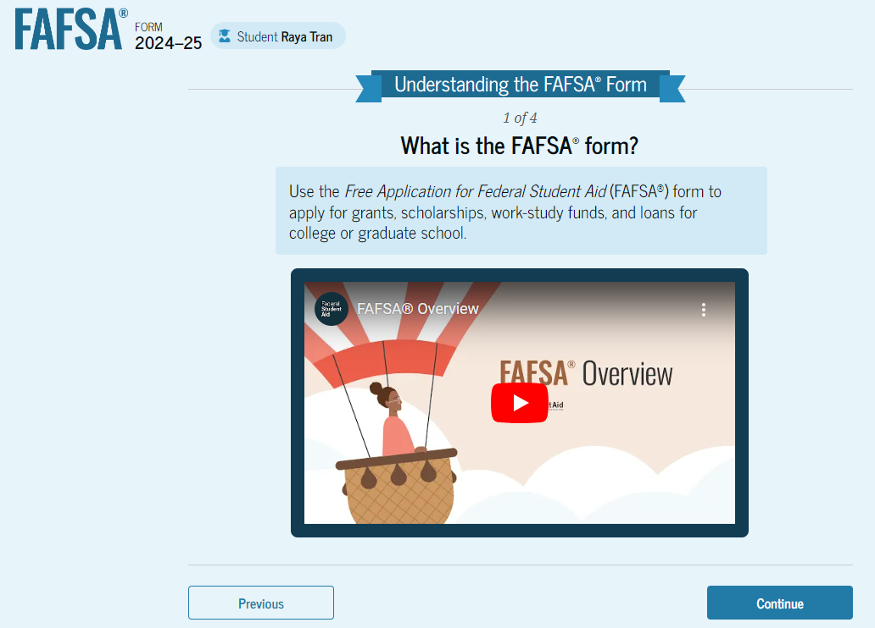
FAFSA Onboarding
When the student starts the 2024–25 FAFSA form for the first time, they are taken through the FAFSA onboarding process. The first onboarding page provides an overview of the FAFSA form and an accompanying video.
Notes:
Christina

Slide 26



Takeaway: FAFSA and WASFA in December
The 2024-25 FAFSA & WASFA will be available in December
2025-26 and beyond will be available in October
Class of 2024 will complete the 2024-25 FAFSA or WASFA using 2022 income information
OR WASFA

Slide 27
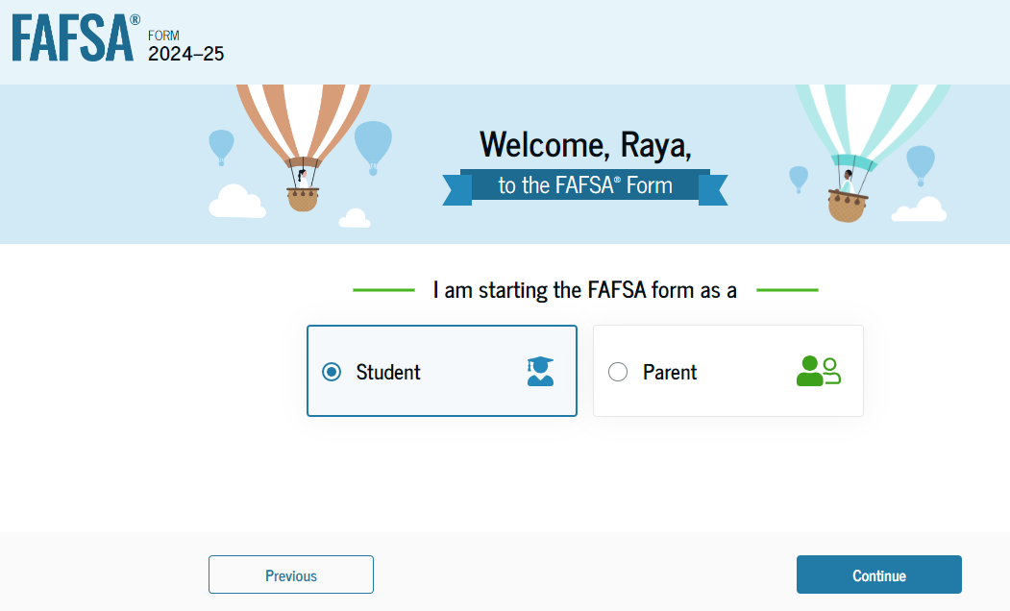
Role Based Information Entry
This new form design allows users to fill out only the portion of the form pertinent to them.
Each role (student, parent, other parent, and student spouse) identified as required on a particular FAFSA form completes their own section.
Notes:
Christina

Slide 28
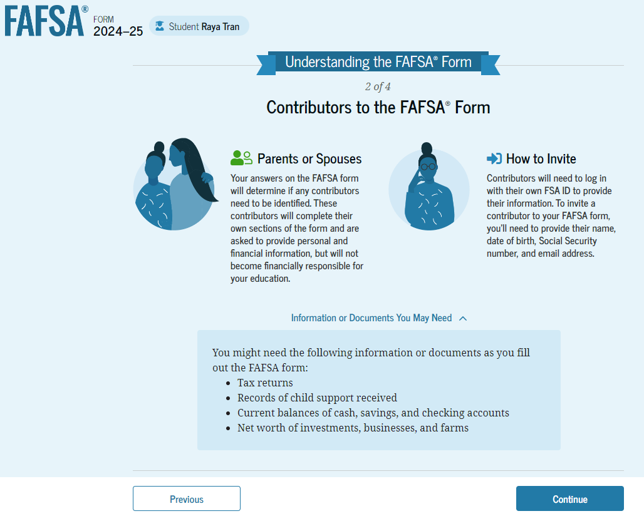
Role Based Information Entry
Both the student and contributor can access the application at the same time.
Role based information entry will eliminate the use of the save key.
If completing the form online, they must log in with their FSA ID to access and complete their section.
Notes:
Christina

Slide 29
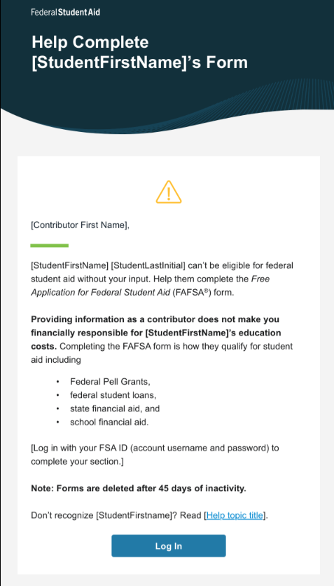
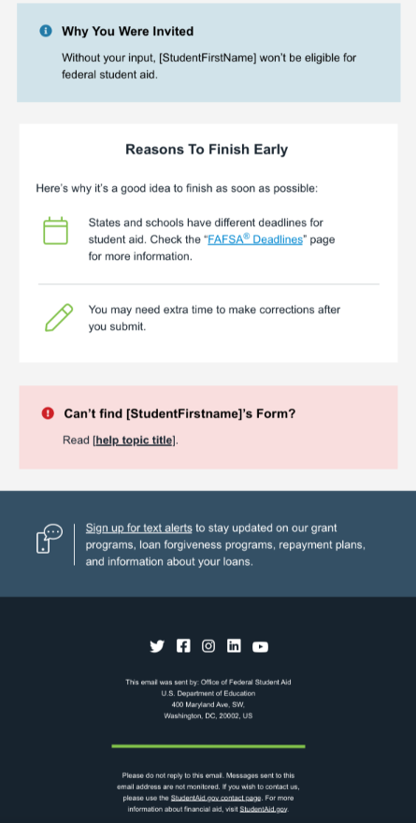
FAFSA Form Changes – Contributor (Parents) Information
Parents will now be listed as contributors to their student's application
Parent will need to log into the application with their FSA ID to enter information.
If a student completes their portion of the application first, FSA will email the designated contributor (parents) to provide information.
Notes:
Christina

Slide 30
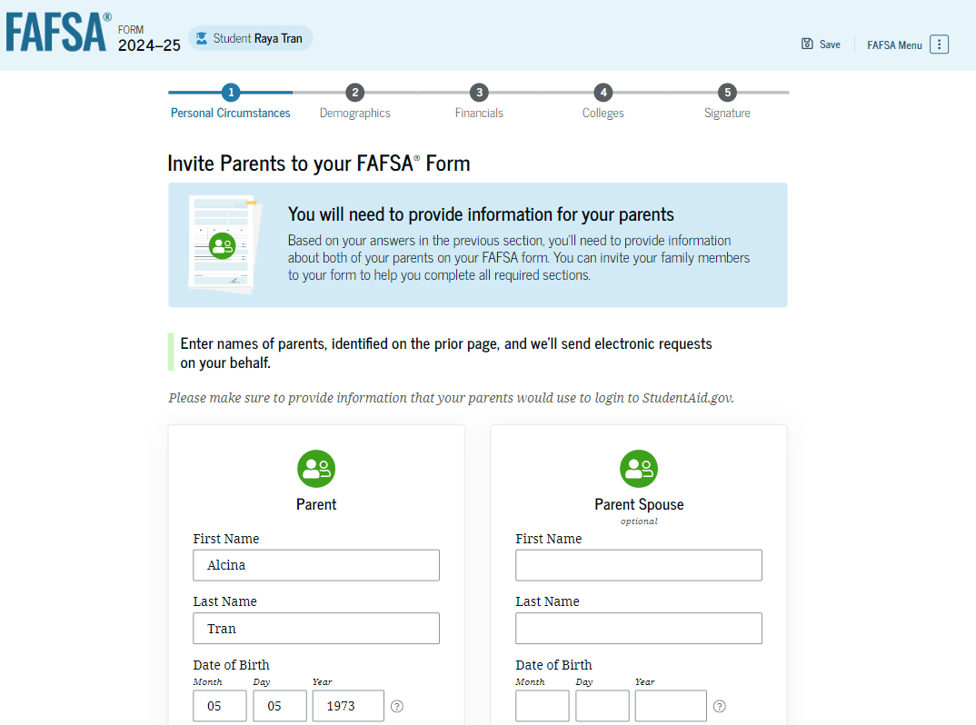
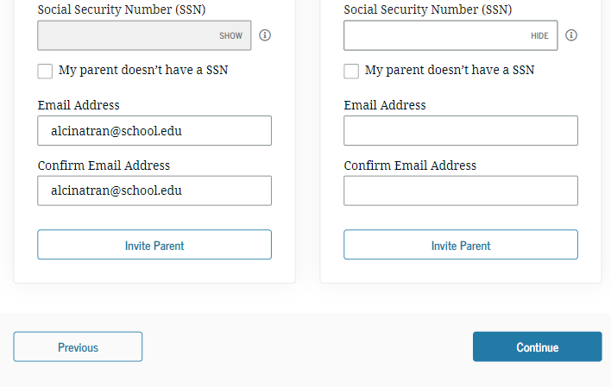
FAFSA Form Changes – Contributor (Parents) Information
The student is asked to enter personal information about their parents in order to send them an invite to their FAFSA form. This information includes Name, DOB, SSN (if applicable) and email address. The email does not have to match their FSA ID email address. They have 45 days to access the application.
Notes:
Christina

Slide 31
FAFSA Form Changes - Income Information Exchange
FSA will now directly transfer federal tax information (FTI) from the IRS into the FAFSA form as long as the user has provided FSA with the consent to do so.
There are very limited paths for people to manually enter their financial data, separated couples, non-US tax filers, undocumented parents.
The IRS Data Retrieval Tool (DRT) will be replaced with this process.
Notes:
Christina

Slide 32
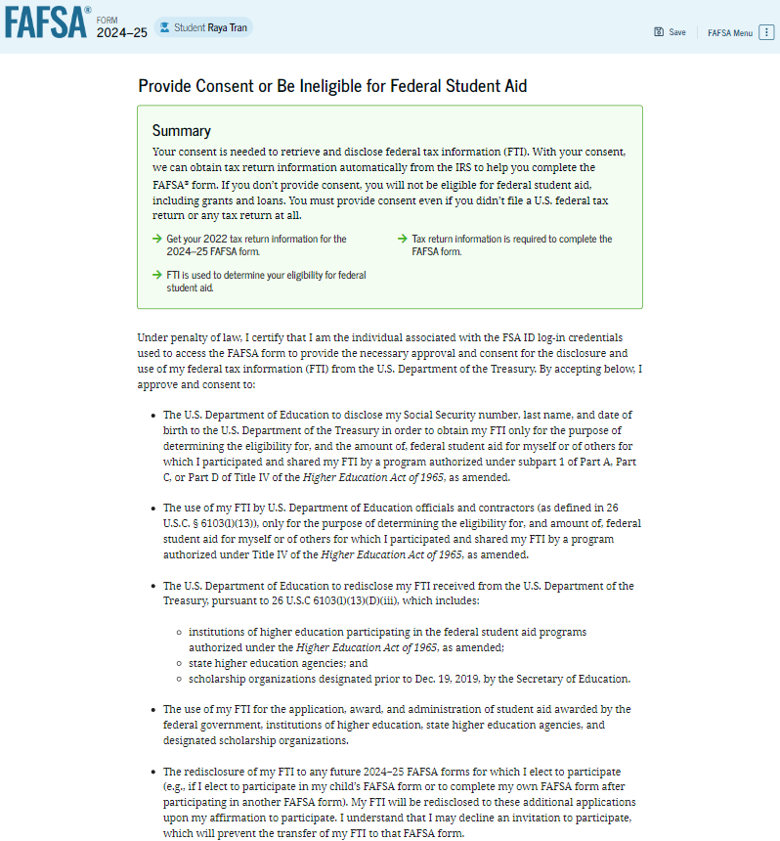
FAFSA Form Changes – Providing Consent
All students, parents, and spouses, regardless of whether they file a US tax return, will be required to provide consent for the IRS to transfer any data they have directly into the FAFSA form.
If no information is on file with the IRS, specific codes will be sent indicating that person’s status with the IRS.
Notes:
Christina

Slide 33
FAFSA Form Changes - Student Aid Index (SAI)
The Expected Family Contribution (EFC) will be replaced with the Student Aid Index (SAI)
Different measure of their ability to pay for college and a change in the methodology used to determine aid
The new formula will be cost of attendance (COA) – SAI = financial need.
Allows a minimum SAI of negative $1,500 to give financial aid administrators more insight when making determinations for students
Notes:
Christina

Slide 34
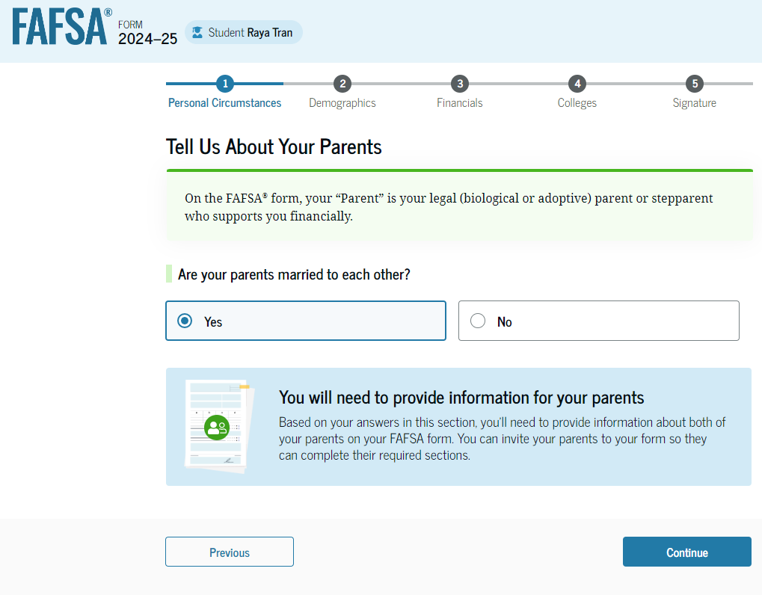
FAFSA Form Changes -Who is the Parent
Parent info to be provided on the FAFSA will no longer be defined as primary custodial parent. New definition is “parent which provided the greater portion of the student’s financial support”
For dependent students-income reported and family size may be for a household that they do not reside in.
FSA has created a parent wizard that will help the student understand whose information should be provided.
Notes:
Christina
Talk about situations where both contributors will need to provide information.

Slide 35
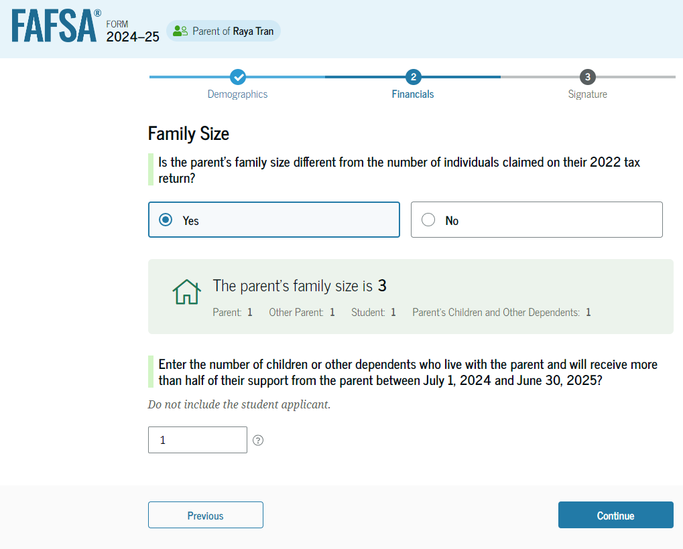
FAFSA Form Changes – Family Size
The new name for household size is family size and will be determined by the number of exemptions claimed on the federal tax returns.
Because family situations can change, there will be a question that allows the student to modify the family size to reflect the current number.
Notes:
Christina

Slide 36
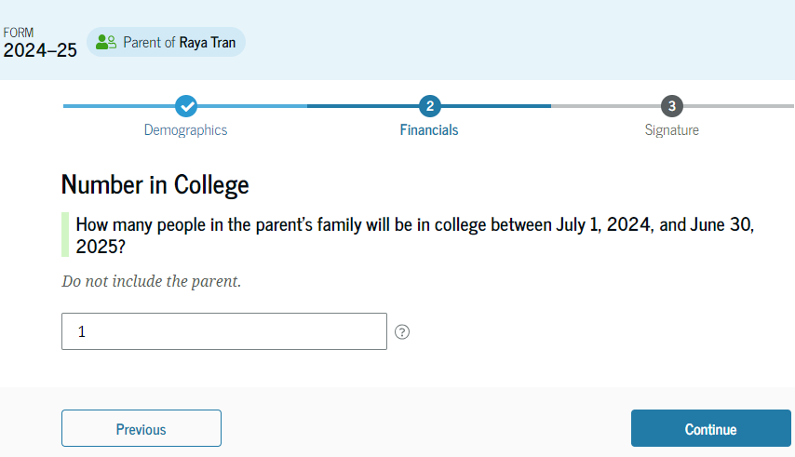
FAFSA Form Changes – Number in College
SAI will no longer be divided by number in college.
With number in college removed from the formula-many students may have SAI double or triple with no change in family income
Current students may see reduction or loss of Pell Grant or state need-based grant
Notes:
Christina

Slide 37
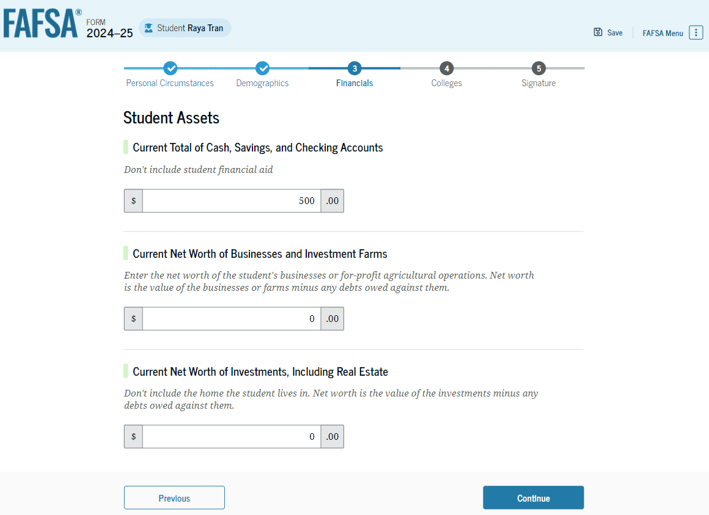
FAFSA Form Changes – Assets
Families with an adjusted gross income of greater than $60,000 (up from $50,000) or those who filed certain schedules will be required to submit assets.
If contributors complete their section first and are not required to provide asset information, the student will not be asked asset questions.
Notes:
Christina

Slide 38
FAFSA Form Changes – Reporting Farms & Small Businesses
If required to report assets, the family would have to report the net value of any business or family farm –no more exemptions for number of business employees or farms on which the family residence is located.
More guidance from federal student aid will be provided this fall.
Notes:
Christina

Slide 39
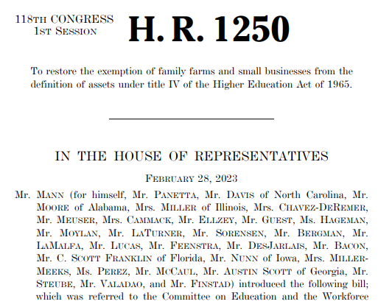
Proposed Legislation - H.R.1250 & S.1237 Family Farm and Small Business Exemption Act
Both the House and Senate introduced the Family Farm and Small Business Exemption Act, which would restore exemptions for family farms and small businesses under the Free Application for Federal Student Aid (FAFSA).
https://www.congress.gov/bill/118th-congress/house-bill/1250/text?s=1&r=7
https://www.congress.gov/bill/118th-congress/senate-bill/1237
Notes:
Christina

Slide 40
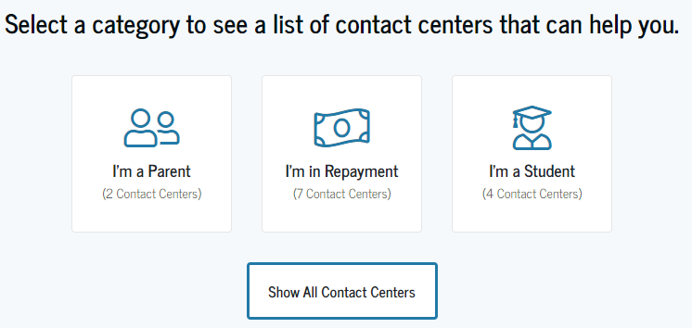
More Languages Available
The FAFSA form will become available in English and Spanish
Additional translation services and support for 9 other languages will be available through the Department of Education office of Federal Student Aid's (FSA) contact center.
https://studentaid.gov/help-center/contact
Notes:
Christina

Slide 41
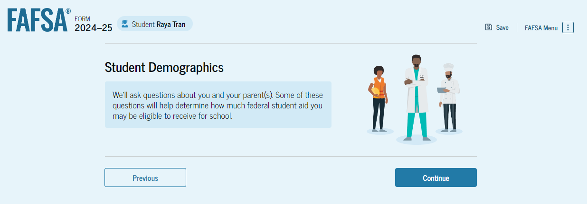
Other Changes
Students can list up to 20 schools on their FAFSA.
The student will be required to complete the demographic section, the information provided will not be sent to the colleges.
Notes:
Christina

Slide 42
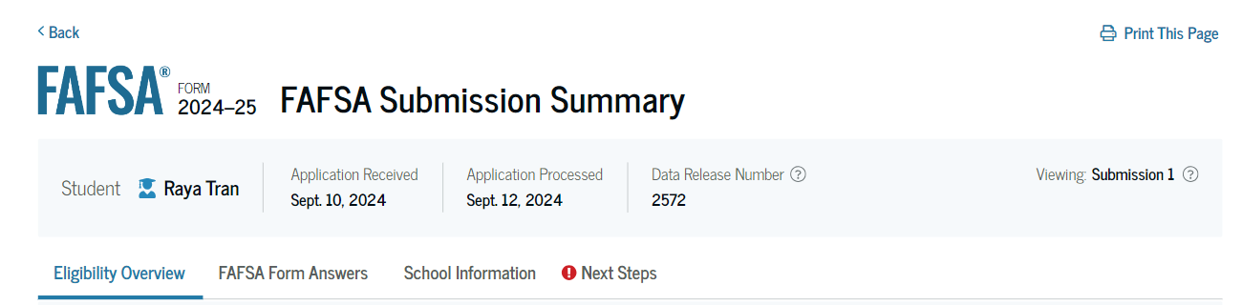
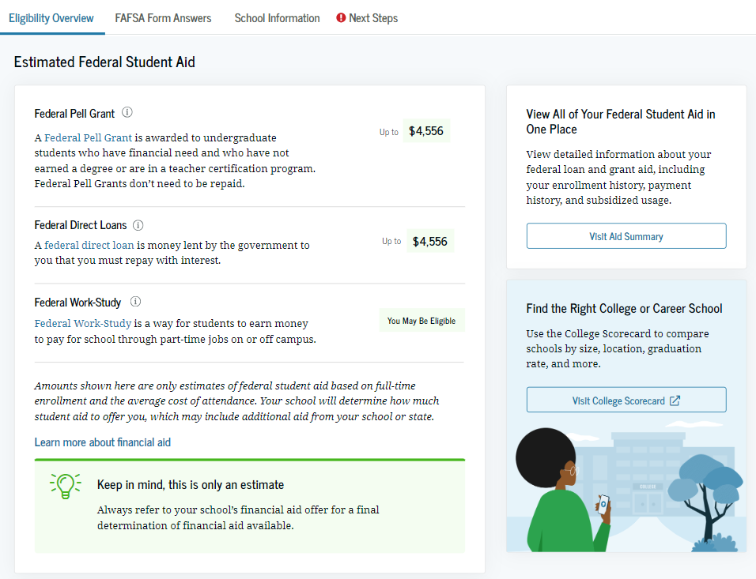
FAFSA Submission Summary
The Student Aid Report (SAR) will be referred to as the FAFSA Submission Summary
Reminds students to request an adjustment for special circumstances
Notes:
Christina

Slide 43
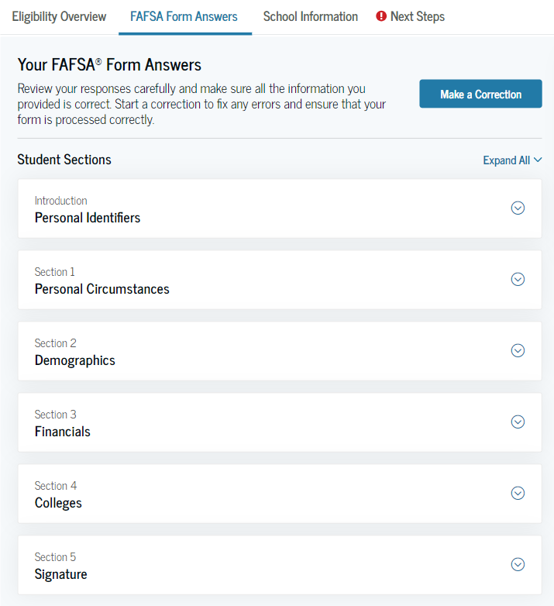
FAFSA Submission Summary
On the FAFSA Form Answers tab, the student sees the answers that they and, if applicable, their contributor(s) provided on their FAFSA form. If any of the provided answers are incorrect, the student can choose to start a correction.
Notes:
Christina

Slide 44
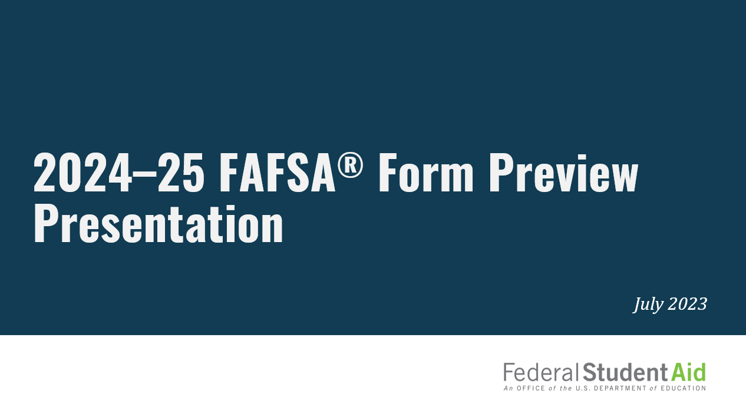
2024–25 FAFSA Form Preview Presentation
https://fsapartners.ed.gov/knowledge-center/library/application-processing/2023-07-31/2024-25-fafsa-form-preview-presentation

Slide 45
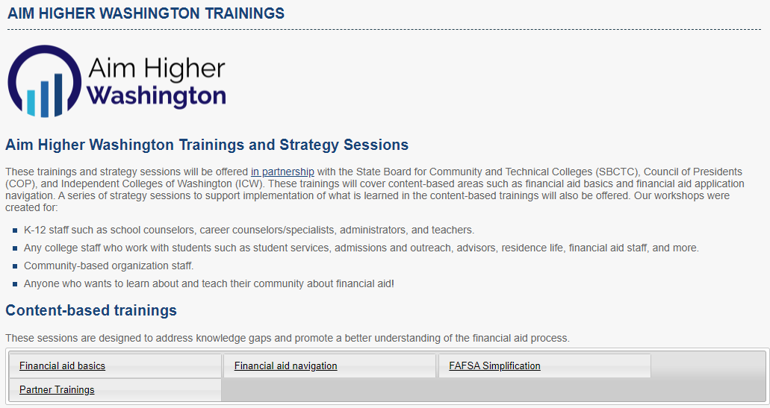
FAFSA Simplification Act Trainings
https://wsac.wa.gov/aim-higher-training
Notes:
Yaslin

Slide 46
FAFSA Simplification Federal Student Aid Resources
https://financialaidtoolkit.ed.gov/tk/announcement-detail.jsp?id=better-fafsa-better-future
Notes:
Yaslin

Slide 47
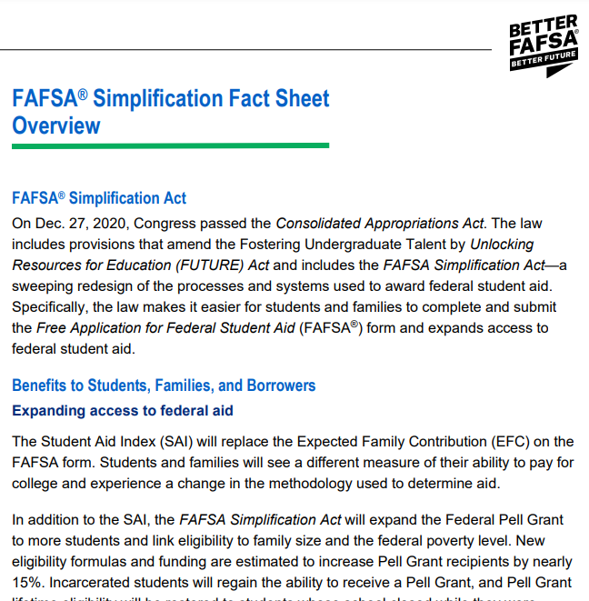
FAFSA Simplification Fact Sheet: Overview
https://financialaidtoolkit.ed.gov/resources/fafsa-simplification-fact-sheet.pdf
Notes:
Yaslin

Slide 48
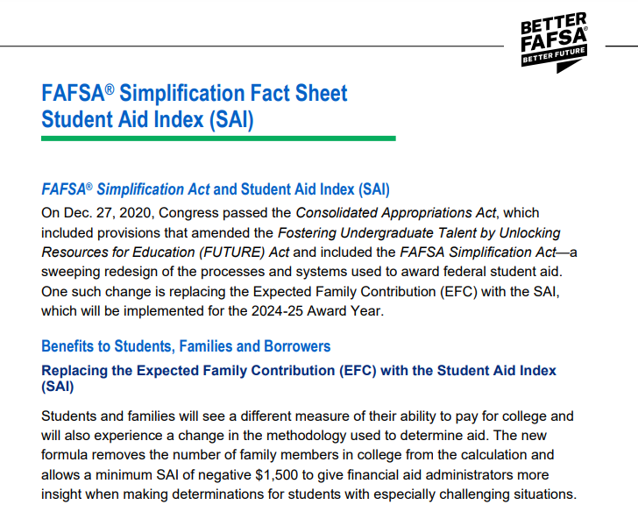
FAFSA Simplification Fact Sheet: Student Aid Index
https://financialaidtoolkit.ed.gov/resources/bfbf-sai.pdf
Notes:
Yaslin

Slide 49
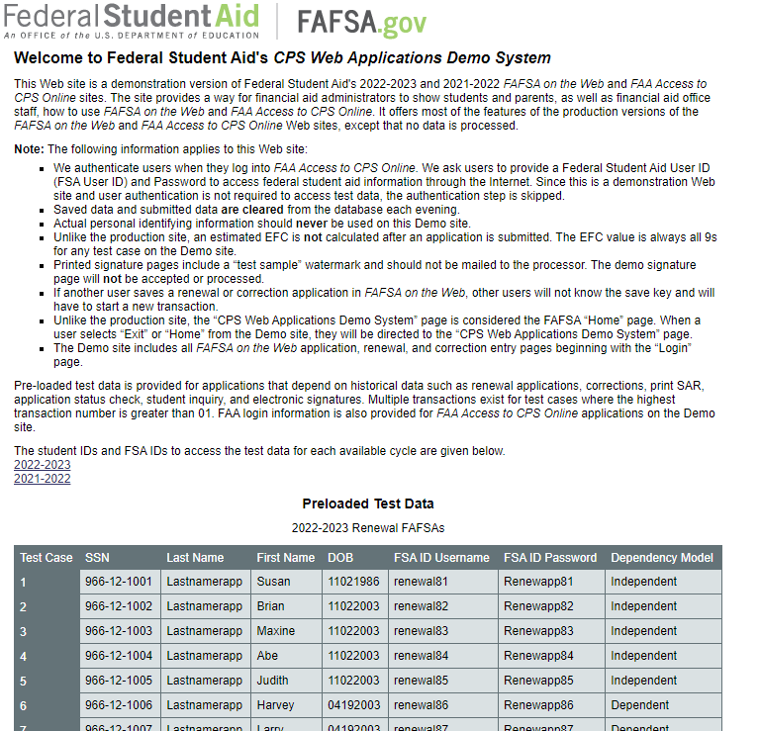
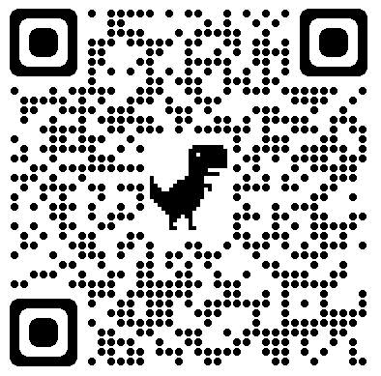
Resources: FAFSA Demo System
FAFSA demo system provides a way for you to show students, parents, and staff, how to use FAFSA on the Web. The 24/25 FAFSA Demo will be available the Sunday before the application opens
https://fafsademo.test.ed.gov/webdemo.htm
Notes:
Yaslin

Slide 50


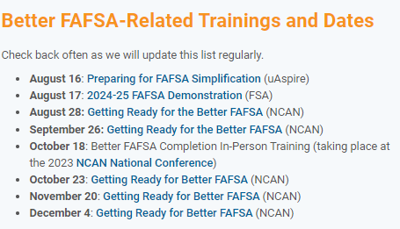
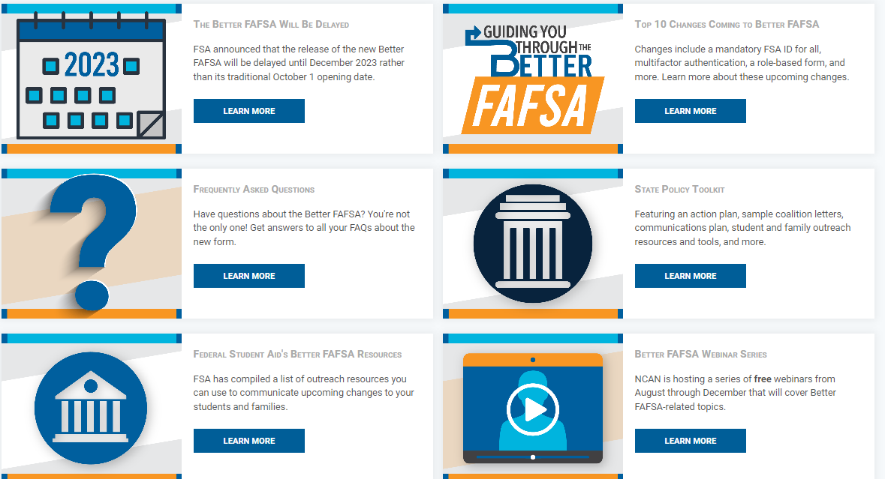
National College Attainment Network (NCAN) Trainings and Resources
https://www.ncan.org/page/better-FAFSA
https://www.ncan.org/page/better-FAFSA-webinar-series
Notes:
Yaslin

Slide 51
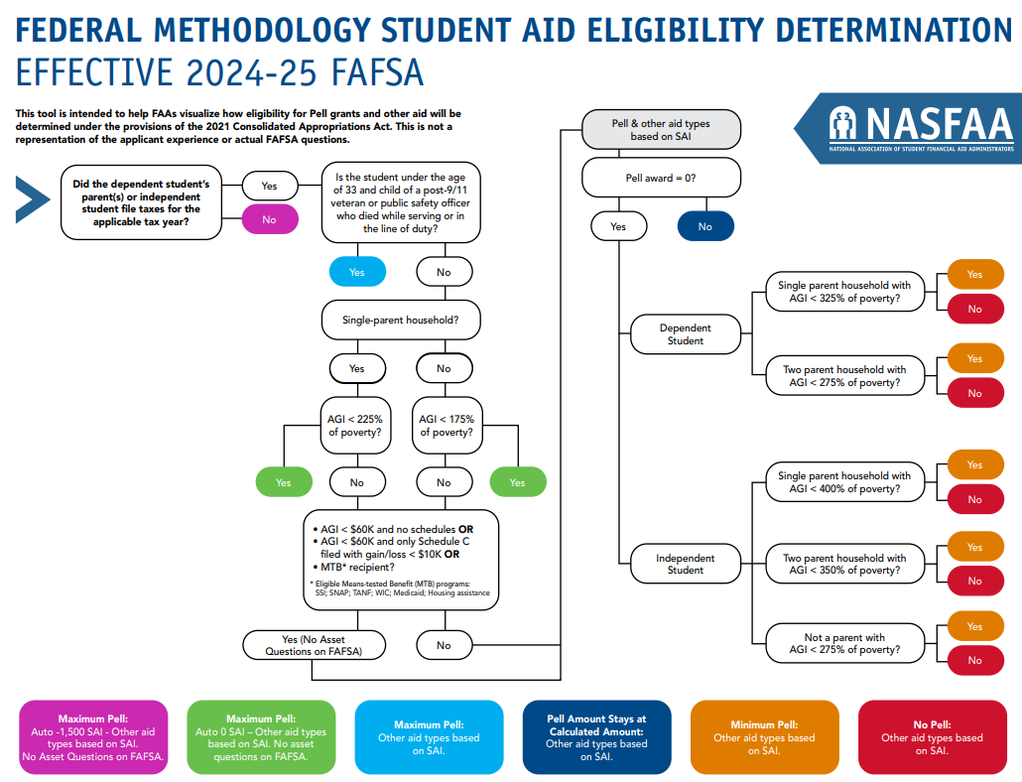
FAFSA Simplification Act Resources - NASFAA
2024-25 Federal Methodology and Pell Formula Changes Flowchart
This chart summarizes changes to the Federal Methodology formula and Pell grants from 2021 through the 2024-25 award year.
https://www.nasfaa.org/uploads/documents/FAFSA_Methodology_Determination_Pell_Title_IV.pdf
Notes:
Yaslin

Slide 52
WSAC College Access Resource Padlet
https://padlet.com/christinaw12/cxbz1z64bch5jbsf

Slide 53
Resource: Student Loan Advocate
Supports current & future student loan borrowers in Washington
loanadvocate@wsac.wa.gov or wsac.wa.gov/loan-advocacy
833-881-0397
Student Loan Education Course at studentloaned.wa.gov provides information on applying for aid, comparing award letters, knowing how much aid a student needs, and repayment topics with 4 tracks:
  Preparing for school
  Understanding my loans
  Loan Repayment
  Supporting my child’s education

Slide 54
Thank you

