Slide 1
How to Create an FSA ID or WASFA Account

Slide 2
The Steps To Applying for Financial Aid
Determine Which Application You Should Use
Create an Account
Complete your FAFSA or WASFA
Gather Your Information
You Are Here

Slide 3
What Information Do I Need to Create an Account?
FSA ID for the FAFSA
WASFA Account
Social Security Number
Your own email address
Please do not use your high school email address as you will not have access after you graduate.
Personal Information including your name as listed on your Social Security Card (if applicable), birthdate, and address.
Your own email address
Please do not use your high school email address as you will not have access after you graduate.
Personal Information including your name, birthdate, and address.

Slide 4
Should I Create an FSA ID or a WASFA Account?
FAFSA
Free Application for Federal Student Aid
FAFSA.gov
WASFA
Washington Application for State Financial Aid
wsac.wa.gov/WASFA
This application is for federal and state financial aid.
This application is for state financial aid only.
OR
If you are unsure if you should complete a FAFSA or a WASFA, use the WASFA Eligibility Questionnaire found at https://wsac.wa.gov/wasfa

Slide 5
Complete One – Not Both
FSA ID for the FAFSA
WASFA Account for the WASFA

Slide 6
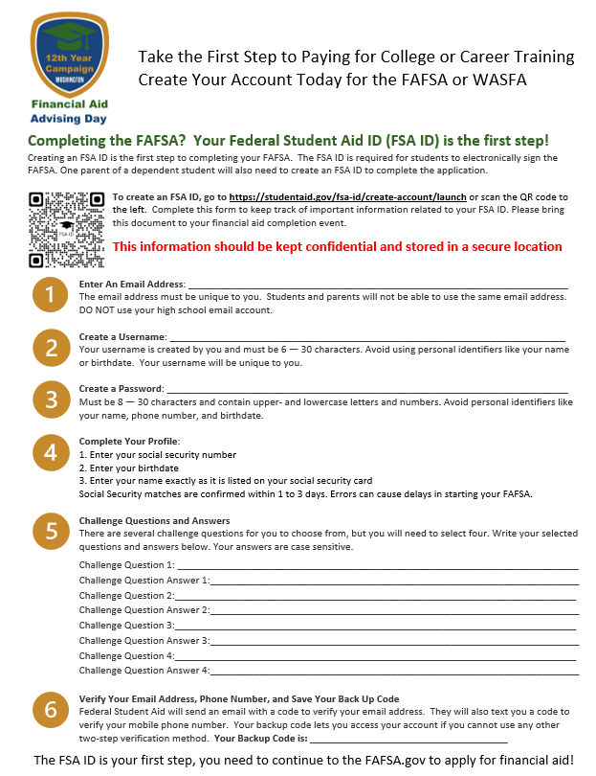
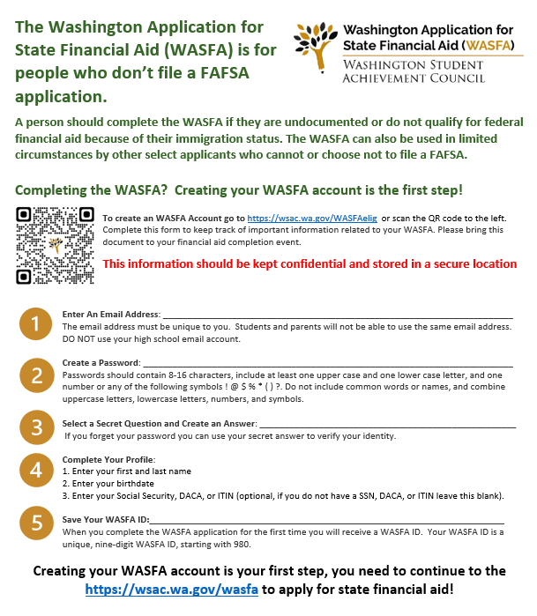
Start with Your FSA ID / WASFA Account Worksheet
This worksheet will walk you through creating your FSA ID or WASFA Account
This information should be kept confidential
The best place to store this is with your 2022 income tax information.

Slide 7
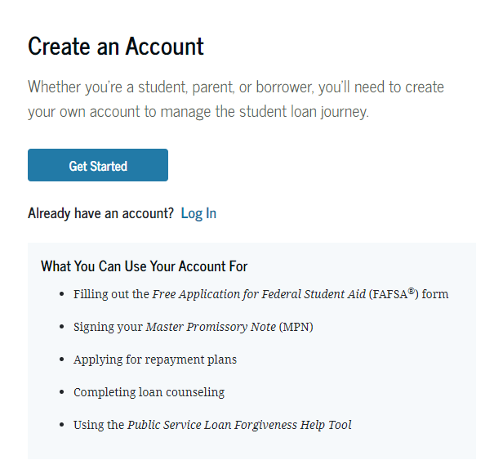
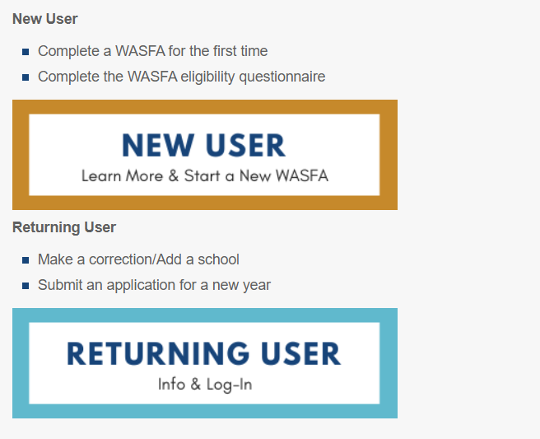
Step #1 – Go to the Correct Website
FAFSA
WASFA
Go to https://studentaid.gov/fsa-id/create-account/launch
Go to https://wsac.wa.gov/WASFAelig

Slide 8
Step #2 – FSA ID - Enter Personal Information WASFA Account – Complete Questionnaire
FAFSA
WASFA

Slide 9
Step #3 – Personal Information
FAFSA
WASFA

Slide 10
Step #4 - Personal Information
FAFSA
WASFA

Slide 11
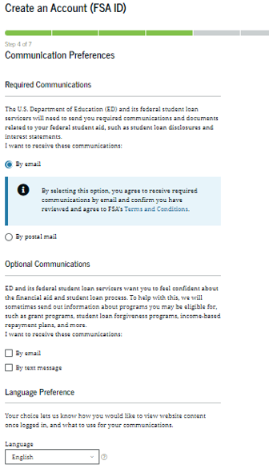
Step #5 – Communication Preferences (FSA ID Only)
FAFSA
WASFA
Congratulations!
Your WASFA account has been created. The class of 2024 can file their WASFA application starting in December 2023.

Slide 12
Step #6 Challenge Questions (FSA ID Only)

Slide 13
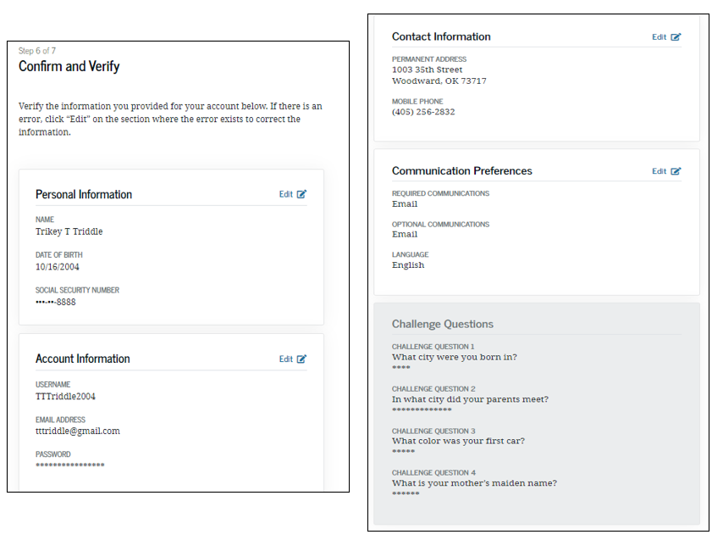
Step #7 Confirm and Verify (FSA ID Only)
Write down the answers to your challenge questions on your FSA ID worksheet.
Double check all your information for accuracy.

Slide 14
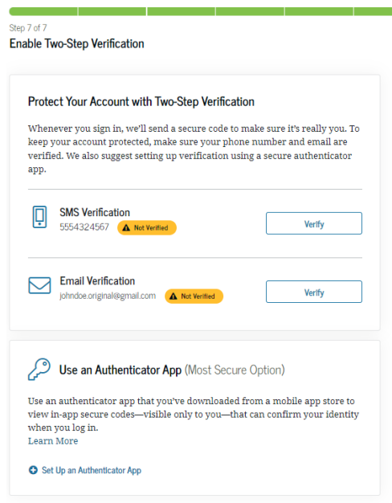
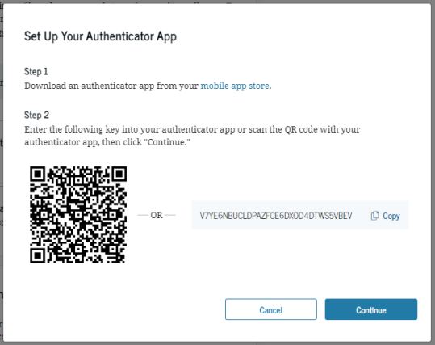
Step #8 Verify Contact Information (FSA ID Only)
Setting up an Authenticator App is an optional process.
You will need to verify your email address or phone number. It is best to verify both.

Slide 15
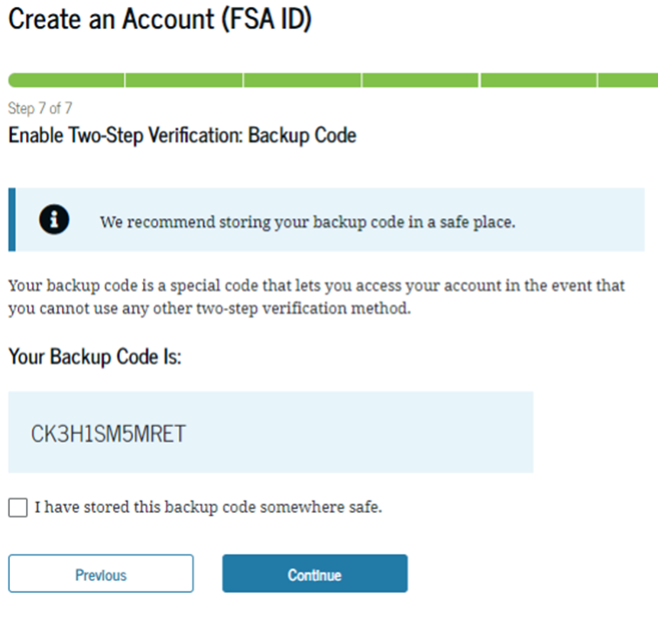
Step #9 Backup Code (FSA ID Only)
Please store your backup code somewhere safe now. If you cannot access your account through two step verification, this is the only way to access your account.

Slide 16
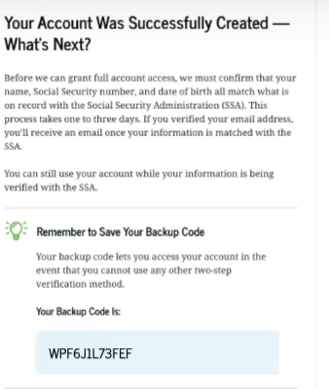
Step #10 – FSA ID Created
Congratulations Your FSA ID has been created!
You will need to wait 1-3 days for your FSA ID is verified before you file the FAFSA.
The class of 2024 can file their FAFSA starting December 2023

Slide 17
Taking the Next Step
Determine Which Application You Should Use
Create an Account
Apply for Financial Aid
Gather Your Information
Your Next Step

