Slide 1
WASHINGTON STATE BOARD OF COMMUNITY AND TECHNICAL COLLEGE WSSSC Wenatchee Valley College May 5, 2012 Tribal Relations and Curriculum Development
Lynn Palmanteer-Holder, Director (Colville)
Tribal Relations and Curriculum Development

Slide 2
Tribal Leaders have a responsibility to build capacity in our communities, education is one of many tools, another is to raise the consciousness of others impacting Tribal communities.

Slide 3
Why Tribal Relations and Curriculum Development?
What? A number of WA CTCs mobilized to expand AIIS and Custom Programs with Tribes.
Who? Tribes and K12 Schools are interested in stronger working relationships with CTCs and Four-Year Universities.
How? Tribal Consultation and Government-To-Government Relationship Building RCW 43.376
Why? Workforce Education and Training needs are not getting met locally, Tribes are sending staff outside area for training.
PILOT CTC Models
Green River College
Wenatchee Valley College
Seattle Central College
Cascadia College
Yakima College
Gray’s Harbor College
Peninsula College
*Spokane Community College
Highland College
Pierce College
*Not Confirmed

Slide 4
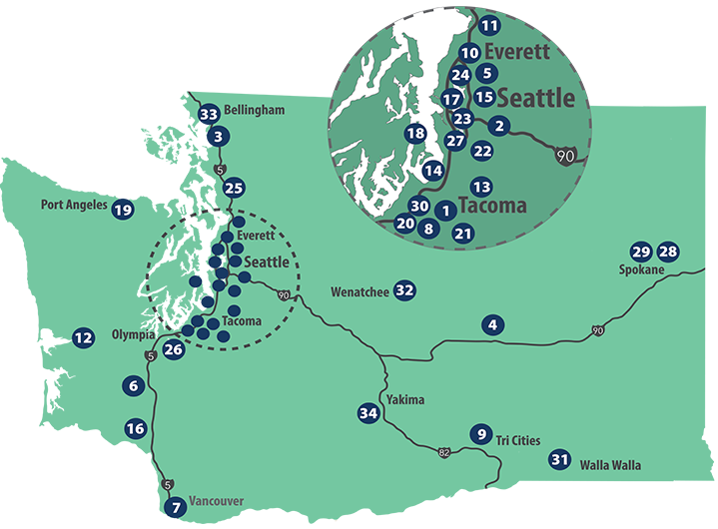
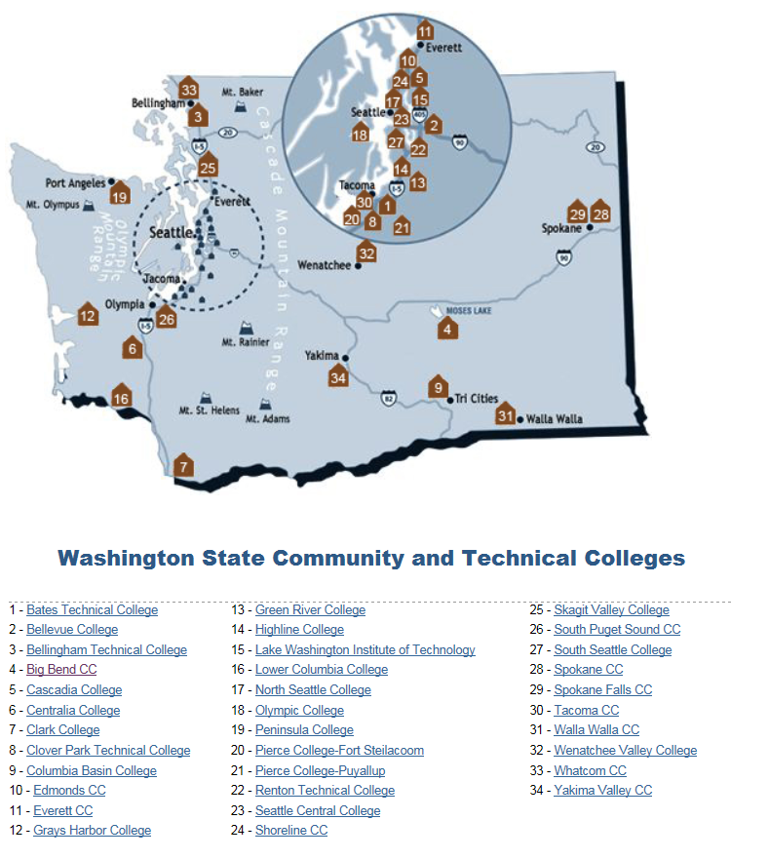
Washington State Community & Technical Colleges
Map
Notes:
Here are the 34 community and technical colleges in the state system and how they are spread on a map of Washington state.

Slide 5
WA 29 Federally Recognized Tribes

Slide 6
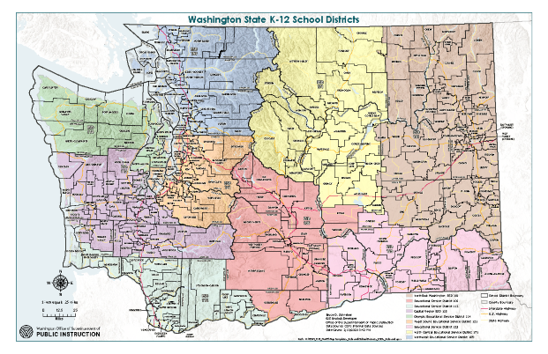
WA STATE
295 WA State Public School Districts
9 Educational Service Districts
7 State-Tribal Education Compact Schools
34 Community & Technical Colleges
6 Public Four-Year Colleges & Universities

Slide 7
RCW 43.376 WA Agencies must build Government-To-Government Relationships with WA’s Federally Recognized Tribes. This law is beyond Land Acknowledgements. Meaningful Tribal Consultation honors each Tribe’s Sovereignty and Self-Governance.
Early
Learning
(IPEL)
G2G Relationships &
Tribal Consultation
From the Cradle to the Grave
TRIBAL LEADER/EDUCATION Leadership
Pre-20+
Basic/Adult Education
Workforce Education
CTE/Trades
Transfer Degrees
Four Year Colleges & Universities
(TLAB)
OSPI
K-12 & Tribal Compact Schools
(WSNEAC)
SBCTC Community & Technical Colleges
(WCAAB)

Slide 8
Imagine, 2025 WA State Board of Community and Technical Colleges intersects Tribal G2G Relationships through DEI Policies across WA Public Education institutions. Imagine, WA CTCs embrace traditional territories alongside WA’s 29 Federally Recognized Tribes in efforts to eliminate AI/AN education & employment disparities, and advance racial, social and economic justice in all communities.
Early
Learning
(IPEL)
G2G Relationships &
Tribal Consultation
From the Cradle to the Grave
TRIBAL LEADER/EDUCATION Leadership
Pre-20+
Basic/Adult Education
Workforce Education
CTE/Trades
Transfer Degrees
Four Year Colleges & Universities
(Tribal Leader AB)
K-12 & Tribal Compact Schools
(WSNEAC)
SBCTC
Community & Technical Colleges
(WCAAB)
Leading with racial equity, our colleges maximize student potential and transform lives within a culture of belonging that advances racial, social and economic justice in service to our diverse communities.
Notes:
Lynn Palmanteer-Holder

Slide 9
INFO SHEET: SBCTC Tribal Relations and Curriculum Development and Washington Community and Technical Colleges American Indian Indigenous Studies Advisory Board (WCAAB)
November 2021: Education Division hired Director Tribal Relations and Curriculum Development
Lynn Palmanteer-Holder, PhC (ABD) UW-Seattle, MEd. WSU and BEd. EWU; 38+ years across education systems, 20+ administration (Colville Tribe)
January 2022: WA CTC Statewide Tribal Consultation Survey Administered
34 CTCs received TC Survey to collect data of formal G2G relationships RCW 43.376, Land Acknowledgements, American Indian Study Coursework, Employment of AI/AN Faculty/Staff, Native Student Pathways Programs, Workforce & CTE collaborations, ABE/BaEd, Tribal Consultation Training needs.
Partnering SBCTC Divisions/Commissions/Councils and Tribal Leader and Education Boards:
SBCTC Education; Instructional Commission; EDI Office; Research & Planning Commission; Diversity & Equity Officers Commission; WSSSC; LLC, WEC, Tribal Leaders Congress; WA State Indian Education Assoc.; UW Center for American Indian Indigenous Studies; WSNEAC;
February/March 2022: WCAAB Kickoff
Intentional Board Recruitment for WA CTC & Tribal Leaders charged to develop a statewide strategic plan to build government-to-government relationships between the 34 CTCs and 29 Federally Recognized Tribes. Aims to reduce AI/AN education/employment disparities; Raise institutional awareness of WA Tribes Historical Burdens e.g, boarding schools, assimilation and relocation policies; raise the consciousness to address contemporary barriers by making space for Indigenous knowledge(s) and curriculum, and finally increase opportunities for Indigenous scholars, professional teachers/administrators.
March 2022 ED Div: College Spark Washington awards SBCTC Education Equity $180,000.
April/May 2022: WSIEA and UW Indigenous Pedagogy Summit for CTCs; May 2022: WCAAB 2-day Retreat @ Green River Community College in collaboration with Muckleshoot Tribe.
Lynn Palmanteer-Holder, Director Tribal Relations and Curriculum Development lpalmanteer-holder@sbctc.edu or c: 509-322-7718

Slide 10
WCAAB
WACTC Leaders/Commissions/Councils | WA Tribal Leaders/ Indian Education Organizations/Indigenous Scholars
WACTC Dr. Yoshiko Harden | WSIEA Anna Armstrong (Kalispel)
IC Dr. Kerry Levett | WSNEAC Jennifer LeBret (Spokane)
DEOC Robert Britten | TLC Chair Leonard Forsman (Suquamish)
WSSSC Dr. B Ivelisse | Tribal College Dr. Denise Bill (Muckleshoot)
WEC Jaclyn Jacot | IPEL Tleena Ives (Port Gamble S’Kallam)
BAS/WF Dr. Tanya Powers | TLC- Delegate ????
AFT David Ortiz | CBO Jessica Porter (Chinook)
Faculty Dr. Vik Bahl | UW CAIIS Dr. Christopher Teuton (Cherokee)
Native SS Dr. Leander Yazzie (Navajo) | Tribal Artist. Ty Juvinel (Tulalip)
SBCTC EDI Ha Nguyen | Linguist/Historian. ????
SBCTC Deputy ED Dr. Carli Schiffner | SBCTC TR&CD Lynn Palmanteer-Holder (CCT)

Slide 11
WASHINGTON GOVERNOR’S OFFICE OF INDIAN AFFAIRS www.goia.wa.gov
2013 Centennial Accord- TRIBAL RELATIONS
RCW 43.376
Governor & Tribal Leaders
GOVERNMENT-TO-GOVERNMENT GATHERING
Evergreen State College
s'gʷi gʷi ʔ altxʷ - House of Welcome

Slide 12
What are WA CTCS DOING? Student Diversity Data
 | Fall 2016 | Fall 2017 | Fall 2018 | Fall 2019 | Fall 2020 | Fall 2021
American Indian/Alaska Native | 6,221 | 6,193 | 6,185 | 6,359 | 5,317 | 5,215
Asian | 31,126 | 31,443 | 30,877 | 30,209 | 25,309 | 23,962
Black/African American | 15,246 | 15,440 | 15,638 | 16,319 | 14,400 | 14,531
Hispanic/Latino | 30,608 | 31,259 | 32,318 | 34,171 | 29,035 | 29,384
Pacific Islander | 2,759 | 2,862 | 3,002 | 3,072 | 2,879 | 2,844
White | 121,861 | 119,624 | 117,113 | 115,292 | 100,254 | 93,654
Total headcount | 227,514 | 227,023 | 225,125 | 221,672 | 178,875 | 167,885
Notes:
Students and faculty may self-report more than one race/ethnicity category. This data counts individuals in each of their reported categories.

Slide 13
HOW ARE CTCS SHIFTING HIRING POLICIES/PRACTICES TO IMPROVE Full-time faculty diversity data
 | 2016-17 | 2017-18 | 2018-19 | 2019-20 | 2020-21 | 2021-22
American Indian / Alaska Native | 56 | 57 | 52 | 58 | 54 | 58
Asian | 259 | 268 | 282 | 294 | 301 | 317
Black / African American | 122 | 131 | 135 | 142 | 141 | 161
Hispanic / Latino | 154 | 172 | 175 | 183 | 196 | 196
Pacific Islander | 9 | 11 | 12 | 14 | 15 | 26
White | 3,145 | 3,152 | 3,177 | 3,127 | 3,064 | 2,977
Total Headcount | 3,724 | 3,749 | 3,796 | 3,789 | 3,735 | 3,675
Percent (%) Change: Fall 2016 – Fall 2021
3.57%
22.39%
31.97%
27.27%
188.89%
-5.34%
-1.32%
Notes:
From SBCTC Faculty and Staff Dashboard
Full-time teaching and non-teaching faculty
Fall values only
Employees are counted in each race that they identify
Total Headcount is unduplicated

Slide 14
SBCTC EDI OFFICE: Senate bills 5227 & 5194
Campus Climate Assessments
Listening & Feedback Sessions
Professional Development Training
Peer Mentoring Strategies
DEI Definitions
Faculty Diversity Program
DEI Strategic Plans
FT Tenured Faculty Positions
Culturally Appropriate Student Outreach Program
Notes:
Ha Nguyen

Slide 15
**Education Division Goals, 21-22:
Respond, support, lead initiatives identified by the system (added 21-22)
Introduce WA TR & CD to WA CTCs to ignite AI/AN Education/Employment Disparities as a primary racial inequity and social justice priority. 2019-2021 data identifies AI/AN students with the lowest enrollment and highest push-out rates.
Intentionally weave and include TR & CD policies through each SBCTC division and CTC DEI plan as opportunities to raise racial equity and enrollment/retention/completion rates of WA’s First Peoples
Develop, advance, and expand internal and external communication and collaborations
Advance a smaller set of WA CTCs mobilization to expand AIIS programs, workforce/CTE, Adult and Basic Education and Tribal student pathways programs through government-to-government relationships and Tribal consultation principles to develop specific coursework (DTAs) and workforce certificate programs.
Increase awareness by providing Training to WA CTCs and SBCTC Commissions/Councils of G2G Relationship Building RCW 43.376- Apply G2G policies and best Tribal Consultation models from other WA State Agencies working with WA 29 federally recognized Tribes.
Create Tribal Relations website as a external resource to WA CTCs and Tribal governments.
Expand professional development opportunities and expectations- internally and externally
Introducing RCW 43.376 Building government-to-government relationships with WA State Board of Community and Technical Colleges Divisions, Commissions and Councils in collaboration with SBCTC EDI office.
Continue expanding with approximately 8-10 WA CTCs highlighting G2G best practices through ongoing seminars/webinars/workshops and plan for 2023 State-Wide G2G Tribal Consultation Conference in collaboration with Tribal Governments & UW American Indian Indigenous Studies.
Statewide Training of RCW 43.376 Building government-to-government relationships between 34 CTCs and 29 federally recognized Tribes will be scheduled across WA State in 6-9 regions by January 2023.
Improve internal and external customer service
Improve customer service applying SBCTC three primary goals e.g., Improve completion rates, increase enrollment, and eliminate equity gaps through intentional relationship building with WA Tribes.
WCAAB-Washington State Community and Technical Colleges American Indian Indigenous Studies Advisory Board was created and kicked off to build a network of Tribal and CTC Leaders to guide a statewide strategic plan to eliminate barriers and create pathways for successful partnerships and the local level.
WCAAB will raise the consciousness across WA CTCs and prioritize policies/practices to expand Indigenous knowledge(s) by formal G2G relationships with Tribal Leaders, Tribal Scholars, Tribal Educators and Tribal Wisdom Holders alongside WA CTC Commission Leaders, Student Services advancing future partnerships across Tribal and non-Tribal communities.
Create a sustainable and equitable work environment
WCAAB collectively with SBCTC EDI to support WA CTCs efforts to increase diverse faculty to represent student population by intentionally recruiting and hiring Indigenous scholars from WA Tribal communities as faculty, administrators and/or staff. Research has demonstrated, when higher education institutions hire people representing diverse communities, students are more likely to identify with their professor, feel a sense of belonging, seek support and complete academic programs.
WCAAB will strive to track WA CTCs formal and informal relationships with Tribal communities. Relationships begin informally, and expand to formal, these relationships have proven to be reciprocal in nature.

Slide 16
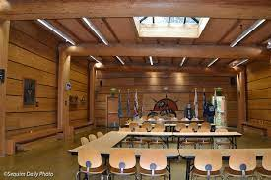
The ʔaʔk̓ʷustəƞáwt̓xʷ House of Learning
Peninsula Community College-Port Angeles, WA
CURRICULUM DEVELOPMENT
WACTCs are making space for Indigenous Knowledge(s), AIIS curriculum, transfer degrees, opportunities to customize workforce and CTE certificates grounded in the economic and community benefits of Washington Tribes:
WIGA-EconImpact2019.pdf (washingtonindiangaming.org)

Slide 17
Highline College

Slide 18
Green River College

Slide 19
Grays Harbor College

Slide 20
WVC AIIS & Workforce Education
FTE - Director Tribal Affairs and Special Initiatives reports to President

Slide 21
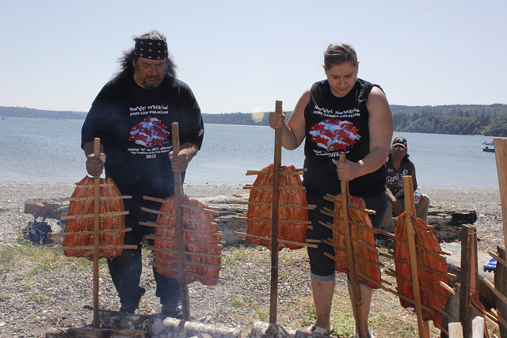
Preserving Culture and Reclaiming Knowledge Systems
Home Page - Washington Indian Gaming Association
This Photo by Unknown Author is licensed under CC BY

Slide 22
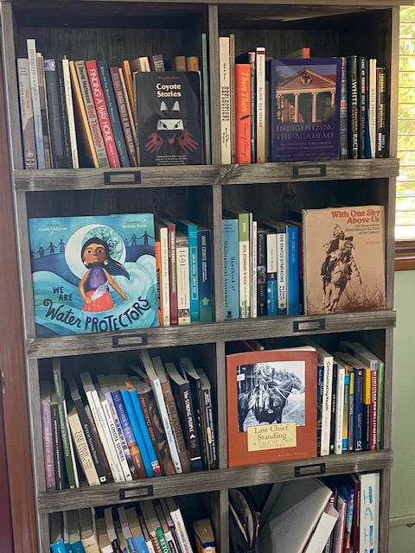
Limlimt (thank you) WSSSC AND WVC for the invitation, and for listening. Lynn Palmanteer-Holder, Director Tribal Relations and Curriculum Development for Washington State Board of Community and Technical Colleges lpalmanteer-holder@sbctc.edu
QUESTIONS???

