Slide 1
Expanding WA American Indian and Indigenous Studies and Program
WA CTC AIIS Interim Advisory Board: Lynn Palmanteer-Holder, Dr. Leander Yazzie, Dr. Vik Bahl, David Ortiz
October 8, 2021

Slide 2
9:00 to 9:05
In Chat: Please briefly introduce yourself, including tribal affiliation and/or cultural identity, gender pronouns, college or organization, department and/or position
(This webinar is being recorded)

Slide 3
M.C. Lynn Palmanteer-Holder (Colville) Tribal Education Consultant – SBCTC
Opening Remarks
Informal Welcome
Honoring Indigenous Peoples Day: Monday, October 11, 2021
Housekeeping
Introductions & Questions re: Please post in chat
Transition Bell (Presenters 1-minute)
5 min breaks---Special Video Presentation-Peninsula College
Agenda Overview
State CTCs Bridge Tribal Education Sovereignty Gap

Slide 4
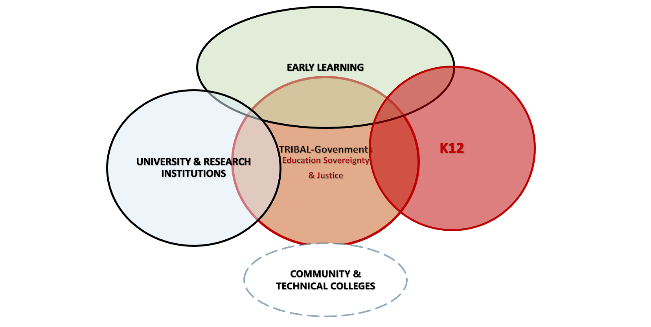
WA Tribes Education Sovereignty & Justice Model
WA CTC GAP-Governor’s Office on Indian Affairs (GOIA)
WA State Education Institutions Compliance with RCW 43.376.10-50 GOVERNMENT-TO-GOVERNMENT with Indian Tribes

Slide 5
Today’s Agenda
Part I – BENEFITS OF GOVERNMENT-TO-GOVERNMENT RELATIONSHIPS
M.C. Lynn Palmanteer-Holder, Tribal Education Consultant SBCTC (Colville)
Dr. Carli Schiffner, Deputy Executive Director of Education, SBCTC
Chairman Leonard Forsman, Suquamish Tribe; Chair of Tribal Leaders Congress on Education
Dr. Christopher Teuton, AIS Faculty, Former Chair of American Indian Studies, UW-Seattle (Cherokee)
Dr. Jim Richardson, President, Wenatchee Valley College
Part II – BEST PRACTICES
Green River College (Dr. Leander Yazzie & Dr. Vik Bahl)
Grays Harbor College (Gary Arthur and Dr. Barbara Smith)
Wenatchee Valley College (Dr. Kestrel Smith)
Cascadia College (David Ortiz, Founding Faculty)
Part III – LESSONS LEARNED & NEXT STEPS
Lessons Learned
WA CTC AIIS Advisory Board Framework
Planning and Prioritizing Essential Resources
WA AIIS Programs Strategic Plan
CTC Tribal Consultation Toolkit
Questions and Comments (from Chat)
Next Steps / Closing Remarks

Slide 6
Part I
WA Community & Technical Colleges & Tribes Building
Government-to-Government Relationships

Slide 7
Dr. Carli Schiffner Deputy Executive Director of Education, SBCTC

Slide 8
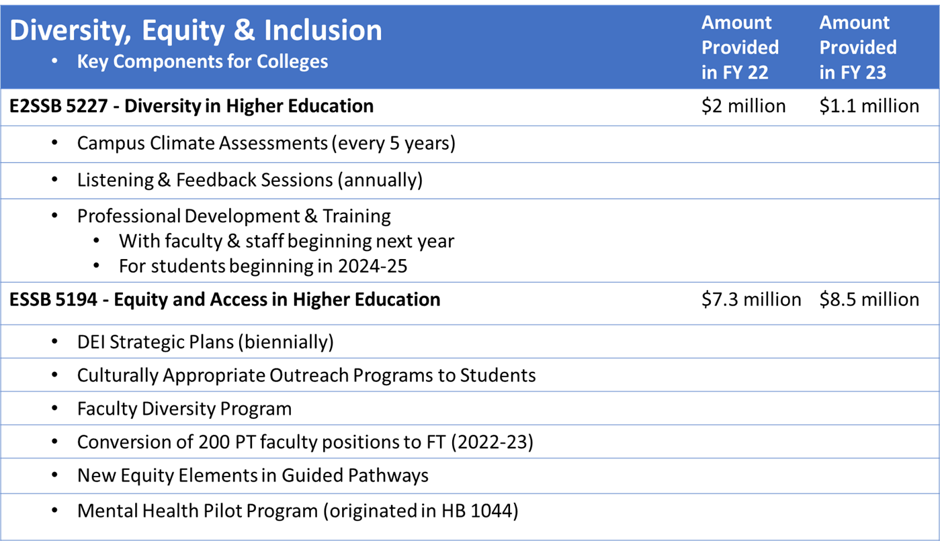
SBCTC Vision
Leading with racial equity, our colleges maximize student potential and transform lives within a culture of belonging that advances racial, social, and economic justice in service to our diverse communities.

Slide 9
Chairman Leonard Forsman (Suquamish) Chair of Tribal Leaders Congress on Education
Welcome
Land Acknowledgement
WA Government-to-Government Relationship Building
Tribal Consultation

Slide 10
Dr. Christopher Teuton (Cherokee) AIS Faculty, Former Chair of American Indian Studies, UW-Seattle
Benefits of Indigenous Knowledge as a part of higher education’s teaching and learning curricula.

Slide 11
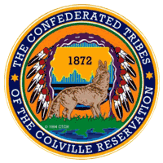
Dr. Jim Richardson President, Wenatchee Valley College
WENATCHEE VALLEY COLLEGE WITH CONFEDERATED TRIBES OF THE COLVILLE RESERVATION
SHARING BEST PRACTICES OF GOVERNMENT-TO GOVERNMENT
RELATIONSHIPS AND MEANINGFUL TRIBAL CONSULTATION

Slide 12
BEST PRACTICE OUTCOMES 2018 WA State Association College of Trustees (ACT) Partner of the Year Award 2019 National ACCT Leadership Congress Award
GOVERNMENT -TO-GOVERNMENT RELATIONSHIPS Sharing Decades of working relationships….

Slide 13
WASHINGTON STATE TEACHERS, ADMINISTRATORS, SCHOOL BOARD MEMBERS AND EDUCATORS TO THE OKANOGAN REGION

Slide 14
Government-to-government relationship tribal consultation
PARTNERSHIPS & PROGRAM DEVELOPMENT
Tribal Language Courses (20+ Years) MOA
ECE Cohort Certificates & Language Nest
Office Asst. Workforce Development Programs
Tribal Gaming Operations Supervisor Certificates
Running Start Partnership
College in the Classroom
High School 21
POLICY OUTCOMES:
CCT Education Center located in Nespelem
WVC Hired: Director of Tribal Affairs & Special Initiatives
CCT Hired – College Admissions and Advisement Liaison
WVC New Facility Named after
Mish ee twie –
Gloria Atkins Wenatchee Tribe Scholar and Advocate

Slide 15
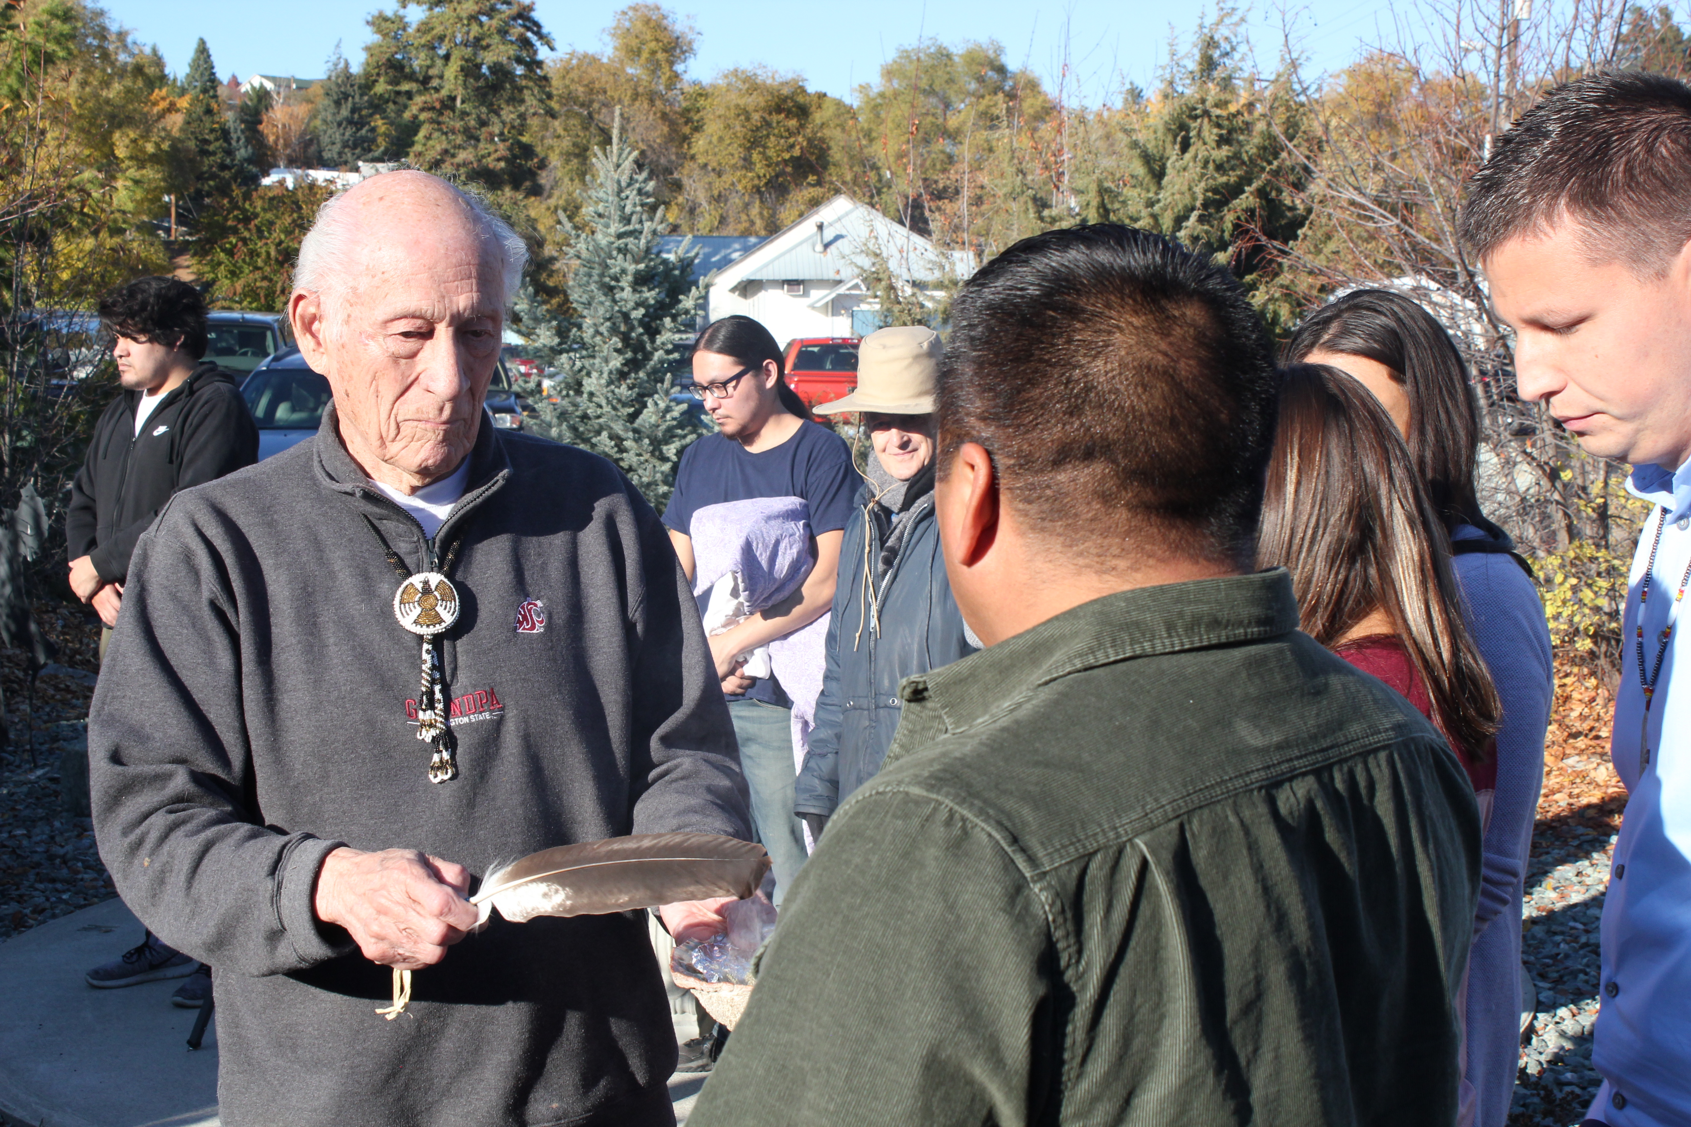
LEADERSHIP IS IMPORTANT TO ADVANCE GOVERNMENT-TO-GOVERNMENT RELATIONSHIPS WITH TRIBAL NATIONS
Leadership is Key-WVC & CCT Roundtable Meaningful Tribal Consultation

Slide 16
BREAK 5 minutes
House of Learning, The Spirit of the Peninsula College Longhouse

Slide 17
Part II
WA Community & Technical Colleges and Tribes Best Practices

Slide 18
Dr. Leander Yazzie (Dine-Navajo) Success and Completion; Native American Student Advisor, Green River College Arizona State University, BS American Indian Studies/BA Sociology; University of Oklahoma, Master of Human Relations; University of Washington Tacoma, Educational Leadership, Ed.D.
Creation Story, Part A
Creating a place of belonging and being for our Native student population.
Involving Tribal communities within the college.
Doctoral Capstone/Dissertation: Introduction of American Indian Studies within the Washington state Community & Technical College System
AIIS in CTC Forum and Webinars; March, May, August
Meaningful Land Acknowledgement (GRC & Tribal Consultation)
Communication with Tribal leaders, and following protocol out of respect of the Tribe.
A sense of trust between both groups, Educational Institution and Tribal Government/Community.
Action statement presenting current and future outcomes of this relationship.

Slide 19
Dr. Vik Bahl English Faculty, Green River College; DEHPD; DEI in WA CTCs Knowledges, Knowledge Needs, and Knowledge Holders of Communities of Color
GRC ODEI-GDEC Series, 2020-21
Asian American Studies (Rick Bonus, Dec 2)
American Indian Studies (Leander Yazzie, Lynn Palmanteer-Holder, et al., Mar 2, May 14)
Pacific Islander / Pasifika Studies (David Palaita, May 18)
Muslim American Studies (Mohja Kahf, May 25)
2021-22
Black Studies (African American, African, and Diaspora)
Chican@ / Latinx Studies

Slide 20
Disaggregating AIIS by Courses, Departments, Programs, and Services
TRANSFER
AIIS Departments/Programs
Since Time Immemorial (STI) mandated curriculum in the CTCs
*Ethnic Studies Departments/Programs
Social Sciences
History
Anthropology
Sociology
Psychology
Law
Humanities
Literature
Languages
Communication Studies
Visual and Performing Arts
STEM
Math
Sciences
Engineering
WORKFORCE DEVELOPMENT / CAREER & TECHNICAL EDUCATION (CTE)
Forestry/Natural Resources
Technology
Nursing
Allied Health / Community Health
Early Childhood Education
Tribal Teacher Certification
Gaming, Hospitality, and Casino Management
Business
Social services
Others?
BASIC EDUCATION
First Year Experience
College Success
High School Completion / GED
STUDENT SERVICES
Native Pathways
Recruitment
Enrollment
Tutoring
Advising
Financial Aid
Running Start
Multicultural Services

Slide 21
Gary Arthur and Dr. Barbara Smith Grays Harbor College

Slide 22
Grays Harbor Native Pathways Program
FACULTY
DEVELOPMENT
CURRICULUM DEVELOPMENT
*Courses
*Native Cases
GHC Native Pathways Program
2 YEAR – 4 YEAR PARTNERSHIP
COMMUNITY BUILDING &
ONGOING EVALUATION & IMPROVEMENT

Slide 23
NATIVE PATHWAYS PROGRAM DESIGN AND SHORT HISTORY
Grays Harbor College Native Program started in 2005 at Evergreen’s request.
Substantial external funding in critical first four years
Hybrid online program to serve reservation based working students.
In the early years online learning was just getting started.

Slide 24
Native Pathways Associate of Arts Degree Program
Quarter | Year 1 column | Year 2 column | Year 3 column
Fall | Fall FYE 101 – Orientation (1 credit) English 101 (5 credits) B-Tech 101 (2 credits) Weekend Classes: FYE 102 (2 credits) HUM 107 (1 Credit) | Fall Anthropology 210: (5 credits) English 102 (5 credits) Weekend Classes: HUM 103 (2credits) HUM 110 (1 credit.) | Fall Earth Science 102 (5 credits) Math 107 (5 credits)
Winter | WTR. Anthropology 206, (5 credits) Library 101 (2credits) Weekend Classes: Hum 101 (2credits) Hum 108 (1 credit) | WTR. Pols 202 (5 credits) Gen Psych 100 (5 credits) Weekend Classes: Hum 105 (2credits) Hum 111 (1 credit) | WTR Health Promotion 101 (5credits) Astronomy 101 (5 credits)
Spring | SP. Biology 100 (5 credits) Art Appreciation 100 (5 credits) Weekend Classes: HUM 102 (2 credits) HUM 109 (1 credit) | SP. Music 105 (5 credits) Anthropology 216 (5 credits)

Slide 25
OUTCOMES AND SUCCESSES
Extensive community building, analysis, and feedback is important
Substantial enrollment, graduation rates and upward mobility
High rate of student & faculty satisfaction with program
Substantial curriculum development
Many faculty include Native content in their courses
Strengthened college-tribal relations & communication

Slide 26
NEXT STEPS, NEEDS, AND LESSONS
Outreach needs
Staff transitions matter
Things change a lot over time – Adapt
Native people and tribes have diverse interests

Slide 27
Dr. Kestrel Smith
AIIS Instructor & Department Chair
Wenatchee Valley College at Omak (WVC-O)

Slide 28
A continuum of earlier work
Creation of a tenure-track AIIS faculty position to begin building AIIS classes at WVC was made possible by earlier collaboration of many people/entities
Curriculum building and transferability are just pieces of a much larger, on-going process

Slide 29
At Wenatchee valley college:
The first full AIIS program at a CTC in WA state (now in year four)
A permanent, dedicated AIIS tenure-track faculty position
Indigenous Language Courses
A permanent Director of Tribal Relations and Special Initiatives position
Workforce Development Programs

Slide 30
Commitment to community at Wenatchee valley college
Permanent Director of Tribal Relations and Special Initiatives position
Only such position at a CTC in WA state
Responsible for building and maintaining relationships with WVC, the Confederated Tribes of the Colville Reservation (CCT), and surrounding community
Indigenous Language Courses
Essential to an AIIS program
At WVC, a formal MOA in collaboration with the CCT Language Program; who certify local instructors

Slide 31
Commitment to community at Wenatchee valley college
Workforce Development Programs
Tribal Gaming Operations Supervisor Certificate 18 credits
Certificate evolved from local gaming management advisory board
Early Childhood Education
Third Cohort of ECE Certification for tribal head start teachers (classes taught at the tribal center)
High School 21 (HS21)
WVC hired instructor to teach HS 21 at tribal government center (customizing remedial and academic programs)

Slide 32
Adding aiis curriculum: a teach-as-you-build approach
Year One (18-19): Build 2, teach 1 per quarter –
6 class built
Year Two (19-20): Build 1, teach 2 per quarter –
3 classes built
Year Three (20-21): Teach full AIIS course load – All 9 in rotation
For accessibility: 2 in-person, 1 online each quarter

Slide 33
Full rotation of nine (9) AiiS courses - https://www.wvc.edu/academics/AIIS/
AIIS 102: Introduction to American Indian Indigenous Studies
AIIS 103: The Indigenous Pacific Northwest
AIIS 150: History of American Indian Education
AIIS 170: Film and Cinema Through the Indigenous Lens
AIIS 202: Contemporary Topics in American Indian Indigenous Studies
AIIS 203: Introduction to American Indian Indigenous Literature
AIIS 209: Native American History to 1815
AIIS 210: Native North America 1815 to Present
AIIS 240: Indigenous Women of North America
Additionally: HIST 230: History of the First Peoples of the Plateau Region

Slide 34
Community collaboration and consultation
Quarterly WVC/CCT Advisory Council meetings
Engagement with student body and community for feedback throughout development of courses
Ongoing discussions with CCT Higher Education Liaison & Program

Slide 35
Collaboration with ais department at uw: building pathways
Ultimate goal: 2 + 2 Articulation (Transfer) Agreement
Aligning of courses
Not a copy/paste approach
Integration of local knowledge central to individual AIIS courses
UW AIS Curriculum Committee Review for approval
As AIS Majors: UW will accept up to 30 AIS credits from WVC (55 needed for major)
As AIS Minors: UW will accept up to 15 AIIS credits from WVC (30 needed for minor)

Slide 36
David Ortiz Cascadia College, Founding Faculty
Framing and Imagining “AIIS”
Explore “best” practices for AIIS coursework
Build and maintain partnerships
Reimagine professional development opportunities
Planning the future in the present tense

Slide 37
BREAK 5 minutes
House of Learning, The Spirit of the Peninsula College Longhouse

Slide 38
Part III
WA Community & Technical Colleges and Tribes
Lessons Learned & Next Steps

Slide 39
Lessons Learned
Many WA CTCs Partnerships with Tribes that can be highlighted as Best Practices-SBCTC will host a survey to gather such partnerships and update CTC Profiles.
Most NOT Formal Government-To-Government Partnerships
In some cases, Tribes are the largest employer in specific regions and CTCs have not engaged this workforce to development custom certificates, programs or CTE pipeline projects with local K12 schools.
Opportunity for CTCs and Local Tribes to Partner and Advance First Peoples Languages & Tribal Teacher Certification Programs.
This is not a sprint, it’s a marathon toward meaningful tribal consultation and relationships
Need models of collaboration with tribes that includes compensation and recognition.
Colleges need to create and support positions such as Director of Tribal Relations/Tribal Affairs, AIIS Faculty or Tribal Liaisons i.e., WVC, Peninsula College

Slide 40
WA CTC AIIS & Programs Advisory Board RCW 43.376 GOVERNMENT-TO-GOVERNMENT with Indian Tribes
Community & Technical Colleges
WA Association of Community & Technical Colleges (WACTC--college presidents)
Instruction Commission (IC)
WA State Student Services Commission (WSSSC)
Diversity & Equity Officers Commission (DEOC)
Workforce Education Council (WEC)
Multicultural Student Services Directors Council (MSSDC)
ACT (Association of College Trustees)
State Board for Community & Technical Colleges (SBCTC)
AIIS Faculty
Tribal Affairs Director
AFT / WEA Reps (faculty unions)
Pacific Islander Studies liaison

Slide 41
WA CTC AIIS & Programs Advisory Board RCW 43.376 GOVERNMENT-TO-GOVERNMENT with Indian Tribes
Tribal Education Organizations
WA State Native American Education Advisory Committee (WSNAEAC)
Tribal Leaders Congress on Education (TLC)
WA State Indian Education Association (WSIEA)
Tribal Higher Education Coordinator
Tribal Elder/Linguist
Tribal Community Scholar
Tribal Scientist

Slide 42
Planning and Prioritizing Essential Resources
Prioritize hiring Tribal Educators
Work with Campus Librarians to Assist with Reading Lists, Textbook and Film Purchases
Extend “honorarium(s)” for Tribal Members
Indigenize the Campus
Language Shift, Thinking, and Time

Slide 43
WA AIIS Programs Strategic Plan
Recognize and foster broader spaces for Indigeneity
Expand presence and success of Indigenous students, faculty, knowledges (pedagogy and curriculum) with a focus on improved student recruitment, retention, and completion
Expand AIIS Academic Programs (including Transfer, Basic Ed, and CTE)
Develop and share successful WA Tribal - CTC reciprocal partnerships, consultations, and community engagement and accountability
Develop and share courses; build protocols for course enrollments from multiple colleges
Identify workforce development needs and build relevant CTE programs; demonstrate benefits to local workforce, communities, and regions
Highlight and share best practices across colleges
Develop a website with system-wide information and resources
Propose appropriate hiring processes related to the range of positions needed to expand and sustain AIIS, including committee composition and job descriptions for faculty, staff, and administrators, prioritizing tribal educators

Slide 44
CTC Tribal Consultation Toolkit
Consultation and Coordination with American Indian and Alaska Native Tribal Governments - Department of Education https://www2.ed.gov/about/offices/list/oese/oie/tribalpolicyfinal.pdf
Every Student Succeeds Act (ESSA) of 2015, Public Law 114-95 (AZ) ESSA Tribal Consultation | Arizona Department of Education (azed.gov)
Effective Tribal Consultation: https://udall.gov/Documents/Institute/Training/201%20Syllabus.pdf
GRC/Balcstar PLLC Consulting Communication/action checklist
**Advisory Board will continue to build upon and revise toolkit and resources as needed.
**Recognizing that American Indian tribes are diverse, we will create a toolkit for the CTCs with appropriate protocols for each tribe.

Slide 45
Next Steps / Closing Remarks
If you or your college are interested in a follow up meeting from this webinar, please don’t hesitate to contact our AIIS interim Advisory Board:
Lynn Palmanteer-Holder, Tribal Education Consultant balcstar.llc@hotmail.com
Dr. Vik Bahl, English Faculty, Green River College vbahl@greenriver.edu
Dr. Leander Yazzie, Student Pathways, Green River College lyazzie@greenriver.edu
David Ortiz, Founding Faculty, Cascadia College dortiz@cascadia.edu
Dr. Carli Schiffner, Deputy Director of Education, SBCTC schiffner@sbctc.edu
If you are interested in being on the WA CTC AIIS Advisory Board please contact us.

