Slide 1
ctcLink update & Focus on financial aid
Washington State Student Services Commission & Financial Aid Council Meeting
Dec. 3, 2020

Slide 2
agenda
TOPIC | MINUTES | FACILITATOR
ctcLink Update – Project | 10 | Christy Campbell
ctcLink Update – Customer Support | 10 | Dani Bundy, Grant Rodeheaver
Financial Aid Concerns/Questions Highlights of response document | 20 | Christy Campbell, Dani Bundy
Communication Channels | 5 | Christy Campbell
ctcLink Governance & Enhancement Request Process | 5 | Christy Campbell
Questions | 10 | All

Slide 3
Ctclink program status

Slide 4
Replacement solutions
New Online Admissions Application will be ready for ctcLink colleges Jan. 28, 2021
CampusCE (Continuing Education) integration with ctcLink planned for completion in Feb 2021
Eliminates double entry!

Slide 5
OAA Timeline
Activity | Timeline | Status
Kastech SIT | Oct. 5 – 30, 2020 | Complete
ctcLink SIT | Nov. 11 – Dec. 18, 2020 | In progress
Kastech test scripts | Oct. 30, 2020 | Complete
Kastech training documents | Nov. 13, 2020 | Complete
ctcLink develop UAT test scripts | Nov. 11 – Dec. 18, 2020 | In progress
ctcLink develop training documents | Dec. 1 – Dec. 30, 2020 | In progress
College UAT/Training | Jan. 11 – 22, 2021 | Pending
DG2 & DG3 Go-Live | Jan. 28, 2021 | Pending

Slide 6
OAA Go-Live Dates by Deployment Group
Deployment Group (DG) | Go-Live
DG2 & DG3 | Jan. 28, 2021
DG4 & DG5 DG4 OAA activities will align with DG5 implementation activities and timeline | October 2021
DG6 DG6 activities will align with DG6 implementation activities/timeline | March 2022
ctcLink Deployment Groups and High-Level Timeline

Slide 7
CAMPUSCE Timeline
Activity | Timeline | Status
Report Writer Customization and UAT tested by colleges. CampusCE migrates to college production environments. | Sept 2020 | Complete, Sept 2020
CampusCE/ctcLink business process alignment prototype | Sept 2020 | Complete
Continuing Education Council (CEC) executive committee review processes and integration points for initial feedback | Oct/Nov 2020 | Complete
Unit Testing / System Integration Testing | Nov 2020 | In Process
CEC reviews processes and integration | Dec 2020 | Scheduled
User Acceptance Testing | Dec 2020–Jan 2021 | Pending
Deploy Integration / Go Live | Jan/Feb 2021 | Pending

Slide 8
ctcLink Deployment Groups and Timeline

Slide 9
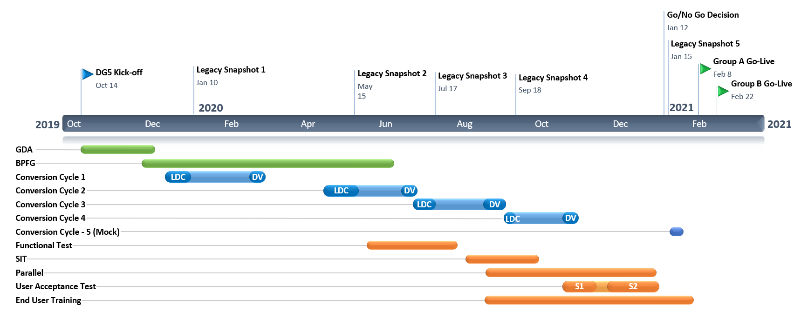
Deployment Group 4 Timeline (High Level Phases) |  | Y
We are here

Slide 10
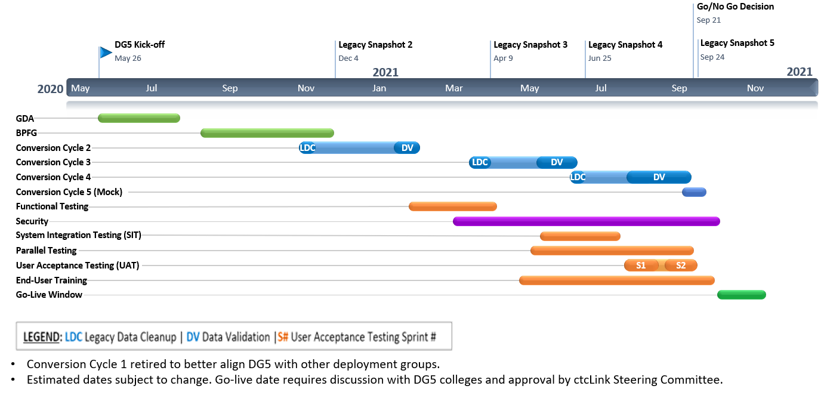
Deployment Group 5 Timeline (High Level Phases) |  | G
We are here
Conversion Cycle 1 retired to better align with other deployment groups.
Estimated dates subject to change. Go-live date requires discussion with DG6 colleges and approval by ctcLink Steering Committee.

Slide 11
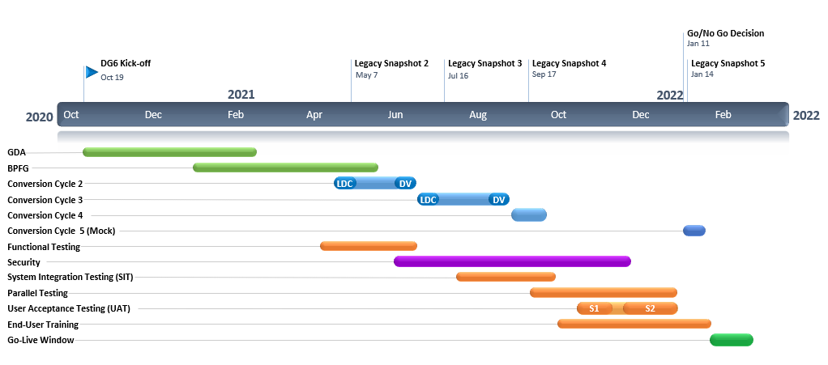
Deployment Group 6 DRAFT Timeline (High-Level Phases) |  | G
We are here
Conversion Cycle 1 retired to better align with other deployment groups.
Estimated dates subject to change. Go-live date requires discussion with DG6 colleges and approval by ctcLink Steering Committee.

Slide 12
Ctclink Customer Support

Slide 13
CTCLINK SUPPORT update
ctcLink Customer Support (Dani)
Staffing Update
ctcLink Production Support Updates (handout/web)
Guided Pathways in ctcLink
Sub-Plans (Dani)
Meta-Majors (Grant)
ctcLink Accessibility Update (Grant)
Update on Accessibility Testing by Level Access
Update on Improvements
ctcLink Accessibility web page

Slide 14
Financial Aid in ctclink

Slide 15
Today’s focus on financial aid in ctclink
FAC concerns provided by ctcLink Steering Committee WSSSC Representative
Concerns/Questions sorted by:
Implementation phase (Pre-Go-Live)
ctcLink Customer Support (Post-Go-Live)
Current Communication Channels/Protocol
ctcLink Project Governance
Notes:
Christy

Slide 16
The big picture
ctcLink is one global instance of PeopleSoft for all Washington community and technical colleges.
This means one global design (plus limited local configuration), which depends largely on consistent business processes across the college system.
Financial Aid is one of the few exceptions since each college/district interprets federal and state regulations independently and is responsible for local policies to adhere to regulations. This can cause confusion when transitioning to a common system.
Notes:
Christy

Slide 17
Implementation (Pre-Go-Live)
Improving Implementation Activities – Highlights
Aid Year Rollover changes made based on lessons learned
Note: Dependent on Oracle’s release of PeopleSoft Update Manager (PUM) 19
Financial Aid documentation revamped in response to not having enough information
More improvements are in the works
Some issues identified are related to learning the system and not the system itself
Some issues identified need local decisions
Notes:
Dani

Slide 18
customer support (Post go-live)
Post Go-Live Customer Support
Increased capacity
Beginning Dec. 11 – FA Webex sessions to support colleges with the awarding process
Support during the Webex sessions will focus on understanding of ctcLink/PeopleSoft system (not local college policies and procedures). ctcLink system support
Satisfactory Academic Progress
Testing a solution to eliminate basic education classes from SAP calculations
Notes:
Dani

Slide 19
Customer Support (Post Go-live), Cont.
Support Materials
Revising some materials to incorporate the explanation of the different steps to process aid.
Queries
Existing queries have been developed by SBCTC Data Services and some Colleges
Successful query requires understanding college data to confirm it returns the desired results
Question tickets to Data Services for support
Notes:
Dani

Slide 20
Ctclink Communication channels

Slide 21
Ctclink Communication channels – pre Go-live ctclink project
Thursday UAT check-in sessions (during UAT)
Weekly Project Manager Meetings
Monthly Executive Sponsor Meetings (project member attends for Org. Change Mgmt. support)
Monthly All College Project Manager Meetings
ctcLink Project-College Communication - Who should pre-go-live colleges talk to about ctcLink?
Notes:
Christy

Slide 22
Ctclink Communication channels – post go-live ctclink support
Weekly Customer Support Workshops (by pillar/module)
Weekly Project Management Meetings (live colleges)
Developing System Technology Groups (FAST)
Listservs (eLists)
Notes:
Dani

Slide 23
customer support lists for live colleges
Customer Support sends updates, outage notices, changes to configuration, training, workshops, and more.
Ask your peers how-to questions and best practices.
Click to join a list!
ctcLinkSME-HCM – Human Capital Management
ctcLinkSME_FIN - Finance
ctcLinkSME_StuFin – Student Financials
ctcLinkFinAidSupport – Financial Aid
ctcLinkCSSupport – Campus Solutions
ctcLinkSME-rpt – General Reporting
ctcLink-coding – General Coding
ctcLink-Security – Security
Lists not intended for Service Desk, support or questions about system issues. Submit tickets to the ServiceDesk following the Tier Support plan.
Notes:
Who may join?
At this time, we strongly encourage anyone live on ctcLink PeopleSoft — including ctcLink Project Team and SBCTC staff members to join — especially those using FIN, HCM, CS, coding and reporting staff.
Only Washington state community and technical college system .edu domain addresses will be approved for subscription.

Slide 24
Ctclink governance and enhancement Request process

Slide 25
ctcLink governance framework

Slide 26
ctcLink Work Priorities & Governance Policy
The ctcLink Change Management and Prioritization policy outlines how changes to ctcLink PeopleSoft in production (live on ctcLink) are received and prioritized by SBCTC IT and ctcLink Support.
How are approved changes to ctcLink prioritized for implementation?
Who may submit Enhancement Requests to the ctcLink Working Group?
How do individual users, commissions, councils and other stakeholders with ideas/requests for changes and enhancements partner with ctcLink governance (i.e. ctcLink Working Group), ctcLink Project and SBCTC IT ctcLink Support?

Slide 27
Questions?

