Slide 1


Financial Aid Train-the-Trainer
Welcome!

Slide 2

About the Council
We advance educational opportunities and attainment in Washington.

Slide 3


Washington’s Attainment Goals
100%
High school diploma or equivalent
70%
Postsecondary credential
Washington population ages 25-44
Washington Student Achievement Council
Notes:
In 2013, WA legislature adopted these attainment goals for 2023. I mention these because all of our collective work support these goals – which is what the state’s economy will demand.

Slide 4
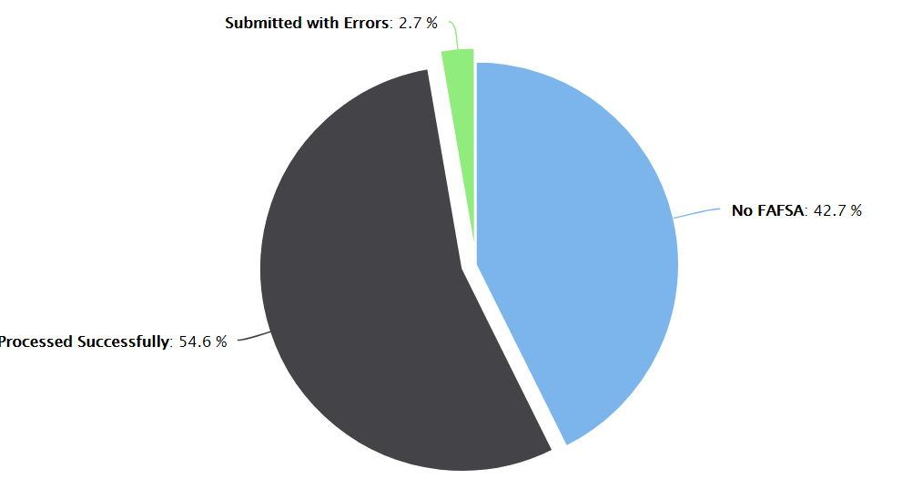

Nearly Half of WA Seniors Didn’t Complete a FAFSA
WA Public HS Seniors FAFSA Completion 2018-19
Submitted with Errors 1.9%
No FAFSA 44.5%
Processed Successfully 53.6%
WSAC FAFSA Completion Portal bit.do/FAFSACompletionData.
Notes:
As of the end of August
FAFSA is an important part of accessing all of the programs we’ve just spoken about. Some students may complete a WASFA.

Slide 5

Aim Higher Washington
The combination of the Washington College Grant
and the investment to increase financial aid applications
provides a unique opportunity to engage statewide.
WSAC’s affordability initiative focused on increasing financial aid applications (FAFSA/WASFA) for the High School Graduating Class of 2020.
12th Year Campaign
Outreach to students, parents, and local educators
Partnerships with education and government leaders
Digital Tools, including texting to CBS seniors

Slide 6


Trainer/Navigator vs. Expert
But …
Notes:
Train the trainers to be navigators not experts.

Slide 7
Takeaways
Applying for financial aid
Washington College Grant
Financial aid overview
Training, action planning and next steps!

Slide 8

Financial Aid As An Umbrella
Grants
Scholarships
Loans
Work Study
Income-based, federal, state and institutional.
Merit and income-based, from public, private, and nonprofit sources.
Income-based, federal and private.
Income-based, federal, state and institutional.
Notes:
Key takeaway: Financial aid is not solely one “thing”.
Four main types of financial aid
Grants
Scholarships
Loans
Work study
Within each of those there may be federal, state, institutional and private options.

Slide 9

Federal Financial Aid Programs
Pell Grant
Federal Work-Study
Unsubsidized/Subsidized Student Loans
Parent Loans
Notes:
Key takeaway:
FA is an umbrella term. Two main sources of financial aid are federal (US Dept of Ed) and Washington State (for residents/for WA schools).
These are some examples of Federal programs.

Slide 10


Washington State Financial Aid
Washington College Grant
(formerly State Need Grant)
College Bound Scholarship
State Work-Study
Passport to Careers
Opportunity Grant
Notes:
Key takeaway:
The Washington Student Achievement Council administers the majority of the state’s student financial aid programs, which are known collectively as Opportunity Pathways. These programs help tens of thousands of students annually earn college credits, certificates, and degrees.
Last program is administered by the SBCTC but is considered state aid.
TheWashBoard – WA scholarship search engine. Last year over $40 million dollars in scholarships were listed on TWB.

Slide 11


CBS Commitment
Early commitment of state financial aid to eligible 7th and 8th grade students who apply by June 30th of 8th grade.
Combines with other state financial aid to cover the average cost of tuition (at public rates), some fees, and a small book allowance = commitment.
Can be used at over 60 two- and four-year public and private colleges and universities.
Notes:
Key takeway: You are probably familiar with College Bound and some of this but a good refresher. I’m going to give you some talking points to use with your students
CBS is still here and an important resource for students because:
Puts them in the pipeline for additional outreach and supports
Maximizes their potential state financial aid eligibility
Early state financial aid commitment to eligible students. CBS funds may come from different buckets of state financial aid (that were mentioned on the last slide), but those costs listed (tuition at public rates, small fees and book allowance will be covered)
Can be used for 4 year, 2 year, technical, vocational programs at over 60 schools in WA.
Since 2007, 300,000 students applied for the College Bound Scholarship.

Slide 12
Eligibility is a Two-Step Process
Step One
Apply in middle school by end of 8th grade year. Some 9th graders may be eligible to apply.
Step Two
Meet income requirements.
Fulfill the College Bound Pledge.
Foster Youth are auto-enrolled.
Meet income requirements.
Be accepted to and attend an eligible college.
Notes:
Key takeaway: CBS is a two step process
Step 1: Complete that app, or auto-enrolled if in state foster care. You may have heard there was a bill this last session about MS counselors signing for parents that are unreachable, if you have more questions let WSAC know. Also, new this year (and we’ll talk about next) some 9th graders may be eligible to apply.
Step 2:
- Fulfill the College Bound Pledge in high school (Grad from WA HS or homeschool program…2.0 GPA and no felonies)
additional note if asked about how do we know if they have a felony? WSAC has a review process that looks at public record searches and Washington State Patrol records to confirm a student’s eligibility.
- Meet income requirements; verified by the college using information from FAFSA or WASFA
- Be accepted to and attend an eligible college within one year of graduating high school (i.e. they have 5 years after graduating high school to use 4 years of funds – up to a bachelor’s degree- can’t use for grad school)

Slide 13

The NEW Washington College Grant!

Slide 14

Washington College Grant (WCG)
Washington State has made a groundbreaking commitment to
financial aid for low- and middle-income people of all ages with the new Washington College Grant (WCG).
Notes:
More money for more students for more programs.

Slide 15
Washington College Grant
Additional funding to serve about 6,000 more students
2019-20
2020-21
Guaranteed funding for eligible students
Maximum award amounts increased to cover full tuition and fees at public rates
Expanded eligibility to 100% Median Family Income
Registered apprenticeships added
Notes:
Need to make clear it can be used at both public and private institutions as well as other key messages.
Washington College Grant, formerly State Need Grant….
Two-year phase in of the program
More students served in 2019-20 (now)
Guaranteed funding for eligible students in 2020-21
Expanded income eligibility
Registered Apprenticeships will be included (more info to come on that)
Can be used at over 60 public and private colleges and universities
If people ask follow up questions:
Any education after high school—college, apprenticeship, or other training—expands career options and increases earning potential.
There are affordable college and career training opportunities for everyone. The first, best step is to apply for financial aid. Completing a FAFSA or WASFA financial aid application is vital to maximizing options after high school, and can help sustain families through career changes later in life.
With the new Washington College Grant, Washington State has made a groundbreaking commitment to financial aid for low- and middle-income people of all ages.
The new Washington College Grant gives more money to more students for more kinds of postsecondary education.
For a family of four making around $50,000 or less per year, Washington College Grant will cover full tuition at any in-state public college or university, or provide a comparable amount toward tuition and other education-related costs at an approved private college or career training program. Partial grants are available for families making up to the state’s median family income, around $97,000 per year.
From welding to nursing, from English to computer science—whether 18-month apprenticeship or 4-year college degree—whatever the goal, Washington College Grant can help.

Slide 16
Washington College Grant
An eligible student from a family of four making around $50,000 or less per year would receive a full award.
Partial grants are available for families making up to the state’s median family income, around $97,000 per year.

Slide 17
Washington College Grant: Income Eligibility
Income level (% of WA Median Family Income) | Income at MFI cap for a family of 4 (2019-20 levels) | Award proration (% of max award)
 |  | Current through 2019-20 | Starting in 2020-21
0 – 50 | $46,000 | 100% | 100%
51 – 55 | $50,500 | 70% | 100%
56 – 60 | $55,000 | 65% | 70%
61 – 65 | $59,500 | 60% | 60%
66 – 70 | $64,000 | 50% | 50%
71 – 75 | $69,000 | Not eligible | 24.5%
76 – 100 | $97,000 | Not eligible | 10%
Source: WSAC Published MFI Chart for 2019-20 WCG
Notes:
Give a sense of income ranges and award rates and two year roll-out.

Slide 18

Applying for Financial Aid

Slide 19
FAFSA/WASFA: Rule of One
FAFSA
Free Application for Federal Student Aid
FAFSA.gov
WASFA
Washington Application for State Financial Aid
ReadySetGrad.org/WASFA
OR
Notes:
Only complete one application.
Fill out the FAFSA if you are eligible for federal aid (i.e. US citizen/permanent resident) and this will also be used to determine state aid eligibility
If you are ineligible for federal aid due to immigration status but you are eligible for a state financial aid program (i.e. are an undocumented student), complete the WASFA.
Additional info:
WASFA for college aid: If a student doesn’t meet residency eligibility for WCG, or doesn’t have a CBS app…not really eligible for state aid, a college (typically 4 year privates) may need an EFC for school scholarships.

Slide 20

FAFSA and WASFA Beginning in October
Fill out 2020-21 FAFSA or WASFA
OR WASFA
Notes:
Notes:
2020-21 FAFSA and WASFA available October 1, 2019 (coincides with admissions applications)
Families use 2018 taxes
Apply as early as possible to maximize financial aid opportunities. Some programs, such as the Washington College Grant (formerly the State Need Grant) are not fully funded at this time which means some eligible students may not receive funding.

Slide 21
FAFSA Overview

Slide 22
Three Ways to Apply
Website
FAFSA App
Paper FAFSA
Notes:
Paper FAFSAs are not encouraged but are used primarily by students who are incarcerated.
Web and FAFSA app most common.
FAFSA app is free – don’t pay for an app!

Slide 23
Common FAFSA Mistakes
Legal information: Name, Social Security Number
Correct FAFSA Year
Tax information
Student Marital status
Student Household size
Number in college
Notes:
There are places where students and families often make mistakes on the FAFSA. These are some things I suggest double checking when you’re working with students and families on the FAFSA. First, make sure that the name the student puts on the FAFSA matches the legal name on that student’s social security card or alien registration number. This is particularly important when the student or parent applies for a PIN. The name the student uses to apply for a PIN absolutely must match the student’s name on the SSN.
Also, make sure the income information is as accurate an estimate as possible. Where I would often see mistakes with income and tax information has to do with the student or parent mistakenly listing their Adjusted Gross Income as equal to the amount of taxes paid for the last year. The FAFSA will flag this mistake and have the filer go back and correct it. Make sure you watch for it.
Double-check the parents’ marital status. Due to changes that were made on the 2014-15 FAFSA, it is easy for filers to make a mistake here. I’ll discuss this further in the line-by-line training.
Household size – make sure that the correct number of people who live in the home are listed.
Number in college – Make sure the filer has listed any brothers, sisters, or parents who are in college at the same time.
FAFSA changes:
The 2018 tax form changes resulted in a few FAFSA questions being deleted, added, combined, or replaced.
The Student Aid Report (SAR) will be available in the myStudentAid mobile app.
The office of Federal Student Aid is working with the IRS to make the Data Retrieval Tool (DRT) mobile-responsive.
The myStudentAid mobile app now contains the 2019-20 and the 2020-21 FAFSAs. Please make sure your students are completing the FAFSA for the year they will be attending college.

Slide 24
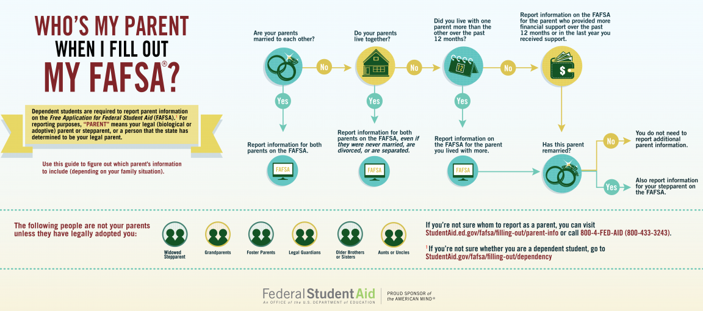
Who Is My Parent?
Married
Both parents
Remarried
The parent (and step parent) you live with most.
Single or Widowed
The single or surviving parent
Unmarried, Separated, or Divorced but Living Together
Both parents
Divorced or Separated and not living together
The parent you live with most.
Notes:
This is always the most confusing question on the FAFSA for filers.
Basically, students should enter information for the parent they live with the most. If a student’s biological or adoptive parents are married, the student enters information for both parents. If the student’s parents are divorced, but the parent the student lives with is remarried, then the student answers questions about the parent and stepparent he or she lives with the most. If the student’s parents are single or widowed, the student enters information for the single or surviving parent.
Where it starts to get really tricky is with divorced or separated parents. The FAFSA requires the student answer income questions about the parent the student lives with the most. In cases of a 50/50 split, the student can’t just pick the parent that makes less money – this is committing fraud (so don’t encourage students to do this!). Legally, the student has to answer questions about the parent he or she lives with the most. Remind the student that there are 365 days in a year. Or ask the student “who provides you with the most support?”
If the parents are unmarried, but living together, the student should enter information about both parents, regardless of marital status. A couple scenarios where this would occur – Mom and Dad had kids and live together but have never gotten married. Both parents’ incomes are now required on the FAFSA. Another would be if Mom and Dad had kids, got divorced, but Dad couldn’t afford to move out and lives in the second bedroom. Both parents’ incomes are now required on the FAFSA even though the parents are divorced.
With same sex parents, you follow the above guidelines. Because the Supreme Court declared the Defense of Marriage Act unconstitutional, the federal government must recognize same sex marriages for federal benefit purposes. In Washington State, same sex parents can be legally married. So students whose parents got legally married would include both parents’ income. If a student’s same sex parents are unmarried but living together AND the student has been legally adopted by the biological mother or father’s partner, then information about both parents would be included on the FAFSA.
Link: www.studentaid.gov and on the key.

Slide 25
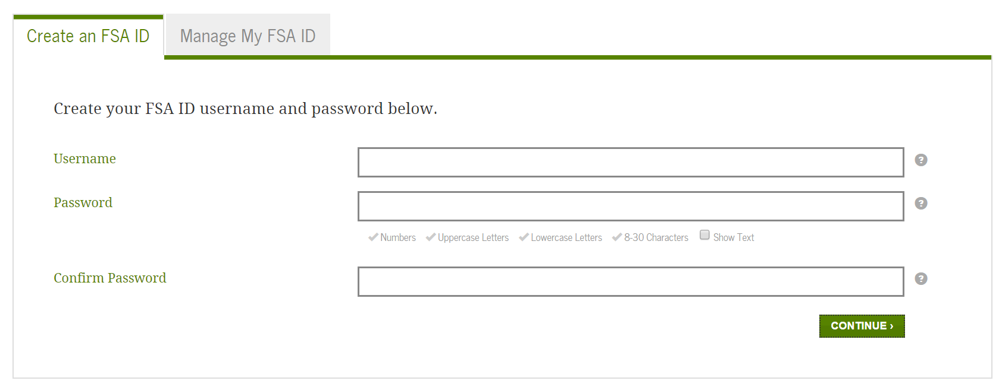
FSA ID – The First Step
The FSA ID (username and password) replaced the PIN for student, parents, and borrowers accessing all FSA systems
FAFSA can be accessed with:
  Social Security Number, Date of Birth, Name OR
  FSA ID
Notes:
The FSA ID (username and password) replaced the PIN for students, parents, and borrowers accessing all FSA systems starting on 4/25/15. It affects the FAFSA, and the National Student Loan Data System – and potentially also loan servicers. After this date, the FAFSA can be accessed with:
SSN, DOB and Name or
FSA ID.
If the filer uses the SSN, DOB and Name to access the FAFSA, he or she will be asked to enter the FSA ID to use the IRS data retrieval tool and to sign and submit the FAFSA.
Parents only need to make one FSA ID. They can use the same one for multiple children.

Slide 26
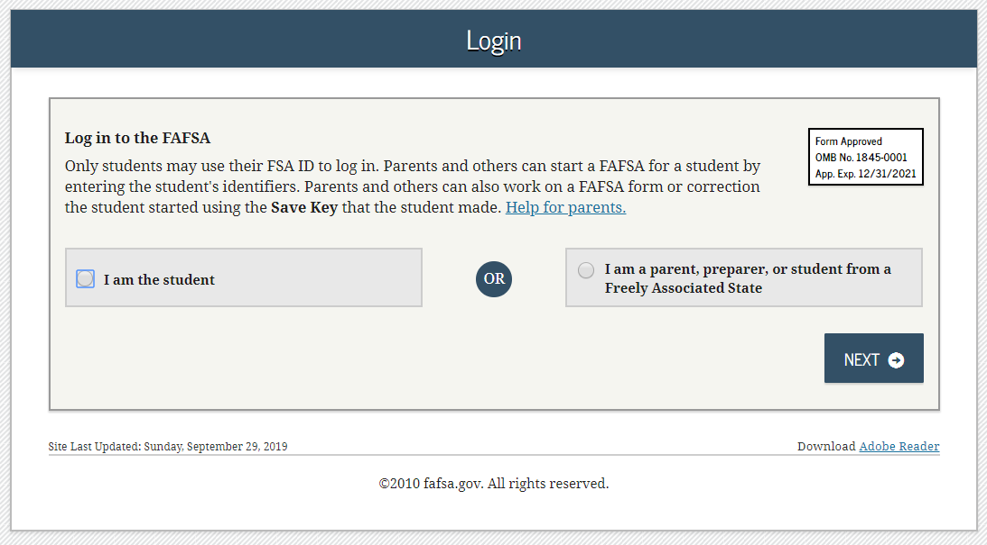
Login Page
Notes:
*FAFSA screenshot
This process is much easier if you use your FSA ID vs using student identifiers (i.e. SSN, DOB, etc) because of a glitch that loops students back to the login screen. This has been reported to FSA.
Make sure the sections students are filling out reflect the right role – student or parent.
I also want to point out the integrated support features that appear through the FAFSA. The first of these integrated features is the Help and Hints section to the right of the screen. This section is dynamic and will change as you move through the FAFSA to give you information on how to answer each question. As you click in each answer field, the Help and Hints section will provide information for that specific question.
If you need additional help after that, every page of the FAFSA will also have the option to get help from a real person by either clicking “Need Help?” or “Contact Us.”

Slide 27
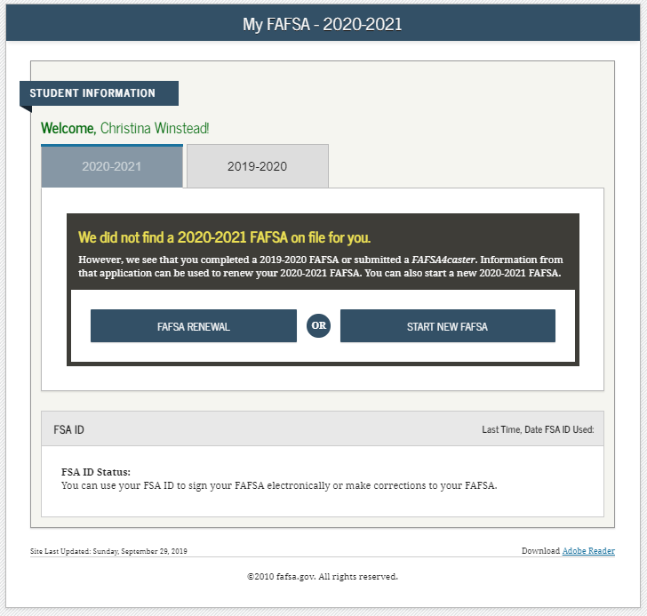
Selecting the correct FAFSA year
The high school class of 2020 will complete the 2020-2021 FAFSA
Notes:
Choose the next year for HS seniors.

Slide 28
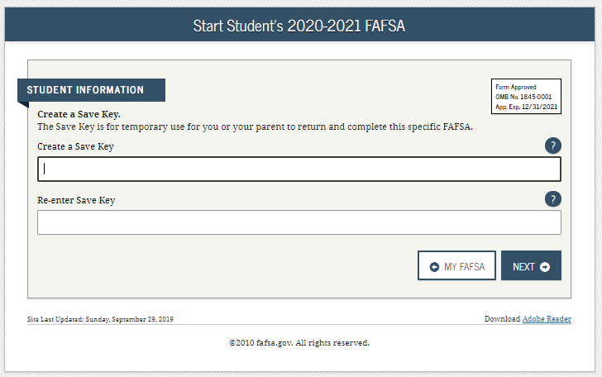
Creating a save key
Notes:
Must be between 4-8 characters long and the applicant will need to remember it!

Slide 29
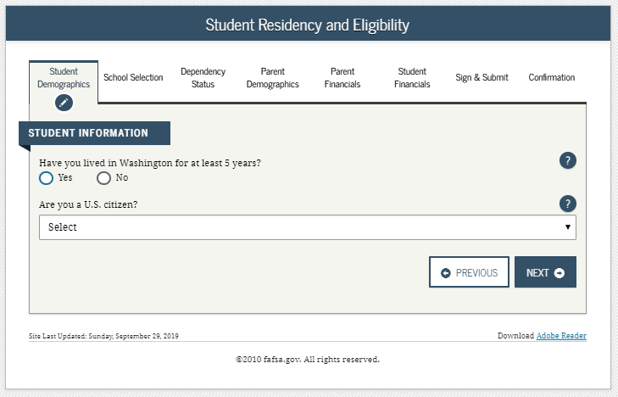
Student Residency and Eligibility

Slide 30
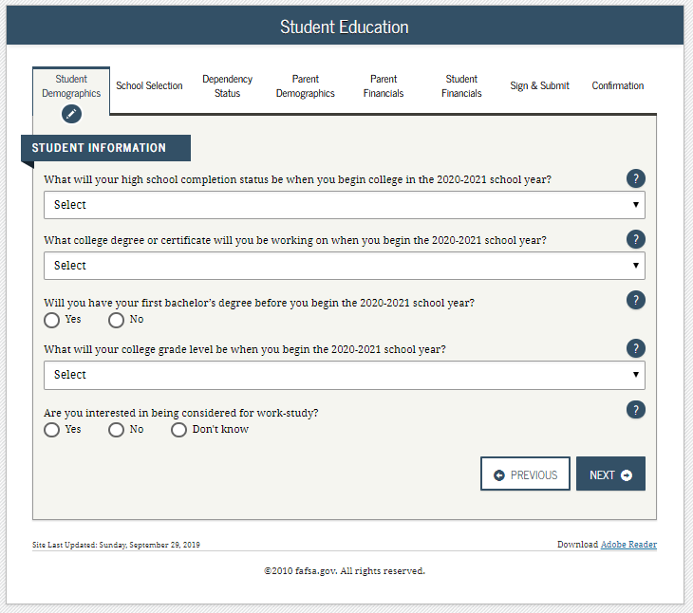
Student Education
If a student wants to be considered for work study please have them select yes. Some schools will not consider a student for work study if they check Don’t Know

Slide 31
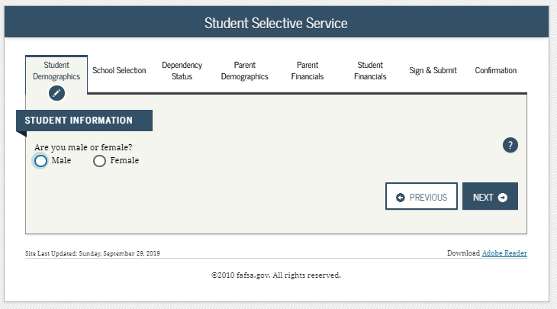
Selective Service
Notes:
It’s federal law.
Can register for Selective Service on the FAFSA – it will redirect them and register them. If you don’t register you will be ineligible for aid.
If you’re 17, it will ask you if you will do it when you turn 18, double checks later.
Gender at birth.
May get asked about women. Can’t speculate, not currently a requirement for FAFSA.
May get asked about new gender designations in WA: Are looking into how this impacts FAFSA. Aware of changes, looking for guidance from Dept of Ed.

Slide 32
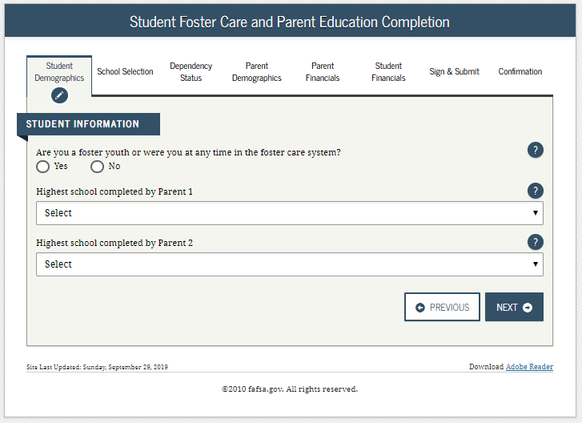
Student Foster Care and Parent Education
Notes:
If you say yes, it will ask about your age in care to determine if you should be considered an independent student. Also considers you for other support programs.

Slide 33
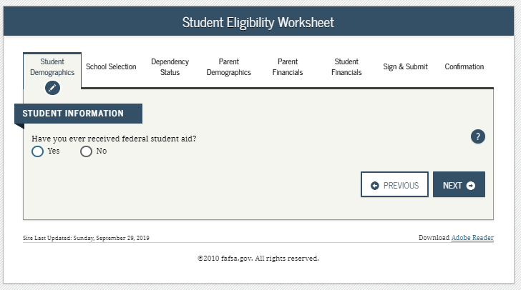
Student Eligibility Worksheet
Notes:
Misconception that incarcerated youth aren’t eligible aid – they mostly are eligible for aid.
Actual: convicted of a drug felony while receiving aid makes you ineligible.

Slide 34
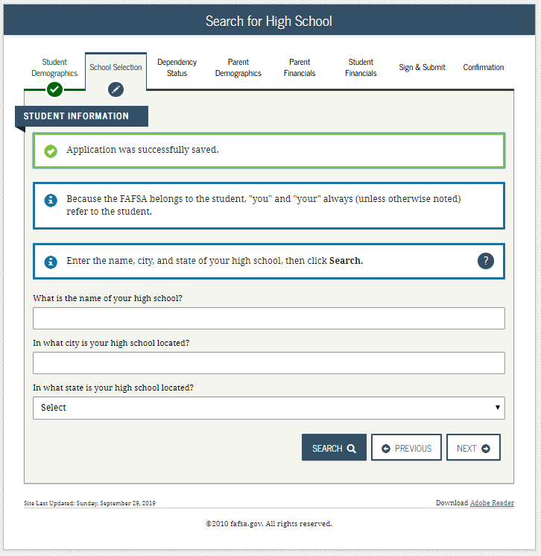
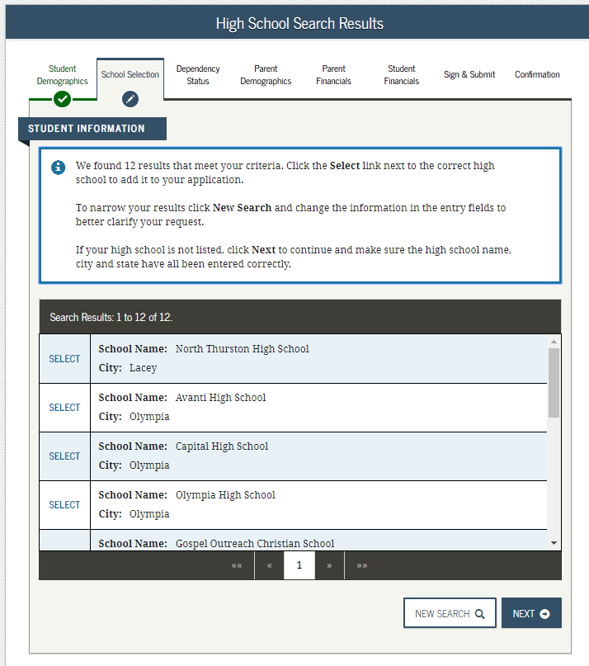
Confirming High School

Slide 35
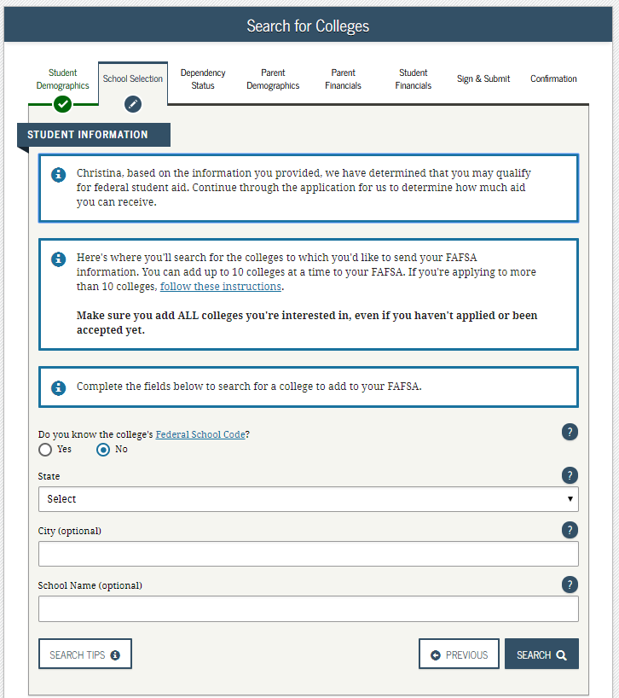
School Selection
Notes:
Now you’re going to indicate which colleges you would like your financial records sent to. You should select all schools you’re applying to. The FAFSA has room to accommodate up to 10 schools. If you have more than 10 schools you are applying to, you can always go back and change or update your school list. If you are applying to more than 10 schools, you should prioritize 4-year schools over two-year colleges because 4-year schools will be preparing their financial aid packages first and you should prioritize according to each school’s financial aid deadline. If one school needs your FAFSA information before another, make sure that school is on your initial list of schools here. After you’ve filed the FAFSA, your financial records will be sent to the schools you indicate. After that, you can go back and add more schools by replacing schools you’ve already selected with new ones. Once your initially listed schools have gotten your records, that’s ok.
If you know your Federal School Codes, you can enter them in this box. Most students don’t come to the FAFSA quite that prepared, so I’ll show you how to search for your schools. Similar to the HS search, you can start by entering the state of the school you want to apply to and hitting “Search.”
If students cannot find branch campuses like UW Tacoma and WSU Vancouver in their search, they should select to send their FAFSA to the main campus (UW Seattle or WSU Pullman). The main campus processes financial aid for all campuses.

Slide 36
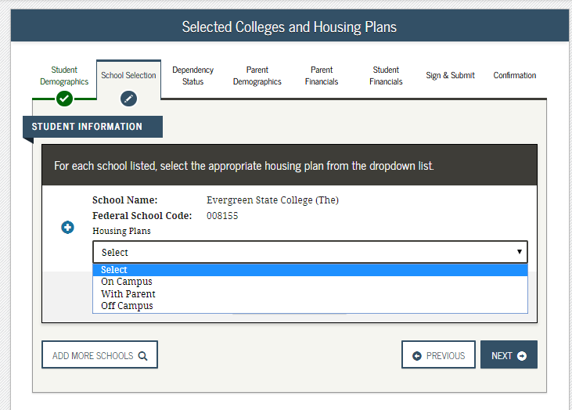
College Housing Plan
Notes:
*FAFSA Screenshot
For each school that you select, you’ll have to enter a housing plan option (on campus, off campus, or with parents). This is one factor each school will use to help determine your need. For example you’ll have greater need if you live on campus because it is more expensive. Don’t think that you can say you’ll live on campus so you can be considered needier and then actually live off campus to save money. All of this information will be confirmed. If you are unsure what you’re going to do, you can put that you are going to live on campus for now and change it once you know for sure. Keep in mind that you will need to be familiar with the housing options that are available at each school you apply to as the FAFSA will present you with all 3 options whether or not those options actually exist for a particular school. For example, even though the FAFSA gives you the option to choose to live On Campus at South Seattle Community College, South Seattle Community College doesn’t have on-campus housing.
Be honest, does not tie to admissions decision.

Slide 37
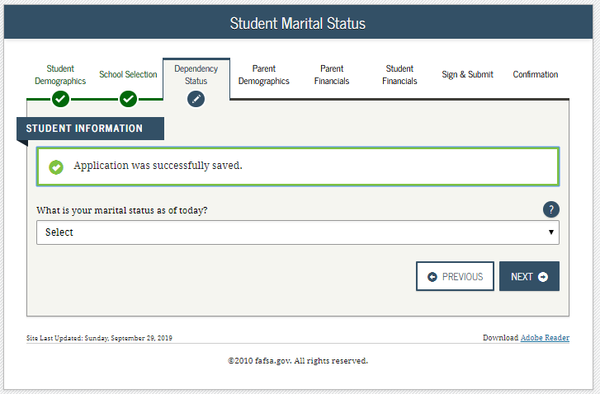
Student Marital Status
Notes:
“as of today”. Common error that this is incorrect.

Slide 38
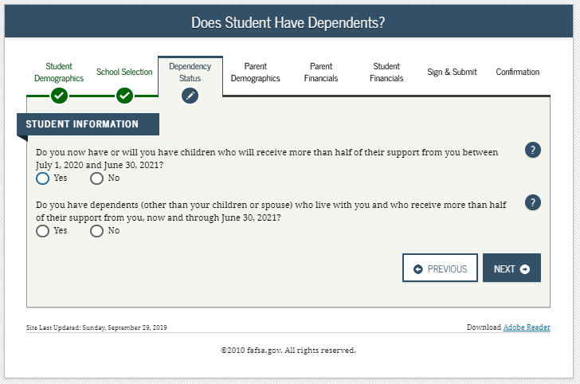
Dependency Determination
Notes:
*FAFSA Screenshot
I already went over dependency status earlier, so I won’t go over this section in great detail. These questions are designed to determine if a student is considered independent. If the student is 24 or older he is automatically considered independent. If you answer YES to any of these questions, the screen will change and you may have to answer some additional questions to clarify the situation. For example, if you indicate that you have dependents who live with you, another question will appear that will ask you about the number of people are in your household.
If you are determined independent, you’ll have the option of bypassing the parental information and just entering your financial information.
As you continue to click “no” through the questions on this screen, additional questions will appear on the bottom of the page. Students who answer no to all of these questions will be considered dependent and will then be prompted to answer questions about their parents.

Slide 39
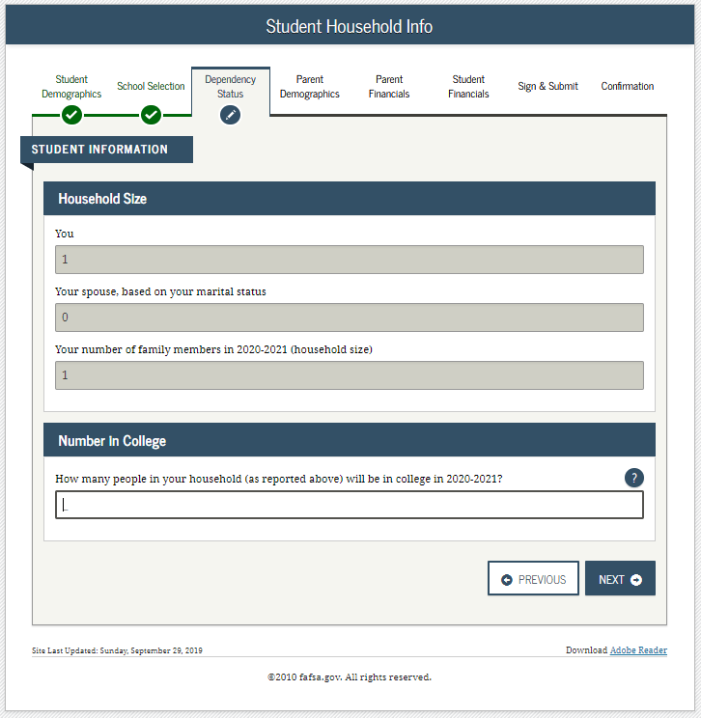
Student Household Size
Notes:
Common error
Common definitions are critical.

Slide 40
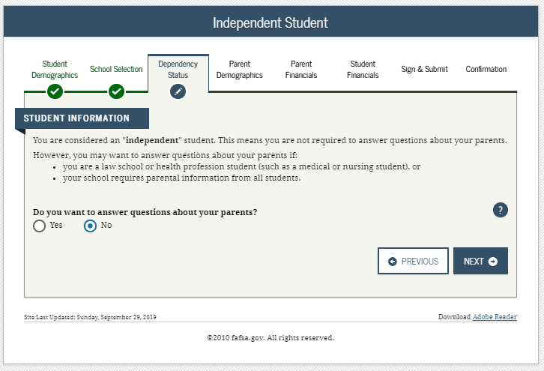
Dependency Status Results - Independent
Notes:
If a student is considered independent then it will still ask “if” they want to answer questions about their parents. They do not have to answer these questions.

Slide 41
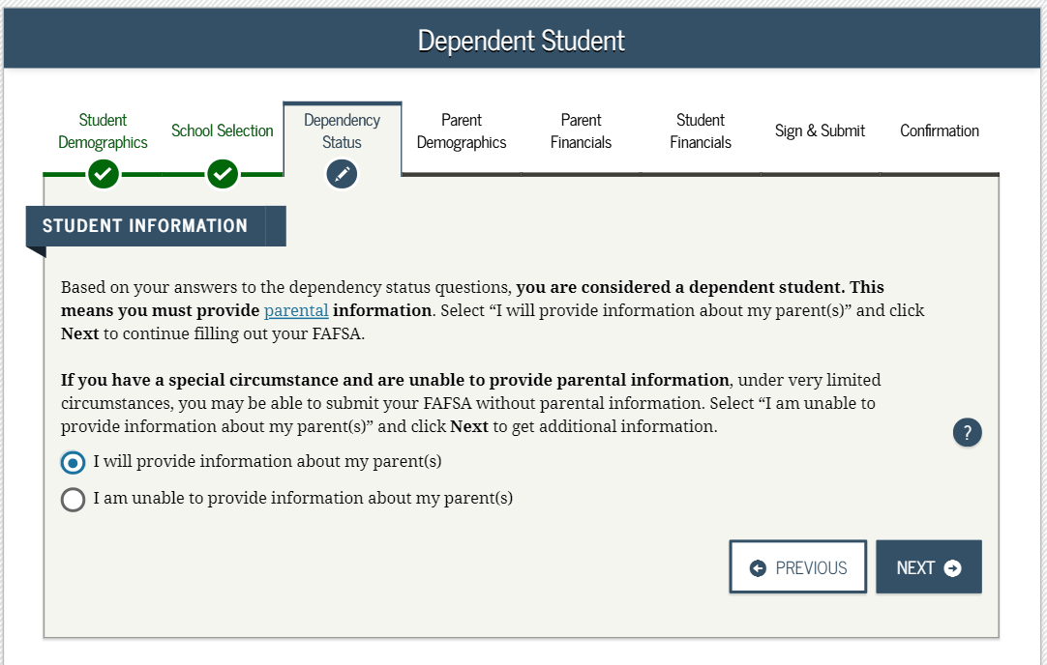
Dependency Status Results - Dependent
Notes:
Since most undergraduates are considered dependent, we’re going to walk through what it looks like for someone to file as a dependent student. After answering all of the Dependency Status questions, you’ll be taken to a page that shows the results of those questions that determine eligibility. If you’re determined to be a dependent student, you will see this screen. Most filers will answer “yes” to “I will provide parental information.”
If you cannot provide parent information because of a special circumstance, you will select that you are “unable to provide parental information.” FAFSA will allow you to move through the application and submit it with only your information, BUT it will “reject” your application from the FAFSA system, and you will need to contact the financial aid office at the colleges you wish to attend to receive their help in fixing the “reject” status on a college-by-college basis.
Please answer this question thoughtfully. If you select that you are unable to provide parental information because your parents are difficult to contact or they refuse to give it to you or if they don’t provide for you financially, you’ll have to go through a lengthy process with EACH school you apply to. Each school has a different process and most require several letters and support documents indicating that you are in fact an independent student. IF you cannot verify this satisfactorily and within a timely manner, the school can opt to reject your FAFSA which would limit your eligibility for many kinds of aid.
If you’re independent, you’ll see a slightly different screen, but you will STILL be asked if you’d like to provide parent information. Some medical schools require students to provide parental information, even if the student is independent.

Slide 42
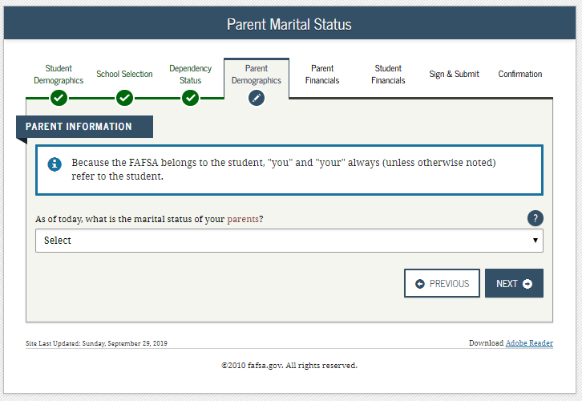
Parent Demographics
Notes:
*FAFSA Screenshot
Now we’ve come to the Parent Demographics section. The left bar will say PARENT and the page headings are purple.
After you indicate your parents’ marital status, an additional question will appear asking you which parent you will be entering information for. Fields will appear to enter identifying information for the parent(s) you indicated. Just as you did with your own information, double check the accuracy of the identifying information. This information will be used to match your parent with their PIN so they can sign your FAFSA electronically. If your parent doesn’t have a SSN, enter all zeros in that field. Remember that you need a SSN to complete the FAFSA, but your parent does not. You may have to click next a couple of times to verify that you did mean to enter all zeros in that field.
Notice there a place to enter your parent’s email so they can receive emails from FAFSA as well. It’s always a good idea to keep parents informed.
You’ll also answer questions about your parents’ household.

Slide 43
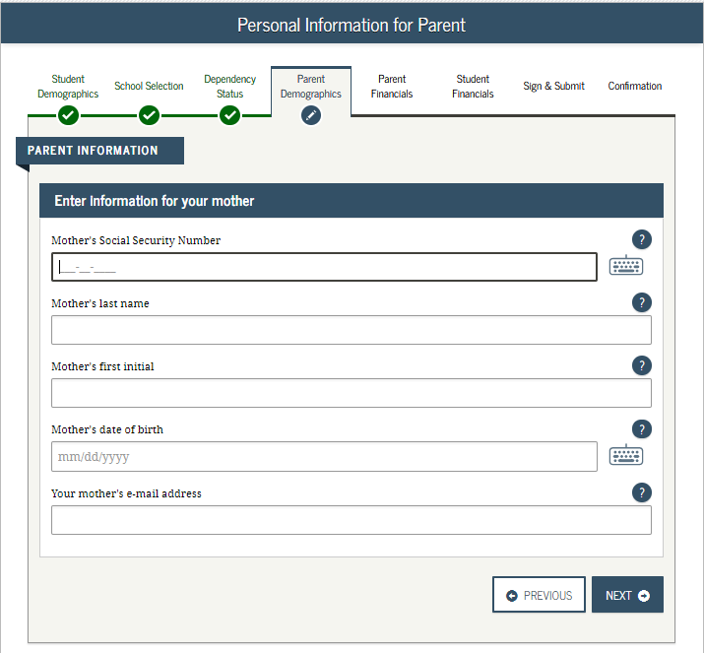
Parent Information
If a parent does not have a Social Security Number they will need to enter 000-00-0000 in the SSN box.
Notes:
Using SSN or 0’s, not Tax ID numbers – it will lead to an error in the application.

Slide 44
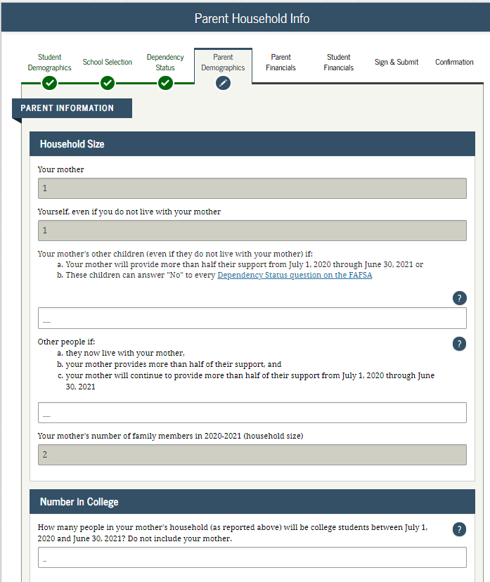
Parent Household Info

Slide 45
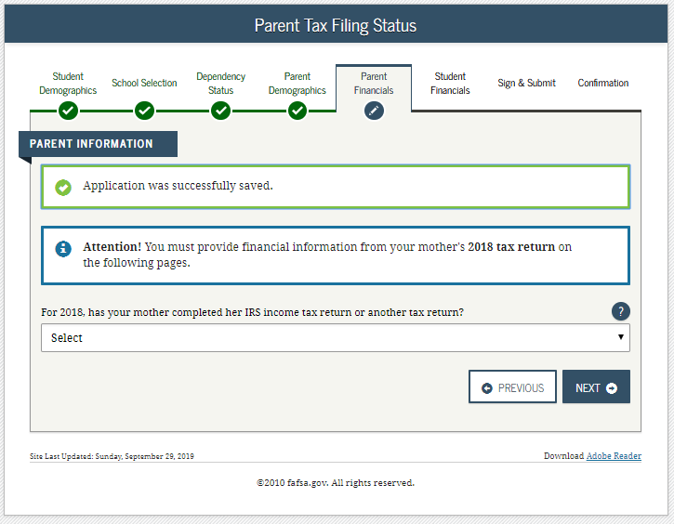
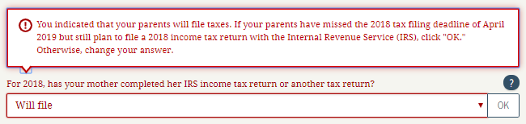
Parent Tax Information
If a family hasn’t filed 2018 taxes but plans to in the future they can select “Will File”.
You must click “ok” to continue
Notes:
*FAFSA Screenshot
Now you can see that we’ve moved on to the Financial Information section. You can also see that we are currently answering questions about the parent. You will answer the exact same questions about yourself after you’ve answered all of the financial questions about your parents. You’ll first be asked if your parents completed the previous year’s income tax return.
You have several options for this question. You can indicate that your parents will, have already completed or will not be filing their taxes. If you indicate that your parents will file, the FAFSA will know that they amounts you enter are estimates and you’ll be expected to make corrections after your parents’ taxes have been filed in order for your FAFSA process to be complete. It is totally fine to file with estimates and the FAFSA even provides tools to help you estimate. Remember that when you file your FAFSA initially, even if you file with estimates, this puts you in line to receive funds. The sooner you file, the more aid is available to you.
There is an additional question about your parents’ tax filing status.
If you indicate that your parents already completed their taxes, the FAFSA will expect that the amounts you enter will be final. You can pull tax information directly from the IRS to your FAFSA using the IRS Data Retrieval Tool. The FAFSA website will walk you through that process. This is the fastest and most accurate way to enter your tax information, and it helps verify that the information you entered on the FAFSA is correct. It’s best to file taxes electronically when using the DRT – this makes them available faster for you to transfer the tax information.
If you indicate that your parents will not file taxes, you’ll still have to provide information about your parents finances. You can use paystubs or w-2s to get this information.

Slide 46
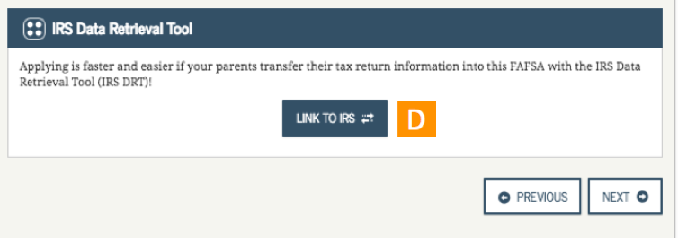

Data Retrieval Tool
Notes:
*FAFSA Screenshot
This is what students will see when leaving the FAFSA to go use the DRT. The IRS pages are the same for the student and the parent. If the parent and/or the student are eligible to use the DRT, they will follow the same process outlined on this slide.
Use the same address on the taxes or it won’t match.

Slide 47
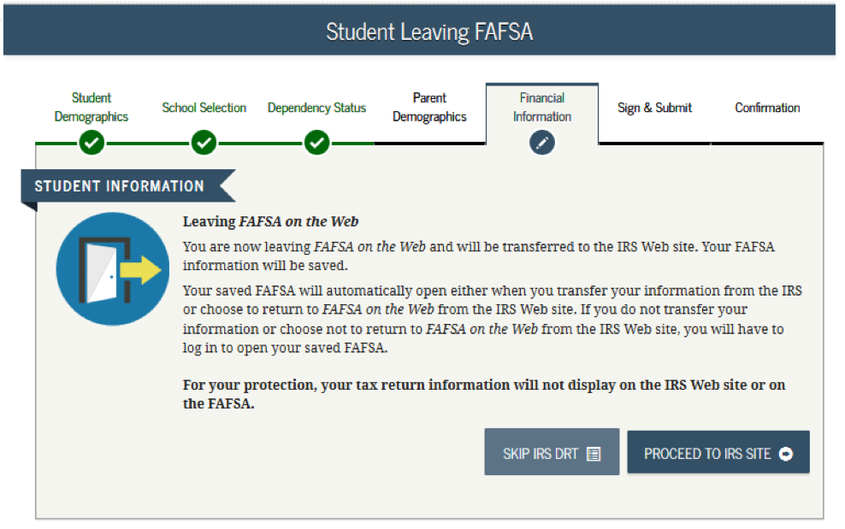
Data Retrieval Tool
Notes:
*FAFSA Screenshot
This is what students will see when leaving the FAFSA to go use the DRT. The IRS pages are the same for the student and the parent. If the parent and/or the student are eligible to use the DRT, they will follow the same process outlined on this slide.

Slide 48
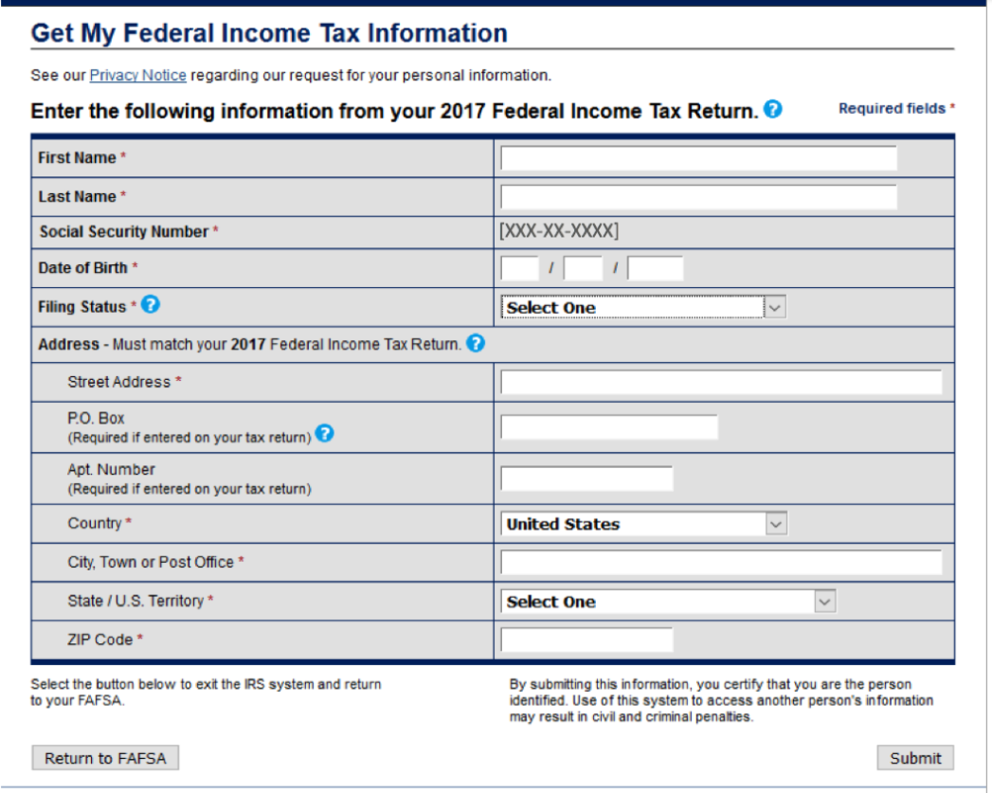
Data Retrieval Tool
Notes:
*Screenshot

Slide 49
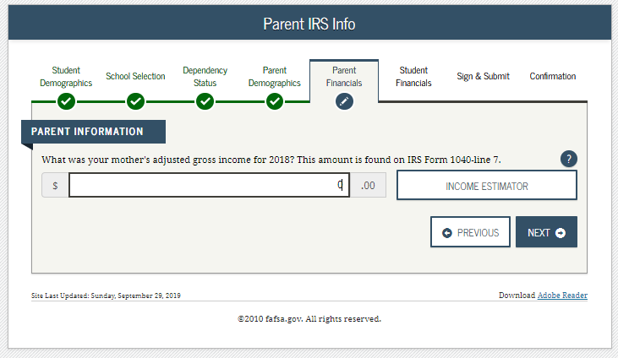
Parent Tax Information
Notes:
If you don’t use the DRT.

Slide 50
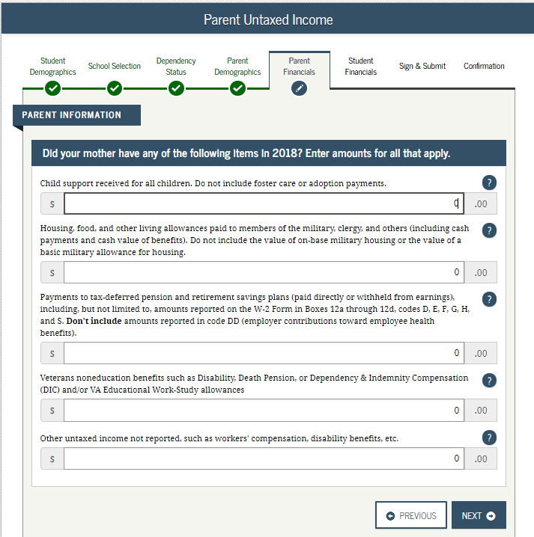
Parent Untaxed Income
Notes:
If you don’t use the DRT.

Slide 51
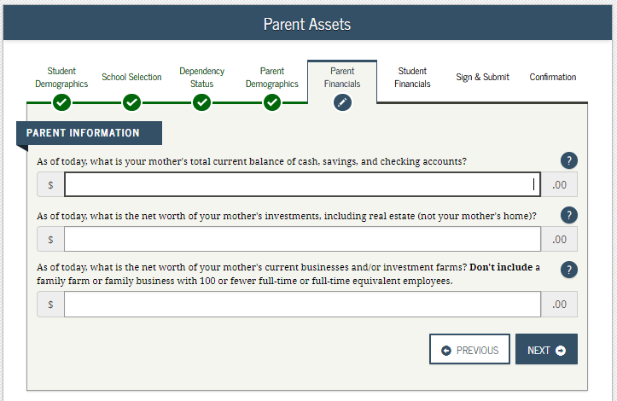
Parent Assets
Assets | Cash, savings, checking accounts
Investments | Real estate, trust funds, stocks, CD, special minor accounts, money market funds, securities, commodities, college savings plans (529 college savings/prepaid tuition plans), mutual funds, bonds, etc

Slide 52
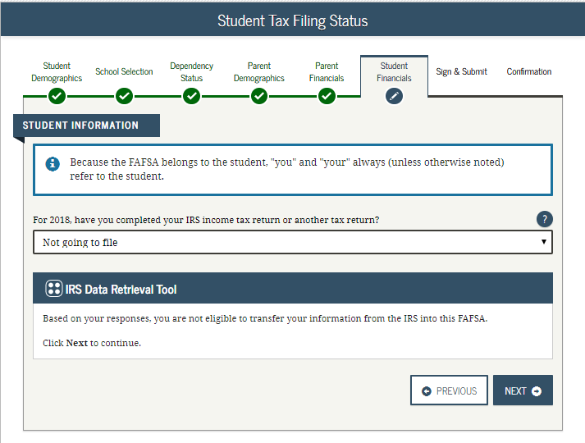
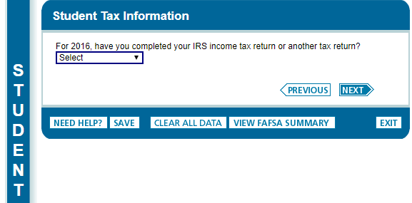
Student Financial Information
Notes:
*FAFSA Screenshot
This is where you’ll automatically go if you are an independent student and don’t need to answer parent information. If you aren’t required to file taxes, you’ll still enter information about your income and assets. As I mentioned before, students will answer all of the same financial questions that were asked of the parents. Since the questions are the same, I’m not going to go over the student financial information in further detail. After you’re finished entering your financial information, you’ll be taken to the Sign & Submit section.

Slide 53
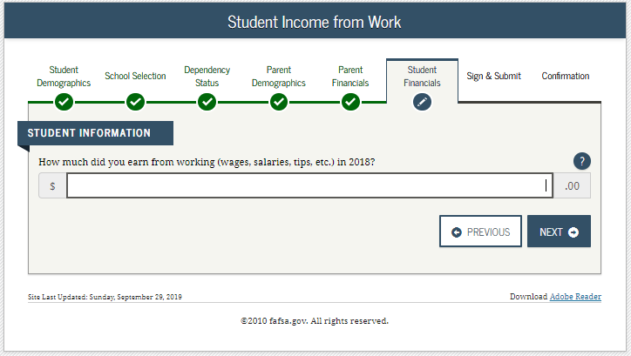
Student Financial Information
Notes:
If they don’t use the DRT or if they didn’t earn enough to file taxes. You can see that the student is asked the same questions as the parent. As a result, I won’t go over this section in great detail.

Slide 54
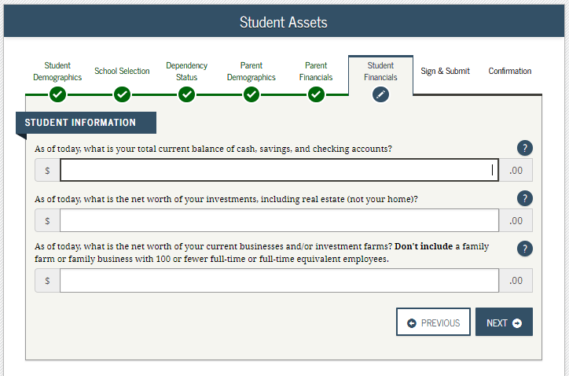
Student Financial Information
Notes:
Remind students this is THEIR assets not their parent’s assets. Checking/savings and if they have a 529 college savings account in THEIR name.

Slide 55
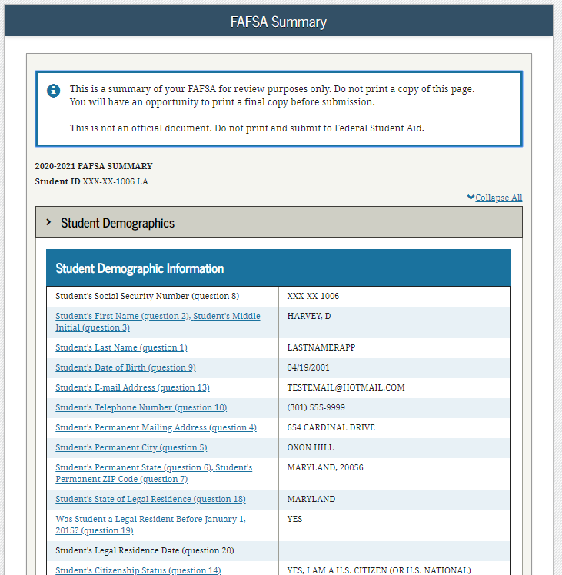
FAFSA Summary
Notes:
This the last time to correct before submitting – they can always go and update when submitted, but now is better!

Slide 56
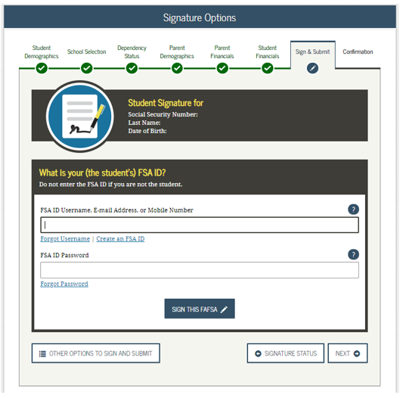
Signature Page
Notes:
*FAFSA Screenshot
Now we’ve come to the end and all we have to do is sign. You’ll notice that it took us a while to go through all of that information, but it should actually go a lot faster when you’re filing yourself and you don’t have me explaining everything. The more you are prepared up front with the information you’ll need, the smoother and faster it will go.
I want to point out 3 main things on this page. First, when it asks if you are a preparer, it is really asking if you are someone who is being paid to prepare this FAFSA for someone else (similar to how you might pay someone to do your taxes). It is not asking if you were the person who prepared your FAFSA. So you’ll click NO.
Lastly, make sure to AGREE to the terms after you read them . If AGREE is not selected, you won’t be able to sign and submit.

Slide 57
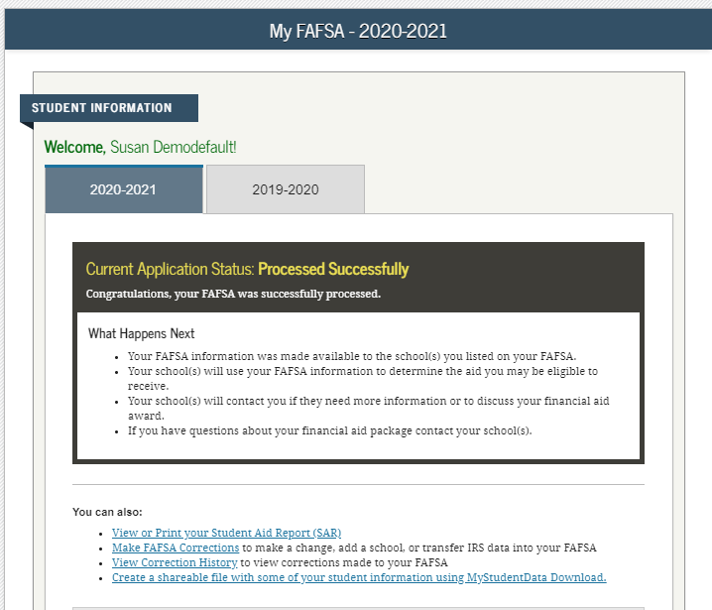
Confirmation Page
Notes:
After you hit sign & submit, you’ll be directed to your confirmation page. That’s your cue that you’ve filed your FAFSA.
There are a couple of things I want to point out on this page.
1-If you are filing initially with tax estimates, the EFC given (point out where this is – middle bottom of page) will be an estimate. The amounts listed to the right of your Estimated EFC are not guarantees or even estimates of what you will receive. They are examples of things you might be eligible for.
2-This confirmation page is not your Student Aid Report – that will be mailed to you. You can tell from this page if your FAFSA has been randomly selected to be verified. If there is an asterisk next to your EFC, you’ll have to complete the verification process for each college you’ve been accepted into if you want to receive a financial aid package from them. If your FAFSA is not randomly selected for verification, individual colleges may still opt to have you verify your information with them.
Really quickly, Verification is similar to an auditing process where the college will ask you to submit certain documentation to verify the information you’ve entered on the FAFSA. Keep in mind that even though you file the FAFSA on the federal level, Verification happens on the school level. At least 1/3 of FAFSAs filed are randomly selected for verification. So it’s not uncommon and is not bad. It just means that you’ll have a few extra steps you’ll need to take to complete your FAFSA process. If you are selected, again you can know by looking for an asterisk by your EFC and/or your school will contact you. It’s really helpful to know what your school may require from you in the event that you are selected for verification so you can have that ready. Contact your financial aid office if you have questions about this.
3-The third thing to notice on this page is if you have a brother or sister who needs to also complete a FAFSA, use the “optional feature” to begin their FAFSA from this page.
4-This confirmation page will also list some very basic information about the colleges you listed on your FAFSA. This is just there for your information.

Slide 58
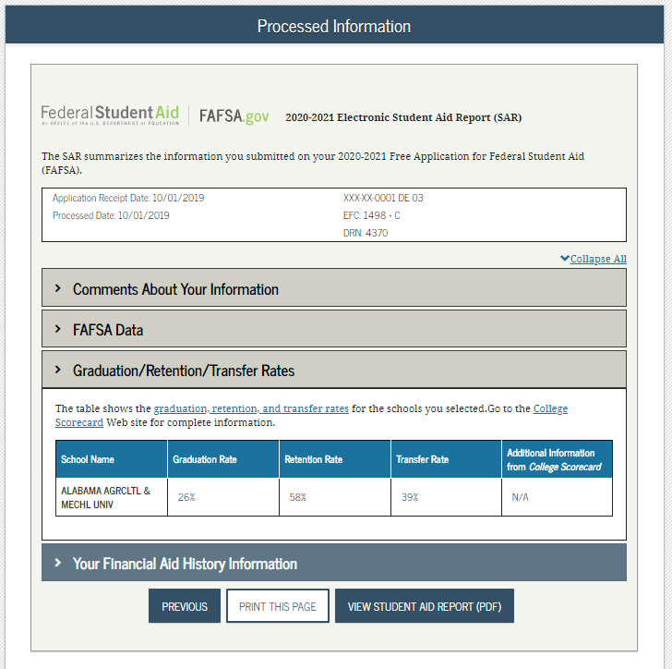
Student Aid Report (SAR)

Slide 59
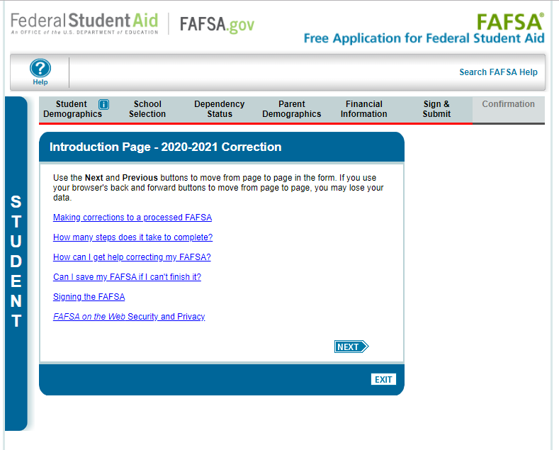
Corrections
Notes:
Page for corrections looks like the old FAFSA – not reformatted as new FAFSA. Students are in the right spot! It’s retro.

Slide 60
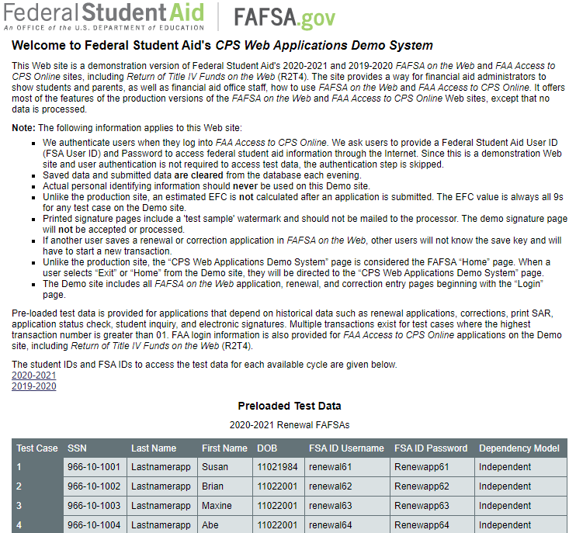
FAFSA Demo Site
https://fafsademo.test.ed.gov/webdemo.htm

Slide 61
WASFA Overview

Slide 62
General Tips
Your job is to assist, not prepare a WASFA for someone else.
Be mindful of sensitive information.
State financial aid eligibility.
If you need help:
On-site financial aid expert
http://readysetgrad.org/wasfa
Notes:
I thought I’d start with some general tips on working with students and families.
As a FAFSA/WASFA helper, our job is to assist filers. Be there as a resource and help WASFA filers. The student or parent should be the one entering his or her information into the WASFA. Not the volunteer. Your job is to assist, and even though it may be tempting to sit down and do a WASFA for someone else, you shouldn’t prepare another person’s WASFA for them.
Be mindful of sensitive information. WASFA filers will have confidential financial information with them at events. Filing the WASFA itself can be sensitive and scary for some people – some students may be open about their undocumented status, while others may be fearful and may want to keep it quiet. As a best practice, if a student or family member wants to have a confidential conversation with you, with the financial aid expert, make sure that you can provide the space to do so. Also, with both the FAFSA and the WASFA, people may be revealing personal details about their lives. Your job isn’t to judge – it’s to help students through the financial aid application process.
It’s a good idea to take a quick look around the computer to make sure nobody has left their tax materials behind. Also, please make sure that folks log out of the WASFA and close the browser completely before a new person sits down at the same computer to file a new application.

Slide 63

Umbrella Term: Undocumented Students
Non-citizens who meet Washington residency requirements (HB1079).
Non-citizens with Deferred Action for Childhood Arrivals (DACA), a federal status(expired or not).
Non-citizens who do not meet state residency requirements.
Notes:
Key Message – there are financial resources, including state aid, for undocumented students.
HB 1079 was a 2003 state law that outlined residency for in-state tuition purposes (additional info: three years in the state prior to HS grad/GED, HS grad/GED from WA, etc)
DACA is a federal status – not a requirement for state financial aid programs but it can be a way students can meet a residency requirement – expired or valid
Undocumented students who do not meet any type of WA residency requirement (i.e. perhaps new to the state). These students do not qualify for state financial aid.

Slide 64
Residency Alignment WCG and CBS
DACA
(expired or unexpired)
HB 1079
  Reside in WA for 36 months right before earning WA H.S. diploma or equivalent.
OR
  High school graduates must complete full senior year at WA H.S.
Same process as US citizens in WA
  Continuously after receiving diploma or equivalent until admittance to college.
  Sign affidavit saying they will file permanent resident app when eligible.
Notes:
Takeaway – this is relatively new!
In the past, College Bound and State Need Grant (now Washington College Grant) had different residency requirements written into law. The 2018 legislative session aligned them – essentially broadening College Bound’s residency requirements to be the same as Washington College Grant (formerly State Need Grant.)
Undocumented students can meet the residency requirements for either program using the DACA standard or by meeting the 1079 requirements.
Again, what’s new – CBS students don’t solely have to have DACA to meet program’s residency requirement. They can meet 1079.
Students still must meet program requirements in addition to residency (i.e. CBS app, income requirements, etc).

Slide 65
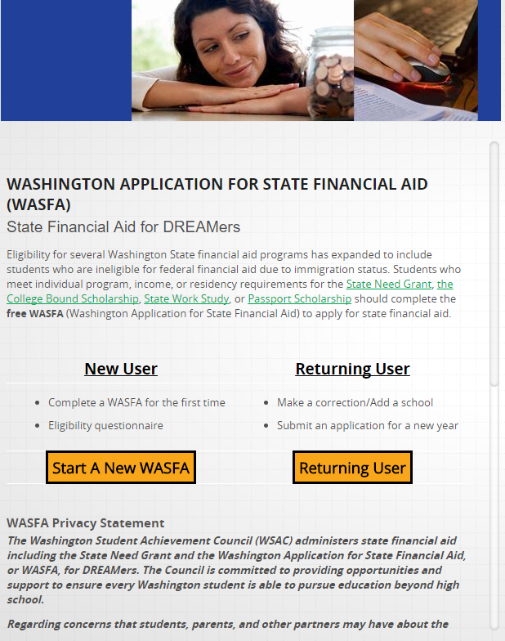
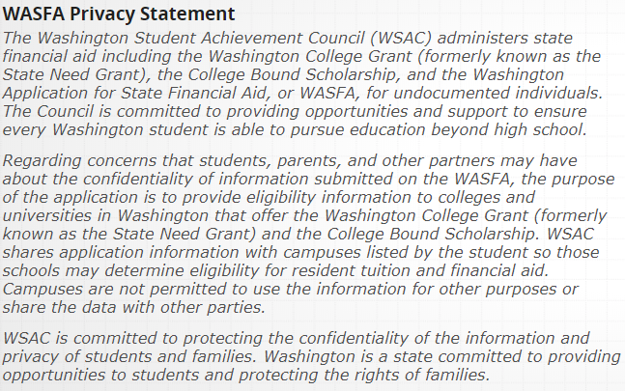
Start on Ready Set Grad
www.readysetgrad.org/wasfa
Notes:
Privacy statement – can’t guarantee to the level some people want but the state is committed to protecting student information – see Governor's executive order linked on the page.

Slide 66
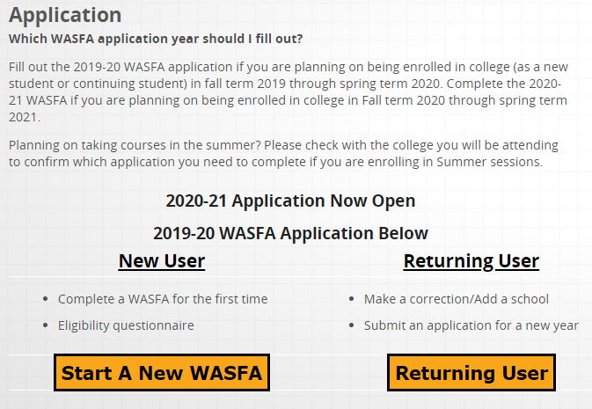
Starting a WASFA
Notes:
New users will click start a new WASFA – this will take you to questionnaire to help determine if WASFA is appropriate app or FAFSA. Returning users need to click returning user to log in.
New questions to help determine if students have DACA status, have already submitted a FAFSA.

Slide 67
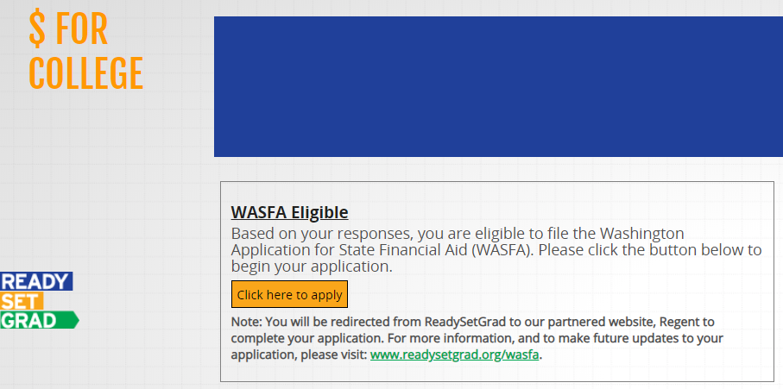
WASFA Eligible
Notes:
If a student answers “yes” to the residency questions, she is taken here and told she is WASFA eligible. Click on the orange box to apply.

Slide 68
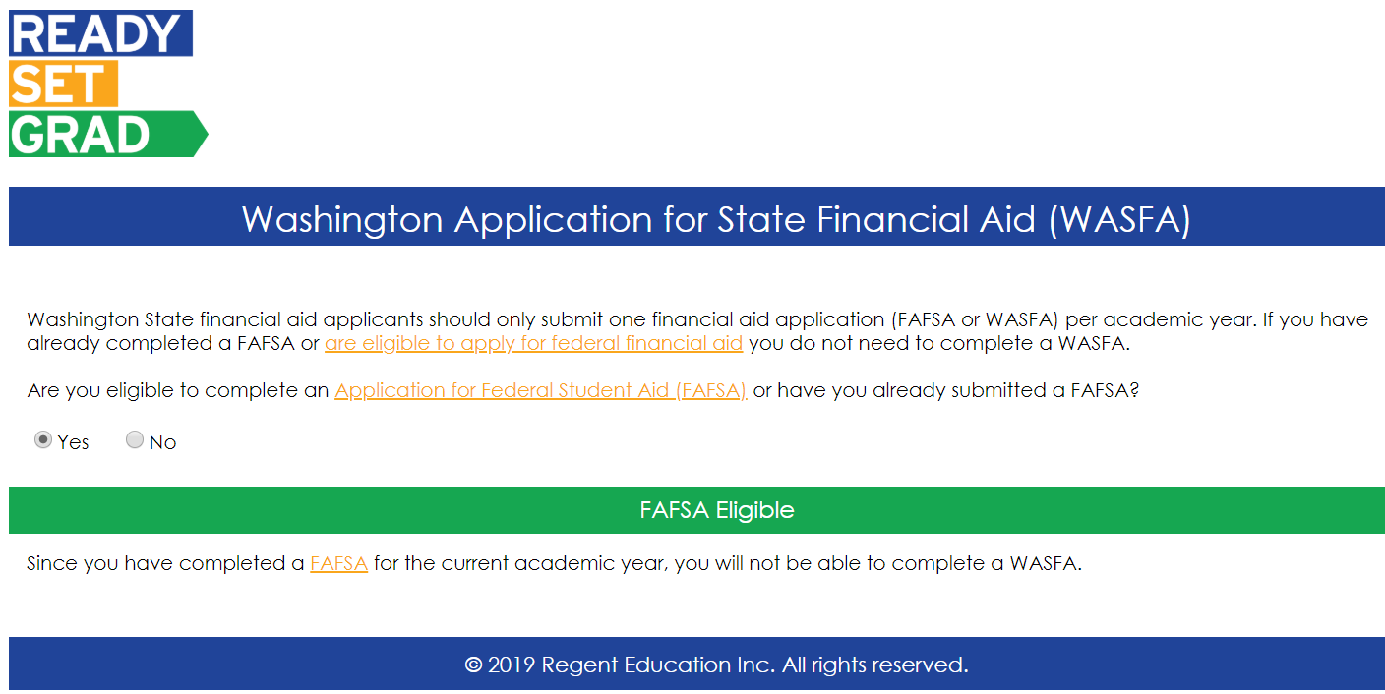
Rule of One
Notes:
Helps students figure out which application to use – should only apply with one application.

Slide 69
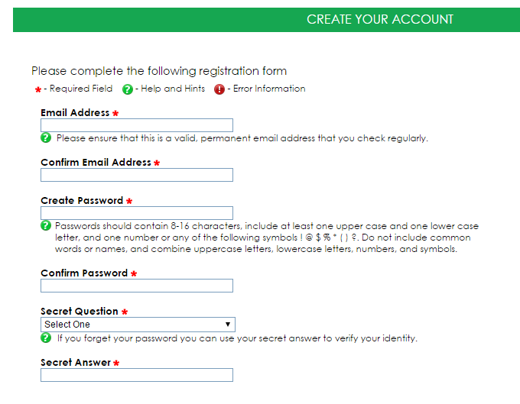
Create new account
Register for new WASFA Account
Please use an email you will be able to check regularly.
Notes:
Don’t use school email account.

Slide 70
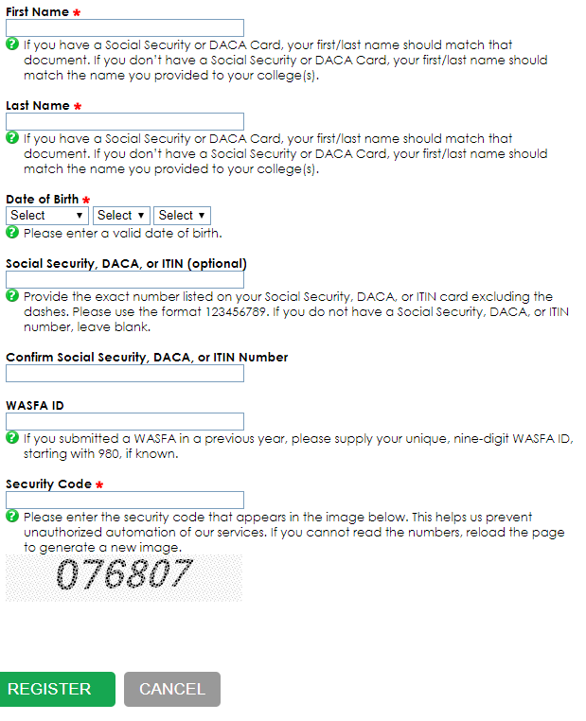
Create new account
Please double check the spelling of your name AND your Date of Birth.
If you have a SSN, DACA, or ITIN, enter it here. If you don’t, leave blank.
If you previously applied under a 980 WASFA ID and now have a SSN, DACA, or ITIN, enter both SSN, DACA, or ITIN and WASFA ID fields.
If you previously applied and know your WASFA ID, enter that WASFA ID. (Unique nine-digit ID starting with 980)
What numbers do I use?
What numbers do I use?
Notes:
If you have never applied before and do not have a SSN, DACA, or ITIN nor a WASFA ID, leave all SSN, DACA, or ITIN and WASFA ID fields blank

Slide 71
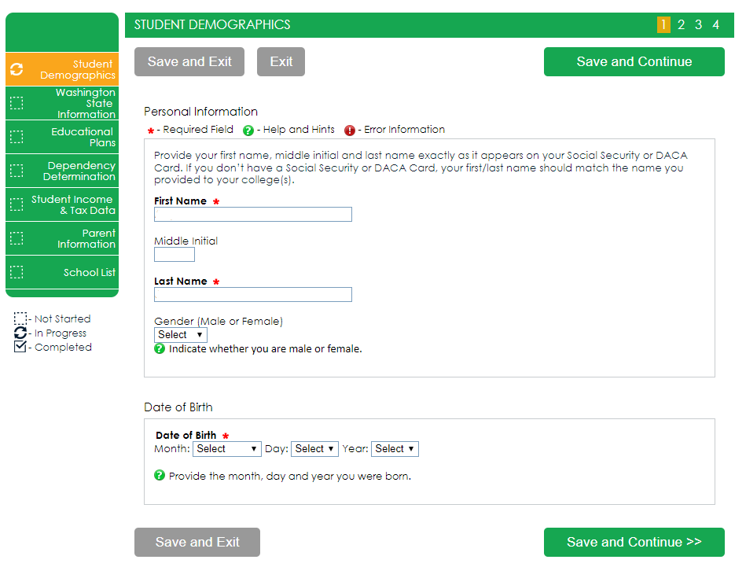
Application in Progress
Upon clicking the “Start, edit, or complete an application” button from the WASFA homepage, you will begin the application process. Answer the questions and click on the “Save and Continue” button to continue moving through the application process.

Slide 72
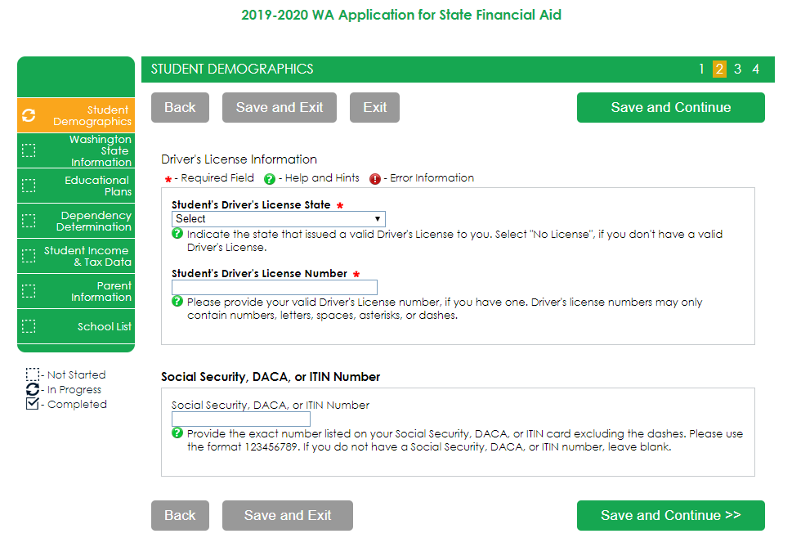
Application in Progress
As you move through the application process, the green menu on the left side will tell you what section you are on, and the numbers in the top green bar will tell you how many parts are in that section, and what part you are on. You need to hit “Save and Continue” on every page.

Slide 73

Application in progress
The following instructions will not show a screen shot for every question, however we will highlight a few of the areas asked about most often.
The section and page number within the section we are discussing is circled in red in the left green menu and top green bar.

Slide 74

Family Size Information
On Student’s Family Information answer all questions as they relate to only the student and who the student financially supports. “Student’s Household Number of Family Members” should only count dependents the student financially supports by themselves. Same for number in college.

Slide 75


Residency Information
On Residency Information answer all the residency questions carefully and accurately.
In this section you are certifying the answers to: “Washington Residency Certification – (WA High School Graduate)” and “Certification Regarding Permanent Residency Application and Related Responsibilities”. Please read the descriptions carefully.
Choosing “I will not meet” will open questions for you to answer regarding DACA.

Slide 76

Residency Information
On Residency Information answer all the residency questions carefully and accurately.
In this section you are certifying the answers to: “I will not meet House Bill 1079 conditions by the time I begin college” and will need to compete the DACA question.
Note: You will not get the DACA question if you answered “I certify that, by the time I begin college, I will have met all House Bill 1079 conditions above”.

Slide 77


Dependency Determination
On Dependency Determination answer all the residency questions carefully and accurately.

Slide 78


Dependency Determination
SPECIAL CIRCUMSTANCES
If you are determined to be a “dependent”, you will be required to answer questions about your parents. Most people will fall into this category.
You may be able to submit your application without parent information under special circumstances if you meet outlined criteria. Your financial aid office will either approve or request for you to submit your parent information.
Note: Claiming special circumstances when you do not qualify may delay the processing of your application.
Notes:
New 8/13/19

Slide 79

Student Income and Tax Data
On Student Income & Tax Data answer all questions as they relate to only the student, including additional income and federal benefits. If the family receives food assistance or other assistance, those numbers will be captured in the parent section of the application.

Slide 80

Parent Information
For Parent Information answer all questions as they relate to the parent/s and all the people they are responsible for supporting.

Slide 81

Parent Information – No Parent SSN
IMPORTANT:
Parent/s do not need a Social Security Number for their child to apply for financial aid.
If your parent/s do not have a Social Security Number enter all zeroes.

Slide 82


Parent Information
For Parent Information answer all questions as they relate to the parent/s. If the family receives federal benefits such as Medicaid, SSI, food assistance, free or reduced price school lunch or any other assistance, those numbers will be captured on this page under the Parents’ 2017 or 2018 Federal Benefits Information.

Slide 83

School Selection
If you want to live on campus, or don’t know what your housing plan will be yet, select “On Campus”
Select the schools you are considering attending, even if you haven’t applied or been accepted. You may chose up to 10 schools. This will allow you to get your financial aid application submitted to assist in meeting any financial aid priority deadlines schools might have in place.
If you don’t know what your housing plan will be, select “On Campus”. If you change your mind later, let the financial aid office know.

Slide 84

Preview Application Responses
Sign My Forms – The Preview My Forms section is an opportunity to review all your answers by clicking on the View Form button. You MUST open and preview this form before you can acknowledge that the information is true and correct. The form will open in a separate tab. Once you have viewed it you can close the window, check the box acknowledging your information is true and correct, then click on the Next button.

Slide 85

Electronic Signature
Sign My Forms – Electronic Signature Consent & Disclosures. Please read disclosures and select the “I consent to the use of an electronic signature option to complete and submit my application.” Then click on the Next button.

Slide 86

Electronic Signature
Sign My Forms – Electronic Signature Hardware & Software Requirements. Please read the system requirements and select the “I acknowledge that my computer supports the recommended minimum hardware and software system requirements needed for conducting an electronic signature within this site.” Then click on the Next button.

Slide 87

Electronic Signature
Sign My Forms – Electronic Signature Process. Please read the disclosures you are certifying when electronically signing your application that state you are certifying the information you provided is true and correct. Name and password information entered must be exactly the same as when you created your account. Then click on the Next button.
Invite your parent to sign your application

Slide 88

Application Complete / Incomplete
Once you complete the electronic signature section, you will be redirected to the WASFA home site. If you are an independent student your application is complete and will be sent to your prospective schools. YOU WILL NOT RECEIVE AN EMAIL CONFIRMATION.
If you are a dependent student, you will need to invite your parents to electronically sign your application. To invite a parent click on the
button in the Actions column that is highlighted to the right.
Notes:
Difference from FAFSA: They will not get confirmation, they will be told to go back in and look at the WASFA page here for status update.

Slide 89

Parent Signature Process
Once you click on the “invite a parent to sign an application” button in the Actions column, it will bring up your parent choices. Choose only one parent and make sure their email address is correct. If necessary, correct or update the email address, then click on the Save and Continue button.
IMPORTANT:
The parent email address cannot be the same email address the student used to create the account, and the parent must use this email address to create their parent account to be able to sign and submit the student’s application.
Notes:
Must be a different email than the student’s email.

Slide 90

Confirm Parent Selection
Once you click on the Save and Continue button, it will ask to confirm your parent selection. Check the box confirming your parent selection, make sure the email address is correct, and click on the Generate Portal Access and E-Signature Email.

Slide 91
WASFA Next Steps
WASFA follow up
Update colleges (if applicable).
Scholarships
Use thewashboard.org to search and apply for scholarships.
Colleges
Keep an eye out for financial aid letters and requests.
File any additional, college-specific financial aid documents as needed.
Respond by May 1 (some institutions) or school deadlines to accept aid.
Have parent digitally sign and submit (if applicable).
Beyond 1079
Notes:
Students should update income information and tax information (if applicable).
Use thewashboard.org to search and apply for scholarships.
File any additional college-specific financial aid documents as needed.
Respond to four-year institutions by May 1 to accept aid.
Financial aid money gets released to the student’s account when the term begins.

Slide 92
Best Practices and Next Steps
Provide translated materials
Financial Aid Nights Avoid using the term FAFSA nights
Partnering with Parents or Guardians
Identifying trusted sources on college campuses
Resource sharing
United We DREAM
Northwest Immigrant Rights Project
Beyond HB 1079

Slide 93
Trainer/Navigator vs. Expert
But …

Slide 94

Resource: 12th Year Campaign
Free Materials and Training
3 models of participation to fit your needs
FAFSA Completion Portal: www.wsac.wa.gov/fafsa-completion
Aggregate FAFSA data (Tableau and tables)
www.readysetgrad.org/12thyear

Slide 95
Resource: Student Loan Advocate
Supports current & future student loan borrowers in WA
Understanding the different types of loans
Stephanie Sampedro
Stephanies@wsac.wa.gov
360-753-7781
Income driven repayment
Public service loan forgiveness
Loan discharges, deferment & forbearance, consolidation, private loans
Notes:
The Student Loan Advocate supports current and future student loan borrowers in Washington State. The Advocate works to provide unbiased, reliable and timely information to borrowers on their rights, responsibilities, and repayment options. She also receives and addresses student loan borrower complaints in coordination with other state agencies. Some examples of topics that the advocate can assist with are:
Understanding the different types of student loans
Income Driven Repayment (IDR)
Public Service Loan Forgiveness (PSLF)
Loan discharges
Deferment and forbearance
Consolidation
Private loans

Slide 96

Introducing Otter!
Otterbot is a free texting service designed to help Washington high school seniors navigate financial aid for college and career education.
Students can access Otterbot via text message 24 hours a day, seven days a week by texting
"Hi Otter" to 360-928-7281.
Notes:
Encourage students to text into Otter!

Slide 97

Introducing Otter!
For more information on Otter visit wsac.wa.gov/otterbot

Slide 98

Training Navigators: Action Planning

Slide 99
Next Steps: Training Navigators
Partner with your financial aid office
Practice the content and get to know available resources
Identify other campus staff to train
Identify connections to local high schools/community-based organizations for training
Target district follow-up from WSAC
Your own ideas!

Slide 100

What are some of your plans?

Slide 101

Join us!
Notes:
Join us in this important work – train more people to help students and families through the financial aid process! You are a part of this!!!

Slide 102
Continue the Conversation
Online:
www.readysetgrad.wa.gov
On Twitter:
@WSACouncil
@Ready_Set_Grad
On Facebook:
www.facebook.com/WSACouncil
www.facebook.com/ReadySetGrad
www.thewashboard.org
www.wsac.wa.gov
Notes:
Thank you! Peace out!

