Slide 1
ctcLink Project Update Washington State Student Services Commission
October 11, 2019
Christy Campbell – SBCTC ctcLink Project Director

Slide 2
governance
Complete description of ctcLink Governance Framework

Slide 3
ctcLink Governance Responsibilities
ROLE/RESPONSIBILITY | WORKING GROUP (Meets Bi-Weekly) | STEERING COMMITTEE (Meets Bi-Weekly) | EXECUTIVE LEADERSHIP COMMITTEE (Meetings aligned with WACTC)
Change ctcLink Requirements (add or remove) | Recommends | Approves | Informed
New Global Configuration | Approves | Informed | Informed
New Customizations | Approves | Informed | Informed
Common Process Approvals | Recommends | Approves | Informed
ctcLink Maintenance | Approves | Informed | Informed
Timeline or scope changes within approved total budget | Recommends | Approves | Informed
Timeline or scope changes that exceed approved total budget | Recommends | Recommends | Approves

Slide 4
Ctclink quality gates & milestones
Ctclink quality gates & milestones
GATE 1 | GATE 2 | GATE 3 | GATE 4 | GATE 5
INITIATION
STRUCTURE
CONSTRUCT
TRANSITION
DEPLOY
Project Planning (Checklists & Templates)
Global Design Adoption (GDA)
Determine Exception
Solutions
Production Cutover Planning
Go/No Go Decision
Business Process Fit/Gap (BPFG)
Update BP Flows
Production Environment Prep
Start Change Impact Analysis & Change Action Plan
Pre-User Acceptance Testing Training
Update BP Flows
Update CEMLIs
User Acceptance Testing
Production Cutover
Local Configuration
Update Configuration
Chart of Accounts Redesign (DG2 only)
Training Materials
Analysis/Build
Convert and
Validate Data
End-User Training
Production Validation
Build PeopleSoft Environments
UAT Test Definition
Security Matrix
Mapping
Performance Testing
Milestone Sign-Off
Security Redesign (DG2 only)
UAT Materials Build
Functional Testing
Legacy System Shutdown Procedures in Place
Finalize Local Configuration Guides
Identify Exceptions
Prepare QA
Environment
Organizational Change Management Assessments Begin
Design Extensions
Prepare Parallel
Environment
Cutover Mitigation Planning
GO LIVE
Prepare or Update
Test Scripts
System Integration Testing
GATE 1 PEER REVIEW
Map Supplemental Systems Data
Parallel Testing
Production Go/No Go Decision
Lessons
Learned
OCM Assessment, Activities & Deliverables for Colleges & SBCTC
College Project Charter Resource Plan & Budget Plan Deliverables Legacy BP Mapping Initial Supplemental Systems Analysis Change Impact Analysis 25% | GDA and BPFG Participation Supplemental Systems Data Mapping Initial Config Guides Sign-Off UAT Definition Sign-Off Change Impact Analysis 50% | Design Requirements Sign-Off Security Matrix Mapping Data Validation Sign-Off Change Impact Analysis 75% | OCM Readiness Checklist UAT Sign-Off End-User Training Policy/Procedures Updated Cutover Plans, Legacy Shutdown Procedures Change Impact Analysis 100% | College Cutover Plan Go/No Go Sign-Off Milestone Sign-Off Config Guides Sign-Off College Lessons Learned Rev. 2019-03-05

Slide 5
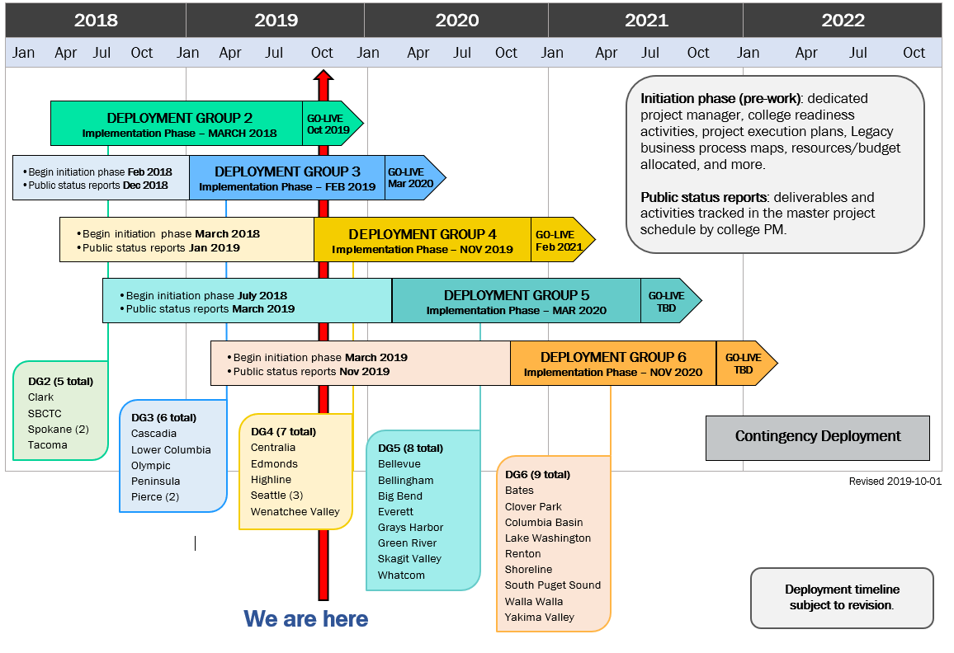
Deployment groups & timeline

Slide 6
Ctclink Remediation status

Slide 7
Pilot remediation overview & status
Date | Total Open Items | Open Items With a Plan to Complete (Appendix A) | Open Items Needing a Replacement Solution (Appendix A) | Open Items That Were Closed, but Reopened in Remediation Agreement (Appendix B)
 |  | 2016, 2017, 2018 Financial Books Close and Reconciliation Framework | Continuing Education Online Admissions Budget Planning | Financial Aid Customizations
11/29/17 | 195 | 101 | 10 | 84
12/13/18 | 41 | 29 | 10 | 2
4/01/19 | 22 | 11 | 10 | 1
10/1/19* | 15 | 5 | 10 | 0
*FirstLink (pilot) colleges are validating open and closed items/numbers
Notes:
Spokane’s recent updates 9/13/2019
Unable to close yearend 2016, 17, 18, 19: SBCTC has not posted all adjusting journals and run closing rules. Asked for SBCTC plan to export adjustments for FY16, 17, 18 into Excel to run the closing rules for accurate opening and fund balances.
Book to Bank Cash Reconciliation: SBCTC changed accounts to be used for cash posting, and changed the chartstrings on several item types to try and partially alleviate the ongoing problem, however, a total solution has not been identified. Spokane still needs reports that will assist the reconciliation process, and a complete list of Finance system processes that run with dependencies to help us troubleshoot discrepancies.
$18 million-dollar cash variance: Spokane has chosen to write off the $18 million book to bank cash variance as SBCTC was unable to identify underlying problem, or provide accurate data on how the variance occurred. We are very concerned a variance will remain, because it was not completely resolved.
*If status is yellow or red, describe why.
Delay of Security Roles puts CCS at risk for Security Audit. Testing and validating new security roles is a significant hit on all resources; and we are still unable to begin testing. Not able to plan for or schedule this work.
Scope for validating the security role mapping validation exercise has now grown substantially as SBCTC was not able to provide us the mapping helper guides as initially communicated. We are still waiting for scaled down mapping workbooks for each pillar.
The CoA conversion also resulted in substantial manual work; some planned and some unplanned work

Slide 8
Other ctcLink Project Activities – Status as of September 13, 2019
Solution | Status | RFP Publish | Solution Decision
Accessibility | Develop and published RFP, Work Group evaluated RFP Responses Final Decision on Vendors to be awarded Vendor contracts awarded Statement of Work completed Phase 1 Accessibility Testing has completed with exception of Mobile/Message Center and results being evaluated (Student & Employee Self-Service) | 5/10/2019 | Phase 1 complete with exception of Mobile and Message Center Phase 2 will begin in October
Continuing Education | RFP was developed and approved by Governance RFP proposals were due November 15, 2018 3 Vendors responded and subgroup is evaluating solution Governance approved procurement and decision of Vendor Vendor contract/SOW1 signed - System wide BPFG (Nov dates proposed) | 10/15/2018 | Contract Draft Complete Overall Pricing in Negotiations
Online Admissions Application | Sub-Committee finalized OAA requirements Project Team performed Fit/Gap of ctcLink functionality OAA workgroup evaluated select solutions currently in use at other PeopleSoft universities and colleges OAA workgroup developing a short list of best/possible solutions to identify those solutions on 2/12/2019 RFI to understand possible solutions and costs before final decision on RFP or custom solution Continue to enhance current OAA based on requirements for RFI | TBD | RFI requested Current ctcLink OAA requirements being prioritized prior to continue improvements
Budget Planning Tool | Committee formed to review, finalize, approve Budgeting requirements Budget Planning Tool Work Group meetings underway to finalize requirements and vet Oracle PBCS Solution Oracle/Mythics building Prototype of PBCS Solution with templates from (Peninsula, Pierce, Spokane, and SBCTC) Work Group will recommend to ctcLink Governance if PBCS will meet requirements or if an RFP will need to be developed | TBD | ctcLink Budget Planning Requirements Approved

Slide 9
Accessibility Testing Scope
Phase 1
PeopleSoft Employee Self Service – HCM
PeopleSoft Employee Self Service – FIN
PeopleSoft Student Self Service – CS
HighPoint Mobile & Message Center (Not Complete)
Phase 2
Online Admissions Application - PeopleSoft CS / Bolt On
OSECE - PeopleSoft CS / Bolt On
CampusCE

Slide 10
Student Self Service Scripts
Sign-in
Student Homepage
My Preferences
Course History
Additional Resources
View My Exam Schedule
Tasks - To Do List
Academic Progress - Requirement Details
View My Classes
Enrollment Dates
Personal Information Verification
High School Transcript
My Academic Requirement
Class Search Results

Slide 11
Employee Self Service Scripts - Finance
NavBar Navigator
Create Travel Authorization
Create Cash Advance Confirm
View Cash Advance
Expense Report History
Location Look-Up
Expense Report Entry

Slide 12
Employee Self Service Scripts - HCM
Log-in
First User Log-in
Report Time
W-2/W-2c
Direct Deposit
Paycheck
Tax Withholding
Paycheck Modeler
Add Earnings
Request Absence
Request Absence (Partial Day)
Employee SS Homepage
Fluid Timesheet (Week 1 of 3)
Fluid Timesheet (Week 3 of 3)

Slide 13
Accessibility findings – severity
Severity measures how large an impact on the user experience a violation of the best practice will have.
It is ranked on a scale of 1 to 10 based on user experience analysis; this ranking represents the impact that a violation of the best practice would have on users.
A violation of a best practice with a severity of 1 would have virtually no impact.
A severity of 10 represents an insurmountable obstacle in the user experience.
SEVERITY VALUE | SEVERITY DEFINITION
1 – 3 | LOW
4 - 7 | MEDIUM
8 -10 | HIGH

Slide 14
Phase 1 – Test Execution Findings
 | Student Self Service | Employee Self Service - HCM | Employee Self Service - FIN | High-Point Mobile Message Center
Number of Scripts | 17 | 14 | 7 | N/A
Total of Violations | 192 | 182 | 35 | N/A
Severity Rating |  |  |  | N/A
1 | 0 | 0 | 0
2 | 6 | 0 | 3
3 | 23 | 8 | 3
4 | 9 | 17 | 2
5 | 42 | 24 | 8
6 | 34 | 25 | 3
7 | 39 | 71 | 3
8 | 4 | 20 | 4
9 | 0 | 0 | 1
10 | 35 | 17 | 8

Slide 15
Accessibility Testing Next Steps
College help to prioritize findings for ctcLink
Project Team has logged 3 - Sev#2 Service Requests with Oracle
Working with Oracle Product Managers in each pillar to provide the product road map for Oracle to resolve the findings in PeopleSoft
Project and Support have begun working on PeopleSoft login (DG2) and Self Service priority fixes
Complete Phase 1 – Mobile/Message Center Testing
Begin Phase 2 Accessibility Testing

Slide 16
Continuing Education - CampusCE Progress
September 2019
October
2019
Nov
19, 20, 21, 2019
December
2019
2020
2021
2022
Master Contract signed
SOW1 - ctcLink Baseline signed
ctcLink and CampusCE
Pre-Planning
Meetings
ctcLink CampusCE
Business Process Demo and Fit/Gap
ctcLink CampusCE
Baseline
Build
ctcLink CampusCE
Deployment and Integration Build and Deployment
ctcLink CampusCE
College Deployments
ctcLink CampusCE
College Deployments
Business Process Review and Fit/Gap Objective
Understand CampusCE Solution, Process, and Setup needs
Document any processes and setup that can be standardized across colleges.
Identify any system gaps to be considered as system customizations to be paid for by ctcLink
Review delivered reports
Document any reporting gaps
Identify any system reporting gaps to be considered as needed for system to be paid for by ctcLink
Provide attendees an understanding of the ctcLink Baseline
Provide attendees and understanding o the implementation approach

Slide 17
Project Overall Status – September 16 to 27, 2019
Overall | Y | Program is on track, per timeline, scope and budget DG2 Go-Live Approved, continuing to work on outstanding conditions of remediation, Clark and SBCTC DG3 Security activities delayed due to DG2 parallel work | Scope | Y | Requirements Traceability Matrix (RTM) needs to be updated to validate original RFP requirements have been implemented, tested, and end-users trained on the processes and functionality
Schedule | Y | Monitoring scope and impact of schedule of: Budgeting Tool, Continuing Education, Online Admissions Application, and OBIA solutions | Budget | G | Currently tracking under budget Allotment for Gate 4 funding has been partially approved (Partial approval with conditions per 8/30/19 OCIO letter). Remaining Gate 4 funding in process per OCIO.
Executive Summary
The project is tracking per schedule and under budget. Scope review and definition for each deployment continues due to rework of key solutions. Each Deployment Group (DG) is engaged and all colleges now have an Initiation or Implementation Work Plan: DG2 is preparing for October go-live. Go decision (with conditions) passed unanimously during Sept. 24, 2019 Steering Committee. ctcLink will be offline for the DG2 upgrade Oct. 11-14 and again for cutover activities Oct. 25-28. DG3 is in the Construct Phase, focused on Conversion and Data Validation and Functional Unit Testing. Steering Committee approved new March 9, 2020 DG3 go-live date. Steering Committee approved DG4 to enter the Implementation Phase, with a kick-off slated for Oct. 14, and a revised DG4 go-live date of Feb. 1, 2021. DG5 colleges are in the Initiation Phase and continue Initiation Deliverables status reporting. Gate 1 Initiation Phase Peer Review slated for early Dec. 2019. DG6 is in the Initiation Phase and will start public status reporting this fall. The Initiation Phase Road Shows are being held throughout Oct. 2019. Contract negotiations continue for a new Continuing Education solution. An RFI is being developed for the Online Admissions Application (OAA), in parallel with additional improvements to the current OAA solution. Steering Committee approved the requirements for the Budget Planning Tool. Oracle/Mythics is developing a prototype and will provide a demo to the Budget Planning Tool work group. Level Access completed Accessibility testing for Student and Employee Self-Service completed. Mobile and Message Center will begin in October. Phase 2 includes online admissions application and continuing education tools (OSECE and CampusCE).
Overall Status Summary per Deployment Group
DG# | PMO- Reported Status | Comments | College/ Agency | Self-Reported Status
DG2 | Y | Security Production Build and Mapping late Readiness conditions of work still in progress | Clark | G
 |  |  | SBCTC | Y
 |  |  | Spokane | R
 |  |  | Tacoma | G
DG3 | G | Conversion cycles have begun Functional Unit Testing Preparing for System Integration Testing | Cascadia | G
 |  |  | LCC | G
 |  |  | Olympic | G
 |  |  | Peninsula | G
 |  |  | Pierce | G
DG4 | G | College teams working on Initiation Phase activities | Implementation begins Nov. 2019
DG5 | G | College teams working on Initiation Phase activities | Implementation begins March 2020
DG6 | G | College teams working on Initiation Phase activities | Implementation begins Nov 2020
17

Slide 18
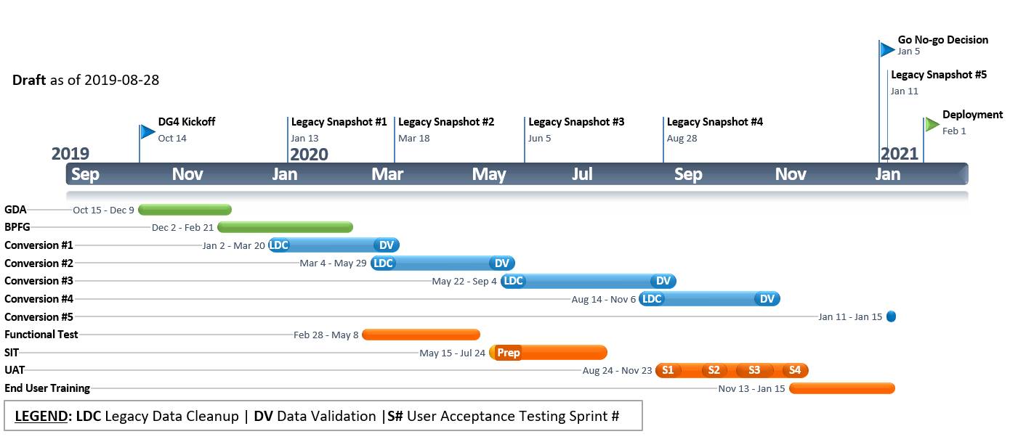
Deployment Group 4 Dashboard Reports – September 16 to 27, 2019
DG4 Initiation Phase Completion Summary
 | Percentage of deliverables completed and tracked in Project Web App (PWA) by each college: College Orientation & Resourcing College Project Planning (from templates) Conduct Initial Data Cleansing Document Current Legacy Business Processes Supplemental Systems Analysis
College/District | As of Sept. 27, 2019
Centralia College | 72%
Edmonds Community College | 74%
Highline College | 64%
Seattle Colleges (3) | 63%
Wenatchee Valley College | 70%
DG4 General Timeline Draft |  | G

Slide 19
Deployment Group 5 Dashboard Reports – September 16 to 27, 2019
DG5 Initiation Phase Completion Summary
 | Percentage of deliverables completed and tracked in Project Web App (PWA) by each college: College Orientation & Resourcing College Project Planning (from templates) Conduct Initial Data Cleansing Document Current Legacy Business Processes Supplemental Systems Analysis
College/District | As of Sept. 27, 2019 | Target Percentage for Sept. 2019
Bellevue College | 22% | 55%
Bellingham Technical College | 32% | 55%
Big Bend Community College | 28% | 55%
Everett Community College | 34% | 55%
Grays Harbor College | 40% | 55%
Green River College | 35% | 55%
Skagit Valley College | 45% | 55%
Whatcom Community College | 46% | 55%
DG5 Pre-Implementation and General Timeline |  | G

Slide 20
Dg6 Status
Initiation Roadshows in progress
Colleges working on initiation phase activities
Begin ctcLink status reporting beginning Nov 2019

Slide 21
ctcLink Quality Assurance Scorecard - Moran Technology Consulting , November 2018
ctcLink Quality Assurance Scorecard / Moran Technology Consulting Report August 2019 | Overall Status | Y
STATUS | PROJECT AREA | DESCRIPTION / NOTES
G | SBCTC/Governance | The Go/No Go Decision for DG2 implementation is planned to be made in late September by the ctcLink Steering Committee. This decision is considered most critical to meeting the schedule for success of DG2 and impacts all remaining Deployment Groups.
G | Project Management | The PMO continues to make adjustments in staffing, and team continues working well together. PMO was preparing the Readiness Template for intended use with DG2.
Y | Phase Scope | QA continues to remain concerned that the risk created by the number of solutions to be re-implemented to replace/augment current PeopleSoft functionality. Major scope changes will impact budget, schedule, and project and support staffing. The implementation of enhanced role security for ctcLink is a major Project and QA schedule risk concern.
Y | Schedule Status | The DG2 schedule is now less than 60 days from Go-live. Pressures are mounting on the project team and the DG2 Colleges and State Board. The PMO was actively detailing multi-step plans for DG2 Go-live data conversions and production cutover. FLC colleges will be going into a production upgrade state with new functionality, while Clark and the State Board will be first time implemented with PeopleSoft.
Y | Training | Training team and consultants continue working on preparing materials for the delivery of end-user training courses scheduled for September. This scope includes a combination of Self-Paced Courses and Instructor-Led Training workshops. However, considering the workstream schedule, QA continues to be concerned that considerable content development remains for the 56 courses to support range of end-user training. The majority of the planned 36 Instructor –Led courses is Finance pillar specific and requires support from functional project staff.
Y | Testing | The last DG2 User Acceptance Testing (UAT) Sprint (Sprint #6) is now scheduled for the first week of September. DG2 has been executing a large testing workstream that includes parallel testing for payroll, financial aid, and tuition calculation.
G | Configurations / Data Conversion | Technical staff supported the DG2 cycle 4B conversion for additional data validation by Clark and SBCTC. The data conversion and production implementation of the Bio-Demo data for Clark College and SBCTC has a September 7 target date. Performance Load Testing identified technical production to ensure ctcLink system meets increased student user usage projections (20, 000 active student users).
G | Organizational Change Management | PMO/OCM is actively engaged with all colleges now involved with their Deployment Groups. ctcLink management teams continue to meet with DG colleges via on-site check-ins. With 60 days until Go-live, QA remains concerned the PMO focuses on the DG2 schedule/priority activities.
G | Project Staffing | Project staffing is adequate at this time and continues to make staffing adjustments as appropriate. PMO is recruiting for open positions. PMO to begin using off-shore technical resources to perform and augment systems integration testing work.
Y | Technical Environment | The IT division continues addressing processes and critical staffing. Additional positions supporting ctcLink production have been approved and hiring underway. The ERP Change Management Board is being re-implemented to improve coordination and scheduling of changes. Service Level Agreement is awaiting final signatures.
LEGEND | GREEN | YELLOW | RED
Risk Description: | Low risks may be encountered. NO immediate action needed | Moderate risks may be encountered. Serious deficiency and action item recommended. | High risks may be encountered. Needs to be escalated and can impact project effort or cost.
21

Slide 22
Questions & WRAP-UP

