Slide 1
ctcLink Project Update ctcLink Executive Leadership Committee
April 25, 2019
Jan Yoshiwara – SBCTC Executive Director, ctcLink Executive Sponsor & cELC Co-Chair
Joyce Loveday – Clover Park Technical College President & cELC Co-Chair
Grant Rodeheaver – SBCTC Deputy Executive Director of IT and ctcLink Project Sponsor
Choi Halladay – District Vice President for Administrative Services, Pierce College, ctcLink Steering Committee Chair
Christy Campbell – SBCTC ctcLink Project Director

Slide 2
Agenda
Item | Description | Minutes | Facilitator
1. | Welcome | 3 | Joyce
2. | Approval of Minutes | 2 | Joyce
 | Steering Committee Decisions & Governance Update Deployment Group Alignment (Shoreline) Go-Live Dates Discussion | 10 | Choi/Christy
3. | Pilot Remediation Overview and Status | 15 | Christy
4. | ctcLink Program Status Project Status Budget OCIO Conditions Moran QA Report Top Program Risks | 20 | Christy
5. | Key Messages for WACTC Business Meeting | 10 | Joyce
6. | Adjourn |  | Joyce

Slide 3
celc Meeting Minutes
March 21, 2019

Slide 4
steering committee decisions & governance update
Deployment Group Alignment (Shoreline decision)
Go-Live Dates Discussion

Slide 5
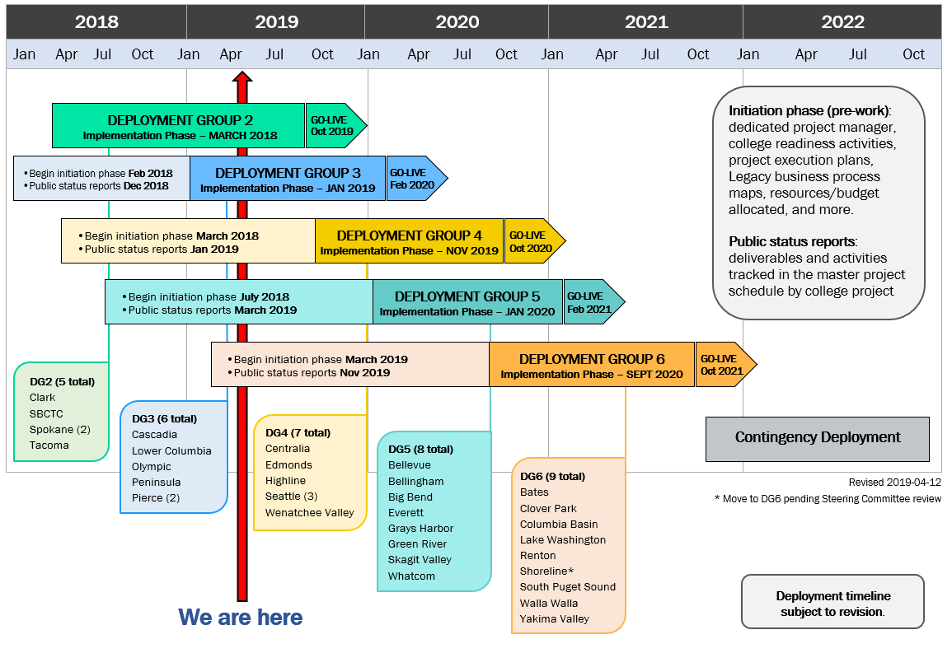
DEPLOYMENT GROUPS AND TIMELINE
Deployment Changes:
Bellevue: DG4 to DG5
Columbia Basin: DG4 to DG6
Shoreline: DG5 to DG6 as of April 23, 2019

Slide 6
Pilot remediation overview & status
Date | Total Open Items | Open Items With a Plan to Complete (Appendix A) | Open Items Needing a Replacement Solution (Appendix A) | Open Items That Were Closed, but Reopened in Remediation Agreement (Appendix B)
 |  | 2016, 2017, 2018 Financial Books Absence Management (DG2) DRS Redistribution (In Testing) | Continuing Education Online Admissions Budget Planning | Financial Aid Customizations
11/29/17 | 195 | 101 | 10 | 84
12/13/18 | 41 | 29 | 10 | 2
4/01/19 | 23 | 11 | 10 | 2
*FirstLink (pilot) colleges are validating open and closed items/numbers
Notes:
DRS – Department of Retirement Systems

Slide 7
ctcLink Remediation Status Reports – April 12, 2019
Solution | Status | Due Date
Campus Solutions | 10 of 45 remain open | DG3
Financial Management | 5 of 39 remain open | DG2
Human Capital Management | 6 of 25 remain open | DG2
Faculty Workload | Complete | March 2019
DRS Redistribution | Preparing for UAT | April 2019
Absence Management | Complete | April 2019
Security Audit Controls | Security Redesign Mapping Framework | FLC / DG2
Student Billing/Third-Party Billing | Complete | April 2019
Budget Planning | Form Work Group | Jan 2020
Online Admissions App | Governance | DG2
Continuing Education | Vendor Negotiations | DG3
Chart of Accounts | Due/Finish | Status
TCC Chart of Accounts Adoption Kickoff | Dec. 12, 2018 | Complete
CCs Chart of Accounts Adoption Kickoff | Feb. 1, 2019 | Complete
Foundational Chartfield Configuration | March 22, 2019 | Complete
College Configuration Review and Updates | May 3, 2019 | In Progress
Functional and System Integration Testing | May 10, 2019 | In Progress
User Acceptance Testing | May 10 - June 3, 2019 | Not Started
Readiness Gate / Go-No Go Decision | June 10, 2019 | Not Started
Production Cutover | July 2019 | Not Started
New Solution | Status | RFP | Decision
Continuing Education | CampusCE chosen as successful vendor Governance approved Continuing Education Implementation Approach Global Approach for consistent student experience Pricing aligned based upon college size and enrollment Integration for ctcLink CampusCE baseline Vendor negotiations underway, using implementation approach as a guide | 10/15/2018 | Subgroup assisting with final negotiations
Online Admissions Application | OAA workgroup evaluated select solutions currently in use at other PeopleSoft universities and colleges, based on OAA requirements review and Fit/Gap OAA Work Group to review final feedback, make recommendation to governance In addition, improvements (Quick Wins) to existing OAA solution identified, approved by Governance and being implemented . | TBD | Jan 2019 Feb 2019 April 2019
Budget Planning | Committee to form to review, finalize and approve Budgeting requirements Review requirements against Oracle PBCS Solution Develop RFP if needed | TBD - | Feb 2019 April 2019
Physical Inventory (Asset Tracking) | Vendor Solutions being evaluated Evaluate new PeopleSoft functionality that provides integration for asset-tracking scanners directly with ctcLink | 5/21/2018 | DG3 (Feb 2020)

Slide 8
Project Status – April 1 to 12, 2019
Overall Project Status Summary
Category | Status | Comments
Overall | Y | Program is on track, per timeline, scope and budget DG2 Training content development and UAT framework making good progress Security Mapping activities impacting UAT
Schedule | Y | Monitoring scope and timing of Budgeting Tool, Continuing Education, Online Admissions Application, Physical Assets and OBIA implementations
Scope | Y | Requirements Traceability Matrix (RTM) needs to be updated to validate original RFP requirements have been implemented, tested, and end users trained on the processes and functionality
Budget | G | Currently tracking under budget New Technology Plan approved as well as Stage Gate #3 for OFM/OCIO Technology Pool funding
Executive Summary
The project is tracking per schedule and under budget. Review and definition of scope for each deployment continues due to the rework of key solutions. Each Deployment Group (DG) is now engaged in the project at some level. DG2 is in the Construct Phase and the ctcLink project team is performing DG2 System Integration Testing (SIT) and conversions. Conversations are underway to set go-live dates. DG3 is in the Structure Phase, focused on Business Process Fit/Gap sessions (BPFG) through May. DG4 is in the Initiation Phase, with most colleges nearing the halfway mark on deliverables. DG5 colleges have begun Initiation Phase and are learning the public status reporting process. DG5’s first report is included in this status update. DG6 will soon begin initiation phase and reporting process. The spring 2019 Project Managers Summit will be held at Wenatchee Valley College, with May 6-7 focused on overall Implementation Phase activities for all colleges and May 8 focused on the Initiation Phase for DG5 and DG6. Contract negotiations are underway for a new Continuing Education solution. The Online Admissions Application (OAA) work group is actively pursuing an OAA replacement. The Budget Planning Tool work group is reviewing and finalizing business and technical requirements.
Overall Status Summary per Deployment Group
DG# | Status | Comments
DG2 | Y | Significant progress with Training content and UAT Framework Security Mapping activities impacting UAT
DG3 | G | College resources have been engaged in BPFG Workshops Conversion cycles have begun
DG4 | G | College teams working on Initiation Phase activities
DG5 | G | Started tracking college Initiation and included in status reports
Christy
Overall Timeline (All Deployments)

Slide 9
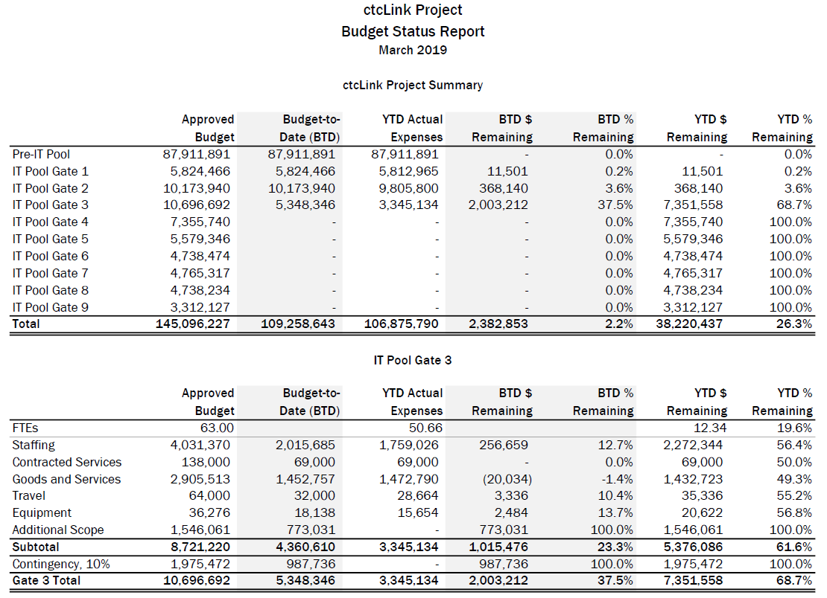
Budget Status – as of March 31, 2019 |  | G
Notes:
Budget Notes:
Currently under budget by nearly $2.4 million due to timing of decisions and implementation of replacement solutions. All funds are allocated.
In December 2017, WACTC approved increasing the funds for ctcLink by an additional 1 percent of operating fees for fiscal years 2020, 2021, 2022.
Budget Notes:
Currently under budget by nearly $2.4 million due to timing of decisions and implementation of replacement solutions. All funds are allocated.
In December 2017, WACTC approved increasing the funds for ctcLink by an additional 1 percent of operating fees for fiscal years 2020, 2021, 2022.

Slide 10
WA State Office of the Chief Information Officer (OCIO) Oversight
WA State Office of the Chief Information Officer (OCIO) Oversight as of April 2019 | Overall Status | Y
WA State Office of the Chief Information Officer (OCIO) Oversight
OCIO Conditions to new ctcLink Investment Plan Approval |  |  | Status
G | 1 | Project must remain in line with SBCTC and OCIO policies | Ongoing
G | 2 | QA (Moran) to report to ctcLink executive sponsor and State CIO | Complete
G | 3 | Follow pre-determined OFM funding gates and approvals | Complete
G | 4 | Monthly status reporting | Complete
G | 5 | Continue reporting on Remediation items in Integrated Work Plan | Complete
Y | 6 | OCIO approval of the 4 remediation solutions: Budgeting tool, Continuing Education Application, Online Admissions Application | In Progress
G | 7 | OCIO must be notified prior to use of contingency funds | N/A
G | 8 | Perform a post-implementation review (lessons learned) after each deployment and post on the OCIO dashboard within 30 days of go-live | Planned as Activities in Project Work Plans
G | 9 | Process and timeline for filling the SBCTC CIO position by 1/31/2018 | Complete
ctcLink Technology Pool Status and Gate # |  |  | Status
G | -- | Pre-IT Pool Implementation, Stability & Remediation | Approved
G | 1 | Planning & Remediation | Approved
G | 2 | DG2 – Initiation & Structure Phase | Approved
G | 3 | DG2 – Construct Phase DG3 – Initiation & Structure Phase | Approved
G | 4 | DG2 – Transition & Deploy Phase DG3 – Construct Phase DG4 – Initiation & Structure Phase | Deliverables in Progress 7/1/2019
G | 5 | DG3 – Transition & Deploy Phase DG4 – Construct Phase DG5 – Initiation & Structure Phase | Future 1/1/2020
G | 6 | DG4 – Transition & Deploy Phase DG5 – Construct Phase DG6 – Initiation & Structure Phase | Future 7/1/2020
G | 7 | DG5 – Transition & Deploy Phase DG6 – Construct Phase | Future 1/1/2021
G | 8 | DG6 – Transition & Deploy Phase | Future 7/1/2021
G | 9 | Contingency Deployment | N/A 1/1/2022
Note: New ctcLink Investment Plan approved by OCIO, with above conditions, on Jan. 19, 2018.

Slide 11
ctcLink Quality Assurance Scorecard - Moran Technology Consulting , November 2018
ctcLink Quality Assurance Scorecard Moran Technology Consulting Report: March 2019 | Overall Status | Y
STATUS | PROJECT AREA | DESCRIPTION / NOTES
G | SBCTC/Governance | Governance framework continues to work as expected. Meetings are held according to schedule, with materials distributed beforehand, and decisions made at the appropriate level.
G | Project Management | Project Management Office (PMO) is fully staffed, working well together and continuing to address improvements in project management processes.
Y | Phase Scope | QA concerned about implementation schedules for replacement solutions. Impacts to scope and schedule for DG2 and DG3 will be more defined once solutions are selected.
Y | Schedule Status | DG2/DG3/DG4 schedules and resource constraints now directly impact all deployment groups. Schedule compression and key project resources are heavily allocated to tasks.
Y | Training | The decisions and actions taken by PMO have enabled recovery of this key work stream. The external contractor supporting delivery of training materials has made good progress with the Finance and HCM pillars. PMO has decided to coincide just-in-time targeted training with UAT Sprints which achieves a number of positive benefits.
Y | Testing | This work stream is yellow, but is now trending green due to changes made by the PMO. The PMO has added another PS experienced key resource for this work stream. DG2 Testing work stream relies heavily on availability and expertise of functional project staff.
G | Configurations / Data Conversion | Technical work for DG2 System Configurations and Data Conversion Cycle 4 is underway with good results reported.
G | Organizational Change Management (OCM) | PMO/OCM is actively engaged with all colleges now involved with their Deployment Groups. QA concerned that PMO focus remains on the DG2 schedule.
G | Project Staffing | Project staffing is adequate at this time and continues to make staffing adjustments as appropriate. QA and the PMO remain concerned that the overlap of DG2/DG3/DG4 may require additional project and contractor resources. Project leadership and staff morale is positive given schedule pressures.
Y | Technical Environment | Future PS updates/bundles and 3rd party software installation and support work is being managed by the IT Division outside of the project responsibility. Overall planning of these changes needs to be tightly integrated with the ctcLink DG2/DG3/DG4 schedules. This becomes more challenging with the overlap in implementation schedules.
LEGEND | GREEN | YELLOW | RED
Risk Description: | Low risks may be encountered. NO immediate action needed | Moderate risks may be encountered. Serious deficiency and action item recommended. | High risks may be encountered. Needs to be escalated and can impact project effort or cost.

Slide 12
Top PROGRAM Risks
# | Risk Description | Mitigation | Deployment Focused
1. | College Project Manager/Executive Sponsor Engagement | Hire a Project Manager Identify engaged and supportive Executive Sponsor | Deployment Group 5 Deployment Group 6
2. | College Resource Availability Other College and System wide Initiatives Daily Operations Staff Retention (Retirement/Role Changes) | Create ctcLink resource plan Backfill or add additional staff as needed for your college | All Deployment Groups
3. | College leadership understanding of ctcLink project methodology and resource participation requirements Pre-implementation Implementation Post Implementation | ctcLink Project Management Office to provide detailed resource plan to colleges for implementation College Project Managers need to account for additional college tasks | All Deployment Groups
4. | ctcLink Permanent Support Organization – A clear plan and understanding of the sizing, service capacity and service levels provided by SBCTC | SBCTC working on Service Level Agreements with colleges to structure the evolving ctcLink support plan Plan will need to include appropriate staffing levels for all deployments as well as post implementation | All Deployment Groups

Slide 13
ctcLink executive leadership committee key messages for wACTC – april 26, 2019
TOPIC | KEY MESSAGE/TALKING POINTS

Slide 14
Questions & WRAP-UP

Slide 15
Campus Solutions
Human Capital Management
Other
Finance
Recruitment & Admissions
Student Records
Academic Advising
Financial Aid
Highpoint Mobile & Message Center
Student Financials
Self-Service (Student, Faculty, Advisor)
Campus Community (3Cs)
25Live (Room Scheduling) integration
Canvas LMS integration
Online Admissions Application (OAA)
Online Student Enrollment for Continuing Education (OSECE)
General Ledger
Budgets (Commitment Control)
Accounts Payable, Accounts Receivable
Expenses
Billing (eBilling)
Grants
Projects
Project Costing
Contracts
Cash Management
Purchasing (eProcurement)
Asset Management
Financial Gateway
ctcLink SCOPE
Application Portal (Gateway)
Single Sign-on PeopleSoft Security
DataLink (Data Repository)
Address Correction (Runner Tech)
User Productivity Kit (UPK)
Enterprise Interaction Hub
Process Scheduler
Work Centers (HCM, FIN)
Reporting Tools: Query, Oracle Business Intelligence (OBIA/OBIEE), nVision
HR Core
Payroll
Base Benefits
Absence Management
Time & Labor
Talent Acquisition Management
Self-Service (Employee, Manager)
In Progress: Continuing Education, Online Admissions Application, Budget Planning, Physical Asset Inventory Tracking, Accessibility
Not purchased or De-Scoped: ePerformance, Succession Planning, Inventory, Enterprise Learning Management, Customer Relationship Management, Supplier Contract Management, Strategic Sourcing, eCompensation

Slide 16
Ctclink quality gates & milestones
GATE 1 | GATE 2 | GATE 3 | GATE 4 | GATE 5
INITIATION
STRUCTURE
CONSTRUCT
TRANSITION
DEPLOY
Project Planning (Checklists & Templates)
Global Design Adoption (GDA)
Determine Exception
Solutions
Production Cutover Planning
Go/No Go Decision
Business Process Fit/Gap (BPFG)
Update BP Flows
Production Environment Prep
Start Change Impact Analysis & Change Action Plan
Pre-User Acceptance Testing Training
Update BP Flows
Update CEMLIs
User Acceptance Testing
Production Cutover
Local Configuration
Update Configuration
Chart of Accounts Redesign (DG2 only)
Training Materials
Analysis/Build
Convert and
Validate Data
End-User Training
Production Validation
Build PeopleSoft Environments
UAT Test Definition
Security Matrix
Mapping
Performance Testing
Milestone Sign-Off
Security Redesign (DG2 only)
UAT Materials Build
Functional Testing
Legacy System Shutdown Procedures in Place
Finalize Local Configuration Guides
Identify Exceptions
Prepare QA
Environment
Organizational Change Management Assessments Begin
Design Extensions
Prepare Parallel
Environment
Cutover Mitigation Planning
GO LIVE
Prepare or Update
Test Scripts
System Integration Testing
GATE 1 PEER REVIEW
Map Supplemental Systems Data
Parallel Testing
Production Go/No Decision
Lessons
Learned
OCM Assessment, Activities & Deliverables for Colleges & SBCTC
College Project Charter Resource Plan & Budget Plan Deliverables Legacy BP Mapping Initial Supplemental Systems Analysis Change Impact Analysis 25% | GDA and BPFG Participation Supplemental Systems Data Mapping Initial Config Guides Sign-Off UAT Definition Sign-Off Change Impact Analysis 50% | Design Requirements Sign-Off Security Matrix Mapping Data Validation Sign-Off Change Impact Analysis 75% | OCM Readiness Checklist UAT Sign-Off End-User Training Policy/Procedures Updated Cutover Plans, Legacy Shutdown Procedures Change Impact Analysis 100% | College Cutover Plan Go/No Go Sign-Off Milestone Sign-Off Config Guides Sign-Off College Lessons Learned Rev. 2019-03-05

