Slide 1
College Promise
E2SSB 5393
Ruben Flores Student Services Policy

Slide 2
The promise through session
https://app.leg.wa.gov/committeeschedules/Home/Document/188045#toolbar=0&navpanes=0
2SSB 5393 Last Promise Standing
Sets the maximum award at public institutions equal to tuition only, excluding S&A fees.
Creates an Escape Clause if revenue declines
Requires the institutions to prioritize institutional aid (3.5% Funds) for S&A fees of Washington college promise scholarship recipients.

Slide 3
E2SSB 5393
Returned the maximum award back to tuition and estimated fees. There is no longer a requirement for public institutions to prioritize use of their institutional 3 ½% fund to cover S&A fees
Entitlement at or below 110% of Federal Poverty.
Eligibility for the program remains at 70% MFI with awards that include the current proration between 50-70% MFI, but they are not an entitlement and are subject to appropriations.

Slide 4
Who IS Currently Entitled?
 | Current Pgm (HC) | Current FTE (FTE) | 110% FPL (HC) | 110% FPL (FTE) | % HC | % FTE
All | 90,804 | 73,098 | 46,737 | 36,845 | 51.47% | 50.40%
CTC | 48,492 | 33,895 | 27,004 | 18,679 | 55.69% | 55.11%
Comp. | 14,438 | 12,820 | 7,181 | 6,270 | 49.74% | 48.91%
Priv. 2 | 1,363 | 1,172 | 727 | 611 | 53.34% | 52.13%
Priv. 4 | 7,671 | 6,610 | 3,234 | 2,804 | 42.16% | 42.42%
Research | 19,752 | 18,601 | 9,097 | 8,480 | 46.06% | 45.59%

Slide 5
Notes:
Overall 68,000 to 93,000 CTC 37,800 to 48,300 27.7% increase. Our sector represent more than half of the SNG population
CTC Max Award of $3,694

Slide 6
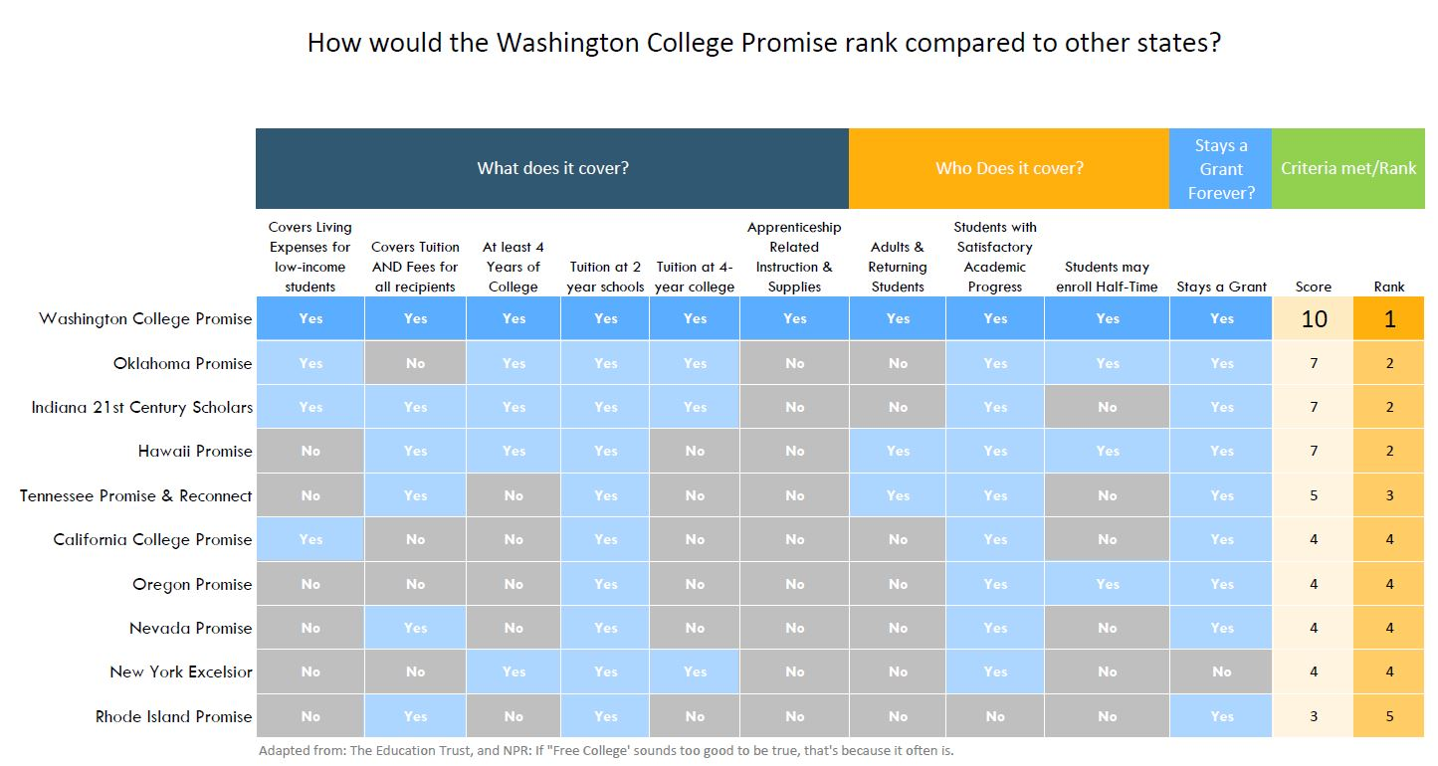

Slide 7
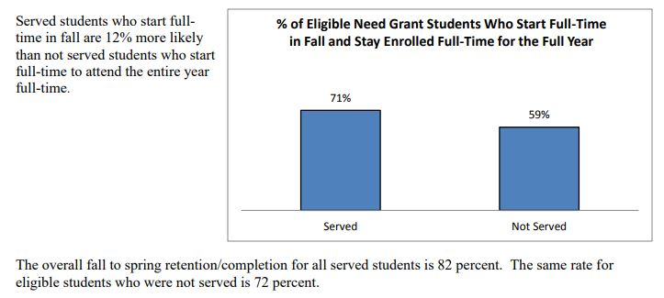

Slide 8
Financial Aid Director’s perspective Full Promise
“We are already looking at these students whether we have SNG funding left right now and packaging them as “unserved”. We are also checking SAP because the student likely has other aid. Currently, if additional funding becomes available we have to go back and review our unserved population again. So, to me, this would streamline the process if we knew we could award each eligible student up front.”
“Sure a possible increase in enrollment and more files to review would place more burden on an already overburdened office. However, I wouldn’t expect such a huge enrollment increase that we wouldn’t be able to absorb the impact. Again, I could just be overly optimistic and time will tell.”

Slide 9
Financial Aid Director’s perspective Current Promise
The value of a fully funded promise for FA offices is that they would no longer have to prioritize and forecast funding for students. This change will add another level of prioritization for them.
“If we don’t have SNG fully funded then we’re just doing what we’re already doing so it definitely doesn’t ease any burden on us.”

Slide 10
Questions?
Contact info:
Ruben Flores, MS (Vet)
State Board for Community and Technical Colleges
Policy Associate, Student Services
rflores@sbctc.edu

