Slide 1
Developing an Adult Reengagement Framework in Washington State
Rachelle Sharpe, PhD Deputy Executive Director
Gray Sterling, M.Ed. Assistant Director of Policy and Planning
Ami Magisos, M.Ed . Assistant Director of Policy and Planning
Notes:
Rachelle

Slide 2
100% High school diploma or equivalent
70% Postsecondary credential
Washington population ages 25-44
Notes:
Rachelle

Slide 3
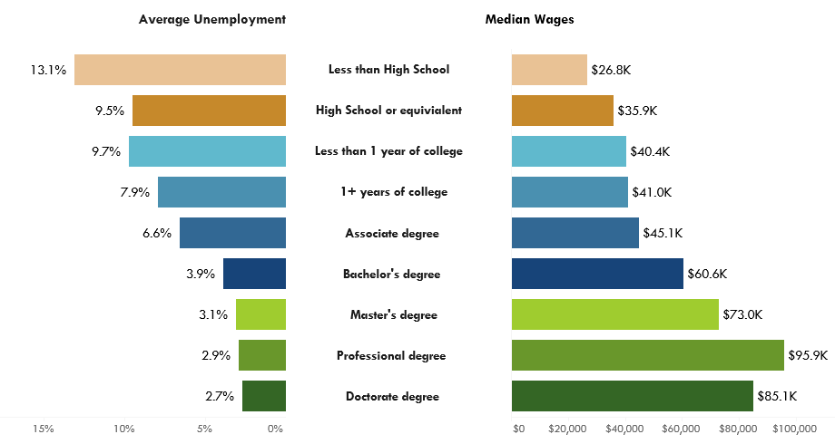
Bold Strategies Needed
Employers need a highly skilled workforce to remain competitive.
Source: Roadmap Dashboard & WSAC analysis of 2011-2015 American Community Survey, U.S. Census
Notes:
Rachelle

Slide 4
Bold Strategies Needed
Employers need a highly skilled workforce to remain competitive.
Our residents are not earning the needed credentials – and there are gaps at every educational level.
Source: 2017 WSAC, SBCTC, WFB Skilled and Educated Workforce Report.
Notes:
Rachelle

Slide 5
Bold Strategies Needed
Employers need a highly skilled workforce to remain competitive.
Our residents are not earning the needed credentials – and there are gaps at every educational level.
Employers find talent elsewhere and our residents are not competitive for living-wage jobs.
Source: WSAC Roadmap Dashboard. IPEDS Fall Enrollment data from the U.S. Department of Education, IPEDS Completions, survey A data from the U.S. Department of Education
Notes:
Rachelle

Slide 6
Key Challenge Areas Impeding Progress
Close Opportunity Gaps
Provide support for underrepresented students
Support Regional Leaders
Engage and support communities
Reconnect Adult Learners
Provide Affordable High Quality Pathways
Address regional workforce shortages
Remove system barriers for underserved students
Target former students with credits
Recruit and support adult learners
Provide multiple high quality pathways
Address financing and affordability gaps
Notes:
Rachelle

Slide 7
Many Adults Start a Program without Completing
Adults 25 to 44 1.9 million
No HS 179,000
HS no college 405,000
Some college 389,000
Credential 766,000
Enrolled 183,000
Measure comparisons over time:
Portion of population engaged in system.
Portion of high school cohort who attended but did not complete within 8 years of graduation.
Reengagement of similarly situated populations over time.
300,000 with 1 year of credit
Source: WSAC analysis of American Community Survey, 2009-2013 5-Year Estimates.
Notes:
Rachelle

Slide 8
Adult learners face unique barriers
Individual
Family & work obligations
Remediation
System
Stale credits
Credit acceptance
Aid timeframe limits
Veterans transitions
Negative experiences
Access to records
Notes:
Rachelle

Slide 9
Many Partners are Involved in the Statewide Initiative
Notes:
Rachelle

Slide 10
Adult Reengagement Vision
Support adults to return and complete their education so they can compete to meet the needs of Washington employers.
Notes:
Rachelle

Slide 11
Adult Reengagement Goals
Provide information and support to recruit, retain, and graduate adults who have not completed a credential.
Target Washington residents who have earned college credit without completing a credential.
Notes:
Rachelle

Slide 12
Adult Reengagement Principles
Engage all sectors of institutions, employers, policy makers.
Make it scalable, sustainable, and cost effective.
Highlight local and regional efforts for returning adults.
Consider institutions’ business and enrollment management practices.
Evaluate and address barriers for adult learners.
Integrate campus-based initiatives, data systems, on-line resources, and strong partnerships.
Use an equity lens to develop student identification, outreach, services, etc.
Notes:
Rachelle

Slide 13
Key Framework Components
Communication
Student identification
Cost
Microgrant
Financial aid messages
Completion
Enrollment navigation
Employer & regional partners
Outreach
Child care
Student support
Program & career match (portal)
Coordination of benefits
Adult Reengagement
Adult Reengagement
Notes:
Rachelle

Slide 14
Communication
Notes:
Gray

Slide 15
Initial target population
Former financial aid recipient
20 or older
Attended 25%
No credential
No financial aid issues
Notes:
Gray

Slide 16
Interactive Web-Based Tool
Robust relevant content
Program matching
Referrals to institutions
Academic programs based on individual career, personal goals.
Career exploration and advancement.
Short questionnaire related to past experiences and goals.
Inquiries shared with selected institutions.
Address individual and unique needs of returning adults.
Coordinate with other resources.
Notes:
Gray

Slide 17
Tool features & functionality
User interface
Personalization & information sharing
Education pathways
Matching students to programs
Filter on campus profile (delivery, location, etc.)
Career pathways
Career exploration
Questionnaire (student entered information – pass to state & campuses)
Email Follow-up (by state &/or campuses)
Field of study
Time to completion
Prior learning assessment
Transferable credits
Credentials for certain careers
Placement and wage information
User logins for students and institutions
Reporting
Notes:
Gray

Slide 18
Message development
Economic and Intrinsic Motivators
Advance career
Support family
Common Barriers
Financial
Flexible program (time/place)
Credit for prior experience
Market Segmentation Prioritization (messaging and/or imagery)
Sub-Populations: Veterans, Parents
Demographics: Age, Race/Ethnicity
Barriers: Defaults/Repayments
Customize by Region or Campus
Source: UNT Health Science Center.
Notes:
Ami
Filtering
* Low-income; WA residents
Unemployed or underemployed or employed
Employment – broad marketing in the Worksource Centers
Parents of first generation or CBS – broad marketing

Slide 19
Cost
Notes:
Gray

Slide 20
Affordability for Returning Adults
Affordability
Policy review
Microgrant Fund
Financial aid counseling
Strong messages
Child Care
Coordination of benefits
Notes:
Gray

Slide 21
Policy Review – Barriers & Possible Solutions
Are financial aid policies imposing unnecessary barriers for returning adults?
deadlines
rolling deadlines
set-aside for returning adults
satisfactory academic progress
improve information
coordinate fed & state SAP
college readiness & time to degree
amnesty term
appeals process & tips
low-cost options to provide “ability to benefit”
credit for prior experience
Notes:
Gray

Slide 22
Tailoring Relevant Information for Adults
defaults
rehabilitation
repayments
good standing
prior fees & holds
transcript holds
training benefits
bankruptcy
change in income
child care
Notes:
Gray

Slide 23
Microgrant – Small Dollar Pre-Enrollment Barriers
Student Selection
Broad vs. targeted outreach
Portal & campus
Eligibility
Former fees vs. aid repayments
Pre-enrollment
Fund Distribution
State pays former campus
Reporting
Campus Role
Match (waive fees; release transcripts; emergency funds)
Receiving campus communicates
Notes:
Gray

Slide 24
Affordability Messaging for Returning Adults
Washington has not authorized an Adult Promise program
Strong State Need Grant permits state-level messaging
Think you can’t afford college? Think again.
Leverage all state aid programs – Opportunity Grant for high demand certificates
Institutions can offer a financial commitment for eligible students
Husky Promise; Cougar Commitment; South Seattle 13th Year
Notes:
Gray

Slide 25
Child Care for Student Parents
Accessible
Available
Affordable
Convenient
Capacity
Cost
Policy Barrier: Washington is one of the more restrictive states for the work requirement for child care subsidies
Notes:
Gray

Slide 26
Promising Practices for Benefit Coordination
Start Next Quarter
United Way of King County
Seattle Colleges
Clark College
Electronic information exchange
Coordination of benefits through online tools, partnerships across agencies and one-stop supports on campuses
Notes:
Gray

Slide 27
Completion
Notes:
Ami

Slide 28
Completion: Student support
Share effective practices that support adult learners.
Expand partnerships with employers.
Establish regional networks of support.
Improve state-level policies to remove barriers for adult learners.
Notes:
Ami/Rachelle

Slide 29
Support Returning Adult Learners
PROPOSAL DESIGN
Provide individualized support to inquiring students to address career, academic program, and financial issues.
Refer prospective students to campus or regional coaches.
Provide funding to regional navigators with capacity to support adult learners.
Provide technical assistance to campuses regarding policies, programs and services.
Provide funding to campuses to engage in assessment of services.
Adult Reengagement
Communication
Cost
Completion
$1,000,000
Ensure returning adult students have access to knowledgeable professionals to navigate enrollment.
Support campuses to assess and improve completion strategies.

Slide 30
Expand Child Care Assistance
PROPOSAL DESIGN
Expand eligibility students attending two- and four-year institutions.
Prioritize campuses engaged in adult reengagement initiative.
Coordinate funding with child care subsidies.
$3,000,000
Support 1,200 more student parents with child care funding.

Slide 31
Campus & State Role - DRAFT
Activity | State | Campus
Student Identification | centralized – flexibility to coordinate | TBD
Outreach | centralized – flexibility to coordinate | TBD
Microgrant | Student identification Make payments | Student identification Simplified reporting
Student Financial Aid | State financial aid (SNG, SBCTC OG) | Messaging to certain groups.
Portal | Content management Data management Site maintenance Transfer inquiries to campus | Provide program & services content Describe student incentives Respond to inquiries Simplified reporting
Completion Supports | Share and coordinate practices Training and technical assistance Pre-enrollment support Employer and partner engagement Resource allocation Child care services and support | Enrollment support Financial commitment Program delivery Employer and partner engagement Completion support Child care services and support
Notes:
Rachelle
State refers to WSAC, WFB, SBCTC and future possible legislative direction or resources
Financial: commitment; prior fees/fines; application waivers
Student supports: Child care, transportation, Veterans
Academics: online/weekend/consistent scheduling/PLA (transcript, experience)
Responsiveness to leads: designated person

Slide 32
Student Identification – DRAFT Roles
WSAC
Identify former financial aid recipients.
Database management, student permissions, and updating contact information.
Evaluate population enrollment and completion metrics.
Coordinate and administer data share agreements as necessary.
Campuses
May elect to identify former students.

Slide 33
Outreach & Communication – DRAFT Roles
WSAC
Develop the marketing communications plan.
Share outreach plan and messages with the advisory team.
Initiate outreach to the selected students following evidence-based models reviewed by the advisory team.
Coordinate regionally-unique messages if requested.
Advocate for pre-enrollment assistance for adult learners.
Advocate for enhanced campus services for adult learners.
Campuses
May elect to initiate outreach to former students.

Slide 34
Web-based Portal & Data Exchange – DRAFT Roles
WSAC
Facilitate agreement on the features and functionality of the tool.
Manage the Request for Proposals.
Coordinate with the Workforce Education Training Coordinating Board (WTB) to interact with Career Bridge to expand program data and maximize the user experience across portals.
Develop and maintain content relevant to adult learners regarding planning and paying for postsecondary education.
Maintain the tool throughout the duration of the initiative.
Ensure the tool provides an ability for student inquiries to be transferred to institutions.
.

Slide 35
Web-based Portal & Data Exchange – DRAFT Roles
Campuses
Provide academic program data to WSAC or WTB.
Provide and update student services and point of contact information.
Respond to student inquiries within one week.
Report student enrollment status variables for portal inquiries (admissions, enrollment, retention, completion).
Describe the student services for adult learners provided and campus-specific response to student inquiries.

Slide 36
Student Financial Aid – DRAFT Roles
WSAC
Evaluate affordability for adult learners.
Develop information related to adult learner-specific financial barriers to include in the portal.
Design and manage a statewide MicroGrant to cover pre-enrollment financial barriers for identified students.
Allow method to identify students through the portal.
Communicate student service using a system similar to the State Need Grant Transfer tool.
Manage payments and share record-level information across institutions.
Share MicroGrant participation requirements with advisory team.
Advocate for child care funding and tuition assistance for adult learners.

Slide 37
Student Financial Aid – DRAFT Roles
Campuses
Provide feedback for affordability messages and develop campus specific messages.
Refer students to WSAC for MicroGrant eligibility and payment.
Report outcomes to WSAC for MicroGrant recipients.

Slide 38
Completion Supports – DRAFT Roles
WSAC
Gather and share expertise through statewide and regional trainings.
Collect, analyze and share best practices regarding adult learner supports.
Advocate for student pre-enrollment navigation supports.
Advocate for resources to support campuses to evaluate adult learner student experiences form inquiry to completion.
Prioritize adult reengagement campuses for technical assistance, child care funding, and student supports as resources are available.
Engage employer and community partners in the initiative.

Slide 39
Completion Supports – DRAFT Roles
Campuses
Describe approach to develop, evaluate, or modify a plan to serve returning adult learners.
Outline supports to adult learners that address barriers resulting from balancing work and family obligations, and related time and financial pressures.

Slide 40
2018 Milestones
Winter
Narrow target population
Determine features and functionality of portal
Spring
Draft portal RFP
Develop communications plan
Summer
Develop budget recommendations
Campus engagement
Fall
Statewide effective practice exchange
Employer engagement
Post portal RFP and select vendor
Scope micro-grant
Notes:
Rachelle/Ami

Slide 41
Adult Reengagement Summit & Pave the Way 2018
This year’s
Pave the Way Conference, focused on advancing equity, expanding opportunity, and increasing educational attainment will take place on
November 29.
Notes:
Ami

