Slide 1
ctcLink Project Update Joint Summer Session Instruction Commission & WSSSC
July 11, 2018
Christy Campbell – SBCTC ctcLink Project Director

Slide 2
Agenda
ctcLink Update
Continuing Education Solution Progress
Online Admissions Solution Progress

Slide 3
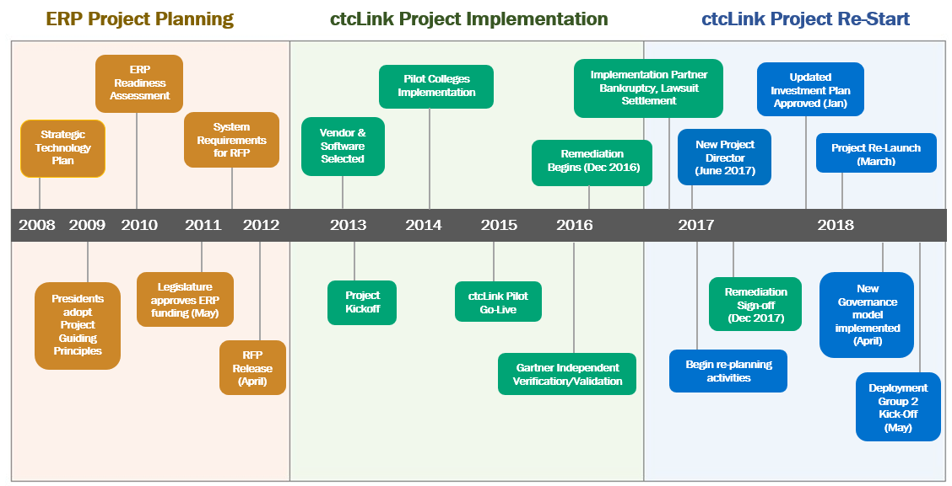
Ctclink project evolution

Slide 4
Lessons Learned outcomes from pilot phase
ctcLink Project Director (with PeopleSoft/Higher Ed Experience)
Implement Foundational Project Management Practices
New Governance Model
New ctcLink Methodology (Organizational Change Management, Training, Testing and Communication Approach)
New Project Timeline
New College Partner & Engagement Model
New Common Process Models
New Global Template
New Security Model
New Chart of Accounts

Slide 5
Remediation / Fiscal Year End
Remediation
Remaining items in progress
Upgrade dependent items will be implemented with Deployment 2
New Solutions for OAA, Continuing Education, Budget Planning
Fiscal Year End
State Board resources working with Pilot Colleges to complete Fiscal Year End activities

Slide 6
New ctclink investment plan
New Technology Budget
Project Reporting
Comprehensive Staffing Plan
New Deployment
Method & Timeline
New Governance Model
New Investment Plan
IV & V Recom-mendations
Remediation Schedule & Sign Off
New OCM Strategy
External QA Open Items
RFQ for Systems Integration
Readiness Assessment

Slide 7
New ctclink investment plan - approved
Gate 1
Oct 30, 2017
Nov 16, 2017
Dec 1, 2017
Dec 6, 2017
Dec 11, 2017
Jan 11, 2018
SBCTC internal review
Present draft to OCIO for review, feedback
WACTC-Tech/WACTC formal approval
SBCTC Board review, approval
Present to TSB, OCIO for Review
Present to TSB, OCIO Approval

Slide 8
Nine checkpoints to success
ctcLink Methodology
Quality Gates
ctcLink Working Group
Moran Technical Consulting
ctcLink
Steering Committee
ctcLink Internal Controls
ctcLink External Controls
OCIO (TSB)
ctcLink Executive Leadership Committee
OFM (Budget)
WACTC (Presidents)
SBCTC Board

Slide 9
ctclink Governance Framework
Executive Leadership Committee
Overall Project Schedule / Total Project Budget / Global Scope
Change Initiation
Co-Chairs (voting): SBCTC Executive Director / WACTC-Tech Chair
Other Voting Members (4 College): WACTC-Tech Presidents
Other Members (non-voting): Project Director, Steering Committee Chair, SBCTC Deputy Exec. Dir. for Information Technology, OCIO Rep.
Meets monthly
College Executive Sponsors
Commission Chairs (+ representing their Councils)
Data Governance Co-Chairs
SBCTC ctcLink Leads
Common Process Development Team
External Mandates
Escalated Issues, Unresolved Appeals,
Clarifications
Project Steering Committee
Committee Outputs: Minutes, Issue & Decision Log, Reports
Deployment Schedule, FY Project Budget, Scope w/in Budget, Global Configurations, Appeals
Chair: Executive Sponsor (rotating)
Voting Members (6 College, 3 SBCTC): 6 College ctcLink Executive Sponsors, 3 SBCTC Deputy Executive Directors
Other Members (non-voting): Project Director, External Qual. Assurance Rep, 2 College PMs
Meets bi-weekly
Formal Change Request Forms
Escalated Issues, Appeals, Clarifications
Issue & Decision Log
(online)
Project Working Group
Implementation Plan / Configuration Management / Training Plan / OCM Plan
Chair (non-voting): Project Director
Voting Members (6 College, 5 SBCTC): 6 college reps (minimum 2 PMs, 3 Pillar Leads, 1 additional); 3 SBCTC Production Supp. and Project Staff (1 per Pillar – CS, HCM, FIN), 1 Data Serv. rep, 1 App. Serv. Rep
Other Members (non-voting): SBCTC reps from Production Support (all pillars), Project Support (all pillars), Security and Training/OCM
Meets weekly
Agenda
Requests for Review / Clarification

Slide 10
ctcLink Project Methodology
Quality Milestones
Exit and Entrance criteria evaluated by ctcLink Governance
P
Initiation
Structure
Construct
Transition
Deploy
Project Planning
Global Design Review
Determine Exception
Solutions
Organizational Change Management Readiness
Fit/Gap
Update BP Flows
Production Environment Prep
Chart of Accounts Re-Design
Update BP Flows
Update CEMLI’s
Production Cutover Planning
Local Configuration
Update Configuration
Build PeopleSoft Environments
Regional Trainer and End User Testing
Training Materials
Analysis
Convert and
Verify Data
Production Cutover
Project Relaunch
Security Re-Design
Training Materials
Build
Security Matrix
Mapping
UAT Test Definition
Functional Testing
UAT Materials Build
Prepare QA
Environment
User Acceptance Testing
Identify Exceptions
Milestone
Sign-Off
Prepare Parallel
Environment
College
Resource/Planning
-Legacy BP Mapping
-Supplemental System Analysis
-Data Cleansing
-Change Impact
Analysis
Performance Testing
Design Extensions
Perform Systems
Integration Test
Lessons
Learned
Prepare or Update
Test Scripts
Perform Parallel Testing
Begin Production

Slide 12
Quality assurance Readiness gates
Structure Phase Criteria
Data Mapping for
Supplemental Systems
Sign-off on Initial
Configuration Guides
UAT Test Design Sign-Off
Construct Phase Criteria
Design Requirements
Sign-Off
Security Matrix Mapping
Data Validation Sign-Off
Transition Phase Criteria
College OCM Readiness Checklist
User Acceptance Testing Sign-off
Policy/Procedure Updates Complete
End User Training Delivered
Cutover Mitigation Plans Defined
Legacy System Shutdown Procedures in Place
Deployment Criteria
College Cutover Plan in Place
Go/No Go Decision Sign-Off
Production Cutover
Milestone Sign-Off & Acceptance
Finalized Deployment Group Local Configuration Guides Sign-Off
Lessons Learned
Approved Resource
Plan & Budget
Project Execution
Plans in place
Legacy Business
Process Mapping
Business Process
Fit/Gap
Initial Supplemental
Systems Assessment
Plan for Executing
Legacy Data
Cleansing Activities
Entry Criteria

Slide 13
project phases (Deployment 2 / Upgrade Example)
Initiation
Includes all project planning & preparation tasks, Security Redesign and Environment Builds.
Structure
Includes Global design, FIT/GAP, updates to Business Process Flows, Local Configuration, UAT Test Definition, Training and UAT Material Builds.
Construct
Includes Technical Development (updates to CEMLI’s), Security Matrix Mapping, Functional and System/Integration Testing, Parallel Testing, Data Upgrade and Spot-Check Validation.
Transition
Includes OCM Readiness Transition, Production Cutover Planning, Regional Trainer and End User Training, User Acceptance and Performance Testing.
Deploy
Includes Production Environment Prep, Production Cutover, Milestone Sign-Off and Acceptance, Lessons Learned.

Slide 14
Global Design review
Global Configurations
Enterprise-Managed Business Processes
Sessions scheduled Monday –Thursday (3 weeks)
Only subject matter experts related to that topic need attend
Remote participation support with in-room facilitation
All 34 colleges + State Board
Concurrent: Bio/Demo Conversion (Cycle #1) Activities

Slide 15
Fit/gap – business process diagram
What Will Change – College Change Action Plans
Updating Business Process Flows
Merging Lucid Chart Business Process Diagrams & Common Process Flows
User Acceptance Test Scope Definition:
End-to-End Business Processes, Data Scenarios & Error Conditions
End User Training Definition
Special training needs for unique populations
Configuration (Homework Assignments Reviewed)
Sessions Scheduled Monday – Thursday (4 weeks)
Only subject matter experts related to that topic need attend
Remote participation support with in-room facilitation
Concurrent: Conversion-Related Configuration for Cycle #2

Slide 16
Conversion Activities
Colleges Tasks:
Maintain crosswalks
Perform data validation
Sign-off on data validation

Slide 17
Training
Regional Train the Trainer
Software Training for college staff who will take point on End User Training at their campus or other colleges.
End User Training (Pre-UAT)
Software Training provided by staff who have gone through the Regional Trainer program.
Train on processes ‘Just in Time’ (2-3 weeks) before the related User Acceptance Test for that process.
End User Training (College Defined)
Smaller, business-practice trainings offered by college staff to address college-specific needs or practices to help staff learn how to use the system ‘your way.’

Slide 18
User acceptance testing
Scope to be defined during FIT/GAP sessions.
Occurring in October to December timeframe.
New UAT test documentation format:
UAT Test Articles in ctcLink Reference Center.
Links to flow diagrams and Quick Reference Guides arranged by business process.
Includes information on data scenarios, error conditions and security.
Linked to next step in the end-to-end business flow.
No Excel spreadsheets or ‘staged’ data.
Will require departments involved in the end-to-end business flow to coordinate and plan their tests.
Tracking of test defects/success status in OTM and supported by QA Team.

Slide 19
College Resource commitments
Workshop Participation
Global Design, FIT/GAP + Configuration
Change Action Plan Management
Conversion Data & Process Validation
Training
User Acceptance Testing
Cutover Planning and Dry Run

Slide 21
Continuing Education Solution
The business requirements team was managed by Mark Jenkins and Steve Gance; the technical requirements team was managed by Andy Duckworth.
A committee of CEC members put in a lot of hours developing requirements and vetting that work.
Requirements are documented and complete.
CEC group has approved the requirements.
Next Steps:
IC to approve the requirements and request to ctcLink Governance that an RFP be developed (Process?)
ctcLink Governance approval to develop and post RFP

Slide 22
Online Admissions Application Solution
The Online Admissions Application sub-committee has met to discuss the requirements
Another meeting is scheduled fro July 23 with the full team to request a smaller sub-group of volunteers to draft the detailed requirements.
All-day sessions scheduled for August 6 (10am-4pm) to do a requirements drafting activity with the smaller sub-group.
Joe Holiday, Joe Carl & Tara Keen will lead that discussion
Next Steps:
Sub-group documents the requirements and approves
IC/WSSSC to approve the requirements and request to ctcLink Governance that an RFP be developed (Process?)
ctcLink Governance Approval to develop and post RFP

Slide 23
Questions?

