Slide 1
Guided pathways 2018
WSSC & IC
Kristi Wellington-Baker, SBCTC ED Student Success Network
July 10, 2018

Slide 2
Statewide Happenings
January - March
Technology Tools Event
April - June
Student Success Institutes
July - Sept
Scale of Adoption Assessment
BEdA Transitions Event
Coaching for Equity capacity building
College site visits- Coaches, CCRI, David Prince, Tom, KWB
Reflection Experience Event @ Everett
Learning Agenda Dev
CCRC Final report release
College site visits- Coaches, CCRI, David Prince, Tom, KWB
Learning Agenda published
Notes:
Statewide events 4 scaling work
CSW cohort colleges
Evaluations

Slide 3
CCRC Suggested Collective Priorities for Guided Pathways in WA
Strengthen mapping of transfer pathways
Find ways to help all new students explore career/colleges interests and develop a full-program plan by end of quarter 2
Integrate and contextualize academic support in field-linked math pathways to enable students to pass college math in one year
Institutionalize focus on equity

Slide 4
CCRC REDESIGN CONSIDERATIONS
STEP 4
STEP 3
STEP 2
START HERE
CONNECTION
From interest to application
ENTRY
From entry to passing program gatekeeper courses
PROGRESS
From program entry to completion of program requirements
COMPLETION
From completion of credential to career advancement and further education
Market program paths
Build bridges from high school and adult ed. into program streams
Help students explore options/ make full-program plan
Integrate academic support into critical program gateway courses
Clearly map out program paths
Redesign advising/scheduling around maps/plans
Monitor student progress, provide feedback and support as needed
Align program outcomes with requirements for success in career-path employment and further education

Slide 5
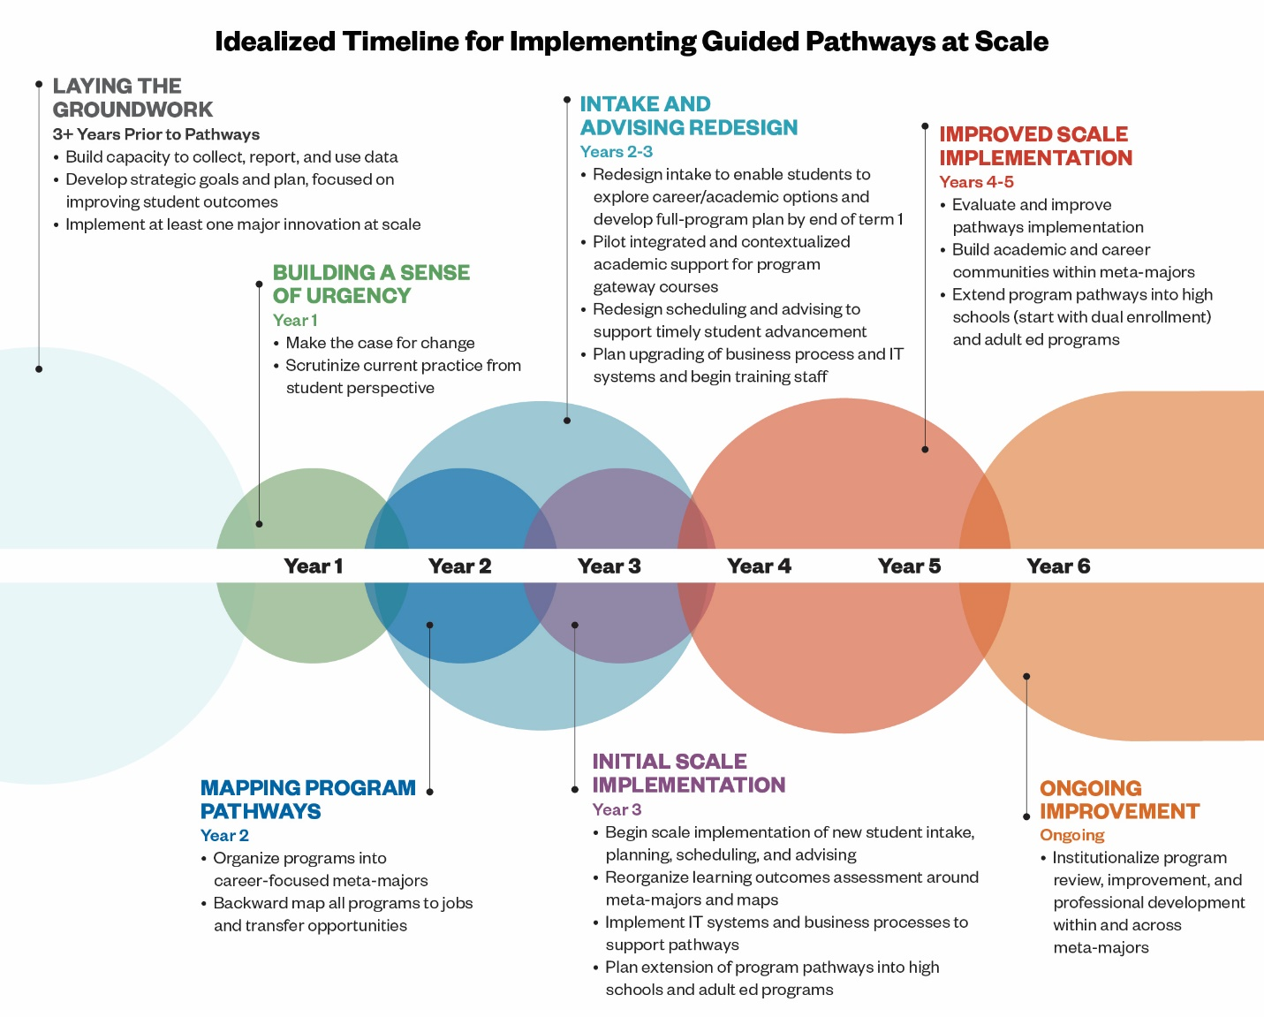

Slide 6
Data & PRIORITIES: transfer

Slide 7
DATA & PRIORITIES: math

Slide 8
EARLY INDICATORS
COMPLETION WITHIN FIRST YEAR - IDENTIFIED PATHWAY
College Level Math
College Level English
15 CREDITS

Slide 9
PARTNERSHIPS & INVESTORS
Washington state Legislature – $2 million investment
Jobs For the Future (JFF) – $500k initial investment + Network Services:
National Center for Inquiry and Improvement (NCII)
Aspen Institute
Community College Research Initiatives* (CCRI)
2018 Coaching for Equity grant
2019 Coaching & Technical Assistance RFP
College Spark Washington (CSW)
Gates Foundation (BMGF) – Multiplier Effect Grant
Community College Research Center (CCRC) – Scale of Adoption Assessment & Statewide data evaluation
*New partners/ TA in 2018

Slide 10
Learning agenda
Equity
Adaptive
Leadership
Pre-College
Redesign
Integrated Student Supports
Academic Architecture

Slide 11
Learning agenda
College Technical Assistance
National Partnership Training
Communities of Practice
Early Adopter College Spark Retreats
Statewide Institutes
EDI Practice Capacity Building

Slide 12
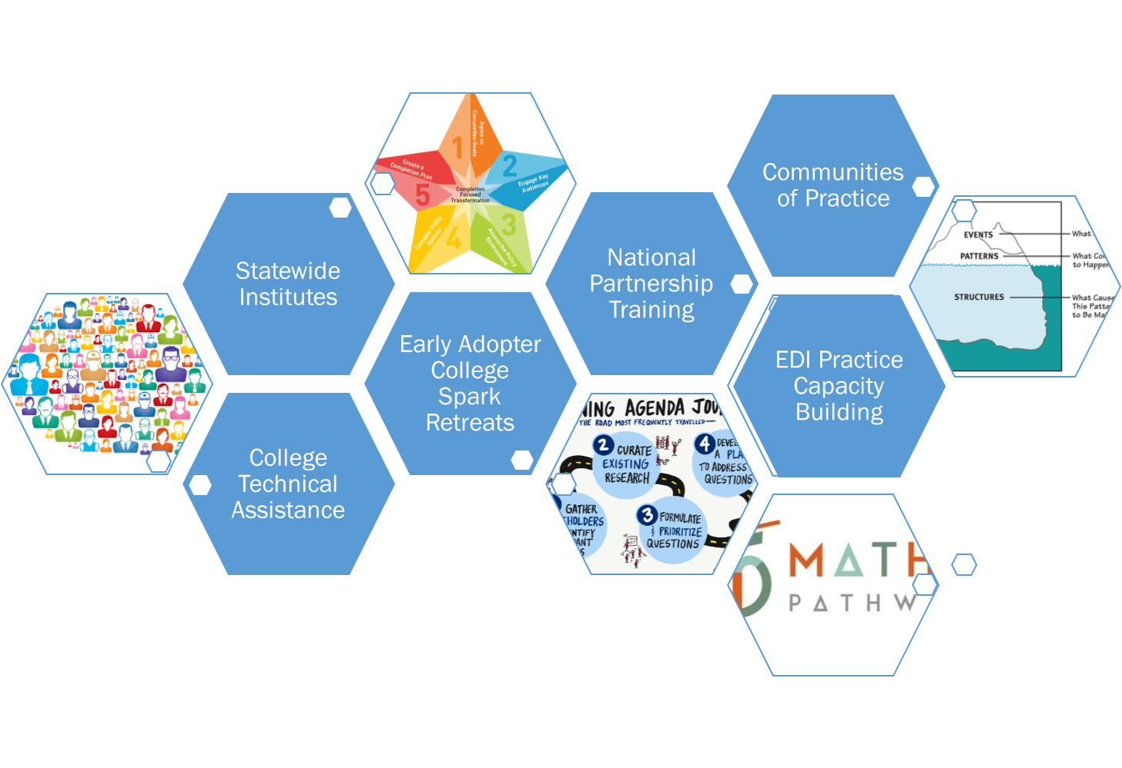
2018-19 institutes & national training opportunities
July 31 Technology Summit – Deadline to sign up: July 13
August 1-2 Summer Cohort Retreat* Deadline to sign up: July 13
Keynote: Michele Siquerios, CEO Campaign for College Opportunity
October 8-11, 2018 Holistic Student Support Institute – State Team sponsorship
October 10, 2018 Fall Student Success Institute- Keynote: Eddie Moore Jr
November, 2018 Regional DataLabs
January 16-18,2019 Winter Cohort Retreat*
Winter, 2019 Advising Institute
Spring, 2019 Spring Student Success Institute
*CSW Funded Colleges

Slide 13
COMMUNITIES OF PRACTICE & Technical assistance
Opportunities
Statewide Capacity Building
National expertise
Momentum building & retention
Vertical integration
Direct Service Staff

Slide 14
What do you wish you had more of?
What are the current struggles in implementation?
What can the State Board do for your college?
KWELLINGTONBAKER@SBCTC.EDU
(O) 360.704.1022
(C) 509.301.8466

