Slide 1
Adaptive Equity-Minded Leadership
Adaptive Equity-Minded Leadership Workshop (2 hours)
Debra Bragg, Gabrielle Gerhard &
Joe Lott
Bragg & Associates Inc.
October 5, 2017

Slide 2
Multiplier Effects Project
Assess synergies and advise on ways to promote transformative change
“Critical Friend” evaluation methods
Our team: Debra Bragg, Joe Lott, Gabrielle Gerhard, Deena Heg, & Bob Watrus
Focused Inquiry
Strategic Feedback
Transformative Change
Reflective Practice

Slide 3
Big Goals
Increase Completion
Close Equity Gaps
Develop Change Leaders

Slide 4
Goals & Reforms
Increase Completion
Student Success Center
Develop Change Leaders
Guided Pathways
Close Equity Gaps
Math Pathways

Slide 5
“Inside Higher Ed”in last 4 days
“A White Supremacist TA?” (Oct. 4)
“Diversity Matters: How 2 Universities Upped Minority Faculty Hiring” (Oct. 3)
“College President Wants to Recruit Conservative Students” (Oct. 2)
“Making Diversity Happen” (Oct. 1)

Slide 6
Adaptive “Equity-Minded” Leadership
Equity as Core Value
Pro-Equity Strategies
Equitable Outcomes

Slide 7
Adaptive Leadership
Connects organizational change to people’s core values, capabilities and dreams
Creates organizational culture that collects and honors diversity of opinion
Understands learning processes associated with large-scale change
Understands large-scale change is incremental
The Practice of Adaptive Leadership (Heifetz, Grashow, & Linsky, 2009)

Slide 8
Equity-Mindedness
“A state of awareness of how structures, policies, cultural norms, practices, and other ways of thinking and knowing that appear to be race-neutral may in fact negatively affect individuals and groups of people.”
(Dowd & Bensimon, 2014)

Slide 9
Color-blindness
Diversity
Equity
Equity- Mindedness

Slide 10
Equity-Minded Leaders Believe…
No talent should go untapped to nurture and support change that is transformative
Transformative change confronts inequities in power and resources embodied in existing structures, policies and practices
Transformative leaders are change-makers who use their knowledge and skills to bring about more fair and socially just outcomes
Catching the Spark (Bragg, McCamgbly, & Durham, 2016)

Slide 11
Critical Reflective Practice
Builds on self-awareness and critical thinking
Four lenses:
Autobiographical
Learners’ eyes
Colleagues as “critical mirrors”
Theoretical literature
Imperative to equity-minded leadership

Slide 12
What CTC Professionals Told Us
Feel and carry the responsibility
Discomfort representing entire groups
Worry about retaliation and labeling
Feeling of being an outsider
Inside vs. outside focus (Guided Pathways)

Slide 13
More Thoughts
Equity needs to be at the heart of change
Equity & closing the equity gap avoidance
More dialogue needed for action
Historic roots - require training

Slide 14
Critical Reflection
Reflect for a moment
Share your thoughts
Consider how will you continue to engage in critical reflection

Slide 15
Critical Reflection What is Equity?
What does equity mean…
To you?
To your college?
To your communities?

Slide 16
Five Dimensions of Equity (EvCC)
Equitable aspiration
Equitable access
Equitable achievement
Equitable economic progress
Equitable engagement

Slide 17
Equity-Based Inquiry
Equity-Based Inquiry
Problem negotiation
Co-design
Implemen-tation
Efficacy
Translation to different contexts
Continuous feedback loop

Slide 18
Equity-Based Inquiry
Problem negotiation
Co-design
Implemen-tation
Efficacy
Translation to different contexts
Continuous feedback loop
Framing the problem at multiple levels
Organizational
Relational
Individual
Getting on the same page
Multivoicedness

Slide 19
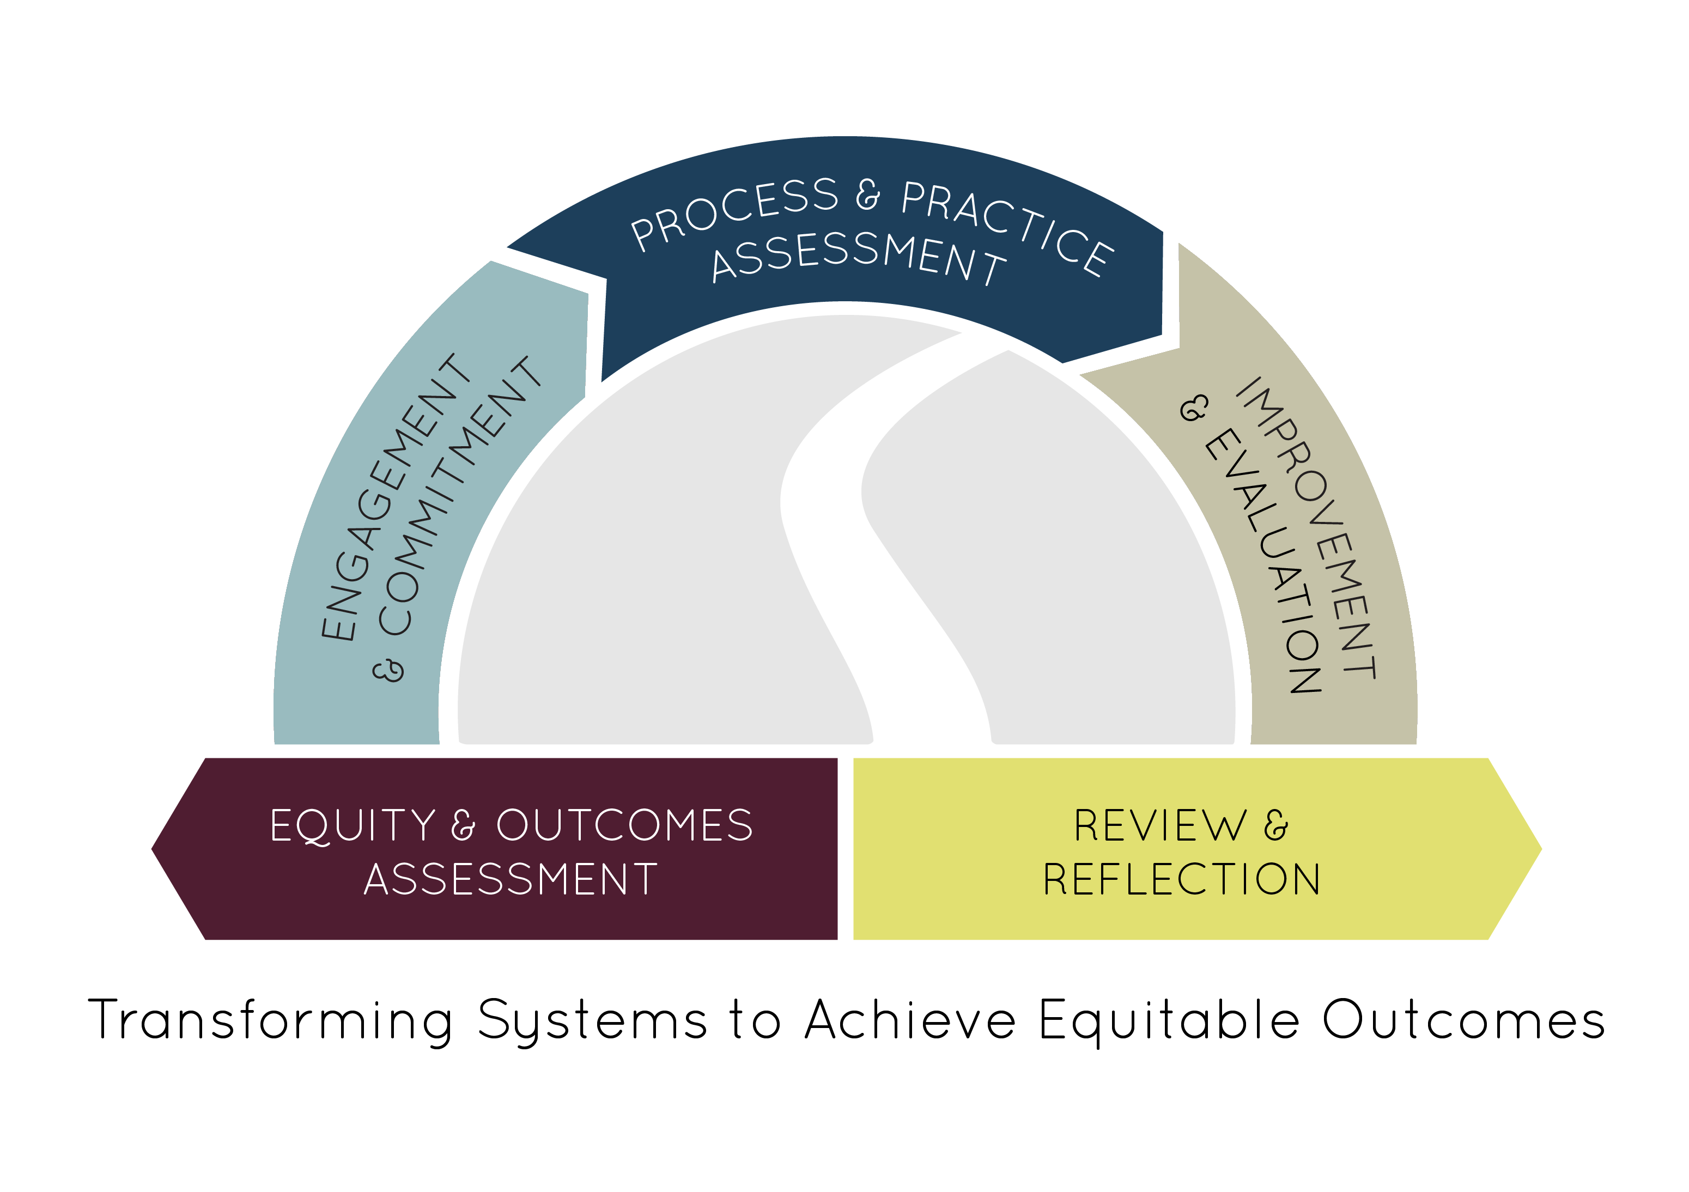
Pathways to Results

Slide 20
What’s Your Next Step?

Slide 21
“Making Higher Education Just”
Reminiscent of the late Marvin Gaye’s song “What’s Going On?”, it is time for us all to answer this one simple question:
What can I do to change what is going on?
Making Higher Education Just (Estela Bensimon, 2017)

Slide 22
Contact Info
Debra Bragg, Lead of the Multiplier Effects Project
President, Bragg & Associates, Inc & Director, Community College Research Initiatives, University of Washington Seattle
Bragg.Associates.Inc@gmail.com
217-377-3100

