Slide 1
A Primer on Inclusive Excellence
Transforming Academic Theory to Institutional Praxis
Dr. Rachel Alicia Griffin, Asst. Professor of Race and Communication, University of Utah
Dr. Frank Tuitt, Senior Advisor to the Chancellor and Provost on Diversity and Inclusion & Professor of Education, University of Denver

Slide 2
The Beliefs We Arrive With…
Our Objectives…
Conversations about diversity are really difficult in different ways for most people.
Examining relations across identity and ideological differences is hard and disheartening work— particularly now.
Most people move through our daily lives with good intentions; good intentions do not guarantee inclusive outcomes.
U.S. American higher education as it is, simply is not the best it can be.
To bravely employ critical self-reflexivity and humility.
To develop a common vocabulary of concepts related to equity, diversity, and inclusion (EDI).
To highlight our individual and societal responsibility to be and become better at talking about and taking action toward EDI.
To bridge Inclusive Excellence and Guided Pathways to inform and fuel data-driven policy and practice.

Slide 3
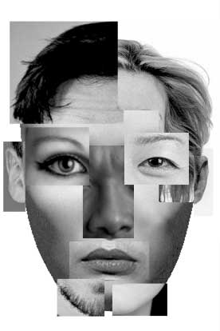
Social Identity Pie Charts
To create a Social Identity Pie Chart:
List 5 aspects of your identity that are most important to you.
Draw each slice in proportion to how important each aspect of your identity is.
Choose one identity as your most important identity.
Think of an example of how that aspect of your
identity influences your work at your institution.

Slide 4
Social Identity Pie Charts Cont’d
Achieved Identity - Salient characteristics we identify ourselves with (Martin & Nakayama, 2013).
Ascribed Identity - Characteristics others perceive as salient and assign to us (Martin & Nakayama, 2013).
Essential Questions for Self-Reflexivity
What identities are the most important to me?
What might those I serve (e.g., students) and/or lead (e.g., colleagues) perceive as important about who I am?
How might the systemically privileged identities I hold prevent me from seeing, understanding, or even imagining the experiences of systemically marginalized students and colleagues?
Notes:
4

Slide 5
Developing a Common Vocabulary:
Key Terms and Definitions
Privilege: a position of systemic superiority; individual and/or group ability to construct societal systems and norms based on their perceptions, interests, needs, and values (Goodman, 2011; Kendall, 2013).
Power: the ability to construct and control social institutions
and people within them; used to dominate, influence,
produce, reproduce, resist, and/or generate change (Allen, 2010).
Marginalization: a position of systemic inferiority; being systemically defined, controlled, and exploited; characterized by a lack of access to power, agency, voice, and resources (Goodman, 2011; Kimmel, 2006).
Social Justice: “seeks to establish a more equitable distribution of power and resources so that all people can live with dignity, self-determination, and physical and psychological safety…[Social Justice] creates opportunities for people to reach their full potential within a mutually responsible, interdependent society” (Goodman, 2011).

Slide 6
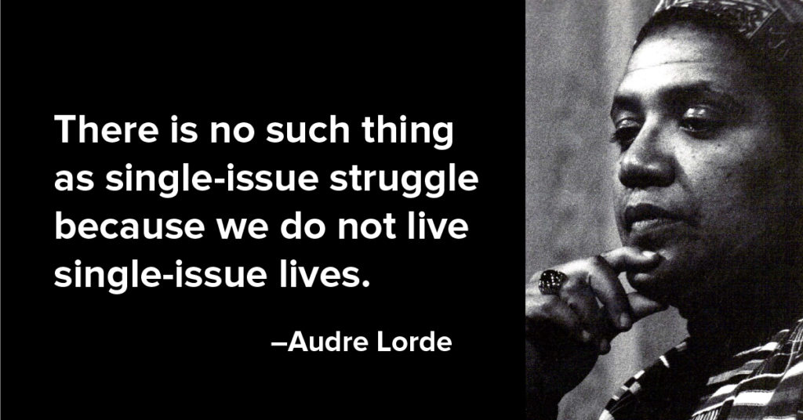
Developing a Common Vocabulary:
Key Terms and Definitions Cont’d
Intersectionality: Identity markers function intersectionally at the micro and macro crossroads of marginalization and/or privilege (Crenshaw, 1995; Lorde, 1983).
“the academy must recognize diversity and inclusion as essential to educational excellence. All that students are—their gender, racial and ethnic background, socioeconomic and class status, sexual orientation, religion, physical and mental abilities—influences teachers’ expectations of their students’ capabilities and students’ beliefs about their own potential” (Clayton-Pedersen, 2009)

Slide 7
Developing a Common Vocabulary:
Key Terms and Definitions Cont’d
Equity: The creation of opportunities for ALL students to have equal access to and participate in tertiary educational programs that are capable of closing the achievement gaps in student success and completion.
Access: is understood as the compositional number and success levels of ALL students. It is important to note that access and equity account for more than a numerical change in the demographics of students, but also involves the representation and equitable achievement of ALL students.
Equity-mindedness: A demonstrated awareness of and willingness to address equity issues among institutional leaders, instructors, and staff (Center for Urban Education, University of Southern California).
Inclusive Excellence: is a multi-layered process through which we achieve excellence in learning; research and teaching; student development; institutional functioning; local and global community engagement; workforce development; and more (AAC&U, 2013).
Notes:
Diversity, Inclusion, and Equity: Core Principles
AAC&U endeavors to develop “equity-minded practitioners,” who are willing to engage in the necessary, and sometimes difficult, conversations and decision-making that can lead to transformational change for student learning and achievement.

Slide 8
Making Excellence Inclusive?
“Inclusive Excellence (IE) is the recognition that a Higher Education Institution’s success and vitality is dependent on how well it values, engages and includes the rich diversity of students, staff, faculty, administrators, and alumni constituents. More than a short-term project or single office initiative, this comprehensive approach requires a fundamental transformation of the institution by embedding and practicing IE in every effort, aspect, and level of a university (unit, department, & class). The goal is to make IE a habit that is implemented and practiced consistently throughout an institution.”
Center for Multicultural Excellence & Strategic Plan for Inclusive Excellence, University of Denver
Notes:
8

Slide 9
Why Promote Inclusive Excellence?
Demographic shifts in our campus populations require engagement with cross-cultural understanding.
Internationalization and the complexity of world issues requires “knowledge, skills, and attitudes that transcend conventional intellectual paradigms that accentuate one lens over another” (ACE, 2007).
Shifting social policies and laws.
Persistent social and educational inequities.
Increased access to higher education has not
produced equitable results.
Equity is a good barometer for inclusion and quality.
http://www.philosophy.rutgers.edu/images/diversity02_transparent.gif

Slide 10
Access and Equity in the State of Washington
Increase access for lower SES students, LGBTIQ students, undocumented students, and students of color.
Community and technical colleges (CTCs) are the gateway to postsecondary education.
K-12 schools are not as successful in helping Black, Latinx, & Native American (BLNA) students graduate from high schools;
BLNAs are tracked into and subsequently overrepresented in the CTC system;
CTCs graduate and successfully transfer BLNAs at lower levels.
Transfer rates are significantly higher for Whites and Asians who transfer to 4yr institutions within one year after completing a degree program in the CTC system.
Notes:
According to the 2014 Community and Technical College Student Access and Success by Race/Ethnicity and Socioeconomic Status
2014 Progress Report: Populations of color have increased in Washington State from 18 percent to 28 percent in the ten year period 2000 to 2010. Projections for 2012 to 2022 show that diversity will continue to grow in our population. Hispanics will increase 19 percent, Black/African Americans 7 percent, Asians 14 percent, American Indian/Alaskan Natives 1 percent, Native Hawaiian/Pacific Islander 25 percent, and persons reporting multiple races in combination 130 percent. During this period the non-Hispanic white population will decrease 1 percent.
For example, high school or less attainment for adults 29-39 years ranges from over half (53 percent) for Hispanics to one third (33 percent) for Black or African Americans. Native Hawaiian/Pacific Islanders and American Indian/Alaskan Natives have 48 percent and 42 percent respectively of this age cohort with at most a high school education. These compare to 27 percent for whites and 16 percent for Asians.

Slide 11
Inclusive Excellence Dimensions
To help institutions guide and assess their efforts, the AAC&U proposed the Inclusive Excellence Scorecard consisting of four dimensions:
Access & Equity is understood as the compositional number and success levels of ALL students.
Institutional Climate involves the attitudes, behaviors, standards, and practices of the organization and its members that impact the access for, inclusion of, and level of respect for underrepresented individuals’ needs, abilities, and potential (Rankin & Reason, 2008).
Curriculum & Pedagogy (Programs & Services) includes considering not only the incorporation and integration of diversity in educational activities’ curriculum, programs, services, activities, and overall experiences but also how they are delivered.
Learning and Development considers whether or not the organization is preparing all of its members to be successful in an increasingly diverse, and global context. (Williams et al., 2005)

Slide 12
Inciting Transformative Conversation…
If your unit/institution/commission/board achieves Inclusive Excellence, what would it look like, sound like, and feel like?

Slide 13
Barriers to Inclusive Excellence & Institutional Transformation
Failure to conceptualize IE work in terms of changing the organization and enhancing institutional culture;
Resistance to the logic that access and equity are fundamental to excellence;
Low levels of meaningful & consistent support from senior leadership/management
Failure to allocate sufficient resources to the process of change;
Lack of accountability systems & the means to engage individuals in the change process at all levels;
Lack of leadership and infrastructure to guide and facilitate the change journey and direct campus Inclusive Excellence efforts at all levels of the institution; and
Lack of comprehensive & widely accepted frameworks to define & track IE progress.
(Williams, Berger, & McClendon, 2005)

Slide 14
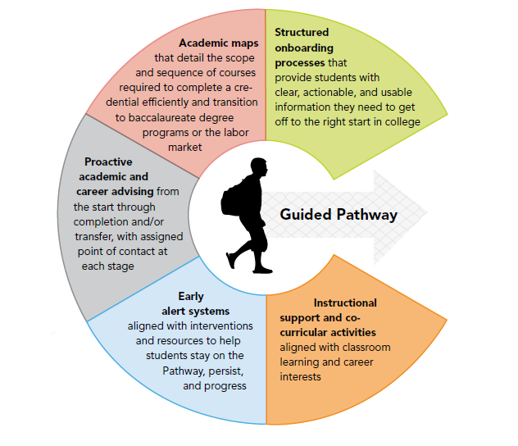
Guided Pathways: Designing for Success
Notes:
A Guided Pathway is a descriptive and easy-to-use plan that guides a student INTO and THROUGH college to the successful COMPLETION of a credential and the transition to a baccalaureate program or the labor market. A Guided Pathway integrates academic and student services together in a coherent and intentional system of curricular and co-curricular experiences that match a student’s interests and goals, and better prepare him or her for success in a rapidly changing global environment. We realize that every institution is working on Guided Pathways at their own respective space’ wherever that is with regard to implementation is okay – important connections to Inclusive Excellence will emerge from various stages of implementation.

Slide 15
?
Particular to your respective institution, what are some specific opportunities for embedding Inclusive Excellence into Guided Pathways efforts via Student Services? Via Instruction?
Synergies Between Inclusive Excellence and Guided Pathways?

Slide 16
Making Excellence Inclusive: Best Practices
Understand aspects of the institutional context (internal & external) that affect the advancement of access, equity, and inclusion;
Identify specific desired outcomes related to advancing access, equity, and inclusion;
Seek out and engage a diverse range of change agents, campus partners, and key stakeholders throughout the institution to be involved in the change process;
Interrogate institutional policies, practices, and processes (PPPs) that have the potential to create more equitable conditions and outcomes for ALL stakeholders – especially those PPPs that can be assessed for access and equity.
Build or strengthen institutional capacity for change: Develop infrastructure and support systems that can facilitate the change process and direct efforts to advance access, equity, and inclusion at all levels of the institution;
Make informed data–driven decisions and assess actions and impact in multiple ways – within and across levels – and adjust accordingly;
Remember that moving beyond access to equity and inclusion is a change process not a program or a plan and definitely not the responsibility of a person or an office.
(Williams, Berger, & McClendon, 2005)

Slide 17
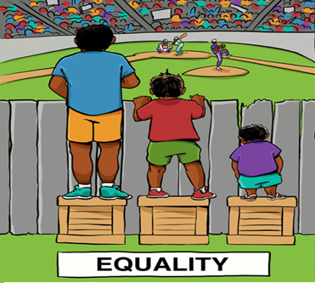
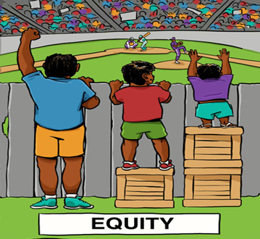
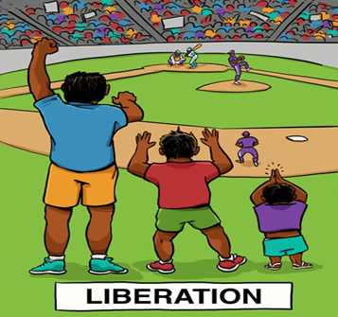
Envisioning Making Excellence More Inclusive

Slide 18
What can the commissions, and each respective institution, do Today, Tomorrow, and Beyond?
Develop and teach a common vocabulary around issues of diversity and IE.
Examine values and norms and determine if they align with the tenets of IE.
Identify the relevant IE vital signs, highlighting areas of success, areas of improvement, and directions for next steps.
Interrogate organizational policies, practices, & procedures for presence/absence of indicators of access and equity.
Critically examine campus culture through the lens of IE. Consider the ways in which you can embed IE in strategic plans, institutional initiatives (e.g., Guided Pathways), etc.
Engage in interdisciplinary dialogue with students, units, staff, faculty, administration, commissions, boards, etc., and other community stakeholders regarding the benefits and challenges for achieving IE.
Become the epicenter for promoting Inclusive Excellence by studying efforts to advance access and equity as a scientific problem to be solved. Study it, assess it, and redesign it.

Slide 19
Bearing Witness…
Equity, Diversity, and Inclusive Excellence labor admittedly often looks and feels like this:
And yet after decades
of labor, we are
absolutely optimistic…

Slide 20
Inclusive Excellence & the Search for Paradise
The academy is not paradise. But learning is a place where paradise can be created. [Washington state’s community college and technical college system], with all its limitations, remains a location of possibility. In that field of possibility we have the opportunity to labor for freedom, to demand of ourselves and our comrades, an openness of mind and heart that allows us to face reality even as we collectively imagine ways to move beyond boundaries, to transgress. This is education as the practice of freedom.
bell hooks, 1994

Slide 21
Questions & Final Thoughts
Dr. Frank Tuitt
Frank.tuitt@du.edu
Dr. Rachel Alicia Griffin
Rachel.a.griffin@Utah.edu

Slide 22
References & Resources
AAC&U (2013). Board statement on diversity, equity, and Inclusive Excellence. Retrieved from: http://www.aacu.org/about/statements/2013/inclusiveexcellence.cfm
ACE (2007). At home in the world: Bridging the gap between internationalization and multicultural education. Washington, CD: American Council on Education.
Allen, B. J. (2010). Difference matters: Communicating social identity (2nd ed.). Long Grove, IL: Waveland Press Inc.
Asumah, S. N., & Nagel, M. (Eds.). (2014). Diversity, social justice, and Inclusive Excellence: Transdisciplinary and global perspectives. Albany, NY: State University of New York Press.
Bauman, G. L., Bustillos, L. T., Bensimon, E. M., Brown, C., & Bartee, R. D. (2005). Achieving equitable educational outcomes with all students: The institution’s roles and responsibilities. Association of American Colleges and Universities.
Bensimon, E. M. (2004). The diversity scorecard: A learning approach to institutional change.” Change, 36(1), 45–52.
Bensimon, E. M., Hao, L., and Bustillos, L. (2006). Measuring the state of equity in higher education. In P. Gándara, G. Orfield, & C. L. Horn (Eds.), Expanding Opportunity in Higher Education: Leveraging Promise. Albany, NY: State University of New York Press.
Center for Urban Education. (n.d.). Developing a practice of equity minded indicators. University of Southern California. Retrieved from https://cue.usc.edu/files/2016/02/Developing-a-Practice-of-Equity-Mindedness.pdf
Clayton-Pedersen, A. (2009). Rethinking educational practices to make excellence inclusive. Diversity & Democracy: Civic Learning for Shared Futures. Association of American Colleges and Universities.
Crenshaw, K. W. (1995). Mapping the margins: Intersectionality, identity politics, and violence against women of color. In D. Danielson & K. Engle (Eds.), After identity: A reader in law and culture (pp. 332-354). New York, NY: Routledge.

Slide 23
References & Resources Cont’d
Ferreyra, María Marta, Ciro Avitabile, Javier Botero Álvarez, Francisco Haimovich Paz, and Sergio Urzúa. 2017. At a Crossroads: Higher Education in Latin America and the Caribbean. Directions in Development. Washington, DC: World Bank. doi:10.1596/978-1-4648-0971-2. License: Creative Commons Attribution CC BY 3.0 IGO
Goodman, D. J. (2011). Promoting diversity and social justice: Educating people from privileged groups (2nd ed.). Thousand Oaks, CA: Sage Publications.
Kendall, F. (2013). Understanding White privilege: Creating pathways to authentic relationships across race (2nd ed.). New York, NY: Routledge.
Kimmel, M. (2006). Toward a pedagogy of the oppressor. In A. D. Mutua (Ed.), Progressive Black masculinities (pp. 63-72). New York, NY: Routledge.
hooks, b. (1994). Teaching to transgress. New York, NY: Routledge.
Lorde, A. (1983). There is no hierarchy of oppressions. Interracial Books for Children Bulletin, 14(3-4), 9.
Martin, J. M., & Nakayama, T. K. (2013). Intercultural communication in contexts. (6th ed.). New York, NY: McGraw-Hill Companies, Inc.
Milem, J., Chang, M., & Antonio, A. (2005). Making diversity work: A researched based perspective. Washington, DC: AAC&U. Retrieved from https://www.aacu.org/sites/default/files/files/mei/milem_et_al.pdf
Rankin, S., & Reason, R. (2008). Transformational tapestry model: A comprehensive approach to transforming campus climate. Journal of Diversity in Higher Education, 1(4), 262-274.
Williams, D. A., Berger, J. B., & McClendon, S. A. (2005). Toward a model of inclusive excellence and change in postsecondary institutions. Washington, D.C.: AACU.
Williams, D. A. (2007). Achieving inclusive excellence: Strategies for creating real and sustainable change in quality and diversity. About Campus, 8-14.

