Slide 1
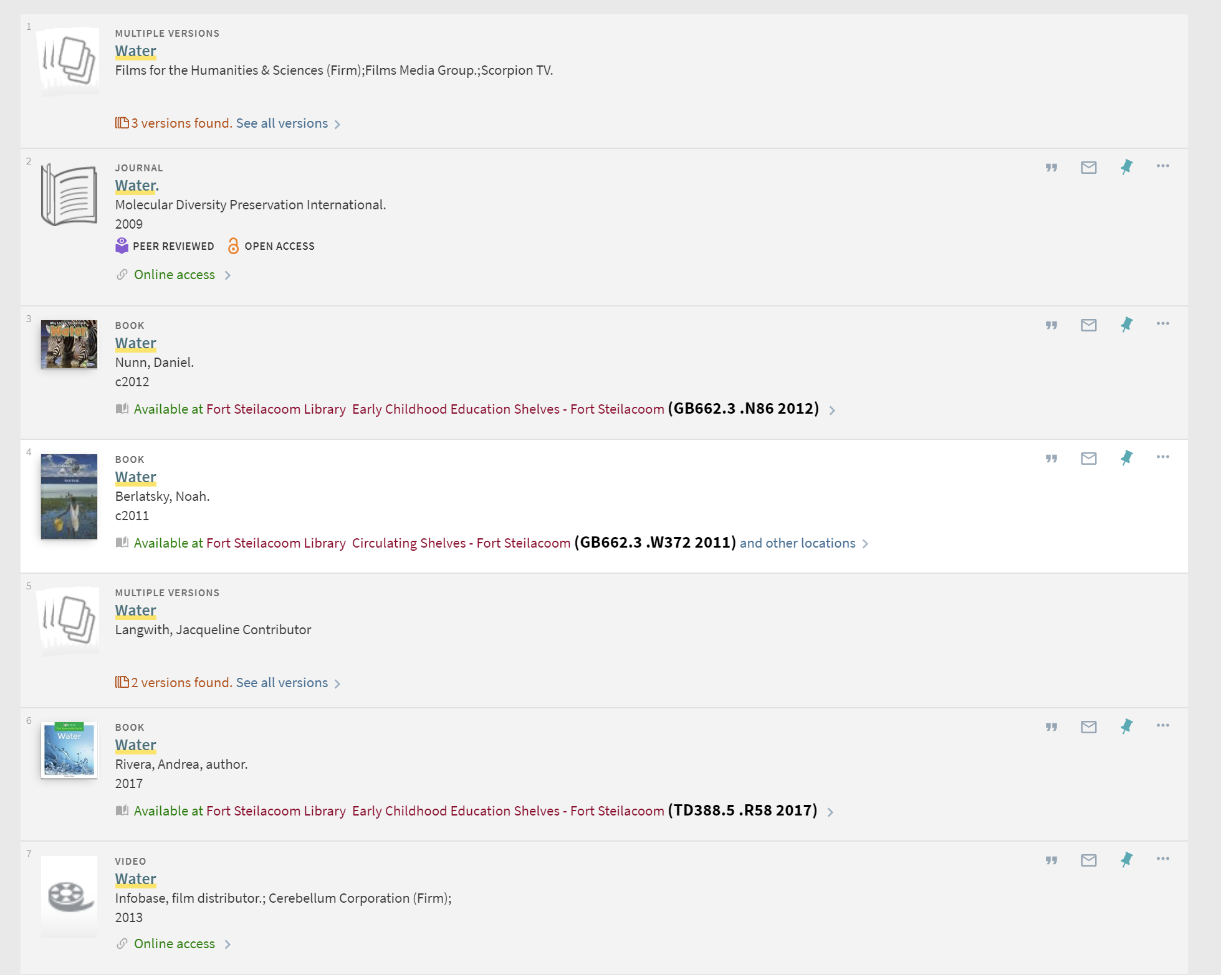
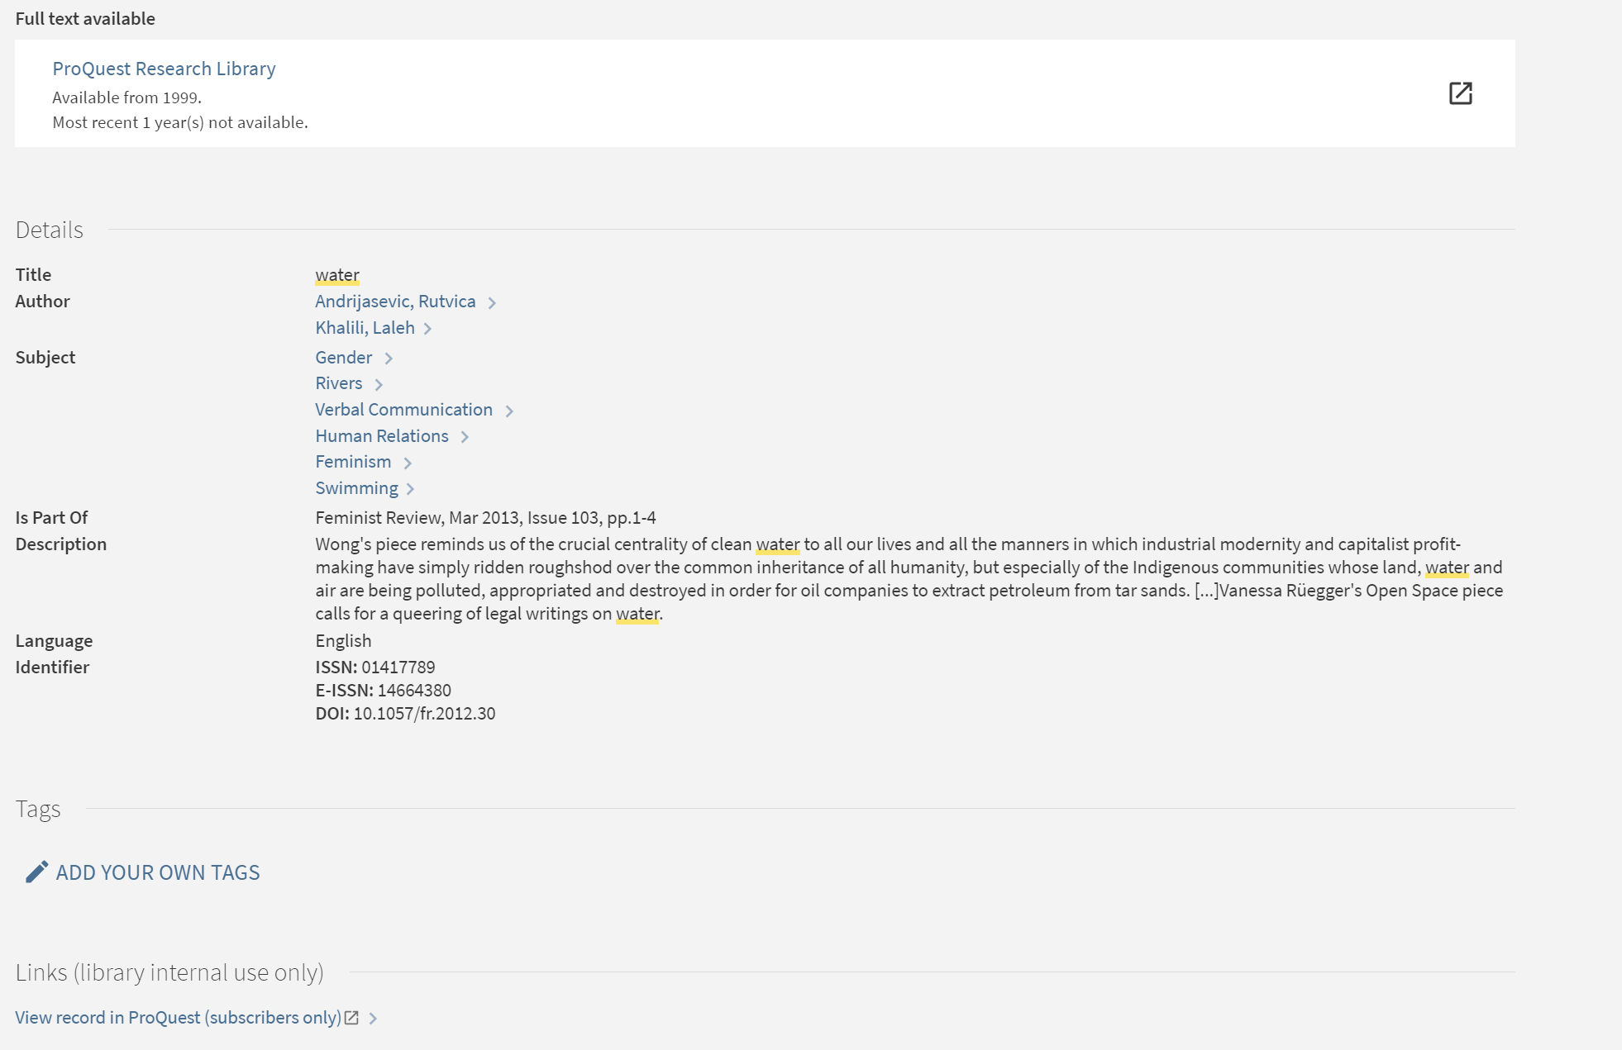
Primo search results
Weekly index of CZ activations
PCI (soon to be CDI)
Full text article citation
Articles appear in Primo search results if they are available to the institution, as per the weekly CZ pubishing cycle
http://vendor-permalink/....
Full text article citation
Links generated by Alma Link Resolver (uresolver), based on citation metadata
Full text article citation
Full text article citation
Links generated when PCI article citation includes a URL of some kind
http://vendor-permalink/....

