Slide 1
LLC Fall 2024
WACTCLC
Services Manager Updates and Exec report

Slide 2
October is Cybersecurity Month
Federated access: enhanced security, streamlined access
Systems moving from authorization to authentication
The clock is ticking on IP authentication; IPs were never intended for this use
Gen Z often trade personal information for compensation
Use of illegal sites like Scihub continues to grow, 400+ universities have had networks/data compromised by Scihub
CHOICE-ACRL Webinar Cybersecurity in Academic Libraries – an SNSI Security Summit

Slide 3
OpenAthens
Opportunity to engage IT leaders at CTCs
Need a strategic plan for funding and timeline for transition
Asking for a work group/task force/special ops team
I’m interested!

Slide 4
HeinOnline trial
January-June free trial of Academic Package for all CTCs
Info session on Nov. 5, 10 a.m.
Register here
Participation application
Sign me up!

Slide 5
LibKey Project
LibKey links implemented fully in 24 Primo environments
LibKey page on WACTCLC
BrowZine page coming soon to WACTCLC site
support@thirdiron.com
bridgette@thirdiron.com

Slide 6
LibKey still available to implement!
Tacoma - integration exists for Summon
Clark - very easy!
Koha - we’ve found a partial integration!
Bates
Walla Walla
Columbia Basin
Clover Park

Slide 7
Current Contact lists
I would like to expand and make more inclusive my WACTCLC communications
Existing ctc listservs for Alma and Primo do not reach everyone
Please update your staff contacts here

Slide 8
WACTCLC Bylaws
WACTCLC Exec has been working on a revision to the bylaws
Not revised since written in 2016
Main focus was to reflect current practice, add clarity, and give room for future growth
Comparison of original and proposed
Full text of proposed bylaws for commenting or questions
Seeking feedback and questions ahead of a full presentation at the February meeting

Slide 9
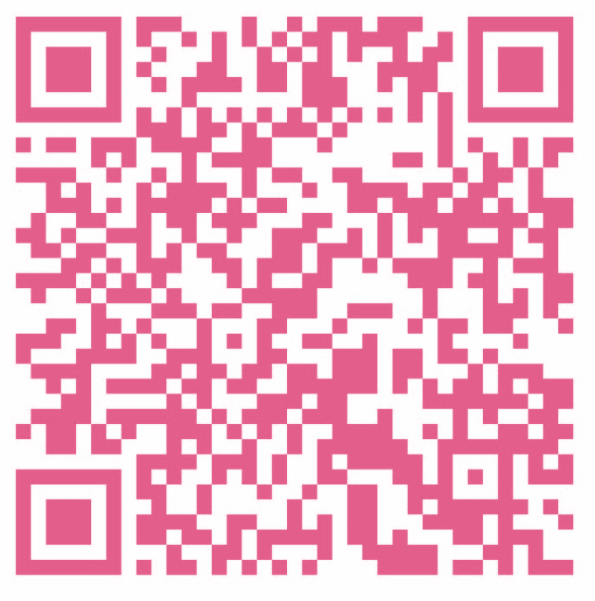
WACTCLC Executive Committee Election
Slate was proposed and shared by Christie Flynn in September via closed listserv
Need membership vote to approve the slate
Vote here or here
Deadline Nov. 1

Slide 10
WA DES RFID solicitation
State Department of Enterprise Services launched competitive solicitation process to award Cooperative Purchasing Agreements for RFID vendors
Second category - Library Collection Inventory Management Solution –
Services, products, equipment/hardware, and software to implement solutions for a library collection to include passive tags that enable circulation, security, collection management, interactive components, or combinations to deliver a complete RFID solution
Bids are in, evaluation about to start, awards announced Jan. 10

