Slide 1
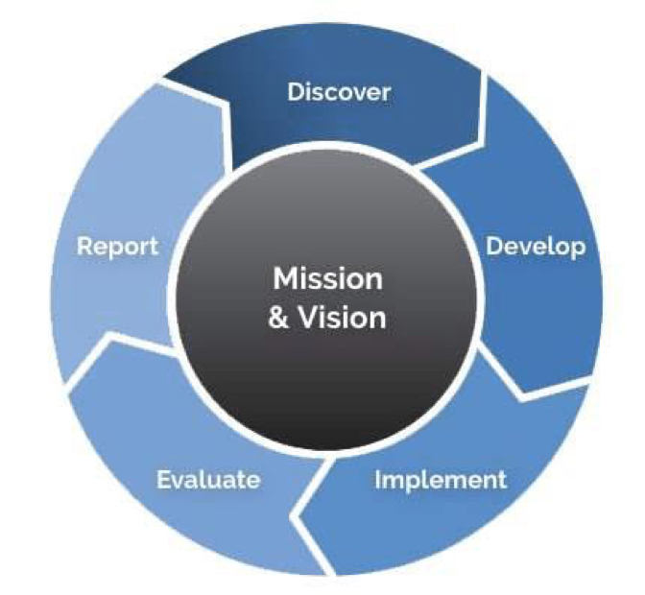
2021 GUIDED PATHWAYS WORK PLAN webinar
GUIDED PATHWAYS VISION
A system that advances
racial, social, and economic justice by achieving equitable student
aspiration, access, economic progress, and educational and career attainment.
Guided Pathways Work Plan Webinar
March 24 & 25, 2021
Kristi Wellington Baker, WA State Student Success Center

Slide 2
2021 GUIDED PATHWAYS WORK PLAN webinar
Welcome & Introductions
Land & Labor acknowledgement
Mission
Work Plan Purpose
Work Plan 3.0
Q & A

Slide 3
LAND ACKNOWLEDGEMENT
As a step toward honoring the truth and achieving healing and reconciliation, we are opening today by acknowledging the traditional Native lands on which we individually and collectively work. While we are distributed across many first people’s nations, we remain dedicated to opening our time together by honoring those that came before us.
We know that such statements only become truly meaningful when coupled with authentic relationships and sustained commitment, and as such, we commit to continued efforts to build our collective understanding and action to foster authentic native community connections.

Slide 4
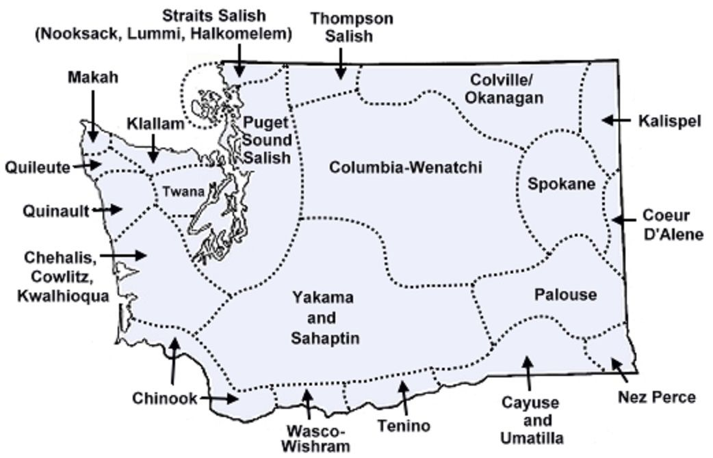
LAND ACKNOWLEDGEMENT

Slide 5
LABOR ACKNOWLEDGEMENT
We acknowledge that our nation (and our institutions) have benefited from the free enslaved labor of Black people. We recognize the interconnected histories of Indigenous peoples who were forcibly removed from their land and the history of those who were forcibly brought to it. We acknowledge the enduring impacts of the African diaspora, honor the contributions, talents, and dreams of our Black communities.
We acknowledge the immigrant labor that has contributed to the this country as a critical labor force, including voluntary, involuntary, trafficked, forced, and undocumented peoples. We recognize and honor their important contributions.
In these acknowledgements, we commit to the essential work of moving beyond awareness to action through meaningful changes at our institutions and in our communities.

Slide 6
GUIDED PATHWAYS MISSION
Create an equitable system that
prepares all learners
To engage in a diverse society and workforce,
Achieve economic mobility
through educational attainment and
contribute to a socially just society.

Slide 7
GUIDED PATHWAYS WORK PLAN PURPOSE
The Guided Pathways Implementation work plan is
designed to support colleges’ development of
a tightly connected set of
evidence-based,
actionable priorities designed to
improve student outcomes
and eliminate equity gaps.

Slide 8
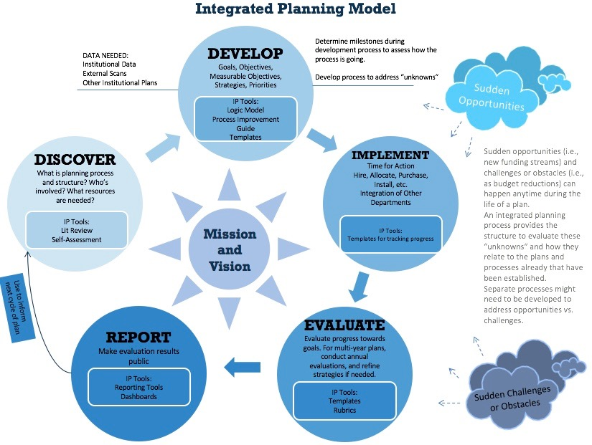
GUIDED PATHWAYS WORK PLAN DESIGN
Integrated Planning is the linking of
vision, priorities, people and the physical institution in a flexible system of evaluation, decision-making, and action.
Image from Continuous Learner

Slide 9
GUIDED PATHWAYS WORK PLAN structure
College
Assess how far along you are in implementing Guided Pathways practices
Plan for scaled implementation and iteration in areas where additional work is needed
Monitor your progress in implementation and impact on equitable student outcomes
System Strategic Support
Inform the learning agenda for future statewide professional development events, coaching, and additional technical assistance
Support resource development to support college’s commitment to and progress in implementing Guided Pathways with fidelity.

Slide 10
2021 Work plan – overview
SECTION 1: Implementing Large Scale Change
SECTION 2: Pathway Design
SECTION 3: Student Experience

Slide 11
Section 1: 𝐈𝐦𝐩𝐥𝐞𝐦𝐞𝐧𝐭𝐢𝐧𝐠 𝐋𝐚𝐫𝐠𝐞 𝐒𝐜𝐚𝐥𝐞 𝐂𝐡𝐚𝐧𝐠𝐞
COLLEGE INFRASTRUCTURE
Clear Purpose
Effective College Committee Structure
Student Centered culture
Committed Leadership
College-wide Engagement

Slide 12
Section 2: 𝐏𝐚𝐭𝐡𝐰𝐚𝐲 𝐃𝐞𝐬𝐢𝐠𝐧*
PRACTICE AREAS
Pathways (Meta Majors), Programs of Study, and Program Maps
Outcomes Alignment
Structured Exploratory Experiences
Predictive Courses
Math Pathways
Scheduling

Slide 13
Section 3: Student experience*
PRACTICE AREAS
Intake
Placement
Equity Competent Educational Planning
Degree Math and English within One Year
Progress Monitoring
Engaging Students in support of completion
Classroom Environment and Course Design

Slide 14
Section 1: 𝐈𝐦𝐩𝐥𝐞𝐦𝐞𝐧𝐭𝐢𝐧𝐠 𝐋𝐚𝐫𝐠𝐞 𝐒𝐜𝐚𝐥𝐞 𝐂𝐡𝐚𝐧𝐠𝐞
𝐏𝐮𝐫𝐩𝐨𝐬𝐞
Share a 2-3 sentence explanation of your college purpose in implementing Guided Pathways.
How will you ensure that College and Guided Pathways vision and goals are aligned and clearly communicated throughout your college?

Slide 15
Questions?
Section 1: 𝐈𝐦𝐩𝐥𝐞𝐦𝐞𝐧𝐭𝐢𝐧𝐠 𝐋𝐚𝐫𝐠𝐞 𝐒𝐜𝐚𝐥𝐞 𝐂𝐡𝐚𝐧𝐠𝐞
POLL – CHECK IN

Slide 16
Section 2: 𝐏𝐚𝐭𝐡𝐰𝐚𝐲 𝐃𝐞𝐬𝐢𝐠𝐧
PART 1 – RESPOND TO ALL (FOUNDATIONAL) QUESTIONS
PART 2 – IDENTIFY 2 PRIORITY PRACTICE AREAS. UPON SELECTION, RESPOND TO ADDITIONAL QUESTIONS WITH DETAILS SPECIFIC TO PLANNED ACTIVITIES.

Slide 17
Section 2: 𝐏𝐚𝐭𝐡𝐰𝐚𝐲 𝐃𝐞𝐬𝐢𝐠𝐧
PRACTICE AREAS
Pathways (Meta Majors), Programs of Study, and Program Maps
Outcomes Alignment
Structured Exploratory Experiences
Predictive Courses
Math Pathways
Scheduling

Slide 18
Section 2: 𝐏𝐚𝐭𝐡𝐰𝐚𝐲 𝐃𝐞𝐬𝐢𝐠𝐧
Outcomes Alignment
To what degree have course outcomes been aligned to programs of study? How do you know?
What disaggregated student outcomes data (quantitative and/or qualitative) will you use to measure your progress on this practice?

Slide 19
Section 2: 𝐏𝐚𝐭𝐡𝐰𝐚𝐲 𝐃𝐞𝐬𝐢𝐠𝐧
Scheduling
Does your college publish a two year course schedule?
How many quarters beyond their first term is a student able to schedule (not register) their academic plan?
What disaggregated student outcomes data (quantitative and/or qualitative) will you use to measure your progress on this practice?

Slide 20
Questions?
Section 2: 𝐏𝐚𝐭𝐡𝐰𝐚𝐲 𝐃𝐞𝐬𝐢𝐠𝐧
POLL – CHECK IN

Slide 21
Section 3: Student experience
PART 1 – RESPOND TO ALL (FOUNDATIONAL) QUESTIONS
PART 2 – IDENTIFY 2 PRIORITY PRACTICE AREAS. UPON SELECTION, RESPOND TO ADDITIONAL QUESTIONS WITH DETAILS SPECIFIC TO PLANNED ACTIVITIES.

Slide 22
Section 3: Student experience
PRACTICE AREAS
Intake
Placement
Equity Competent Educational Planning
Degree Math and English within One Year
Progress Monitoring
Engaging Students in support of completion
Classroom Environment and Course Design

Slide 23
Section 3: Student experience
Placement
How are details about the process and implications of the placement process communicated to students?
How does your college support student access to all mechanisms of placement for every student? If your college does not, how can the college address the systemic barriers to access?
How does your college collect student feedback about their experience in the placement process? How is that information shared and used to inform practice?
Disaggregated by race and gender, what percentage of new degree seeking students are being placed directly into the first college level, program appropriate math course or higher? (Do not use enrollment data as proxy for placement data. If you do not currently collect this data, how will you construct a practice this year to address that gap in data collection and analysis?)

Slide 24
Section 3: Student experience
Placement
Disaggregated by race and gender, what percentage of new degree seeking students are being placed directly into the first college level, program appropriate English course or higher? (Do not use enrollment data as proxy for placement data. If you do not currently collect this data, how will you construct a practice this year to address that gap in data collection and analysis?)
What data is being used to assess the equity of your college placement process?
What data is being used to assess the efficacy of your college placement results?

Slide 25
Questions?
Section 3: Student Experience
POLL – CHECK IN

Slide 26
college work plan submission link 𝐏𝐥𝐞𝐚𝐬𝐞 𝐝𝐨 𝐧𝐨𝐭 𝐞𝐱𝐢𝐭 𝐰𝐢𝐭𝐡𝐨𝐮𝐭 𝐬𝐮𝐛𝐦𝐢𝐭𝐭𝐢𝐧𝐠. 𝐘𝐨𝐮𝐫 𝐰𝐨𝐫𝐤 𝐰𝐢𝐥𝐥 𝐧𝐨𝐭 𝐛𝐞 𝐬𝐚𝐯𝐞𝐝 𝐮𝐧𝐭𝐢𝐥 𝐲𝐨𝐮 𝐡𝐢𝐭 𝐬𝐮𝐛𝐦𝐢𝐭. 𝐘𝐨𝐮 𝐰𝐢𝐥𝐥 𝐛𝐞 𝐚𝐛𝐥𝐞 𝐭𝐨 𝐫𝐞𝐭𝐮𝐫𝐧 𝐭𝐨 𝐲𝐨𝐮𝐫 𝐟𝐨𝐫𝐦 𝐚𝐟𝐭𝐞𝐫 𝐬𝐮𝐛𝐦𝐢𝐭𝐭𝐢𝐧𝐠 𝐭𝐨 𝐜𝐨𝐧𝐭𝐢𝐧𝐮𝐞 𝐰𝐨𝐫𝐤𝐢𝐧𝐠 𝐨𝐫 𝐭𝐨 𝐦𝐚𝐤𝐞 𝐞𝐝𝐢𝐭𝐬
Work Plan Technical Notes

Slide 27
NEW - Office hours – Beginning March 29, 2021, Every Monday from 3:00 – 5:00 Open office hours https://us02web.zoom.us/j/84557277304 Coaches – Your Guided Pathways coaches are an excellent resource as you draft your plan!
Data – SBCTC dashboards are excellent resources to supplement your college research & planning offices and local data to identify priorities and measure progress.
Work Plan Supports

Slide 28
Work Plan Review Process
Work plan Review Teams
Team composition - College representatives, SBCTC staff, Coaches, Evaluators
Multiple readers for every plan
Timeline
DUE May 17, 2021
REVIEW May 18-26, 2020
FEEDBACK & APPROVAL June 1, 2020

Slide 29
Questions?
Kristi wellington-baker kwellingtonbaker@sbctc.edu 509.301.8466 (c)

