Slide 1
WA Higher Education Reopening Plan Fall 2020 Information Session
Jan Yoshiwara, Executive Director
Carli Schiffner, PhD, Deputy Executive Director
June 26, 2020

Slide 2
Governor’s Proclamation + Higher Education Fall 2020 Guidance
*Effective August 1 for all higher education institutions.
*Replaces Safety Protocols for Phases 1 and 2, with no further alignment to county phases.
*Colleges need to have a “Safe Back to School” plan available.
*Caveat—Colleges in Phase 1 and Phase 1.5 counties are required to have the local health department approve their reopening plan.
*Student services and classroom instruction are allowable with 6 foot distancing and PPE.
*Requirements are in addition to, not a substitute for, general public health requirements that are already in place.

Slide 3
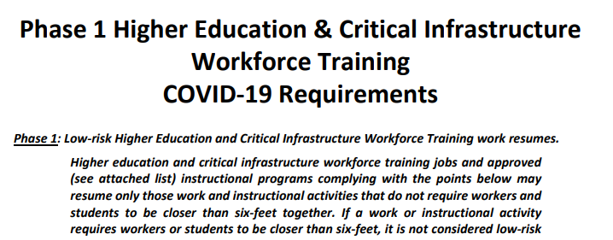
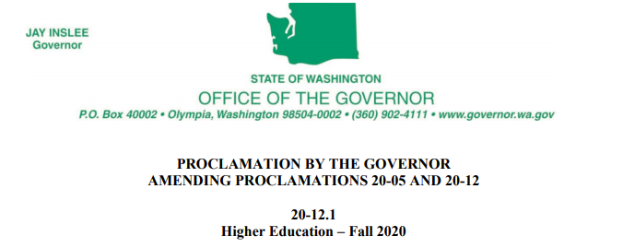
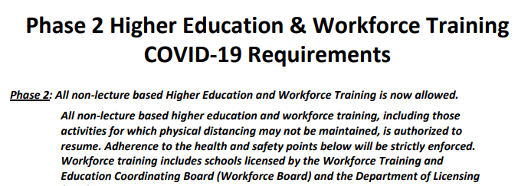
Which Guidance Should You Use?
Yes, until August 1, 2020
Colleges in phase 1 and phase 1.5 counties: use Phase 1 requirements
Colleges in phase 2 counties and above: use phase 2 requirements
Yes, starting August 1, 2020
Proclamation contains mandates
Guidance contains recommendations
Together they form the Higher Education Reopening Plan

Slide 4
Governor’s Proclamation Outlines Baseline Requirements
Campus Safety
Social Distancing, PPE, Safe Back to School Plans…
Student and Personnel Support
Plans for helping students and staff remain safe…
Visitor Expectations
Limit or prohibit when possible, clear communication on campus…
Food Service
Minimize capacity at dining facilities, PPE, transactions…

Slide 5
Higher Ed Reopening Guidance Fall 2020
Baseline Requirements
(as outlined in the Governor’s Proclamation)
+
Guidance for campus safety and support, food service, residence halls, and campus transportation.
Checklists are provided for each section noted above in the guidance document.

Slide 6
Frequently Asked Questions so far…
When does the reopening plan take effect?
Which colleges and universities does it apply to?
How does the plan align with county phases?
What are some of the big differences between the Phase 1 and Phase 2 safety protocols and this plan?
What will college look like beginning in the fall?
What are colleges required to do under the Higher Education Reopening Plan?

Slide 7
Frequently Asked Questions so far…
What are rules for resuming sports?
Are colleges still required to have a COVID-19 safety supervisor available, with designees in each learning space?
Must students, faculty and staff still self-quarantine for 14 days if they’re visiting or returning to Washington after visiting a state other than Oregon or Idaho?
Are temperature-checks still required before people come to campus?
What about prospective students? Can they visit?

Slide 8
Questions? Carli Schiffner: cschiffner@sbctc.edu
Resources
Governor’s Inslee’s Higher Education Reopening Plan: https://bit.ly/2A42Wro
Governor Inslee’s face mask requirement: https://bit.ly/2YxGRuS
COVID-19 – risk assessment dashboard: https://bit.ly/2BgiokK
CDC guidelines for cleaning and disinfecting: https://bit.ly/31k5JYX
SBCTC website: https://bit.ly/2YAxiv9
As an employer of faculty and staff:
Department of Health Workplace and Employer Resources and Recommendations: https://bit.ly/2VhEg6c
Labor & Industries guidance for employee masks, “Which Mask for Which Task?”: https://bit.ly/31nTn1N
Labor & Industries General Requirements and Prevention Ideas for Workplaces: https://bit.ly/2VnWPFM
Labor & Industries risk-assessment guide for employers: https://bit.ly/3dBIyLZ
Example used by UW: https://bit.ly/2VlQ3k0

