Slide 1
Long-Term Advocacy Message Training
Kelly Evans, Sound View Strategies
Mary Kay Clunies-Ross, Sunshine Communications

Slide 2
Today’s Goals
Review CTC messaging
Research findings
Components of message
Message training
Using the message
Table Discussion and Q&A
Long-term advocacy plan update
Notes:
This project began with the mission of developing both a long-term advocacy plan and strong messaging to support it. Normally we start by talking about the advocacy plan because it’s the purpose for the strong message.
However, it’s session and key education bills are being heard today. Kelly Evans, our advocacy lead, is in committee meetings at the moment. We bumped her part until the end in the hopes she can join us, talk about the plan and give us an update on what’s happening in Olympia.
So we’ll first talk about message– the research we used to develop it, how it’s structured and how you can put it to work with you. We’re also going to go over our basic speaker training.
As professional PIOs, these concepts are not new to you- you probably use them consciously or unconsciously every day, and you likely also train people. But we want to run through this on a high level so you know what we’re saying to others in your organization. We’ve given this speaker training to the presidents, the trustees, and the state board staff.
And before you think you can sleep through this whole thing, we’ve got a couple of discussion points and a practical exercise!

Slide 3
Legislature & Governor
Legislative and Executive Staff
General Public
Stakeholders (Internal and External)
Overall project goal:
To develop an advocacy strategy and plan, including compelling messages that are bedrocked on research of state leaders and public opinion.
Notes:
Here’s a reminder of the work we set out, with the Long Term Advocacy Task Force, to do.
Our focus has always been on the Legislature and Governor, but the messages needed to work in any setting. Because of that, we did several stages of research so we could have confidence in the message.

Slide 4
Research: Stakeholder Insights and Public Opinion
Messaging: Focus on Research
Notes:
All of those survey results and stakeholder interviews were essential as we developed the public poll.

Slide 5
Stakeholders: Interviews and Surveys
Stakeholder Interviews
4 business leaders
4 community organization leaders
5 education groups (including K-12)
3 labor leaders
8 legislators
3 committee staff or government
Online Surveys
The CTC-leaders survey was answered by 182 people;
The community (or non-CTC) leader survey was answered by 123 people.
Caveat: the online survey respondents varied significantly by location, depending on how widely the survey was shared by the campuses.
Notes:
Intro:
We started this process by doing interviews and online surveys with stakeholders– that is, those people who we already have some kind of relationship with. We did about 30 stakeholder interviews with legislators, business and industry leaders, education groups and community groups.
Since those are time-intensive, we also created an online survey so we could reach people outside that narrow sampling. One version was for people who were already in the system (such as trustees, student leaders and faculty) and those who were outside, such as business leaders and other non-profit partners.

Slide 6
Methodology
Public Opinion Survey
Live telephone survey of Washington Residents
Survey conducted June 14-24, 2018
701 interviews; overall margin of error ±3.9 percentage points
Interviews were conducted by trained, professional interviewers; landlines and mobile phones included
Survey respondent data was weighted to be demographically and geographically representative
Notes:
Then we went out into the field for a public opinion survey

Slide 7
CTC Favorable Rating
Washingtonians have overwhelmingly favorable views of public community and technical colleges in Washington state. Two-thirds or more in every significant subgroup have a favorable opinion of CTCs.
 | Fav. | Unfav. | Net Fav.
Overall | 80% | 8% | +72
M 18-49 (30%) | 77% | 12% | +65
M 50+ (20%) | 84% | 5% | +79
F 18-49 (26%) | 84% | 5% | +79
F 50+ (24%) | 77% | 9% | +69
No college (20%) | 67% | 11% | +56
Some college/2-year degree (35%) | 78% | 10% | +68
4-year degree or more (45%) | 88% | 5% | +83
Taken a CTC class - Self (24%) | 86% | 9% | +78
Taken a CTC class - Family (29%) | 85% | 5% | +80
Taken a CTC class - Both (30%) | 79% | 9% | +70
No one in family has taken a class (17%) | 67% | 10% | +57
Eastern WA (21%) | 79% | 9% | +70
Greater Puget Sound (48%) | 83% | 7% | +76
Other Western WA (31%) | 76% | 8% | +68
Urban (28%) | 84% | 6% | +78
Suburban (43%) | 81% | 6% | +74
Rural (28%) | 76% | 12% | +64
Q7. Do you have a strongly favorable, somewhat favorable, somewhat unfavorable, or strongly unfavorable opinion of public community and technical colleges in Washington state?
Notes:
Strong, super strong

Slide 8
Connection to CTCs
Most say they have some connection with CTCs, either because they themselves attended classes at a CTC or a family member attended classes.
 | Connected
Overall | 82%
M 18-49 (30%) | 81%
M 50+ (20%) | 76%
F 18-49 (26%) | 87%
F 50+ (24%) | 83%
Eastern WA (21%) | 82%
Greater Puget Sound (48%) | 84%
Other Western WA (31%) | 79%
Urban (28%) | 82%
Suburban (43%) | 84%
Rural (28%) | 82%
Q42. Have you, or has anyone in your immediate family, ever taken classes at a Washington state community or technical college?
Notes:
This give us a little insight into the connection between the public and the CTCs, and while moods and favorability is high right now, it can fluctuate. However, there is still going to be a bond between the public and CTCs, so as long as you continue to have and nourish that connection, you’ll still have a reservoir of good feeling to tap into.

Slide 9
After Messaging: Importance of Increasing Funding
After messaging, there is no change in the already-high number who say increased funding is important, but there is a small increase in intensity.
Initial
After Messaging
Q37. Do you think it is important for the state legislature to increase funding for Washington state’s public community and technical college system or not? Use a scale of 1 to 10, where 1 means you feel it is not at all important and 10 means you feel it is extremely important.

Slide 10
Key Findings
Washington residents have markedly positive views of the state’s community and technical colleges (CTCs) and recognize the benefits they bring to the students and communities they serve, as well as to our economy
Most have some connection or familiarity with CTCs, either because they themselves attended classes at a CTC or a family member attended classes
Washingtonians are in broad agreement that it is important for the state legislature to increase funding for CTCs
CTCs are seen as filling a vital role in higher education, providing a critical path to the post-secondary education that is seen as absolutely necessary in today’s economy
Student-centered communications that emphasize the difference CTCs make in students’ lives and the variety of paths they afford students resonate strongly, solidify positive attitudes about CTCs, and create a more intensely positive overall view of CTCs

Slide 11
Review of the CTC Message
The most important thing Community and Technical Colleges do is meet people where they are and put them on the path to a better future.
It is a unique and highly valued mission.

Slide 12
Elevator Pitch
Elevator Pitch
“Today's jobs require education or training beyond high school. Whether a student is 16 or 60, rural or urban, their local community and technical college can prepare them for the next step up.
With more investment in our local Community & Technical Colleges, more Washington residents will have access to affordable, high-quality education that puts them on the path to high-skilled jobs and a better future.”
Notes:
This message has national resonance, too– it reflects national trends where people, esp. Millennials and younger, are much more cynical about the message that “you must go to college for a high-paid job” and the sister-implication that “if you go to college, you will get a high-paid job.” Neither of those are true, and we’re the ones to tell that story.

Slide 13
Pillars of the CTC Message
Students of all ages, races and backgrounds can find career pathways at our local Community & Technical Colleges.
Community & Technical Colleges are affordable and accessible for students and families in our community.
Community & Technical Colleges already help meet our state and local workforce needs, and are well-positioned for growth.
State investments in Community & Technical Colleges pay off in big ways for local residents, businesses/employers and communities.
Notes:
These are important elements for all conversations about CTCs, the fourth is more legislative-facing, but it’s a good point to make with other community groups, partners, local officials and the like.
These main messages are the ones you’re going to go back to, over and over. This is home base. What’s more, everything do you comes back to these big ideas. Unlike the trustees, and even the presidents, you’re much more on the front lines of answering difficult operational questions. But just because you need to answer detailed questions doesn’t mean you don’t need the main messages– it’s even more important that you do. This is how you stay out of going down a rabbit hole.
One of the exercises we did with Laura was to basically crosswalk some of the more tactical questions and issues to these pillars, I’m sure she’d send that out again if hasn’t already.
(Maybe Laura could add how they’re using the message right now)

Slide 14
Notes:
This is my reminder to pause for questions about the content of the messages. We’re going to talk about how to use them in a more practical way in a minute, but let’s be sure we have a good sense of the research and the messages.
We can go back to any of the previous slides if you want, too.

Slide 15
Message Training

Slide 16
Fundamentals of Message
Based on Research
Consistent
Simple
Notes:
Quick review of research that helped us develop and test the CTC message
Let’s hit some highlights of what makes up effective messaging
Messaging
Support organizational goals
Reinforced by factoids, stats & anecdotes
Consistent, simple, succinct, clear
Can be audience-tailored, while still consistent
Permeates all communications
What we want the public to know through our messaging process is what your issues ‘mean’ to them – how they affect their lives. In marketing we refer to the ‘is…, does…, means…’ marketing and communications framework: you can tell what something is (a pair of running shoes), what is does (supports your inner sole and provides running comfort), and what it does “makes you a winner!).
That’s why our messaging focuses on students and people- not institutions. We are CTCs, we provide affordable, accessible education, and we provide access to a better future.

Slide 17
Message Delivery
Know your objectives
Know your audience
Know basic techniques
Notes:
So again, we’re going through this so that you know what your presidents and trustees have seen. This is probably all familiar territory for you, but if you want to explore a specific point or talk through how a technique can be useful in a particular issue that you’re facing, that’s great.

Slide 18
Delivery: Know Your Objectives
Be prepared.
What is your goal?
What are your main messages?
How will you communicate them?
Notes:
You’re essential here!

Slide 19
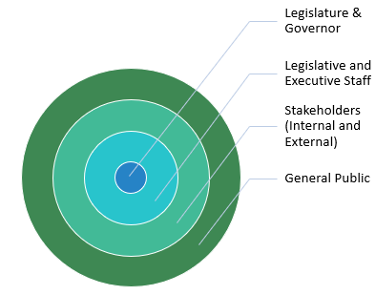
Delivery: Know Your Audience
Notes:
Remember- there might be overlap, and certainly there is consistency, but these aren’t the same messages that we use to recruit students or faculty. These are messages most useful in the public affairs setting.

Slide 20
Delivery: Techniques
The Message Box
Bridging
Repetition

Slide 21
The Message Box
Us on Us | Them on Them
Us on Them | Them on Us

Slide 22
Us on Us: Home Base Students of all ages, races and backgrounds can find career pathways to today's jobs at our local Community & Technical Colleges. Community & Technical Colleges are affordable and accessible for students and families in our community. Community & Technical Colleges already help meet our state and local workforce need; and are well-positioned for growth. State funding investments in Community & Technical Colleges pay off in big ways for local residents, employers and communities. | Them on Them We don’t have enough money to fund everything. We have other more critical priorities (K-12 – paramount duty, mental health – crisis). Where should the $ come from? What should we cut? Or what taxes do you support increasing? We have a looming budget problem, increased costs outpacing revenues.
Us on Them During the recession, we endured deep cuts that we still haven’t recovered from. The Legislature has made policy decisions that has led to increased costs for our campuses. We are continuously expected to do more with less. | Them on Us CTC system is too top heavy- too much administration, too many administrators paid too much Need accountability for $ - student outcomes, completion rates Budgeting process is opaque Higher ed needs to be more unified
The Message Box
Notes:
Don’t bother looking at the slide; look at the handout.
I want to point out something that’s NOT here– whining. Talking about the past. The 2008 recession. Previous budget cuts. Fairness. None of that is here. Why? Just because it’s true doesn’t make it an effective message. Policymakers don’t want to hear it. They want, like any of us want, to contribute to something important and meaningful. No one wants to fill potholes. They want to build new roads into the future. Which is great, because we are building new roads into the future. Stay there, encourage your people to stay here.
PAUSE for questions

Slide 23
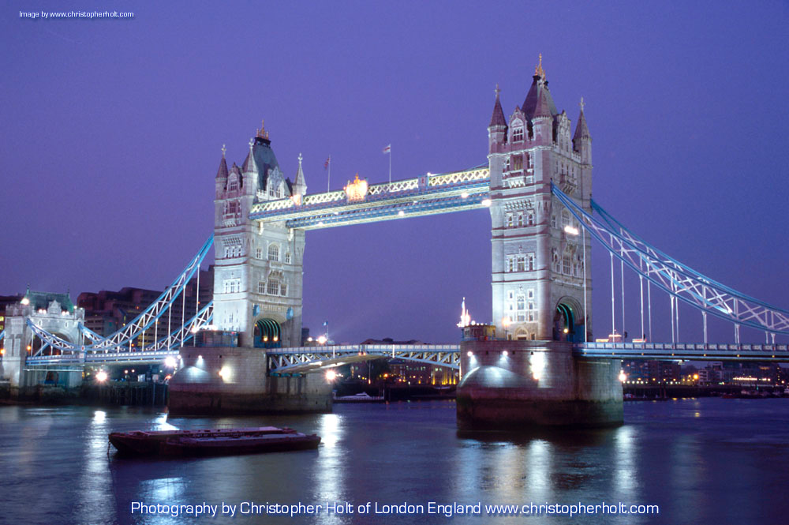
A =
Answer
B=
Bridge
C=
Communicate
Text
Bridging
Notes:
Bridging: The Key to a Winning Interview or Q&A
Some people call this the pivot- someone tries to push you into another part of the message box, and you bridge or pivot back to your box.
Frame responses to always highlight one of the key messages
Rephrase a question
“Bridge” from the question to your message
“What is really important is…” (flagging)
“That’s true, and …”
“Let me tell you what we are doing…”
“One thing your readers/viewers will want to know is…” (flagging)

Slide 24
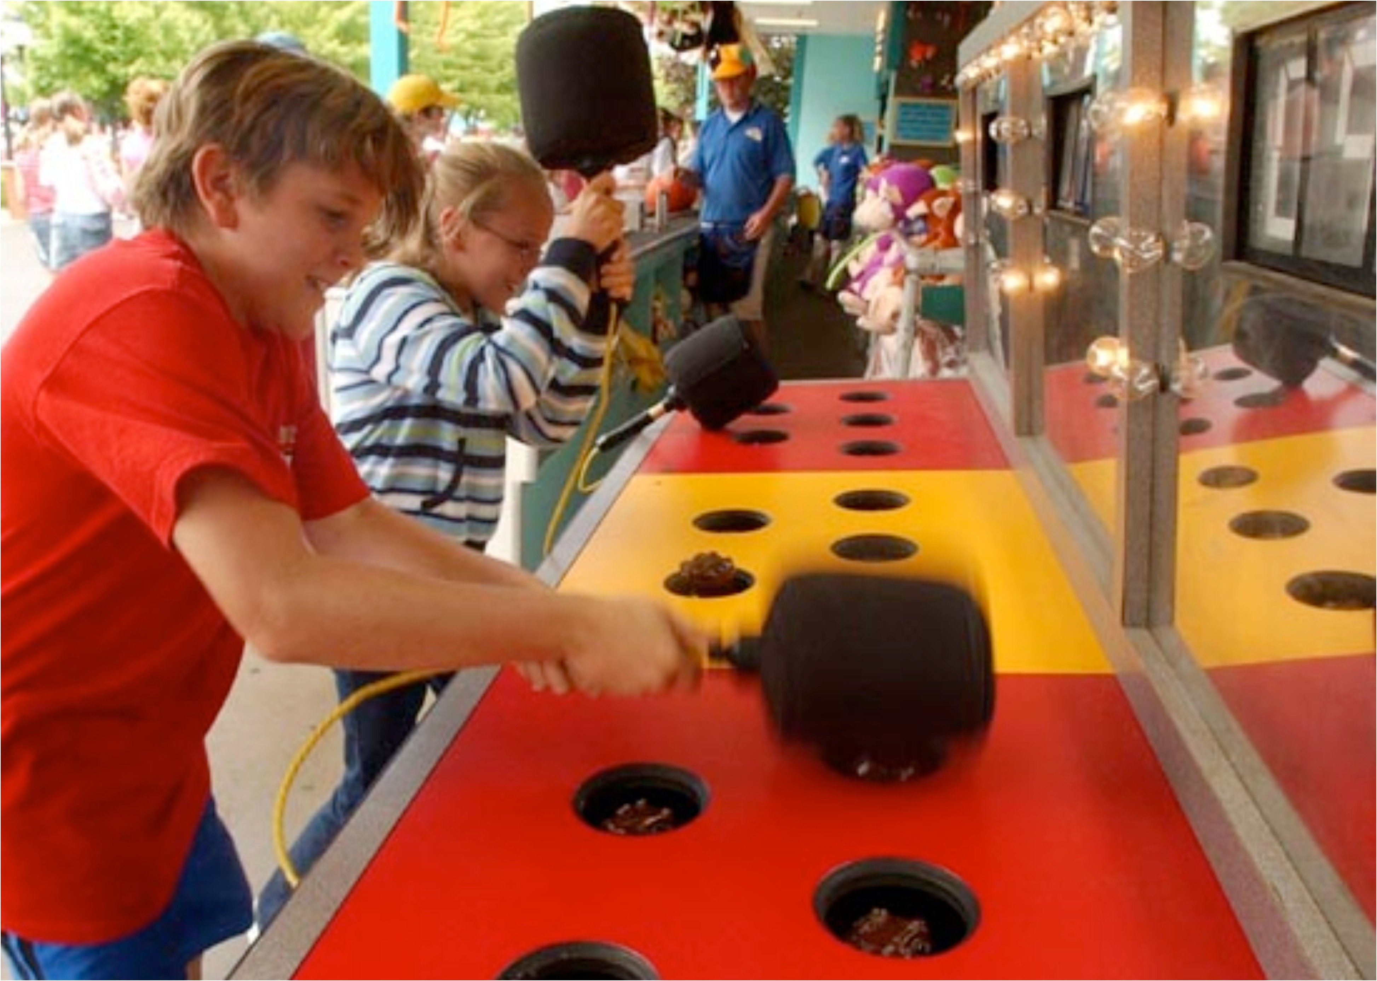
Repetition, Repetition
(and Repetition)
Notes:
Remember that when you are tired of repeating your message, likely the first time someone else has heard it.
Especially the message “Talk about the future, not the past.”

Slide 25
Remember the Research
Washington residents have markedly positive views of the state’s community and technical colleges (CTCs) and recognize the benefits they bring to the students and communities they serve, as well as to our economy
Most have some connection or familiarity with CTCs, either because they themselves attended classes at a CTC or a family member attended classes
Washingtonians are in broad agreement that it is important for the state legislature to increase funding for CTCs
CTCs are seen as filling a vital role in higher education, providing a critical path to the post-secondary education that is seen as necessary in today’s economy
Student-centered communications that emphasize the difference CTCs make in students’ lives and the variety of paths they afford students resonate strongly, solidify positive attitudes about CTCs, and create a more intensely positive overall view of CTCs
Notes:
My own personal message box has “talk about the future” and “stay student-focused” in it.

Slide 26
Table Discussion
What are some previous issues or topics that that you’ve had trouble talking about?
Using the message pillars and tactics, how would you talk about them now?
Are there issues that don’t feel connected to the main message or the pillars?
Notes:
Let’s pause for 15-20 minutes or so, and just talk in pairs or small groups at your tables– how can you be using these messages? Let’s talk for a little bit, and then do some Q&A– save some of those dilemmas for the larger group, so we can connect your issues to the research and do some peer-to-peer sharing as well.

Slide 27
Long-Term Advocacy Plan: Strategies and Tactics

Slide 28
Using the Message: Legislative Advocacy
Work with partners
Employers/local business and industry
Community organizations and local leaders
Students
Faculty
Unions (internal and external)
Education partners (K-12 and higher ed)
Focus on benefits to students of all ages and communities (not needs of institutions, not previous budget cuts)
Use stories– students, job training, community partnerships

Slide 29
What’s Happening: Fall 2018 and January 2019
Advocates
Advocacy training
Pre-session meetings with other organizations
Meeting with legislators/advocacy days
Infrastructure
Setting goals
Identify opportunities to capture and share best advocacy practices at the campus level
Messaging/Communications
Develop advocacy materials and communication channels
Outreach to other internal audiences
Alignment with other efforts (College Promise Coalition, Career Connect Washington)
Media plan implementation (editorial board visits, opinion editorials)

Slide 30
Questions?

