Slide 1
FACTC Update
February 02, 2018

Slide 2
Agenda
Item | Description
1. | ctcLink Background Overview
2. | Status Of Pilot College Activities Remediation / Fiscal Year Close Activities Remediation Sign-Off
3. | OCIO Investment Plan Requirements Project Manager Project Summit #1 / July 2017
4. | Deployment Timeline
5. | Upgrade Approach
6. | What’s Next
7. | Questions

Slide 3
ctcLink Historical Background Overview
Timeline | Key Event/Action
2008 | Strategic Tech Plan to include new ERP
2009 | Development of ERP Principles
2010 | Project Readiness Assessment and Implementation Planning
2011 | Governor Signs for ERP Approval and ctcLink officially named
2012 | Requirements gathered, Request for Proposal Posted for Software, Budget Approved, and PeopleSoft Selected
2013 | Request for Proposal Posted and Partner selected / Contract complete – Ciber Project Kicked Off
2014 | Original Deployment for Pilot colleges Delayed
2015 | Tacoma CC; Spokane CC; Spokane Falls CC; Spokane District Office go-live as “pilots”
2016 | ctcLink stabilization Gartner issues final IV&V report; Project presented findings at TSB meeting; Project directed to apply all resources to the remediation process Remediation Began
2017 | Remediation work and closure ctcLink Re-planning
2018 | Investment Plan Approved Project re-Kick-off

Slide 4
Steps to closure of remediation phase
Analyzed current Remediation progress, reconciled open items with colleges’ critical issues list
Developed plans for the remainder of in-scope items and colleges’ additional critical issues
Colleges reviewed and provided feedback on detailed plans for Remediation Phase closure
Sign off:
✓Spokane
✓Tacoma
✓WACTC-Tech
✓Exec Sponsor

Slide 5
conditions for sign-off
ISSUE/TOPIC | COLLEGE | DESCRIPTION | TIMING
Financial Year-End Close Month/year-end closing processes | Tacoma, Spokane | SBCTC staff provide assistance and knowledge-transfer to pilot college staff SBCTC to provide workshops and resource materials on closing processes | 2/2/18 3/27/18
Internal Controls (Security/Roles) | Spokane | Spokane-appointed Security lead to work with SBCTC lead to review, understand, update, assign roles and permissions for Spokane staff | 3/2/18
Absence Management | Spokane | SBCTC provided leave accrual and balance analysis to Spokane for review. Following college analysis of the data, SBCTC will provide support to guide Spokane through necessary corrective actions. | 2/28/18
DRS | Spokane | Correcting the hours-redistribution for Department of Retirement Services reporting | 2/20/18
Faculty Workload | Spokane | Make requested improvements to the faculty contract module | 5/30/18
Student billing (including 3rd-parties) | Spokane | Improve the template for student billing and invoices (including 3rd party agencies) | 5/16/18

Slide 6
New ctclink investment plan
New Technology Budget
Project Reporting
Comprehensive Staffing Plan
New Deployment
Method & Timeline
New Governance Model
New Investment Plan
IV & V Recom-mendations
Remediation Schedule & Sign Off
New OCM Strategy
External QA Open Items
RFQ for Systems Integration
Readiness Assessment

Slide 7
New ctcLink investment plan - approved
Gate 1
Oct 30, 2017
Nov 16, 2017
Dec 1, 2017
Dec 6, 2017
Dec 11, 2017
Jan 11, 2018
SBCTC internal review
Present draft to OCIO for review, feedback
WACTC-Tech/WACTC formal approval
SBCTC Board review, approval
Present to TSB, OCIO for Review
Present to TSB, OCIO Approval

Slide 8
Nine checkpoints to success
ctcLink Methodology
Quality Gates
ctcLink Working Group
Moran Technical Consulting
ctcLink
Steering Committee
ctcLink Internal Controls
ctcLink External Controls
OCIO (TSB)
ctcLink Executive Leadership Committee
OFM (Budget)
WACTC (Presidents)
SBCTC Board

Slide 9
ctcLink Governance Framework
Executive Leadership Committee
Overall Project Schedule / Total Project Budget / Global Scope
Change Initiation
Co-Chairs (voting): SBCTC Executive Director / WACTC-Tech Chair
Other Voting Members (4 College): WACTC-Tech Presidents
Other Members (non-voting): Project Director, Steering Committee Chair, SBCTC Deputy Exec. Dir. for Information Technology, OCIO Rep.
Meets monthly
College Executive Sponsors
Commission Chairs (+ representing their Councils)
Data Governance Co-Chairs
SBCTC ctcLink Leads
Common Process Development Team
External Mandates
Escalated Issues, Unresolved Appeals,
Clarifications
Project Steering Committee
Committee Outputs: Minutes, Issue & Decision Log, Reports
Deployment Schedule, FY Project Budget, Scope w/in Budget, Global Configurations, Appeals
Chair: Executive Sponsor (rotating)
Voting Members (6 College, 3 SBCTC): 6 College ctcLink Executive Sponsors, 3 SBCTC Deputy Executive Directors
Other Members (non-voting): Project Director, External Qual. Assurance Rep, 2 College PMs
Meets bi-weekly
Formal Change Request Forms
Escalated Issues, Appeals, Clarifications
Issue & Decision Log
(online)
Project Working Group
Implementation Plan / Configuration Management / Training Plan / OCM Plan
Chair (non-voting): Project Director
Voting Members (6 College, 5 SBCTC): 6 college reps (minimum 2 PMs, 3 Pillar Leads, 1 additional); 3 SBCTC Production Supp. and Project Staff (1 per Pillar – CS, HCM, FIN), 1 Data Serv. rep, 1 App. Serv. Rep
Other Members (non-voting): SBCTC reps from Production Support (all pillars), Project Support (all pillars), Security and Training/OCM
Meets weekly
Agenda
Requests for Review / Clarification

Slide 10
Project Methodology
Quality Milestones
Exit and Entrance criteria evaluated by ctcLink Governance
P
Initiation
Structure
Construct
Transition
Deploy
Project Planning
Determine Exception
Solutions
Determine Exception
Solutions
Organizational Change Management
Review Flows
Update Flows
Project Team Orientation
Review Procedures
Update Procedures
Develop User Guides and
Train Users
Build Demo Environment
Review Setups
Update Setups
Convert and
Verify Data
Convert and
Verify Data
Prepare
Production
Environment
Maintain
System
Conduct
CRP 1 – (Gather Requirements)
Update System
Test Scripts
Update Integration
Test Scripts
Prepare Dev
Environment
Prepare QA
Environment
Conduct CRP 2.0
(System Testing)
Conduct CRP 3.0
(Integration Testing)
Convert and
Verify Data
Identify Exceptions
Identify Exceptions
Propose
Future
Direction
Identify
Exceptions
Perform User
Acceptance
Test
Design Extensions
Perform Systems
Integration Test
Gather
Business
Architecture
Requirements
Create and Test
Custom Extensions
Prepare Custom
Test Scripts
Begin Production
10

Slide 11
Upgrade project phases
Initiation
Includes all project planning & preparation tasks, security redesign and environment builds.
Structure
Includes Global design, FIT/GAP, updates to Business Process Flows, Local Configuration, UAT Test Definition, Training and UAT Material Builds.
Construct
Includes Technical Development (updates to CEMLI’s), Security Matrix Mapping, Functional and System/Integration Testing, Parallel Testing, Data Upgrade and Spot-Check Validation.
Transition
Includes OCM Readiness Transition, Production Cutover Planning, Regional Trainer and End User Training, User Acceptance and Performance Testing.
Deploy
Includes Production Environment Prep, Production Cutover, Milestone Sign-Off and Acceptance, Lessons Learned.

Slide 12
DEPLOYMENT APPROACH & TIMELINE
2018 |  |  |  | 2019 |  |  |  | 2020 |  |  |  | 2021 |  |  |  | 2022
JAN | APR | JUL | OCT | JAN | APR | JUL | OCT | JAN | APR | JUL | OCT | JAN | APR | JUL | OCT | JAN | APR | JUL | OCT
TCC, CCS
1-2 Colleges
SBCTC
Upgrade Project
College Prep Work
Deployment 3
6 Colleges
College Prep Work
Deployment 4
8 Colleges
College Prep Work
Deployment 5
8 Colleges
8 Colleges
College Prep Work
8 Colleges
Deployment 6
College Prep Work
TBD
Contingency
Deployment
Contingency
12

Slide 13
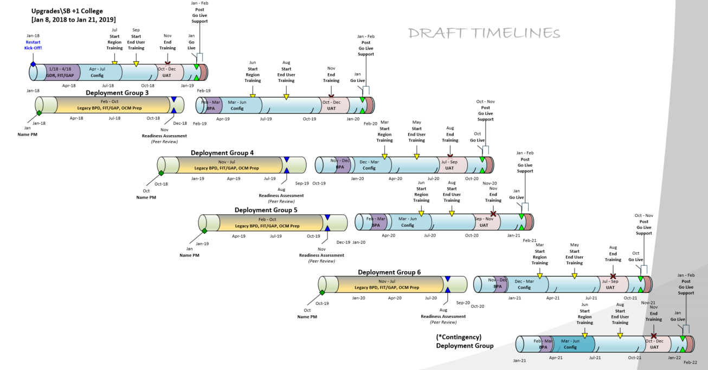
Integrated Work Plan

Slide 14
Upgrade Key Activities Need to be Revisited…..
Upgrade - Why?
Global / Local Configuration Design Workshops (Maximize Automation)
New Chart of Accounts
Security Re-Design
Portal Re-Design
New Approach's to Support College Activities
New Data Conversion Validation Framework
Updated Communication Plan
New Organizational Change Management Framework
New Training Approach
New User Acceptance Testing Framework

Slide 15
Next Steps
Continue Common Process Workshops
Project Staffing Ramp Up
Governance Membership
Deployment Schedule Alignment to Colleges
College Executive Sponsors and Project Managers Summit (March)
PeopleSoft Upgrade Project (Kick-off April)

Slide 16
questions?

