Slide 1
Helping High School Students Achieve Higher Learning Standards: Washington’s Smarter Balanced Placement Policy Agreement & Bridge to College Courses
(Update of February 2016 Presentation
to Education Writers’ Association)
Dr. William S. Moore
Director, Core to College Alignment and K-12 Partnerships
State Board for Community and Technical Colleges
bmoore@sbctc.edu

Slide 2
Why Develop this Policy Agreement?
Dissatisfaction with existing placement tools and ongoing move toward “multiple measures”
Quality of Common Core standards and Smarter Balanced assessments
Collaboration with K-12 partners to address college readiness and improve curricular alignment

Slide 3
Key Elements of the Agreement
Offers Washington high school students the opportunity to establish their readiness for college-level coursework based on their scores on high school Smarter Balanced assessment
Represents Washington higher education’s commitment to improve student college readiness by
providing an incentive for achieving the Common Core standards
creating alternatives for students to use their senior year more effectively
Details at https://www.sbctc.edu/about/agency/initiatives-projects/bridge-to-college.aspx

Slide 4
How Did We Get There?
Promote agreement statewide
System policy work group (Fall 2013)
Cross-sector summit gathering (November 2014)
Review data and re-assess agreement (by January 2019-now 2020)
Review and endorse proposal
Develop specific proposal for SB use in higher education
CTC system May 2014
BIs
Sept. 2014
System group and institutional review (Winter 2014--Spring 2014)
Notes:
Implementation chronology handout

Slide 5
Smarter Balanced High School Achievement Levels
Notes:
Source: http://reportcard.ospi.k12.wa.us/

Slide 6
What are the Common Core State Standards?
What They Do
What They Don’t Do
Define knowledge and skills students should have in the areas of English Language Arts and Mathematics so that they will graduate high school able to succeed in college and careers.
Dictate how teachers teach
Dictate what instructional / curricular materials should be used
Standards ≠ Standardization!
Notes:
3-minute Video: http://vimeo.com/51933492
In order to improve education, to attend to more students meeting the requirements for post-secondary success, we needed greater clarity in what is expected of students each year.
Typical state standards that preceded the Common Core were too vague and too long to realistically inform instruction.
So the Common Core was designed to be a set of standards that are fewer in number, clearer in describing outcomes, and higher to the degree that what is included is what is expected.
The decisions around how to focus the standards had to be grounded in evidence regarding what students in fact need in order to be prepared. Evidence regarding necessary content and skills was used to make decisions about what would be included.
In order to deliver on the promise that these Standards would in fact prepare students for post-secondary success, developers had to have clarity around what students need to master each year; the incredibly long lists of expectations which were never able to be addressed within a school year, had to be shortened.
This initiative presents an opportunity to level the field and clearly define the foundation of academic standards by which all students should know and be able to do during their K-12 experience.
Prior to the CCSS, 50 state had 50 difference set of academic standards, with 50 different means for assessment.
In addition to the opportunities it presents for aligned instructional resources, and consistency for mobile students and teachers, the CCSS provides great opportunity to leverage and align resources to support implementation.
While in the past many state’s focus has been developing standards and tests, the focus can now shift toward support with implementation and deep learning.

Slide 7
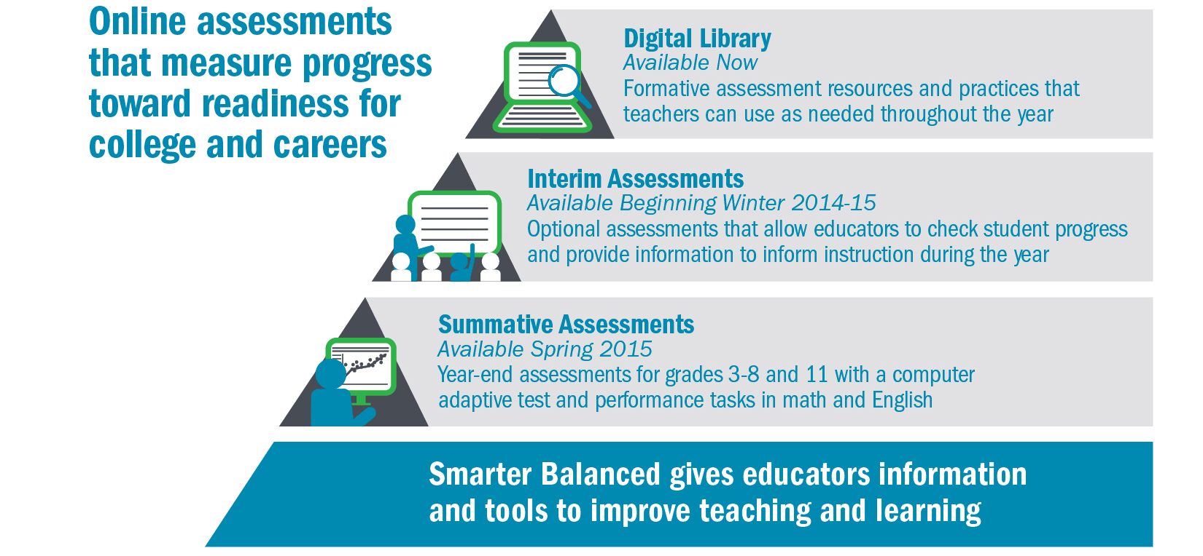
Smarter Balanced: Not Just a “Test”
Notes:
The Smarter Balanced assessment system is composed of 3 complimentary elements, all aligned to the Common Core state standards:
A digital library of instructional and professional development resources to help teachers implement the formative assessment process in their classrooms
Optional interim assessments to inform school decision-making throughout the year
End-of-year summative assessments to replace existing tests used in Grades 3-8 and 11 for state and federal accountability reporting. The grade 11 summative assessment also will be used by colleges and universities as evidence of student readiness for entry-level courses
Schools throughout the consortium began implementing each element of the assessment system during the 2014-15 school year.

Slide 8
Advantages of Using Smarter Balanced
Content and format
Thoughtful approach to assessment equity issues
State-led membership consortium
Free (to students or colleges)
Notes:
Designed to assess the higher-order skills required by the Common Core, using a computer-adaptive approach
Computer-adaptive model more accurate for full range of students and more engaging
State-of-the-art accommodation and accessibility features
involving WA faculty and high school teachers in content decisions

Slide 9
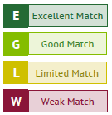
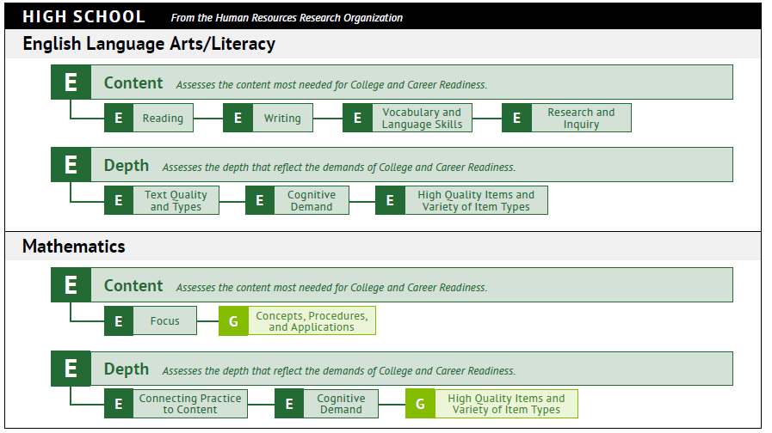
Recent External Evaluation: Alignment Results Report Card
Notes:
From the Fordham Institute and the Human Resources Research Organization

Slide 10
What Does the Placement Agreement Do?
Allows students to establish their college readiness based on the high school assessment
Creates an incentive for students to meet the Common Core standards while in high school
Details at WA Student Achievement Council College Readiness
or State Board for Community & Technical Colleges Bridge to College
Notes:
The agreement when adopted will be in effect for all Washington higher education institutions opting to endorse the recommendations and will apply to the high school graduating classes of 2016 through 2018. It will be reviewed and renewed or revised formally in winter 2018 based on relevant data gathered on the Smarter Balanced assessment, including a) correlations with SAT/ACT scores, b) grade 12 student performance, and c) student course-taking and performance in college.
and offers a way to use senior year more effectively

Slide 11
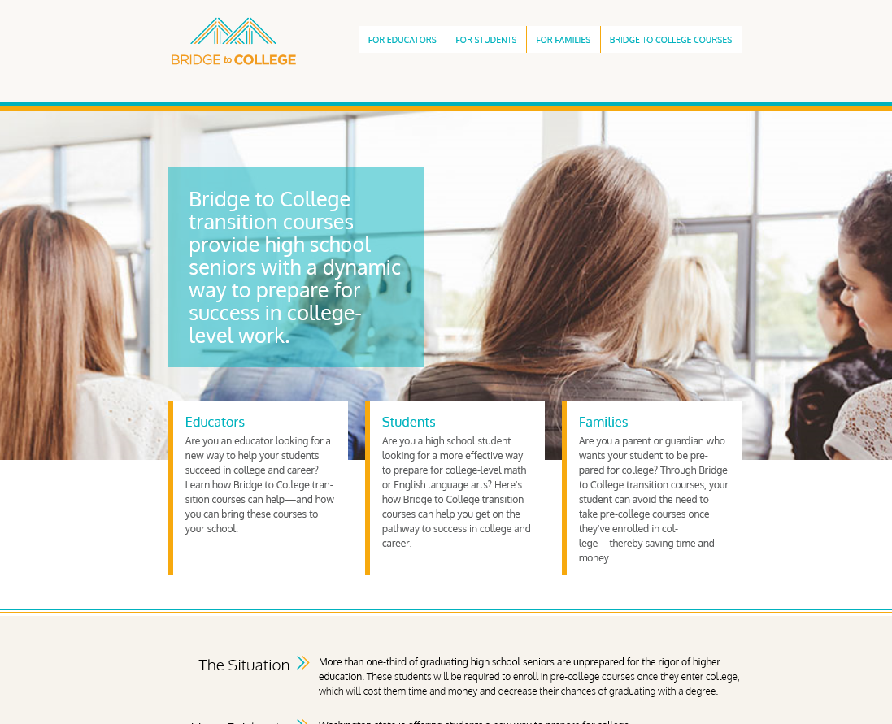
Washington Bridge to College Courses
Pathway for students scoring below “college-ready” on the high school assessment
Jointly developed and coordinated by college faculty and high school teachers
Ongoing professional learning support for teachers
Bridge to College Initiative Web Site
Notes:
Math and English
Professional Learning System:
The Bridge Course Trainers are supported by a leadership partnership between OSPI (Teaching and Learning) and the State Board of Career and Technical Colleges.
The difference between a higher ed partner and a higher ed contact is the amount of time they have dedicated to the project. The partner receives a honorarium to support the CoP and the contact does not.

Slide 12
For More Information
For specific recommended changes to the existing placement agreement, see
https://drive.google.com/open?id=1noQ30Umg1V41ZjisDz5VX7uw-YIhyyTS
Notes:
Broad public audience

