Slide 1
Faculty Matter in the Enrollment Game
Presentation to FACTC Winter 2017 Meeting
Notes:
Introduce selves
We’re going to:
Give an overview of our social media/search engine campaign
Give you some ideas for supporting enrollment
Take some questions and answers

Slide 2
Social Media & Digital Search Campaign Case Study
History: This was SBCTC’s first foray into digital advertising.
Vendor: Turtledove Clemens chosen after competitive RFP.
Goal: To raise awareness of high school completion options at community and technical colleges, and to generate visits to an SBCTC webpage where visitors could get more information and be forwarded to a community or technical college website.
Campaign period: July 1 to Sept. 30, 2016

Slide 3
“It’s Never Too Late to Graduate.”
Budget: $50,000
Funded with a federal grant
$45,000 media purchases
$5,000 media agency services
All ads purchased on a per-click-basis

Slide 4
Budget Detail
Media Purchases, $45,000
Social and online advertising
Search engine marketing
Agency Services: $5,000
Conduct keyword research for search engine marketing
Create a plan for purchasing social and on-line media advertising and search engine marketing
Includes at least one in-person meeting and numerous meetings via phone.
Develop appropriate messaging (copywriting)
Provide creative assets (artwork)
Provide report of metrics to illustrate campaign results

Slide 5
Advice
Get people at the highest level engaged early so there are no surprises.
Establish an advisory panel to run ideas by. Our advisory panel was:
Robin Gashi, Tacoma Rescue Mission
Amy Diehr, Tacoma Community House
Theresa Stalick, Lower Columbia College
Diane Smith, Grays Harbor College
Alonda Williams, Bellevue College
Aaron Parrott, Wenatchee Valley College

Slide 6
“It’s Never Too Late to Graduate.”
Advisory panel agreed to this message: “It’s Never Too Late to Graduate.”
Panel members also provided sample student quotes.
Web landing page at SBCTC.edu
http://www.sbctc.edu/becoming-a-student/basic-education/never-too-late-graduate.aspx
Notes:
Target market: Originally, we planned to target ads to counties with the lowest educational attainment.
This sparked an interesting discussion: Is it better to target ads to areas of state with the lowest educational attainment, with the goal of getting more people enrolled in those areas? Or, is it better to target ads to college districts that have already shown an increase in BEdA enrollments and are therefore “hot” markets that are likely to respond with an advertising nudge?
This second approach is what politicians do: they campaign hardest in districts where people are most likely to vote and which have the most “swing” voters – voters who can be persuaded to vote for the candidate. If the goal is to get more “votes” – or, in our case, enrollments – would it make more sense to target ads to college districts where people are more likely to sign up? As a statewide agency serving all colleges, we decided to distribute the ads across the state. Ads were targeted to 17-35 year olds – equal gender.

Slide 7
Media Purchased
Google AdWords remarketing. People visited our SBCTC website, clicked on a page related to BEdA, a cookie was set, and we deliver ads to them when they visit other sites. You look at shoes at the Zappos.com site. After that, it seems you will see a Zappos ad everywhere you go online. That’s remarketing.
Google paid search. You are probably very familiar with this type of advertising. A person searches for something related to BEdA, and an ad appears that looks very much like a search result. The ads are either at the top or the right of the search results page.
Facebook newsfeed ads
Notes:
Google Adwords is good for: familiarizing people with your brand, keeping your brand “top-of-mind” for consumers who are comparison shopping or not likely to make a decision immediately, and to advertise products that are enticing in photos – such as luxury products or vacations
According to The WordStream Blog, Google search is effective because it targets an active searcher, who is on a mission to find something. People are actively looking for products or services already. Paid search is good when you’re working with a limited budget, or have to sell an “emergency” product – ie, a product or service that users look for on an as-needed basis. (SBCTC purchased Google search ads when ITT Tech shut down.) The most powerful search term for high school completion was “GED,” however, you have to get permission from the GED Testing Service to use it as a search term in advertising. The GED Testing Service will scour through the landing page and your entire website, and require specific language everywhere they find reference to GED.
If you’re on Facebook, you know what these ads look like. According to Turtledove Clemens, “…the paid Facebook newsfeed cost, ability to target and performance have proven itself as a very good tool for you” (ie, good for advertising high school completion programs).

Slide 8
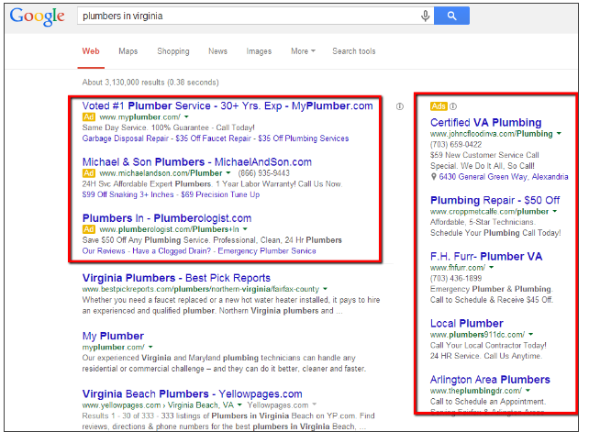

Slide 9
Notes:
The ITT was a quick, mini-campaign after ITT tech closed. Not related to this campaign.

Slide 10
Results Detail
CLIENT: | SBCTC |  | CAMPAIGN: | BASIC ADULT EDUCATION
START DATE: | 6/23/2016 |  | END DATE: | 9/26/2016
MEDIA |  |  | CURRENT SPEND (GROSS) | IMPRESSIONS | CLICKS | CTR
GOOGLE TOTAL |  |  | $29,473 | 5,774,432 | 13,777 | 0.24%
GOOGLE -BEDA |  |  | $26,433 | 5,740,867 | 12,817 | 0.22%
GOOGLE - ITT STUDENTS |  |  | $1,894 | 23,092 | 572 | 2.48%
GOOGLE - GED |  |  | $1,146 | 10,473 | 388 | 3.70%
FACEBOOK - BEDA |  |  | $19,412 | 590,238 | 146,433 | 24.81%
FACEBOOK - ITT |  |  | $1,900 | 15,487 | 1,013 | 6.54%
BING - NEVER TOO LATE |  |  | $932 | 11,237 | 102 | 0.91%
BING - ITT |  |  | $76 | 968 | 24 | 2.48%
TOTAL |  |  | $51,794 | 6,392,362 | 161,349 | 2.52%

Slide 11
Results Summary
More than 6 million impressions
161,000 people drove to the SBCTC website
Average click-through rate of 2.5% (meaning, they clicked on ad and went to our website for more information). For education sector, an average search nets 2.2%
Notes:
What we learned
The paid Facebook newsfeed cost, ability to target and performance have proven itself as a very good tool for you. The other thing was pretty clear was how immediate was the response for GED.
The ITT situation certainly helped our numbers.
For BEdA, Turtledove advised us to not target any specific sub-geography in the State as they thought it would not be right for us to pre-determine which geographies to target.
Instead, the better strategy was to put the same message “Not Too Late to Graduate" out to all geographical areas and give everyone the same opportunity to respond.
And in fact, the response was pretty close to statewide population densities. We did, however age-target to 17-35 yr olds, equal gender.

Slide 12
Well, that’s nice, but …
… what can faculty without a budget do?

Slide 13
“Old School” Means Business
Social media can grab attention, but good web content and personal follow-up win the day.
Most students prefer “official” channels to communicate with colleges (email, letters, phone) rather than social media or texts.
Social media feels less serious and some are reluctant to share social account details with colleges.
Notes:
http://www.qsdigitalsolutions.com/blog/what-is-the-role-of-social-media-in-student-recruitment/

Slide 14
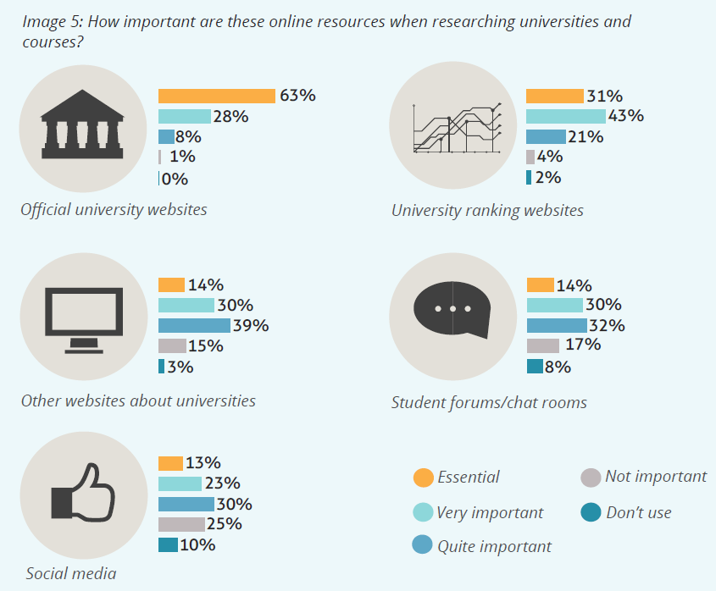
Notes:
http://www.qsdigitalsolutions.com/blog/what-is-the-role-of-social-media-in-student-recruitment/

Slide 15
Enrollment Challenges
Costs
Financial aid
Tuition, fees
The economy
Demographics
Competition
Notes:
SLIDE 15
Costs
Students - Financial aid funds are stretched
Students - Tuition costs are too high for middle class students not eligible for aid
Colleges – budget cuts over the years, no class schedule mailing
The economy
Employment rate goes up, enrollment goes down
Conditions and student populations vary widely across the state.
Less than four percent unemployment in the greater Seattle area, coupled with challenging traffic congestion that affected prospective students’ choices to attend college.
This is less true in the rural areas that still might face
Demographics
Depending on your community, declining number of high school graduates in most service areas.
Competition
The competition is NOT other community or technical colleges. Any student any CTC gets is a win.
Four-year state colleges and universities are competing for the same graduating high school class and making efforts to accept more students. They can lower and raise the bar to admissions, siphoning off college-ready students.
Proprietary schools are getting hit hard with bad publicity.
--------------------------
Annual system level enrollment summary for 2015-16. It includes the following highlights:
* Total enrollments for the system from all fund sources declined 1% from 2014-15, primarily due to a 2% decline in state funded FTES.
* Changes varied by mission area with precollege courses showing the largest decline (-7%), fewer workforce enrollments (-3%) and more basic skills enrollments (+3%).
Academic enrollments remained flat with declines in state supported academic FTES offset by increases in contract funded academic FTES due to growth in Running Start.
* Enrollments in certain programs continued to grow:
o applied baccalaureate programs increased 57% to 1,627 FTES
o apprenticeships increased 18% to 3,292 FTES
o I-BEST grew 14% to 2,493 FTES
o eLearning grew 5% to 47,443 FTES
o Running Start grew 12% to 18,335 FTES
* Worker Retraining grew for the first time since the recession, up 7% to 7,206 FTES. * Enrollments declined for international students, WorkFirst and corrections education.

Slide 16
Enrollment Opportunities
Costs
Scholarship awareness
Financial aid workshops
The economy
Demographics
Competition
Notes:
Costs
Be aware of resources available at your college
Worker retraining funds, BFET, Workfirst, scholarships, aid opportunities
Scholarship awareness
Help get the word out to your students
Most colleges have scholarship and financial aid workshops
The economy
Not everyone is getting ahead.
There are still prospective students seeking better lives
Demographics
Not a lot of high school graduates?
Find the adults.
Competition
The competition is NOT other community or technical colleges
Work with your outreach/admissions/recruiting office to help them help you
Mini campaigns
Your college’s facebook and social media campaigns – contact your PIO or marketing office

Slide 17
Inreach
Get to know your advisors/counselors and educate them about your class/program
Help your outreach/admissions team
Campus tours, classroom visits, information sessions for current pre-college, GED, ABE and ESL students
Notes:
Get to know your advisors and counselors.
When undecided students land at their desk, they are more likely to direct them your way if there’s a possible match.
Campus tours and information sessions for pre-college, GED, ABE and ESL students
Welcome tours into your classroom –
You sell yourself – not the tour guide.
Ask them questions.
Tour groups remember friendly teachers and students and feeling welcomed. Not stats and saw an enrollment bump

Slide 18
Outreach
Mini campaigns
Your college web page:
Accounting
Areas of Study (transfer)
Team up with your recruitment, outreach, strategic enrollment management groups
Welcome tours into your classrooms
Notes:
Slide 18
Mini campaigns
Solo or team up with your colleague faculty to create Sector Squads – accounting, business, economics, math – philosophy, English, fine arts – automotive, diesel, autobody, etc.
Host high school teachers for a campus visit. Or visit them.
Send them program updates on a regular basis.
Send your college newspaper or student anthology or ? -- with a cover letter
Work with your admissions office to pull a list of applicants in your general area. Call or email those students, ask if you can help in some way, invite them to your classes.
Your college web page:
Despite the lure and attraction of instagram and reddit, when it’s time to get serious about college research, students turn to the now-considered-old-fashioned website.
So make sure your departmental and personal (faculty) college web content is inviting.
Team up with your recruitment, outreach, strategic enrollment management groups
Ask how you can help them. Volunteer for new student orientations, information sessions, phone banks.
Ask them how they might help you. Can you capitalize on mailings, events, emails, admissions letter follow-up./
Welcome tours into your classrooms
Transfer classes get overlooked in favor of professional-technical, because it’s easier to tour a welding lab or aviation hangar than a lecture class.
Sometimes, the outreach/tour staff gets the message that lecture classes cannot and should not be bothered.
Let them know you welcome visitors to your anthropology or political science class. Have a two or three-minute spiel ready, be friendly, let your college students engage the tour group.

Slide 19
Questions?
Sherry Nelson, online content and new media manager, slnelson@sbctc.edu, 360-704-4308
Katie Rose, Communications & Marketing Associate, krose@sbctc.edu, 360-704-4367
Communications Office
Washington State Board for Community and Technical Colleges

