Slide 1
Reconciliation at Bellevue College
Financial Aid
Student Financials
General Ledger

Slide 2
Agenda
Who’s who
Who does what
G5 vs COD
Reconciliation
Schedules
Communication
Tools
Reports
Financial Aid Responsibilities
FARC FARP
Monthly Meetings

Slide 3
Who’s Who
Financial Aid Staffing
Currently 2 PS2s (ISIRS, uploads, ticketing, customer service), 1 PT PS2 until 6/30 (phones), 1 open position
Student Financials
6 full-time employees plus a full-time supervisor.
A couple of the SFS team also help with some AR duties.
Finance Office
One Fiscal Analyst 5 completes all draws and recons, with the support of the Finance Manager
6 PS3s (2 open positions – SAP and Pell) State Aid, Scholarships, Direct Loans, Work Study, WorkForce, R2T4 with Census and Disbursements
Associate Director and Director of Financial Aid

Slide 4
Responsibilities
Financial Aid Staffing
Disburse aid
Student Financials
Process Refunds (Bankmobile, AP, etc)
Finance Office
All Reconciliations: COD to SJS, SJS to GL, FA to SJS, etc.
Reconcile COD to FA Data
Offer aid
Post Disbursements
G5 and WSAC Draws

Slide 5
Monthly Meeting – FA & Finance
Review Status of G5 and WSAC awards
Current COD-SJS Recon Status + Issues
Current Draw Status
Current SJS-GL Status
Any FA801 to SJS Issues
Participants
Financial Aid Associate Director (and FA Director if available)
Finance Fiscal Analyst 5
Finance Manager
Communication Tool
MS Loop Chart
Teams Chat

Slide 6
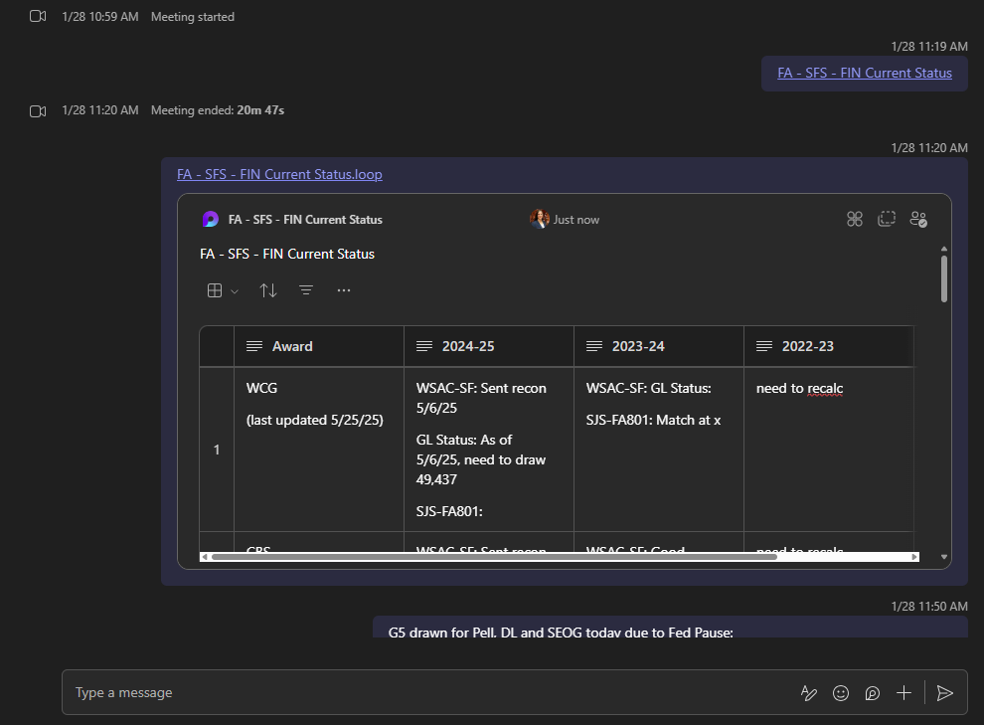
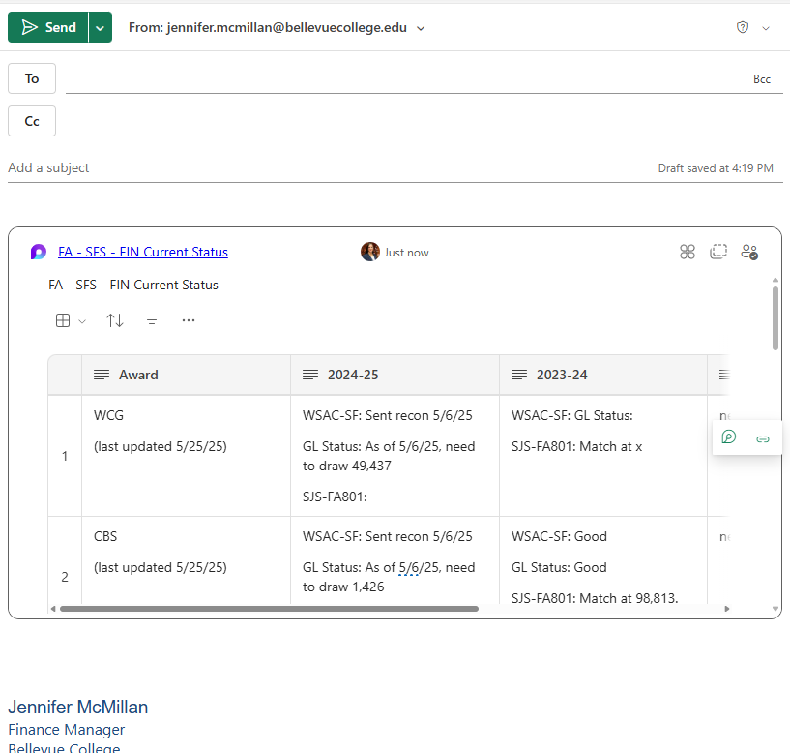
Monthly Meeting – FA & Finance

Slide 7
COD vs G5
COD
Allows Financial Aid to review student aid records
Linked to G5
Reconciled to Financial Aid awards
G5
Allows the Finance Office to draw federal funds
Linked to COD
Reconciled to General Ledger Revenue

Slide 8
The FA-SF-GL Cycle
Financial Aid
Student Financials
Second Journal Set
General Ledger
Recon

Slide 9
Reconciliation Cycle – Basic Flowchart

Slide 10
Reconciliation Cycle – G5 (Pell and DL)
Bellevue College
Timeline of COD to SJS Reconciliation Schedule with G5 Draws
Purpose: Create a routine of Financial Aid requesting the SAS file on the 16th and 1st of each month, allowing time to reconcile, make corrections, draw data and enter to the appropriate fiscal month, ensuring GL Expenses and Revenues are coded in the same fiscal period.
Disbursement dates 1st - 15th of month: draw between the 22nd and 25th of the month
Disbursement dates 16th – end of month: draw between the 7th and 10th of the next month
Timeline (by day of the month):
Disbursement dates 1st - 15th of month:
· 16th: Financial Aid requests SAS file.
· 17th: Financial Aid sends SAS file to Finance. Finance recons and returns to Financial Aid.
· 18th-21st: Financial Aid enters corrections in COD/PS. Financial Aid notifies Finance when complete.
· 22nd-25th: Finance draws for SJS expenses in the 1st-15th time period.
Disbursement dates 16th - end of month:
· 1st: Financial Aid requests SAS file.
· 2nd: Financial Aid sends SAS file to Finance. Finance recons and returns to Financial Aid.
· 3rd-6th: Financial Aid enters corrections in COD. Financial Aid notifies Finance when complete.
· 7th-10th: Finance draws for SJS expenses in the 16th – end of month time period.

Slide 11
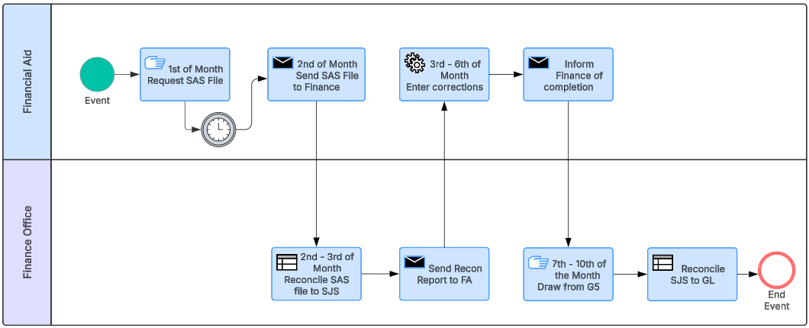
Reconciliation Cycle – G5
Example for the "B" period (16th to End of Month)
Finance only draws amounts in full for SJS semi-monthly period. "A" 1st-15th. "B" 16th-EOM
No draw done if 100% of funds are not available. NO partial draws!

Slide 12
G5 Files – Show and Tell
File: COD to SJS
Direct Loan
File: G5 Draw
Pell, DL, SEOG, FWS
File: General Ledger Recon
Individual Files
Individual Files
Pell
Combined File
Pell, DL, SEOG and FWS
Multi-Year
Monthly
Semi-Monthly
Semi-Monthly
Reconciles FA801 to SJS to GL to G5

Slide 13
Reconciliation Cycle – G5 – COD vs SJS
Example for the "B" period (16th to End of Month)
COD (SAS) to SJS Recon Data Files
QCS_SF_MNTHLY_ITEM_DTL_POST (for disbursement data)
SAS File from COD (for COD data)
QCS_FA_SCC_ISIRVSBIODEMOCIT (for ssn to emplid conversion)
Finance only draws amounts in full for SJS semi-monthly period. "A" 1st-15th. "B" 16th-EOM
No draw done if 100% of funds are not available. NO partial draws!

Slide 14
Reconciliation Cycle – G5 – COD vs SJS
COD SAS FILE
=TEXT(J4,"000000000")
=IFERROR(VLOOKUP(AB4,'SSN EMPLID Crosswalk'!A:B,2,FALSE),"")

Slide 15
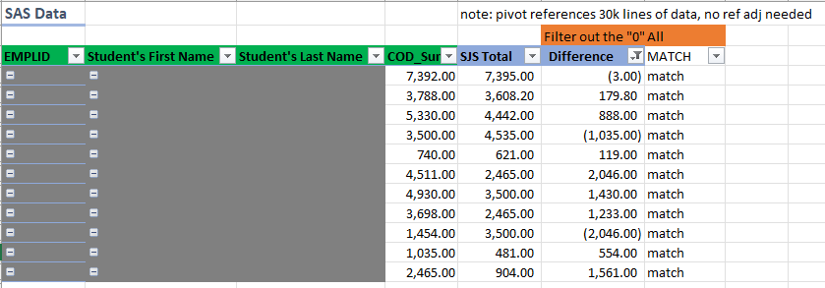
Reconciliation Cycle – G5 – COD vs SJS
PIVOT AND COMPARE
SAS VS JS
These go to the "Detail" section in the recon tab.

Slide 16
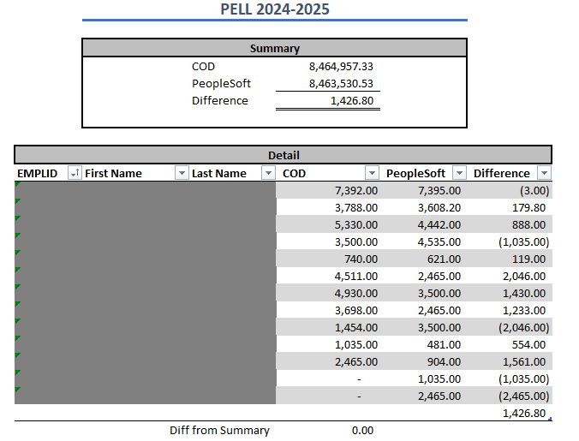
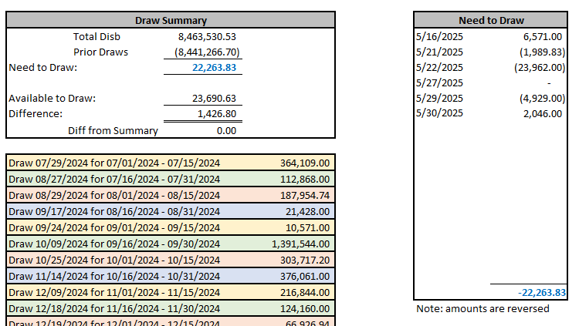
Reconciliation Cycle – G5 – COD vs SJS
PREPARE REPORT

Slide 17
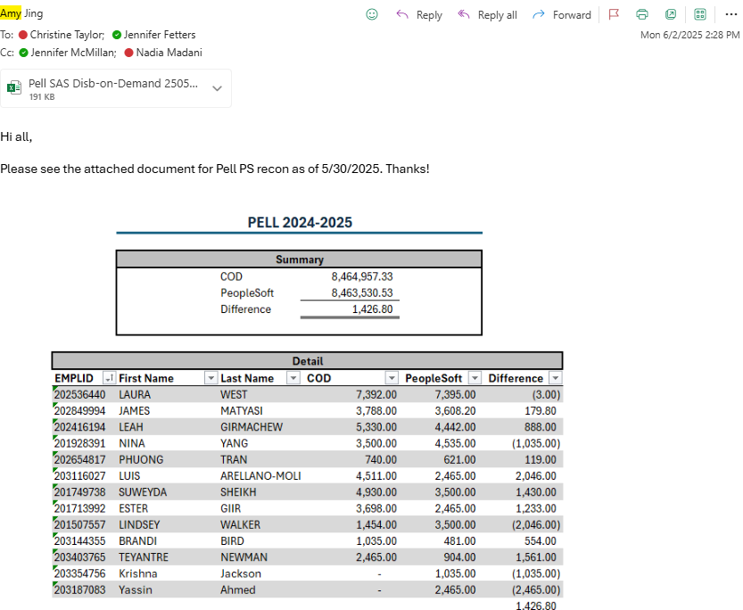
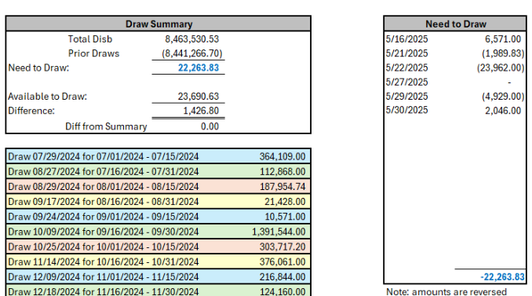
Reconciliation Cycle – G5 - COD vs SJS
EMAIL REPORT TO FA

Slide 18
Reconciliation Cycle – G5 - Draw
Example for the "B" period (16th to End of Month)
G5 Draw
Data Files
QCS_SF_MNTHLY_ITEM_DTL_POST (for disbursement data)
QFS_GL_ACCOUNT_ANALYSIS (for FWS GL data)
Finance only draws amounts in full for SJS semi-monthly period. "A" 1st-15th. "B" 16th-EOM
No draw done if 100% of funds are not available. NO partial draws!

Slide 19
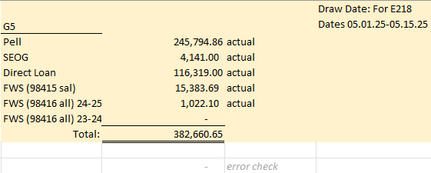
Reconciliation Cycle – G5 - Draw
PREPARE DRAW DATA

Slide 20
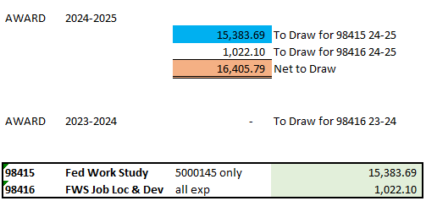
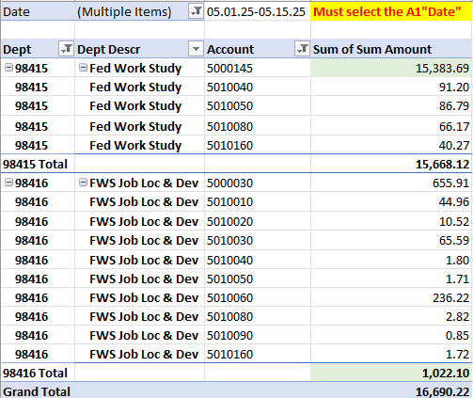
Reconciliation Cycle – G5 - Draw

Slide 21
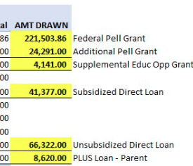
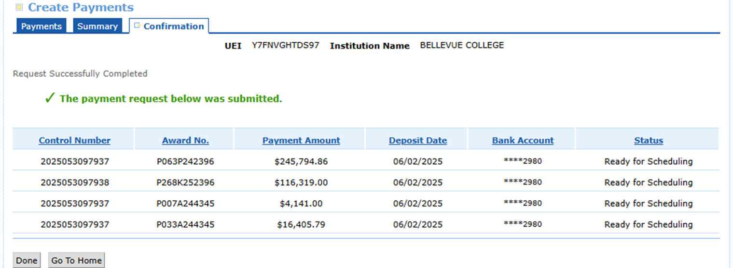
Reconciliation Cycle – G5 - Draw
PREP JOURNAL
DATA

Slide 22
Reconciliation Cycle – G5 – Recon SJS to GL
Example for the "B" period (16th to End of Month)
Monthly Recon
Data Files
QCS_SF_MNTHLY_ITEM_DTL_POST (for disbursement data)
QFS_GL_ACCOUNT_ANALYSIS (for GL data)
FA801 (for FA data)
G5 Detail
Reconciles
G5 to GL (Revenue)
SJS to GL (Expense)
FA801 to SJS (FA vs SF)
Finance only draws amounts in full for SJS semi-monthly period. "A" 1st-15th. "B" 16th-EOM
No draw done if 100% of funds are not available. NO partial draws!

Slide 23
Reconciliation Cycle – G5– Recon SJS to GL
Prep GL Data by entering Award year and splitting any SJS journals if needed
PREPARE GL DATA

Slide 24
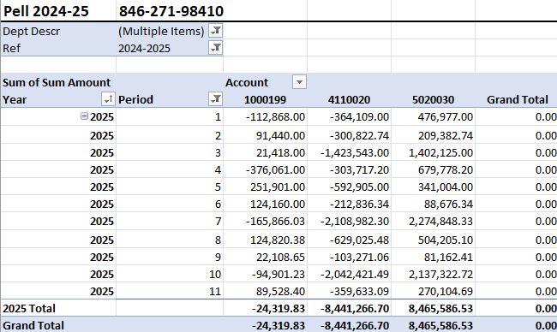
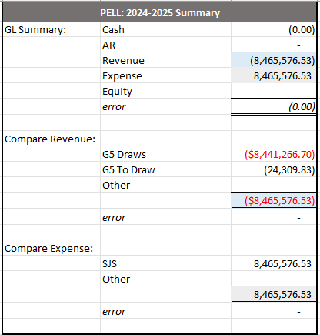
Reconciliation Cycle – G5– Recon SJS to GL
Pivot table is not limited to a fiscal year. Award year 2023-24 will have two fiscal years of data in FY25.
RECON GL TO SJS
RECON SJS TO FA801
RECON G5 TO GL

Slide 25
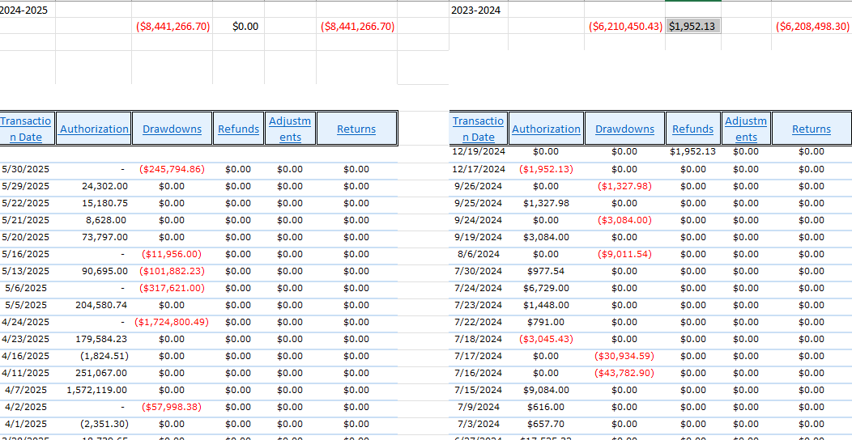
Reconciliation Cycle – G5– Recon SJS to GL
G5 DATA

Slide 26
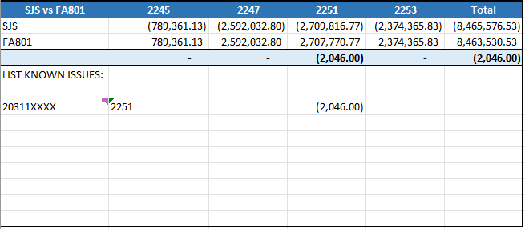
Reconciliation Cycle – G5– Recon SJS to GL
SJS TO FA801 RECON

Slide 27
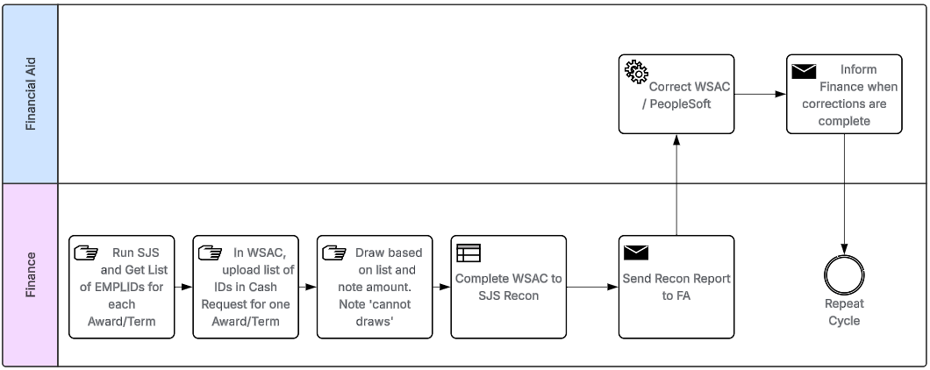
Reconciliation Cycle – WSAC
Draw for any student disbursed for the Award/Term as of a point in time
Do not stop a draw if incorrect match between WSAC and SJS

Slide 28
Reconciliation Cycle – WSAC
File: WSAC Draw
Produces a list of IDs per award per term
File: General Ledger Recon
Individual Files
Combined File (WCG, CBS WBG, PTC)
Multi-Year
Monthly
Semi-Monthly
Reconciles FA801 to SJS to GL to WSAC
File: WSAC to SJS Recon
Access DB
Excel File
Records Draw info
Report discrepancies data
WSAC to SJS recon
process data
Produce discrepancies data

Slide 29
Reconciliation Cycle – WSAC – Prep for Draw
Draw for any student disbursed for the Award/Term as of a point in time
Do not stop a draw if incorrect match between WSAC and SJS

Slide 30
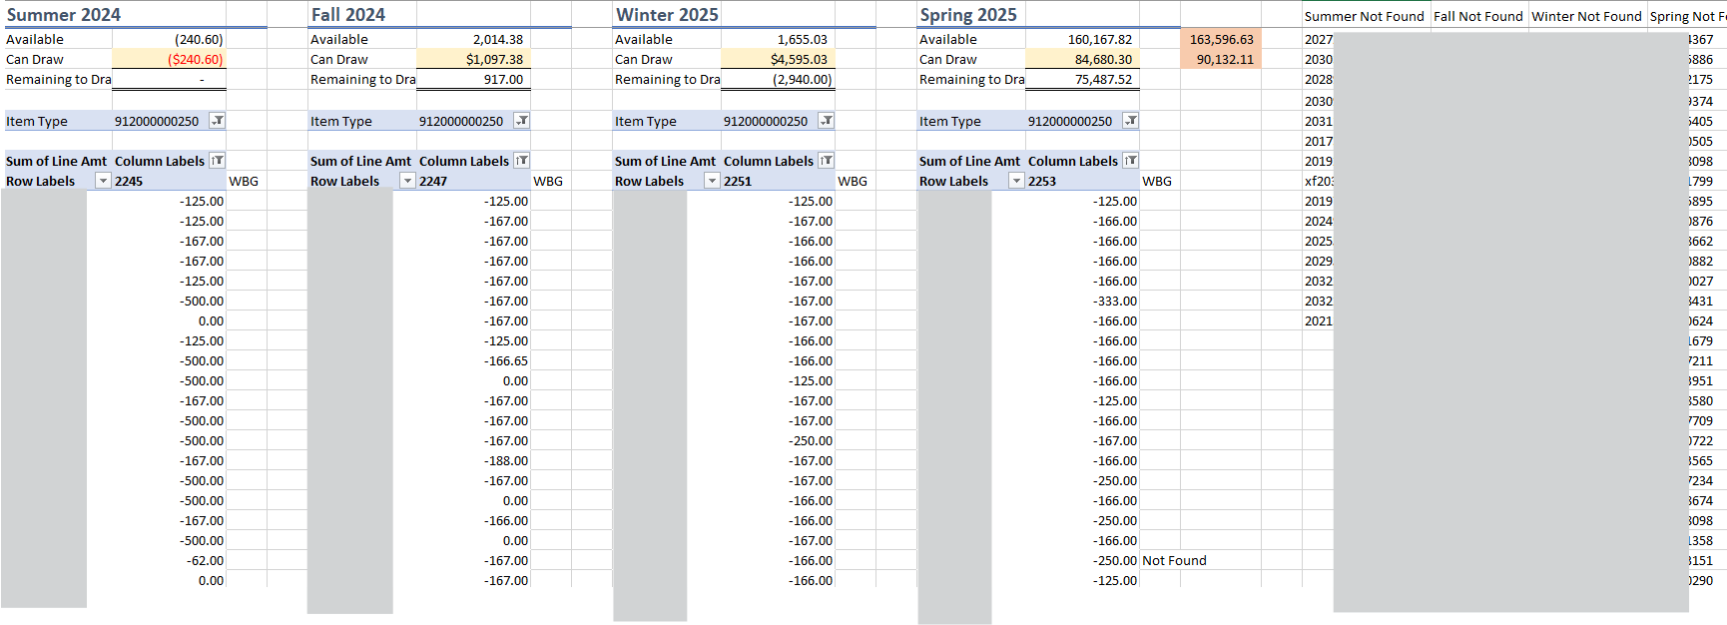
Reconciliation Cycle – WSAC– Prep for Draw
PREP STUDENT ACTIVITY FOR EACH WSAC AWARD, EACH TERM

Slide 31
Reconciliation Cycle – WSAC – Upload List of IDs
Draw for any student disbursed for the Award/Term as of a point in time
Do not stop a draw if incorrect match between WSAC and SJS

Slide 32
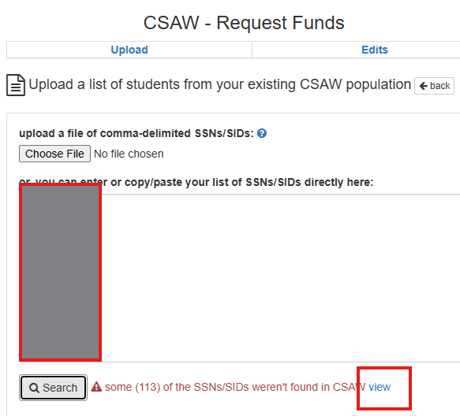
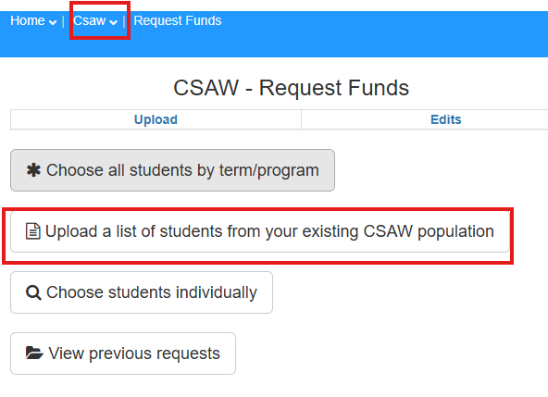
Reconciliation Cycle – WSAC– Upload List of IDs
Load one program for one quarter at a time into WSAC

Slide 33
Reconciliation Cycle – WSAC – Draw (Request Funds)
Draw for any student disbursed for the Award/Term as of a point in time
Do not stop a draw if incorrect match between WSAC and SJS

Slide 34
Reconciliation Cycle – WSAC – Draw (Request Funds)
Complete WSAC draw for each award, term

Slide 35
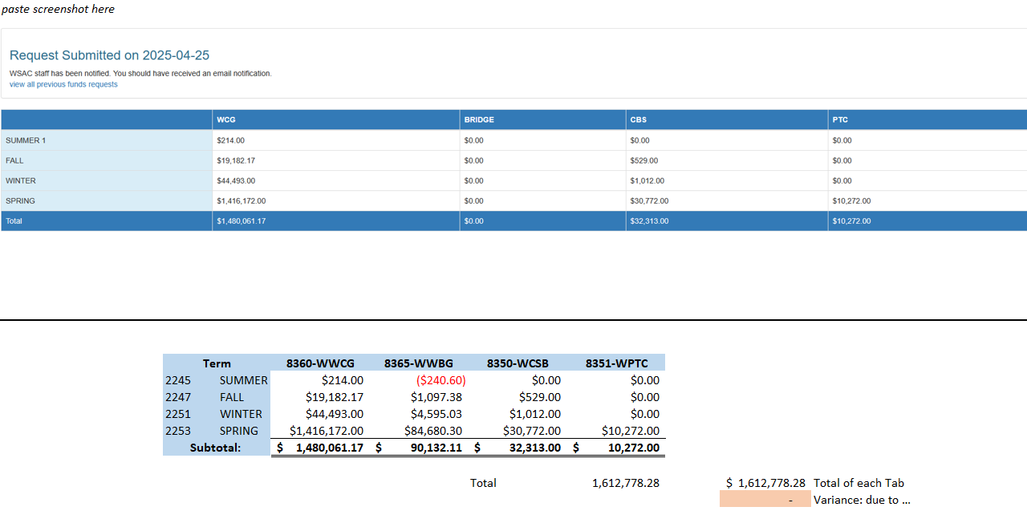
Reconciliation Cycle – WSAC– Draw (Request Funds)

Slide 36
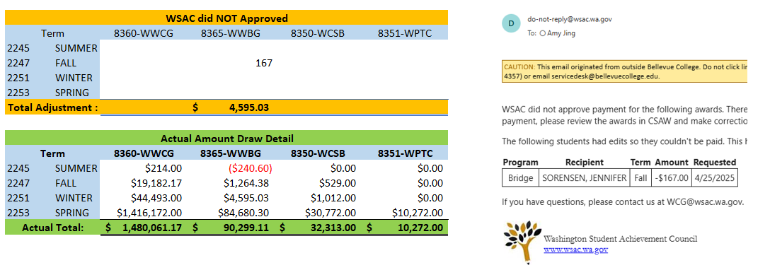
Reconciliation Cycle – WSAC– Draw (Request Funds)
Adjust for Cancels

Slide 37
Reconciliation Cycle – WSAC
Monthly Recon
Data Files
QCS_SF_MNTHLY_ITEM_DTL_POST (for disbursement data)
WSAC 'All payments for program' Report
Repeat for each program and consolidate into one file.
Use a lookup to check SSN-SID match to PeopleSoft
Paste data into existing file that is linked to Access DB
Draw for any student disbursed for the Award/Term as of a point in time
Do not stop a draw if incorrect match between WSAC and SJS

Slide 38
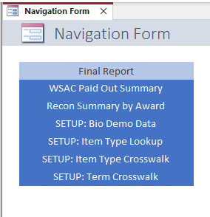
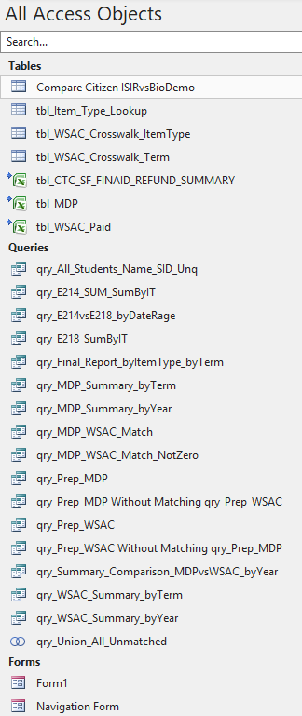
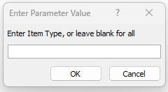
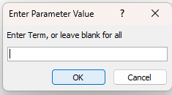
Reconciliation Cycle – WSAC

Slide 39
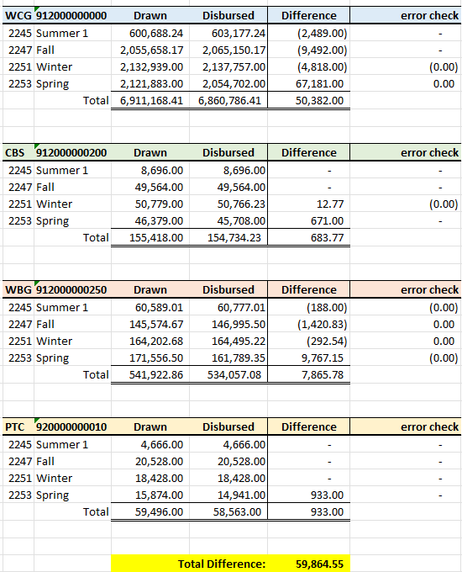
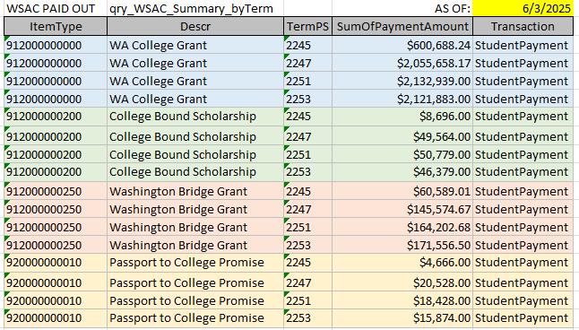
Reconciliation Cycle – WSAC
From SJS

Slide 40
Reconciliation Cycle – WSAC
"Drawn" = Per WSAC Payments report
"Disbursed" = Per SJS
"Error Check" = Drawn less Disbursed less Issues List
Issues List

Slide 41
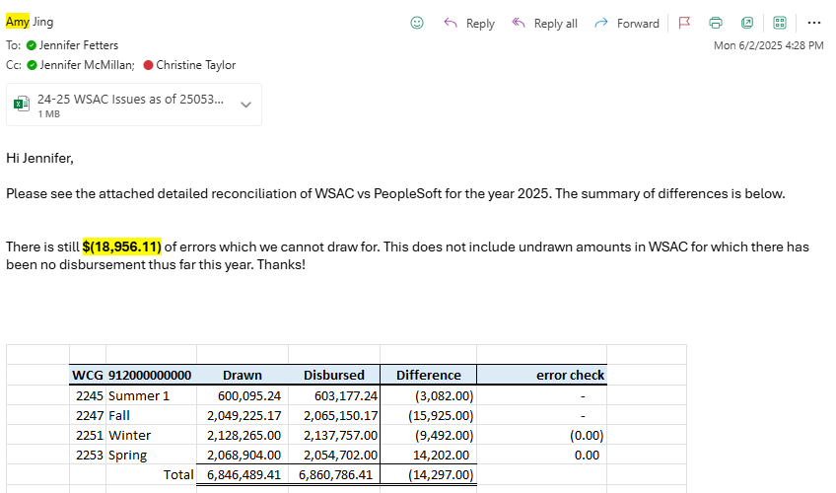
Reconciliation Cycle – WSAC

Slide 42
Reconciliation Cycle – WSAC
Monthly Recon
Data Files
QCS_SF_MNTHLY_ITEM_DTL_POST (for disbursement data)
WSAC 'All payments for program' Report
Repeat for each program and consolidate into one file.
Use a lookup to check SSN-SID match to PeopleSoft
Recon to GL
Paste data into existing file that is linked to Access DB
Draw for any student disbursed for the Award/Term as of a point in time
Do not stop a draw if incorrect match between WSAC and SJS

Slide 43
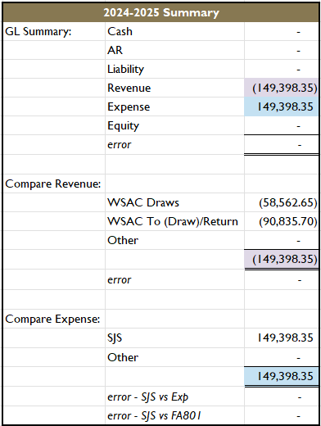
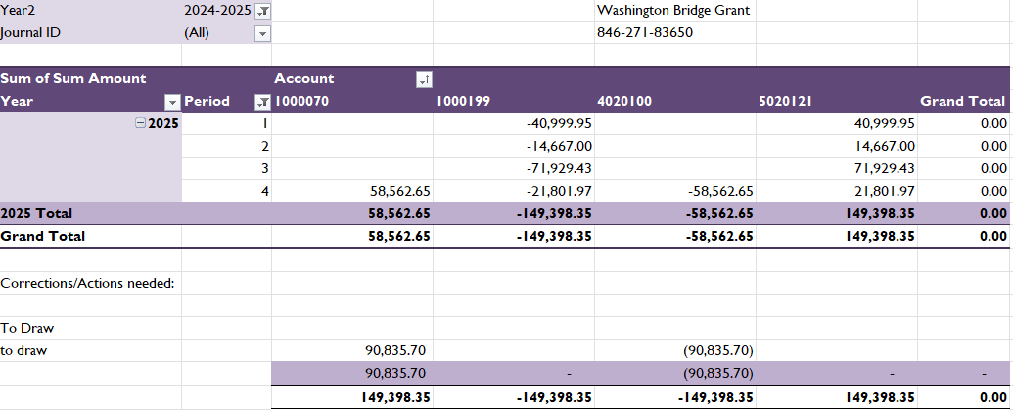
Reconciliation Cycle – WSAC

Slide 44
Reconciliation Cycle – All Awards
Organized by Chartstring
Compares Total Expenses per SJS to GL
Appropriate Adjustments are considered.
<explain the basic principles>
<demonstrate the All Award Recon file>

Slide 45
Financial Aid Responsibilities
Financial Aid...
Timing is EVERYTHING!
Run out and in process a day before
Order SAS report
Instructions found in COD under COD resources
Report comes in day after as PSOY file
Put report in the Reader
Instructions found in COD under COD resources
Printer Friendly version of Cash Activity Page in COD
Find this under School tab in COD
This process is done for both Pell and Direct Loans

Slide 46
Financial Aid Responsibilities
Financial Aid...
Report comes back from Finance
Work through discrepancies
NEVER change things manually in COD
When in doubt phone a friend (send a ticket)
Reports that help us find errors found in your Business Processing Guide
PGPO (pell overpayment)
PGMR (multiple reporting)
Errors/Rejects

Slide 47
FARC FARP

Slide 48
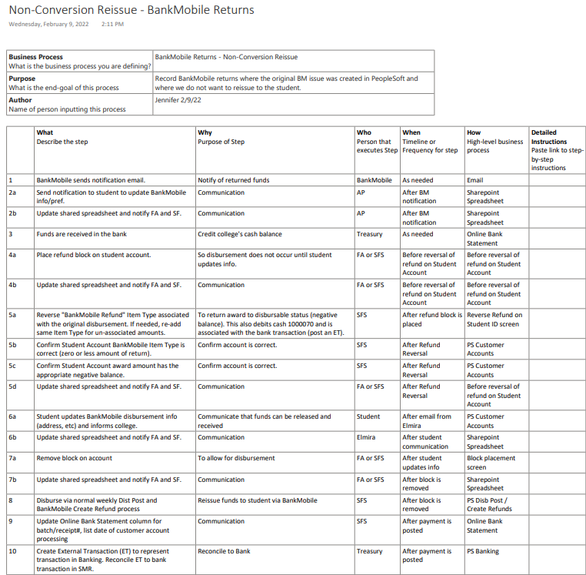

Slide 49
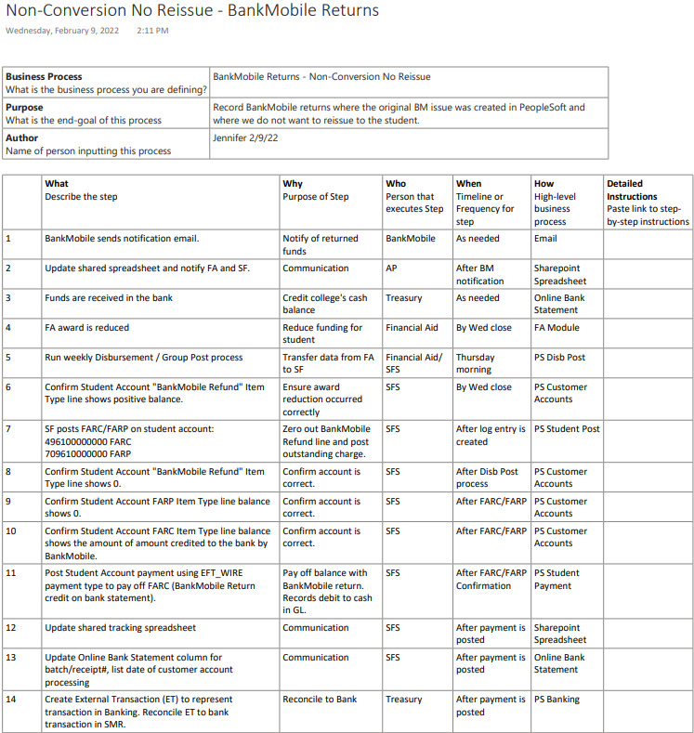

Slide 50
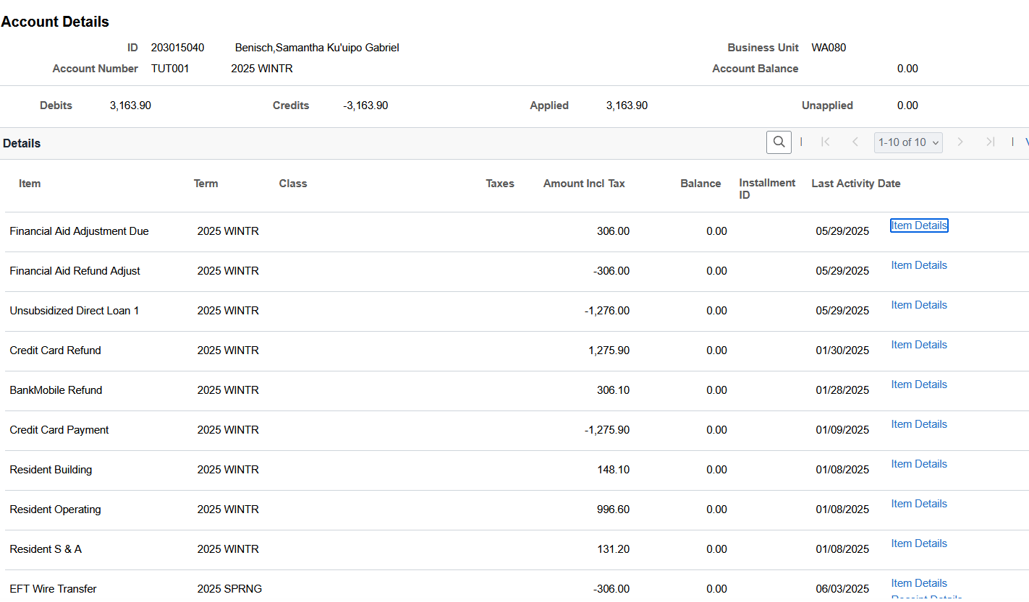
FARC FARP – Do Not Reissue
See next page
Reduces Cash
Increases Cash
Pays off FARC

Slide 51
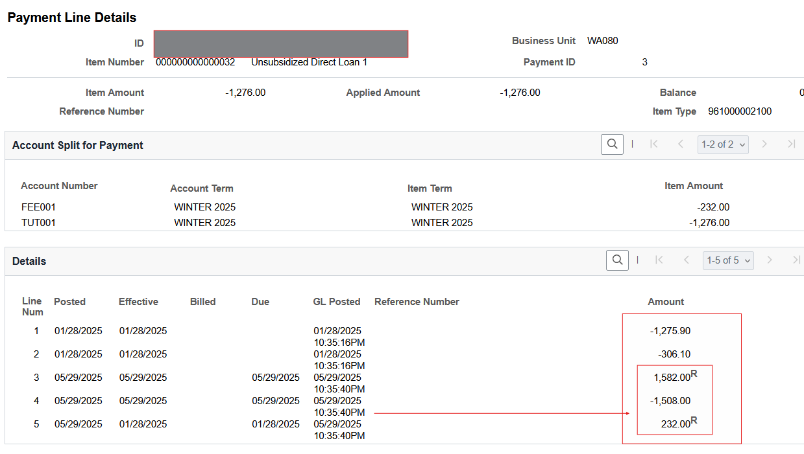
FARC FARP – Do Not Reissue
= $306.00

Slide 52
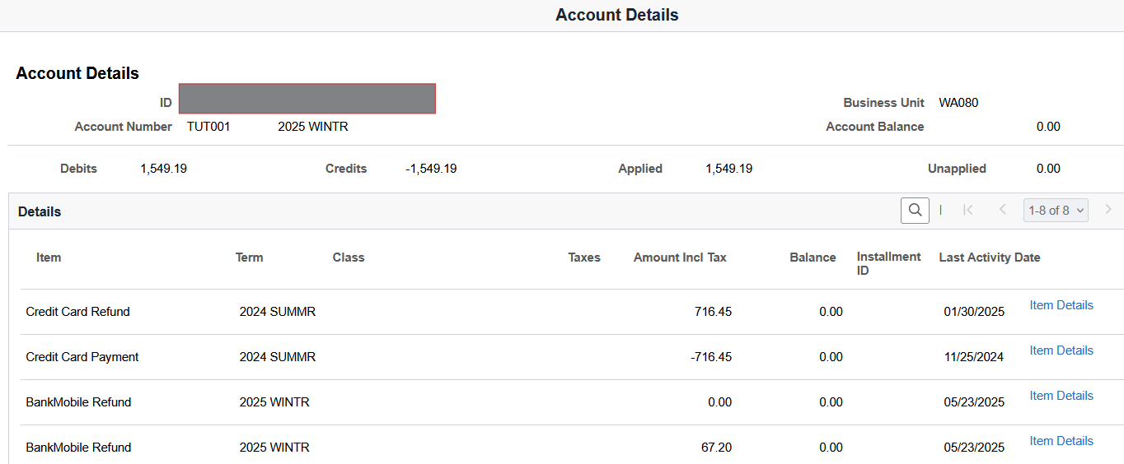
FARC FARP – Reissue
Increases Cash (Rev Refund)
Decreases Cash (Reissue)

Slide 53
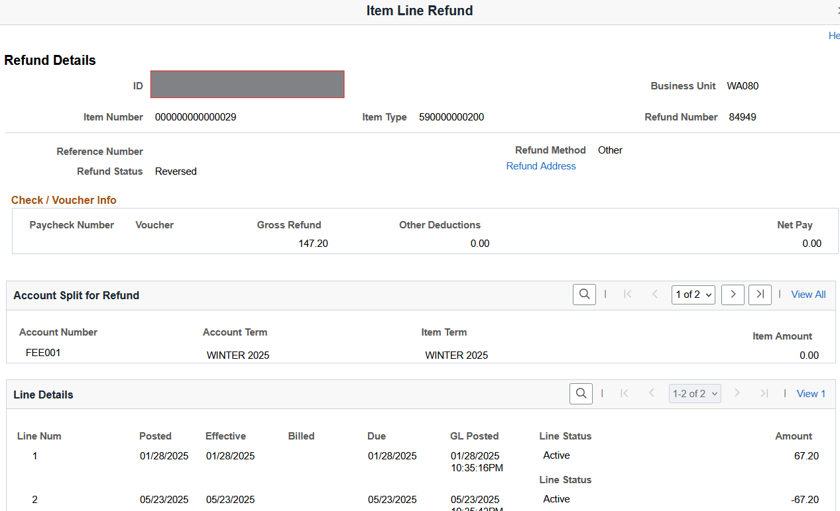
FARC FARP – Reissue
Reduction of cash

Slide 54
FYE Considerations
Journal any G5 / WSAC expenses for awards disbursed after June 30th for 2025 to FY25 in GL until close.
Accrue Revenue. Revenue should match the FYE expense balance and be drawn/returned for that amount in the new year.
Work more often to ensure all awards match GL
Reconcile G5 and WSAC multiple times a week until perfect.
Watch the WSAC draw cutoff date.

Slide 55
Contact Info
FINANCE OFFICE
Jennifer McMillan
Finance Manager
425-564-4281
jennifer.mcmillan@bellevuecollege.edu
Amy Jing
Fiscal Analyst 5
425-564-4252
amy.jing@bellevuecollege.edu
FINANCIAL AID
Christine Taylor
Director-Financial Aid & Veteran Services
425-564-5663
christine.taylor@bellevuecollege.edu
Jennifer Fetters
Associate Director-Financial Aid
425-564-2597
jennifer.fetters@bellevuecollege.edu

Slide 56
Questions?

