Slide 1
FA/SF/FIN Cross-Pillar Training
Topic: End to End Reconciliation
May 5, 2025 (1:00pm – 3:00pm)

Slide 2
MEETING RECORDING NOTICE
The law requires consent prior to recording a person’s participation in an event. Your participation in this video conference (training) equals consent to be recorded, as required by law.
If you do not consent to being recorded but choose to participate, please turn your camera off and use the chat feature to interact with the other participants.
Enable Closed Captions
Enable AI Assistant

Slide 3
HOUSEKEEPING
Session will be recorded - Find session recording in the ctcLink Pillar Work Session Canvas Course (Cross-Pillar Work Sessions 2025)
The captions for this recording are auto-generated. If additional assistance is needed to receive an increased level of access, please contact Alec Risk (arisk@sbctc.edu).
Please mute your line when not speaking
Be ready to participate & ask questions
If we move too quickly, ask us to slow down or to revisit a topic

Slide 4
Objectives
After completing this training, you should be able to:
FA/SF/FIN - Understand the high-level flow of the cross-pillar end-to-end reconciliation process

Slide 5
Financial Aid Objectives
After completing this training, you should be able to:
FA - Demonstrate a sample interdepartment reconciliation worksheet college users can use/build off of to track expenses, revenue, and variances
FA - Understand the available reports and queries in the Fund Management Guide that should be run on weekly, semi-monthly, and monthly basis
FA - Understand the high-level process in FA concerning what queries and reports to run for varying funding sources
FA - Understand the timing in which SAS files are available to use for FA/COD reconciliation

Slide 6
Student Financials Objectives
After completing this training, you should be able to:
SF - Understand how the GL is sent to FIN via SF/CASHIER journals
SF - Understand the available SF queries and how to reconcile them

Slide 7
Finance Objectives
After completing this training, you should be able to:
FIN - Review of GL Account Guidance / Resources
FIN - Understand How SF Data Processes into Finance
FIN - Review SF/GL Reconciliation Queries
FIN - Reimbursement/Drawdown Best Practices

Slide 8
Financial Aid
Kelly Forsberg– SBCTC FA Functional Trainer

Slide 9
CASH MANAGEMENT & RECONCILIATION

Slide 10
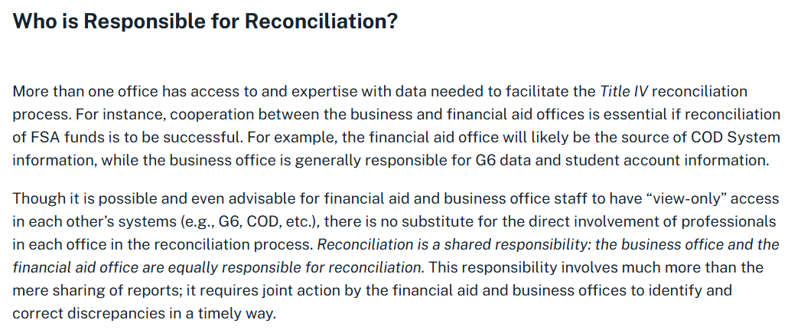
Reconciliation
Source: Reconciliation in the Pell Grant and Campus-Based Programs | 2024-2025 Federal Student Aid Handbook

Slide 11
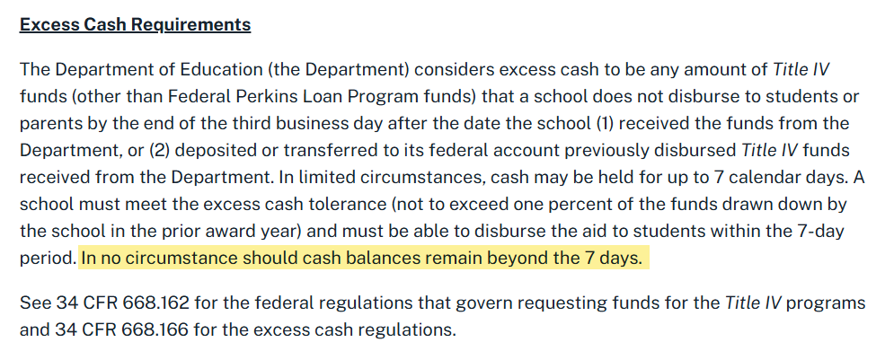
Cash Management
Source: Reconciliation in the Pell Grant and Campus-Based Programs | 2024-2025 Federal Student Aid Handbook

Slide 12
FINANCIAL AID HIGH-LEVEL RECON FLOW

Slide 13
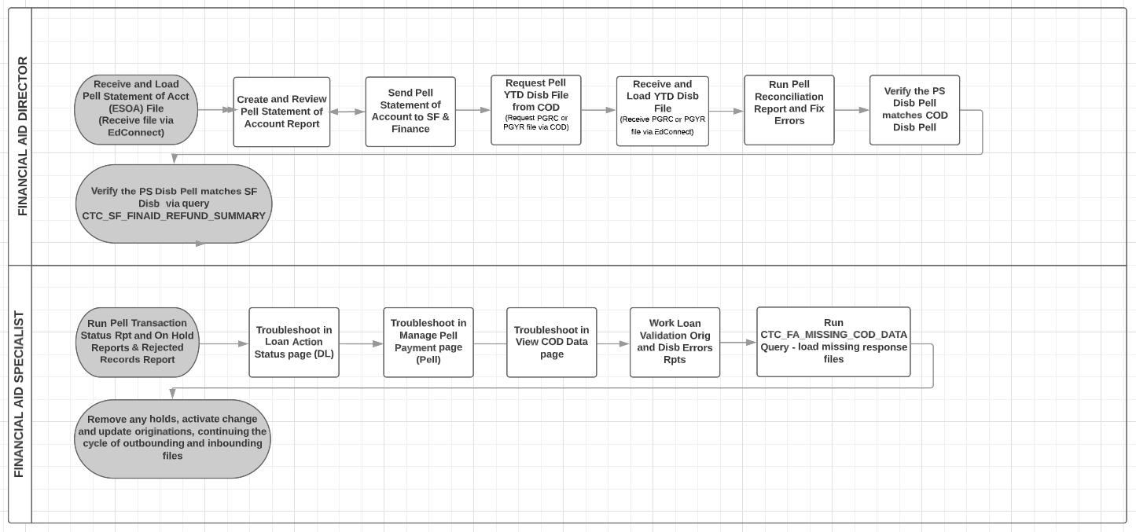
fA: Steps in the process HIGH-LEVEL RECON

Slide 14
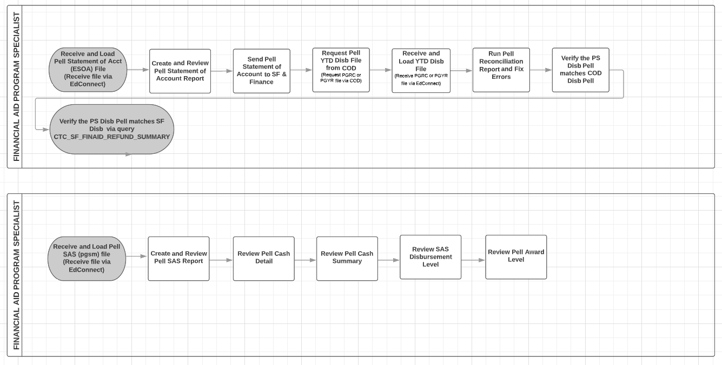
fA: Steps in the process cont’d high-level pell GRANT

Slide 15
fA: Steps in the process cont’d high level direct loans

Slide 16
SHARED RECONCILIATION WORKSHEET EXAMPLE

Slide 17
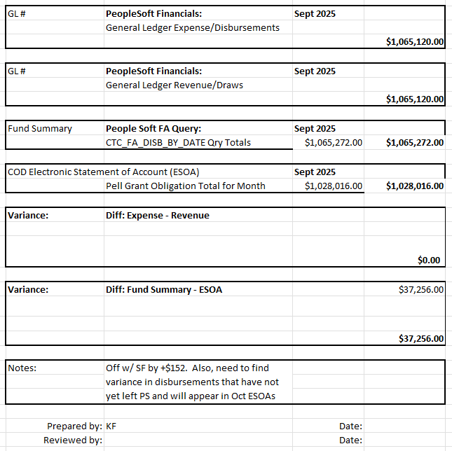
Shared reconciliation worksheet
TRACKING WORKSHEET: Share with FA-SF-FIN staff responsible for reconciliation. Use it to track expenditures, and for variance explanation, and as documentation for auditors.
Example only

Slide 18
DEMONSTRATION

Slide 19
FA RECON: SAS FILES AND ESOA STATEMENTS

Slide 20
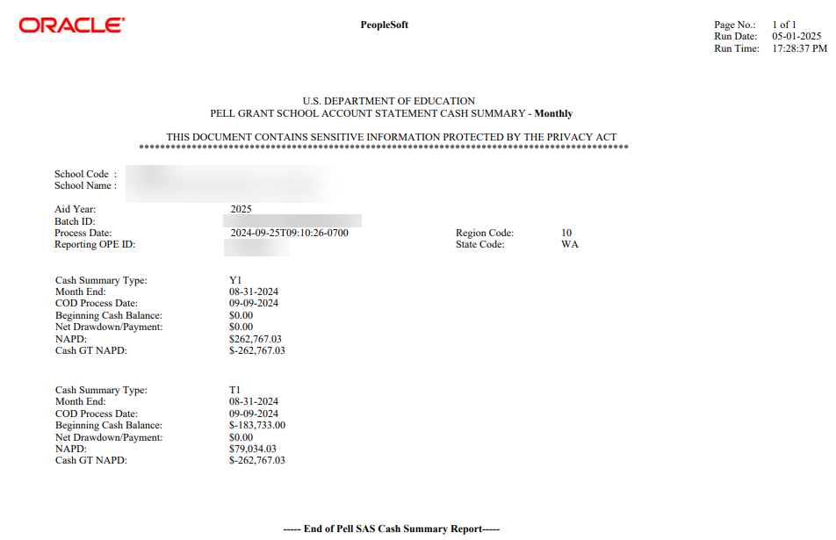
Financial aid SAS FILES
PELL SAS IMPORT PROCESS: Generates a monthly statement, like a bank statement, which summarizes the school's processing activity for that month.

Slide 21
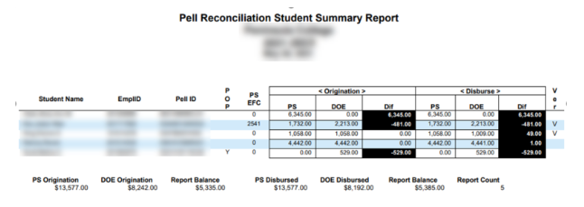
Financial aid SAS FILES cont’d
PELL GRANT RECON REPORT (PGRC file) - Contains comparative disbursement to ctcLink data for the AY.

Slide 22
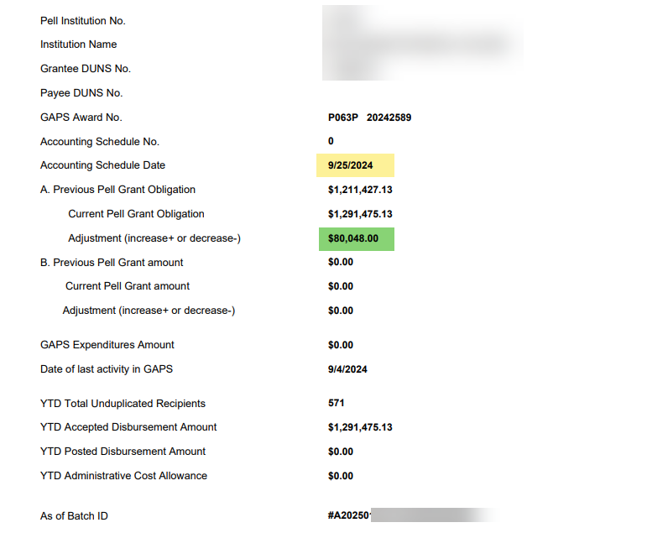
Financial aid ESOA
ELECTRONIC STATEMENT OF ACCOUNT – Generates a statement on previous Pell Grant Obligation and compares it to current Pell Grant Obligation, showing where the adjustment is needed in COD and/or G5.

Slide 23
FA RECONCILIATION QUERIES

Slide 24
FA QUERIES (RECONCILING TO SF)
CTC_FA_SF_DISCREPANCY
QCS_SF_CREDIT_BAL_NONREF
CTC_FA_DISBURSED_BY_DATE_UNITS
QCS_SF_FA_SA_APPLIED_SUMMARY
QCS_SF_FA_SA_APPLIED_DETAILS
Run daily/weekly (suggested)

Slide 25
FA QUERIES (RECONCILING TO SF CONT’D)
Run semi-monthly (suggested)
QCS_SF_ITM_TYPE_GL_INTERFACE
CTC_FA_ITEM_DISBURSED
CTC_FA_CBS_AND_SNG_LIST
CTC_FA_WAITLISTED_AWARDS
CTC_FA_TERM_ITEM_TYPE_AWARDED
CTC_FA_THIRD_PARTY_PYMNTS
CTC_FA_MISSING_COD_DATA

Slide 26
FA QUERIES (RECONCILING TO SF CONT’D)
CTC_FA920 (FUND ROSTER)
CTC_FA801 (AWARD DATA BY ITEM TYPE)
QCS_FA_FISCAL_ITEM_TYPE_BUDGET
Run monthly

Slide 27
Final Reconciliation
TIPS FOR RECON SUCCESS
After you are done running FA Disbursement to SF, immediately run Pell and DL Out to report those disbursements
Work disbursement rejects immediately after receiving the COD response file(s).
Report new student disbursements to WSAC often, so you can request those funds from CSAW.

Slide 28
Student Financials
Alec Risk – SBCTC SF/FIN Functional Trainer

Slide 29
SF: STEPS IN THE PROCESS - ITEM TYPE TO GL

Slide 30
What are Item Types?
Item Types tell a story of a student or organization.
Item Types are influenced by many individuals on and off your campus.
Item Types come in different forms:
Payments
Cash/Check/Credit Card/etc.
Charges
Tuition
Fees
Financial Aid
Waivers
Refunds

Slide 31
SF to FIN via GL – E214
Student-related transactions
Accounting transactions from SF sent nightly
Creates additional accounting entries in the SF_ACCTG_LN table
Journals labeled as SF
Fund balanced debit/credit transactions which includes:
Financial Aid
Payments
Waivers
QCS_SF_E214_ACCTG_LN_CF_DTL

Slide 32
E214 Spreadsheet Recon

Slide 33
SF to FIN via GL – E215
Non-student related transactions, specific to Department Receipts in SF
Journals labeled as SFC
QCS_SF_COLLECT_DEPT_RECEIPTS
QCS_SF_DEPT_RECEIPTS_GL

Slide 34
Second Journal Set (SJS)
A Student Financials to Finance process that assists with accounting entries required for the General Ledger.
Only select payment Item Types (9*** and 75**) are configured.
It generates, based on configuration, expense data lines that offset internal cash and the data lines are posted to the GL.
The expense data can be used as documentation for invoicing or drawing down funds.

Slide 35
SF to FIN via GL – E218
Second Journal Set
Journals labeled as SJS
QCS_SF_2ND_JOURNAL_SET
QCS_SF_ITEM_1ST_2ND_ACCOUNTS
QCS_SF_ITEM_GL_1ST_2ND_DETAIL

Slide 36
SF Queries
QCS_SF_ITEM_1ST_2ND_ACCOUNTS
QCS_SF_ITEM_GL_1ST_2ND_DETAIL
QCS_SF_DEPT_RECEIPTS_GL
QCS_SF_FA_SA_APPLIED_SUMARY
QCS_SF_FA_SA_APPLIED_DETAILS
QCS_SF_ITEMTYPES_TO_CPL

Slide 37
SF Resources
SF – General Ledger Interface QRGs
Understanding Item Types QRG
SF100 SF Fundamentals (Tuition Calculation) Canvas Course
ctcLink Pillar Work Session Information Canvas Course

Slide 38
Finance
Karen Ebert– SBCTC Agency Controller (Formerly FIN Functional Trainer)

Slide 39
FIN GL Account Guidance & Resources
SBCTC Accounting and Business Services web page
SBCTC Webpage for ctcLink Support which includes links to listservs, Training, Support and the Financials Process Schedule.
GL100 General Ledger – Canvas Course
General Ledger section of the ctcLink Reference Center
ctcLink Pillar Work Session Information - Canvas Course
BAR Sub Team – Canvas Course

Slide 40
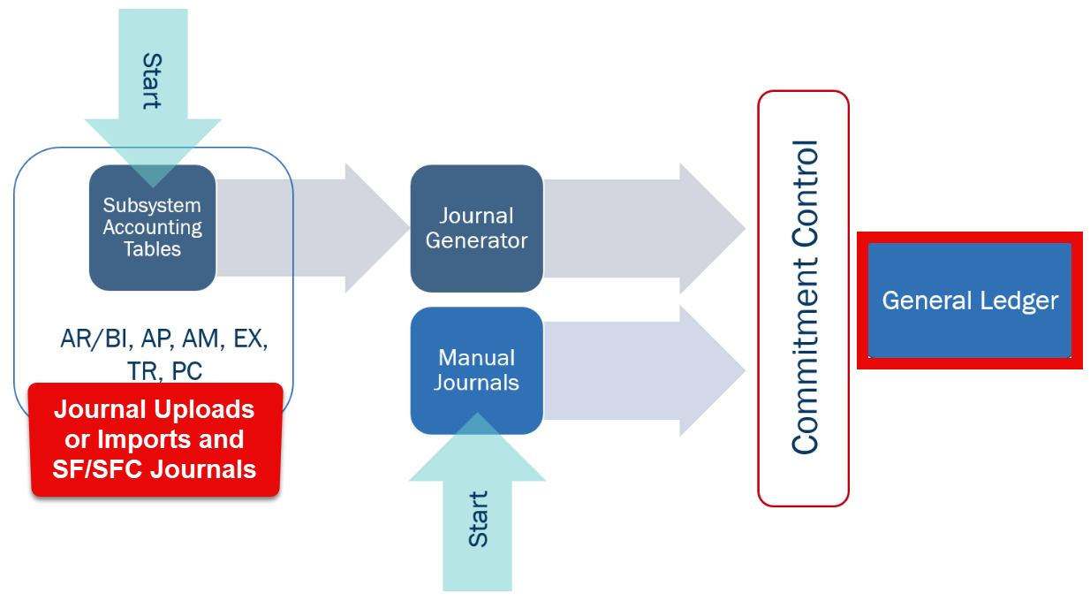
How DATA Processes into Finance…

Slide 41
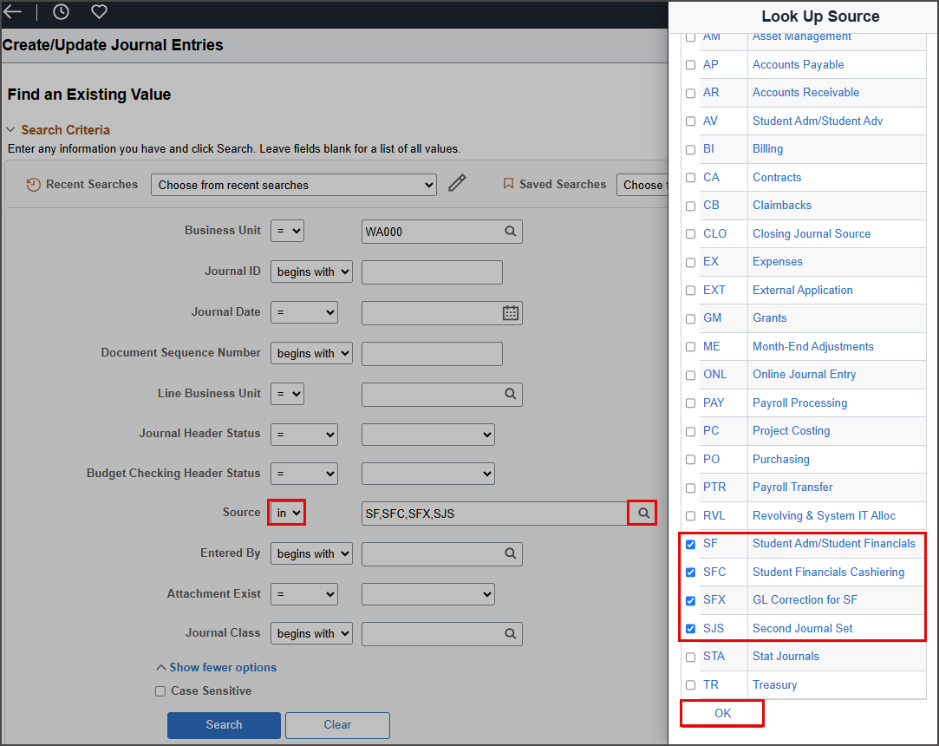
Tip: Search by the “SOURCE” within existing General Ledger Journals…

Slide 42
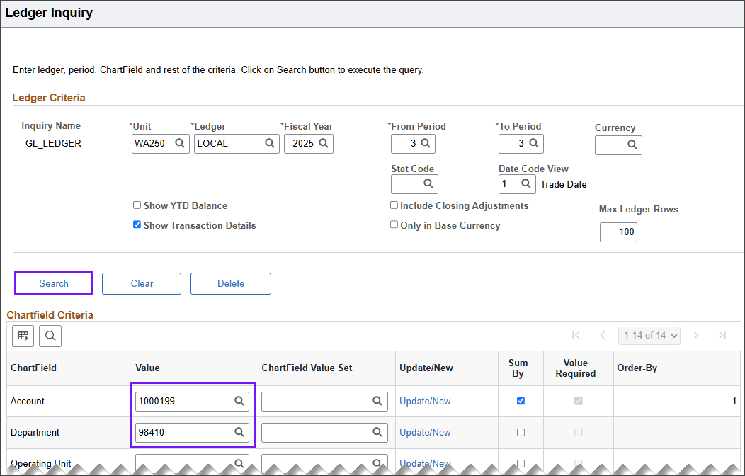
Training example: FAID > SF > FIN Did our data match? QFS_GL_ACCOUNT_ANALYSIS and ctcLink Ledger Summary Navigation: General Ledger > Review Financial Information > Review Ledger Information

Slide 43
SF/GL Reconciliation Queries
QFS_GL_ACCT_ANALYSIS – High level summary data
QFS_GL_ACCOUNT_ANALYSIS – Detailed level data
QFS_GL_SF_JRNL_VERIFY_BY_CF – SF System to Journal to Ledger
QFS_GL_SF_ACCTG_LINE_EXCEPT – SF Accounting Line Exceptions
QFS_GL_SF_ACCTG_GL_JRNL_ID – SF Acct Line to Gl by Jrnl Act

Slide 44
Reimbursement/Drawdown Best Practices
Option 1: Create a MANUAL JOURNAL ENTRY > Post to GL. Per SBCTC Accounting, this method is not recommended as it does not “create an entry” in Banking. Please contact SBCTC ACCTG for questions.
Option 2: Receive a DIRECT JOURNAL DEPOSIT > Post an AR Journal > Post to GL
Option 3: Create an EXPRESS BILL > Receive an Express Deposit and Apply Payment to Bill > Post to GL
**TIPS FOR RECON SUCCESS: Attach supporting documentation, use the Billing “Header Note”, and consider using Billing or AR Speed Types.

Slide 45
Questions?

Slide 46
Objectives
You should now be able to:
FA/SF/FIN - Understand the high-level flow of the cross-pillar end-to-end reconciliation process
FA - Demonstrate a sample interdepartment reconciliation worksheet college users can use/build off of to track expenses, revenue, and variances
FA - Understand the available reports and queries in the Fund Management Guide that should be run on weekly, semi-monthly, and monthly basis
FA - Understand the high-level process in FA concerning what queries and reports to run for varying funding sources
FA - Understand the timing in which SAS files are available to use for FA/COD reconciliation
SF - Understand how the GL is sent to FIN via SF/CASHIER journals
SF - Understand the available SF queries and how to reconcile them
FIN - Review of GL Account Guidance / Resources
FIN - Understand How SF Data Processes into Finance
FIN - Review SF/GL Reconciliation Queries
FIN - Reimbursement/Drawdown Best Practices

