Slide 1
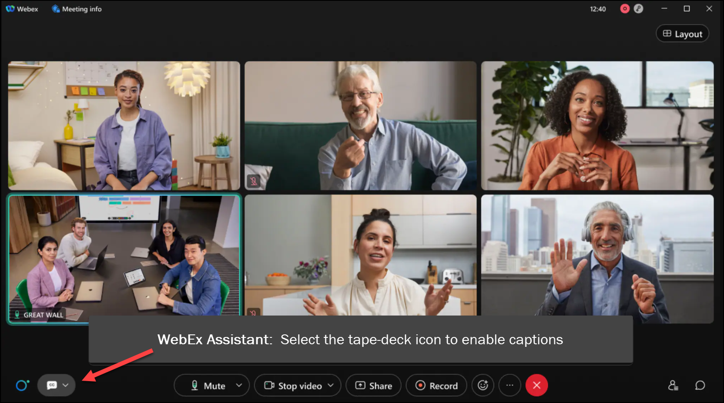

MEETING
RECORDING
NOTICE
The law requires consent prior to recording a person’s participation in an event. Your participation in this video conference (training) equals consent to be recorded, as required by law.
If you do not consent to being recorded but choose to participate, please turn your camera off and use the chat feature to interact with the other participants.

Slide 2
ISIR PROCESSING refresher TRAINING
Kelly Forsberg
ctcLink Functional Trainer | Financial Aid
March 2025

Slide 3
Objectives
After completing this training, you should be able to:
Understand how to set/update User Defaults for the new AY
Understand the steps in ISIR Processing
  Upload/download process
  FA Inbound
  Process Imported ISIRs
Understand how to load ISIRs using the File List Driven process and the Single File process

Slide 4
SETTING UP
USER DEFAULTS

Slide 5
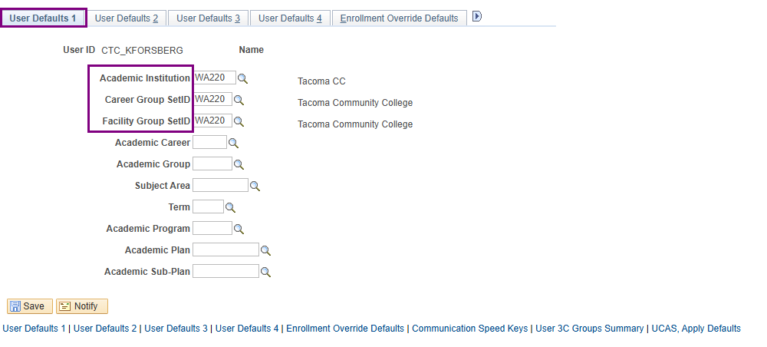
SET UP USER DEFAULTS
Navigation: Set Up SACR > User Defaults
Career Group SetID and a Facility Group SetID are for pages related to Campus Core

Slide 6
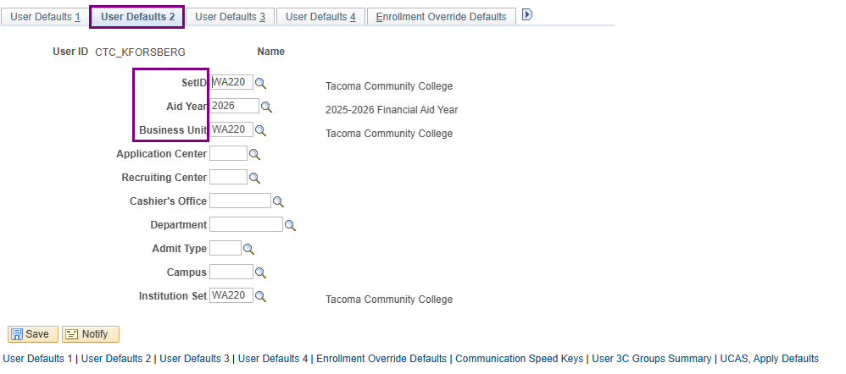
SET UP USER DEFAULTS cont’d
SetID and a Business Unit are for pages related to SF and FIN info.
You can update the Aid Year each year

Slide 7
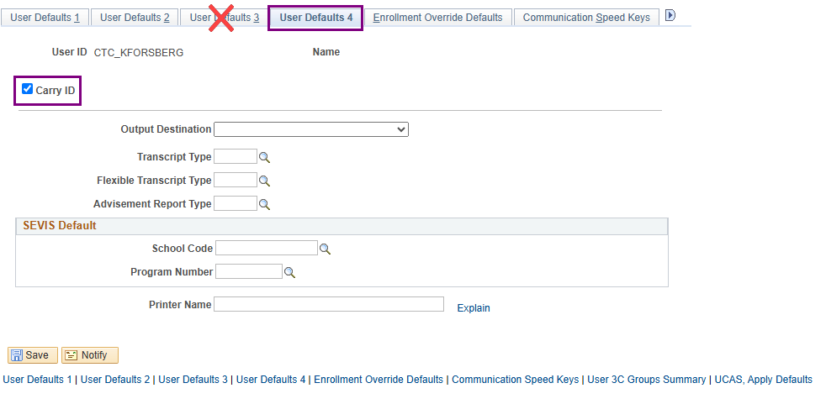
SET UP USER DEFAULTS cont’d
Skip the User Defaults 3 tab …
User Defaults 4, select the Carry ID checkbox (optional)

Slide 8
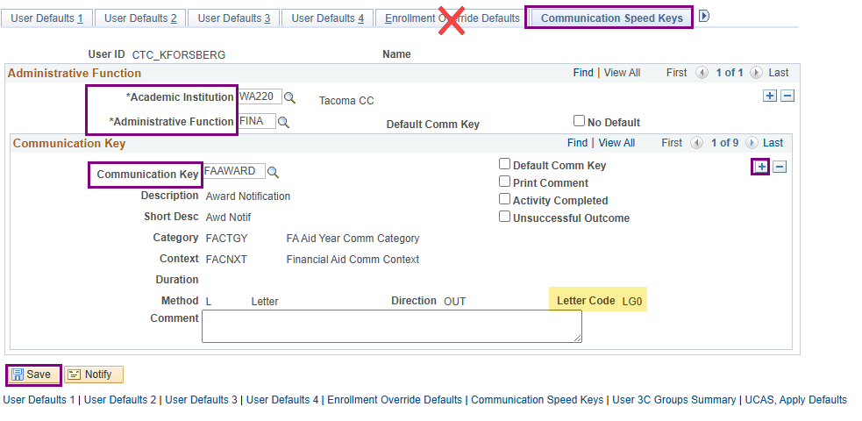
SET UP USER DEFAULTS cont’d
Skip Enrollment Override Defaults . . .
Communication Speed Keys, insert a new row and add all desired Communication Keys – select Save.

Slide 9
DEMONSTRATION

Slide 10
IMPORTING & PROCESSING ISIRS
(SINGLE FILE)

Slide 11
ISIR PROCESSING (inbound)
3-STEP PROCESS
Step 1: File Upload/Download
Step 2: Import Federal Data Files
Step 3: Process ISIRs

Slide 12
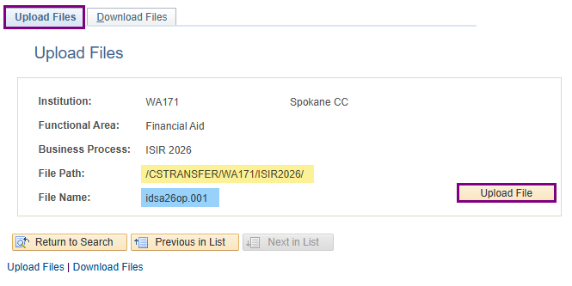
ISIR PROCESSING (inbound)
UPLOAD/DOWNLOAD PROCESS
Navigation: PeopleTools > CTC Custom >Extensions > Upload/Download Files
Note! This file path should be used in subsequent step.
Upload/Download pages are where all the files from ctcLink to EdConnect and EdConnect to ctcLink move through
Upload = Inbound (imports into ctcLink from your desktop or network drive
Download = Outbound (downloads to your network drive to then import into EdConnect)

Slide 13
ISIR PROCESSING (inbound)
3-STEP PROCESS
Step 1: File Upload/Download
Step 2: Import Federal Data Files
Step 3: Process ISIRs

Slide 14
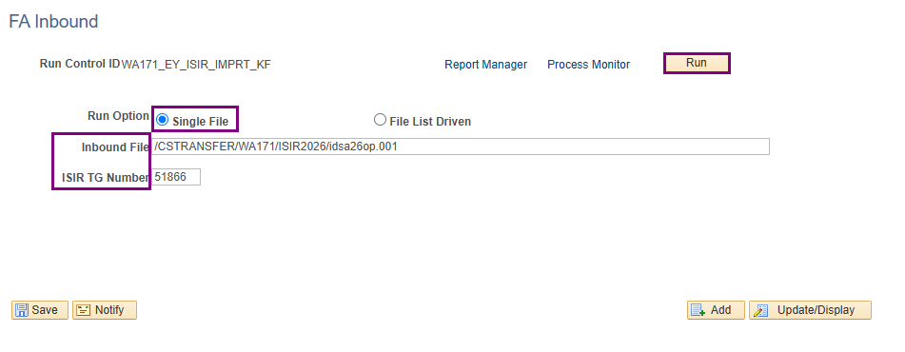
ISIR PROCESSING (inbound) cont’d
IMPORT FEDERAL DATA FILES
Navigation: Financial Aid > File Management > Import Federal Data Files
Note! This screen shot is for a Single File option. The file name will be different if using the File List Driven process.
Note: Steps 2 & 3 are handled in your EY ISIR JobSet. Your daily function is to load ISIRs in the Upload Files page and then update the files paths and file names in your text file, if using the File List Driven option.
If using the Single File option, you will need to update the file name in this run Control ID daily.

Slide 15
ISIR PROCESSING (inbound)
3-STEP PROCESS
Step 1: File Upload/Download
Step 2: Import Federal Data Files
Step 3: Process ISIRs

Slide 16
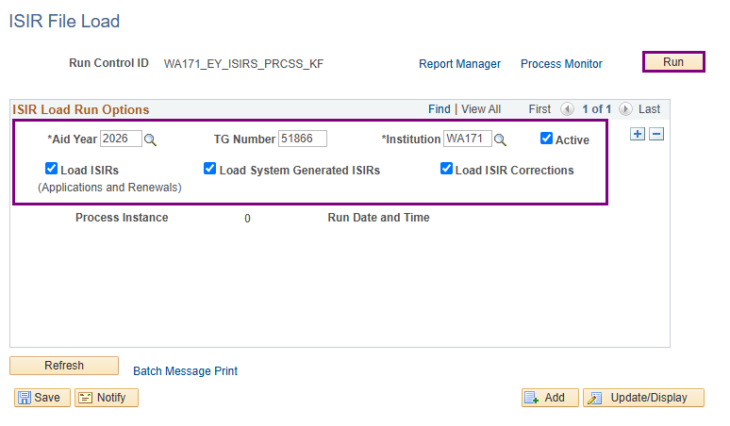
ISIR PROCESSING (inbound) cont’d
PROCESS ISIRS
Navigation: Financial Aid > File Management > ISIR Import > Process ISIRs
Note: This third step is run in your EY ISIR JobSet, to process your ISIRs to the Correct ISIR Records page in ctcLink.

Slide 17

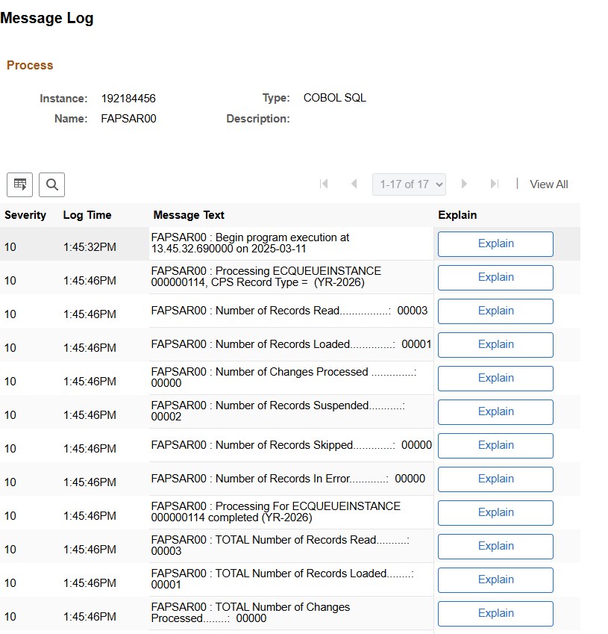
In this batch, how many records were suspended?
Bonus question: What is the EC Queue Instance Number in this batch?

Slide 18
DEMONSTRATION

Slide 19
IMPORTING & PROCESSING ISIRS
(COMBINED FILES)

Slide 20
ISIR PROCESSING (inbound)
COMBINED PROCESS
Step 1: File Upload/Download
Step 2: Import Federal Data Files
Step 3: Process ISIRs

Slide 21
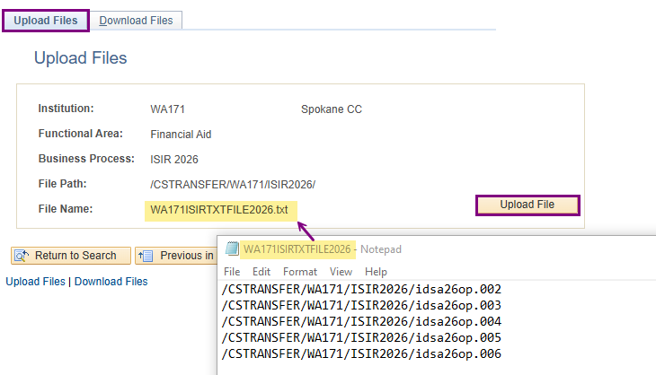
Isir PROCESSING (combined files)
UPLOAD/DOWNLOAD PROCESS
Navigation: PeopleTools > CTC Custom >Extensions > Upload/Download Files
Note– If using the combined process, you must individually upload ISIRs or WASFAs
one at a time to this Upload page.
Next, open a .txt file, list the File paths and the ISIR and WASFA file names in the .txt doc, and upload that .txt file too. The combined process allows all the files listed in the .txt file to be loaded at one time in the next step.

Slide 22
ISIR PROCESSING (inbound)
COMBINED PROCESS
Step 1: File Upload/Download
Step 2: Import Federal Data Files
Step 3: Process ISIRs

Slide 23
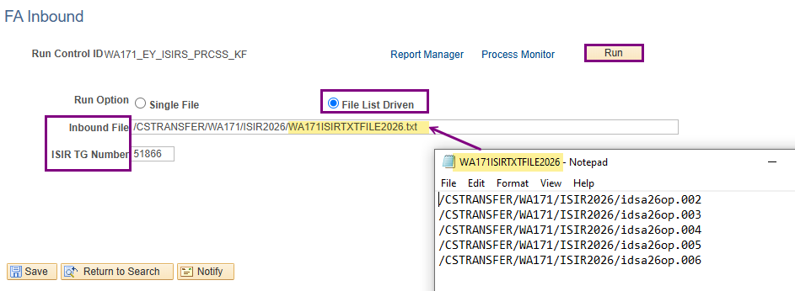
Isir PROCESSING (combined process)
IMPORT FEDERAL DATA FILES STEP
When using File List Driven (aka, the Combined Process), you can load several files at once, using a .txt file
Each ISIR & WASFA file must be uploaded to ctcLink individually, along with the .txt file, but all uploaded files can be imported using one .txt file (Notepad) via the File List Driven Process.
Optional-- You can leave the file name the same and just change the file contents each day, or you can change the name of your .txt file name each time you import it to distinguish it from previous files.

Slide 24
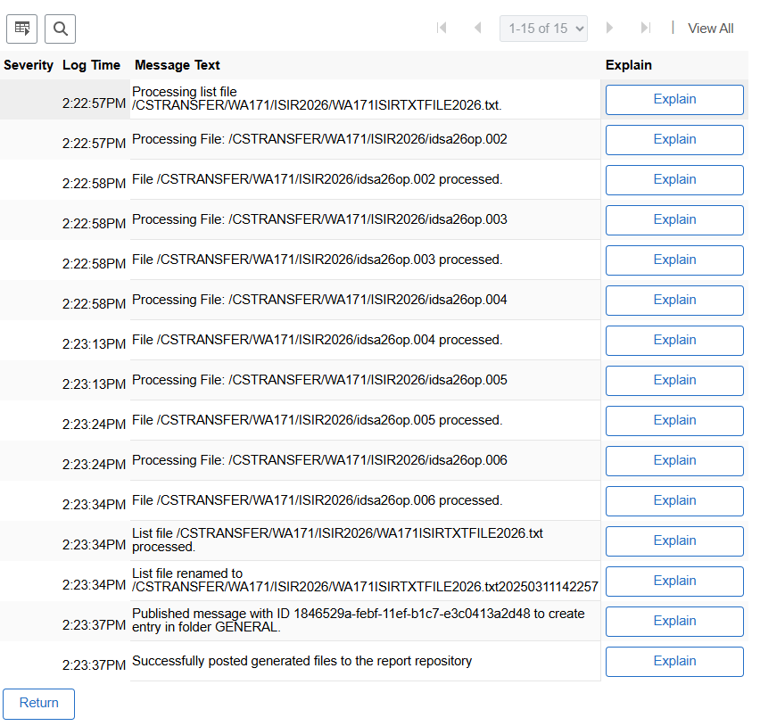
Isir PROCESSING (combined process)
MESSAGE LOG
You should always check your ISIR JobSet Message log, especially on the Import Federal Data Files step.
Make sure your files were loaded.

Slide 25
isir PROCESSING (inbound)
COMBINED PROCESS
Step 1: File Upload/Download
Step 2: Import Federal Data Files
Step 3: Process ISIRs

Slide 26
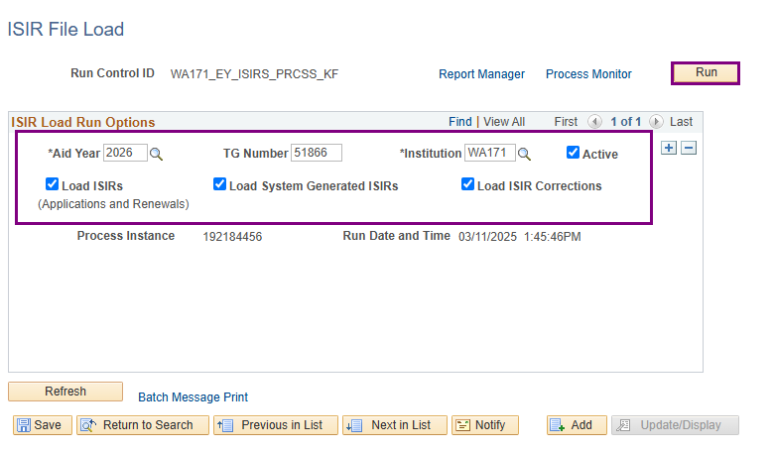
ISIR PROCESSING (inbound)
PROCESS ISIRS
Navigation: Financial Aid > File Management > ISIR Import > Process ISIRs
Note: This step will still be the same in your EY ISIR JobSet

Slide 27
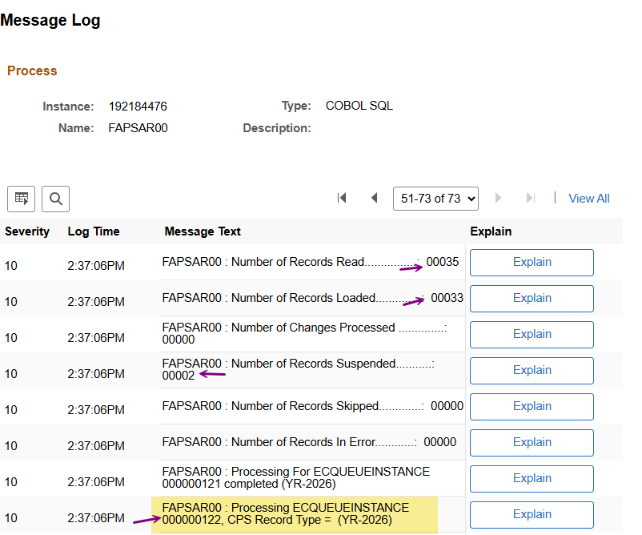
isir PROCESSING (inbound) cont’d
EC QUEUE INSTANCE
Tip: Go to your Process Monitor to find the EC Queue instance number is the sequence of WASFA/ISIR Processing.
You can use these EC Queue Instance numbers in the ISIR Transaction Source Query.
The query will display the ISIR/WASFA source: i.e., student or administrator correction, pushed from WSAC, etc.
Navigation: PeopleTools > Process Scheduler > Process Monitor

Slide 28
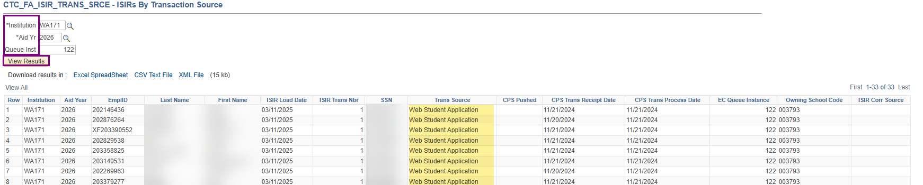
isir PROCESSING (inbound) cont’d
ISIR TRANSAC SOURCE QUERY
Navigation: Reporting Tools > Query > Query Viewer
Optional: You can use this query to track the source of the ISIR transaction.
For example, want to find all FPS-pushed ISIRs? Use this query to sort/filter.

Slide 29
DEMONSTRATION

Slide 30
Outcomes
At training completion, you should be able to:
Understand how to set/update User Defaults for the new AY
Understand the steps in ISIR Processing
  Upload/download process
  FA Inbound
  Process Imported ISIRs
Understand how to load ISIRs using the File List Driven process and the Single File process

Slide 31
Congratulations!
Your ISIR Processing Refresher Training is complete!
Please review the videos and additional resources in your canvas courses as needed
Thank you for your participation today!

