Slide 1
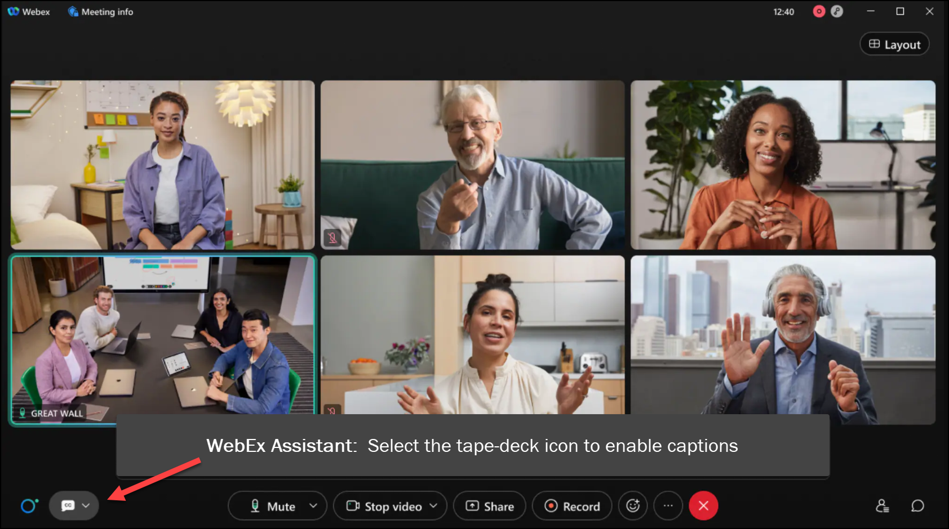

MEETING
RECORDING
NOTICE
The law requires consent prior to recording a person’s participation in an event. Your participation in this video conference (training) equals consent to be recorded, as required by law.
If you do not consent to being recorded but choose to participate, please turn your camera off and use the chat feature to interact with the other participants.

Slide 2
Intermediate loan processing: loan exit counseling processing
Kelly Forsberg
ctcLink Functional Trainer | Financial Aid
February 2025

Slide 3
Objectives
After completing this training, you should be able to:
Understand the difference between the emailed Loan Exit Counseling notification and the paper print out Loan Exit Packet options
Understand how to work email bounces using Communication Management
Understand how to test Loan Exit communications before sending them through Communication Generation
Understand how to print batch Loan Exit Packets using Communication Generation

Slide 4
EMAILED VS. PRINT-OUT
EXIT COUNSELING NOTIFICATIONS

Slide 5
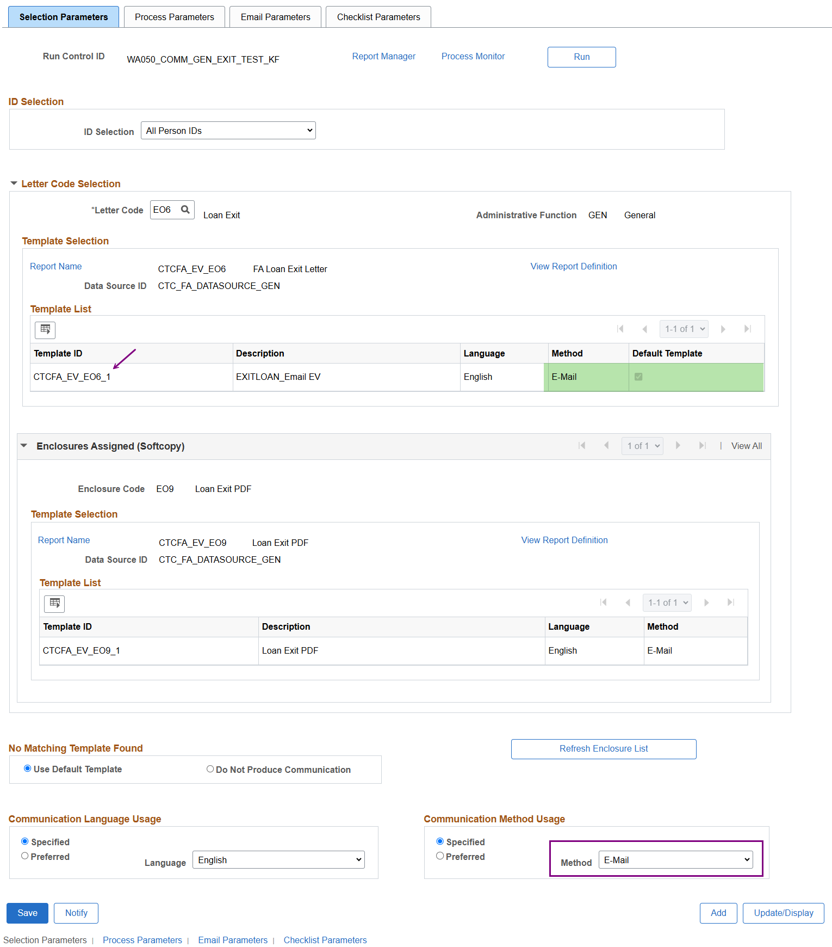
Communication generation
SELECTION PARAMETERS: E-mail
Navigation: Campus Community > Communications > Communication Generation >> Selection Parameters
Note the Enclosure Code is for a PDF, but the Communication Method Usage and the Default Template are Specified to
E-Mail

Slide 6
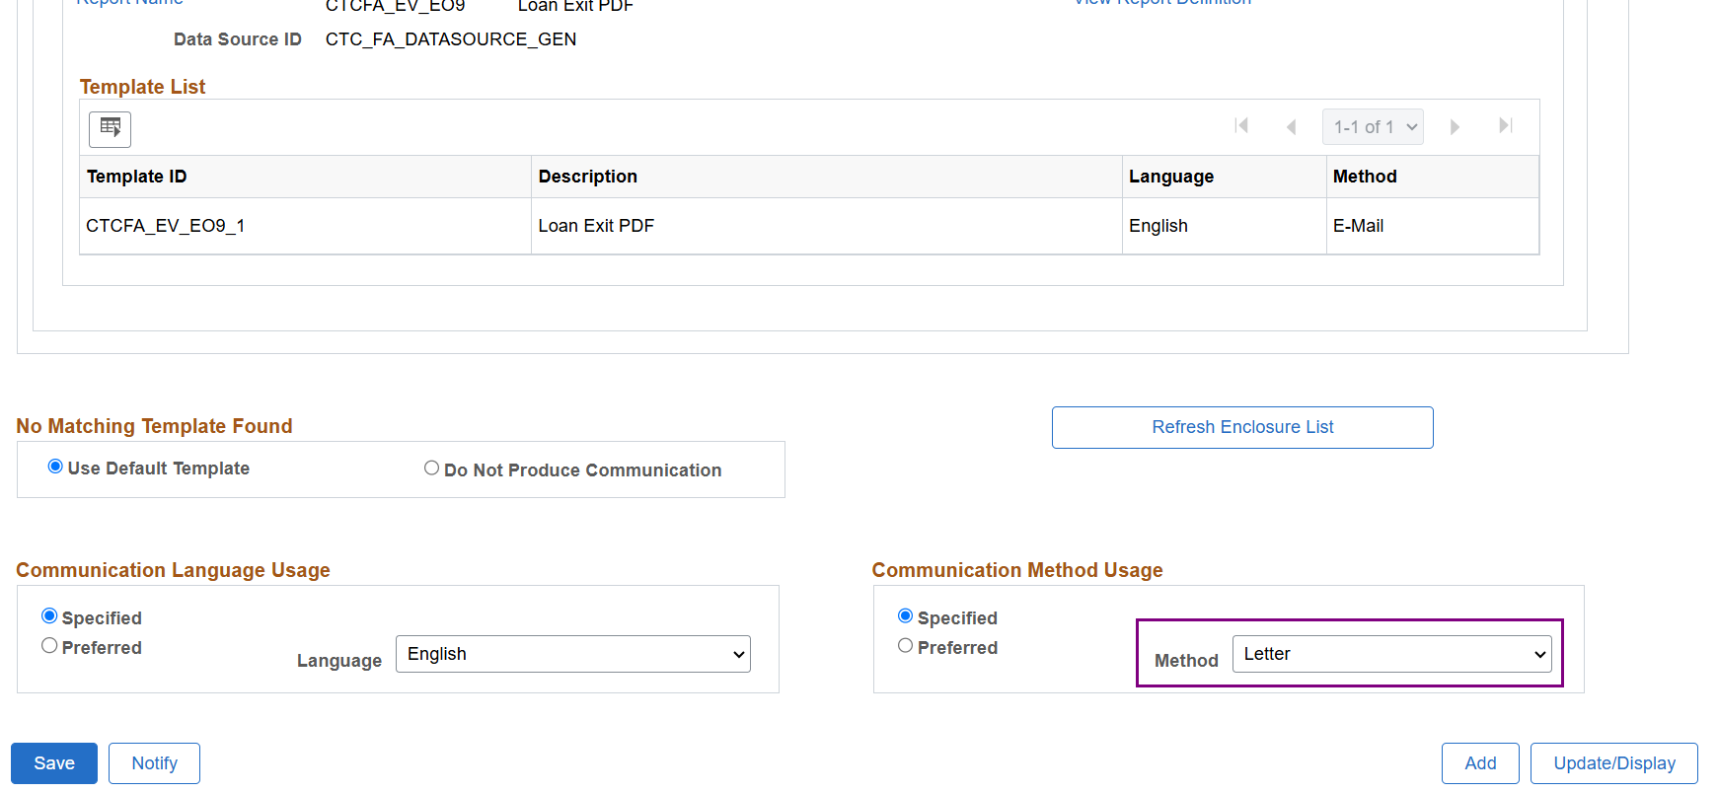
Communication generation
SELECTION PARAMETERS: Letter
Navigation: Campus Community > Communications > Communication Generation >> Selection Parameters
Note, your institution’s Letter Code for the Loan Exit Packet and/or PDF may be different than the emailed Loan Exit Notification

Slide 7
DEMONSTRATION

Slide 8
WORKING EMAIL BOUNCES/
TRACKING UNDELIVERED COMMUNICATIONS

Slide 9
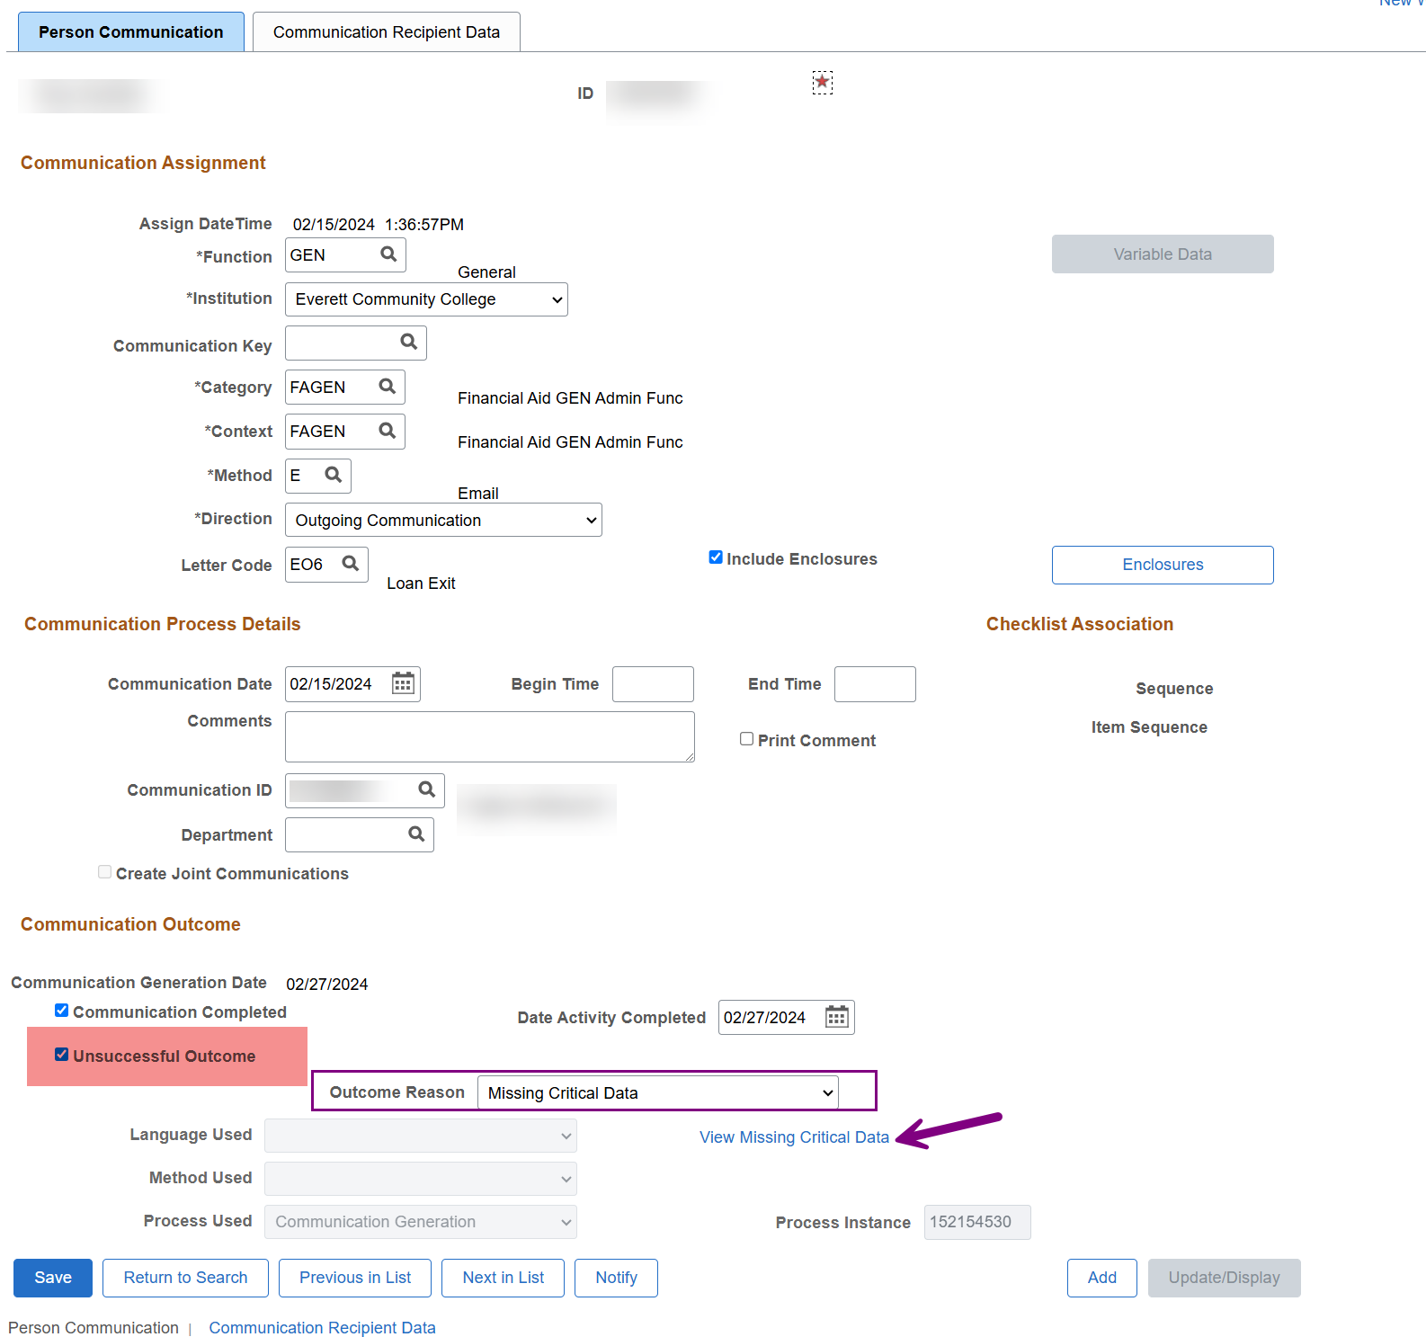
Working email bounces
COMMUNICATION MANAGEMENT
Navigation: Campus Community > Communications > Person Communications > Communication Management
In Communication Management, review the Communication Outcome:
‘Missing Critical Data’
Select the View Missing Critical Data link

Slide 10
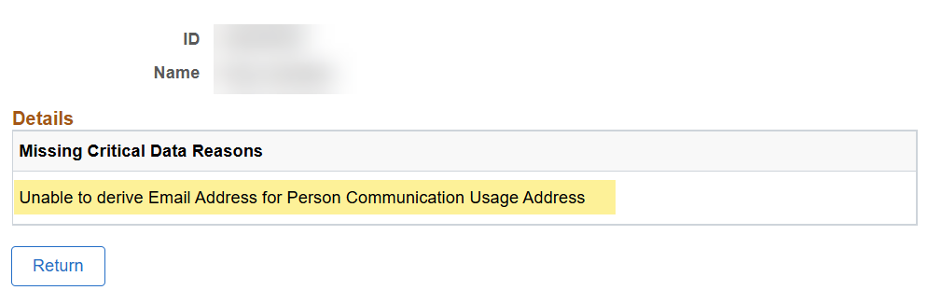
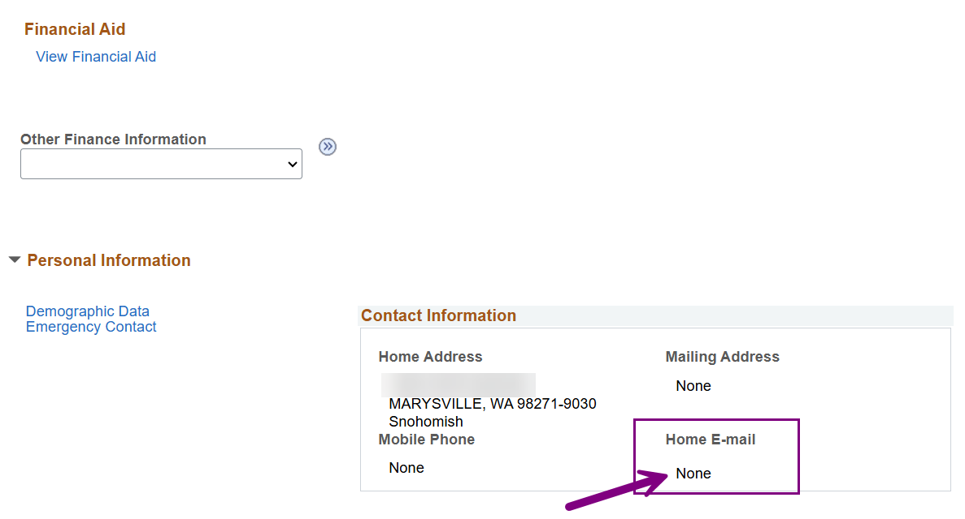
Working email bounces
COMMUNICATION MANAGEMENT CONT’D
Navigation: Campus Community > Student Services Center (Student)
The student’s email is missing from Student Center and needs to be added for Loan Exits to be emailed successfully

Slide 11
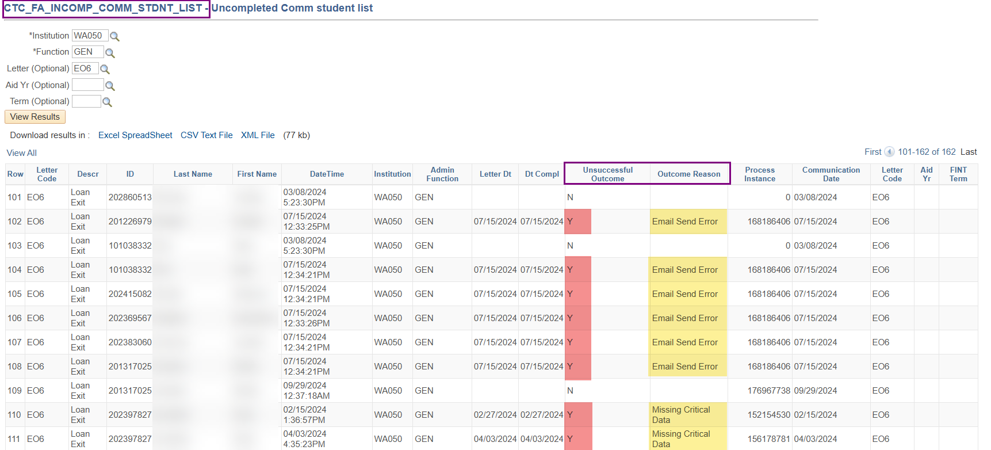
Tracking undelivered comms
QUERY
  CTC_FA_INCOM_COMM_STDNT_LIST
Navigation: Reporting Tools > Query > Query Viewer
Finds students with an Unsuccessful Outcome and lists Outcome Reason why Comm was not able to be sent to student

Slide 12
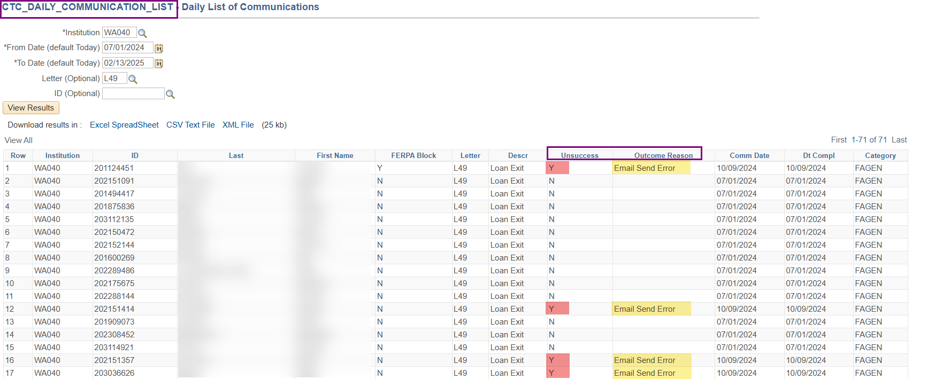
Tracking undelivered comms
QUERY
  CTC_DAILY_COMMUNICATION_LIST
Navigation: Reporting Tools > Query > Query Viewer
You can run this daily or as often as you run Loan Exits. Find your unsuccessful runs and outcome reasons

Slide 13
DEMONSTRATION

Slide 14
TESTING COMMUNICATIONS
BEFORE SENDING

Slide 15
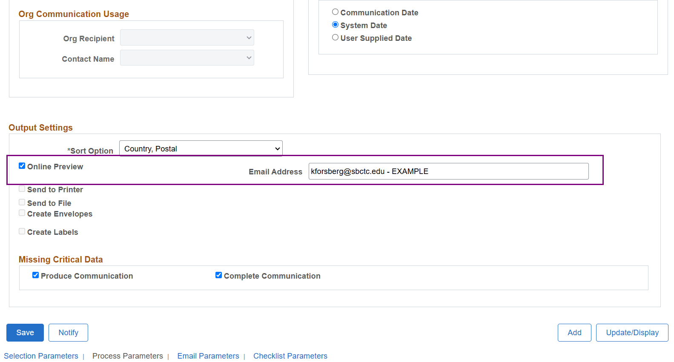
Testing communications before send
PROCESS PARAMETERS >> ONLINE PREVIEW
Navigation: Communications > Communication Generation >> Process Parameters
You can send the batch to yourself or someone else in your office to review what the output will look like before sending out to students

Slide 16
DEMONSTRATION

Slide 17
PRINTING BATCH
LOAN EXIT COMMUNICATIONS
USING COMM GEN

Slide 18
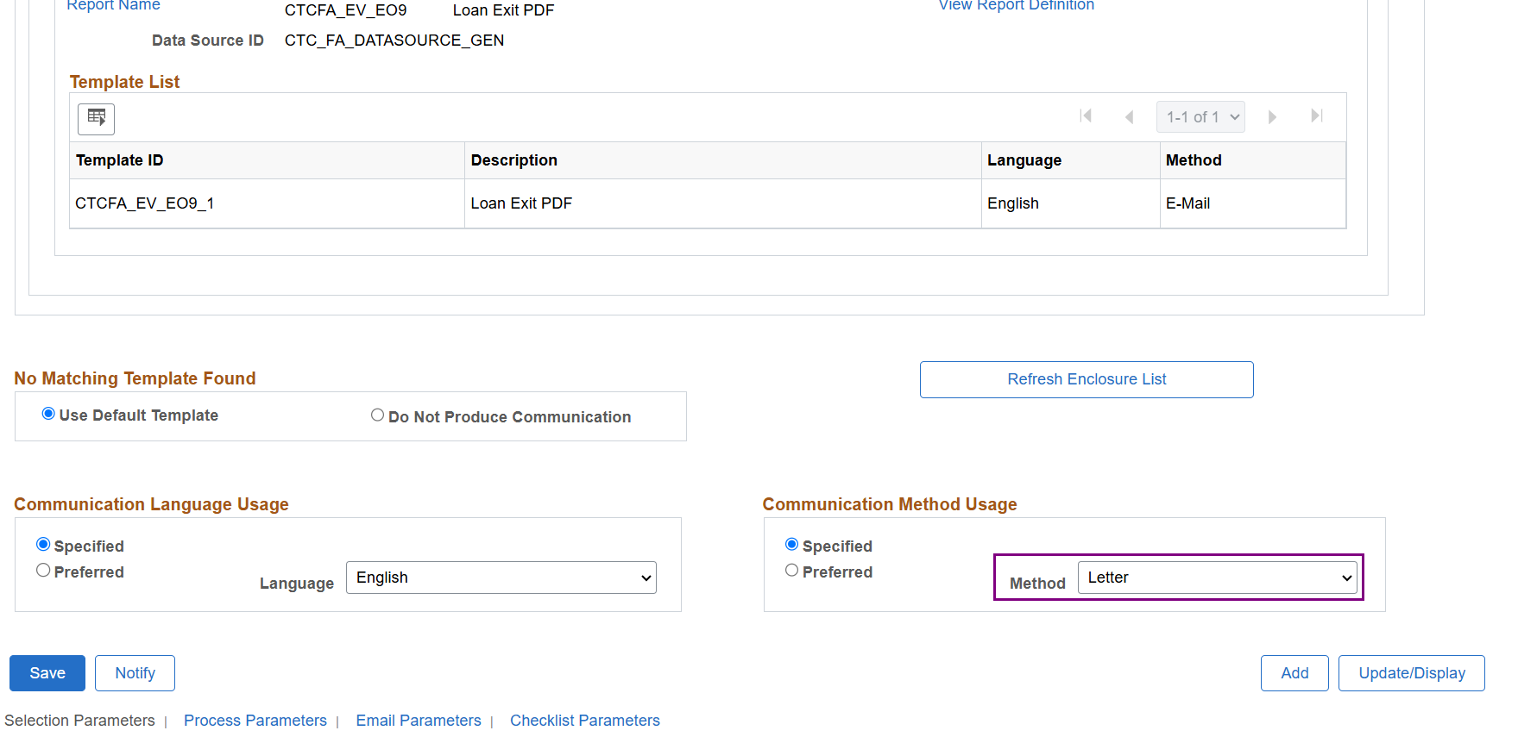
Printing batch loan exit comms
SELECTION PARAMETERS >> METHOD USAGE
Navigation: Communications > Communication Generation >> Selection Parameters
Set the Method to Letter

Slide 19
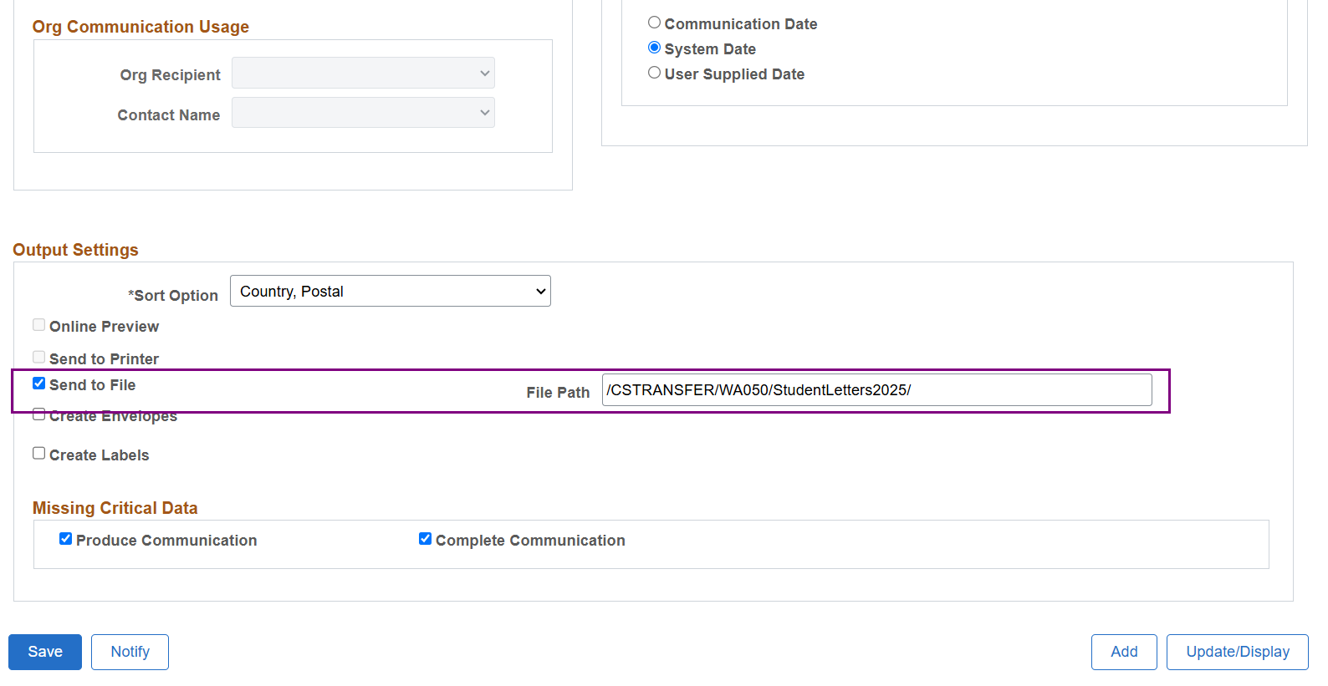
Printing batch loan exit comms cont’d
PROCESS PARAMETERS >> OUTPUT SETTINGS
Navigation: Communications > Communication Generation >> Process Parameters
Set the Output Settings to ‘Send to File’ with the file path from the Upload/Download page. Next, Download the file at the Upload/Download page.

Slide 20
DEMONSTRATION

Slide 21
Outcomes
At training completion, you should be able to:
Understand the difference between the emailed Loan Exit Counseling notification and the paper print out Loan Exit Packet options
Understand how to work email bounces using Communication Management
Understand how to test Loan Exit communications before sending them through Communication Generation
Understand how to print batch Loan Exit Packets using Communication Generation

Slide 22
Congratulations!
Intermediate Loan Processing - Loan Exit Counseling Processing Training Complete!
Please review the videos and additional resources in the ctcLink Reference Center as your progress through the steps
Thank you for your participation today!

