Slide 1
MEETING RECORDING NOTICE
The law requires consent prior to recording a person’s participation in an event. Your participation in this video conference (training) equals consent to be recorded, as required by law.
If you do not consent to being recorded but choose to participate, please turn your camera off and use the chat feature to interact with the other participants.
Enable Closed Captions
Enable AI Assistant

Slide 2
Fin aid training: Plus loan processing
Kelly Forsberg
ctcLink Functional Trainer | Financial Aid
January 2025

Slide 3
Objectives
After completing this training, you should be able to:
Understand awarding the PLUS Loan
performing a credit check
brief discussion about using loan request form vs. PLUS Loan application on studentaid.gov
Understand how to establish the Parent Record in ctcLink
Understand how to establish a student parent relationship
Understand how to link the parent record to the PLUS Loan record
Understand how to work with PLUS-denied students by awarding addt'l unsub

Slide 4
UNDERSTANDING
AWARDING A PLUS LOAN

Slide 5
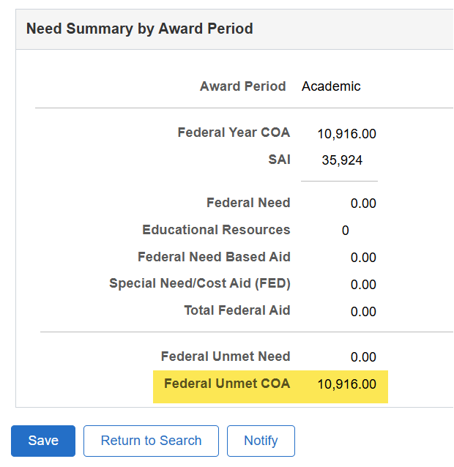
Understanding AWARDING A PLUS LOAN
Parent requests for Dependent student
Can be awarded up to Federal Unmet COA

Slide 6
Understanding awarding a plus loan cont’d
CREDIT CHECKS
Credit check is performed when the parent borrower applies through studentaid.gov
Or you can perform a credit check in COD, if you have written consent from the parent borrower
Credit checks are valid for 180 days
Loan Request Forms vs. PLUS Batches in COD

Slide 7
POLL TIME!

Slide 8
STEPS ON THE PLUS LOAN

Slide 9
PLUS LOAN PROCESSING
6-STEP PROCESS
Step 1: Award PLUS Loan
Step 2: Originate PLUS Loan
Step 3: Create Parent Record
(If none already exists)
Step 4: Establish Relationship for Parent
Step 5: Link Parent to PLUS Loan Record
Step 6: Re-originate PLUS Loan

Slide 10
PLUS LOAN PROCESSING CONT’D
AWARD PLUS LOAN
Navigation: Financial Aid > Awards > Award Processing > Assign Awards to a Student
If other aid is awarded, always sequence the PLUS or PLUS-denied award at the end of the aid package so it deducts properly from COA

Slide 11
PLUS LOAN PROCESSING CONT’D
6-STEP PROCESS
Step 1: Award PLUS Loan
Step 2: Originate PLUS Loan
Step 3: Create Parent Record
(If none already exists)
Step 4: Establish Relationship for Parent
Step 5: Link Parent to PLUS Loan Record
Step 6: Re-originate PLUS Loan

Slide 12
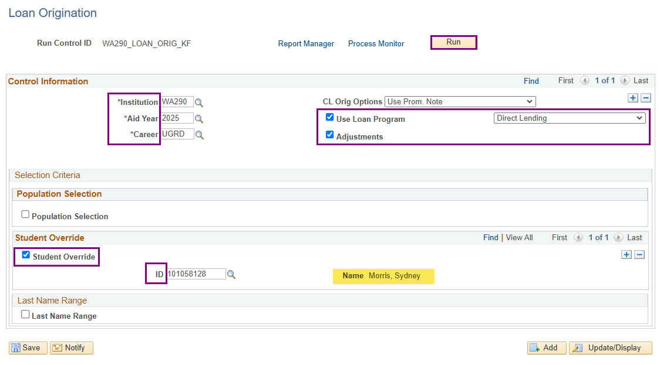
PLUS LOAN PROCESSING CONT’D
ORIGINATE SINGLE LOAN
Navigation: Financial Aid > Loans > Process Loans

Slide 13
PLUS LOAN PROCESSING CONT’D
6-STEP PROCESS
Step 1: Award PLUS Loan
Step 2: Originate PLUS Loan
Step 3: Create Parent Record
(If none already exists)
Step 4: Establish Relationship for Parent
Step 5: Link Parent to PLUS Loan Record
Step 6: Re-originate PLUS Loan

Slide 14
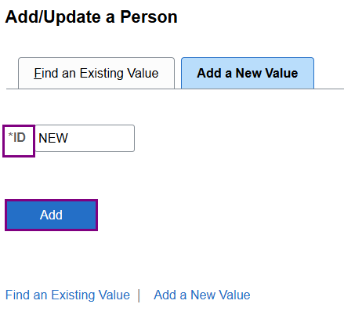
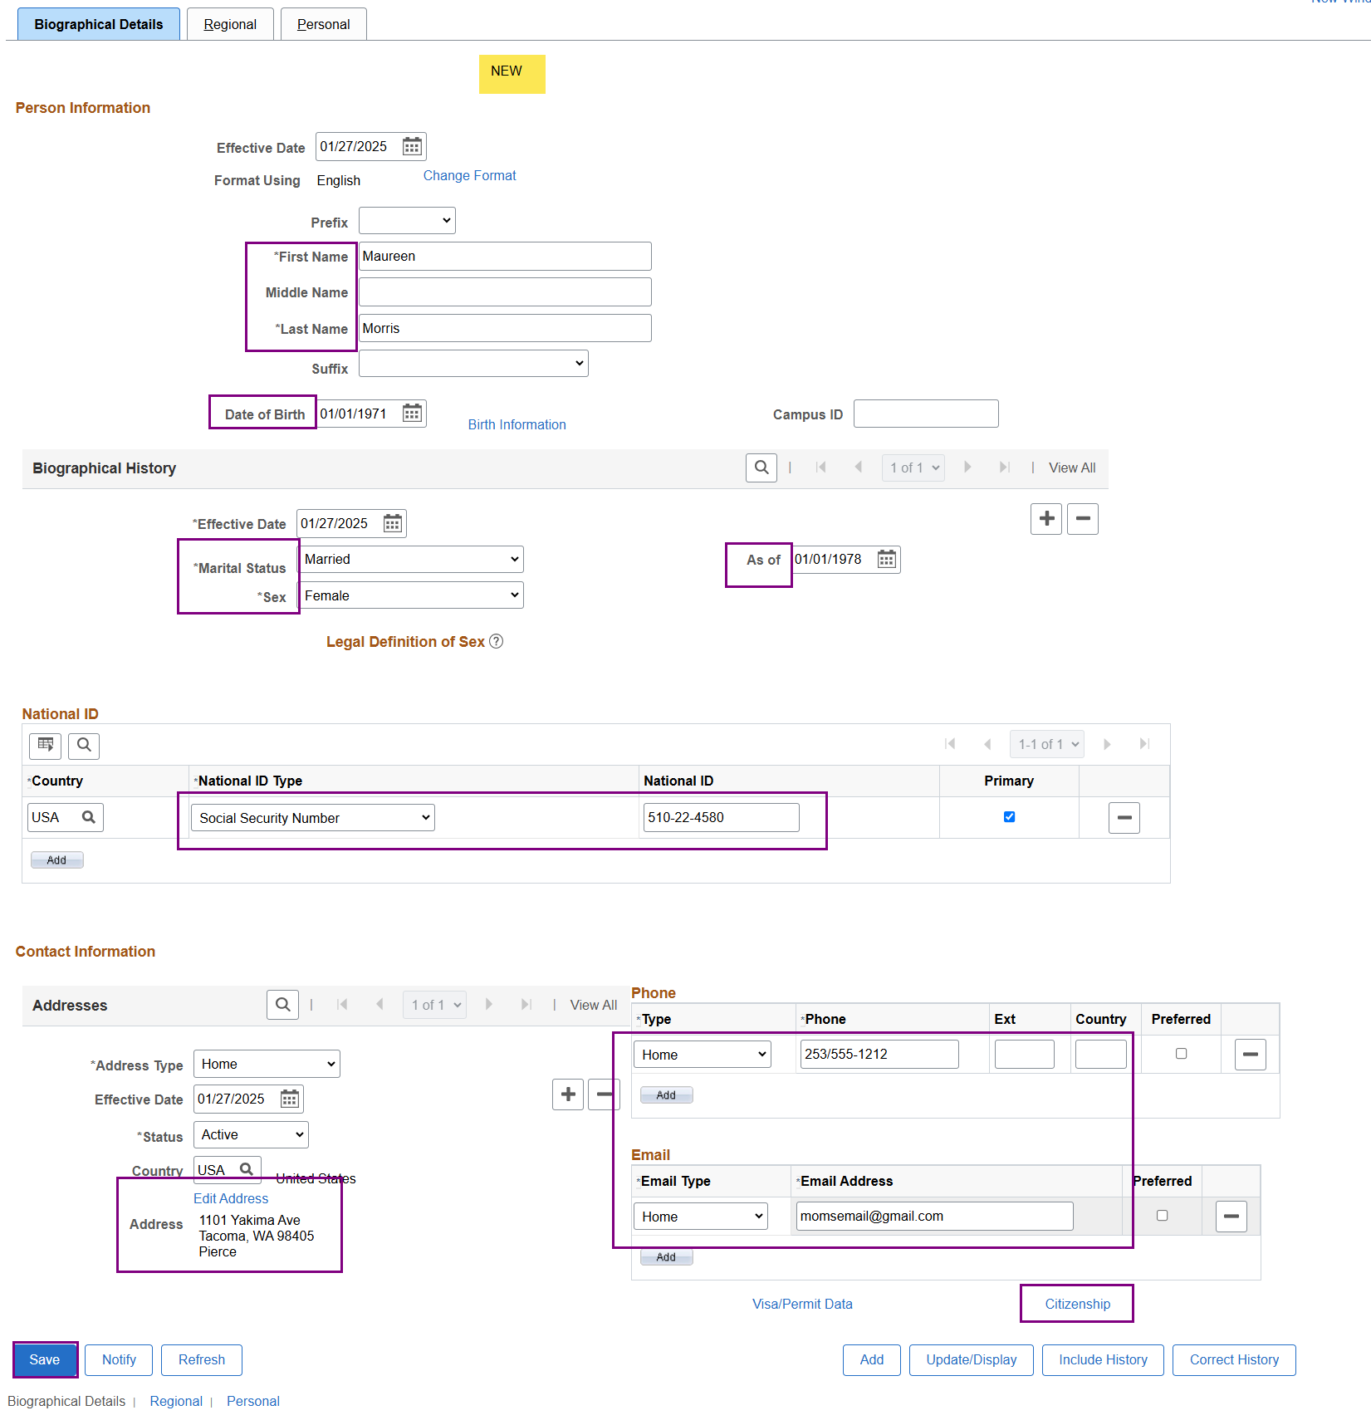
PLUS LOAN PROCESSING CONT’D
CREATE PARENT EMPL RECORD
Navigation: Campus Community > Personal Information > Add/Update a Person
If the parent has no existing EMPL in ctcLink, a EMPL record must be created so you’re able to link the parent borrower to the loan record.

Slide 15
PLUS LOAN PROCESSING CONT’D
6-STEP PROCESS
Step 1: Award PLUS Loan
Step 2: Originate PLUS Loan
Step 3: Create Parent Record
(If none already exists)
Step 4: Establish Relationship for Parent
Step 5: Link Parent to PLUS Loan Record
Step 6: Re-originate PLUS Loan

Slide 16
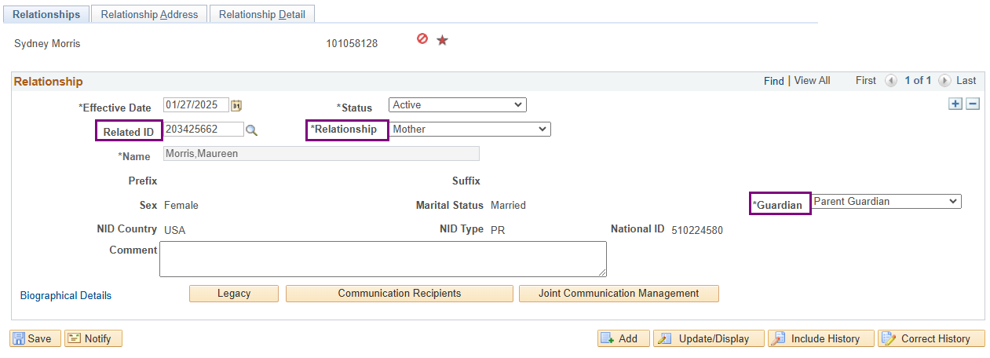
PLUS LOAN PROCESSING CONT’D
ESTABLISH RELATIONSHIP
Navigation: Campus Community > Personal Information > Biographical > Relationships > Relationships
Enter the student’s EMPL when establishing the relationship – not the parent. In the Related ID field, enter the parent’s new EMPL.
Define the Relationship and the Guardianship status.

Slide 17
PLUS LOAN PROCESSING CONT’D
6-STEP PROCESS
Step 1: Award PLUS Loan
Step 2: Originate PLUS Loan
Step 3: Create Parent Record
(If none already exists)
Step 4: Establish Relationship for Parent
Step 5: Link Parent to PLUS Loan Record
Step 6: Re-originate PLUS Loan

Slide 18
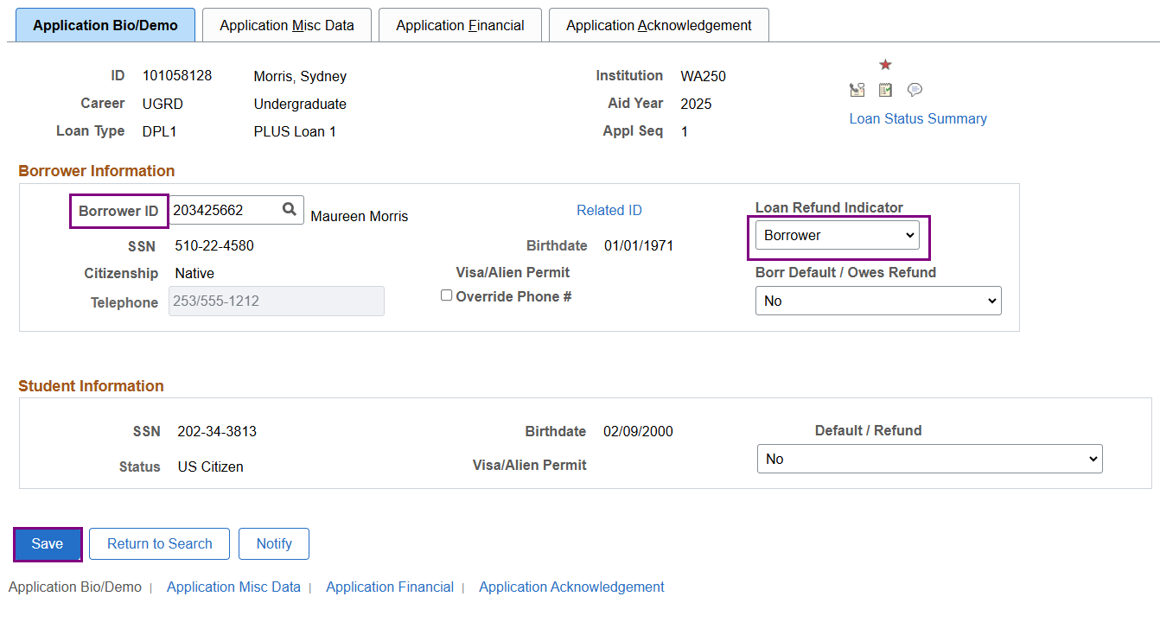
PLUS LOAN PROCESSING CONT’D
LINK PARENT TO PLUS LOAN RECORD
Navigation: Financial Aid > Loans > Direct Lending Management > Manage Direct Loan Application
Enter the parent’s EMPL into the Borrower ID field. Be sure to also define whether the refund should go to the Parent Borrower or the Student on the Loan Refund Indicator drop down box. Select Save.

Slide 19
PLUS LOAN PROCESSING
6-STEP PROCESS
Step 1: Award PLUS Loan
Step 2: Originate PLUS Loan
Step 3: Create Parent Record
(If none already exists)
Step 4: Establish Relationship for Parent
Step 5: Link Parent to PLUS Loan Record
Step 6: Re-originate PLUS Loan

Slide 20
PLUS LOAN PROCESSING CONT’D
PROCESS LOANS AGAIN
Navigation: Financial Aid > Loans > Process Loans

Slide 21
DEMONSTRATION

Slide 22
AWARDING ADDT’L UNSUB FOR
PLUS-DENIED STUDENTS

Slide 23
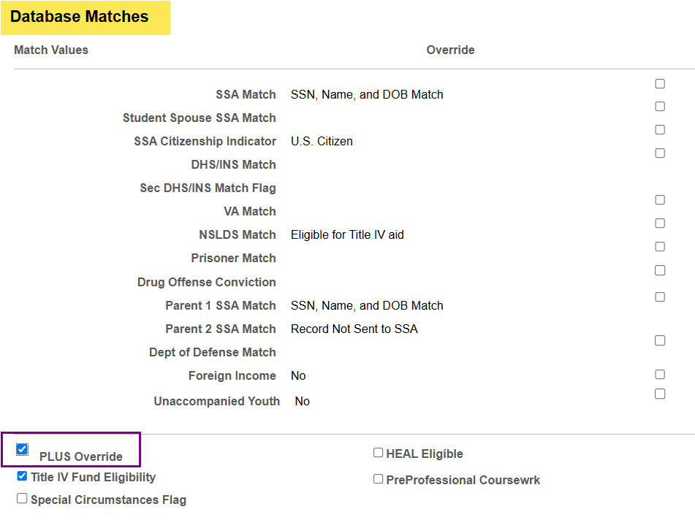
ADDT’L UNSUB FOR PLUS-DENIED STUDENTS
VIEW PACKAGING STATUS SUMMARY PG
Navigation: Financial Aid > View Packaging Status Summary >> Database Matches

Slide 24
DEMONSTRATION

Slide 25
Outcomes
At training completion, you should be able to:
Understand awarding the PLUS Loan
performing a credit check
brief discussion about using loan request form vs. PLUS Loan application on studentaid.gov
Understand how to establish the Parent Record in ctcLink
Understand how to establish a student parent relationship
Understand how to link the parent record to the PLUS Loan record
Understand how to work with PLUS-denied students by awarding addt'l unsub

Slide 26
Congratulations!
PLUS Loan Processing Training Complete!
Please review the Loan Business Processing Guide in the ctcLink Reference Center as your progress through the steps
Thank you for your participation today!

