Slide 1
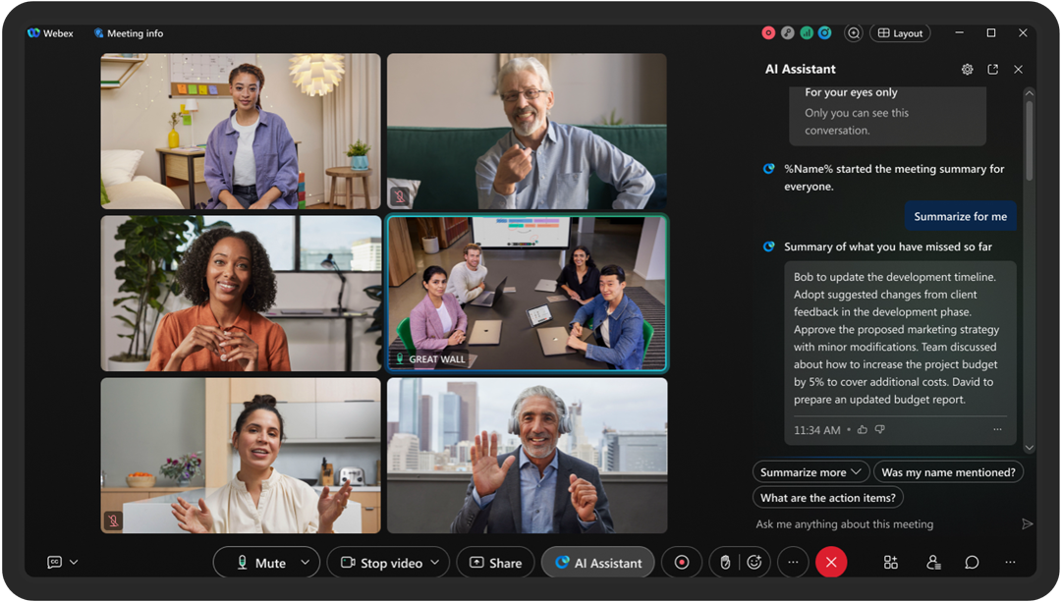
MEETING RECORDING NOTICE
The law requires consent prior to recording a person’s participation in an event. Your participation in this video conference (training) equals consent to be recorded, as required by law.
If you do not consent to being recorded but choose to participate, please turn your camera off and use the chat feature to interact with the other participants.
Enable Closed Captions
Enable AI Assistant

Slide 2
advanced training: processing negative disbursement files
Kelly Forsberg
ctcLink Functional Trainer | Financial Aid
December 2024

Slide 3
Objectives
After completing this training, you should be able to:
Understand what Negative Disbursement files are
Understand why these files appear in your EdConnect queue
Understand how to reduce the occurrence of these files from appearing in your EdConnect queue
Understand how to review and read the Manage Pell Payment page when these files are loaded
Understand how to process Negative Disbursement files in ctcLink

Slide 4
QUICK OVERVIEW OF NEGATIVE DISBURSEMENT FILES

Slide 5

THE HOW AND WHY ON negative disbursement files
Q. WHAT IS A NEGATIVE DISBURSEMENT FILE?
  The crnd file is a COD Message Class file that contains information on disbursements that the COD system has deemed needed to be cancelled or reduced primarily due to Pell Over Payments (POPs)
    Can also be for Pell LEU deobligations, Verification Status Code W, etc.
This Photo by Unknown Author is licensed under CC BY-SA

Slide 6
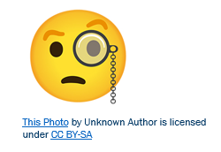
THE HOW AND WHY ON negative disbursement files
Q. WHY AM I RECEIVING NEGATIVE DISBURSEMENT FILES IN EDCONNECT?
  A. COD sends schools Pell MRR (pgmr) files
  Schools have 30 days to resolve the pgmr files with POPs and other flagged records.
  If those records are not resolved and updated to COD, COD then sends a Negative Disbursement (crnd) file to cancel or reduce the Pell record.

Slide 7

THE HOW AND WHY ON negative disbursement files
Q. HOW DO I REDUCE THE OCCURRENCE OF THESE FILES IN MY EDCONNECT QUEUE?
  Work your Pell MRR files within 30 days
  Work your NSLDS Transfer Monitoring Files in a timely manner
  Work your Financial Aid History (FAH) files
This Photo by Unknown Author is licensed under CC BY-SA

Slide 8
STEPS FOR LOADING
A CRND FILE

Slide 9
Pell CRND processing
3-STEP PROCESS
Step 1: Upload crnd file
Step 2: Import Federal Data Files
Step 3: Run Transaction Status - On Hold Report to Identify Students

Slide 10
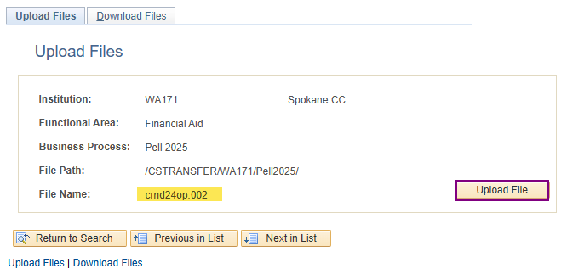
CRND FILE processing
UPLOADING CRND FILE
Navigation: PeopleTools > CTC Custom > Extensions > Upload/Download File
Usually, the first AY’s file comes in as a .dat, then .001, .002, etc.

Slide 11
Pell CRND processing
3-STEP PROCESS
Step 1: Upload crnd file
Step 2: Import Federal Data Files
Step 3: Run Transaction Status – ‘On Hold Report’ to Identify Students

Slide 12
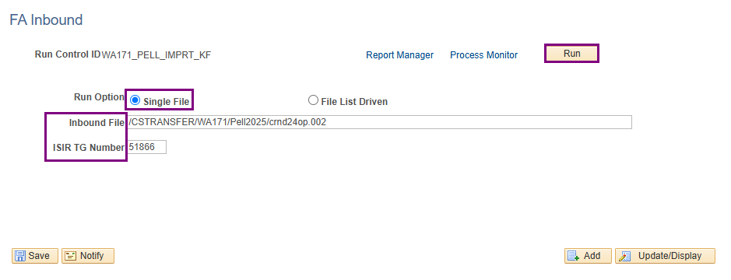
Pell crnd processing CONT’D
IMPORTING PELL CRND FILE
Navigation: Financial Aid > File Management > Import Federal Data Files
Remember that when importing files, the file name is typically lower case.

Slide 13
Pell CRND processing
3-STEP PROCESS
Step 1: Upload crnd file
Step 2: Import Federal Data Files
Step 3: Run Transaction Status – ‘On Hold’ Report to Identify Students

Slide 14
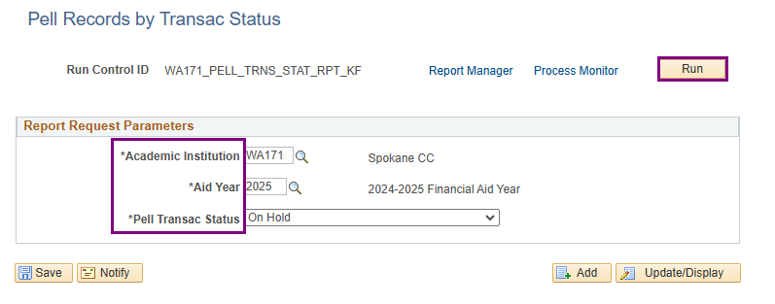
Pell crnd processing CONT’D
TRANSAC STATUS – ON HOLD
Navigation: Financial Aid > Pell Payment > Origination Reports > Transaction Status
This report shows all On Hold statuses. Use Disb Seq 66 as your clue for CRND disbursements

Slide 15
DEMONSTRATION

Slide 16
HOW TO READ
THE MANAGE PELL PAYMENT PAGE
FOR THESE FILES

Slide 17
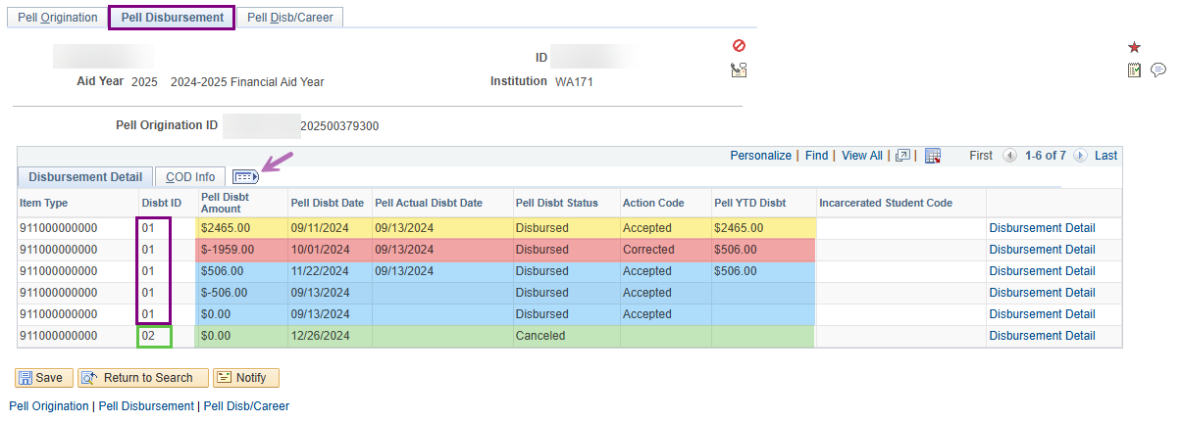
Manage pell payment page AFTER
DISBURSEMENT SEQUENCING
Navigation: Financial Aid > Pell Payment > Manage Pell Payment
Note the Disbt ID 01 has 5 rows. Disbt ID 02 has 1 row.
Expand the detail on the page to view what COD shows.

Slide 18
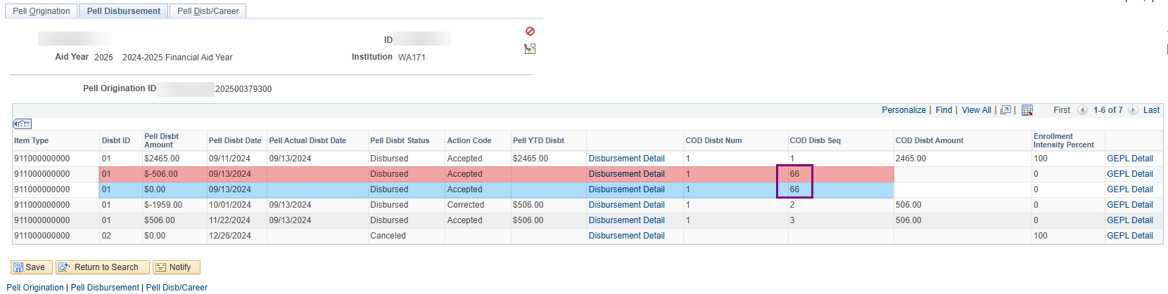
Manage pell payment page
DISBURSEMENT SEQUENCING CONT’D
Note the COD Disbt Seq reflects values of ’66’
COD has corrected these records. ‘RFMS Corrected’

Slide 19
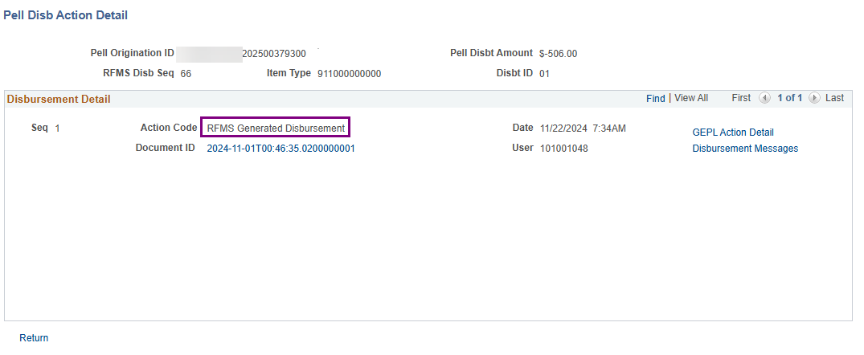
Manage pell payment page
DISBURSEMENT DETAIL
RFMS Generated Disbursement = COD updated this disbursement in the Manage Pell Payment page.
NOTE! This does not mean that this was corrected in the Customer Account. CRND files only update the Manage Pell Payment page to reflect COD activity.

Slide 20
DEMONSTRATION

Slide 21
NEXT STEPS TO RESOLVE negative disbursements on hold
VERIFY THE AWARD IN THE ASSIGN AWARDS TO A STUDENT PAGE
REMOVE HOLD ON MANAGE PELL PAYMENT PAGE
RUN PELL ORIG ON SINGLE STUDENT
RUN PELL OUT
DOWNLOAD FILE AND TRANSMIT NOW VIA EDCONNECT
LOAD RESPONSE FILE
CHECK MANAGE PELL PAYMENT PAGE TO VERIFY DISBURSEMENT IS ACCEPTED

Slide 22
DEMONSTRATION

Slide 23
Outcomes
At training completion, you should be able to:
Understand what Negative Disbursement files are
Understand why these files appear in your EdConnect queue
Understand how to reduce the occurrence of these files from appearing in your EdConnect queue
Understand how to review and read the Manage Pell Payment page when these files are loaded
Understand how to process Negative Disbursement files in ctcLink

Slide 24
Congratulations!
Advanced Pell Processing - Processing Negative Disbursement Files Training Complete!
Please review the Pell Business Processing Guide in the ctcLink Reference Center as your progress through the steps
Thank you for your participation today!

