Slide 1
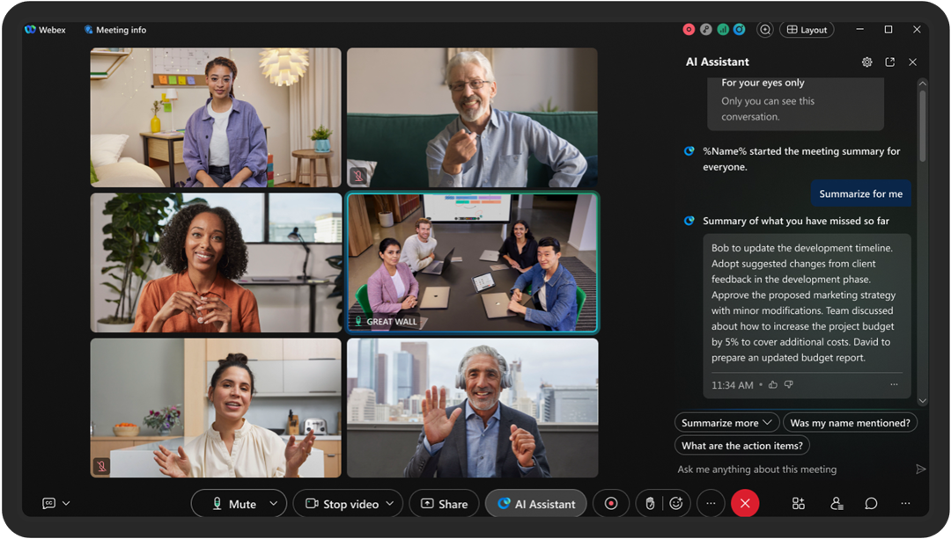
MEETING RECORDING NOTICE
The law requires consent prior to recording a person’s participation in an event. Your participation in this video conference (training) equals consent to be recorded, as required by law.
If you do not consent to being recorded but choose to participate, please turn your camera off and use the chat feature to interact with the other participants.
Enable Closed Captions
Enable AI Assistant

Slide 2
Intermediate training: pell multiple record reporting
Kelly Forsberg
ctcLink Functional Trainer | Financial Aid
November 2024

Slide 3
Objectives
After completing this training, you should be able to:
Understand and work the steps in the Pell MRR Process
  Upload/Download Files
  Import Federal Data Files
  Import Pell Phase-In Data
  Run Pell MRR Batch Report via Review MRR
Understand WHY you need to perform these required steps and how it impacts Pell recon

Slide 4
PELL MRR
PROCESS

Slide 5
Pell mrr processing
4-STEP PROCESS
Step 1: Upload pgmr file
Step 2: Import Federal Data Files
Step 3: Pell Phase In Data
Step 4: Pell MRR Batch Report

Slide 6
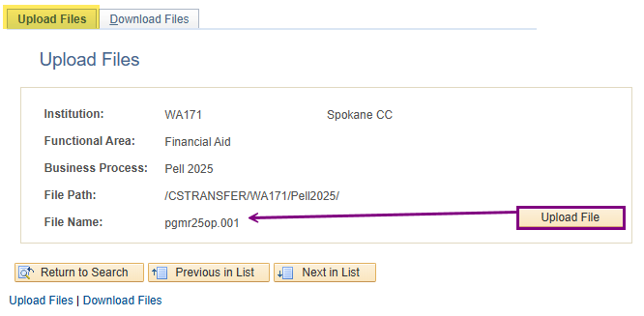
Pell mrr processing
UPLOADING PELL MRR FILE
Navigation: PeopleTools > CTC Custom > Extensions > Upload/Download File
Usually, the first AY’s file comes in as a .dat, then .001, .002, etc.

Slide 7
Pell mrr processing
4-STEP PROCESS
Step 1: Upload pgmr file
Step 2: Import Federal Data Files
Step 3: Pell Phase In Data
Step 4: Pell MRR Batch Report

Slide 8
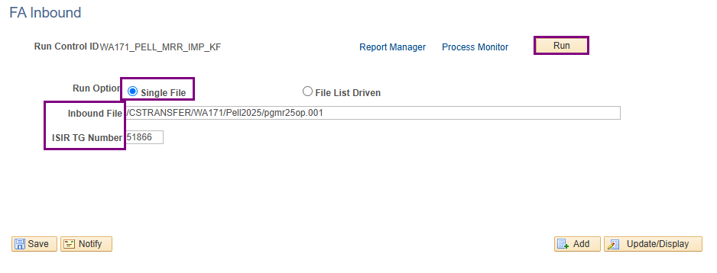
Pell mrr processing CONT’D
IMPORTING PELL MRR FILE
Navigation: Financial Aid > File Management > Import Federal Data Files
Remember that when importing files, the file name is typically lower case.

Slide 9
Pell mrr processing
4-STEP PROCESS
Step 1: Upload pgmr file
Step 2: Import Federal Data Files
Step 3: Pell Phase In Data
Step 4: Pell MRR Batch Report

Slide 10
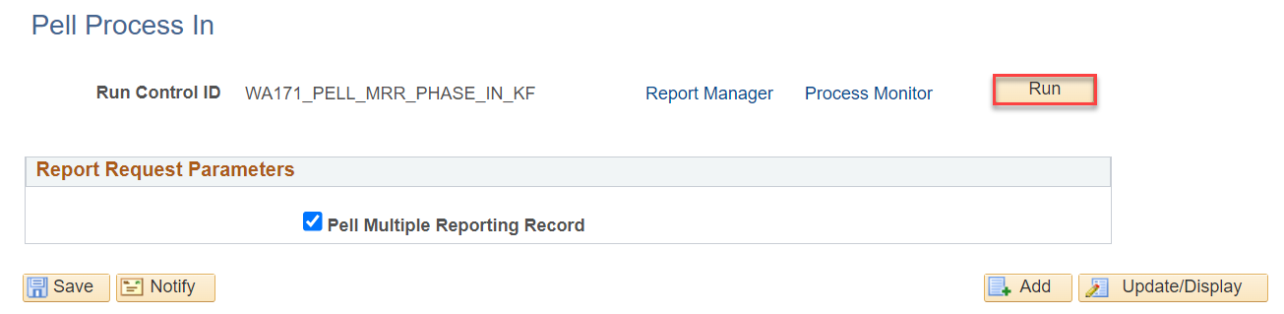
Pell mrr processing CONT’D
PELL MRR PHASE IN
Navigation: Financial Aid > File Management > Pell Grants > Import Pell Multiple Reporting
This step moves the data into a table where batch reporting can be run

Slide 11
Pell mrr processing
4-STEP PROCESS
Step 1: Upload pgmr file
Step 2: Import Federal Data Files
Step 3: Pell Phase In Data
Step 4: Pell MRR Batch Report

Slide 12
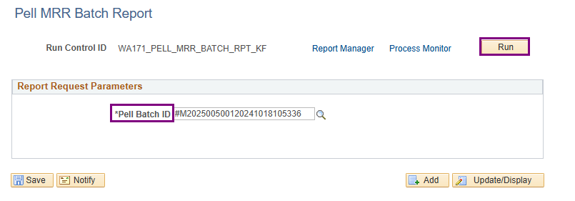
Pell mrr processing CONT’D
PELL BATCH REPORT
Navigation: Financial Aid > Pell Payment > Multiple Reporting > MRR by Batch
Use the lookup tool to find your batch number

Slide 13
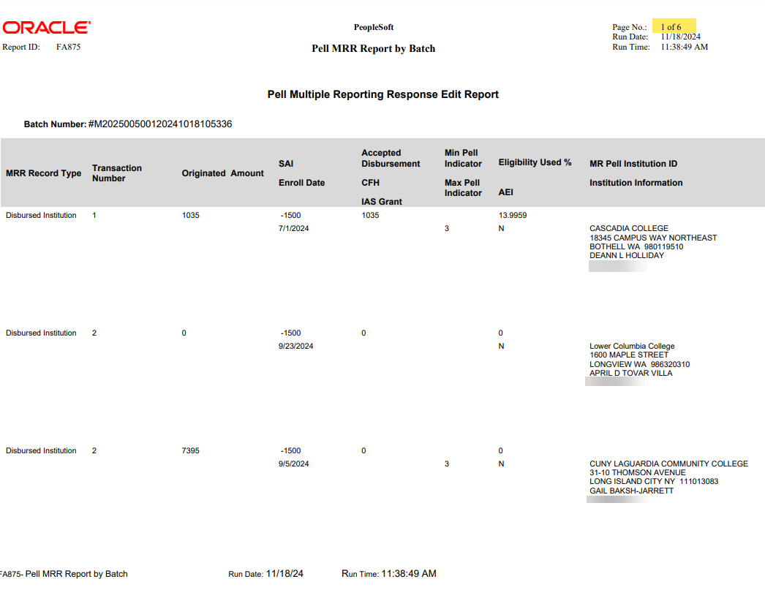
Pell mrr processing CONT’D
PELL BATCH REPORT CONT’D
🐛 24/25 Oracle Bug Alert! = The report does not contain any bio/demo identifiers due to it being removed, see COD Tech Ref Vol 6

Slide 14
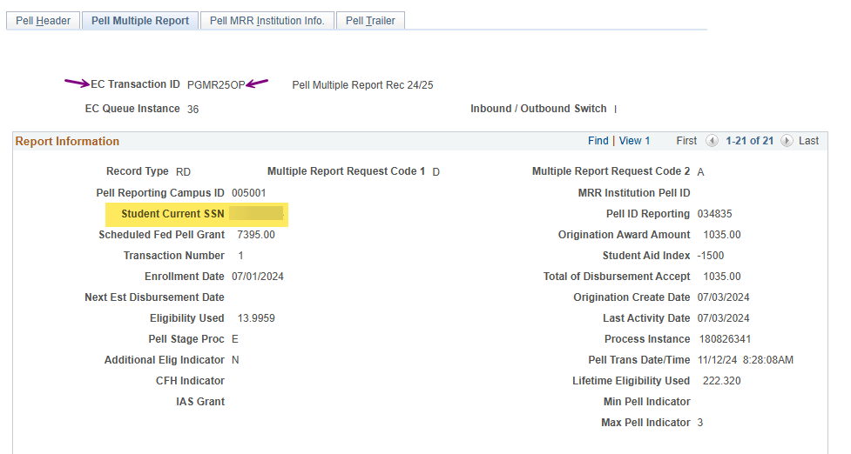
Pell mrr processing CONT’D
REPORT WORKAROUND!
Navigation: Financial Aid > Pell Payment > Multiple Reporting > Review MRR

Slide 15
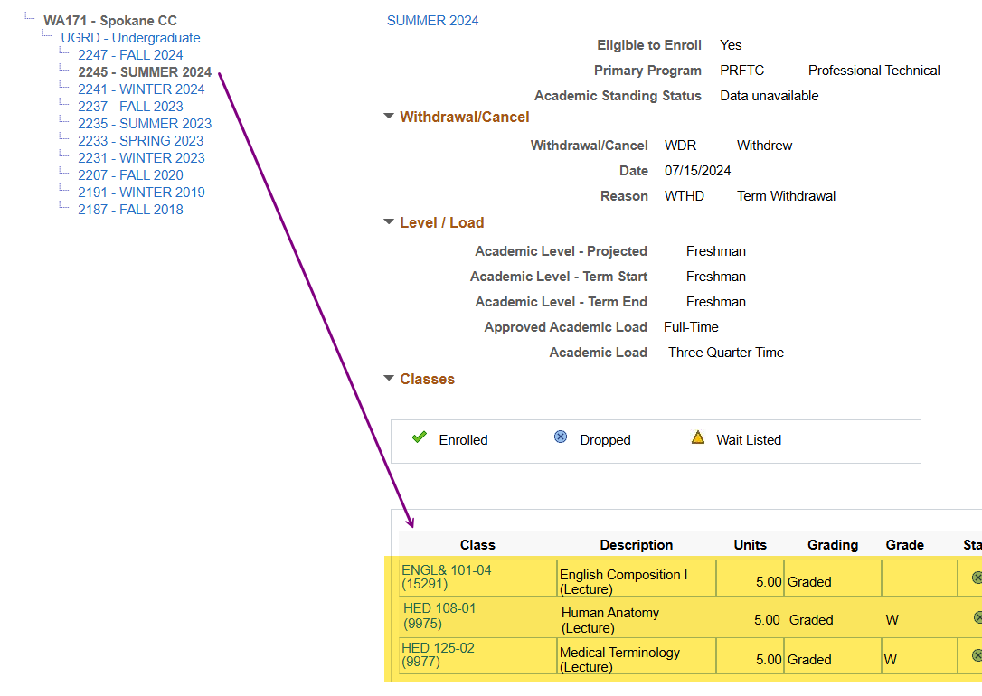
Pell mrr processing CONT’D
CHECK ENROLLMENT
Navigation: Campus Community > Student Services Center (Student)

Slide 16
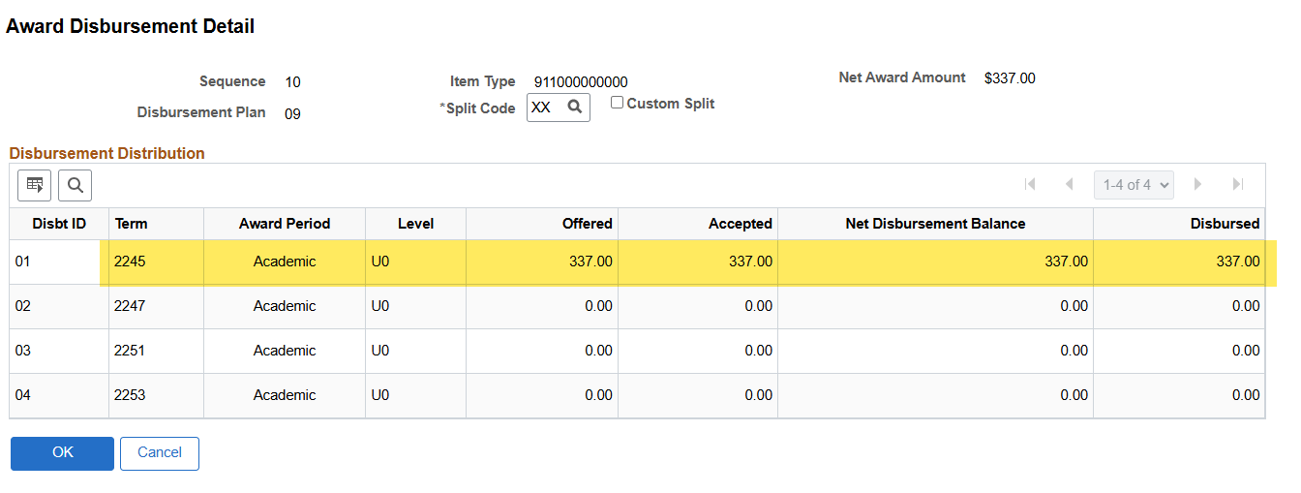
Pell mrr processing CONT’D
CHECK AWARDS
Navigation: Financial Aid > Awards > Award Processing > Assign Awards to a Student
Check the award: does it need to be reduced, cancelled, or adjusted in any way. May need to also check NSLDS and/or COD.

Slide 17
DEMONSTRATION

Slide 18
Outcomes
At training completion, you should be able to:
Understand and work the steps in the Pell MRR Process
  Upload/Download Files
  Import Federal Data Files
  Import Pell Phase-In Data
  Run Pell MRR Batch Report via Review MRR
Understand WHY you need to perform these required steps and how it impacts Pell recon

Slide 19
Congratulations!
Intermediate Pell Processing - Pell MRR Processing Training Complete!
Please review the Pell Business Processing Guide in the ctcLink Reference Center as your progress through the steps
Thank you for your participation today!

