Slide 1
MEETING RECORDING NOTICE
The law requires consent prior to recording a person’s participation in an event. Your participation in this video conference (training) equals consent to be recorded, as required by law.
If you do not consent to being recorded but choose to participate, please turn your camera off and use the chat feature to interact with the other participants.
Enable Closed Captions
Enable AI Assistant

Slide 2
Pell & loan message log review training
Kelly Forsberg
ctcLink Functional Trainer | Financial Aid
November 2024

Slide 3
OBJECTIVES
After completing this training, you should be able to:
Understand how to download the Message Log detail
Understand how to search in the Message Log detail
Understand how to determine what needs further review in the MDLA and Manage Pell Payment pages

Slide 4
DOWNLOADING & SEARCHING IN
MESSAGE LOG DETAIL

Slide 5
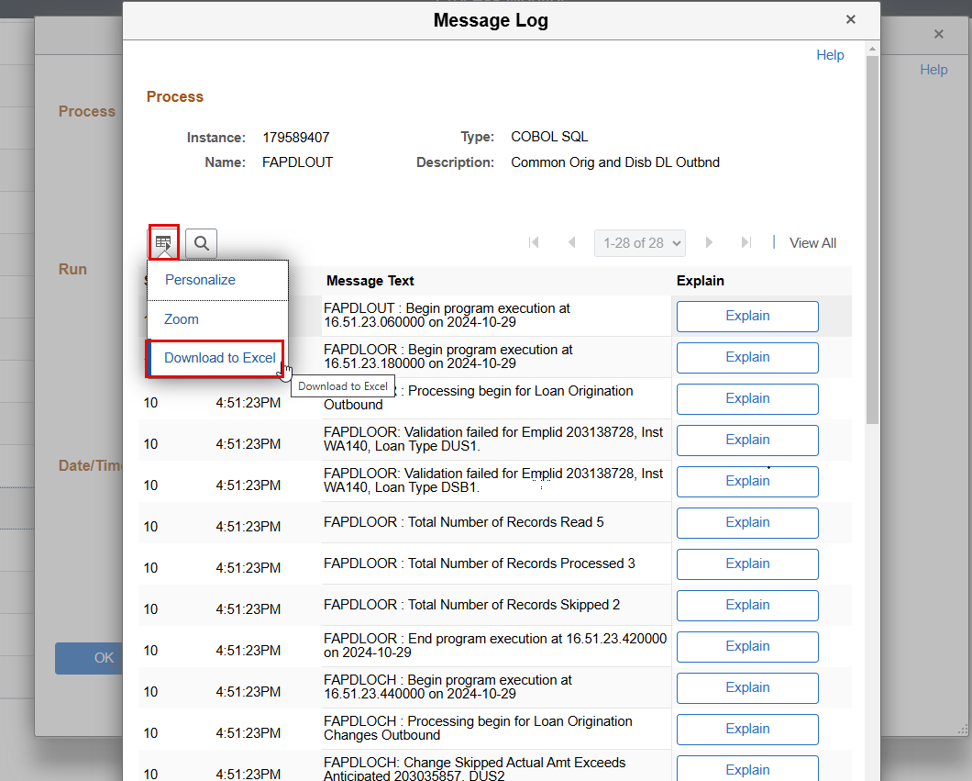
MESSAGE LOG
Navigation: PeopleTools > Process Scheduler > Process Monitor
DOWNLOAD TO EXCEL
Find the Grid and select Download to Excel

Slide 6
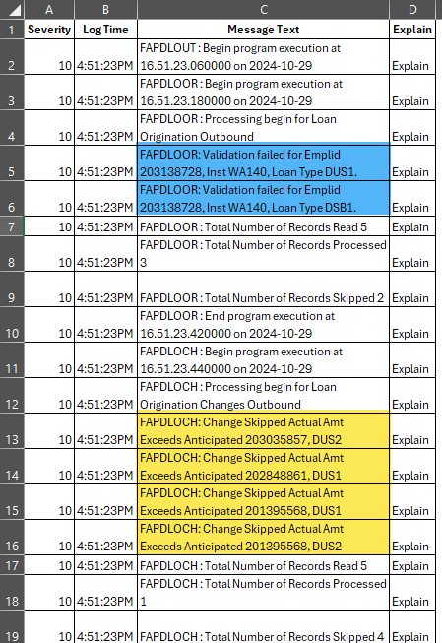
MESSAGE LOG CONT’D
FAPDLOUT EXCEL DOC
Blue highlighted = FAPDLOOR (Direct Loan Origination)
Yellow highlighted = FAPDLOCH (Direct Loan Origination Change)
Not in screenshot = FAPDLODB (Direct Loan Disbursement)
These items have failed Validation and cannot be outbounded to COD until they are resolved

Slide 7
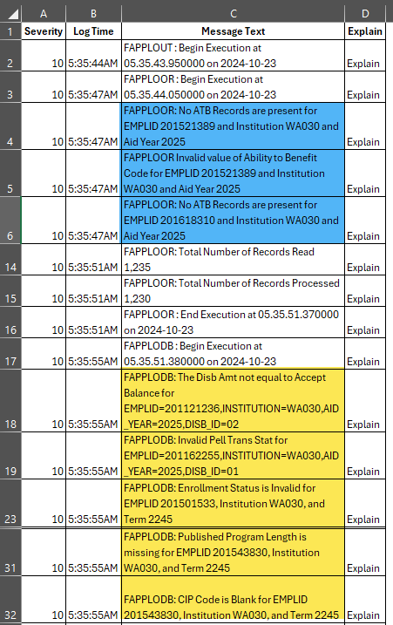
MESSAGE LOG CONT’D
FAPPLOUT EXCEL DOC
Blue highlighted = FAPPLOOR (Pell Origination)
Yellow highlighted = FAPPLODB (Pell Disbursement)
These items have failed Validation and cannot be outbounded to COD until they are resolved

Slide 8
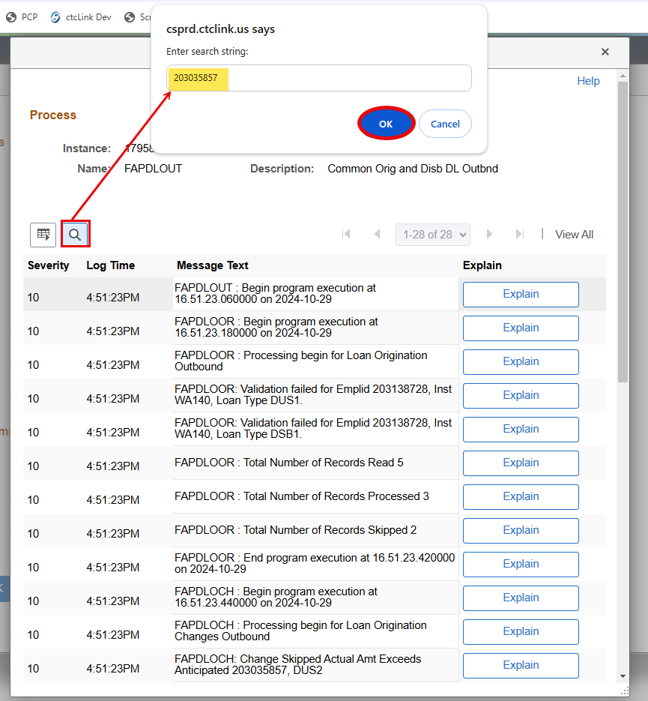
MESSAGE LOG
SEARCHING FOR EMPLS
Select the Look Up Tool to use the search string. Enter EMPL into the Search String.
Tip! You can also use the keyboard commands Ctrl + F

Slide 9
DEMONSTRATION

Slide 10
UNDERSTANDING WHAT NEEDS FURTHER REVIEW
Any record that is not on the Validation Error Reports or the Orig & Disb Status Reports and is on Message Log, needs further review.
Do not ignore your Message Log!

Slide 11
OUTCOMES
At training completion, you should be able to:
Understand how to download the Message Log detail
Understand how to search in the Message Log detail
Understand how to determine what needs further review in the MDLA and Manage Pell Payment pages

Slide 12
Congratulations!
You have successfully completed the Reviewing Pell & Loan Message Log Training!
Please refer to the ctcLink Reference Center for additional resource materials on today’s topics
Thank you for your participation today!

