Slide 1
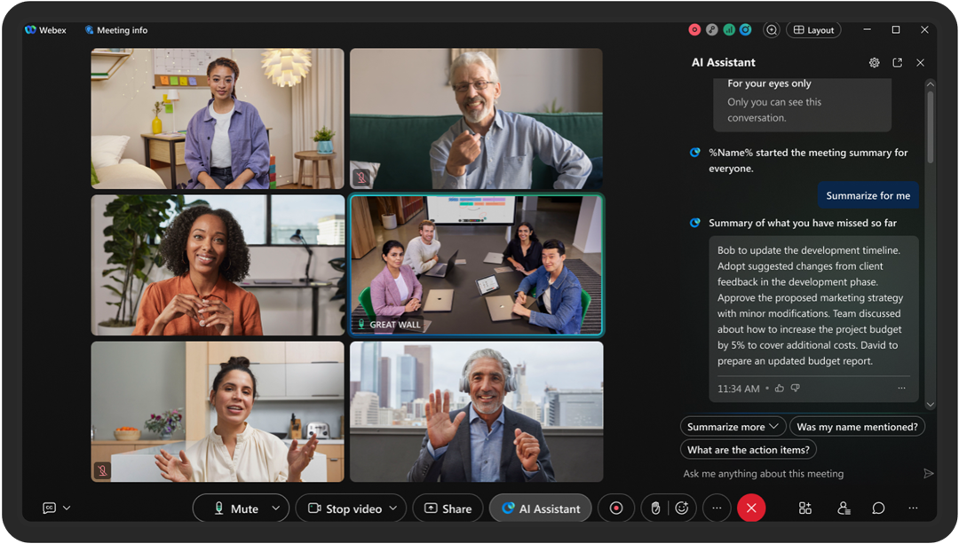
MEETING RECORDING NOTICE
The law requires consent prior to recording a person’s participation in an event. Your participation in this video conference (training) equals consent to be recorded, as required by law.
If you do not consent to being recorded but choose to participate, please turn your camera off and use the chat feature to interact with the other participants.
Enable Closed Captions
Enable AI Assistant

Slide 2
Aid Year Rollover (AYRO)
Prep
Connie Burrow
Senior Functional Analyst | Financial Aid
October 24, 2024

Slide 3
Logistics and Agenda
Times | Activity
13:00 – 13:10 | Greet/Attendance/Objectives
13:15 – 13:30 | Loading 2025-2026 ISIRs early
13:30 – 13:45 | Timeline of upcoming events leading up to turning on ISIR Jobsets
13:45 – 14:45 | AYRO College List Review
14:45 – 15:00 | Session Wrap-Up

Slide 4
ground rules
Be ready to participate
Remove external distractions
Mute your line when not speaking
    Do NOT place Webex line on hold. Use Mute.
    Please leave your line on Mute unless you are speaking
    Sessions are being recorded
Allow your peers to complete their thoughts before beginning yours

Slide 5
Objectives
During this work session, we will be walking through the following:
How to load 2025-2026 ISIRs early
Aid Year Rollover College Review List
Timeline of upcoming events leading up to turning on ISIR Jobsets

Slide 6
Loading 2025-2026 ISIRs early

Slide 7
The situation
2025-2026 ISIRs submission opened on October 1st but the 2025-2026 PRP does not go into the system until January/February (TBD)
By the time 2025-2026 AYRO is completed and Even-Year ISIR Jobset parameters are updated, colleges have hundreds of ISIR files to load
Due to the system being shared by 33 colleges and the ISIR Jobset slowing the system down significantly, colleges are asked to be mindful on how many ISIR files are loaded in one instance so that all ISIR Jobsets finish running between 5PM – 7AM Monday - Friday. Depending on the size of the college, this leads to weeks or months of loading backlogged ISIR files
Colleges may have the option of requesting an Year-to-Date ISIR file
Notes:
New aid year image is released from Oracle at the end of October. After SBCTC receives the image, testing starts and issues and bugs are logged. Oracle releases patches late November so early December is our quickest turnaround for uploading the aid year image.

Slide 8

What isir process does not require an aid year image?
PS ISIR Processing has three steps with two of them requiring an aid year image to be added into the system (late December)
File Upload/Download
Import Federal Data Files Requires 2025-2026 Image
Process ISIRS
Requires 2025-2026 Image

Slide 9
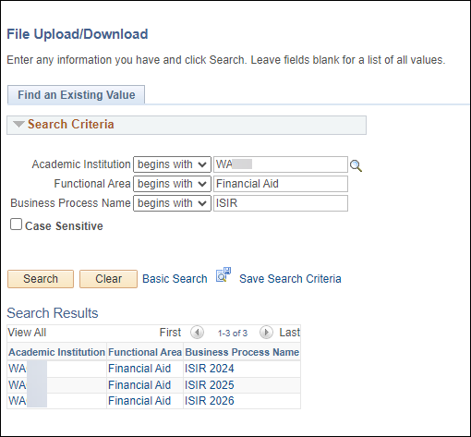
We will create the ISIR 2026 folders in production by December so that colleges can start loading 2025-2026 ISIR Files on the pS server!!
Navigation: Navigator > People Tools > CTC Custom > Extensions > Upload/Download Files
If you are a college that has been and will continue to request Year-to-Date ISIR files, please feel free to continue doing so. ☺
We will create the ISIR2026 folders for colleges that want to start loading all the 2025-2026 ISIR files they receive from Edconnect.

Slide 10
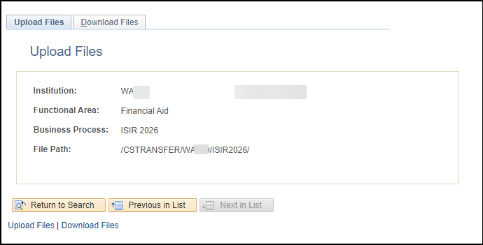

What you Can DO when you get your 2025-2026 ISIR File
Upload 2025-2026 isir files into the ISIR2026 folder in the order of when the files were received
Navigation: Navigator > People Tools > CTC Custom > Extensions > Upload/Download Files
If you upload the 2026 ISIR files out of order, you will end up with many ISIR files in suspense with the reason: Out of Sequence
Notes:
Reminder, Edconnect files expire after 90 days. Be sure to download your ISIR files.

Slide 11
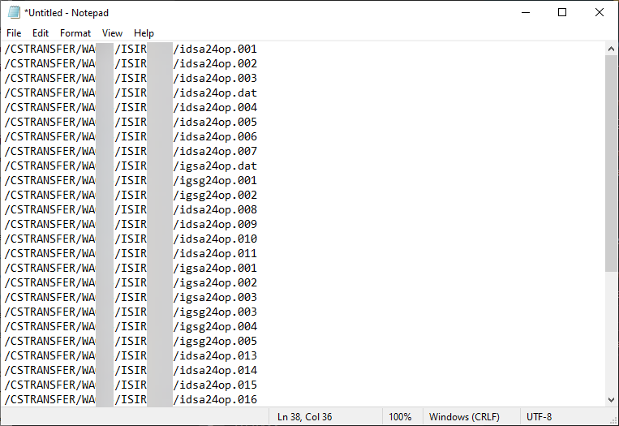
When you are ready to turn on your iSIR JOBSET you can create your own text file of all the files your college loaded in the isir2026 folder – if you need assistance creating the text file submit a ticket to fa support
The text file will list the ISIR files in the order the files were loaded into the ISIR2026 folder

Slide 12
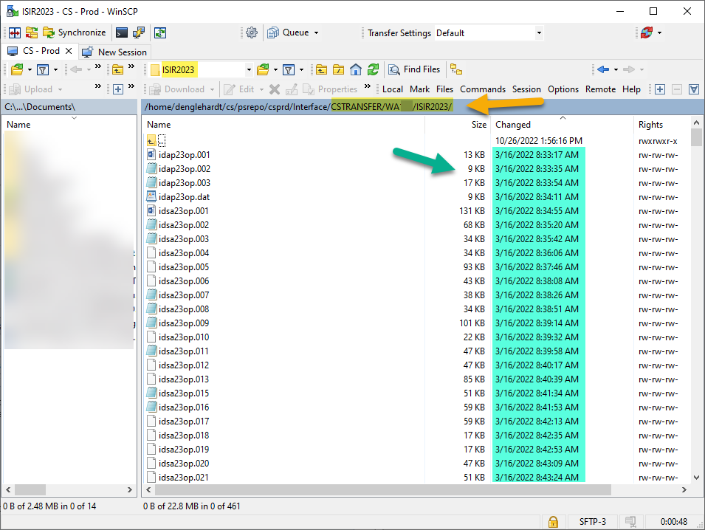
How will we make the text file?
We will grab the files names in from your college’s /CSTRANSFER/Waxxx/ISIR2026 file path
Note: The example in the screenshot is the ISIR2023 folder
We will put the file names in the order of the earliest ISIR file loaded first

Slide 13
Timeline of Upcoming Events Leading up to Turning On ISIR Jobsets

Slide 14
2025-2026 FA PRP 2
What is in the PRP
  ISIR Processing
  FM Need Analysis Calculator (NAC)
  NSLDS TSM/FAH Processing
FA Support Testing period (December/January)

Slide 15
Tentative Timeline of upcoming events leading up to turning on ISIR jobsets
October 2024 – January 2025
Colleges complete Aid Year Rollover Part 1
January 2025 – mid March 2025
Colleges complete Aid Year Rollover Part 2
Mid February 2025
Colleges are informed of bugs and fixes
FA Support testing PRP bugs
FA Support testing ISIR Jobsets
EY ISIR Jobsets can be turned on
Tentative due to unknowns at this point with 2025-2026 PRP 2 testing

Slide 16
AYRO PArt 1 & ayro part 2
AYRO Part 1: Self-paced (You got this!)
  All colleges will be given the Part 1 guide to begin working on select items to prepare AND COMPLETE before their scheduled AYRO Part 2 session
  The AYRO Part 1 guide will be available November 13
AYRO Part 2: Work Session (Please come prepared!)
  Calendar invites will be sent out to POCs for each college
  The AYRO Part 2 Guide will be available by the 1st scheduled AYRO Work Session
  Be sure your security is up-to-date!

Slide 17
AYRO College List Review

Slide 18
AYRO college review Lists 2025-2026
The first two tabs are sized so that they are printer friendly for those who are wanting to print the lists. ☺
Please go to the 2025-2026 AYRO page to download the list:
2025-2026 Aid Year Roll Over Prep | 9.2 FA - Financial Aid Business Process Guides | ctcLink Reference Center

Slide 19
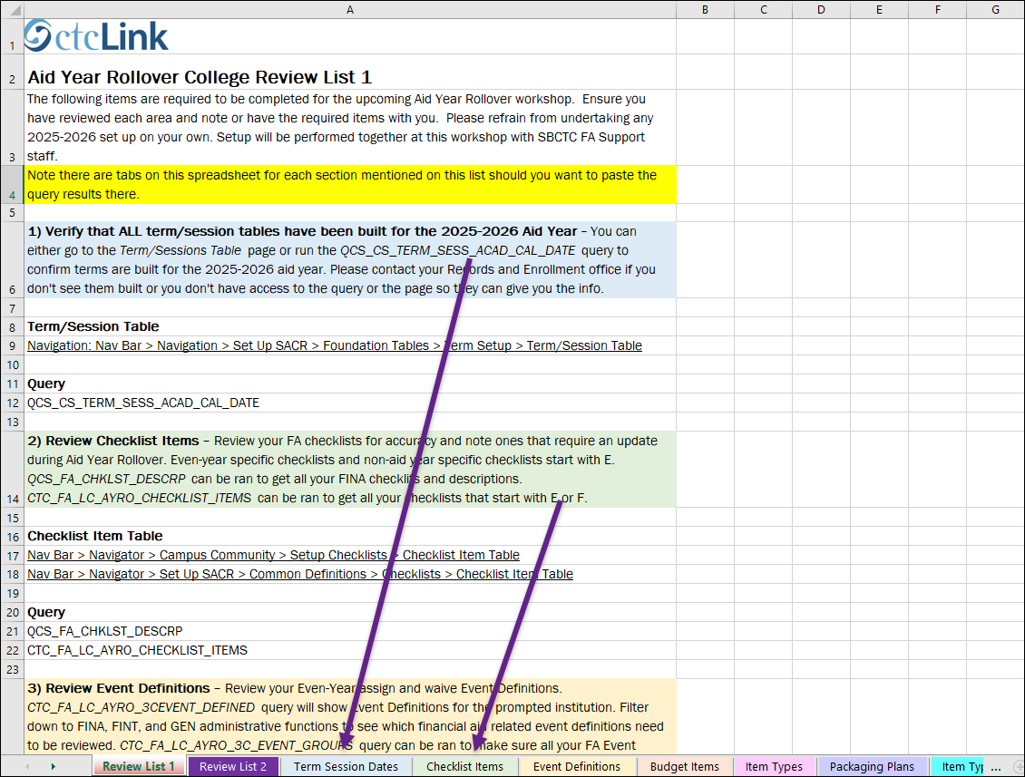
The first tab is Review list 1
Every section on List 1 has a tab associated with it so you can put your query results in there so that you don’t have to come to AYRO with multiple spreadsheets. ☺

Slide 20
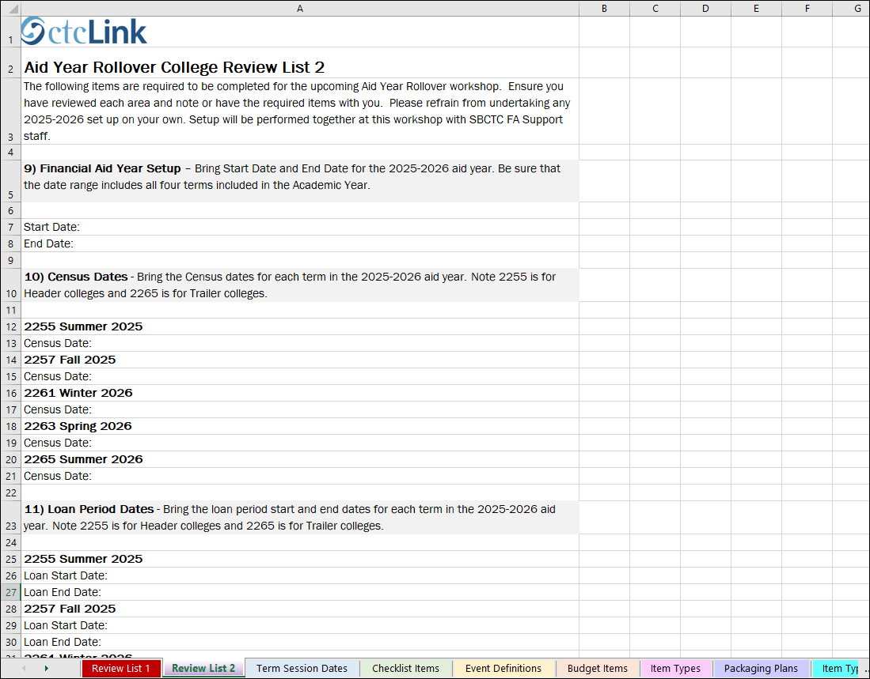
The second tab is Review list 2
List 2 sections do not have tabs associated to them but feel free to create new tabs as you see fit. 😊

Slide 21
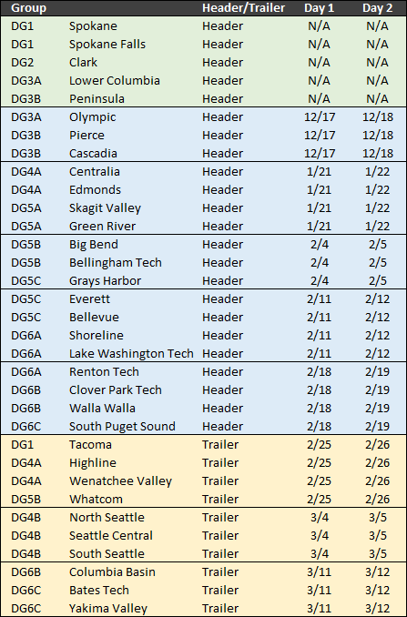
2025-2026 AYRO
Schedule
The 2025-2026 AYRO Guide is still being created and will be available closer to the first 2025-2026 AYRO session
‘Save the Dates’ will go out on the listserv tomorrow. Calendar invites will be sent shortly with the agenda attached to the FA Director
Notes:
We have kept the schedule the same as last year due the many changes this year. However, if DG4A colleges would like to do AYRO on their own & just attend the drop in session they can. We just need to know who wants to do the drop in session so we can make any necessary schedule changes.

Slide 22

Go ahead and start reviewing the two lists and let us know if you have any questions or need some clarification ☺

Slide 23
Outcomes
At work session completion, you should be able to:
Understand the option of loading 2025-2026 ISIRs early
Understand the timeline of upcoming events leading up to turning on ISIR Jobsets
Understand the information that needs to be gathered before attending Aid Year Rollover Day 1:
  With respect and fairness to ALL colleges, colleges not fully prepared the morning of their scheduled AYRO Day 1 will need to reschedule.
  Rescheduled AYRO sessions will occur AFTER the last scheduled AYRO session (Mid-March).
Understand the difference of AYRO Part 1 & AYRO Part 2

Slide 24
Congratulations!
Prepare for Aid Year Rollover Work Session complete!
Thank you for your participation today!
We look forward to working with you during your Aid Year Rollover Workshop!

