Slide 1
MEETING RECORDING NOTICE
The law requires consent prior to recording a person’s participation in an event. Your participation in this video conference (training) equals consent to be recorded, as required by law.
If you do not consent to being recorded but choose to participate, please turn your camera off and use the chat feature to interact with the other participants.
Enable Closed Captions
Enable AI Assistant

Slide 2
Reviewing the View cod data page - training
Kelly Forsberg
ctcLink Functional Trainer | Financial Aid
October 2024

Slide 3
OBJECTIVES
After completing this training, you should be able to:
Understand how to read and interpret values on the View COD Data page
Understand how to search for Entrance Counseling and MPN info by SSN
Understand how to troubleshoot Direct Loan errors using the View COD Data page
Understand where the link to the Doc ID lives on the Manage Pell Payment page and how that can be found/used in View COD Data
Understand how to read the Doc ID on a raw CRAA and CRDL file

Slide 4
READING THE
VIEW COD DATA
PAGE

Slide 5
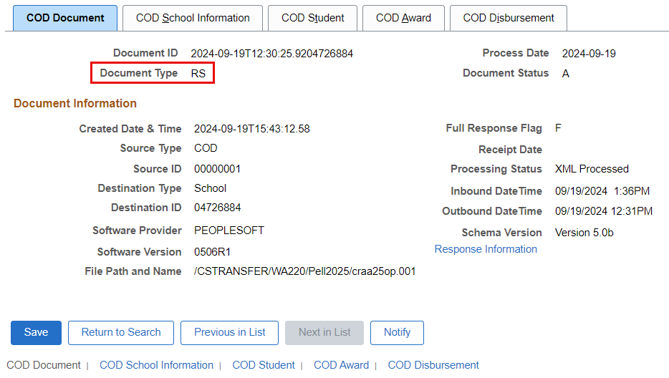
VIEW COD DATA PAGE
Navigation: Financial Aid > File Management > COD Full Participant > View COD Data
COD Document Tab
Document Types:
BN = Booking Notification
CO = Credit Decision Override
EC = Entrance Counseling
ND = Negative Disbursement
PN = Promissory Note
RC = Receipt
RS = Response
SG = System Generated
SP = PLUS Loan Acknowledgment

Slide 6
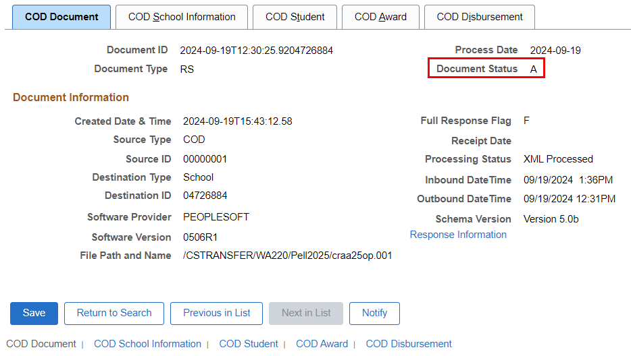
VIEW COD DATA PAGE
Navigation: Financial Aid > File Management > COD Full Participant > View COD Data
COD Document Tab Cont’d
Document Status = Displays the status of the processed document in COD.
A = Accepted
R = Rejected
D = Duplicate

Slide 7
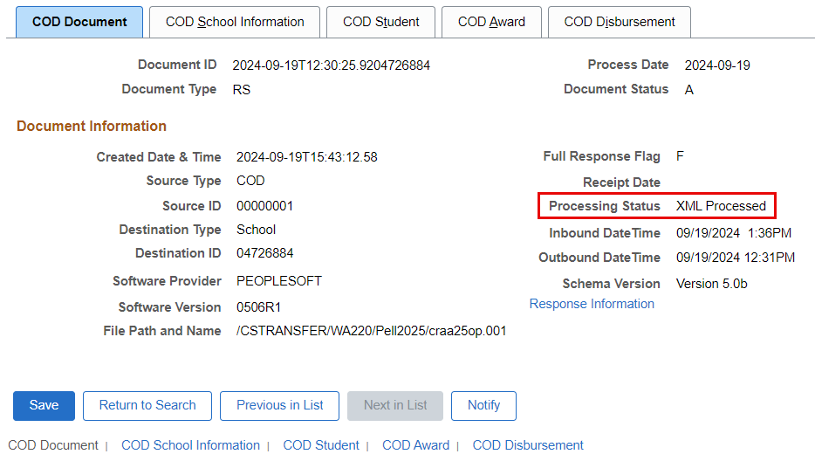
VIEW COD DATA PAGE
Navigation: Financial Aid > File Management > COD Full Participant > View COD Data
COD Document Tab Cont’d
Processing Status = displays the status of the batch.
Outbound and Generated for outbound files
Processed and Loaded for inbound files

Slide 8
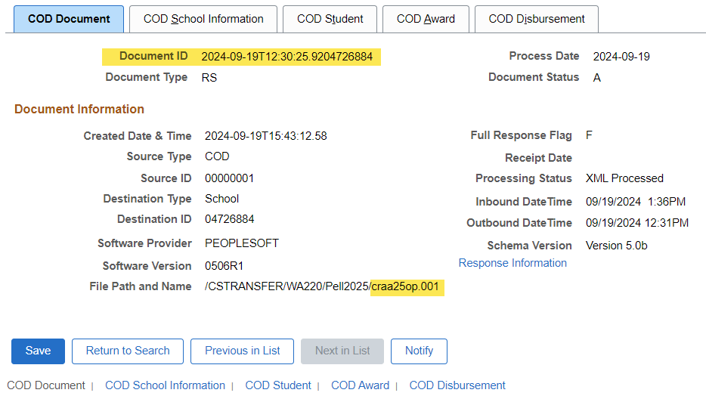
VIEW COD DATA PAGE
Navigation: Financial Aid > File Management > COD Full Participant > View COD Data
COD Document Tab Cont’d
Response Information = Select this link to access the Document Response page to review document level response rejection or correction information.
Document ID = Displays the date and time stamp with the Source Entity ID

Slide 9
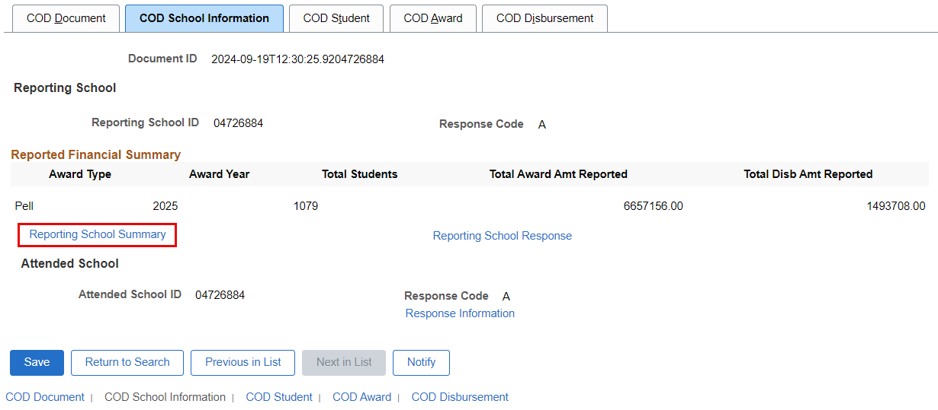
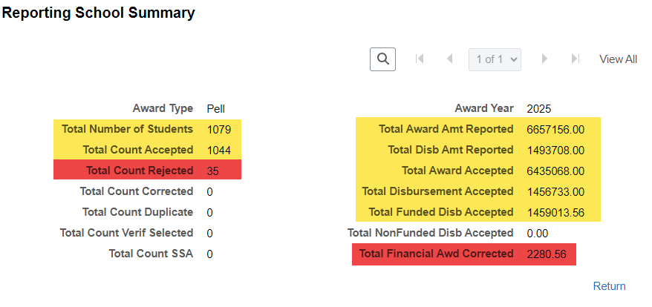
VIEW COD DATA PAGE
Navigation: Financial Aid > File Management > COD Full Participant > View COD Data
COD School Information tab
Reporting School Summary = View document summary totals

Slide 10
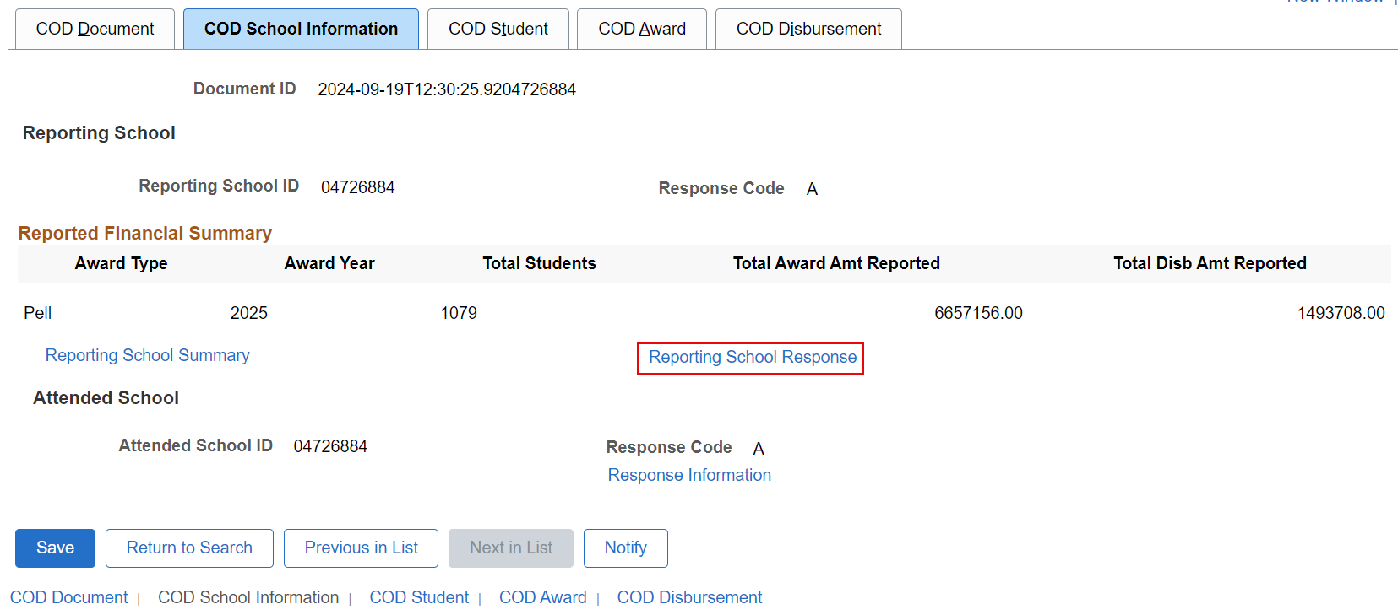
VIEW COD DATA PAGE
Navigation: Financial Aid > File Management > COD Full Participant > View COD Data
COD School Information tab
Reporting School Response = Displays school level response rejection or correction information

Slide 11
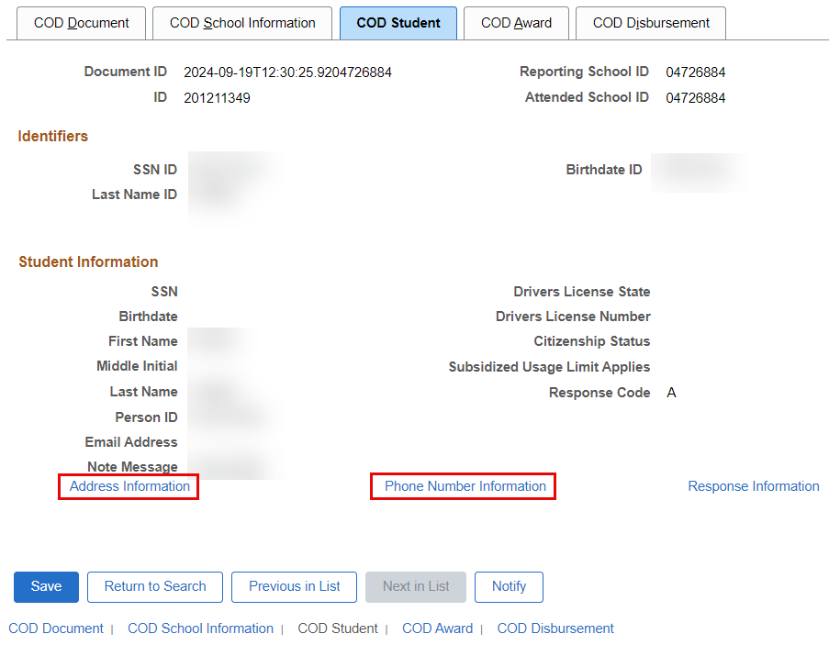
VIEW COD DATA PAGE
Navigation: Financial Aid > File Management > COD Full Participant > View COD Data
COD Student
Address Information and Phone Number Information can be compared to ISIR or COD for differences

Slide 12
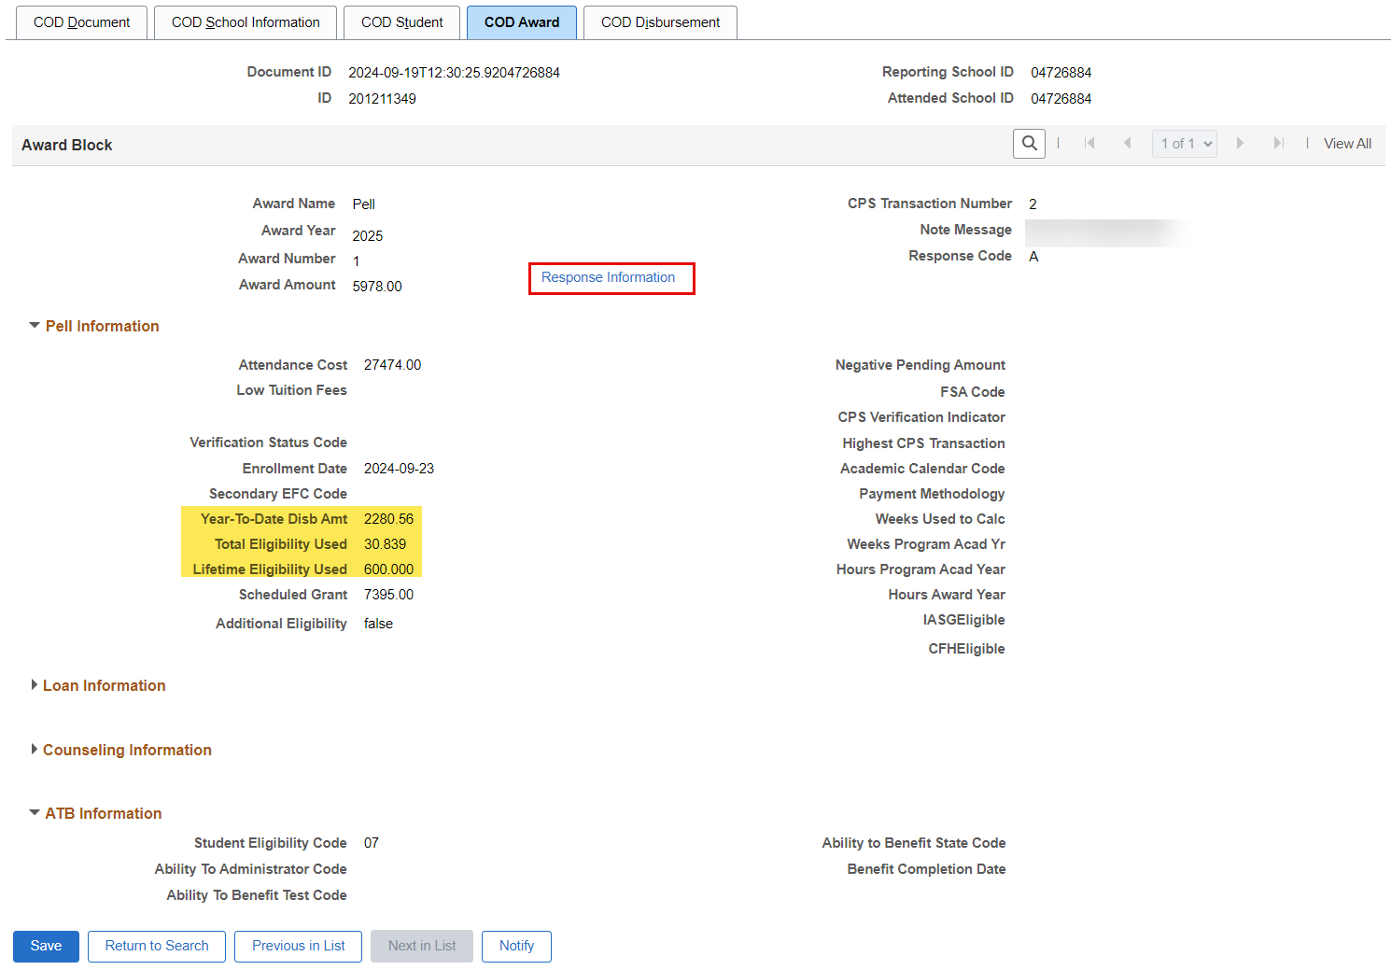
VIEW COD DATA PAGE
Navigation: Financial Aid > File Management > COD Full Participant > View COD Data
COD Award
Response Information displays student award level response rejection or correction information.
Review the Year-to-Date Disb Amt.
Note the Total Eligibility Used.
Note the LEU for the year.

Slide 13
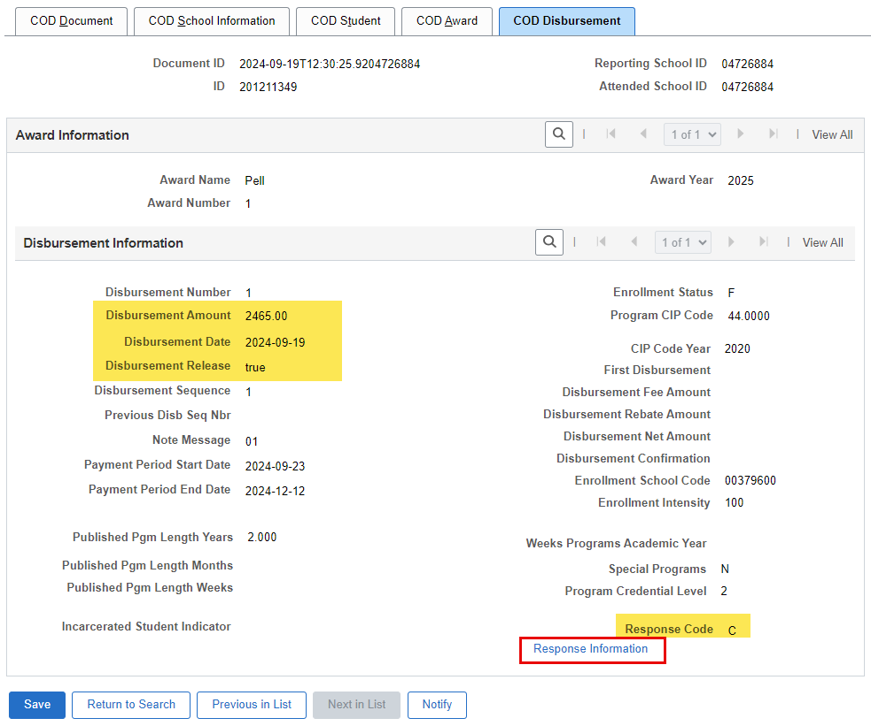
VIEW COD DATA PAGE
Navigation: Financial Aid > File Management > COD Full Participant > View COD Data
COD Disbursement
Note the Disbursement Amount, the Disbursement Date, and the Disbursement Release = true
Response Indicators:
A = Accepted
R = Rejected
D = Duplicate
C = Correction
Note the Response Code = C

Slide 14
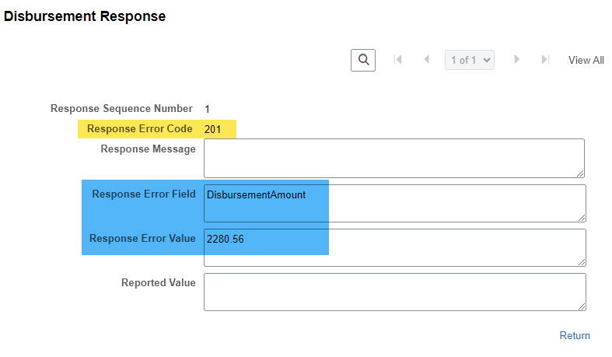
VIEW COD DATA PAGE
Navigation: Financial Aid > File Management > COD Full Participant > View COD Data
COD Disbursement Cont’d
Response Error Codes are COD Rejects
Response Error Field is showing what field in the craa24op.001 (Response File) was corrected (or rejected).
Response Error Value is showing to what the value was corrected.

Slide 15
DEMONSTRATION

Slide 16
SEARCHING BY SSN
FOR EC & MPN INFO ON
VIEW COD DATA PAGE

Slide 17
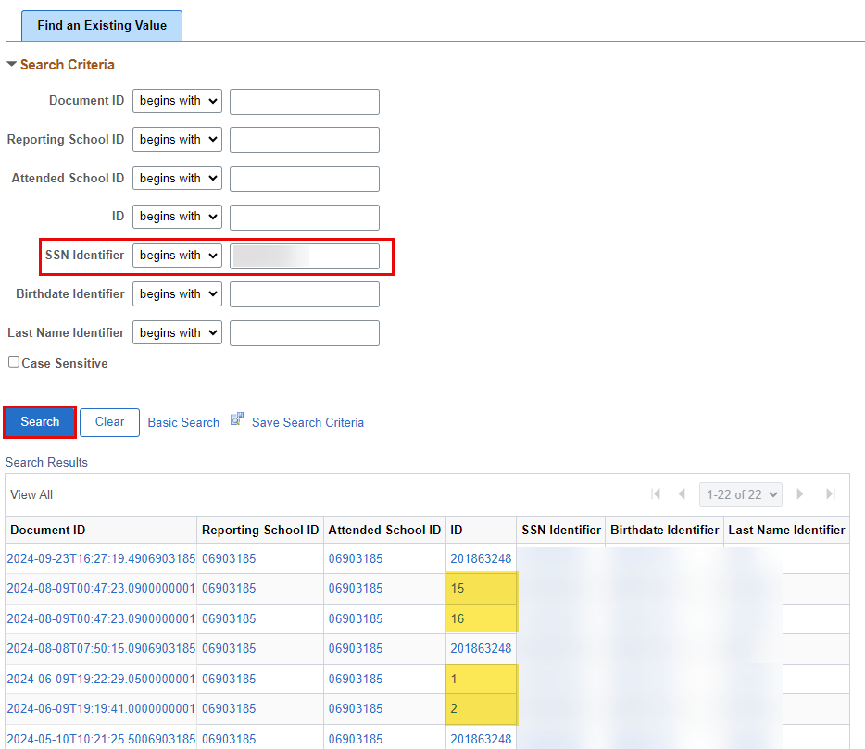
VIEW COD DATA PAGE
Navigation: Financial Aid > File Management > COD Full Participant > View COD Data
Search Page
Enter the SSN to view Entrance Counseling, Promissory Note and Booking Notification data.
Note, if you search by EMPL ID, these items will not display in the search results.
ID of 1, 2, 3, etc. (any numeric values that are not the EMPL) are EC, MPN and BN records.

Slide 18
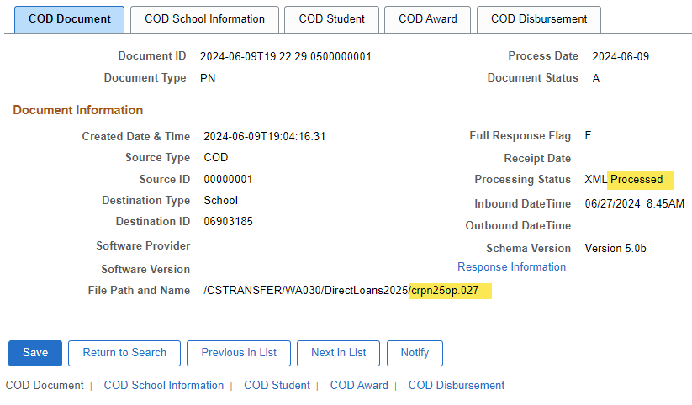
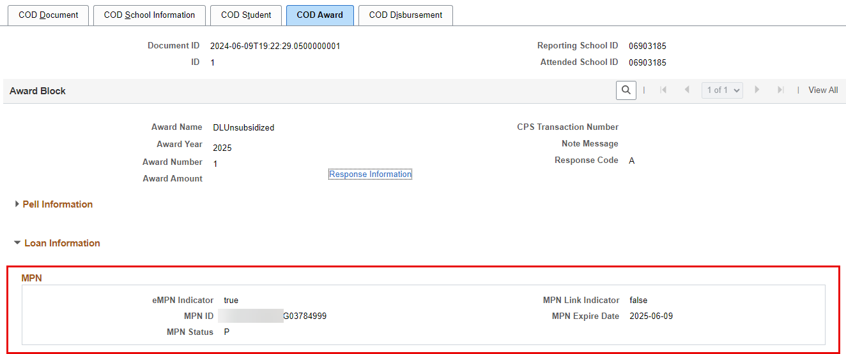
VIEW COD DATA PAGE
Navigation: Financial Aid > File Management > COD Full Participant > View COD Data
Search Page – MPN example

Slide 19
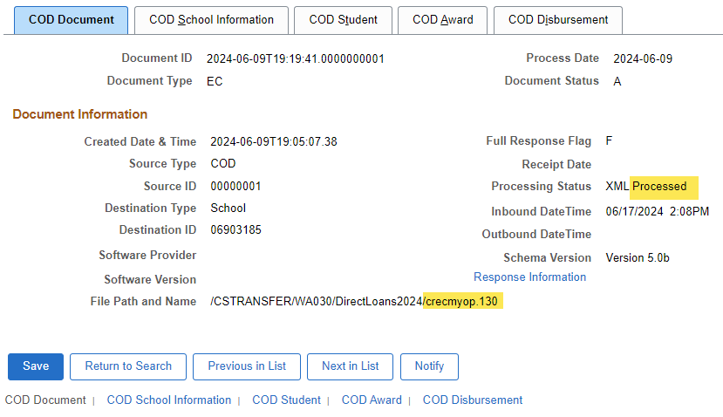
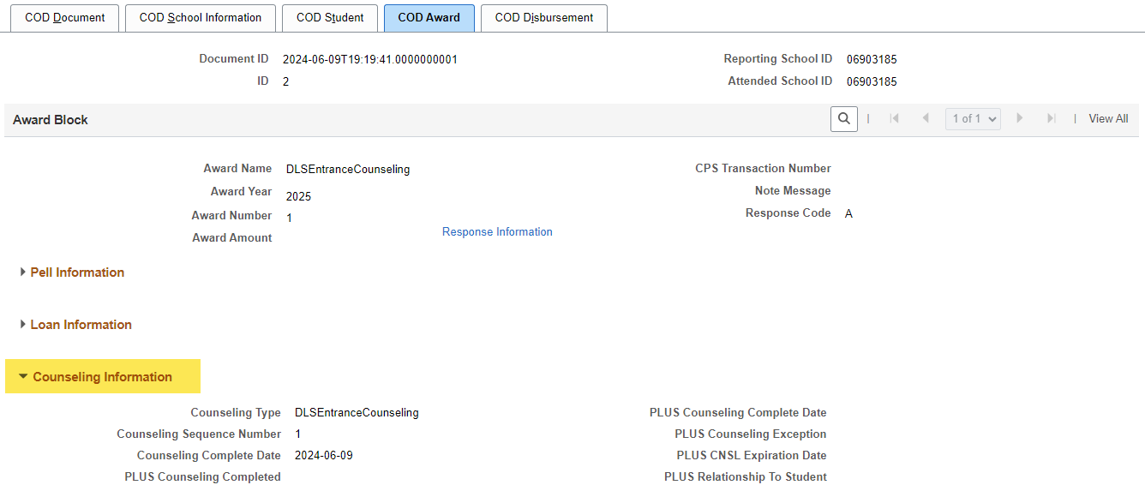
VIEW COD DATA PAGE
Navigation: Financial Aid > File Management > COD Full Participant > View COD Data
Search Page – EC example

Slide 20
DEMONSTRATION

Slide 21
TROUBLESHOOTING
DIRECT LOAN ERRORS
ON THE VIEW
COD DATA PAGE

Slide 22
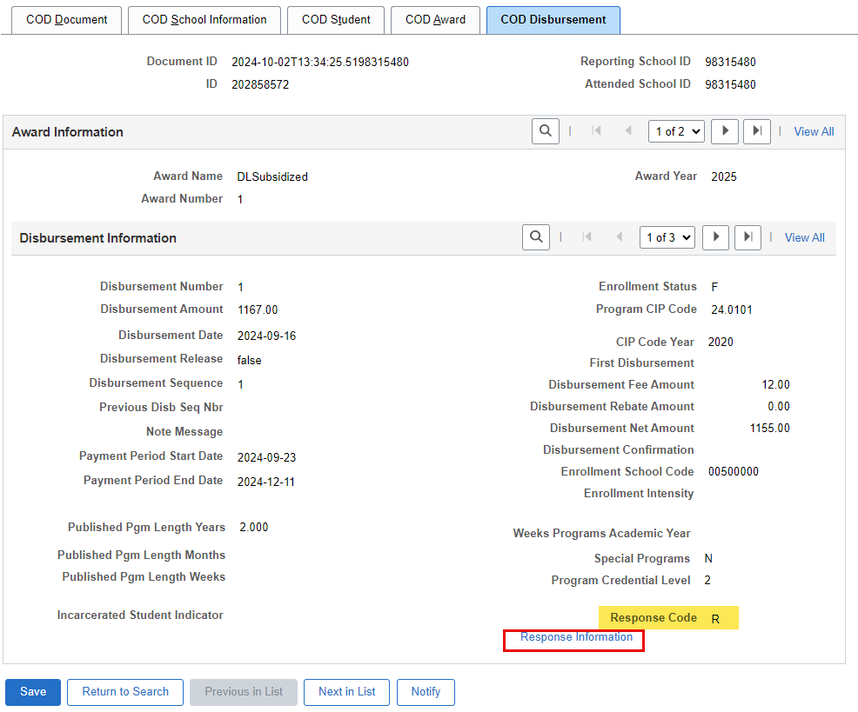
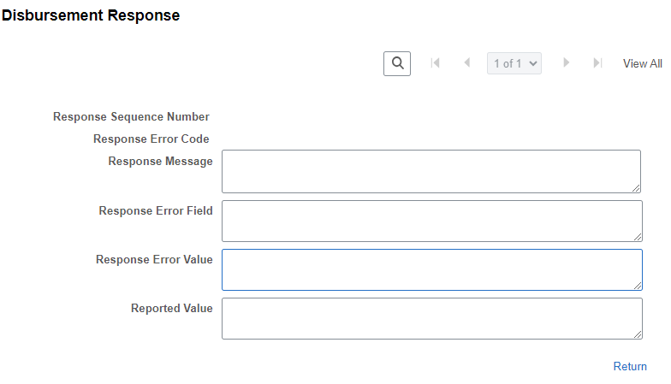
VIEW COD DATA PAGE
Navigation: Financial Aid > File Management > COD Full Participant > View COD Data
FINDING THE RESPONSE CODE

Slide 23
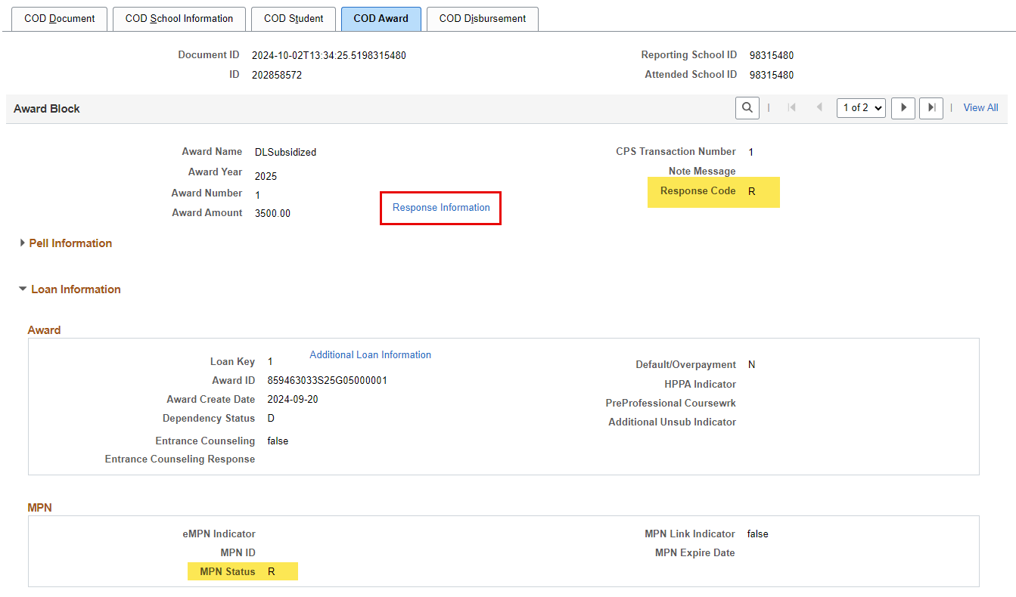
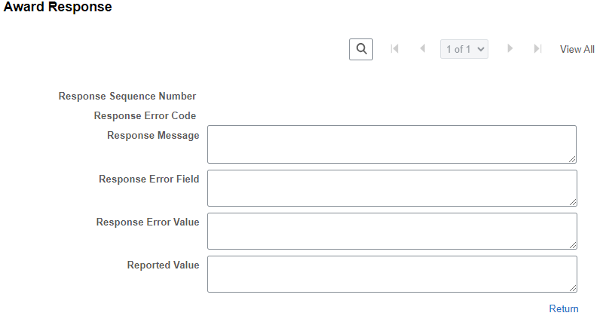
VIEW COD DATA PAGE
Navigation: Financial Aid > File Management > COD Full Participant > View COD Data
FINDING THE RESPONSE CODE

Slide 24
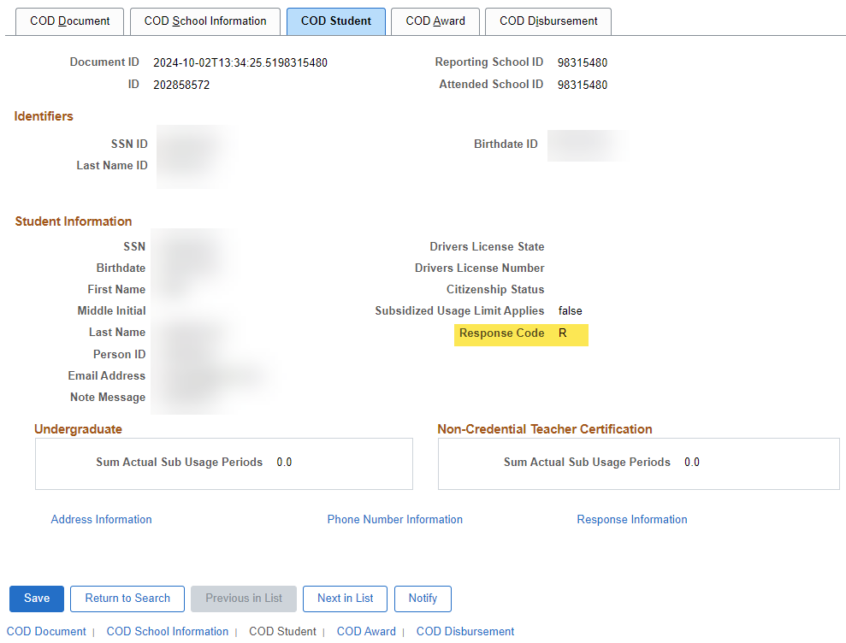
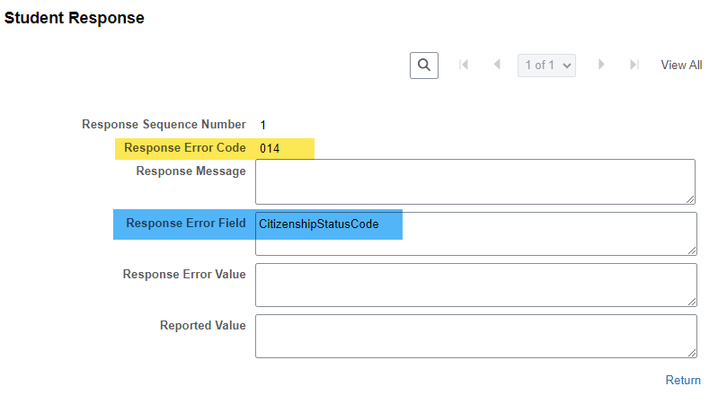
VIEW COD DATA PAGE
Navigation: Financial Aid > File Management > COD Full Participant > View COD Data
FINDING THE RESPONSE CODE

Slide 25
DEMONSTRATION

Slide 26
FINDING THE DOC ID
IN THE MANAGE PELL
PAYMENT PAGE

Slide 27
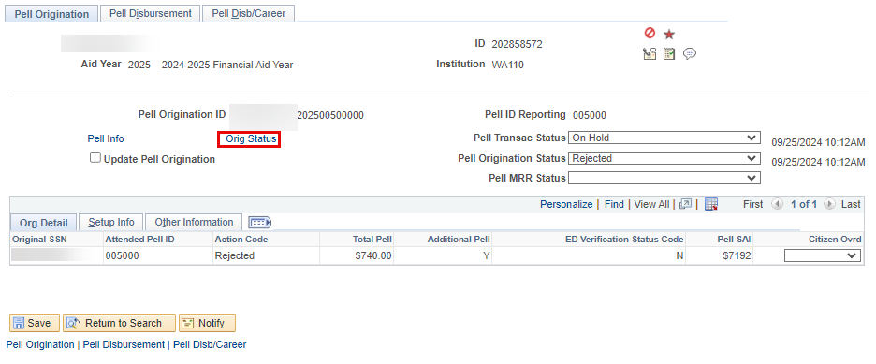
FINDING DOC ID
Navigation: Financial Aid > Pell Payment > Manage Pell Payment Page
MANAGE PELL PAYMENT PAGE
Select the Orig Status link to find the Doc ID

Slide 28
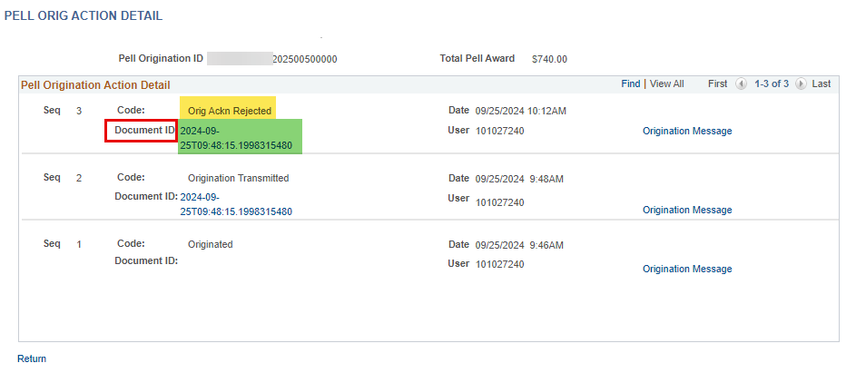
FINDING DOC ID
Navigation: Financial Aid > Pell Payment > Manage Pell Payment Page
MANAGE PELL PAYMENT PAGE
The Document ID is what you can use to track in COD to verify whether the file has been received and to find out more specific information on your student records

Slide 29
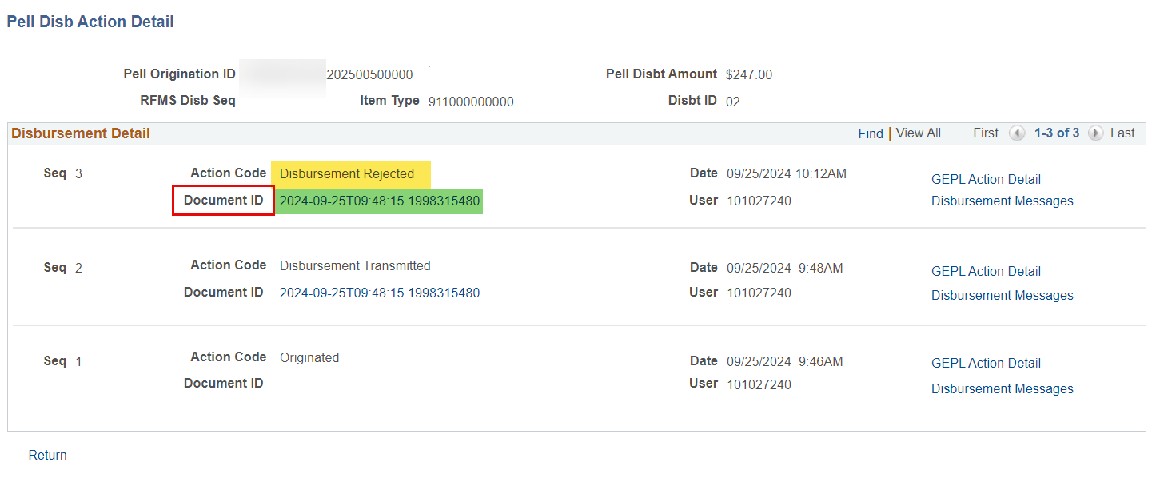
FINDING DOC ID
Navigation: Financial Aid > Pell Payment > Manage Pell Payment Page
MANAGE PELL PAYMENT PAGE
Note! The Disbursement Document ID may be different than the Origination Document ID!
Also check the Document ID in the Disb Action Detail; the Document ID may be different if Orig and Disb files are being sent at different times.

Slide 30
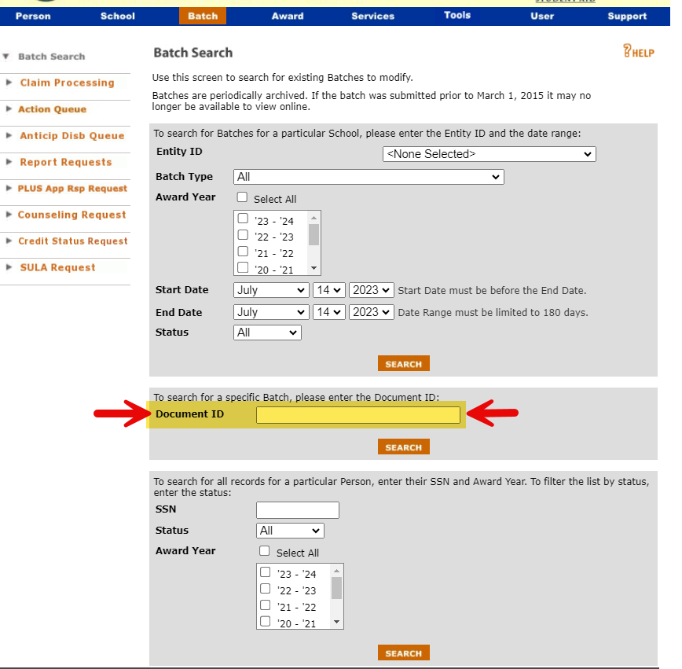
FINDING DOC ID
Navigation: Financial Aid > Pell Payment > Manage Pell Payment Page
BATCH SEARCH IN COD
The Document ID is what you can use to track in COD to verify whether the file has been received and to find out more specific information on your student records

Slide 31
FINDING THE DOC ID
IN A RAW
CRAA OR CRDL FILE

Slide 32
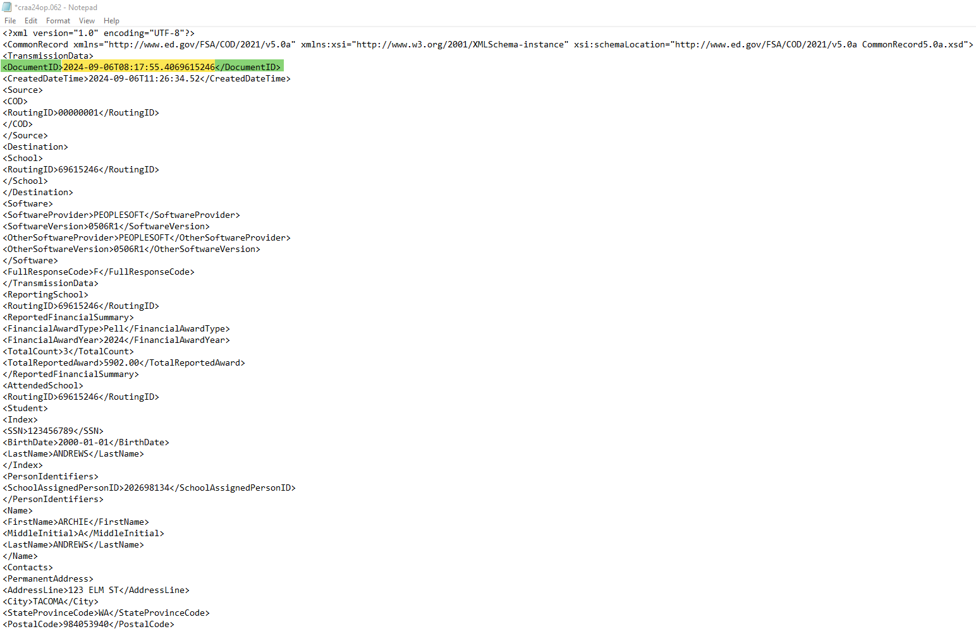
FINDING DOC ID IN A RAW DATA FILE
FOR USE OF BATCH SEARCHING IN COD
The Document ID is found in generated files and response files

Slide 33
OUTCOMES
At training completion, you should be able to:
Understand how to read and interpret values on the View COD Data page
Understand how to search for Entrance Counseling and MPN info by SSN
Understand how to troubleshoot Direct Loan errors using the View COD Data page
Understand where the link to the Doc ID lives on the Manage Pell Payment page and how that can be found/used in View COD Data
Understand how to read the Doc ID on a raw CRAA and CRDL file

Slide 34
Congratulations!
You have successfully completed the Reviewing the View COD Data Page Training!
Please refer to the ctcLink Reference Center for additional resource materials on today’s topics
Thank you for your participation today!

