Slide 1
MEETING RECORDING NOTICE
The law requires consent prior to recording a person’s participation in an event. Your participation in this video conference (training) equals consent to be recorded, as required by law.
If you do not consent to being recorded but choose to participate, please turn your camera off and use the chat feature to interact with the other participants.
Enable Closed Captions
Enable AI Assistant

Slide 2
Census processing refresher
Kelly Forsberg
ctcLink Functional Trainer | Financial Aid
October 2024

Slide 3
Objectives
After completing this training, you should be able to:
Understand the steps in the Census Process
Update the Run Equation with AY and Term
Update the AY and terms on the Build FA Term page Run Controls for Census
Update the AY and terms on the Census Run Equation
Understand how to update the Census JobSet
Understand which Census Queries are available
Notes:
At course completion, you should now be able to:

Slide 4
STEPS IN THE
CENSUS PROCESS

Slide 5
CENSUS PROCESSING
3-STEP PROCESS
Step 1: Build Equation Engine
Step 2: Build FA Term
Step 3: Build Equation Engine Again

Slide 6
update census EQUATION ENGINE
Navigation: Set Up SACR > Common Definitions > Equation Engine > Run Equation
This example shown is from an institution assuming a Fall term start date of 09/23/2024. Choose a date 7 days past your published Census Date

Slide 7
BUILD FA TERM

Slide 8
CENSUS PROCESSING
3-STEP PROCESS
Step 1: Build Equation Engine
Step 2: Build FA Term
Step 3: Build Equation Engine Again

Slide 9
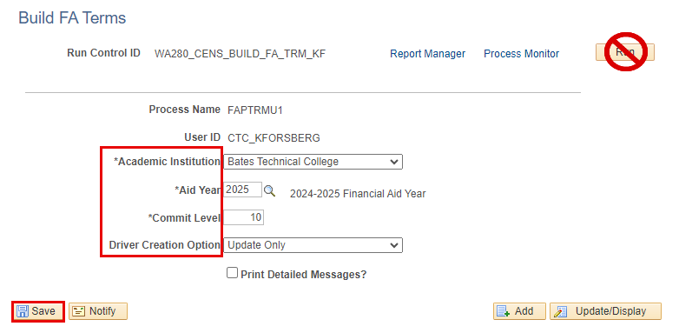
process census EQUATION ENG cont’d
Navigation: Financial Aid > FA Term > Build FA Term in Batch
Note: When running FA term process for Census, its purpose is to capture the enrollment data snapshot at the end of census.

Slide 10
CENSUS PROCESSING
3-STEP PROCESS
Step 1: Build Equation Engine
Step 2: Build FA Term
Step 3: Build Equation Engine Again

Slide 11
UPDATE census equation engINE
Navigation: Set Up SACR > Common Definitions > Equation Engine > Run Equation
This step resets FA Term back to the actual enrollment at census date, and locks it

Slide 12
DEMONSTRATION

Slide 13
SCHEDULING JOBSET DEFINITION

Slide 14
CENSUS PROCESSING
Schedule JobSet
Steps 1 - 3
Schedule JobSet

Slide 15
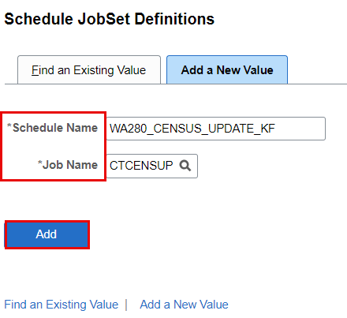
PROCESS CENSUS CONT’D
Schedule JobSet
Navigation: PeopleTools > Process Scheduler > Schedule JobSet Definitions

Slide 16
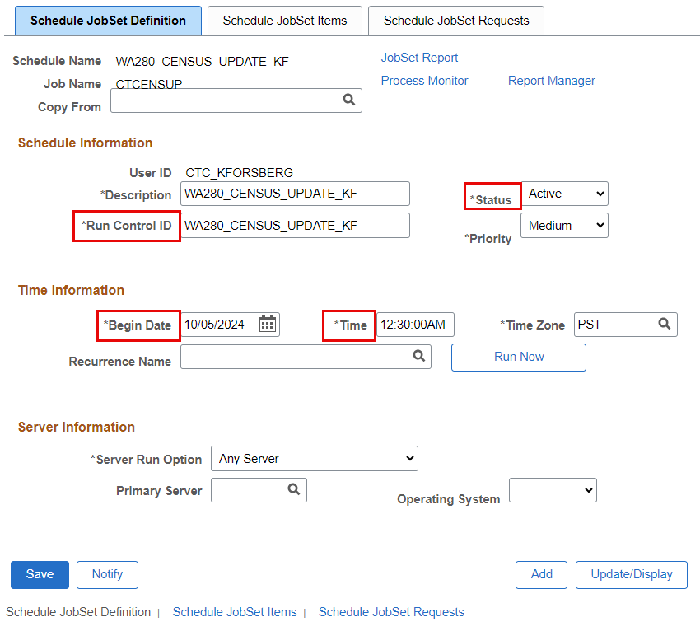
Process census cont’d
Note:
Set a future date* for your JobSet to run, then make the Status “Active”
*The JobSet should be run shortly after midnight on the day after your actual census date.
Schedule JobSet

Slide 17
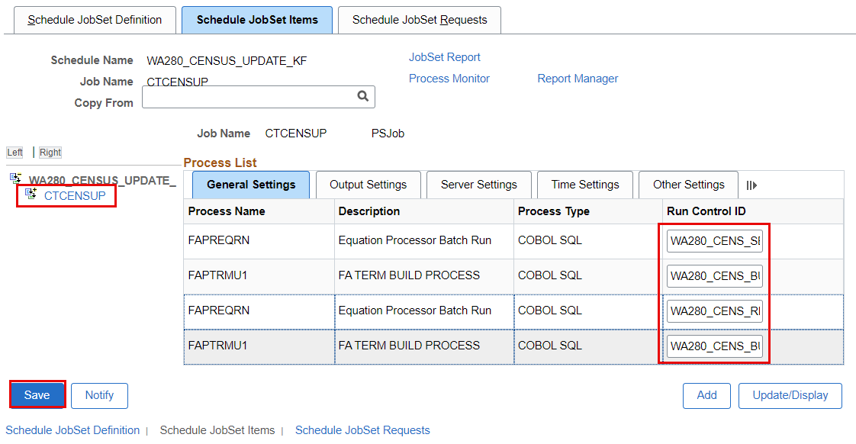
Process census cont’d
Schedule JobSet
Tip! Copy your run control IDs from the previous steps and paste them into the fields on this page to ensure accuracy

Slide 18
DEMONSTRATION

Slide 19
QUERIES

Slide 20
queries
Available queries recommended to run after you’ve begun disbursement, and run daily until Census lock:
CTC_FA_LOAD_COMP_BETWEEN_DATE – Compares students with different FA load level when disbursed to date entered in prompt. Picks up students with all aid
QCS_FA_LOAD_DECREASE_B4_CENSUS – Compares students’ FA Load and Enrollment Intensity at disbursement and compares to date run, identifies drop in enrollment
CTC_SERVICE_INDICATOR_LIST – Run to FLF to see who still has an outstanding FLF Service Indicator

Slide 21
Queries CONT’D
Available queries recommended to run after Census lock:
QCS_FA_CENSUS_DATE_LIST – Identifies students with a discrepancy between FA Load and Enrollment Intensity captured at most recent Authorization run via the Award Activity page vs. the FA Load in FA Term.

Slide 22
DEMONSTRATION

Slide 23
Outcomes
At training completion, you should be able to:
Understand the steps in the Census Process
Update the Run Equation with AY and Term
Update the AY and terms on the Build FA Term page Run Controls for Census
Update the AY and terms on the Census Run Equation
Understand how to update the Census JobSet
Understand which Census Queries are available

Slide 24
Congratulations!
Census Processing Refresher Training Complete!
Please review census business processing guide resource as you are doing your census processing
Thank you for your participation today!

