Slide 1
MEETING RECORDING NOTICE
The law requires consent prior to recording a person’s participation in an event. Your participation in this video conference (training) equals consent to be recorded, as required by law.
If you do not consent to being recorded but choose to participate, please turn your camera off and use the chat feature to interact with the other participants.
Enable Closed Captions
Enable AI Assistant

Slide 2
flf process & enrollment intensity queries
Kelly Forsberg
ctcLink Functional Trainer | Financial Aid
September 2024

Slide 3
Objectives
After completing this training, you should be able to:
Understand all the steps in the FLF Process:
Populate Packaging Variables
Mass Assign FLF Service Indicator
Service Indicator List
Work Awards
Update Packaging Variables
Using new Enrollment Intensity Queries:
QCS_FA_ASSIGN_PKG_VARS_EI QCS_FA_ENROLL_INT_FLF_ADD QCS_FA_ENROLL_INT_FLF_REMOVE QCS_FA_PACK_VARIABLE_LTFT_LIST

Slide 4
FLF PROCESS

Slide 5
Populate packaging variables
Navigation: Set Up SACR > System Administration > Utilities > Population Update > Population Update Process
Enter the following in the Select Fields to Update section:
Field Name Field Value
User Var Num #1 = FALL 1.00
User Var Num #2 = WINTER 1.00
User Var Num #3 = SPRING 1.00
User Var Num #4 = SUMMER 1.00

Slide 6
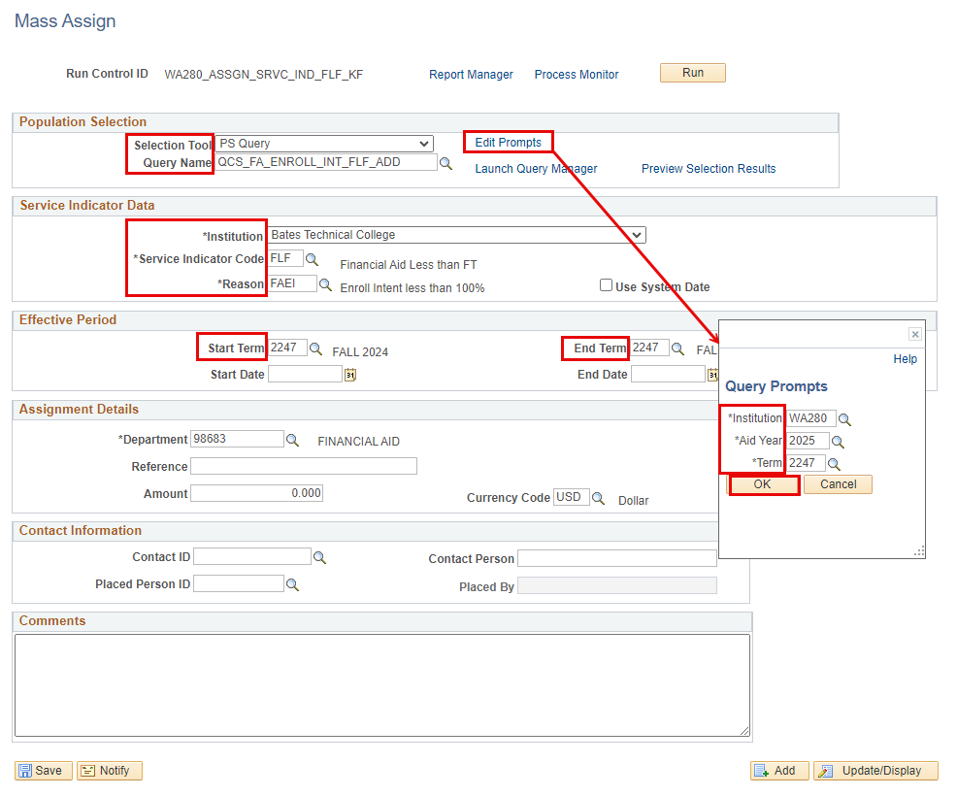
Mass assign flf service indicator
Navigation: Campus Community > Service Indicators (Student) > Mass Assign
Do not enter Start or End Dates
Tip! To get a list of who will be assigned a FLF, you can this query independently in Query Viewer before mass assigning

Slide 7
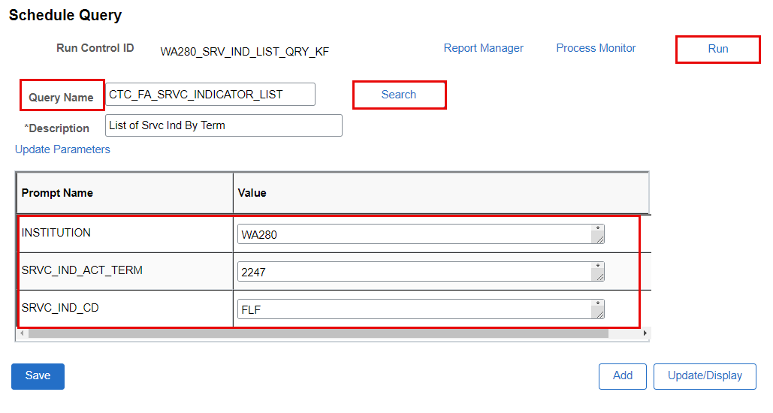
Run service indicator list query
Navigation: Reporting Tools > Query > Query Viewer
Run this list to see who has a FLF, and work the list to see who needs to have:
Awards adjusted to reflect proper enrollment
Packaging Variables updated for the term

Slide 8
Additional Query to find students w/ Var Char variables already assgn’d
QCS_FA_PACK_VARIABLE_LTFT_LIST
Query to find students where packaging variables were adjusted to less than full time values for the prompted aid year.
If you already adjusted the packaging variable for future quarters to T/H/L/N, you can use this query to find those student to update the Enrollment Intensity on the Var Num field.

Slide 9
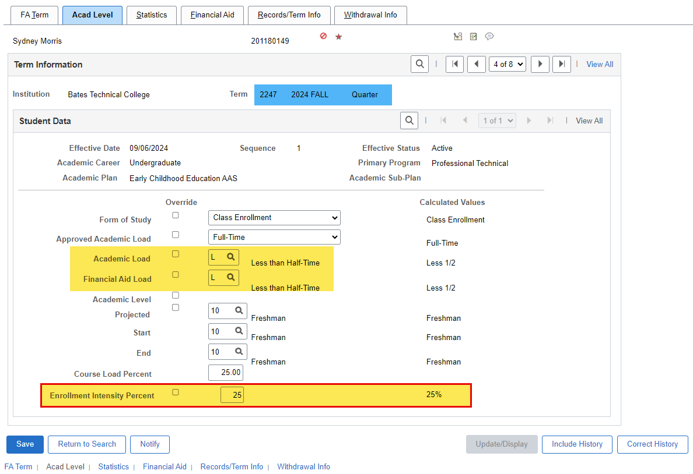
View fa term for enrlmnt intensity
Navigation: Financial Aid > Financial Aid Term > Maintain Student FA Term
From the query list,
Verify Enrollment Intensity Percentage for each student

Slide 10
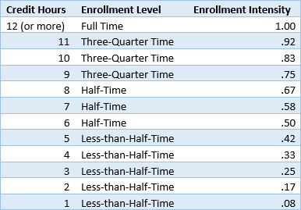
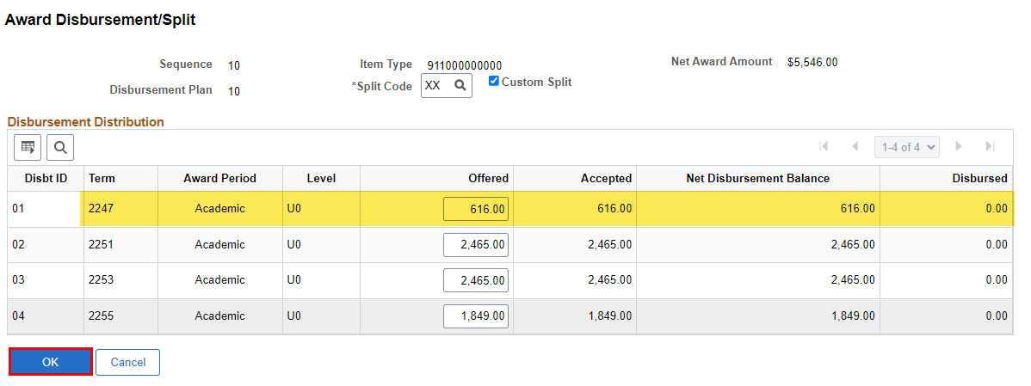
Enrollment intensity % chart by unit
Adjust your awards by the appropriate percentage.
For example:
$2465 Pell x 0.25 = $616

Slide 11
update packaging variables
Navigation: Financial Aid > Awards > Award Processing > Assign Packaging Variables
Enter the following in the Select Fields to Update section:
Field Name
User Var Num #1 = FALL
User Var Num #2 = WINTER
User Var Num #3 = SPRING
User Var Num #4 = SUMMER

Slide 12
Flf process
NEXT STEPS:
Manually, or Batch, remove FLF Service Indicator
Run/Re-Run Authorization in Batch
Run Disbursement in Batch

Slide 13
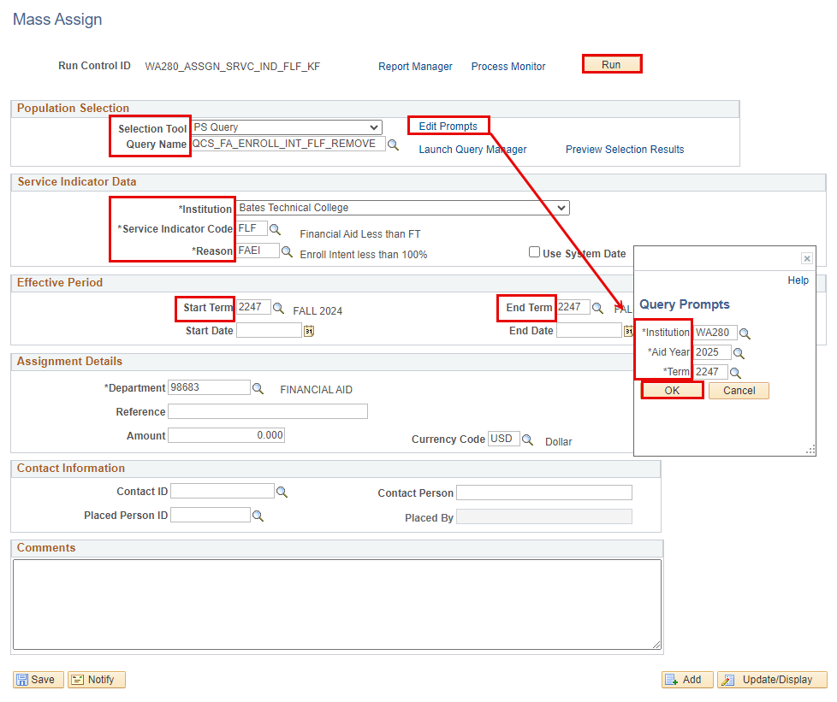
Mass remove flf service indicator
Navigation: Campus Community > Service Indicators (Student) > Mass Assign

Slide 14
DEMONSTRATION

Slide 15
Congratulations!
FLF Process Process w/ New Enrollment Intensity Queries Training complete!
Thank you for your participation today!

