Slide 1
MEETING RECORDING NOTICE
The law requires consent prior to recording a person’s participation in an event. Your participation in this video conference (training) equals consent to be recorded, as required by law.
If you do not consent to being recorded but choose to participate, please turn your camera off and use the chat feature to interact with the other participants.
Enable Closed Captions
Enable AI Assistant

Slide 2
loan PROCESSING refresher training
Kelly Forsberg
ctcLink Functional Trainer | Financial Aid
September 2024

Slide 3
OBJECTIVES
After completing this training, you should be able to:
Understand the loan origination (Batch and Single Student) process
Understand the Loan Origination Outbound and Inbound Process
Understand the Loan Disbursement Outbound and Inbound Process
Understand how to query for missing COD files
Understand how to award and originate a PLUS loan
Understand how to award and process a Private/ALT Loan

Slide 4
LOAN ORIGINATION
PROCESS (BATCH)

Slide 5
LOAN ORIG PROCESS IN BATCH
4-STEP PROCESS
Step 1: Process Loans
Step 2: Process Loan Dates
Step 3: Population Update
Step 4: Process Loans Again
Notes:
Here is a visual of the 4-step process in Loan Processing.

Slide 6
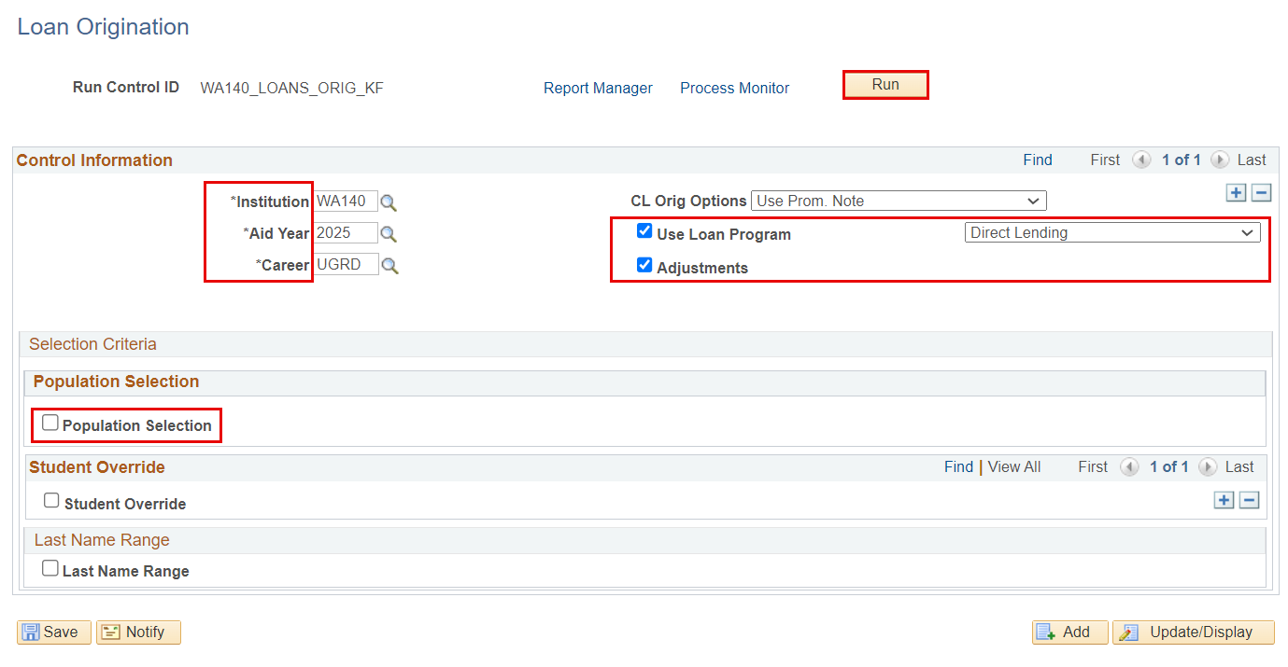
LOAN ORIGINATION IN BATCH CONT’D
RUN PROCESS LOANS
Navigation: Financial Aid > Loans > Process Loans
The Population Selection check box should be unchecked

Slide 7
LOAN ORIGINATION IN BATCH CONT’D
Step 1: Process Loans
Step 2: Process Loan Dates
Step 3: Population Update
Step 4: Process Loans Again

Slide 8
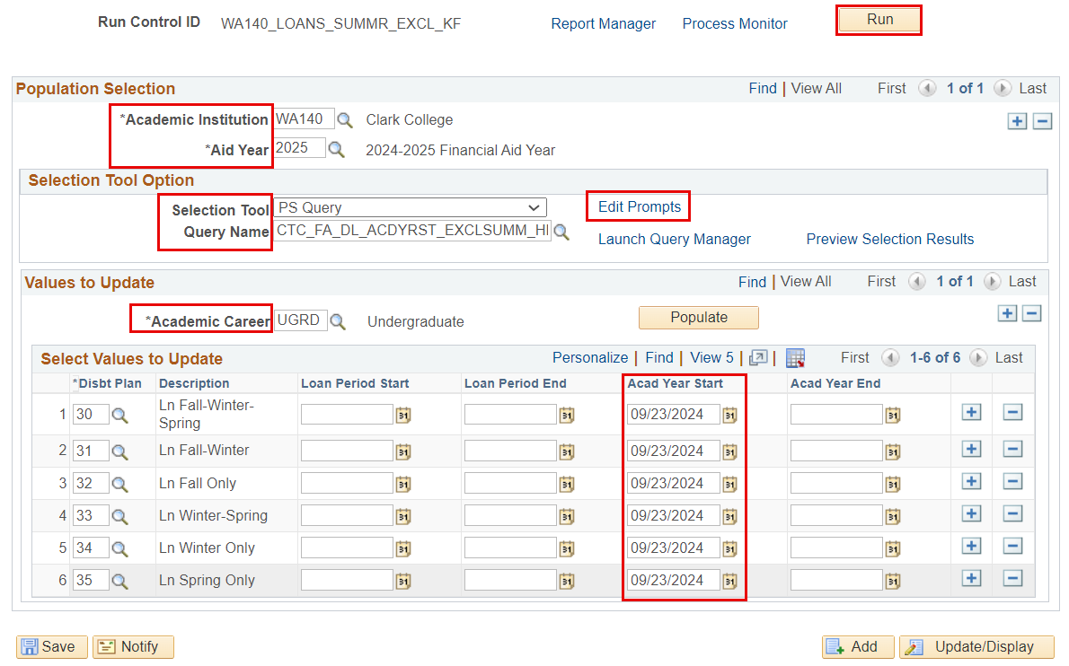
LOAN ORIGINATION IN BATCH CONT’D
PROCESS LOAN DATES (SUMMER EXCLUDE HEADER)
Navigation: Financial Aid > Loans > Process Loan Dates
The set up on these processes is different for Trailer institutions; follow the Loan Processing Guide

Slide 9
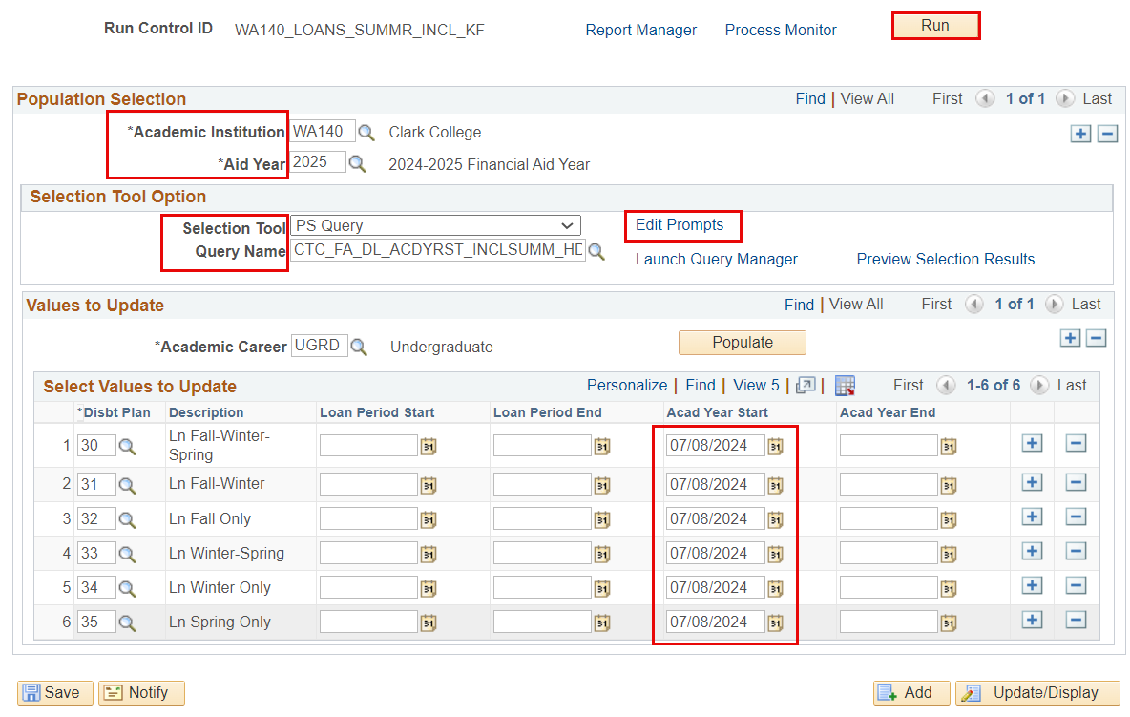
LOAN ORIGINATION IN BATCH CONT’D
PROCESS LOAN DATES (SUMMER INCLUDE HEADER)
The set up on these processes is different for Trailer institutions; follow the Loan Processing Guide

Slide 10
LOAN ORIGINATION IN BATCH CONT’D
POPULATION UPDATE (OFFER ACTIVITY)
Step 1: Process Loans
Step 2: Process Loan Dates
Step 3: Population Update
Step 4: Process Loans Again
Notes:
Returning back to the visual chart, we are now going to move into step 3 of the 4-step loan process. Step 3 is Population Update

Slide 11
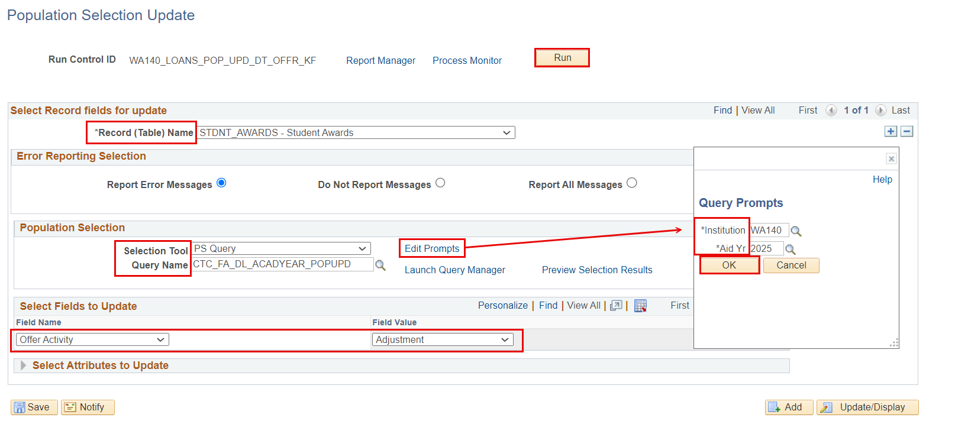
LOAN ORIGINATION IN BATCH CONT’D
POPULATION UPDATE (OFFER ACTIVITY)
Navigation: Set Up SACR > System Administration > Utilities > Population Update > Population Update Process
This process picks up any loans that have had any adjustments to them – it is typical you will not always get results when running this process. Please run it as part of steps in the process.
Notes:
This population update process will move the loan offer activity to an adjustment of accepted.

Slide 12
LOAN ORIGINATION IN BATCH CONT’D
RUN PROCESS LOANS AGAIN
Step 1: Process Loans
Step 2: Process Loan Dates
Step 3: Population Update
Step 4: Process Loans Again
Notes:
We are now at step in processing loans. You will run Process Loans again, which moves all your updates to the MDLA page.

Slide 13
LOAN ORIGINATION IN BATCH CONT’D
RUN PROCESS LOANS AGAIN
Navigation: Financial Aid > Loans > Process Loans
Running process loans again picks up any changes needing to be made to originations – please run as part of the steps in the process

Slide 14
LOAN ORIGINATION
PROCESS (SINGLE STUDENT)

Slide 15
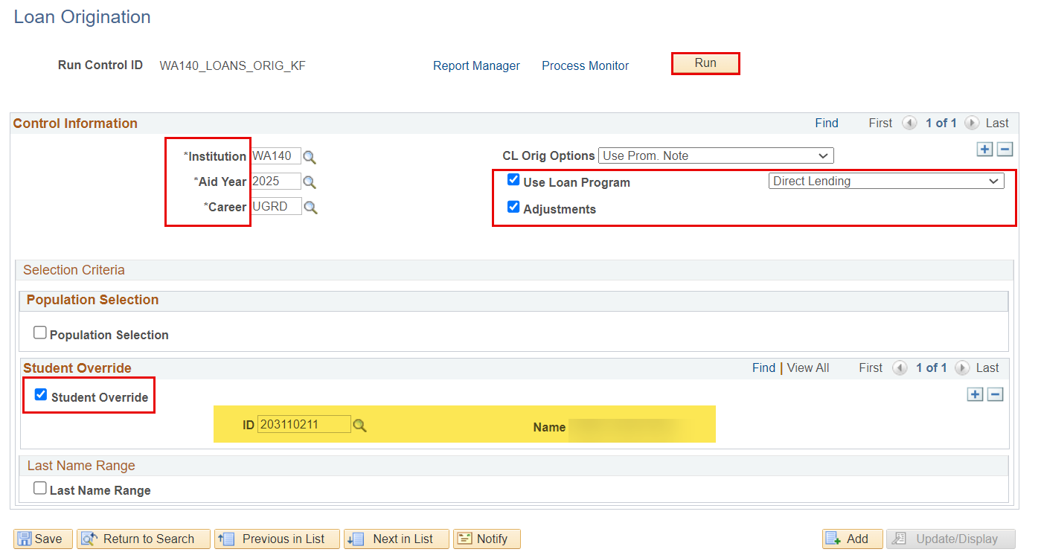
LOAN ORIGINATION SINGLE STUDENT
PROCESS LOANS
Navigation: Financial Aid > Loans > Process Loans

Slide 16
LOAN OUTBOUND/INBOUND PROCESS (ORIGINATION & DISBURSEMENTS)

Slide 17
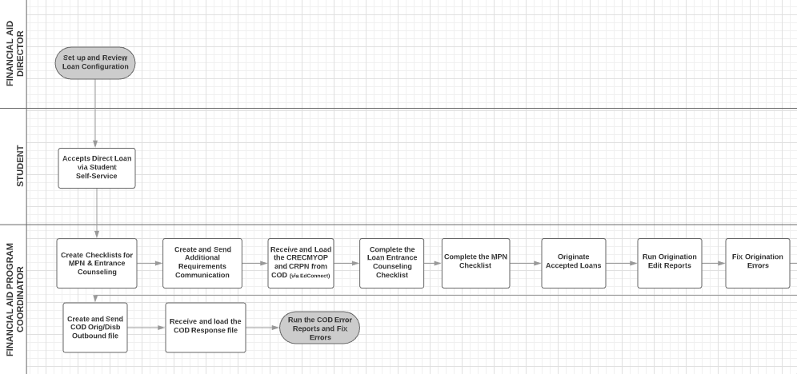
LOAN INBOUND/OUTBOUND FLOW

Slide 18
LOAN OUTBOUND PROCESSING
3-STEP PROCESS
Step 1: Originate Loans
Step 2: Generate Direct Loan Data
Step 3: Download Process

Slide 19
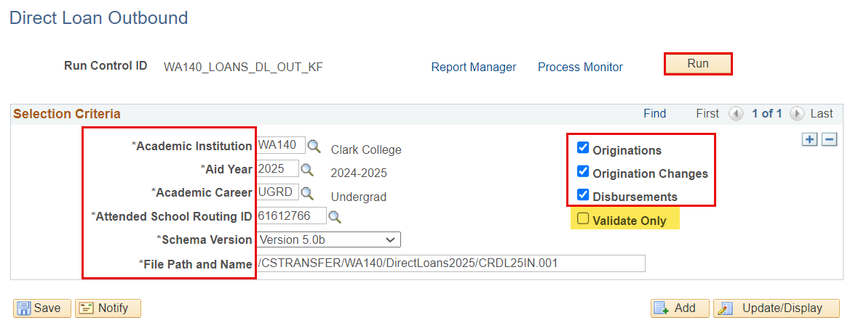
LOAN OUTBOUND PROCESS CONT’D
GENERATE DIRECT LOAN DATA
Navigation: Financial Aid > File Management > COD Full Participant > Generate Direct Loan Data
Selecting the Originations, Origination Changes, and Disbursements check boxes will run the processes. Selecting Validate Only will run it in simulation mode only

Slide 20
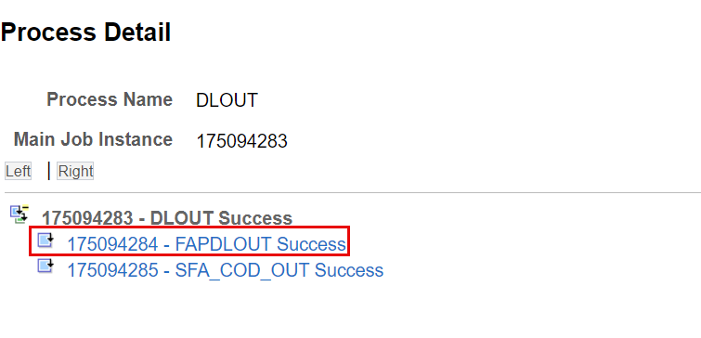
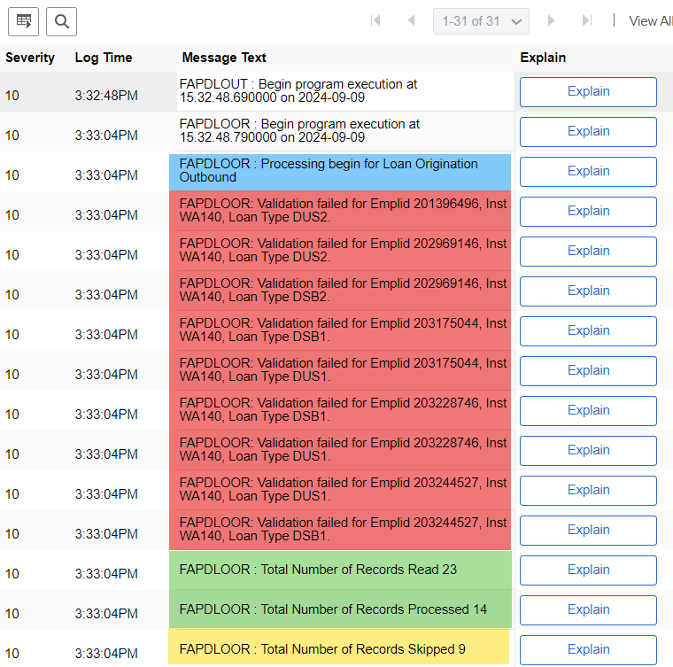
LOAN OUTBOUND PROCESS CONT’D
GENERATE DL DATA CONT’D
Navigation: Financial Aid > File Management > COD Full Participant > Generate Direct Loan Data
For the records that failed validation, work your Validation Errors Report, then re-run the process

Slide 21
LOAN OUTBOUND PROCESS
3-STEP PROCESS
Step 1: Originate Loans
Step 2: Generate Direct Loan Data
Step 3: Download Process

Slide 22
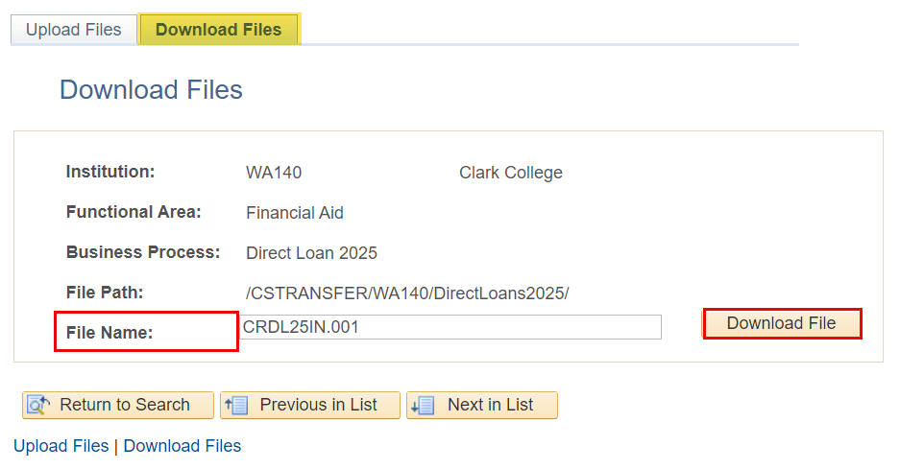
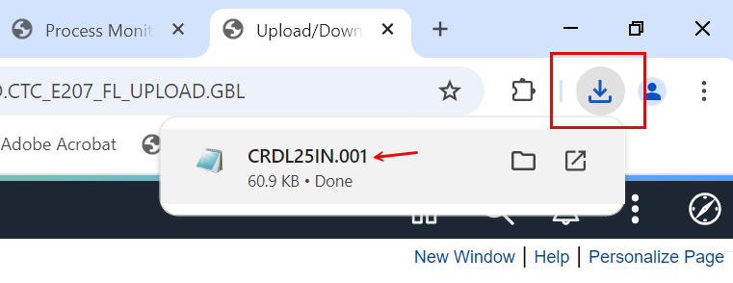
LOAN OUTBOUND PROCESS CONT’D
DOWNLOAD PROCESS
Navigation: PeopleTools > CTC Custom > Extensions > Upload/Download Files
Find your file in your downloads folder on your computer, and then save it in your network drive. Upload to EdConnect.

Slide 23
DEMONSTRATION

Slide 24
QUERY FOR MISSING
COD FILES

Slide 25
QUERY FOR MISSING COD FILES
QCS_FA_MISSING_COD_RESPONSE
Navigation: Reporting Tools > Query > Query Viewer
Run this query to see if you are missing loading any COD response files. When you cannot get funds to disburse, or ctcLink to recognize origination records, it may be due to you missing to load a response file.

Slide 26
AWARDING AND
ORIGINATING
A PLUS LOAN

Slide 27
PLUS LOAN PROCESSING
6-STEP PROCESS
Step 1: Award PLUS Loan
Step 2: Originate PLUS Loan
Step 3: Create Parent Record
(If none already exists)
Step 4: Establish Relationship for Parent
Step 5: Link Parent to PLUS Loan Record
Step 6: Re-originate PLUS Loan

Slide 28
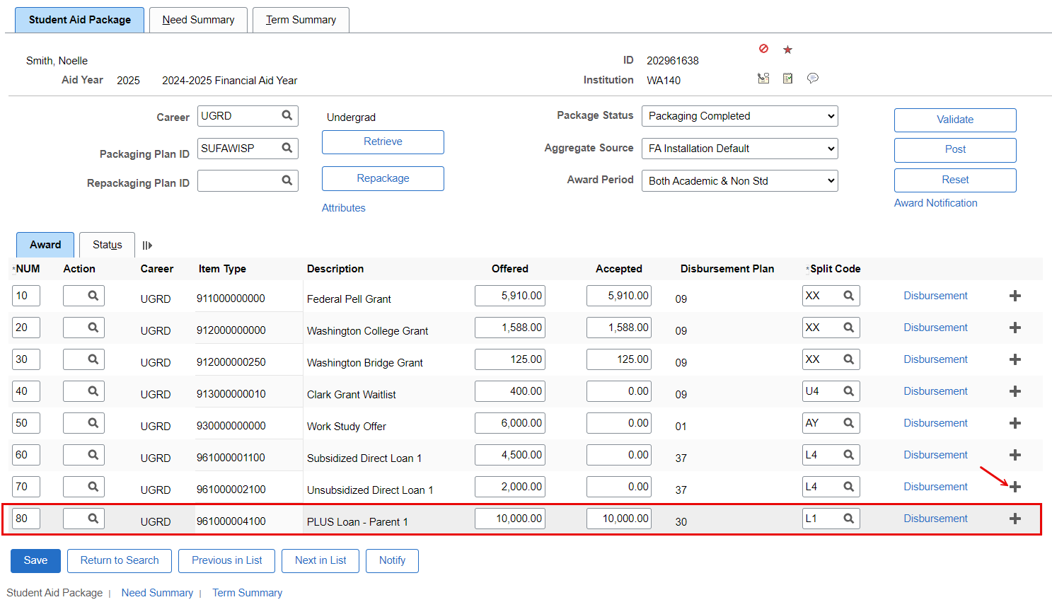
PLUS LOAN PROCESSING CONT’D
AWARD PLUS LOAN
Navigation: Financial Aid > Awards > Award Processing > Assign Awards to a Student
Always sequence PLUS award at the end of the aid package so it deducts properly from COA

Slide 29
PLUS LOAN PROCESSING CONT’D
6-STEP PROCESS
Step 1: Award PLUS Loan
Step 2: Originate PLUS Loan
Step 3: Create Parent Record
(If none already exists)
Step 4: Establish Relationship for Parent
Step 5: Link Parent to PLUS Loan Record
Step 6: Re-originate PLUS Loan

Slide 30
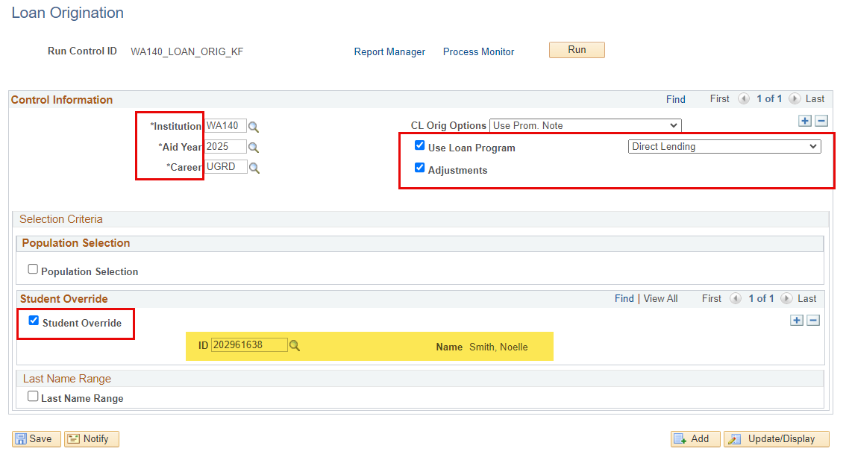
PLUS LOAN PROCESSING CONT’D
ORIGINATE SINGLE LOAN
Navigation: Financial Aid > Loans > Process Loans

Slide 31
PLUS LOAN PROCESSING CONT’D
6-STEP PROCESS
Step 1: Award PLUS Loan
Step 2: Originate PLUS Loan
Step 3: Create Parent Record
(If none already exists)
Step 4: Establish Relationship for Parent
Step 5: Link Parent to PLUS Loan Record
Step 6: Re-originate PLUS Loan

Slide 32
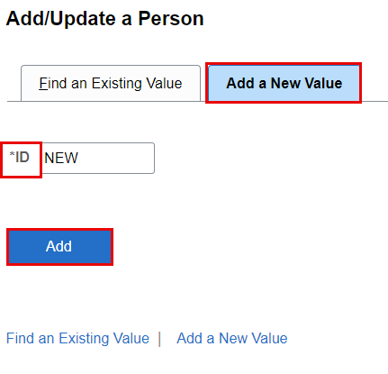
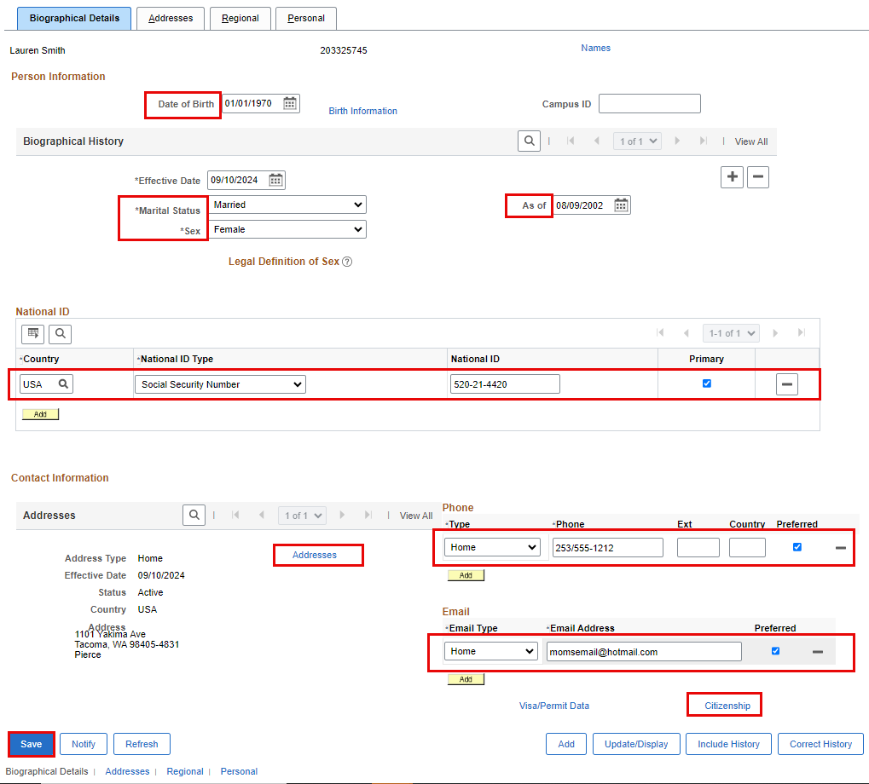
PLUS LOAN PROCESSING CONT’D
CREATE PARENT EMPL RECORD
Navigation: Campus Community > Personal Information > Add/Update a Person
If the parent has no existing EMPL in ctcLink, a EMPL record must be created so you’re able to link the parent borrower to the loan record.

Slide 33
PLUS LOAN PROCESSING CONT’D
6-STEP PROCESS
Step 1: Award PLUS Loan
Step 2: Originate PLUS Loan
Step 3: Create Parent Record
(If none already exists)
Step 4: Establish Relationship for Parent
Step 5: Link Parent to PLUS Loan Record
Step 6: Re-originate PLUS Loan

Slide 34
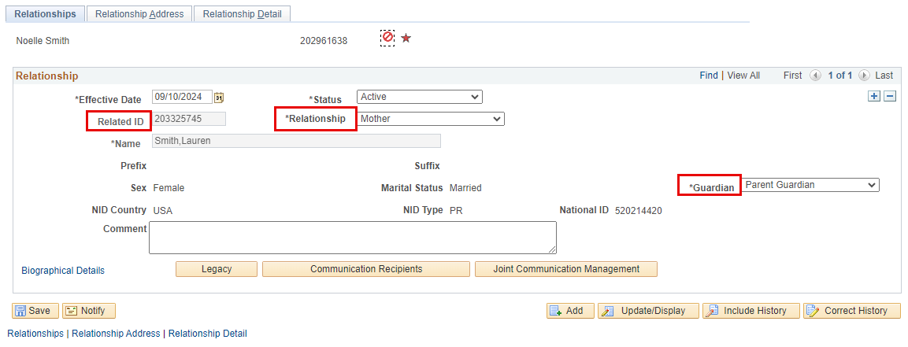
PLUS LOAN PROCESSING CONT’D
ESTABLISH RELATIONSHIP
Navigation: Campus Community > Personal Information > Biographical > Relationships > Relationships
Enter the student’s EMPL when establishing the relationship – not the parent. In the Related ID field, enter the parent’s new EMPL. Define the Relationship and the Guardianship status.

Slide 35
PLUS LOAN PROCESSING CONT’D
6-STEP PROCESS
Step 1: Award PLUS Loan
Step 2: Originate PLUS Loan
Step 3: Create Parent Record
(If none already exists)
Step 4: Establish Relationship for Parent
Step 5: Link Parent to PLUS Loan Record
Step 6: Re-originate PLUS Loan

Slide 36
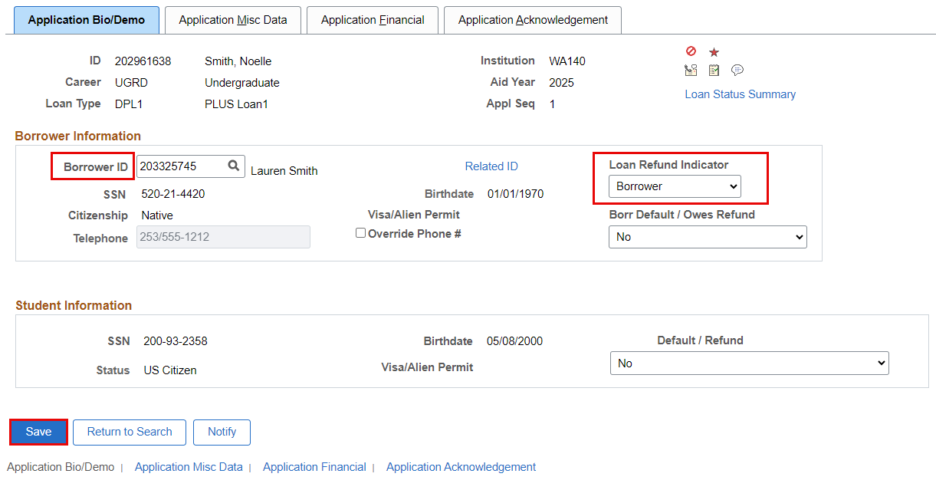
PLUS LOAN PROCESSING CONT’D
LINK PARENT TO PLUS LOAN RECORD
Navigation: Financial Aid > Loans > Direct Lending Management > Manage Direct Loan Application
Enter the parent’s EMPL into the Borrower ID field. Be sure to also define whether the refund should go to the Parent Borrower or the Student on the Loan Refund Indicator drop down box. Select Save.

Slide 37
PLUS LOAN PROCESSING
6-STEP PROCESS
Step 1: Award PLUS Loan
Step 2: Originate PLUS Loan
Step 3: Create Parent Record
(If none already exists)
Step 4: Establish Relationship for Parent
Step 5: Link Parent to PLUS Loan Record
Step 6: Re-originate PLUS Loan

Slide 38
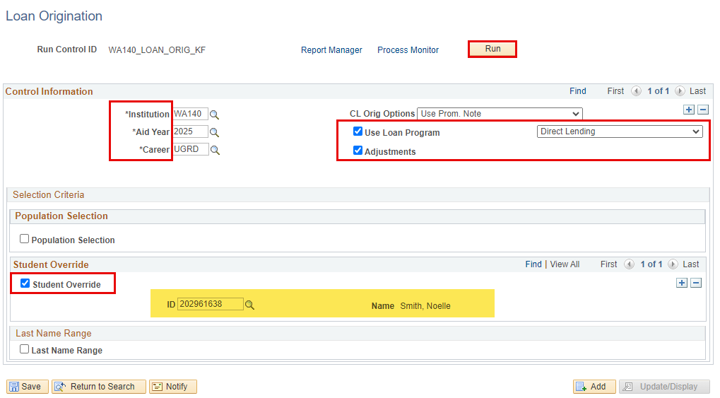
PLUS LOAN PROCESSING CONT’D
PROCESS LOANS AGAIN
Navigation: Financial Aid > Loans > Process Loans

Slide 39
AWARDING AND
PROCESSING
A PRIVATE/ALT LOAN

Slide 40
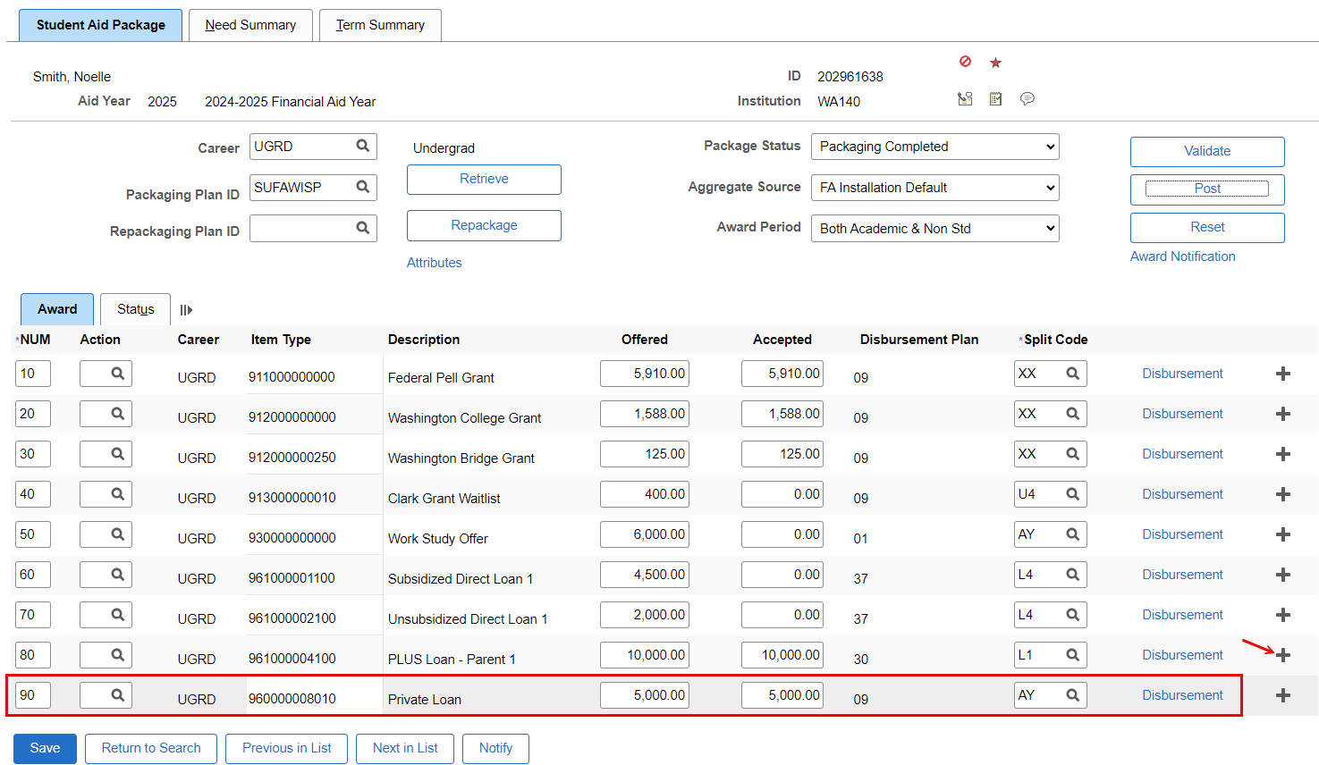
PRIVATE/ALT LOAN PROCESSING
AWARD PRIVATE/ALT LOAN
Navigation: Financial Aid > Awards > Award Processing > Assign Awards to a Student
Always sequence Private/ALT loan awards at the end of the aid package so it deducts properly from COA

Slide 41
PRIVATE/ALT LOAN PROCESSING
QRG ON PROCESSING PRIVATE LOANS:
Awarding and Processing Alternative Loans (FA-SF) | 9.2 FA - Loans | ctcLink Reference Center

Slide 42
OUTCOMES
At training completion, you should be able to:
Understand the loan origination (Batch and Single Student) process
Understand the Loan Origination Outbound and Inbound Process
Understand the Loan Disbursement Outbound and Inbound Process
Understand how to query for missing COD files
Understand how to award and originate a PLUS loan
Understand how to award and process a Private/ALT Loan

Slide 43
Congratulations!
You have successfully completed the Loan Processing Refresher Training!
Please refer to the ctcLink Reference Center for additional resource materials on today’s topics
Thank you for your participation today!

