Slide 1
Loading 2024-2025 ISIRs to be ready for the week of June 10th

Slide 2
The situation
2024-2025 ISIRs submission may open in December but the 2024-2025 PRP does not go into the system until end of December
By the time 2024-2025 AYRO is completed and Odd-Year ISIR Jobset parameters are updated, colleges have hundreds of ISIR files to load
Due to the system being shared by 33 colleges and the ISIR Jobset slowing the system down significantly, colleges are asked to be mindful on how many ISIR files are loaded in one instance so that all ISIR Jobsets finish running between 5PM – 7AM Monday - Friday. Depending on the size of the college, this leads to weeks or months of loading backlogged ISIR files
Colleges have the option of requesting an Year-to-Date ISIR file
NEW
The above information was shared out during AYO and unfortunately, we’ve not seen that ED has afforded YTD option yet - ☹
We’re requesting colleges have their ISIR files at the ready on the server by June 10th – if you haven’t begun to load these already – FILES not ISIRs ☺
We will be prioritizing summer header colleges when we see you all on the 10th

Slide 3
What isir process does not require an aid year image?
PS ISIR Processing has three steps with two of them requiring an aid year image to be added into the system (late December)
File Upload/Download
Import Federal Data Files Requires 2024-2025 Image
Process ISIRS
Requires 2024-2025 Image

Slide 4
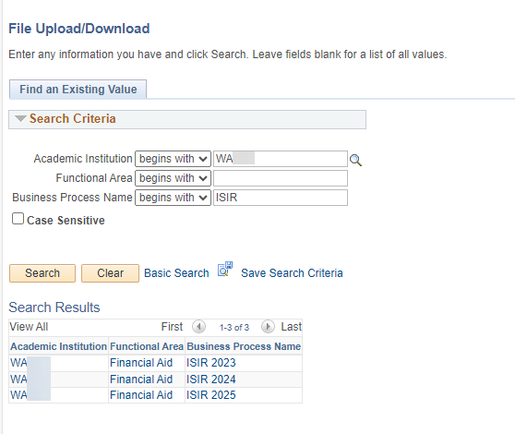
We will create the ISIR 2025 folders in production by December so that colleges can start loading 2024-2025 ISIR Files on the pS server!!
Navigation: Navigator > People Tools > CTC Custom > Extensions > Upload/Download Files
NEW
ISIR2025 folders have already been created - start loading all the 2024-2025 ISIR files you’ve received from Edconnect to your 2025 folder.

Slide 5
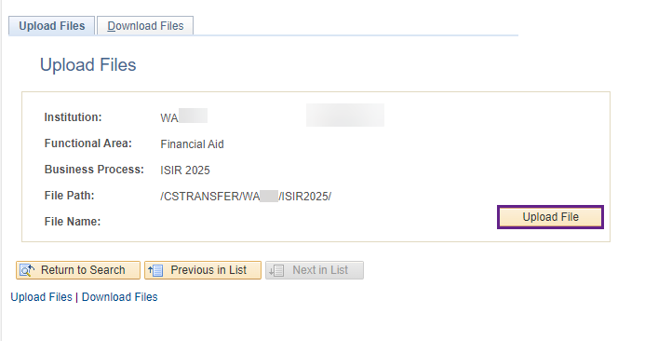
What you Can DO when you get your 2024-2025 ISIR File Upload 2024-2025 isir files into the ISIR2025 folder in the order of when the files were received
Navigation: Navigator > People Tools > CTC Custom > Extensions > Upload/Download Files
If you upload the 2025 ISIR files out of order, you will end up with many ISIR files in suspense with the reason: Out of Sequence

Slide 6
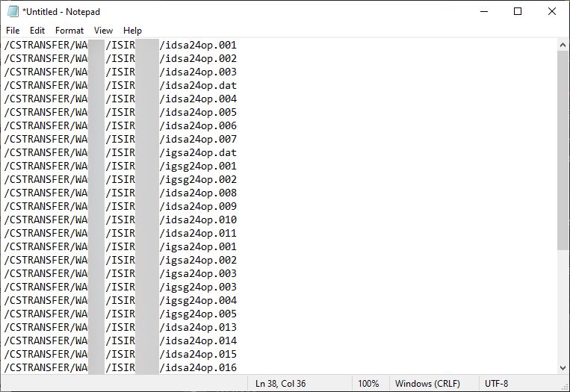
When you are ready to turn on your iSIR JOBSET SUBMIT A TICKET TO FA ERP TO GET A text file of all the files your college loaded in the ISIR2025 folder
The text file will list the ISIR files in the order the files were loaded into the ISIR2025 folder

Slide 7
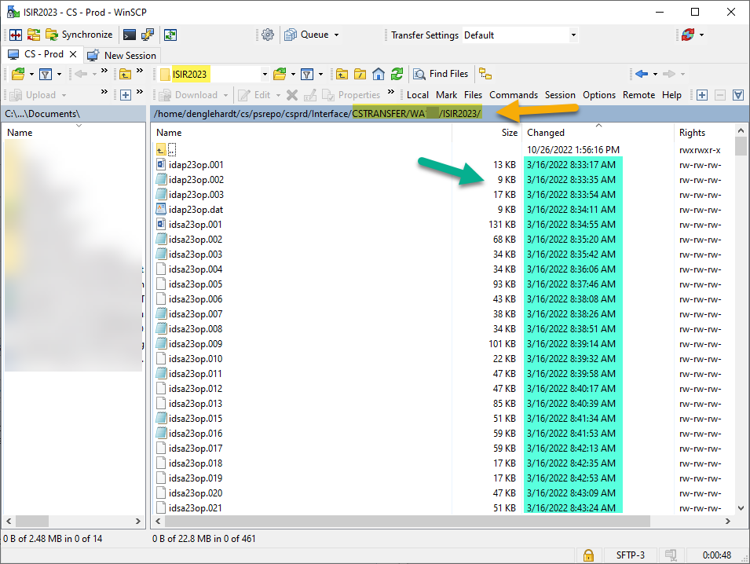
How will we make the text file?
We will grab the files names in from your college’s /CSTRANSFER/Waxxx/ISIR2025 file path
Note: The example in the screenshot is the ISIR2023 folder
We will put the file names in the order of the earliest ISIR file loaded first

