Slide 1
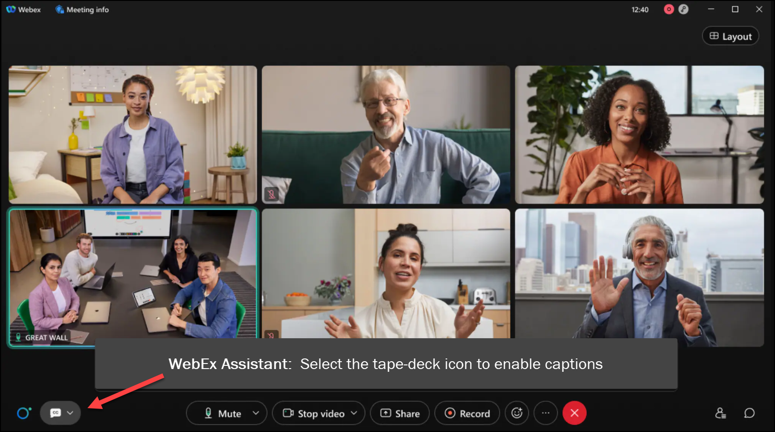
MEETING
RECORDING
NOTICE
The law requires consent prior to recording a person’s participation in an event. Your participation in this video conference (training) equals consent to be recorded, as required by law.
If you do not consent to being recorded but choose to participate, please turn your camera off and use the chat feature to interact with the other participants.

Slide 2
Updating canceled pell records in batch training
Kelly Forsberg
ctcLink Functional Trainer | Financial Aid
April 2024

Slide 3
Objectives
After completing this training, you should be able to:
Understand the steps in Updating Canceled Pell Records in Batch Process:
Update Pell Origination Status to Canceled
Update Pell Origination Flag to Pending
Run Pell Orig in Batch
Run PELLOUT
Understand what fields are being updated in this batch processing

Slide 4
STEPS IN THE PROCESS

Slide 5
UPDATING CANCELED PELL RECORDS IN BATCH
Step 1: Pop Select Pell Orig Stat = Canceled
Step 2: Pop Select Pell Orig Flag = Pending
Step 3: Run Pell Origination
Step 4: Run PELLOUT Process
4-STEP PROCESS

Slide 6
STEP 1:
POP SELECT
PELL ORIG STATUS
TO CANCELED

Slide 7
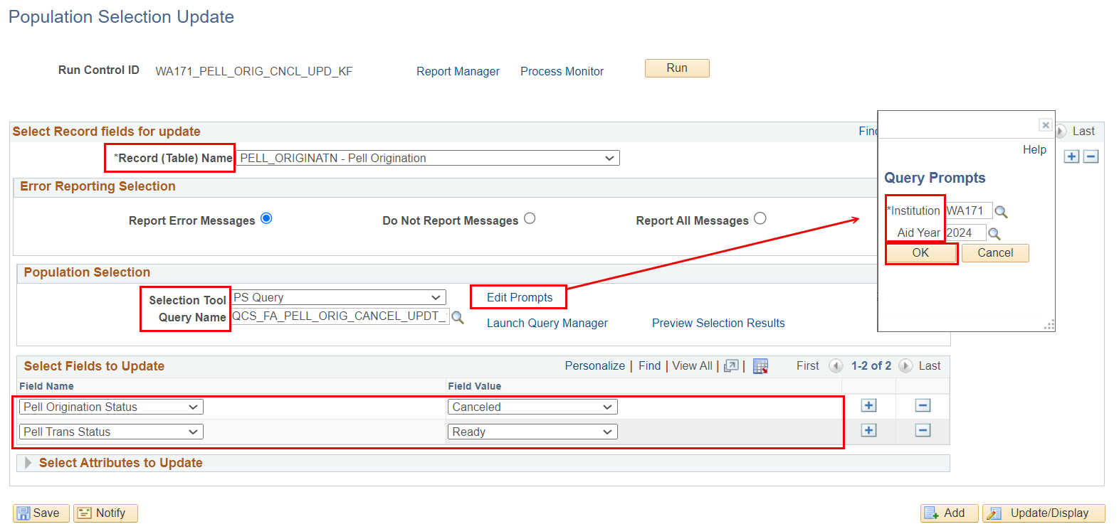
UPD CANCELED PELL IN BATCH
POP UPD CANCEL
Navigation: Set Up SACR > System Administration > Utilities > Population Update > Population Update Process

Slide 8
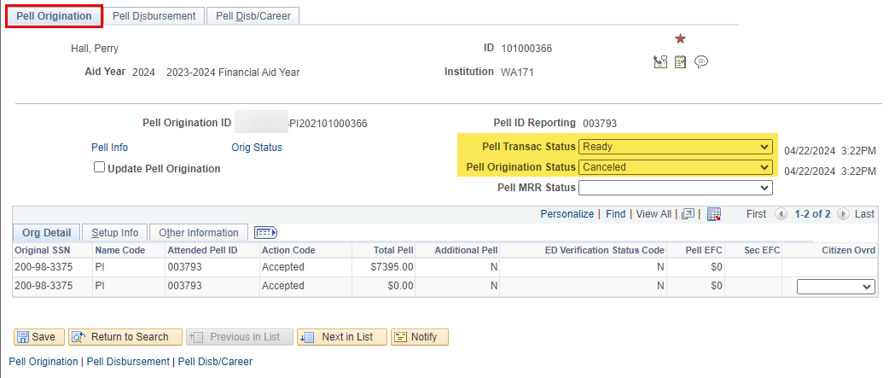
UPD CANCELED PELL IN BATCH cont’d
MANAGE PELL PYMNT PAGE
Navigation: Financial Aid > Pell Payment > Manage Pell Payment
The Manage Pell Payment Pell Transaction Status and Pell Origination Status are the fields being Pop Updated on this page.

Slide 9
STEP 2:
POP SELECT
PELL ORIG FLAG
TO PENDING

Slide 10
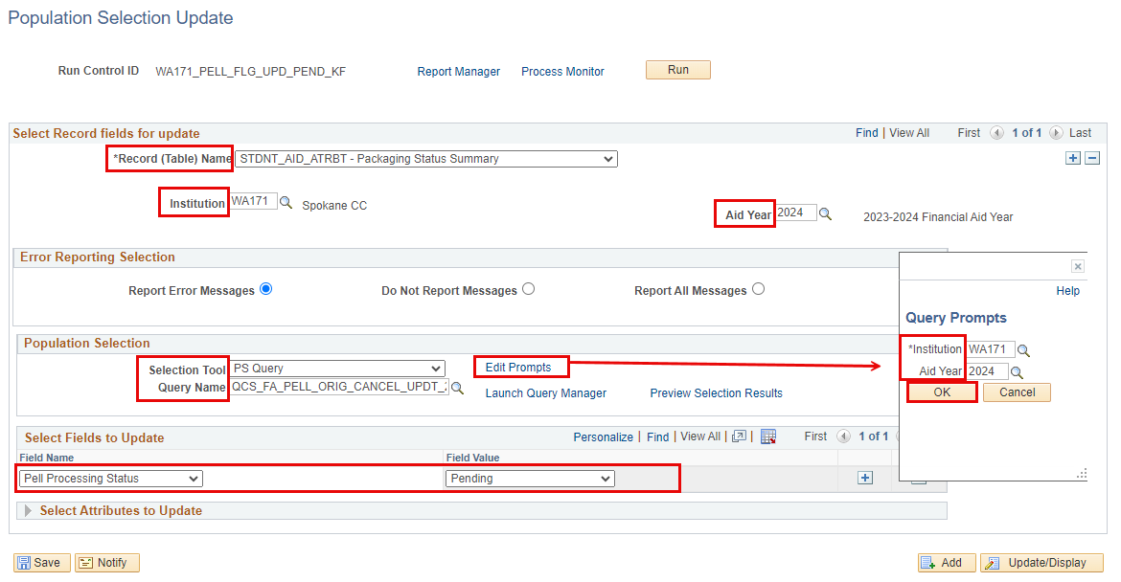
UPD CANCELED PELL IN BATCH
POP UPD PENDING
Navigation: Set Up SACR > System Administration > Utilities > Population Update > Population Update Process

Slide 11
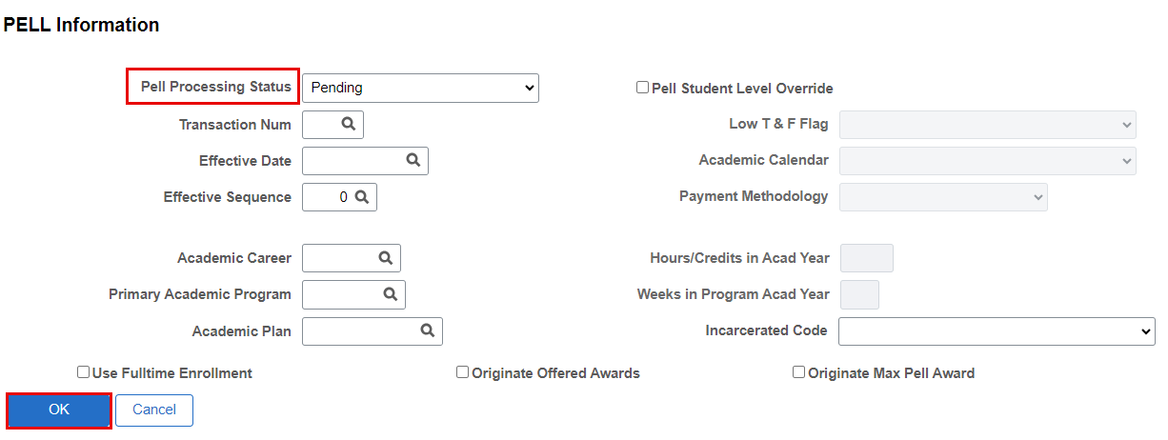
UPD CANCELED PELL IN BATCH
POP UPD PENDING
Navigation: Financial Aid > View Packaging Status Summary
The View Packaging Status Summary - Pell pagelet is the page being updated.

Slide 12
STEP 3:
RUN PELL ORIG
PROCESS

Slide 13
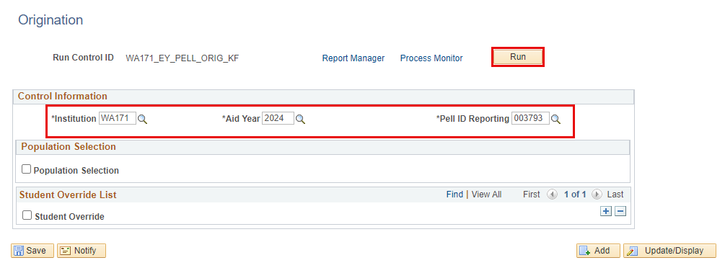
UPD CANCELED PELL IN BATCH
RUN PELL ORIG
Navigation: Financial Aid > Pell Payment > Originate Pell Payment
Note: Records marked with Aid Application Status of Canceled in the View Packaging Status Summary page will not pick up in this process. Please do not set students to canceled application.

Slide 14
STEP 4:
RUN PELLOUT
PROCESS

Slide 15
UPD CANCELED PELL IN BATCH
RUN PELL OUT
Navigation: Financial Aid > File Management > COD Full Participant > Generate Pell Data

Slide 16
DEMONSTRATION

Slide 17
Updating cx’d pell records in batch
BUSINESS PROCESSING GUIDE:
Pell Processing Business Process Guide | 9.2 FA - Loans | ctcLink Reference Center

Slide 18
Outcomes
At training completion, you should be able to:
Understand the steps in Updating Canceled Pell Records in Batch Process:
Update Pell Origination Status to Canceled
Update Pell Origination Flag to Pending
Run Pell Orig in Batch
Run PELLOUT
Understand what fields are being updated in this batch processing

Slide 19
Congratulations!
Updating Canceled Pell Records in Batch Training Complete!
Please review the Pell Processing Business Processing Guide in the ctcLink Reference Center as you progress through updating and reconciling Pell
Thank you for your participation today!

