Slide 1
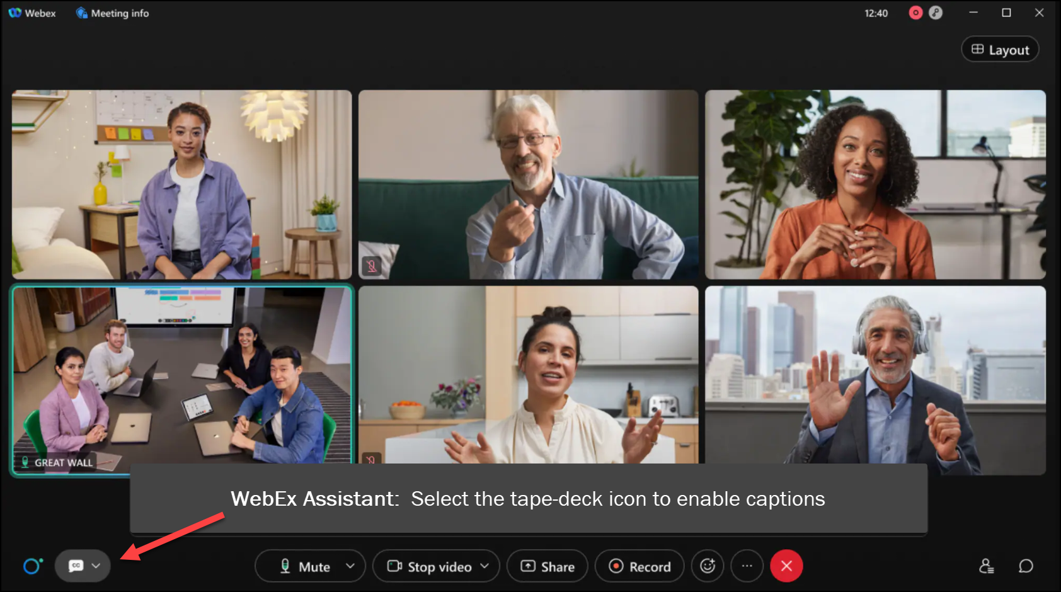
MEETING
RECORDING
NOTICE
The law requires consent prior to recording a person’s participation in an event. Your participation in this video conference (training) equals consent to be recorded, as required by law.
If you do not consent to being recorded but choose to participate, please turn your camera off and use the chat feature to interact with the other participants.

Slide 2
Fa TERM & Student Budget tips & tricks training
Kelly Forsberg
ctcLink Functional Trainer | Financial Aid
April 2024

Slide 3
Objectives
After completing this training, you should be able to:
Understand Tips and tricks on the FA Term and Maintain Student Budget pages
Override expiration date and other features on FA Term
Adding a PJ item on Maintain Student Budget
Pell COA field on Maintain Student Budget

Slide 4
REVIEWING THE FEATURES
ON THE FA TERM PAGE

Slide 5
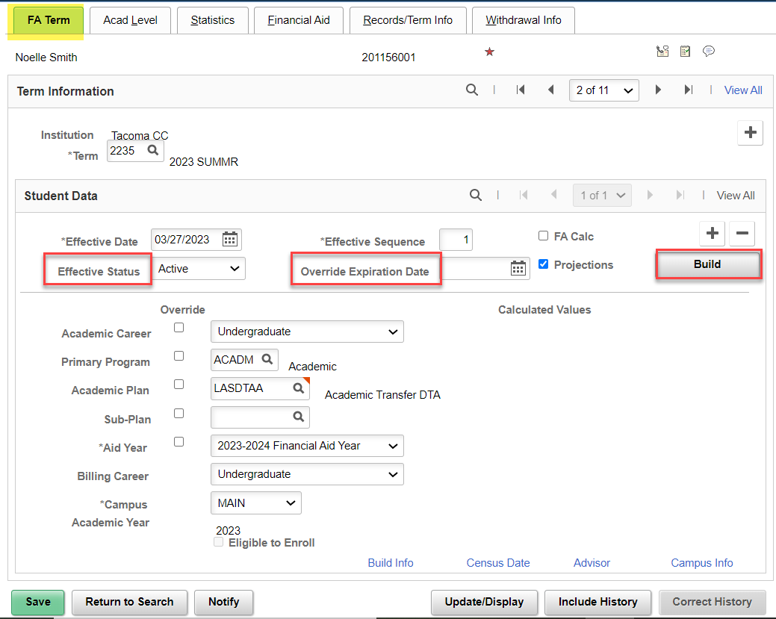
Review of FA term features
Effective Status:
If FA Load is = N at Census Lock, the Effective Status will change to Inactive.
Override Expiration Date:
Can be set to hold overridden data to a specific date. Use sparingly.
Build button:
Student must be Term Activated and Plan Stacked
FA Term Tab
Navigation: Financial Aid > Financial Aid Term > Maintain Student FA Term

Slide 6
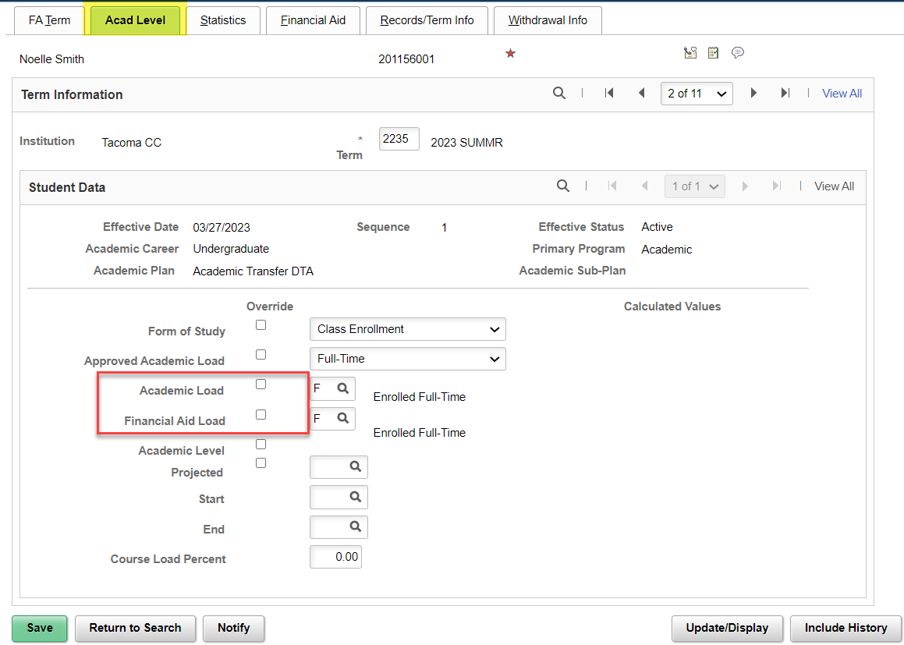
Review of FA TERM features
ACAD LEVEL TAB
Academic Load:
Pulls from Student Records
FA Load:
Is what drives the FA Student Budget
It is common that these may not match all the time, especially if you’re overriding.

Slide 7
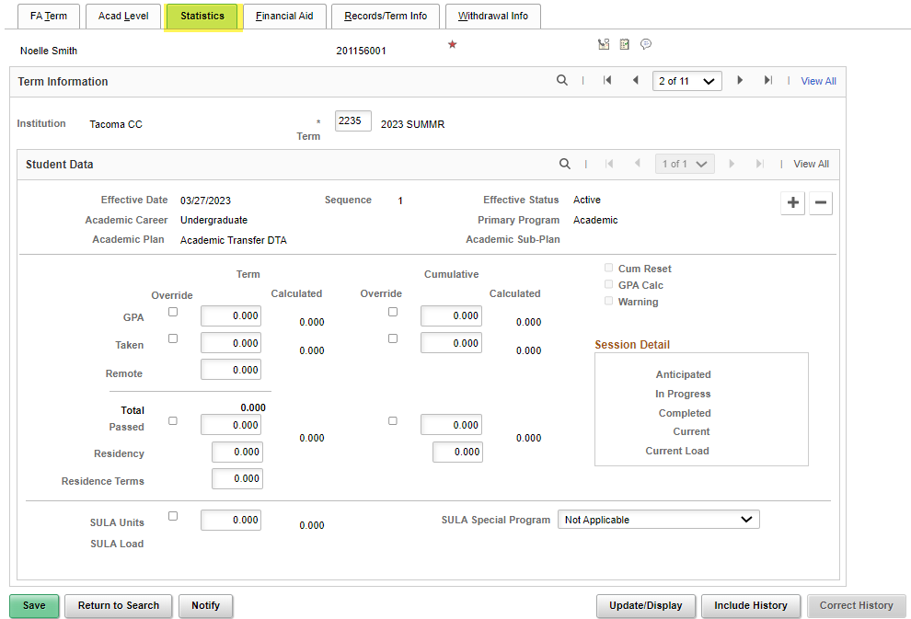
Review of FA TERM features
STATISTICS TAB
Statistics Tab:
Can really leave this tab alone when building manually, but it is reviewable when FA Term process runs in JobSet.
SULA Special Program is a noted feature that displays if this program is a selective Admissions Program.

Slide 8
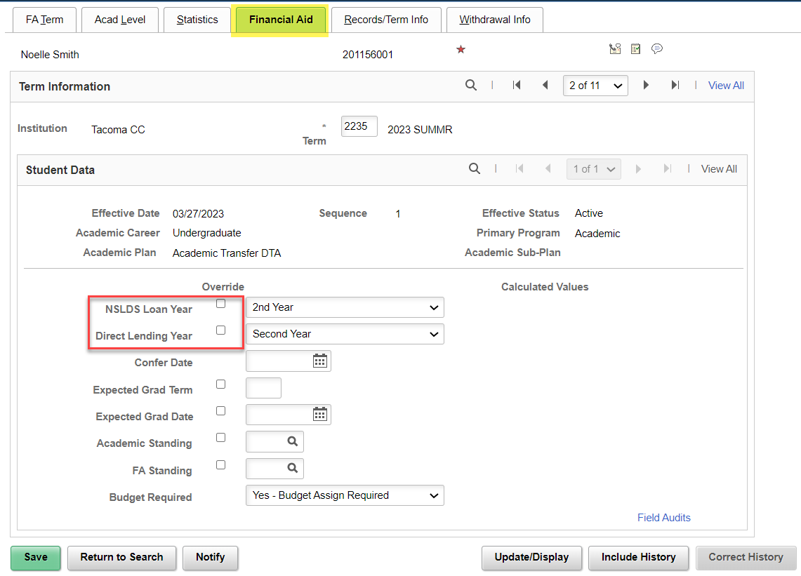
Review of FA TERM features
FINANCIAL AID TAB
Statistics Tab:
NSLDS Loan Year and Direct Lending Year need to be defined.
Will pull in automatically when Batch FA Term process runs from JobSet.
Drives COD reporting data.
Leave other fields blank.

Slide 9
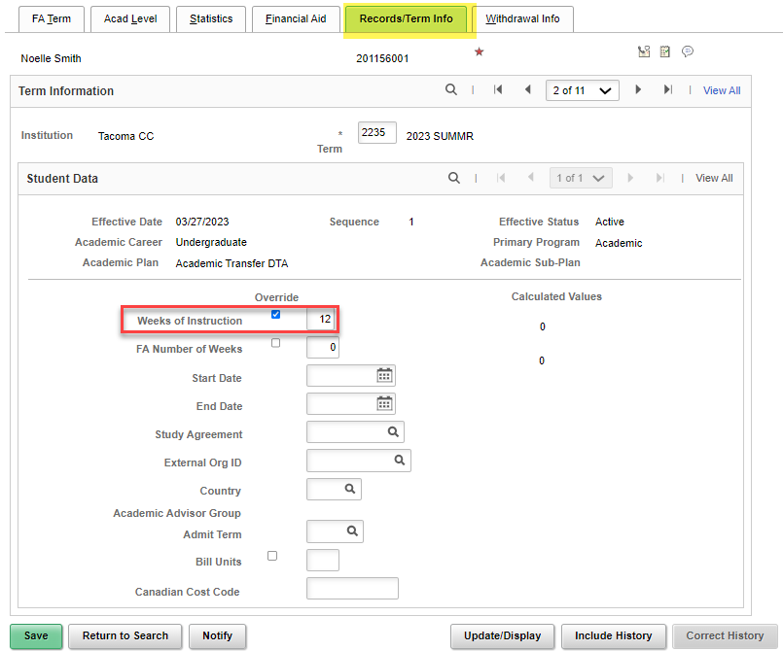
Review of FA TERM features
RECORDS/TERM INFO TAB
Weeks of Instruction:
Override box can remain checked.
Will pull in automatically when Batch Weeks of Instruction Update process runs from JobSet.
Drives COD reporting data.
Leave other fields blank.

Slide 10
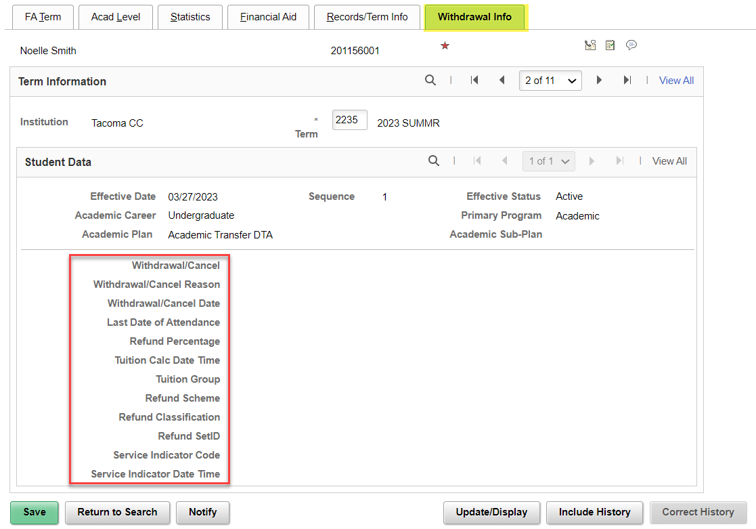
Review of FA TERM features
WITHDRAWAL INFO
Withdrawal Info:
Nothing to build out here, but this information may display when a WD occurs.
Good for review.

Slide 11
DEMONSTRATION

Slide 12
MANUAL
FA TERM
BUILD

Slide 13
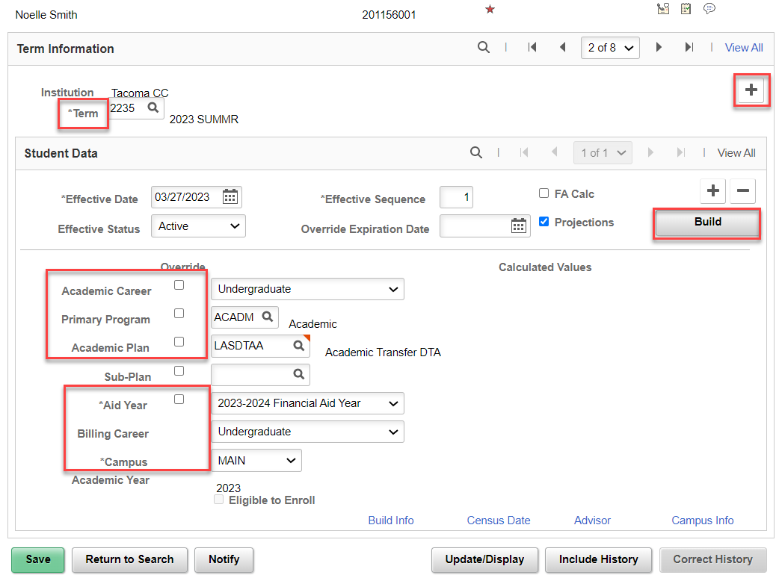
Fa term
MANUAL BUILD
Navigation: Financial Aid > Financial Aid Term > Manage FA Term
The Build button will pre-populate all the necessary fields on this tab if they are Term Activated and Plan Stacked on the Records side.
If they are not enrolled, you will need to put the student in a placeholder program.
Uncheck the override boxes.
Repeat for all 4 terms in the AY

Slide 14
FA TERM
MANUALLY BUILD OUT FA TERM W/O & WITH ENROLLMENT
QRGS:
9.2 Building an FA Term | 9.2 FA - Financial Aid Term | ctcLink Reference Center
9.2 Manually Awarding Aid for a Student without a FAFSA | 9.2 FA - Packaging and Awards | ctcLink Reference Center
9.2 View a Financial Aid Term | 9.2 FA - Financial Aid Term | ctcLink Reference Center

Slide 15
MANUAL
BUDGET
BUILD

Slide 16
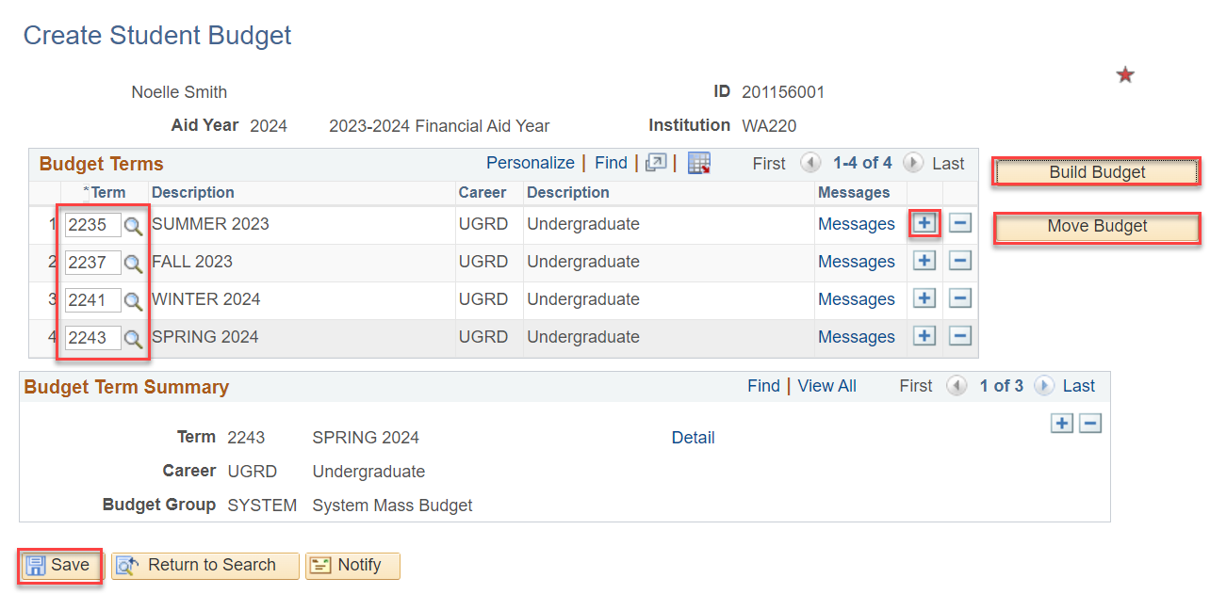
MAINTAIN BUDGETS
MANUAL BUILD
Navigation: Financial Aid > Budgets > Create Student Budget
The AY Terms need to be entered in the Term column. If you do not have a selectable Term in the look up tool, this means you have not built out FA Term for that term. Use the Add a New Row + button to add another row for the next term.
Select the Build Budget and then when it grays out, select the Move Budget button.
Select the Detail link to review the budget items.
You are now ready to enter a non-traditional aid award (outside scholarships, workforce aid)

Slide 17
CREATE A STUDENT BUDGET
W/O ENROLLMENT

Slide 18
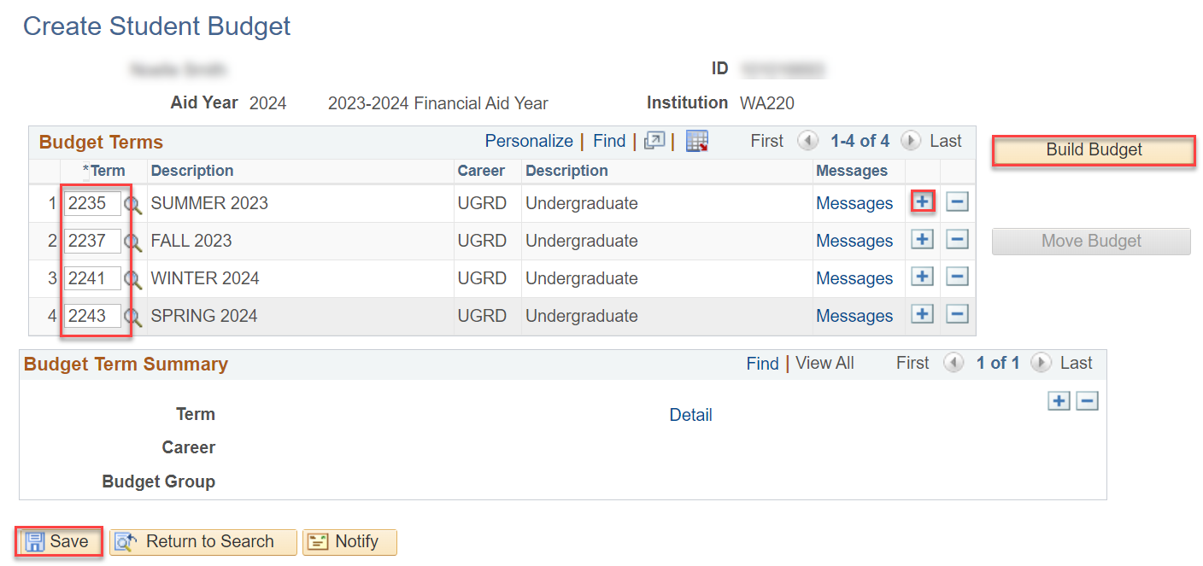
create A BUDGET
BUILD BUDGET
Navigation: Financial Aid > Budgets > Create Student Budget
Select Build Budget

Slide 19
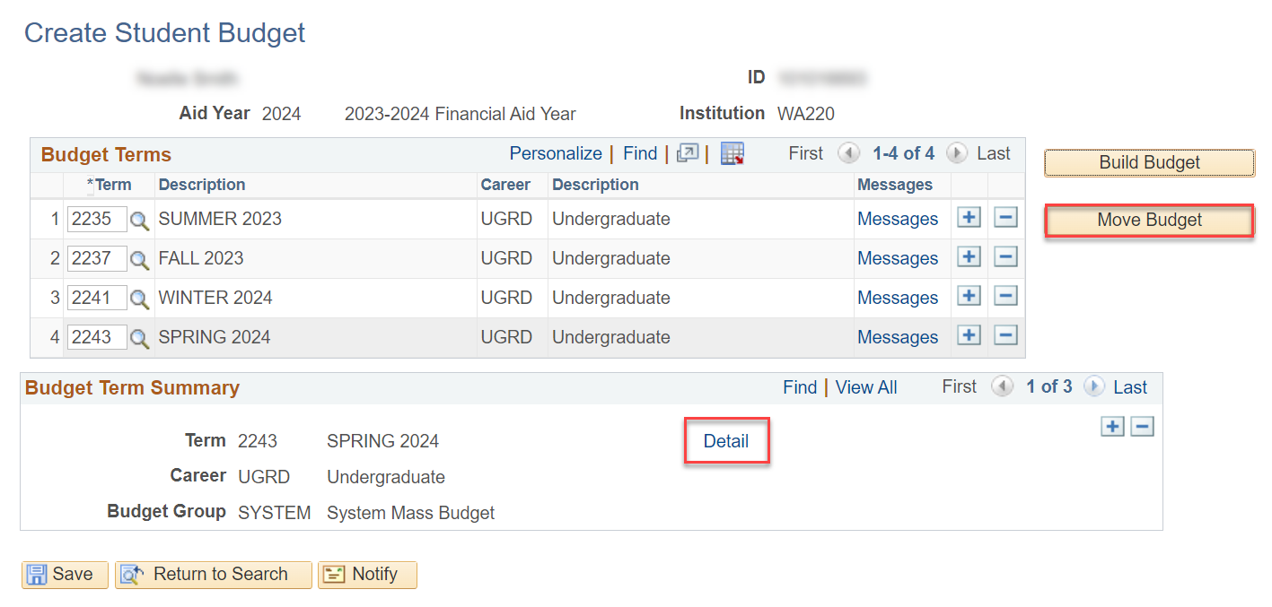
create A BUDGET cont’d
MOVE BUDGET
Move budget button is now available, select Move Budget, and then check the budget Detail

Slide 20
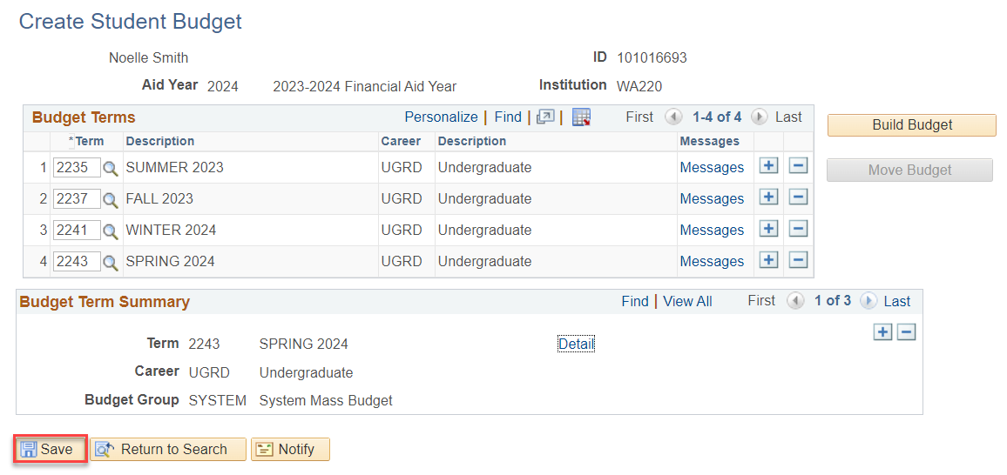
BUDGET ITEMS CONT’D
Save!
Remember to select the Save button!

Slide 21
MAINTAIN STUDENT BUDGET
(ADDING ADDT’L BUDGET ITEMS
& PJ ITEMS)

Slide 22
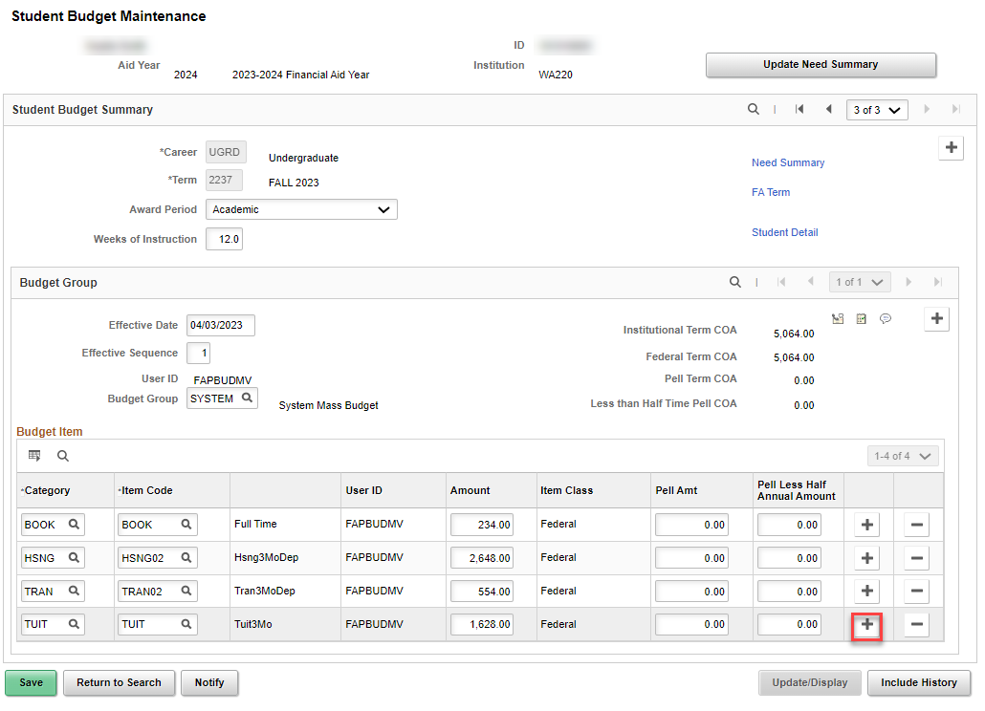
BUDGET ITEMS CONT’D
ADDING PJ ITEMS
Navigation: Financial Aid > Budgets > Maintain Student Budget
You can add PJ Items and/or other items to reflect in COA
as needed by
+ a new row

Slide 23
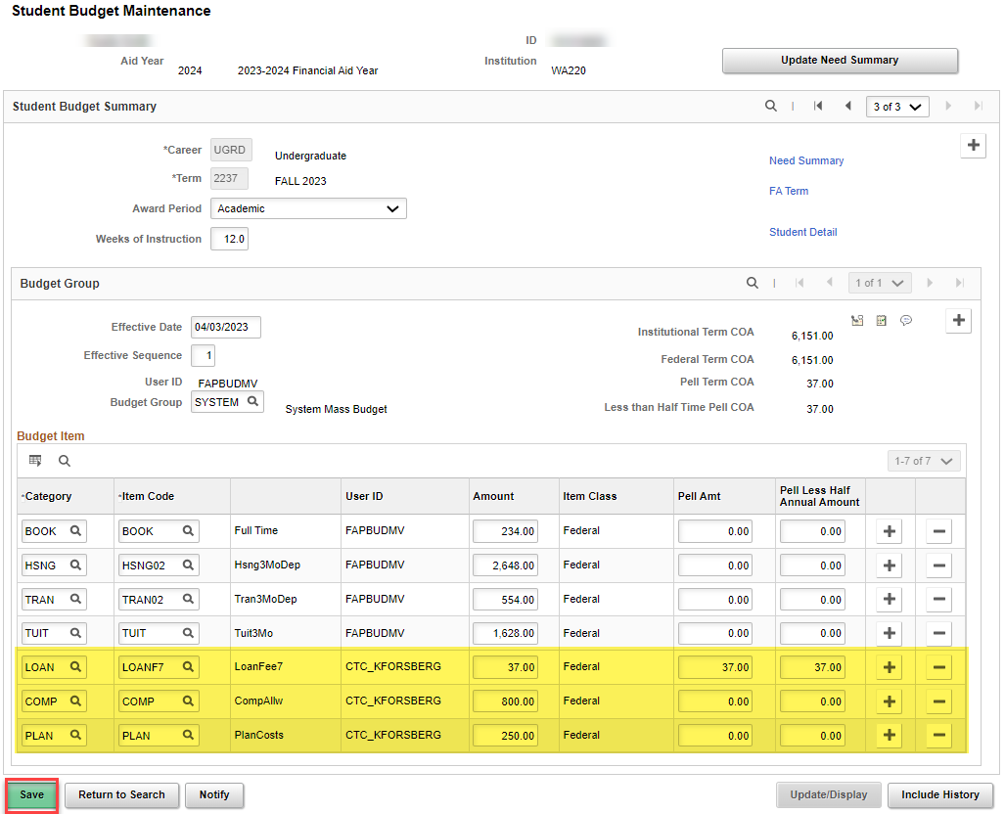
BUDGET ITEMS CONT’D
PJ ITEMS CONT’D
Select SAVE

Slide 24
DEMONSTRATION

Slide 25
Student budgets
QRGS:
9.2 Building a Budget | 9.2 FA - Budgets | ctcLink Reference Center
9.2 Changing a Budget | 9.2 FA - Budgets | ctcLink Reference Center

Slide 26
Outcomes
At training completion, you should be able to:
Understand Tips and tricks on the FA Term and Maintain Student Budget pages
Override expiration date feature on FA Term
Adding a PJ item on Maintain Student Budget
Pell COA field on Maintain Student Budget

Slide 27
Congratulations!
FA Term & Student Budget Tips and Tricks Training Complete!
Please review the videos and additional resources in your canvas course material and the reference center as you progress through students to prep for awarding
Thank you for your participation today!

