Slide 1
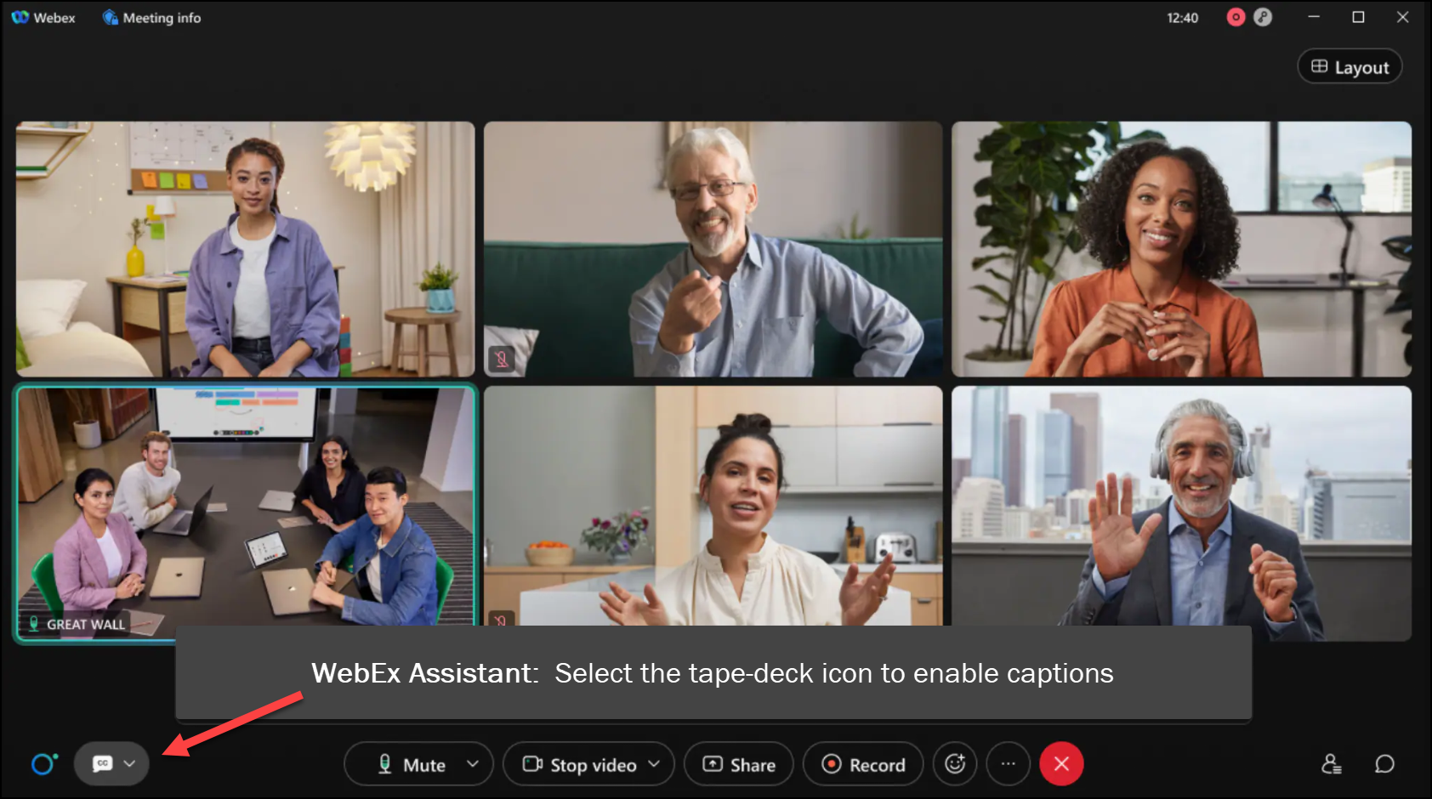
MEETING
RECORDING
NOTICE
The law requires consent prior to recording a person’s participation in an event. Your participation in this video conference (training) equals consent to be recorded, as required by law.
If you do not consent to being recorded but choose to participate, please turn your camera off and use the chat feature to interact with the other participants.

Slide 2
ISIR corrections fundamentals TRAINING
Kelly Forsberg
ctcLink Functional Trainer | Financial Aid
March 2024

Slide 3
Objectives
After completing this training, you should be able to:
Understand how to make ISIR Corrections on specific scenarios
Making Corrections on an Alien Registration Number
Processing Dependency Override/Homeless Youth Determinations
Processing Special Conditions/Circumstances/EFC Adjustment Request
Understand how to Process ISIR Corrections in ctcLink using the following steps:
Process ISIR Corrections
Create Federal Data File
Upload/Download File Process

Slide 4
ISIR CORRECTIONS
SCENARIOS

Slide 5
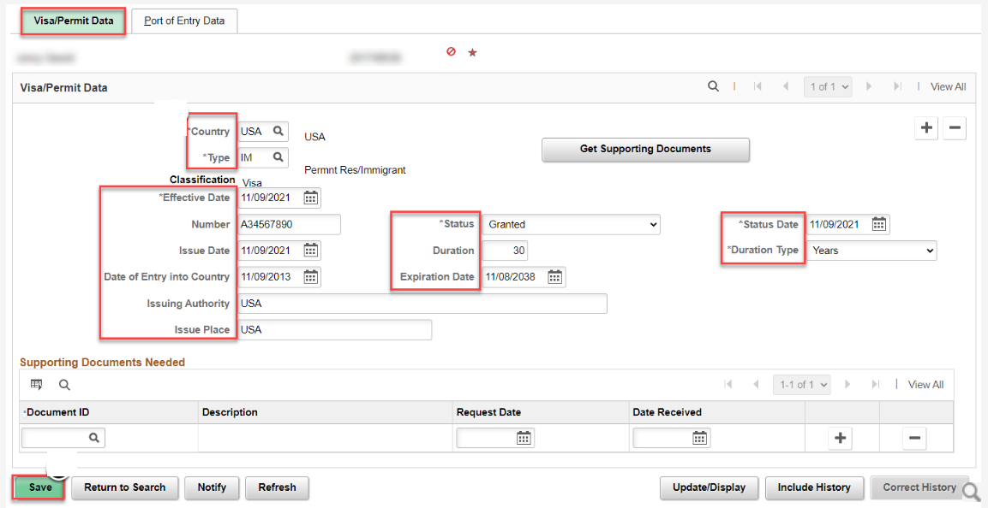
MAKING CORRECTIONS ON AN A#
Navigation: Financial Aid > Federal Data File > Correct 20xx-20xx ISIR Records
Navigation: Campus Community > Personal Information (Student) > Identification (Student) > Citizenship > Visa Permit Data
The ISIR Comment Code for Citizenship must be resolved at the Student Records level before a correction can be made on the ISIR.

Slide 6
Processing dependency overrides and homeless youth determinations
Navigation: Financial Aid > Federal Data File > Correct 20xx-20xx ISIR Records
You must set the corresponding Dependency Override Indicator in the Corrections page before Sending Corrections on DOs and HYDs so it will process as such through FPS

Slide 7
PROCESSING SPECIAL CIRCUMSTANCES AND EFC ADJUSTMENTS
Navigation: Financial Aid > Federal Data File > Correct 20xx-20xx ISIR Records
If doing a special circumstances, check this EFC Calc Requested box before you Send Corrections, so that the ISIR comments reflect a FAA-approved change on the next ISIR TR #

Slide 8
DEMONSTRATION

Slide 9
PROCESSING
ISIR CORRECTIONS

Slide 10
PROCESSING isir corrections (outbound)
Step 1: Process ISIR Corrections
Step 2: Create Federal Data Files
Step 3: Download file
3-STEP PROCESS

Slide 11
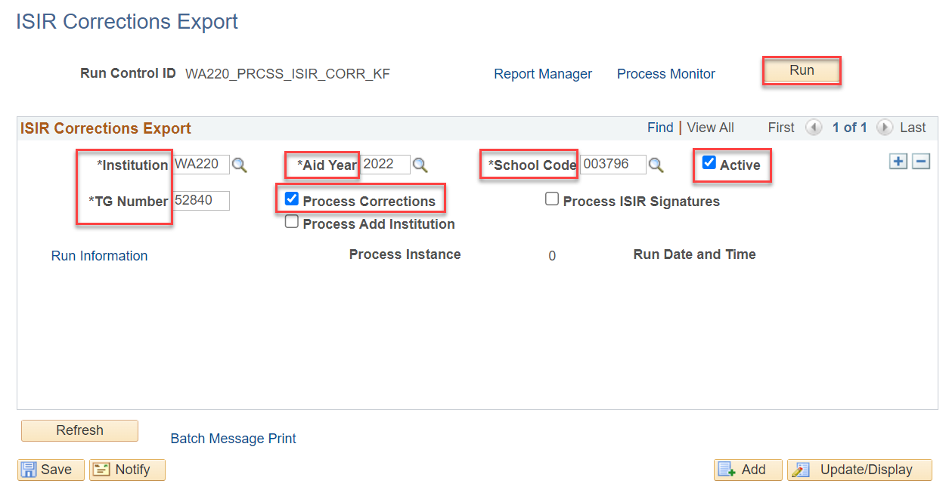
PROCESS isir corrections
STEP 1
Navigation: Financial Aid > File Management > ISIR Corrections > Process ISIR Corrections
Note: Be sure to update the Aid Year before you run this process in the new aid year. You can have two active rows at a time for both aid years in which you are processing corrections. i.e., 2023 & 2024

Slide 12
PROCESSING isir corrections (outbound)
Step 1: Process ISIR Corrections
Step 2: Create Federal Data Files
Step 3: Download file
3-STEP PROCESS

Slide 13
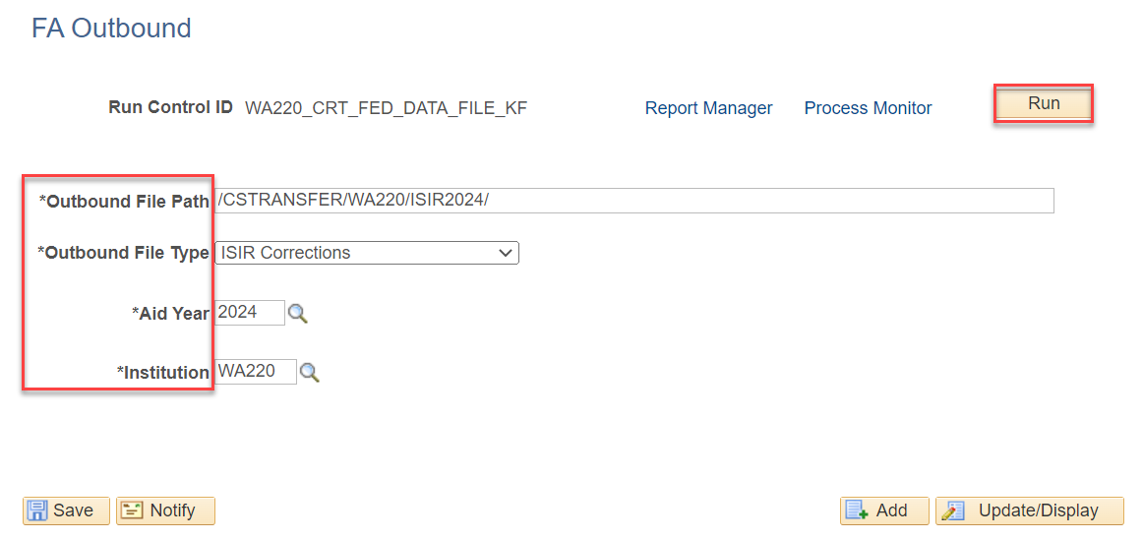
Create federal data file
STEP 2
Navigation: Financial Aid > File Management > Create Federal Data File
Note: To minimize processing errors, please copy the file path from the Upload/Download page and paste it in the Outbound File Path field.
Additionally, you can have two different run controls for this step: one for EY and one for OY, or you can reuse the one Run Control and just change out the Aid Year.

Slide 14
PROCESSING isir corrections (outbound)
Step 1: Process ISIR Corrections
Step 2: Create Federal Data Files
Step 3: Download file
3-STEP PROCESS

Slide 15
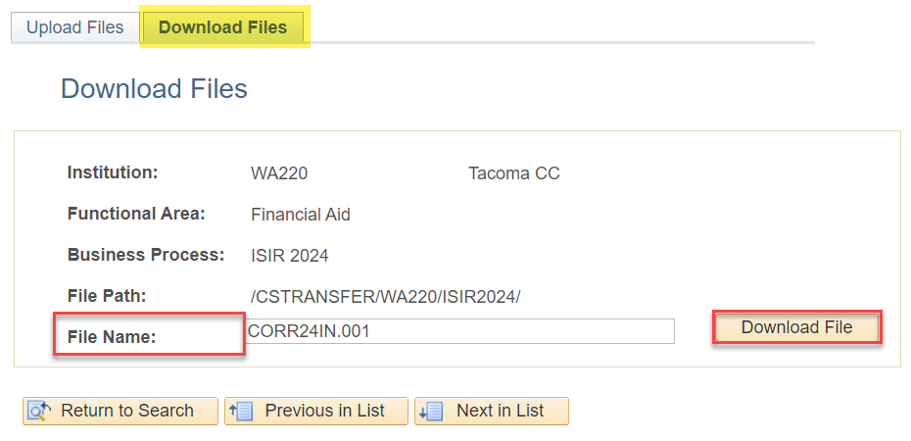
Download file for edconnect
STEP 3
Navigation: PeopleTools > CTC Custom > Extensions > Upload/Download Files
The file name used in the Download step comes from the Message Log Text in the Create Federal Data Files step (Step 2)

Slide 16
DEMONSTRATION

Slide 17
Outcomes
At training completion, you should be able to:
Understand how to make ISIR Corrections on specific scenarios
Making Corrections on an Alien Registration Number
Processing Dependency Override/Homeless Youth Determinations
Processing Special Conditions/Circumstances/EFC Adjustment Request
Understand how to Process ISIR Corrections in ctcLink using the following steps:
Process ISIR Corrections
Create Federal Data File
Upload/Download File Process

Slide 18
Congratulations!
Your ISIR Corrections Fundamentals Training is complete!
Please review the videos and additional resources in your canvas courses as needed
Thank you for your participation today!

