Slide 1
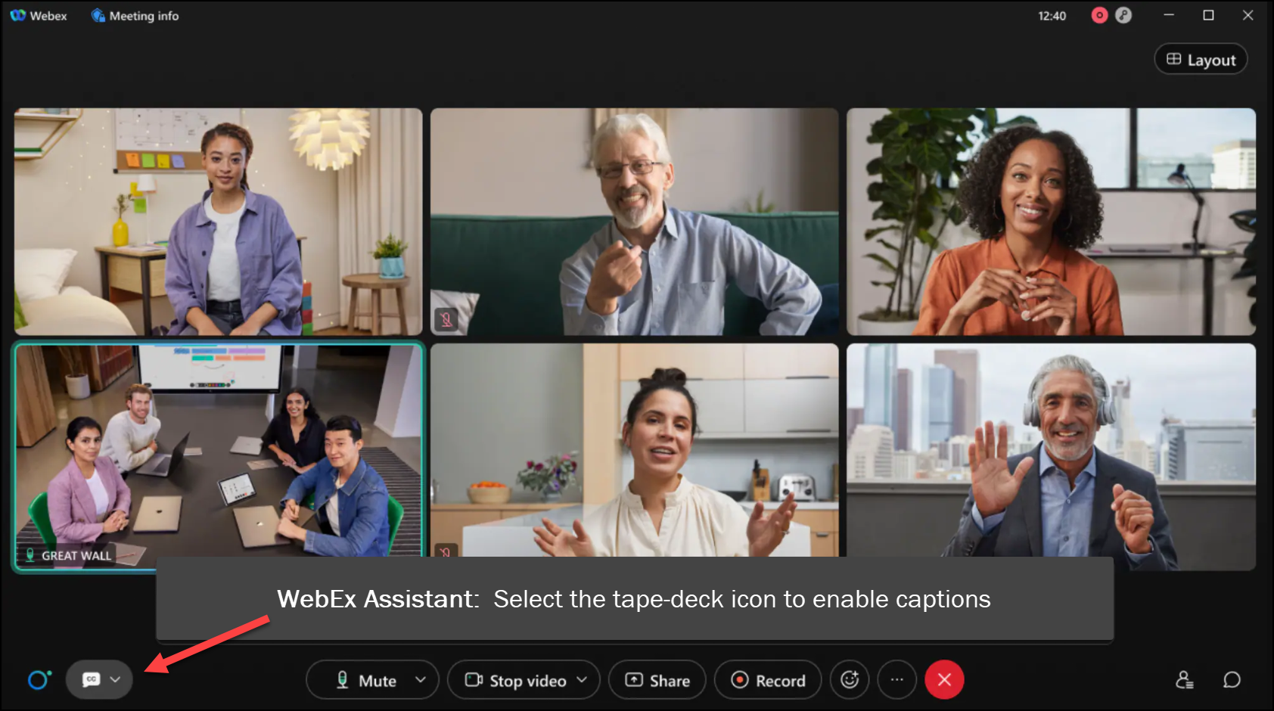

MEETING
RECORDING
NOTICE
The law requires consent prior to recording a person’s participation in an event. Your participation in this video conference (training) equals consent to be recorded, as required by law.
If you do not consent to being recorded but choose to participate, please turn your camera off and use the chat feature to interact with the other participants.

Slide 2
R2t4 Worksheet – work Session Part 2
Molly Groyer - ctcLink Functional Analyst | Financial Aid
Charles Sapien - ctcLink Functional Analyst | Student Financials
February 2024
Notes:
Welcome to the FA R2T4 Worksheet Work Session – Part 2!

Slide 3
agenda
Overview of Institutional Charges for R2T4
Review Item Type Tree, Tree Node and Item Type Group set-up
Review Financial Aid set-up for R2T4 worksheet
Discuss how institutional charges are accounted for on the R2T4 Worksheet
Available queries for item type nodes and groups

Slide 4
Federal definition of institutional charges
As noted in the 2023-2024 Federal Student Aid (FSA) Handbook, Volume 5 – Withdrawals and the Return of Title IV Funds
“Institutional charges are used to determine the portion of unearned Title IV aid that the school is responsible for returning. Schools must ensure that all appropriate fees, as well as applicable charges for books, supplies, materials, and equipment, are included in Step 5 of the R2T4 calculation. Institutional charges do not affect the amount of Title IV aid earned by a student who withdraws.”
https://fsapartners.ed.gov/sites/default/files/2023-2024/2023-2024_Federal_Student_Aid_Handbook/_knowledge-center_fsa-handbook_2023-2024_vol5.pdf
Notes:
Let’s start with the federal definition of Institutional Charges for R2T4 -
As noted in the 2023-2024 FSA Handbook, Volume 5 – Withdrawals and the Return of Title IV Funds
“Institutional charges are used to determine the portion of unearned Title IV aid that the school is responsible for returning. Schools must ensure that all appropriate fees, as well as applicable charges for books, supplies, materials, and equipment, are included in Step 5 of the R2T4 calculation. Institutional charges do not affect the amount of Title IV aid earned by a student who withdraws.”

Slide 5
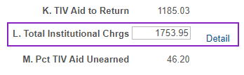
Institutional charges & the r2t4 worksheet
  On the R2T4 Worksheet: Step 5, or field L – Total Institutional Charges, the value must accurately display the total charges, so that the worksheet can calculate “the portion of unearned Title IV aid that the school is responsible for returning.”
  In PeopleSoft, institutional costs are assigned to a student’s account as charge item types.
  We will be reviewing the set-up in PeopleSoft to ensure the correct charge item types are included in the R2T4 worksheet.
Notes:
Why is this important? On the R2T4 Worksheet: Step 5, or field L – Total Institutional Charges, the value must accurately display the total charges, so that the worksheet can calculate “the portion of unearned Title IV aid that the school is responsible for returning.”
In PeopleSoft, institutional charges are assessed by charge item types
We will be reviewing the set-up in PeopleSoft to ensure the correct charge item types are included in the R2T4 worksheet.

Slide 6
Student Financials PeopleSoft Screens

Slide 7
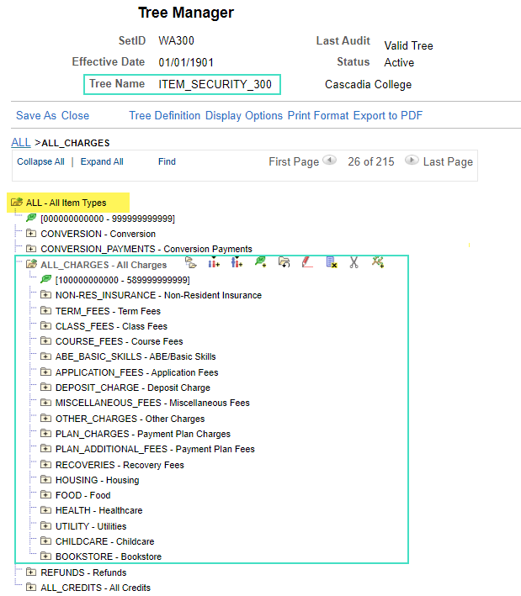
Tree manager
Navigation: Tree Manager > Tree Viewer
Tree Name: ITEM_SECURITY_INSTITUTION CODE
Tree includes all item types for an institution and organizes them by tree nodes
Notes:
Item Types are organized in the Item Type Tree. In Tree Manager, each institution has their own Item Type Tree. Colleges access this page in the Tree Viewer.
The tree levels provide a way to organize tree nodes. In most trees, all nodes at the same level represent the same kind of information. In the item type tree, there are typically tree nodes for charges, payments, and refunds. The nodes can be broken down further. For example, under ALL_CHARGES nodes, there are nodes for TERM_FEES, CLASS_FEES, COURSE_FEES, etc. Today, we will be focusing on charge item types.

Slide 8
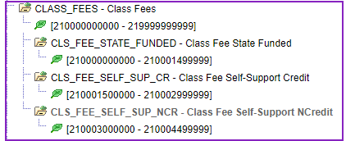
Tree nodes
Tree node example: CLASS_FEES
The item type range for CLASS_FEES is 210000000000 – 219999999999, which includes the item types in the CLS_FEE_STATE_FUNDED, CLS_FEE_SELF_SUP_CR and CLS_FEE_SELF_SUP_NCR nodes

Slide 9
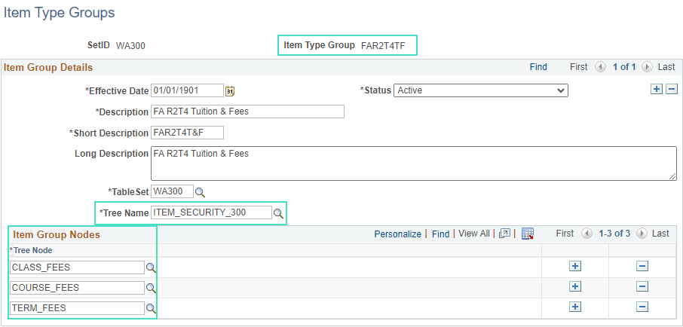
Item type groups
Navigation: Set Up SACR > Product Related > Student Financials > Item Types > Item Type Groups
Item Type Group FAR2T4F
Notes:
Item Types can then be assigned to Item Type Groups via Tree Node. Nodes can be added or removed from the group, if needed. The Item Type Groups are then used on the FA R2T4 set-up pages.
For example, in Item Type Group FAR2T4F – FA R2T4 Tuition and Fees, CLASS_FEES, COURSE_FEES, and TERM_FEES tree nodes are assigned.
Tree Name – displays the Item Type Tree for your institution.

Slide 10
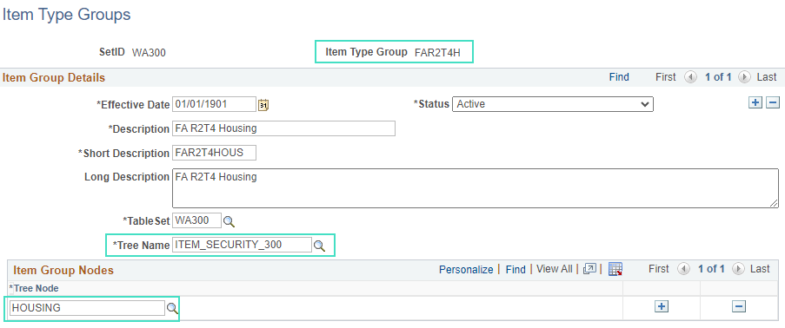
Item type groups continued
Item Type Group FAR2T4H
Notes:
Item Type Group FAR2T4H – FA R2T4 Housing, currently includes HOUSING Tree Node & all corresponding housing related charge item types.

Slide 11
Financial Aid PeopleSoft Screens
Notes:
Now, let’s review how the item type groups are accounted for on the FA set-up pages.

Slide 12
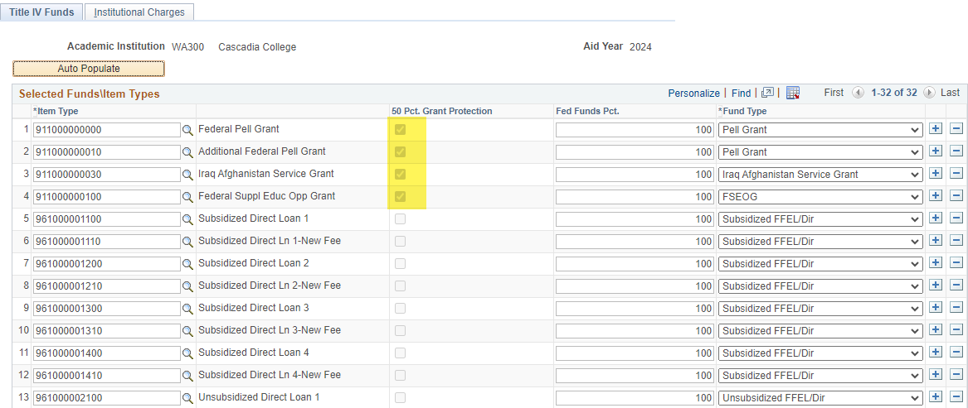
Return of Tiv Aid rules – Title iv funds tab (define rules for return)
Navigation: Set Up SACR > Product Related > Financial Aid > Application Processing > Define Rules for Return
Notes:
The FA R2T4 set-up is done on the Define Rules for Return page. This page should already be set up & is rolled over during AYRO, so we will quickly review this information.
There are two tabs – Title IV Funds tab, which defines financial aid item types for return of funds calculations & the Institutional Charges tab.
Item type: Select the item types that your institution has assigned to the funds awarded as financial aid. The system uses the item type to associate the financial aid transaction with the appropriate general ledger account during the general ledger process. The way in which item types are classified determines how they are processed. Only financial aid item types with a source of Federal can be selected.
50 Pct. Grant Protection (50 percent grant protection): The system selects this check box based on the Item Type and Fund Type selected. Funds that are federal grants or are fully funded by federal funds are under the 50 percent rule. This rule reduces the grant amount to be returned by the student by applying an initial 50 percent reduction in the total grant amount to be repaid.
Fed Funds Pct (federal funds percent): You can edit this field. The default is 100 percent. Enter the percentage of the fund type funded by federal funds. For example, you might enter 50 for a fund such as SEOG that might be matched 50 percent by state funds and 50 percent by federal funds.
Fund Type: Select the type of Title IV program. Pell Grants, PLUS loans, SEOGs, and subsidized and unsubsidized federal Stafford loans are examples of Title IV funds.

Slide 13
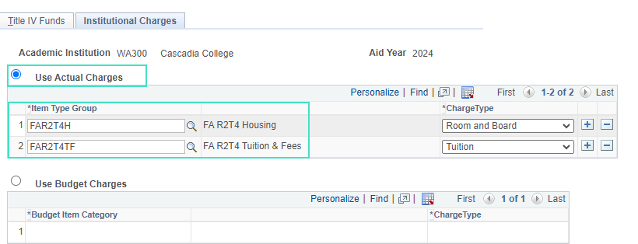
Return of Tiv Aid rules – institutional charges tab
Notes:
On the Institutional Charges tab, this is where colleges determine which item type groups and charge types will be included in the R2T4 worksheet.
FAR2T4H and FAR2T4TF are the default values for all institutions, however, colleges have individual set up for what charges are included in those groups. Also, the Use Actual Charges radio button is currently selected for all colleges & it uses charges calculated in Student Financials. The Charge Type is the type of charge associated with the item type group. Values are Other, Room/Board, and Tuition. This field is required to be completed.
Use Budgeted Charges is not currently utilized by colleges.

Slide 14
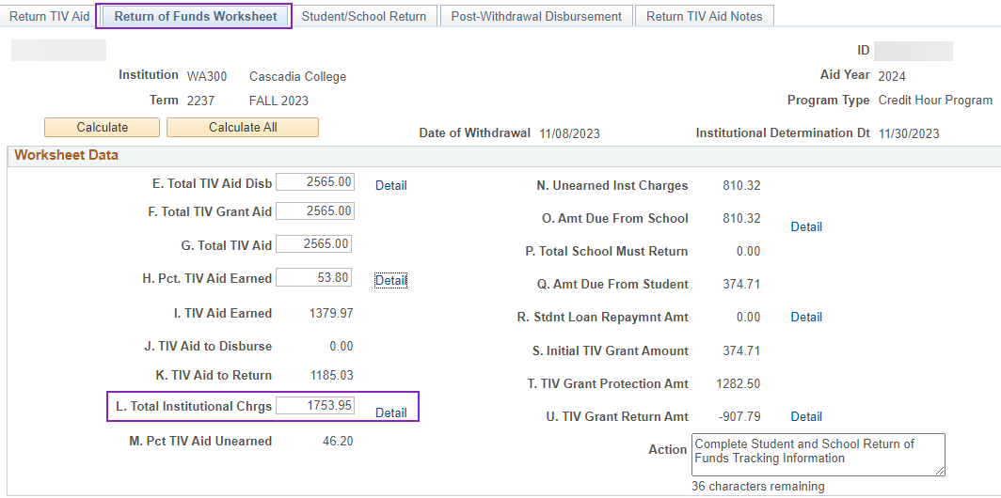
R2t4 worksheet
Navigation: Financial Aid > Return to Title IV Funds > Create Worksheet
Notes:
Where are the Total Institutional Charges accounted for on the Return of Funds Worksheet?
On the Return of Funds Worksheet tab, the Total Institutional Charges value should be populated with the charges assessed to the student in Student Financials. Select the detail link to see the break down of which item types are included & the amounts per item type.

Slide 15
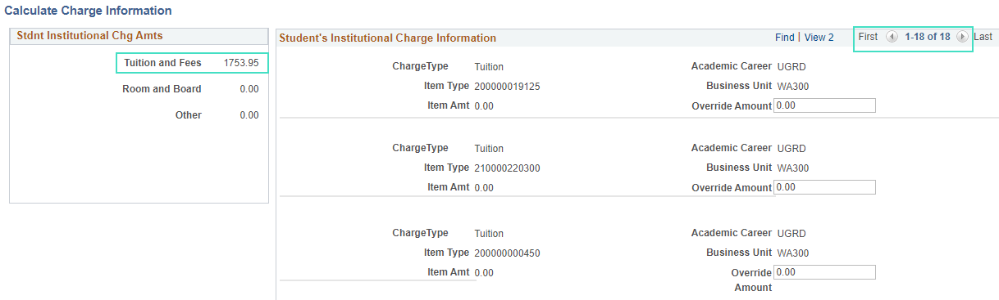
Field l. total institutional charges
Be sure to select “view all” to see all the Charge Information!
Notes:
There are 18 rows, select “view all” to expand the list. The total charges is displayed in the upper left-hand corner – example: Tuition and Fees 1753.95, Room and Board 0.00, Other 0.00

Slide 16
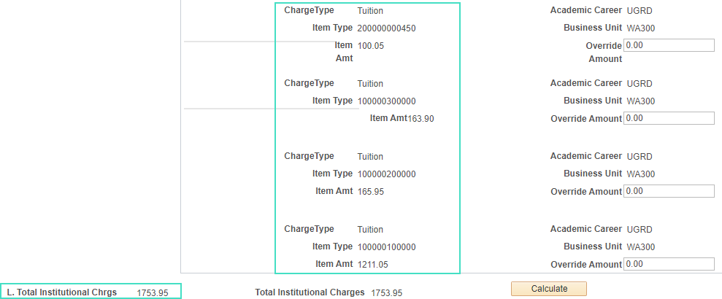
Field l. total institutional chrgs cont.
Notes:
Example of item amount per item type. Can be overridden if needed. Enter a value in the override amount field and then select Calculate on the bottom of the page.

Slide 17
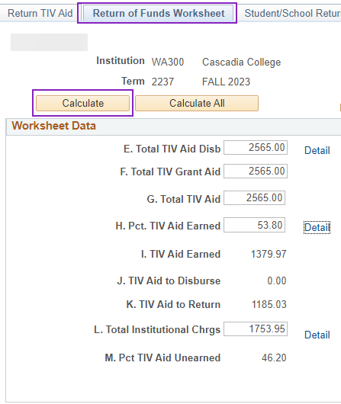
Overriding total institutional charges
After going back to the Return of Funds Worksheet, be sure to select the Calculate button again.
Note: this should be done if the value in field L is overridden on this tab as well

Slide 18
College Example
Notes:
Now, let’s look at a college’s set up in the system (WA220)
Review: Self-support tree node, Gig Harbor item type

Slide 19
Queries
QCS_SF_ITEM_TYPE_TREE_NODE
  Identifies all item types in a specific Tree Node
QCS_SF_IT_GROUP_ITEMS
  Identifies all item types in an Item Type Group
Notes:
These queries will help with your review of the Item Type Tree and Tree Nodes, and Item Type Groups. If changes are needed, FA & SF Staff should work together to submit a ticket.

Slide 20
Congratulations!
Work Session for the R2T4 Institutional Charges is complete!
Thank you for your participation today!

