Slide 1
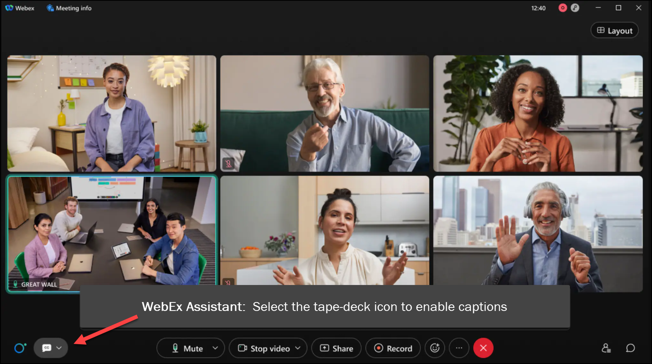
MEETING
RECORDING
NOTICE
The law requires consent prior to recording a person’s participation in an event. Your participation in this video conference (training) equals consent to be recorded, as required by law.
If you do not consent to being recorded but choose to participate, please turn your camera off and use the chat feature to interact with the other participants.

Slide 2
Intermediate pell processing: pell troubleshooting
Kelly Forsberg
ctcLink Functional Trainer | Financial Aid
February 2024

Slide 3
Objectives
After completing this training, you should be able to:
Understand best practices to ensure smooth processing in ctcLink to COD
Understand how to read and work examples on the Pell Reports:
Pell Records by Transaction Status
Pell Records by Status
Pell Origination Validation Report
Pell Disbursement Validation Report
Understand how to perform Pell troubleshooting using various pages in ctcLink
View COD Data page
Manage Pell Payment page
COD Technical Reference Guide

Slide 4
BEST PRACTICES FOR SMOOTH PROCESSING IN CTCLINK TO COD

Slide 5
Best practices for smooth processing in ctcLink to cod cont’d
Do not make Pell awards in the PJ Award page; you will just get COD errors
Do not load duplicate COD response files
Do not update COD manually
When in doubt, submit a ticket to FA Support before ANY manual adjustments in COD

Slide 6
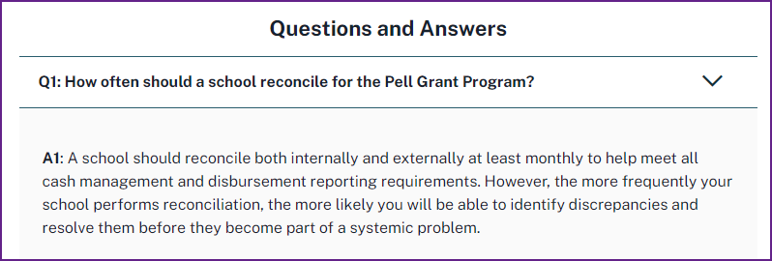
Best practices for smooth processing in ctcLink to cod cont’d from nasfaa ask regs:
Pell Troubleshooting and resolution
is reconciliation

Slide 7
WORKING THE
PELL TRANSACTION STATUS
REPORT

Slide 8
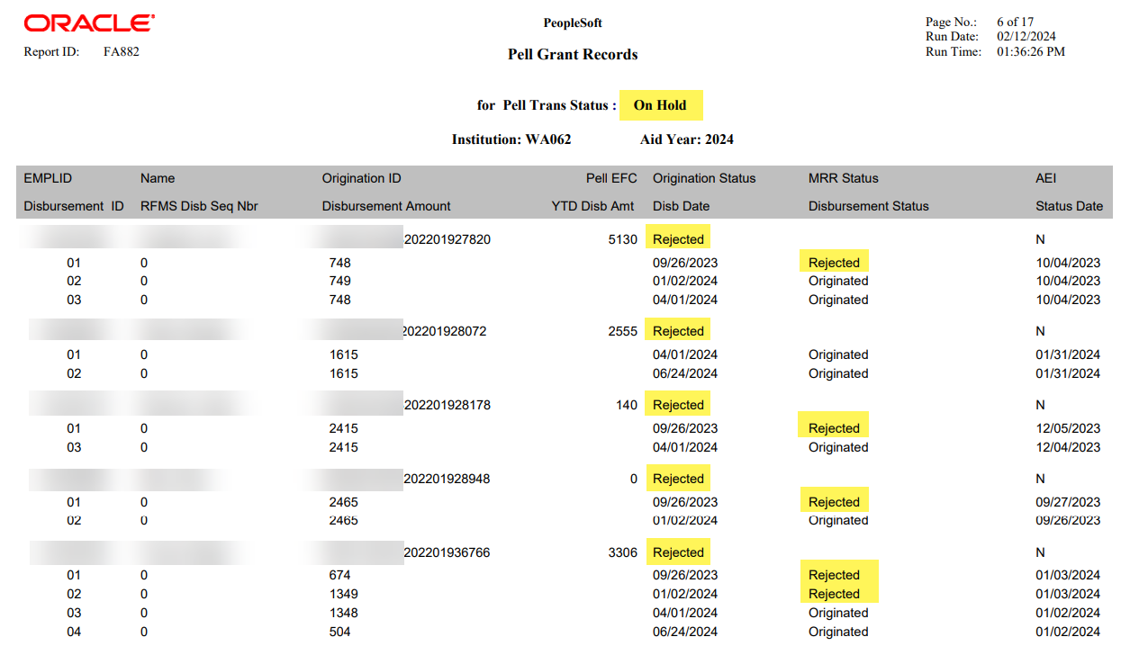
WORKING THE PELL REPORTS
TRANS STATUS: ON HOLD
Navigation: Financial Aid > Pell Payment > Origination Reports > Transaction Status
Review the columns for Origination Status and Disbursement Status

Slide 9
MANAGE PELL
PAYMENT
PAGE

Slide 10
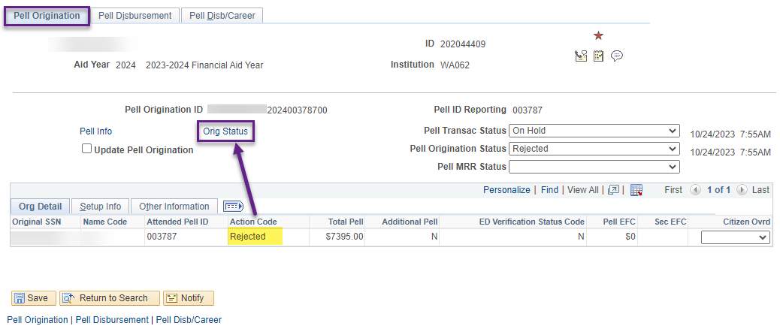
MANAGE PELL PAYMENT
ORIGINATION REJECTION
Navigation: Financial Aid > Pell Payment > Manage Pell Payment
At the Pell Origination tab, note the Action Code of Rejected. Select the Orig Status link to drill down into the message detail.

Slide 11
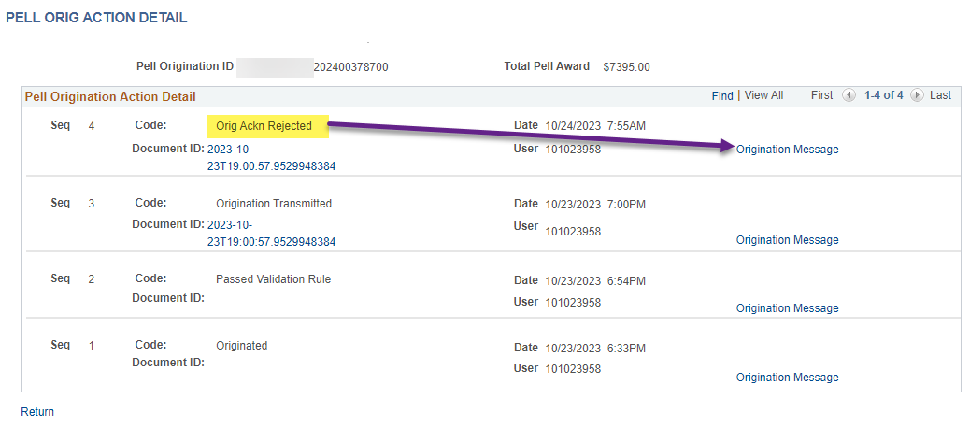
MANAGE PELL PAYMENT
ORIGINATION REJECTION CONT’D
In the Pell Origination Action Detail, note the Code of Orig Ackn Rejected. Select the Origination Message link to drill further down into the reject message.

Slide 12
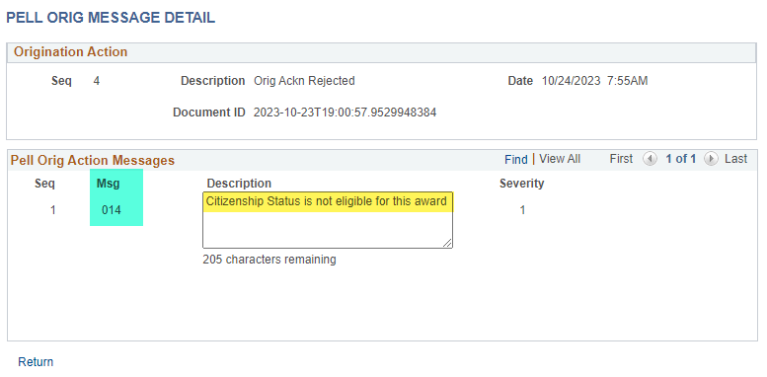
MANAGE PELL PAYMENT
ORIGINATION REJECTION CONT’D
In the Pell Origination Action Messages, note the Description of Citizenship Status is not eligible for this award.
Note the Msg 014 - this is a COD Tech Ref Guide Reject Edit Message Number.

Slide 13
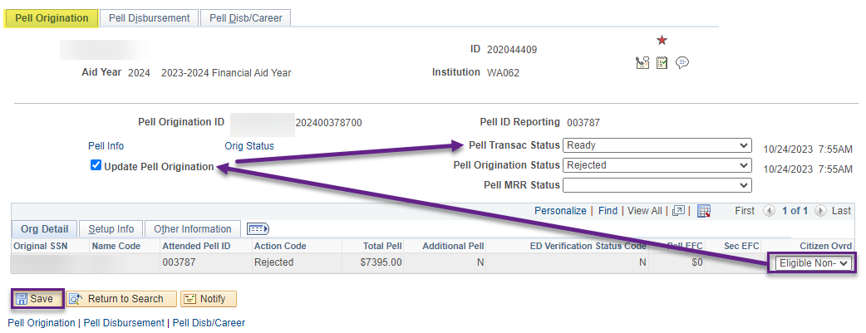
MANAGE PELL PAYMENT
RESOLVING CITIZENSHIP ORIGINATION
Once the Citizenship Status has been resolved, change the Citizen Ovrd drop down to reflect the student’s Citizenship, select the Update Pell Origination checkbox, and change the Pell Transac Status to Ready.

Slide 14
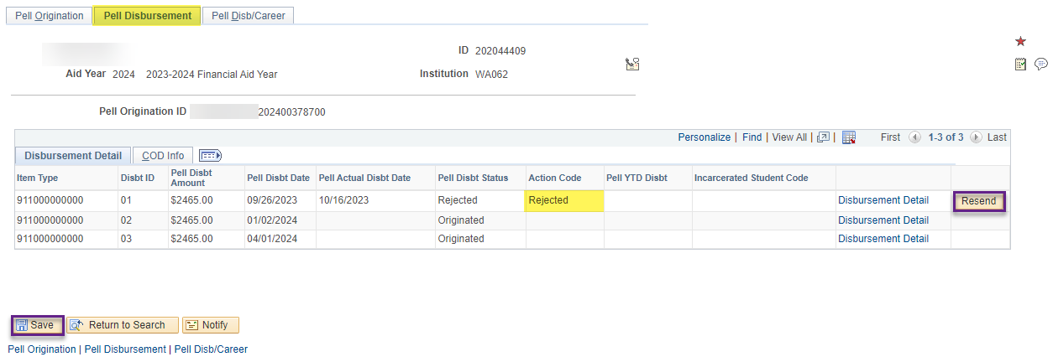
MANAGE PELL PAYMENT
RESOLVING CITIZENSHIP DISBURSEMENT
Once the Citizenship Status has been resolved, resend the Disbursement along with the Origination update.

Slide 15
DEMONSTRATION

Slide 16
WORKING THE
PELL VALIDATION REPORTS –
PELL ORIGINATION

Slide 17
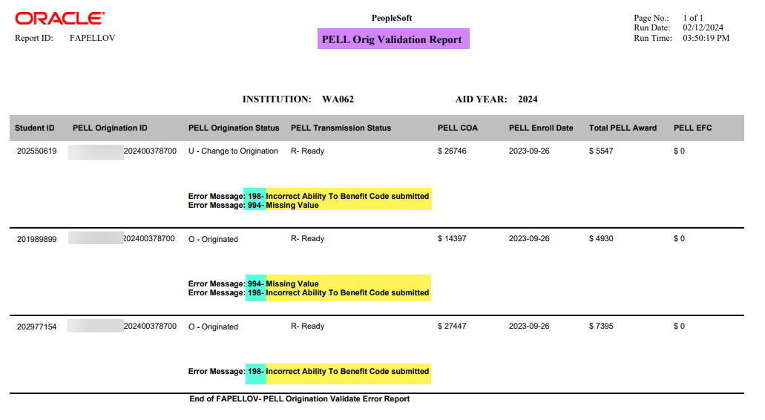
Pell ORIGINATION validation report
REVIEWING ERRORS
Navigation: Financial Aid > Pell Payment > Pell Validation Reports
The COD Reject Edit Error Message numbers are listed in the report.
Tip! You can drill down into the COD Technical Reference Guide to review more detail on the resolution, using the reject edit error message number in the report.

Slide 18
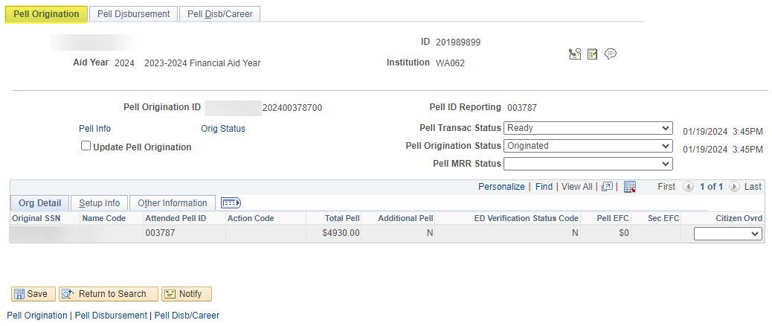
ORIGINATION VALIDATION REPORT CONT’D
MANAGE PELL PAYMENT
Navigation: Financial Aid > Pell Payment > Manage Pell Payment
At the Pell Origination tab,
WHAT’S MISSING?

Slide 19
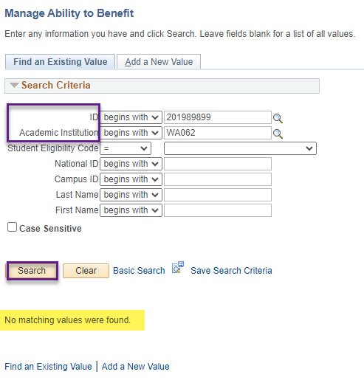
MANAGE PELL PAYMENT cont’d
INCORRECT ABILITY TO BENFIT CODE
Note No matching values were found.

Slide 20
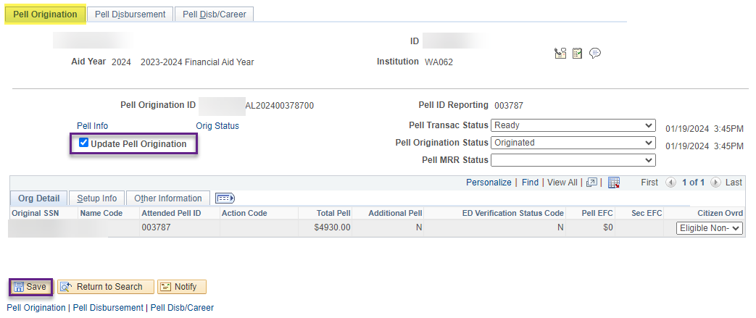
MANAGE PELL PAYMENT cont’d
WHEN ALL IS CORRECTED, QUEUE UPDATE TO ORIG
Select the Update to Origination checkbox. Ensure the Pell Transac Status is set to Ready. Select the Save button.

Slide 21
WORKING THE
PELL VALIDATION REPORTS –
PELL DISBURSEMENT

Slide 22
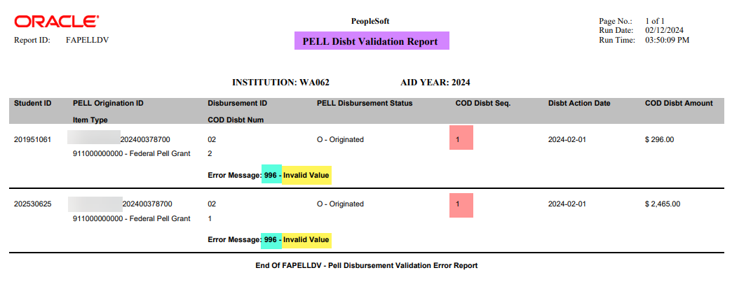
Pell DISBURSEMENT validation report
REVIEWING ERRORS
Navigation: Financial Aid > Pell Payment > Pell Validation Reports
The COD Reject Edit Error Message numbers are listed in the report.
Tip! You can drill down into the COD Technical Reference Guide to review more detail on the resolution, using the reject edit error message number in the report.
Note the COD Disbt Seq. # when troubleshooting.

Slide 23
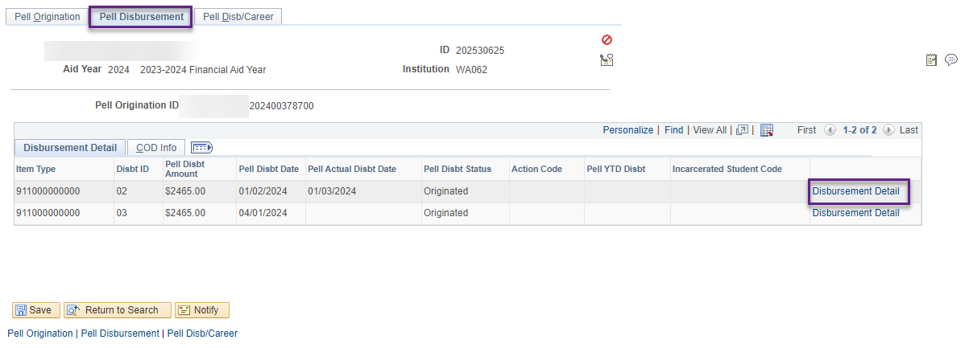
PELL DISBURSEMENT VALID RPT CONT’D
DISBURSEMENT DETAIL
Navigation: Financial Aid > Pell Payment > Manage Pell Payment
At the Pell Disbursement tab, select the Disbursement Detail link.

Slide 24
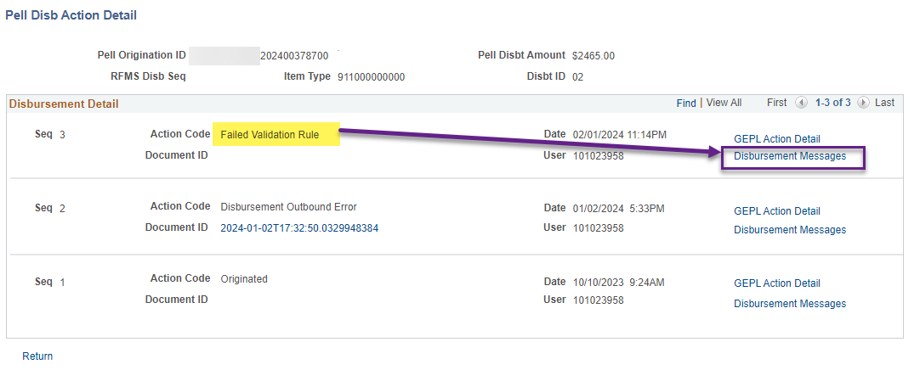
PELL DISBURSEMENT VALUD RPT CONT’D
DISBURSEMENT DETAIL CONT’D
At the Pell Disb Action Detail pagelet, note the Failed Validation Rule code. Select the Disbursment Message link to review more detail.

Slide 25
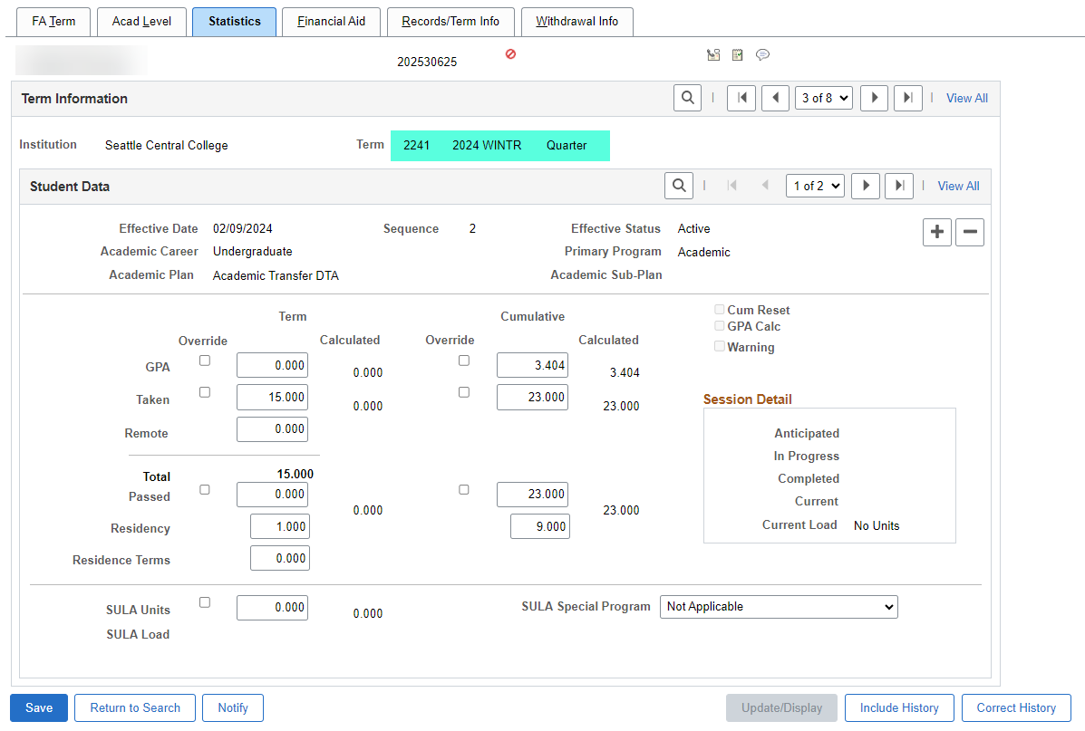
PELL DISBURSEMENT VALID RPT CONT’D
INVALID VALUE
Navigation: Financial Aid > Financial Aid Term > Maintain Student FA Term
At the FA Term page on the Statistics tab,
WHAT’S MISSING?

Slide 26
Pell troubleshooting
NEXT STEPS IN THE PROCESS
After you are done working your reports. Run Pell Origination. Verify the EMPLs are not displaying in the Message Text detail.
Run PELLOUT in Validation Mode and CONFIRM the EMPLs are not displaying in the Message Text detail.
Run PELLOUT in Final Mode.
Re-run your Pell Transaction Status Report and the Pell Origination and Disbursement Validation Reports to confirm the students have dropped off the report.

Slide 27
DEMONSTRATION

Slide 28
Outcomes
At training completion, you should be able to:
Understand best practices to ensure smooth processing in ctcLink to COD
Understand how to read and work examples on the Pell Reports:
Pell Records by Transaction Status
Pell Records by Status
Pell Origination Validation Report
Pell Disbursement Validation Report
Understand how to perform Pell troubleshooting using various pages in ctcLink and varying Dept of Ed Resources
View COD Data page
Manage Pell Payment page
COD Technical Reference Guide

Slide 29
Congratulations!
Intermediate Pell Processing - Pell Troubleshooting Training Complete!
Please review prior training videos in Canvas and additional resources in the ctcLink Reference Center as your progress through the steps
Thank you for your participation today!

