Slide 1
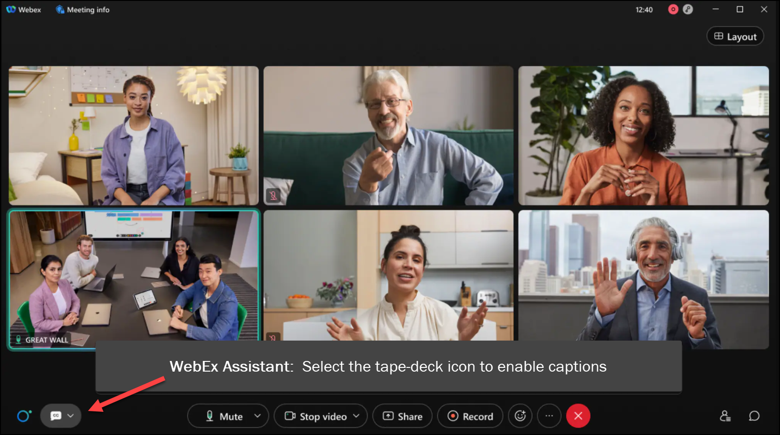
MEETING
RECORDING
NOTICE
The law requires consent prior to recording a person’s participation in an event. Your participation in this video conference (training) equals consent to be recorded, as required by law.
If you do not consent to being recorded but choose to participate, please turn your camera off and use the chat feature to interact with the other participants.

Slide 2
Intermediate loan processing: loan troubleshooting
Kelly Forsberg
ctcLink Functional Trainer | Financial Aid
January 2024

Slide 3
Objectives
After completing this training, you should be able to:
Understand best practices to ensure smooth processing in ctcLink to COD
Understand how to work common examples on the following reports:
Loans on Hold Report
Orig Hold
Orig Change Hold
Rejected Originations Validation Error Report
Rejected Disbursement Validation Errors Report
Understand which ctcLink pages to navigate and how to read and update them when troubleshooting loan reject and loans on hold messages:
View Loan Processing Actions page
View COD Data page
Hold/Suspend Change Data page
Override Loan Data page
Override Processing Status page

Slide 4
BEST PRACTICES FOR SMOOTH PROCESSING IN CTCLINK TO COD

Slide 5
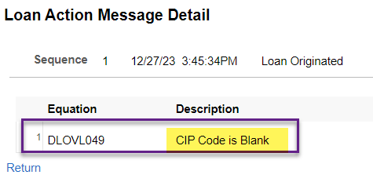
Best practices for smooth processing in ctcLink to cod
Work your origination acceptance from resolving error resolution – never manually accept origination in ctcLink

Slide 6
Best practices for smooth processing in ctcLink to cod CONT’D
Never manually accept origination in ctcLink

Slide 7
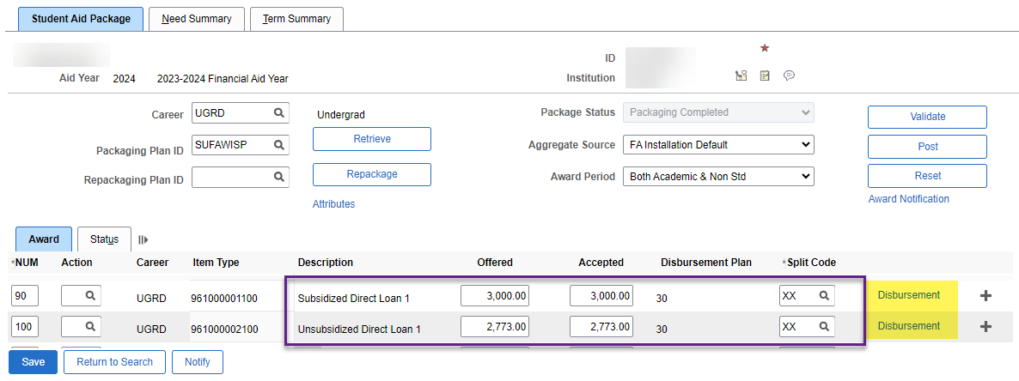
Best practices for smooth processing in ctcLink to cod CONT’D - LOANS WITH MULTIPLE TERMS/DISBURSEMENTS
WHAT’S WRONG WITH THIS PICTURE?
🤔

Slide 8
Best practices for smooth processing in ctcLink to cod CONT’D
NEVER CANCEL LOAN AWARDS IN THE MIDDLE OF THE AY LEAVING A BREAK IN THE PAYMENT PERIOD
☹️

Slide 9
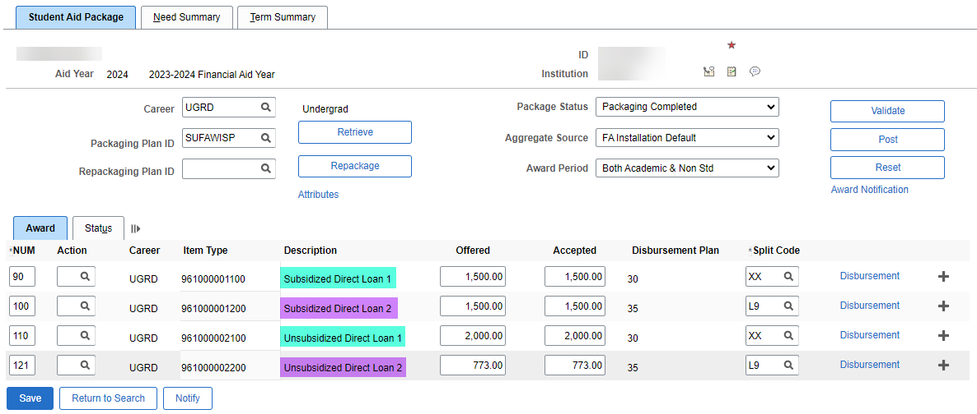
Best practices for smooth processing in ctcLink to cod CONT’D
USE DIRECT LOAN 1 & 2 ITEM TYPES INSTEAD!
👍

Slide 10
Best practices for smooth processing in ctcLink to cod cont’d
OTHER BEST PRACTICES
Do not make loan awards in the PJ Award page; you will just get COD errors
Do not load duplicate COD response files
Do not update COD manually
When in doubt, submit a ticket to FA Support before ANY manual adjustments in COD

Slide 11
WORKING THE
LOANS ON HOLD
REPORT

Slide 12
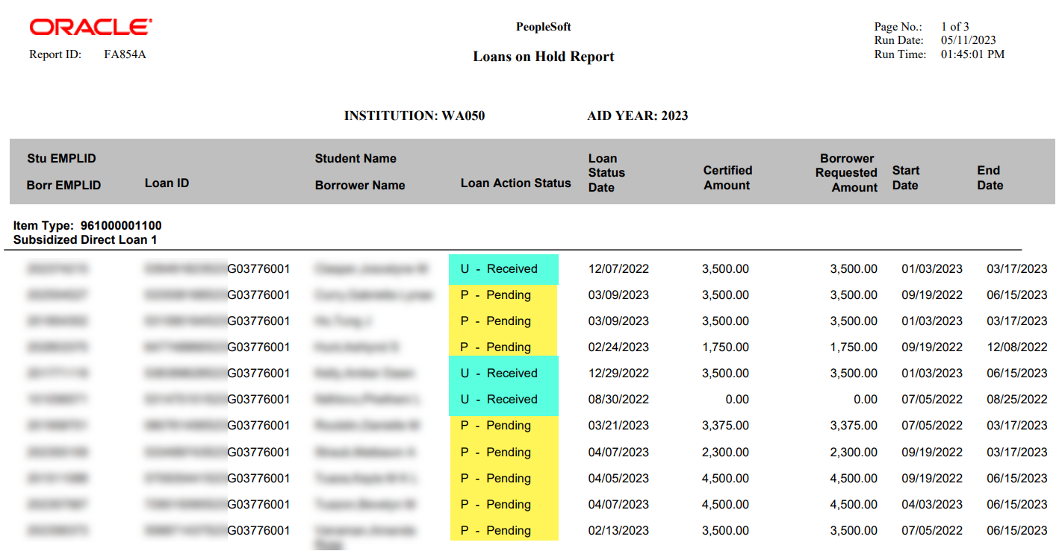
WORKING THE LOANS ON HOLD REPORT
PENDING AND RECEIVED
Navigation: Financial Aid > Loans > Direct Lending Reconciliation > Loans on Hold Report
Review the students and note the Loan Action Statuses. Received typically means COD already has a record. Pending typically means that there is a Change Transaction Pending and it needs to be reviewed/updated, COD may also have the record, but a change was made, and COD may or may not need to be updated.

Slide 13
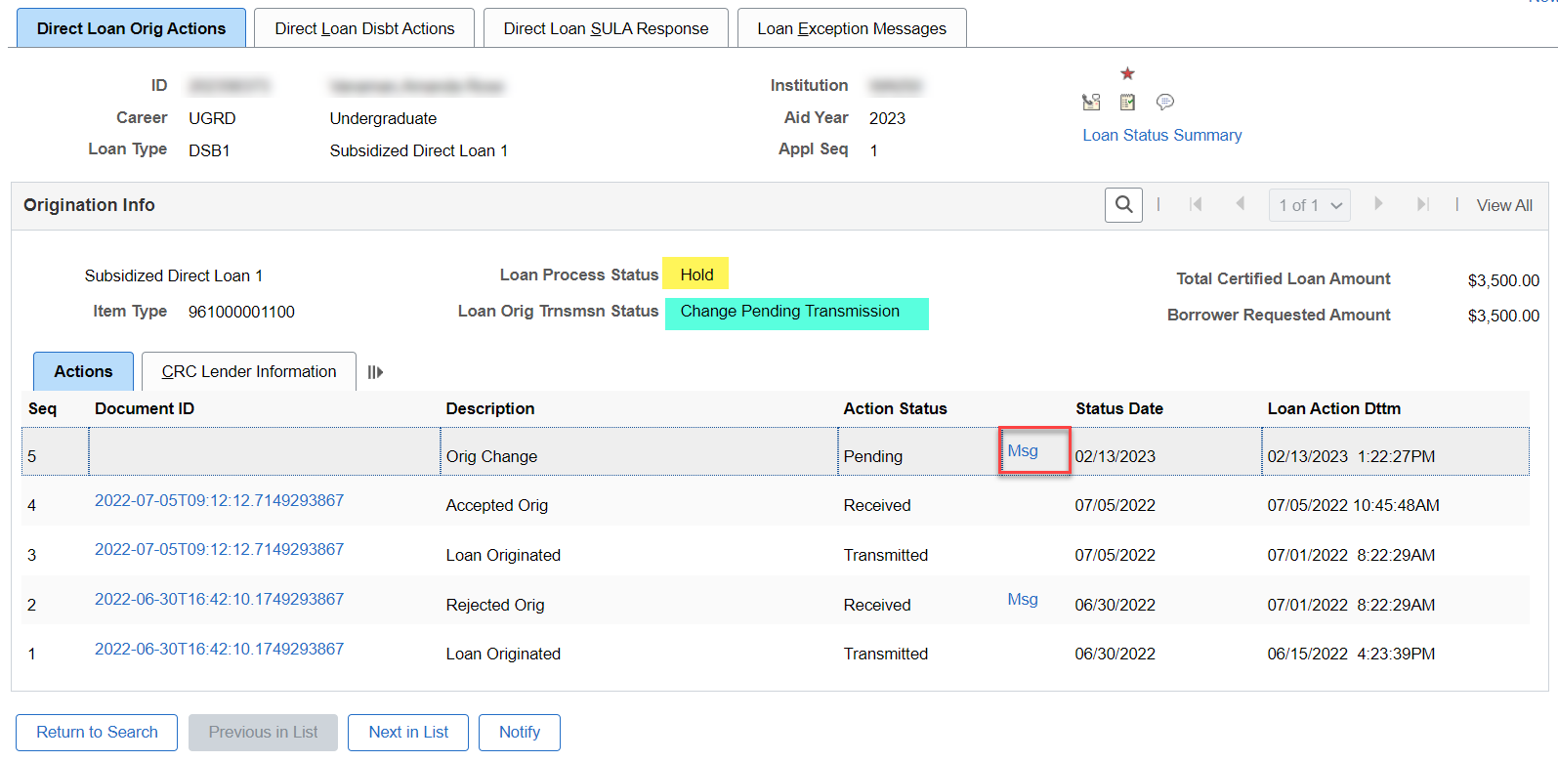
VIEW LOAN PROCESSING ACTIONS PAGE
CHANGE PENDING
Navigation: Financial Aid > Loans > Direct Lending Management > View Loan Processing Actions
At the Direct Loan Orig Actions tab, note the Loan Orig Trsnmsn Status of Change Pending Transmission. Select the Msg link to drill down into the message detail.

Slide 14
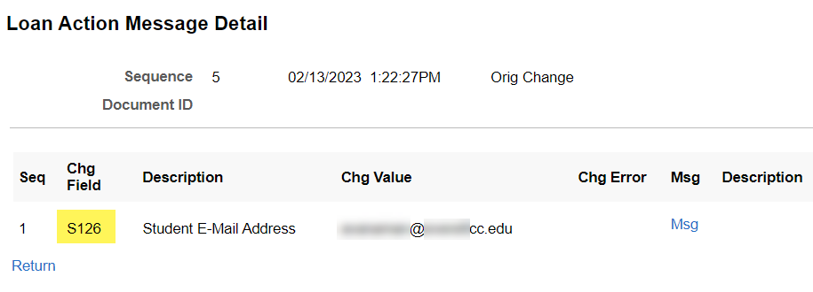
View loan processing actions page cont’d
CHANGE PENDING CONT’D
At the Loan Action Message Detail pagelet, note the Chg Field with a number assigned to it: S126 – Student E-mail Address. This means the student updated their email, and the system is flagging this record for the bio detail change and is waiting for your review.
Solution: Navigate out to Financial Aid > Loans > Direct Lending Management > Hold/Suspend Change Data.

Slide 15
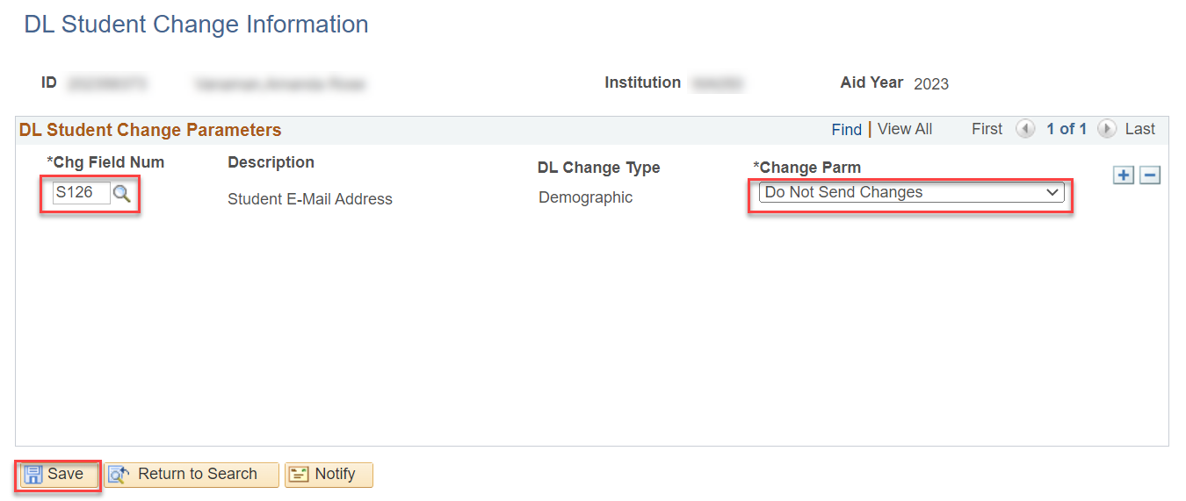
Hold/suspend change data page
UPDATE CHG FIELD NUM
Navigation: Financial Aid > Loans > Direct Lending Management > Hold/Suspend Change Data
In the DL Student Change Information page, note the Chg Field Num. Enter the Chg Field from the View Loan Processing Actions page. Set the Change Parm to Do Not Send Changes. Select Save.
Next, you must remove the Hold and Activate Change on the MDLA page.

Slide 16
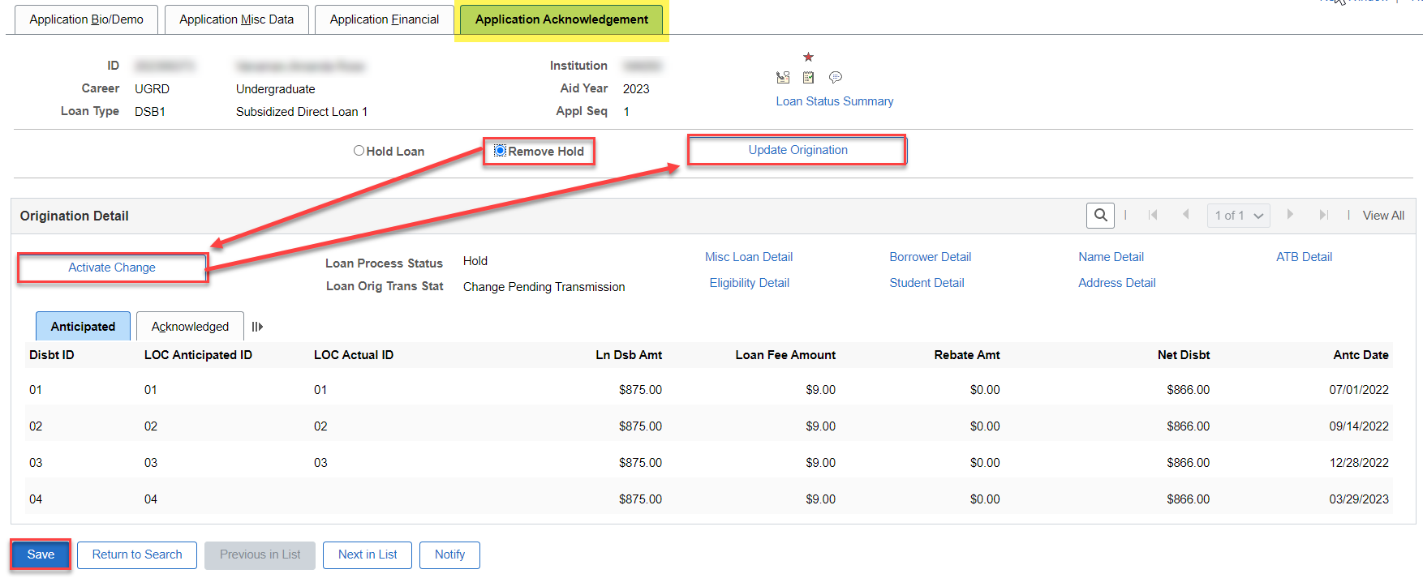
MANAGE DIRECT LOAN APPLICATION PAGE
REMOVE HOLD
At the MDLA page, at the Application Acknowledgment tab, select the Remove Hold button, select the Activate Change button, and select the Update Origination button. Select the Save button. The Loan Processing Status will change to In Service.
Be sure to do this on both the sub and unsub loan if they’re both on the report.
Next, originate on this single EMPL, and then Outbound in Validation mode.

Slide 17
DEMONSTRATION

Slide 18
WORKING THE
LOAN VALIDATION
ERROR REPORTS:
DISBURSEMENTS

Slide 19
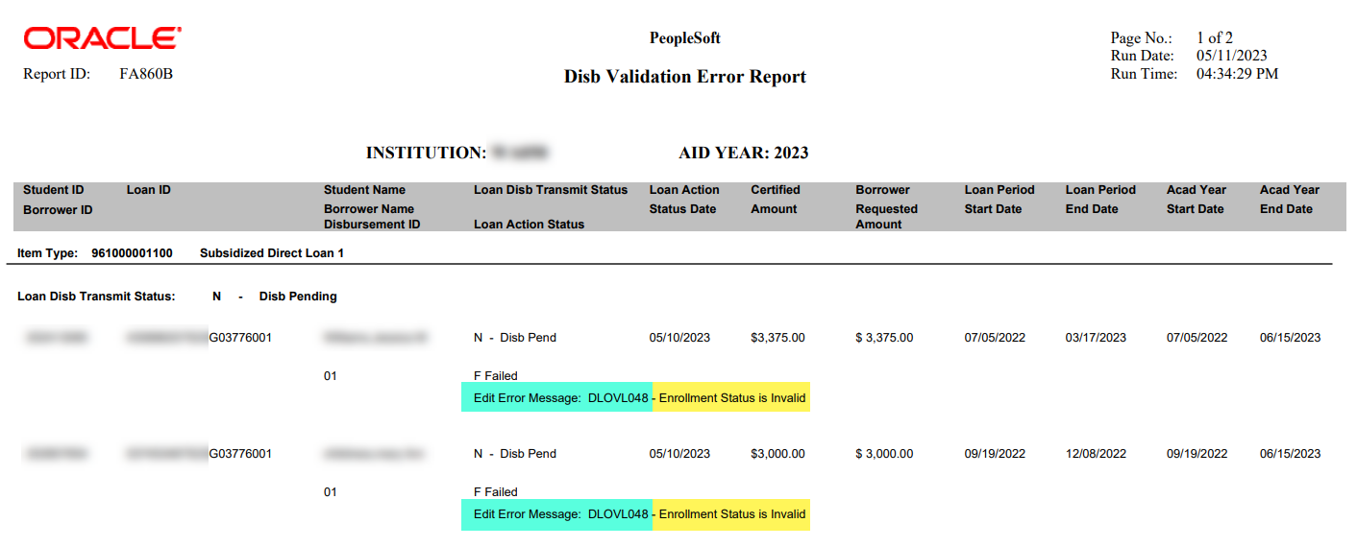
LOAN DISBURSEMENT validation report
REVIEWING ERRORS
Navigation: Financial Aid > Loans > Direct Lending Reconciliation > Validation Error Reports

Slide 20
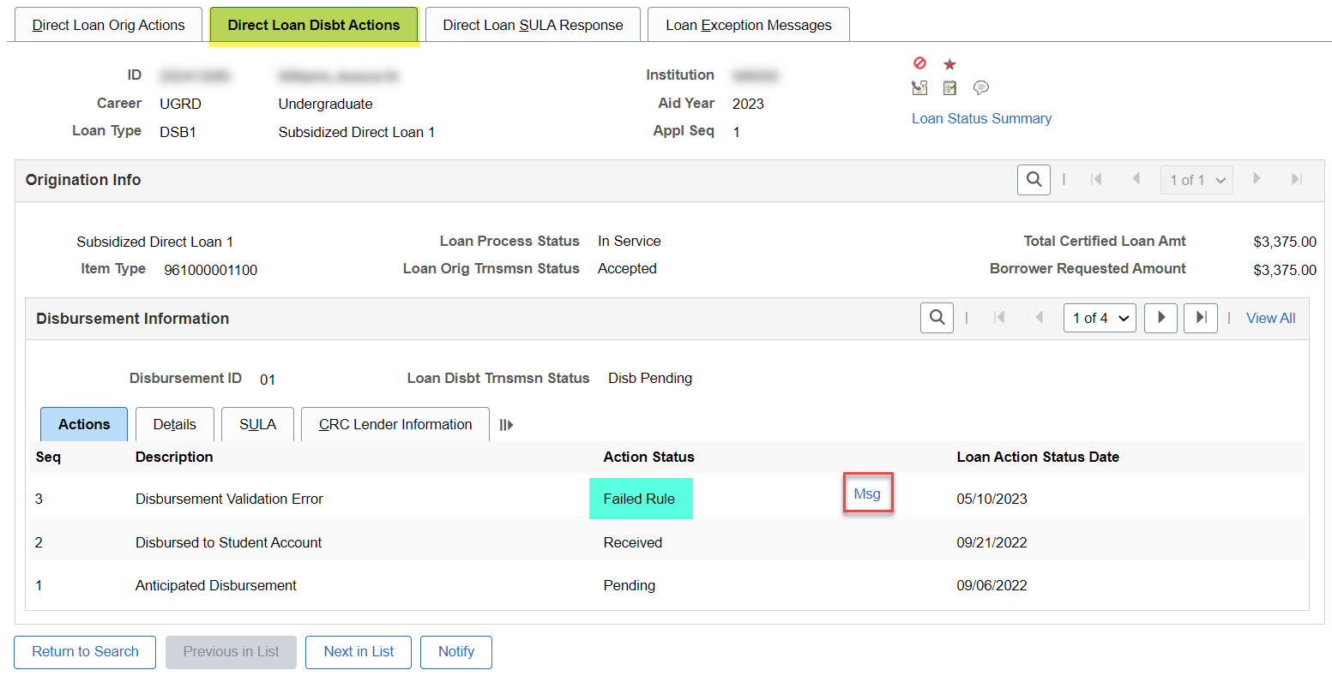
View loan processing actions page
ORIGINATION VALIDATION
Navigation: Financial Aid > Loans > Direct Lending Management > View Loan Processing Actions
At the Direct Loan Disbt Actions tab, note the Action Status of Failed Rule. Select the Msg link to drill down into the reason.

Slide 21
View loan processing actions cont’d
LOAN ACTION MESSAGE DETAIL
Nothing more to see here than what you already saw on the report.
Solution: According to the report, this error is for Disbursement ID 01, so go to the Disbursement link on the Assign Awards to a Student page and check to see in which term the disbursement is. Then, check FA Term.

Slide 22
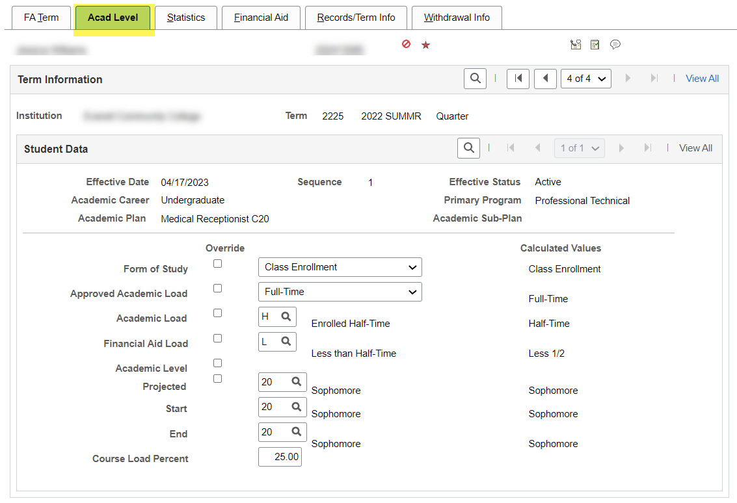
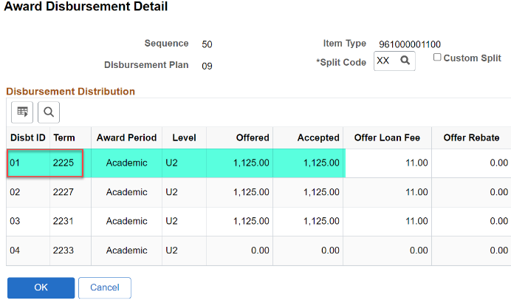
Loan troubleshooting
DISBURSEMENT LINK AND FA TERM
Navigation: Financial Aid > Financial Aid Term > Maintain Student FA Term
What do you notice on this page that is causing the Loan’s Enrollment Invalid Msg on the report?

Slide 23
Loan troubleshooting
DISBURSEMENT LINK AND FA TERM
Navigation: Financial Aid > Financial Aid Term > Maintain Student FA Term
Solution: If the student was truly at H – Half Time status at the time of disbursement, you will need to Override the FA Load to H and Save. Then, go to the MDLA page, and select Activate Change and Save. Outbound in Validation mode. Return here to FA Term, and then change back the FA Load value to L – Less than Half-Time, reflecting the true enrollment status.

Slide 24
DEMONSTRATION

Slide 25
WORKING THE
LOAN VALIDATION
ERROR REPORTS:
ORIGINATIONS

Slide 26
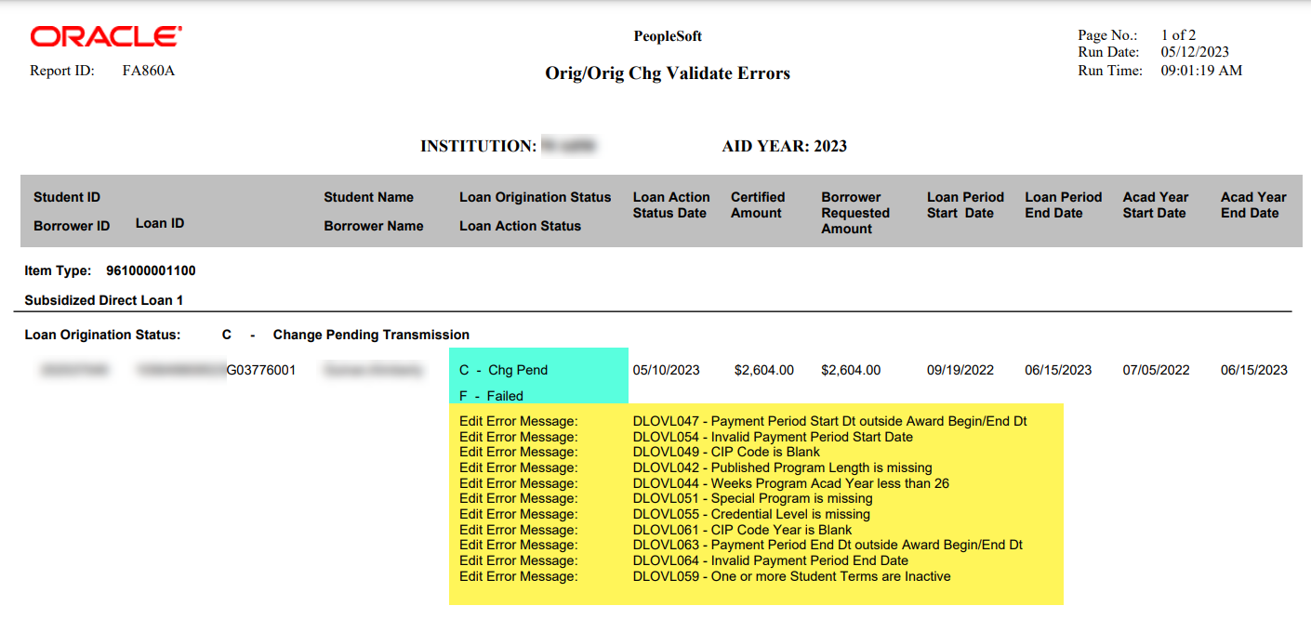
LOAN ORIG & ORIG CHG VALID report
REVIEWING ERRORS
Navigation: Financial Aid > Loans > Direct Lending Reconciliation > Validation Error Reports
Note that the Loan Origination Status is C – Change Pending Transmission.
Knowing you must go to View Loan Processing Actions, etc. to review, what Fin Aid page do you think is missing this data?

Slide 27
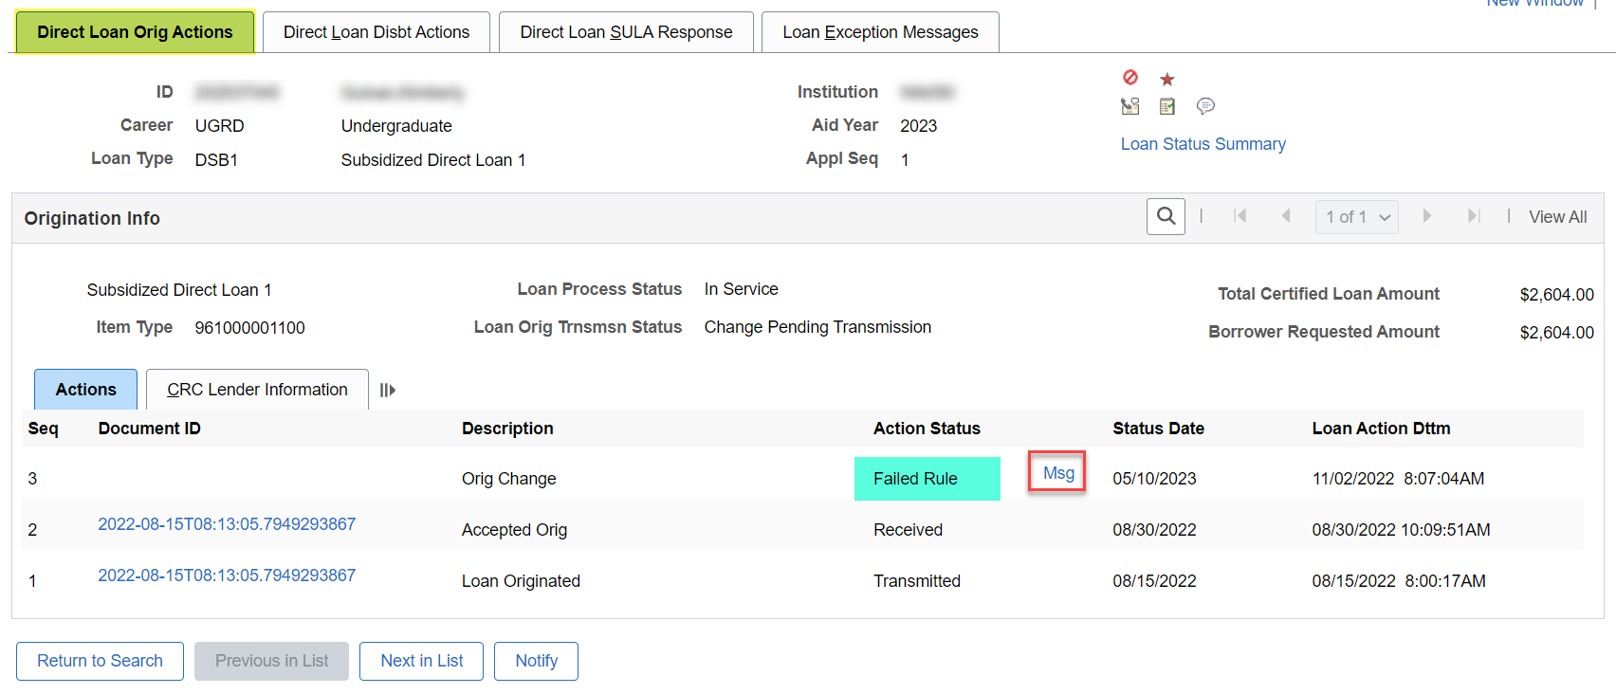
View loan processing actions page
ORIGINATION VALIDATION
Navigation: Financial Aid > Loans > Direct Lending Management > View Loan Processing Actions
At the Direct Loan Orig Actions tab, note the Action Status of Failed Rule. Select the Msg link to drill down into the reason.

Slide 28
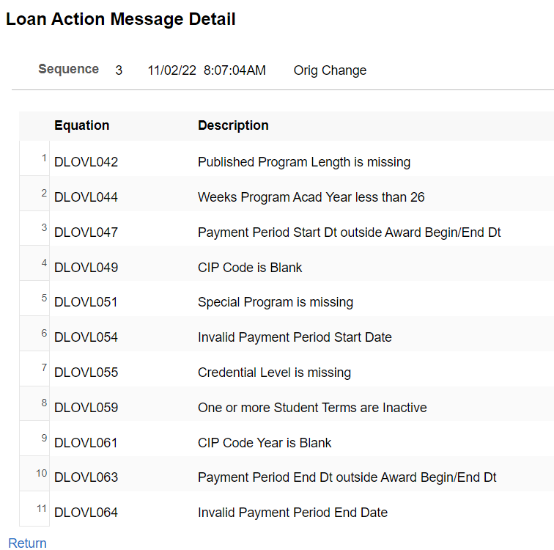
View loan processing actions cont’d
LOAN ACTION MESSAGE DETAIL
Nothing more to see here than what you already saw on the report.
Solution: Check the MDLA page to review Payment Period Start and End Dates, and then on to FA Term to review other missing data relevant to the program.

Slide 29
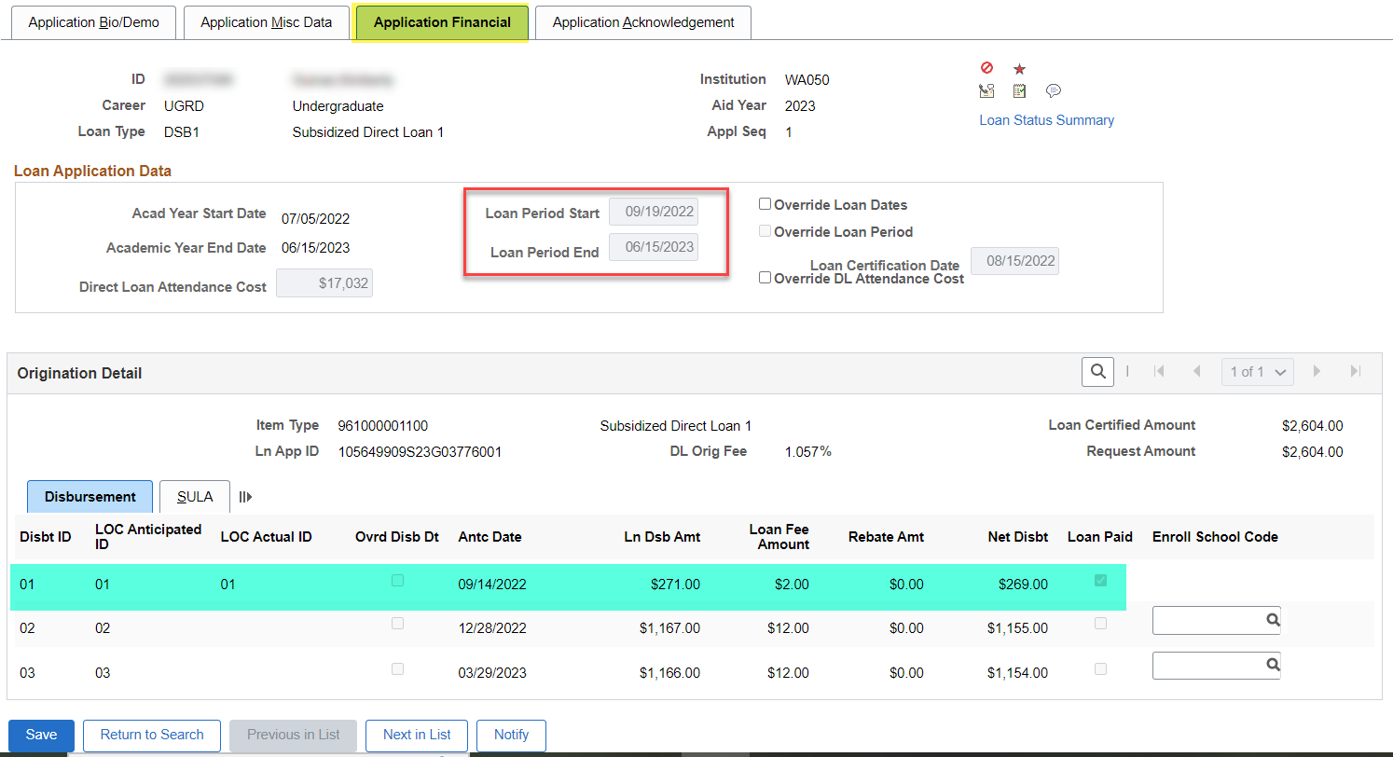
Loan troubleshooting
MDLA PAGE
Navigation: Financial Aid > Loans > Direct Lending Management > Manage Direct Loan Application
At the Application Financial tab, note that the Loan Period Start Date and End Date look correct with the three disbursements. However, note the first disbursement amount has been adjusted down. Move on to FA Term to review data for the 01 disbursement.

Slide 30
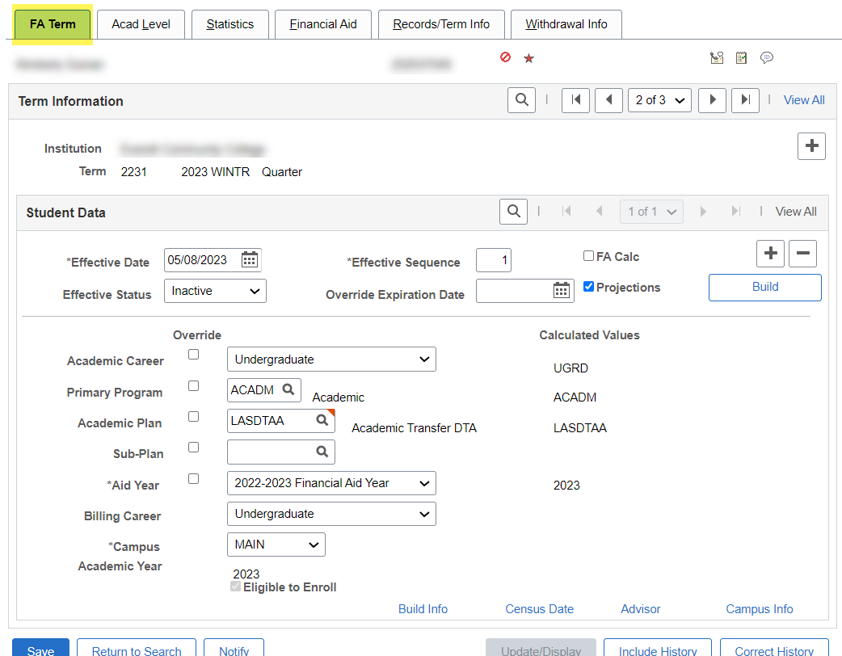
Loan troubleshooting
DISBURSEMENT LINK AND FA TERM
Navigation: Financial Aid > Financial Aid Term > Maintain Student FA Term
In review of the Term, what on this page indicates there is an issue?

Slide 31
LoAN troubleshooting
NEXT STEPS IN THE PROCESS
After you are done working your reports. Run any necessary Loan Origination(s). Verify the EMPLs are not displaying in the Message Text detail.
Run DL Out in Validation Mode and CONFIRM the EMPLs are not displaying in the Message Text detail.
Run DL Out in Final Mode.
Re-run your Loans on Hold Report and the Loan Origination and Disbursement Validation Errors Reports to confirm the students have dropped off the report.

Slide 32
Outcomes
At training completion, you should be able to:
Understand best practices to ensure smooth processing in ctcLink to COD
Understand how to work common examples on the following reports:
Loans on Hold Report
Orig Hold
Orig Change Hold
Rejected Originations Validation Error Report
Rejected Disbursement Validation Errors Report
Understand which ctcLink pages to navigate and how to read and update them when troubleshooting loan reject and loans on hold messages:
View Loan Processing Actions page
View COD Data page
Hold/Suspend Change Data page
Override Loan Data page
Override Processing Status page

Slide 33
Congratulations!
Intermediate Loan Processing - Loan Troubleshooting Training Complete!
Please review the videos and additional resources in the ctcLink Reference Center as your progress through the steps
Thank you for your participation today!

