Slide 1
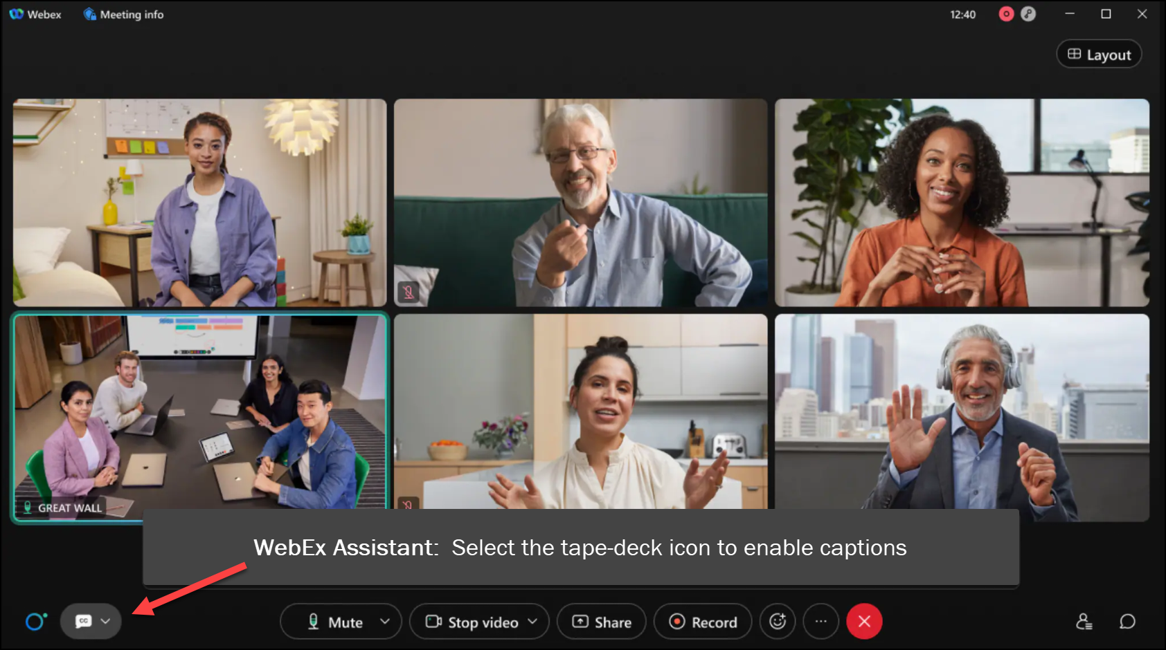
MEETING
RECORDING
NOTICE
The law requires consent prior to recording a person’s participation in an event. Your participation in this video conference (training) equals consent to be recorded, as required by law.
If you do not consent to being recorded but choose to participate, please turn your camera off and use the chat feature to interact with the other participants.

Slide 2
Fa r2t4 Worksheet Work session
Molly Groyer
ctcLink Functional Analyst | Financial Aid
January 2024
Notes:
Welcome to the FA R2T4 Worksheet Worksession!

Slide 3
agenda
Pre-worksheet processing activities
Define field functions on R2T4 worksheet
R2T4 Worksheet process & how to adjust federal awards
Assign F05 Service Indicator
Student example
Review available R2T4 Queries

Slide 4
Objectives
After completing this session, you should be able to:
Identify students to be reviewed for R2T4 by Mass Assigning F03 Service Indicator
Find a student’s withdrawal information in ctcLink
Find a student’s institutional charges
Create & complete an R2T4 worksheet & understand the functionality of key fields on the worksheet
Update a student’s account, adjust federal aid & undisburse/re-disburse
Add an F05 Service Indicator
Use available R2T4 queries for processing

Slide 5
Pre-Work session notes
This is an option for how to do an R2T4 worksheet in PeopleSoft. We are aware that some colleges opt to perform their R2T4 calculations in the COD worksheet, or via another method - that is completely fine.
There are some known challenges with the delivered functionality – we’ll walk through how to navigate around them.
All definitions & information provided is based upon processing for institutions not required to take attendance and for full term courses. ☺
Today, we are focusing on the R2T4 process for federal aid only.
Notes:
We are aware that some colleges opt to perform their R2T4 calculations in the COD worksheet, or via another method - that is completely fine. That is completely fine – this is an option for how to do R2T4 worksheet in PeopleSoft.
There are some known challenges with the delivered functionality – we’ll walk through how to navigate around them. We are looking into how to address these challenges to make processing more efficient for you.
All definitions & information provided is based upon processing for institutions not required to take attendance and for full term courses. ☺ We will not be discussing the process for module courses, post withdrawal disbursements or unofficial withdrawals. We are hoping to offer sessions on those topics in the future.
Today, we are focusing on the R2T4 process for federal aid only. We will not be discussing the process for state aid.

Slide 6
Overview of Pre-worksheet processing activities
Run process to assign the F03 Service Indicator
Find institutional determination date & withdrawal date/last date of attendance (LDA) needed for R2T4 calculation & worksheet
Determine institutional charges
Confirm the federal award amounts are accurate prior to R2T4 calculation
Notes:
Here’s an overview & we’ll go into more detail in later slides.
The first step is to run the process to assign the F03 Service Indicator. This is also outlined the R2T4 Processing Guide BPG.
Then, look for the institutional determination date & withdrawal date/last date of attendance (LDA)
Determine institutional charges
Confirm the federal award amounts are accurate prior to R2T4 calculation

Slide 7
Identifying r2t4 students
2-STEP PROCESS
Step 1: Mass Assign F03 (Refund Hold) SI
Step 2: Query by Service Indicator

Slide 8
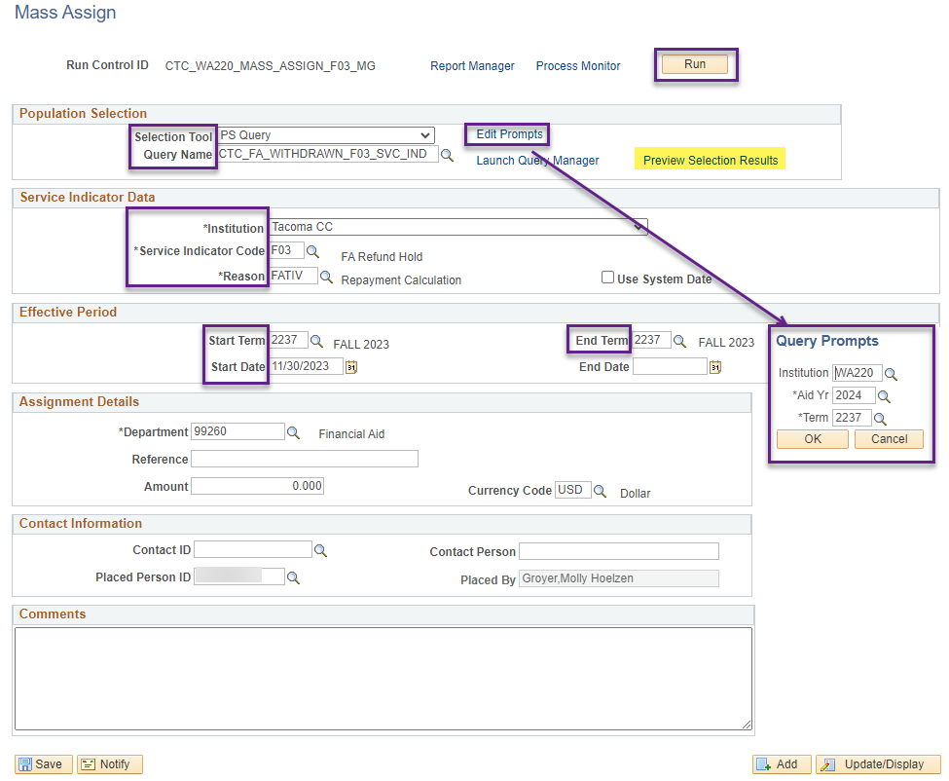
Mass assign f03 service indicator
CTC_FA_WITHDRAWN_F03_SVC_IND
Navigation: Campus Community > Service Indicators (Student) > Mass Assign
This specific query is to be run before grades post . . .
Review the R2T4 Processing Guide for a query to run after grades post
Notes:
Institution & Query prompts should be for your college & aid year/term that you are reviewing students for R2T4. Enter a start term & start date. You can also enter an end term if desired or leave the field blank. Be sure to select “Preview Selection Results” to confirm the F03 will be assigned prior to selecting the Run button

Slide 9
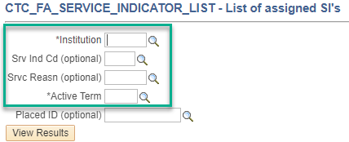
Identify students with f03
CTC_FA_SERVICE_INDICATOR_LIST
Navigation: Reporting Tools > Query > Query Viewer
Notes:
Run the CTC_FA_SERVICE_INDICATOR_LIST query on Query Viewer to identify your list of students who may need to be reviewed for R2T4

Slide 10
institutional determination dT & Withdrawal date/Last date of attendance
There are multiple pages where you may be able to find this information:
Term History, or
Maintain Student FA Term - Withdrawal tab, or
View Customer Accounts
Note: If student withdrew in the first week of the quarter, determine enrollment level at time of withdrawal
Enrollment Request Search & Student Services Center
Notes:
Because there are multiple pages where you may be able to find this information, however, it’s important to discuss with Student Records how they are determining the date of withdrawal, last date of attendance & institutional determination date to ensure you are in compliance.
Note: If student withdrew in the first week of the quarter, determine enrollment level at time of withdrawal on Enrollment Request Search & Student Services Center

Slide 11
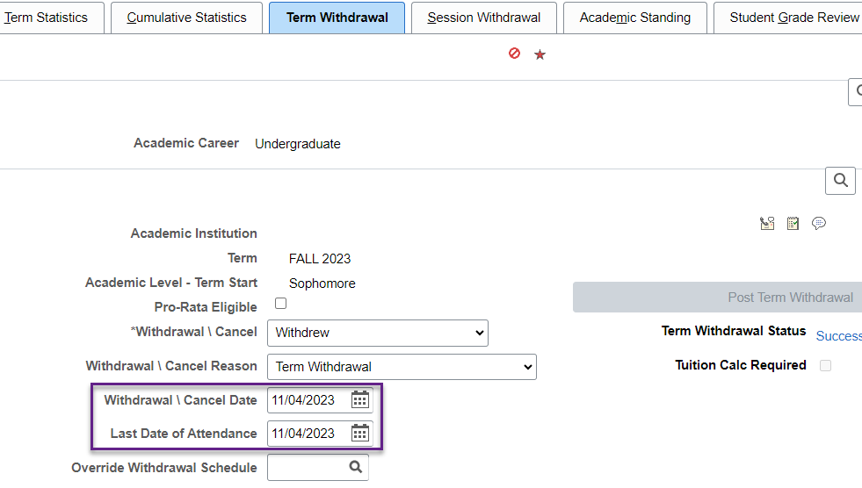
Term history
Navigation: Records and Enrollment > Student Term Information > Term History
Notes:
Withdrawal process is managed by your Student Records office. If you have security to view Term History & your college is using the Term Withdrawal process, you can view withdrawal information on this tab.
From PeopleBooks:
Withdrawal \ Cancel – Withdrew: Select to withdraw the student from all class enrollment for the specified term or session. Posting a student's term withdrawal request refunds her or his fees according to the adjustment calendar associated with the student's tuition group.
Withdrawal \ Cancel Date - Enter the date that the Student Records Term Withdrawal process uses as the action date for the withdrawal or cancellation.
Withdrawal \ Cancel Reason - Select the withdrawal/cancel reason that Student Financials uses for adjustments.
Last Date of Attendance - The system by default sets the last date of attendance to the withdrawal/cancel date, but you can override the value. The Student Records Term Withdrawal process uses the last date of attendance to determine the deadlines, reasons, grading bases, and penalties for withdrawals from dynamic class date and OEE enrollments. The process also uses this date for financial aid and refund calculation purposes. If you override the last date of attendance value, you must recalculate the student's tuition based on the new date you enter.

Slide 12
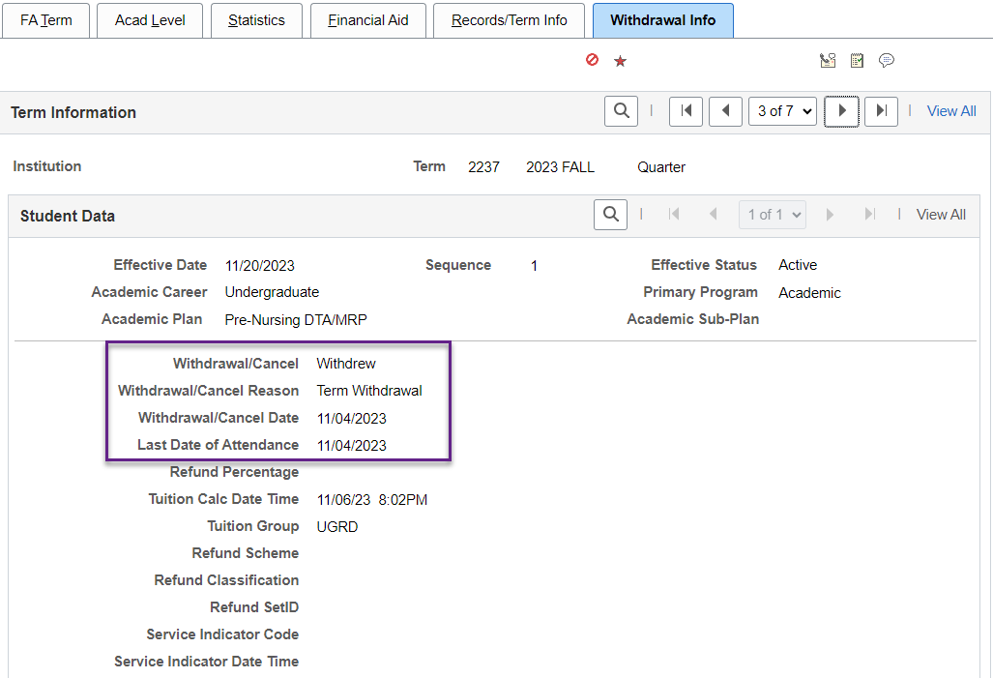
maintain student FA term
Navigation: Financial Aid > Financial Aid Term > Maintain Student FA Term
Notes:
Data pulls over to the FA Term table from Student Records Term History

Slide 13
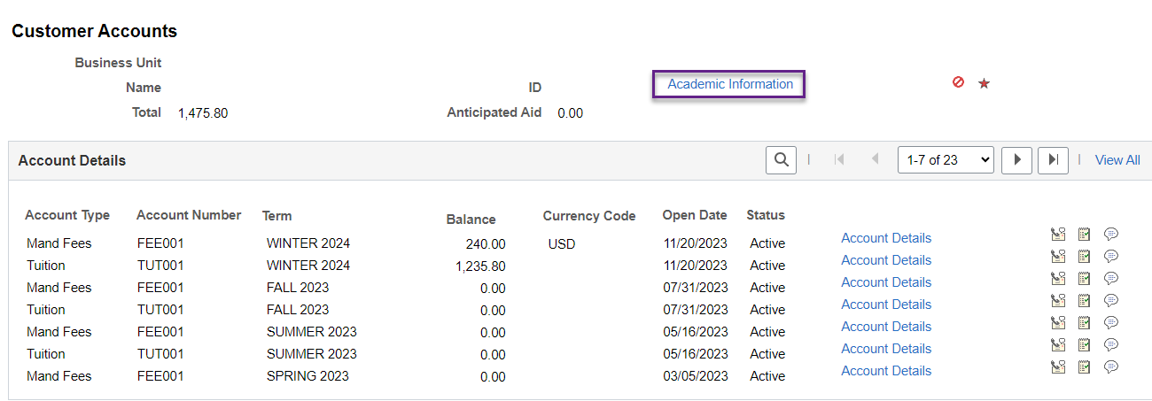
View customer accounts
Navigation: Student Financials > View Customer Account
Notes:
Reviewing Date of Withdrawal/LDA – i.e. when the student’s courses were dropped
Institutional determination date could be different and therefore may not be available on this page

Slide 14
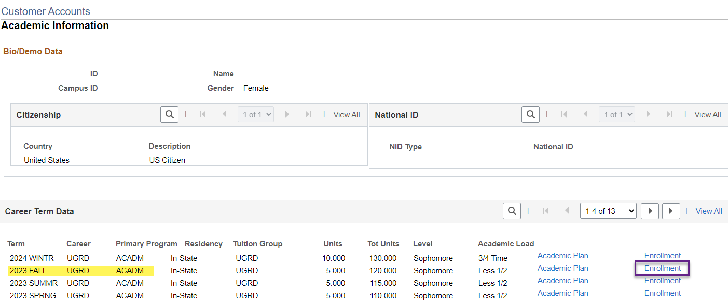
View customer accounts Cont.

Slide 15
View customer accounts Cont.
Select the Dates tab and review “Add Reason” for Withdrawn and the for the latest drop date
Notes:
On the date tab, look for the latest date & reason = withdrawn from class

Slide 16
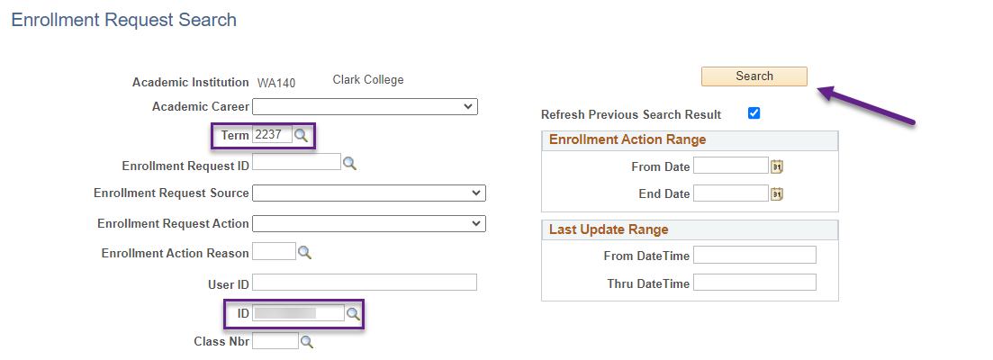
Enrollment request search
Navigation: Records and Enrollment > Enroll Students > Enrollment Request Search
Notes:
We recommend partnering with your Records folks to review this page. They should have the required security role.
If student withdrew in the first week of the term & you want to determine if they could have attended their courses, navigate to Enrollment Request Search.
Screenshot on slide – Clark College’s Fall 2023 term start & end dates: 9/25/23 – 12/14/2023. Student dropped both courses on 9/26/2023 at 9:20am. Next, we’ll review the meeting dates and times to find out if the student could have attended the first scheduled class.

Slide 17
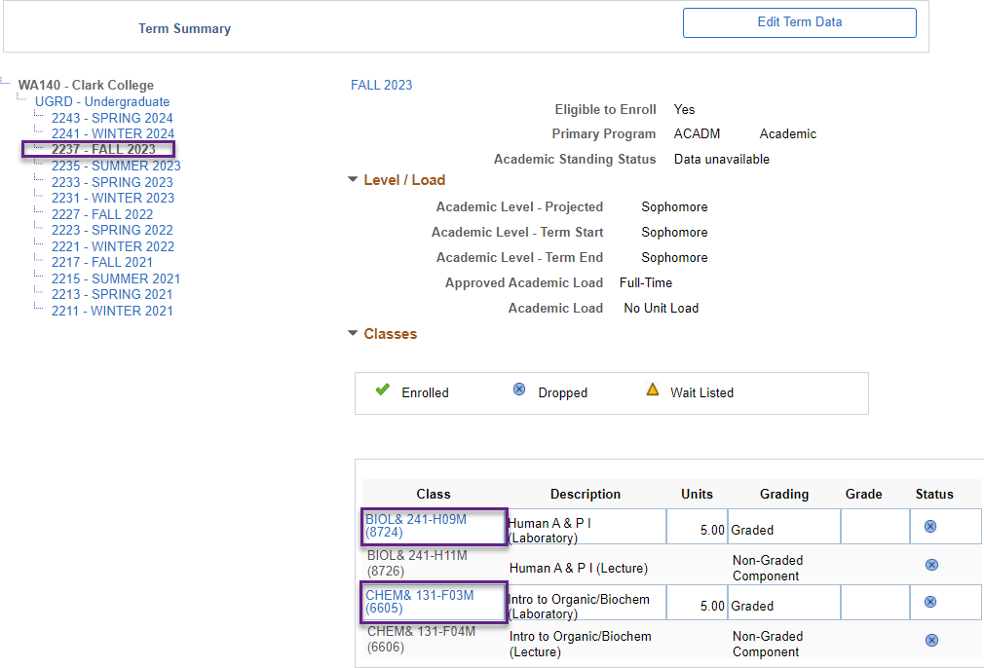
Student services center - Academics
Navigation: Campus Community > Student Services Center
Select the Academics tab
Select the term for your Institution & review each class detail

Slide 18
Student services center – class detail
BIOL& 241
CHEM& 131
Per Enrollment Request Search, student dropped courses on Tuesday 09/26/2023 at 9:20am.
BIO 241: first class meeting was scheduled for Tuesday, 09/26/2023 at 3:00pm. Student dropped the course before she could have attended.
CHEM 131: first class meeting was scheduled for Thursday 09/28/2023 at 12:00pm. Student also dropped course before she could attend.
Notes:
Per Enrollment Request Search, student dropped courses on Tuesday 09/26/2023 at 9:20am.
BIO 241: first class meeting was scheduled for Tuesday, 09/26/13 at 3:00pm. Student dropped the course before she could have attended.
CHEM 131: first class meeting was scheduled for Thursday 09/28/2023 at 12:00pm. Student also dropped course before she could attend.
Question for attendees – is R2T4 required? What should be done with her federal aid? In this case, we wouldn’t continue with R2T4 processing. However, let’s look at all the students who withdrew after the first week of the term

Slide 19
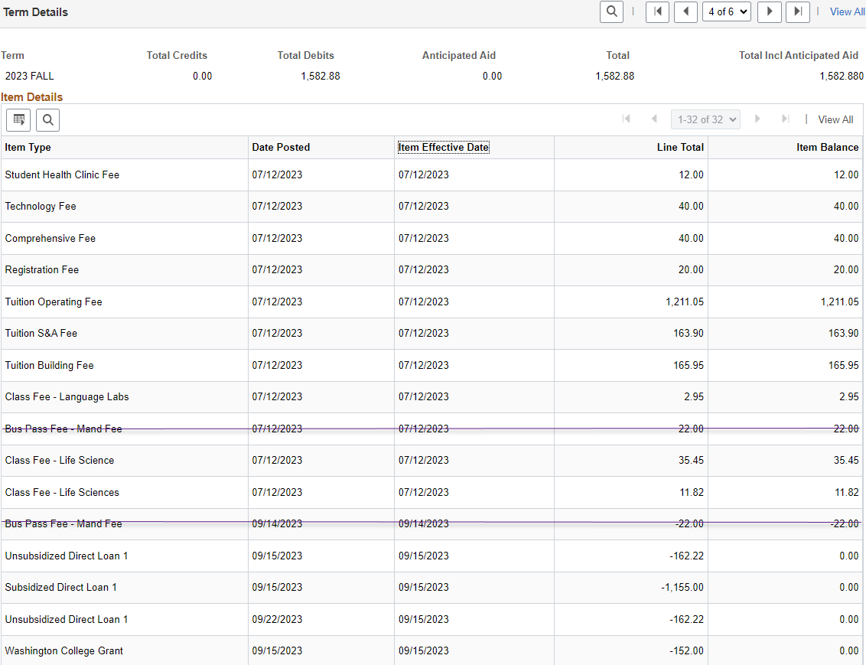
institutional charges
On View Customer Accounts, determine & confirm the correct institutional charge value for field L on the worksheet
Total required institutional charges = $1,703.12
Notes:
We know that there are some challenges with how waivers are posted & with the value of the institutional charges on the R2T4 worksheet. Manually reviewing the institutional charges will help to address these issues until another solution can be identified.
Initially assessed charges/charges assessed PRIOR to withdrawal can be manually calculated on Customer Accounts for now (depending on whether charges were prorated or not) because system pulls current charges into the R2T4 worksheet. I prefer to use the Items by Term page which can be downloaded to Excel, but you can use other options for viewing the charge information under Additional Information or in the Account Details for the Term Account Types
Example: student was enrolled FT – charges assessed in July & aid was disbursed and applied to account in Sept.
Drop date = 09/21/2023 as of 8:31pm (15 units). Tuition, mandatory fees & campus fees total $1,703.12 (bus pass not included as it was removed prior to W/D & students can opt-out).
https://scc.spokane.edu/How-to-Pay-for-College/How-Much-Does-it-Cost/Student-Fees-Explained

Slide 20
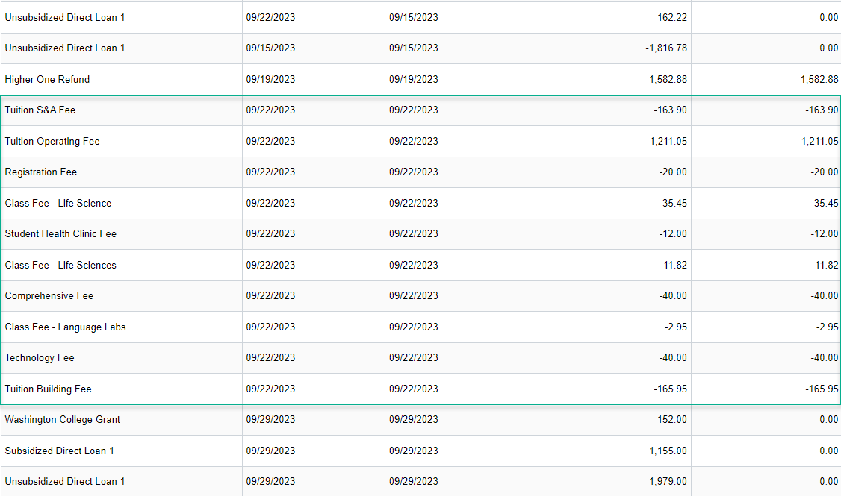
institutional charges continued
After courses were dropped on 9/21/2023, institutional charges were prorated on 9/22/2023
Notes:
This slide is a continuation of the item details from the prior slide – they couldn’t fit on the same slide.
As noted, the student dropped their courses on 9/21. The total institutional charges as of that date was $1,703.12. Then, on 9/22/23 at 10:10am the charges were prorated (per Detail Transactions on View Customer Accounts).
As mentioned, one of the challenges of the R2T4 worksheet is that the current charges will pull into field L. Institutional Chrgs. Additionally, what charges are included is based on your college’s configuration of the Item Type Groups on the Institutional Charges tab of Define Rules for Return.
The prorated charges, may not be the correct amounts for field L – Institutional Charge, which is why it’s important to review Customer Accounts for each student & correct the value on the worksheet, if needed.

Slide 21
View award activity
Navigation: Financial Aid > Awards > View Award Activity
Confirm the federal award amounts are accurate prior to R2T4 calculation
Sometimes, aid can be reduced or undisbursed in error
If award amounts are incorrect, make adjustments on Assign Awards to a Student & disburse aid (if required) prior to Creating the R2T4 Worksheet
Notes:
Confirm the federal award amounts are accurate prior to R2T4 calculation
Sometimes, aid can be reduced or undisbursed in error
If award amounts are incorrect, make adjustments on Assign Awards to a Student & disburse aid, if required (aid that could have been disbursed will need to be awarded correctly) prior to Creating the R2T4 Worksheet.
This is an important step because the R2T4 worksheet pulls the award data directly from Assign Awards to a Student

Slide 22
R2T4 WORKSHEET FIELDS
Notes:
Now, let’s talk about some of the key fields on the R2T4 worksheet

Slide 23
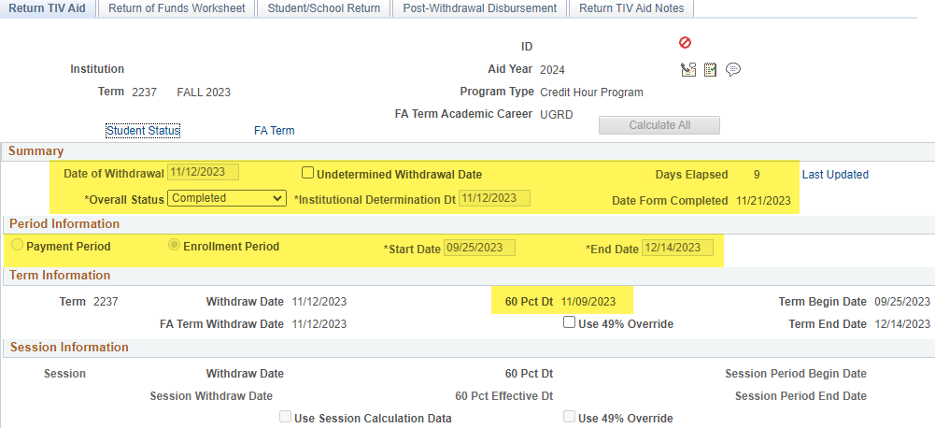
Which field definitions will we discuss today?
Navigation: Financial Aid > Return to Title IV Funds > Create Worksheet
Notes:
Going over these fields will hopefully help to illustrate functionality of the worksheet & Oracle’s intended use for the fields & what information they display.

Slide 24
Key fields on worksheet
Date of Withdrawal (or, the Last date of attendance)
Institutional Determination Dt (Date of school's determination that the student withdrew)
Undetermined Withdrawal Date
Overall Status (either “pending” or “completed”)
Days Elapsed
Date form completed
Payment period, enrollment period, start & end date
60% date
Notes:
The definitions/field explanations are from PeopleBooks may have been edited for clarity.

Slide 25
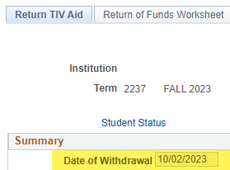
Date of Withdrawal
Date of Withdrawal (or, the Last date of attendance)
Indicates one of the following:
the last date of recorded attendance or academically related activity
the date the student began the official withdrawal process
the date the student provided your school with the intent to withdraw
Date institution administratively withdraws the student
OR the midpoint of the payment period if the student unofficially withdraws
The system displays the default date based on the date that was established in Campus Solutions Student Records.
Notes:
If a school is not required to take attendance, the determination of a withdrawal date varies with the type of withdrawal.
Date of Withdrawal (or, the Last date of attendance) indicates one of the following:
the last date of recorded attendance
the date the student officially withdrew
the date the student began the withdrawal process
the date the student provided your school with the intent to withdraw
or the midpoint of the payment period if the student unofficially withdraws
These are defined by FSA & your institution.

Slide 26
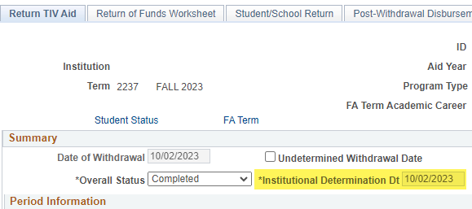
Institutional Determination Dt (date)
Institutional Determination Dt (Date of school's determination that the student withdrew)
Notes:
Institutional Determination Dt (Date of school's determination that the student withdrew/date that the institution became aware that the student ceased attendance). This could be the date that SR determined the student withdrew, FA office, the date that the student provided their intent to withdraw, etc.
Note: the date defaults to the date the worksheet is created but it can be changed if needed.

Slide 27
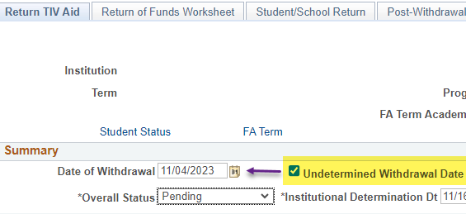
Undetermined Withdrawal DatE
Select for students who have withdrawn unofficially. The system displays the midpoint of the payment period in the Date of Withdrawal field if the student unofficially withdraws.
Notes:
Select for students who have withdrawn unofficially. When the undetermined withdrawal date checkbox is selected, the system will provide a message indicating that the Date of Withdrawal has been set to the midpoint/50% of the term & it will update the Date of Withdrawal.
If the box is unchecked, the Date of Withdrawal will default back to the date on Term History as posted through the Term Withdrawal process.

Slide 28
Days Elapsed & Date form completed
Days Elapsed: After an institution determines the date of withdrawal, the system calculates and displays the number of days passed since the student withdrew. The days are calculated using the Institutional Determination Date field as a starting date.
Date Form Completed: The date is set to the current date by default when you change the overall status to Complete
Notes:
Important fields for tracking & auditing purposes.

Slide 29
Overall status
The values are:
Pending: The calculation and the return of Title IV funds are still in progress. The default status is Pending until you manually change the status to Completed.
Completed: Indicates that the calculation, the student notification, and the return of Title IV funds has occurred. After you set the status to Completed, affected fields and pages become view-only
Notes:
There are two values -
Pending: The calculation and the return of Title IV funds are still in progress. The default status is Pending until you manually change the status to Completed.
Completed: Indicates that the calculation, the student notification, and the return of Title IV funds has occurred. After the status is set to Completed, affected fields and pages become view-only & are essentially locked from editing.

Slide 30
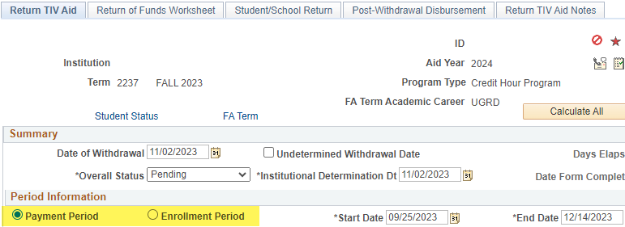
Payment period or Enrollment period
Select either Payment Period or Enrollment Period radio button that corresponds to the start & end dates for the term

Slide 31
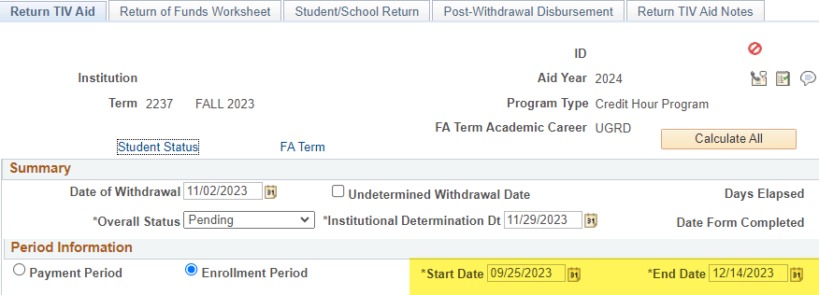
start & end datE
Displays the beginning and ending date of the payment or enrollment period. The system uses the start and end date in the actual Return of Title IV Funds calculation for term processing.
Notes:
The start & end dates are set up on the Term/Session Table by your Registrar’s office. The values in these fields are used in the actual R2T4 calculation.

Slide 32
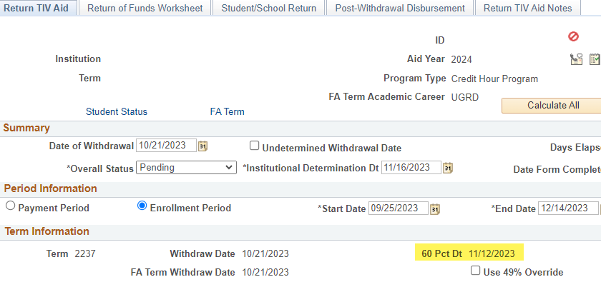
60% pct dt (percent date)
Displays the default value from the Term/Session table. This is the date when a student would have completed 60% of the credit/clock hour of the program for the term.
Notes:
Reminder – Term/Session Table set up is done by your Registrar’s office and the 60 Pct Dt displays the default value from the Term/Session table. This is the date when a student would have completed 60% of the credit/clock hour of the program for the term & therefore, earned 100% of their federal student aid.
This date is a reference point & the system calculates the 60% point (100% earned) based upon the start/end dates entered in the Period Information section.

Slide 33
PROCESSING R2T4 WORKSHEET

Slide 34
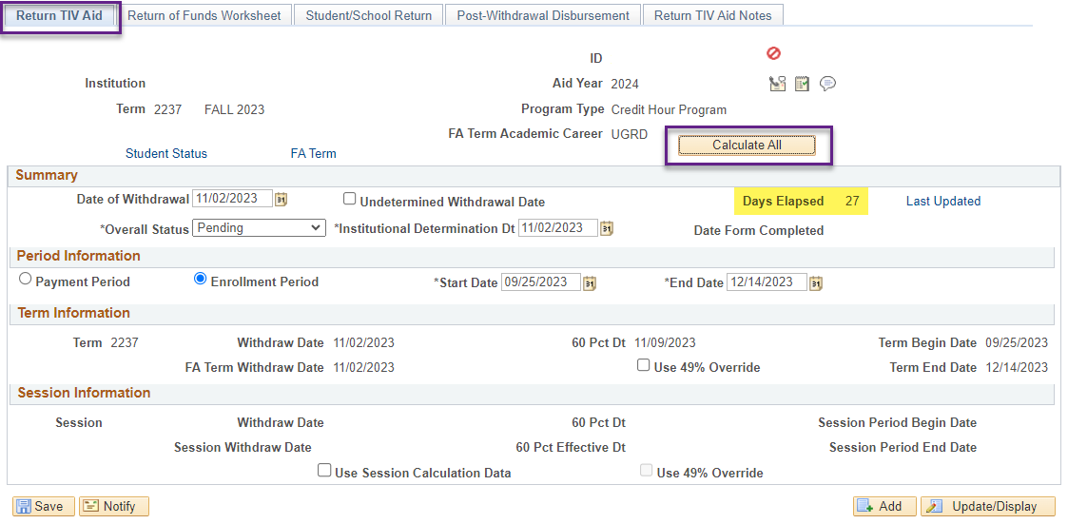
R2t4 worksheet
Notes:
Removed student’s name, ID number & institution for privacy purposes – but this is a real-world example for Fall 2023 quarter.
Assuming we’ve gone through all of the pre-processing activity steps & followed up with SR, we have the institutional determination date & date of withdrawal as 11/02/2023.
Note: if the date is changed from a different date than when the worksheet was created (such as to the date the student completed the withdrawal process at the institution), the Days Elapsed will change to how many days have passed since that date. So, this screenshot was taken on 11/29/2023, which means that 27 days had elapsed since the institutional determination date.

Slide 35
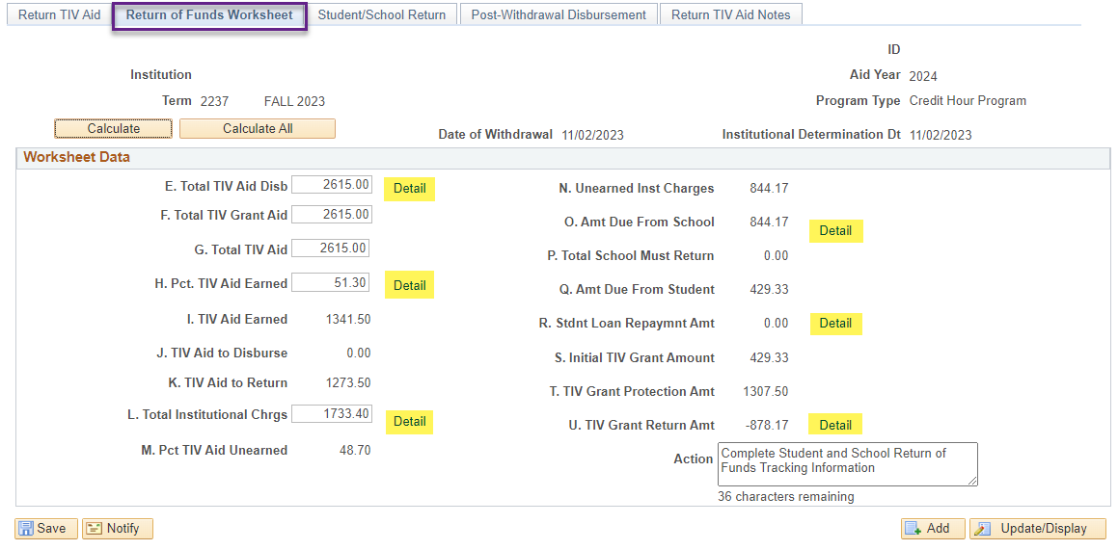
R2t4 worksheet processing cont’d
To view the details of many of the fields – select the “detail” hyperlinks to open the pagelets. The pagelets may have the breakdown of a mathematical calculation (e.g. for field E), or of funds to be returned (e.g. field P)
Notes:
The letters for each field correspond to the steps on FSA’s R2T4 worksheet
To view the details of many of the fields – select the “detail” hyperlinks to open the pagelets. The pagelets may have the breakdown of a mathematical calculation (e.g. for field E), of funds to be returned (e.g. field P), or which item type are included in the total institutional charges (e.g. field L). The hyperlink next to field L. is where the charges can be overridden by item type, if necessary.
We’re going to highlight a few of the pagelets as we discuss the data on the Return of Funds Worksheet tab

Slide 36
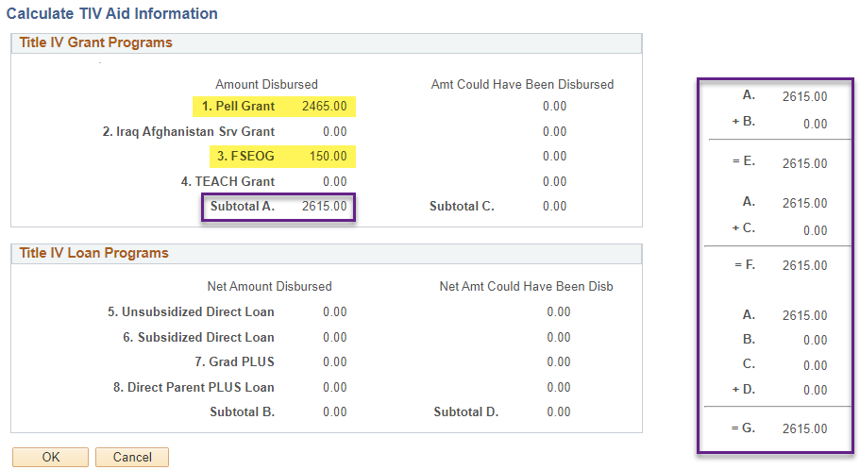
R2t4 worksheet processing cont’d
Pagelet for field E is below & shows the calculation for fields E, F & G
Notes:
The information displayed under Student's TIV Aid Information is from the Student Award Disbursement table and is used to populate the fields under Student's TIV Aid Amounts.

Slide 37
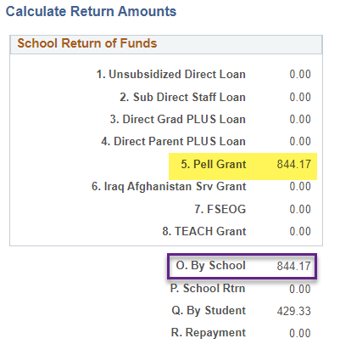
R2t4 worksheet processing cont’d
Here is the pagelet for calculating the school return of funds. In the box, the federal award types & are listed and the amount of federal aid to be returned.
Notes:
View amounts to returned by the institution. In this example, we’ll need to reduce the Federal Pell Grant by $844 to return those funds to the Department of Education.

Slide 38
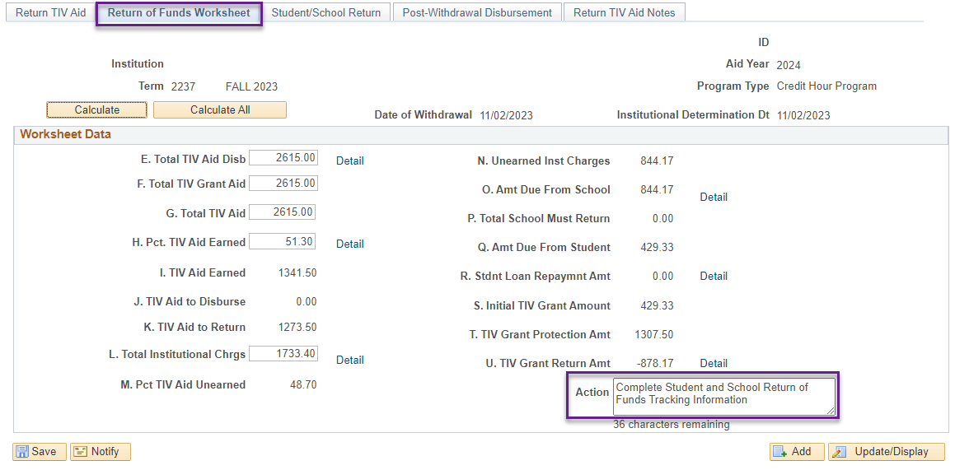
R2t4 worksheet processing cont’d
After the R2T4 is calculated, the system displays a note as a reminder to update the tracking fields on the Student/School Return page or the Post-Withdrawal Disbursement page based on what has occurred with the student.
Notes:
Amt to be returned by the school is $844 Pell. The initial amount of the TIV grant to be returned by the student is $429.33, however, the grant protection allowance is greater, therefore, the student is not required to return Pell (field U is less than or equal to $0).
The worksheet shows the action you should take. The action will change according to the specific student’s scenario. Ex: PWD
Once the calculation is done, go back to the Return TIV Aid tab & change the Overall Status to “complete”. If you prefer to update the Overall Status once the aid is adjusted, be sure to return back to the worksheet because the Days Elapsed will continue to update until the Status is changed.

Slide 39
R2t4 worksheet processing cont’d
Once you are done with the calculation, go back to the Return TIV Aid tab & update the Overall Status to “Completed.”
This step locks the Return TIV Aid & Return of Funds Worksheet tabs and populates the Date Form Completed field
Notes:
If the Overall status is accidentally set to complete & you need to make additional changes, you can set it back to Pending. However, once it’s flipped back to Complete, the Date Form Completed value will update. You can see the history of the changes by selecting the “Last Updated” link. If you are using the Date Form Completed field for tracking or auditing purposes, we’d recommend adding a note on the last tab documenting when the worksheet was originally completed & what changes were made. We will discuss the Return TIV Aid Notes tab later in the presentation.

Slide 40
UPDATE STUDENT ACCOUNT & ADJUST AID
Notes:
If award adjustment is required, proceed to updating the student’s FA load on FA term, re-build the budget & adjust the awards

Slide 41
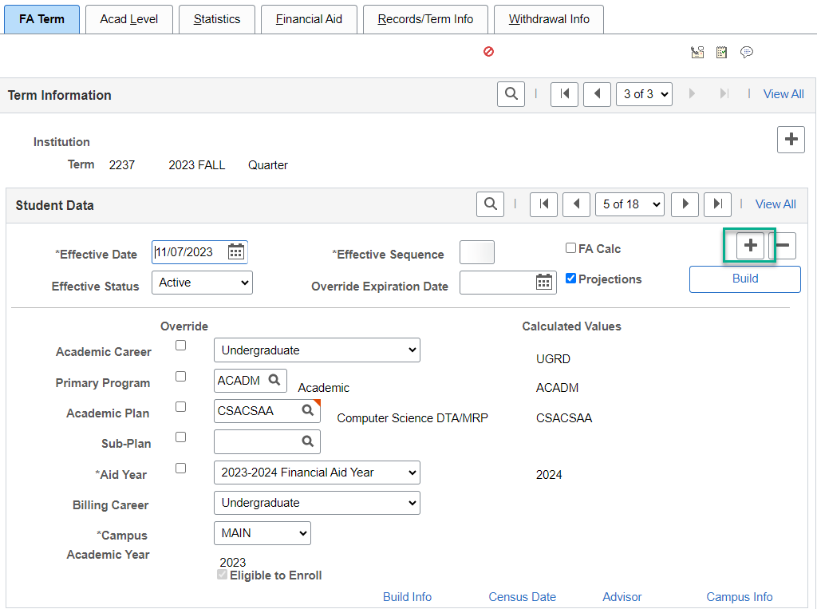
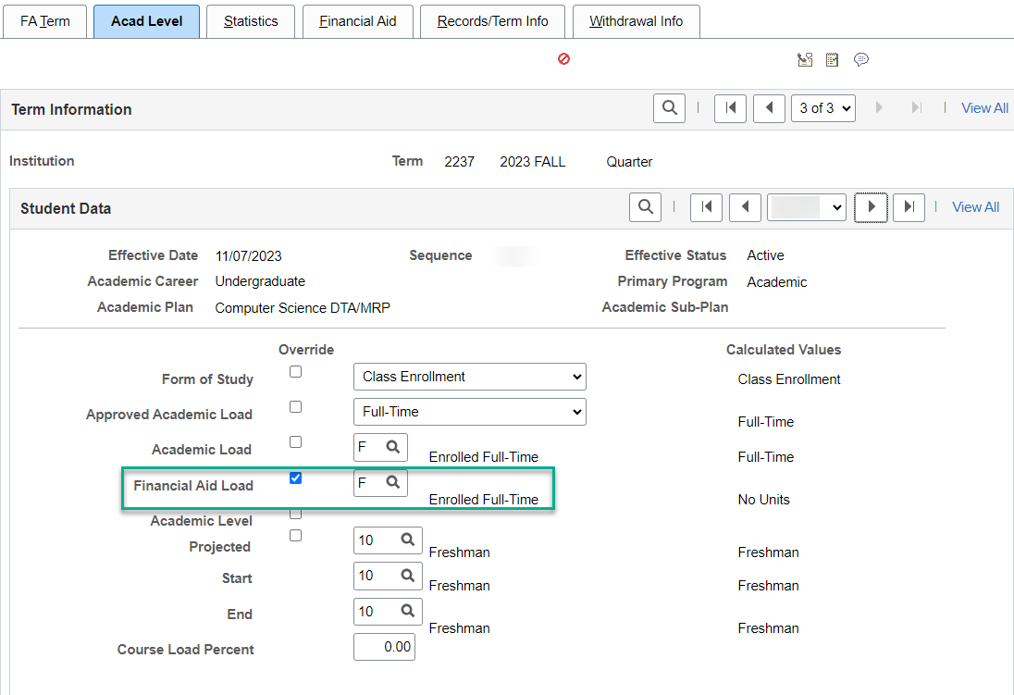
Override FA load
Navigation: Financial Aid > Financial Aid Term > Maintain Student FA Term
If the FA Load is equal to N, override the load to the student’s enrollment level prior to withdrawal
Notes:
On the FA Term tab, add an effective dated row by selecting the [+]. On the Acad Level tab, override the FA Load to L, H, T or F according to their enrollment level prior to withdrawal and select Save. Additionally, you may need to update values on the Statistics tab depending on what type of aid is included in the student’s aid package.

Slide 42
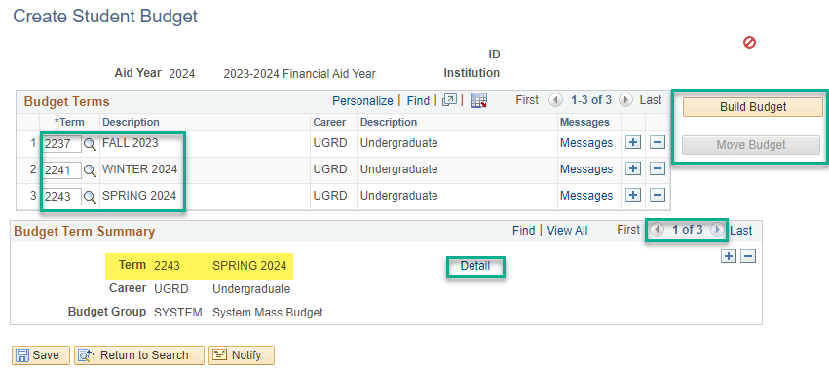
Build budget
On Create Student Budget, re-build the budget for the term in which the student withdrew
Navigation: Financial Aid > Budgets > Create Student Budget
Notes:
On the Create Student Budget page, re-build the budget -
Insert a new Term row under Budget Terms by selecting the [+] button and enter the desired terms. Be sure to rebuild the budget for all the terms in the student’s aid year.
Select the Build Budget button.
Select the Detail link to view the budget information that has been assigned to the terms. Select the arrows to navigate to other terms(s).
Select the Move Budget button to assign this budget to the student’s record.
The Move Budget button will gray out once the process is complete.

Slide 43
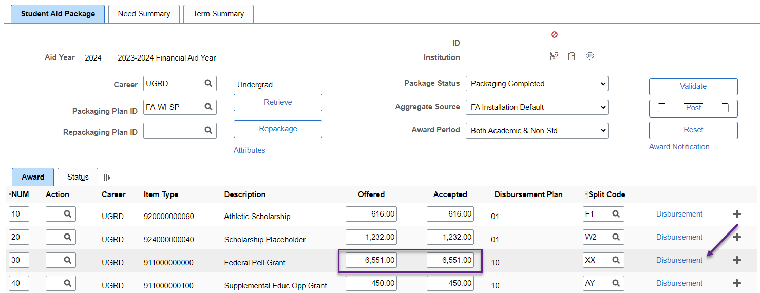
Aid adjustment
Navigation: Financial Aid > Awards> Award Processing > Assign Awards to a Student
On Assign Awards to a Student, reduce or cancel the federal aid (if required)
Notes:
Now, we know that for the student example, we need to reduce the Pell grant by $844.17 to return those funds to the Department of Education. We’re going to round the amount required to be returned from $844.17 to $844. Note: if there are adjustments needed to state or institutional aid, it’s important to make all the adjustments at the same time & especially prior to FARP/FARC process to ensure the student has the correct balance due.

Slide 44
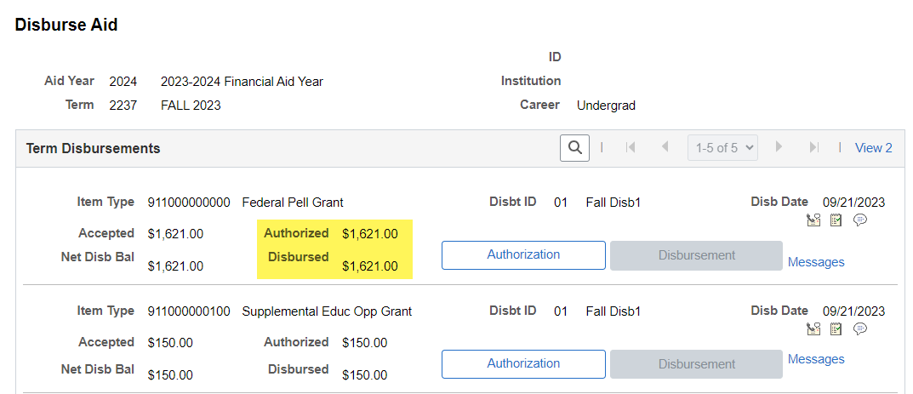
Disburse aid
On Disburse Aid, authorize & disburse the new amount of the federal aid
Navigation: Financial Aid > Disbursement > Disburse Aid
Notes:
Before making any manual disbursements, ensure that no one on your Team is performing batch disbursements as this could cause double disbursements. Manually disbursing the awards will automatically push the disbursements over to Customer Accounts.

Slide 45
Disburse aid Continued
Navigation: Student Financials > View Customer Accounts
The correct amount of Pell now reflects in View Customer Accounts. Contact SF to set the amount the student now owes.
Notes:
Confirm the disbursements are accurate on Customer Accounts & then contact SF to complete the Group Post and any additional steps needed to set the balance on the student’s account
Once adjustments are done, go back to the worksheet to complete the Student/School Return & Return TIV Aid Notes pages

Slide 46
COMPLETING R2T4 WORKSHEET

Slide 47
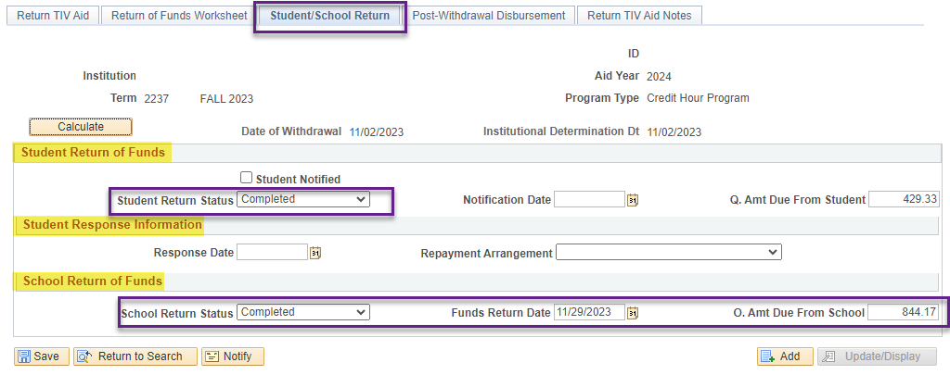
R2t4 worksheet processing
School Return Status: should be flipped to “Complete” when funds are returned
If an overpayment is due, fill out the fields in the Student Return of Funds section (as applicable)
Once the student responds, complete the Student Response Information section
If the student does not need to return funds, update the Student Return Status field to complete.
Notes:
Now that the Pell has been adjusted & disbursed, the School Return Status can be flipped to “Completed” & a date entered into the Funds Return Date field.
If an overpayment is due, fill out the fields in the Student Return of Funds section (as applicable)
Once the student responds, complete the Student Response Information section
If the student does not need to return funds, update the Student Return Status field to complete.

Slide 48
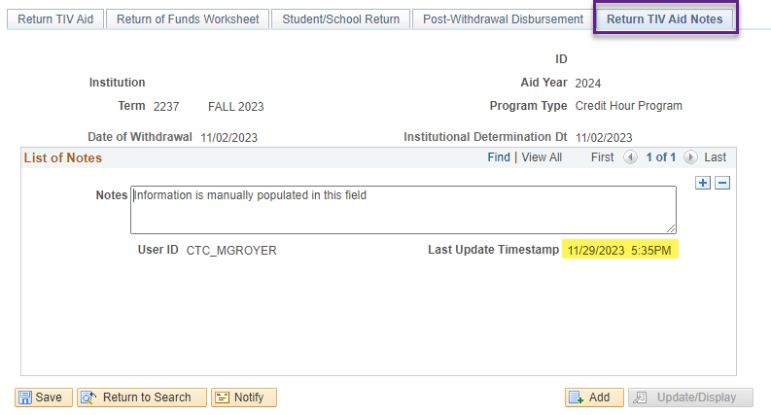
R2t4 worksheet processing cont’d
RETURN OF TIV WORKSHEET HERA
Notes:
You can enter in a comment into the notes field & the note will be timestamped. The timestamp will update anytime the note is edited & saved.
If you want to use this page for documentation purposes & you find that you need to amend or add to your note, add an effective dated row, enter the new comment and save. The new note will have a new timestamp & the original note will retain the original timestamp.
If you have not updated the Overall Status, return to the Return TIV Aid tab & change the status to Completed.

Slide 49
ASSIGN F05 SERVICE INDICATOR

Slide 50
F05 service indicator Assignment
MANUALLY ASSIGN F05 SERVICE INDICATOR
Navigation: Campus Community > Service Indicator (Student) > Manage Service Indicators
Notes:
Manually assign the F05 Service Indicator by selecting [+] Add Service Indicator

Slide 51
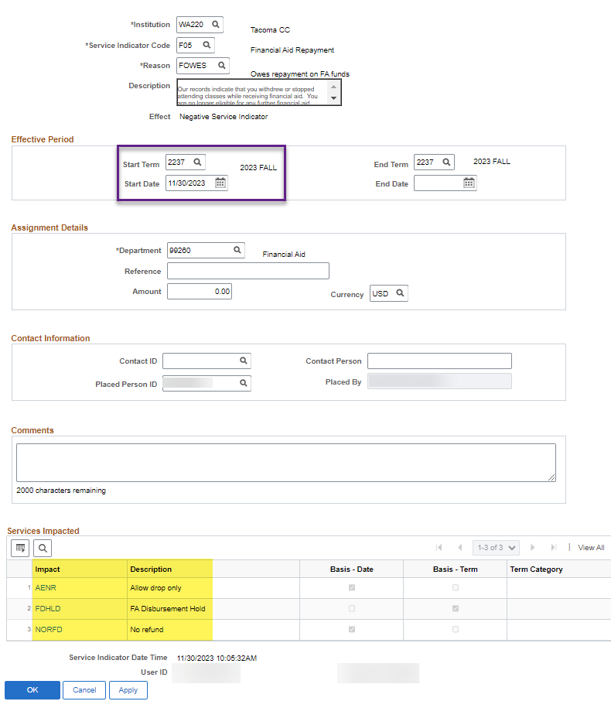
F05 service ind ASSIGNMENT CONT’D
MANUALLY ASSIGN F05 SERVICE INDICATOR
Navigation: Campus Community > Service Indicator (Student) > Manage Service Indicators
Note: Service Impacts can be different for each institution
Notes:
Once students who owe a repayment are identified; assign the F05 Service Indicator and appropriate Reason Code to prevent future Financial Aid disbursements & refunds from posting to a student account.

Slide 52
WAIVE F03 Service indicators
Notes:
Once R2T4 processing is complete – the F03 can be manually removed or removed in batch

Slide 53
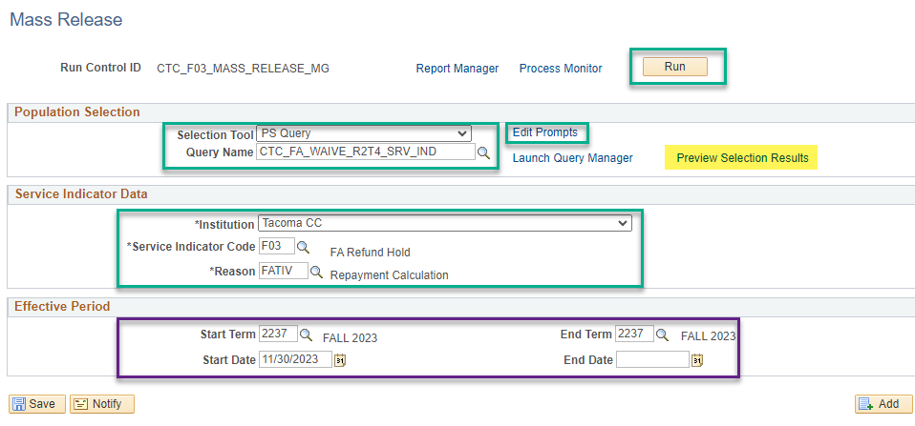
Mass release f03 service indicator
CTC_FA_WAIVE_R2T4_SRV_IND
Navigation: Campus Community > Service Indicators (Student) > Mass Release
Notes:
Once you have completed R2T4 processing, release the F03. If not all students are reviewed on the same day, the indicator can also be removed manually. If removed in batch, navigate to the Mass Release page.
Enter the following:
Selection Tool = PS Query
Query Name = CTC_FA_WAIVE_R2T4_SRV_IND
Institution
Service Indicator = F03
Reason = FATIV
If a specific term was used for the Start and End Term codes to mass assign the service indicator enter that code in the Start Term fields. If a date range was used, then enter the dates for the Start Date or End Date fields.
Click Edit Prompts and enter the following:
Institution
Active Term
Aid Year

Slide 54
Student example & Demonstration
Notes:
Now, let’s do an example together! We’ll go through all the activities for completing the R2T4 for Winter quarter

Slide 55
R2T4 QUERIES

Slide 56
R2t4 queries
Navigation: Reporting Tools > Query > Query Viewer
CTC_FA_SERVICE_INDICATOR_LIST or CTC_FA_NEED_R2T4_WKSHT
Can be used to identify students who have the F03 service indicator
CTC_FA_WITHDRAWN_F03_SVC_IND
Used to assign the F03 Service Indicator in batch and can also be run to identify students who meet the criteria for an F03 (classes that have an Enrollment Status Reason equal to ‘Withdrawn’ or an academic load equal to N in Term Activate a Student, have a loaded ISIR, have a federal item type of Pell, PLUS, SEOG, STFS, STFU, TCH, IASA and/or have any item type listed in the state repayment set up table, and/or have the institutional item type. In addition, the disbursed amount for the selected item types is greater than zero, does not have an F03 and does not have a completed R2T4 or state repayment worksheet and has withdrawn or has drops.
CTC_FA_WITHDRAWN_AID_AWARDS
Identifies students who have fully withdrawn from classes with a W grade, have an official ISIR and have a disbursed balance greater than zero. Includes Item Type amounts, drop date, grades, last date of attendance, R2T4 complete date if they have been marked as complete, and Review Status
CTC_FA_POST_WITHDRAWN
Identifies students who may qualify for a post withdrawal disbursement by selecting students who either do not have any awards posted to the award page OR have an award with accepted amount greater than zero but have not been disbursed, have been enrolled at one point in the quarter and are no longer enrolled
Notes:
Here are R2T4 queries that might be useful for your processing

Slide 57
R2t4 queries continued
CTC_FA_LDA_BY_STUDENT
Pulls the Last Date of Attendance (LDA) for a specific student by term
CTC_FA_UNOFFICIAL_WITHDRAWN
Run AFTER grades are posted because it is looking for classes that are marked as ‘Enrolled’ and Grading Basis equal to anything other than ‘Non-graded’ or ‘No grade’, and the Student Career Term – Units Passed FA equals zero and the academic load in Term Activate a Student does not equal N. Also pulls students who have a loaded ISIR, have a federal item type of Pell, PLUS, SEOG, STFS, STFU, TCH, IASA and/or have any item type listed in the state repayment set up table. In addition, the disbursed amount for the selected item types is greater than zero, does not have an F03 and does not have a completed R2T4 or state repayment worksheet and has withdrawn.
CTC_FA_WITHDRAWN_UNOFF_AID_AWD
Selects students who have not officially withdrawn from classes and should only be run at the end of the term once grades have officially been posted.
Provides additional information to use while creating the R2T4 worksheet. Various data includes, Academic Load, Award Descriptions, Offered, Accepted, Authorized and Disbursed amounts, Student Record update date, Drop Date, Grade, and Last Date of Attendance for students who are enrolled but didn’t earn any units

Slide 58
Outcomes
At training completion, you should be able to:
Identify students to be reviewed for R2T4 by Mass Assigning F03 Service Indicator
Find a student’s withdrawal information in ctcLink
Find a student’s institutional charges
Create & complete an R2T4 worksheet & understand the functionality of key fields on the worksheet
Update a student’s account, adjust federal aid & undisburse/re-disburse
Add an F05 Service Indicator
Use available R2T4 queries for processing

Slide 59
Congratulations!
Training for the R2T4 Worksheet Overview is complete!
Thank you for your participation today!

