Slide 1
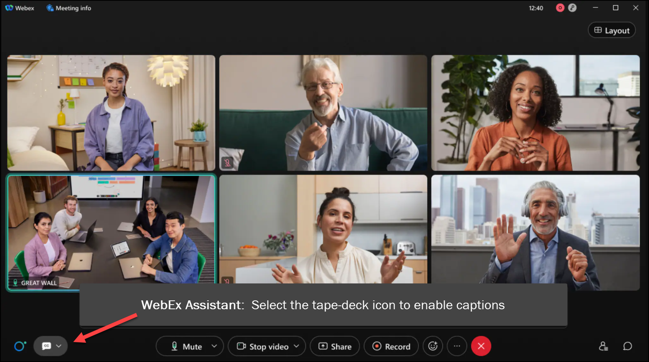

MEETING
RECORDING
NOTICE
The law requires consent prior to recording a person’s participation in an event. Your participation in this video conference (training) equals consent to be recorded, as required by law.
If you do not consent to being recorded but choose to participate, please turn your camera off and use the chat feature to interact with the other participants.

Slide 2
New process! nslds transfer monitoring
Kelly Forsberg
ctcLink Functional Trainer | Financial Aid
December 2023

Slide 3
Objectives
After completing this training, you should be able to:
Understand the changes involved in the NSLDS TSM process
  (Checklist vs. UEM)
Understand how to assign the NSLDS TSM UEM in batch
Understand how to create the Transfer Monitoring request
Understand how to process the Financial Aid History Request
Understand how to complete the File Transfer Process - Inbound/Outbound and the steps involved to process
Understand how to run the Transfer Alert Report
Understand how to work the NSLDS Suspense Management process
Understand when to Resolve the NSLDS TSM UEM
Understand how to run NSLDS Push

Slide 4


What’s changed?
Term-to-term NSLDS TSM tracking
Not required to assign & request same day
UEMs are internal only
UEMs can be resolved early

Slide 5
ASSIGNING
NSLDS (TSM)
USER EDIT MESSAGE

Slide 6
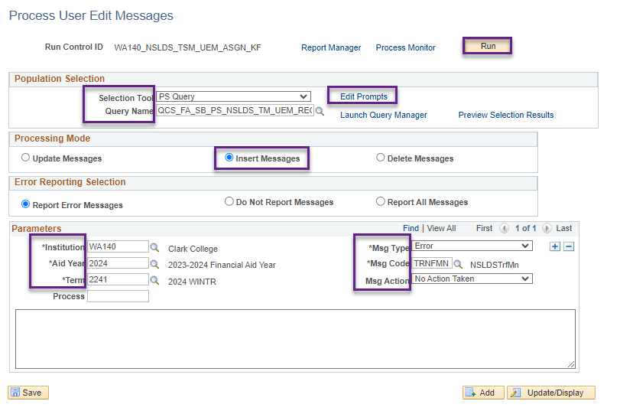
New process! Assign user edit msg
Navigation: Financial Aid > Disbursement > Process User Edit Messages
Prior to this step, you have the option of running the query on its own in Query Viewer to see which students will get the UEM.

Slide 7
CREATING TRANSFER
MONITORING & FINANCIAL AID HISTORY REQUEST

Slide 8
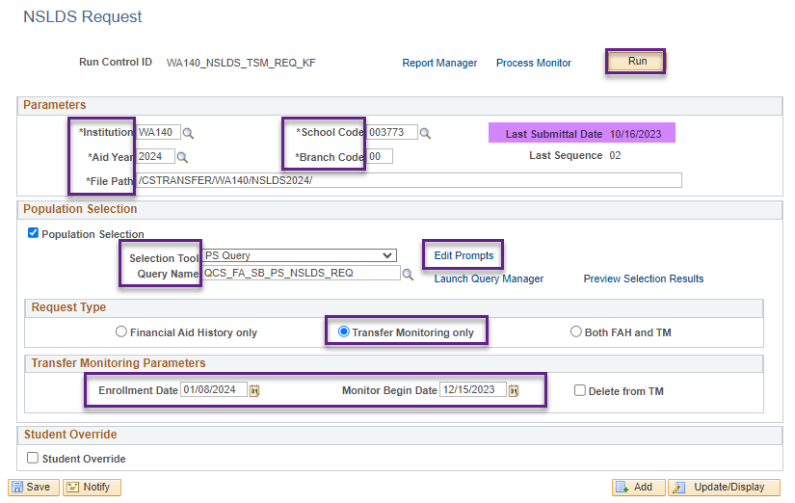
Creating transfer monitor request
Navigation: Financial Aid > File Management > NSLDS > Process NSLDS Request
In the Enrollment Date, set that date as the start of the term. The Monitor Begin Date will throw a warning message and place the Monitor Begin Date to the current date.

Slide 9
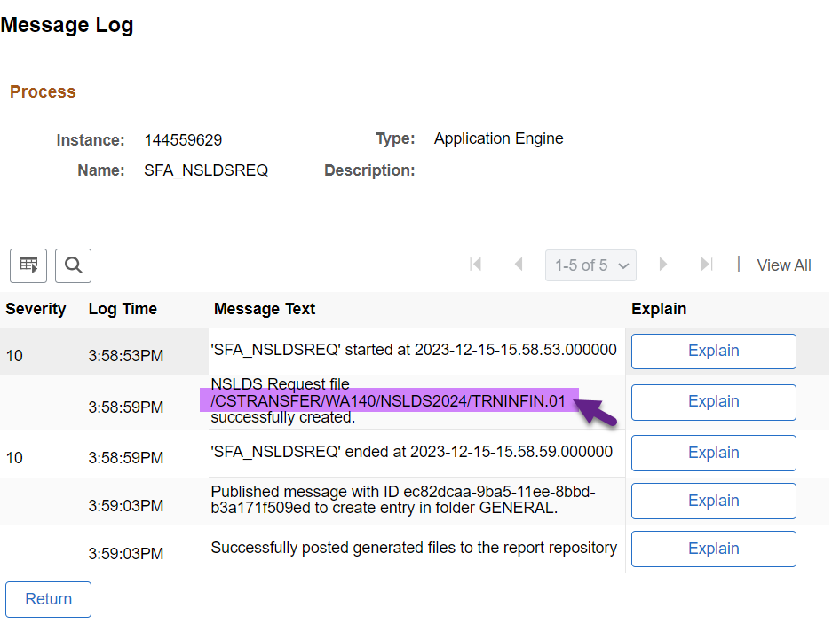
Check message log to see file created
Look for the TRNINFIN.01 file – this will be used in another process

Slide 10
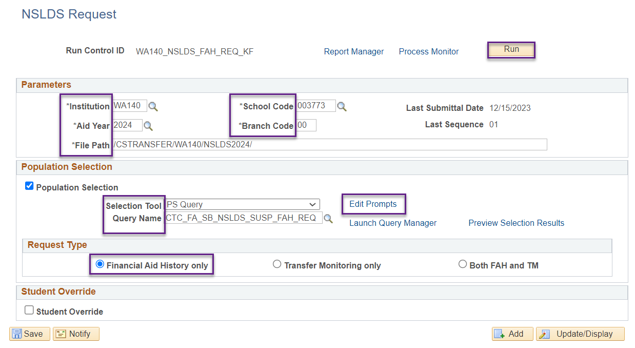
Creating fa history request
Navigation: Financial Aid > File Management > NSLDS > Process NSLDS Request
This query will pull history on suspended ISIRs

Slide 11
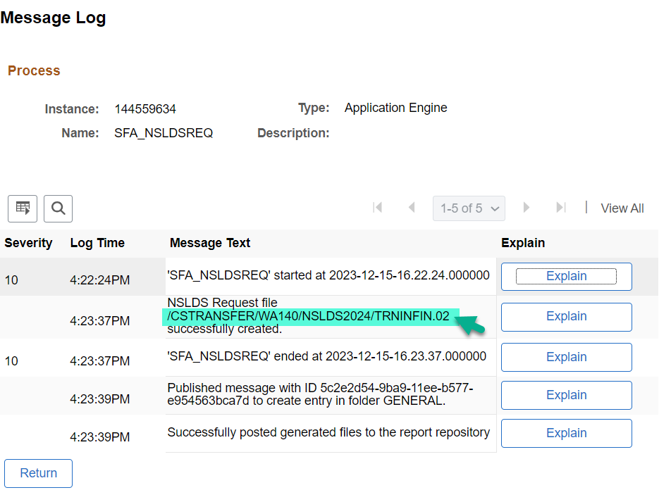
Check message log to see file created
Look for the TRNINFIN.02 file – this will be used in the upload/download process

Slide 12
DOWNLOAD FILES
FOR OUTBOUNDING
TO ED CONNECT

Slide 13
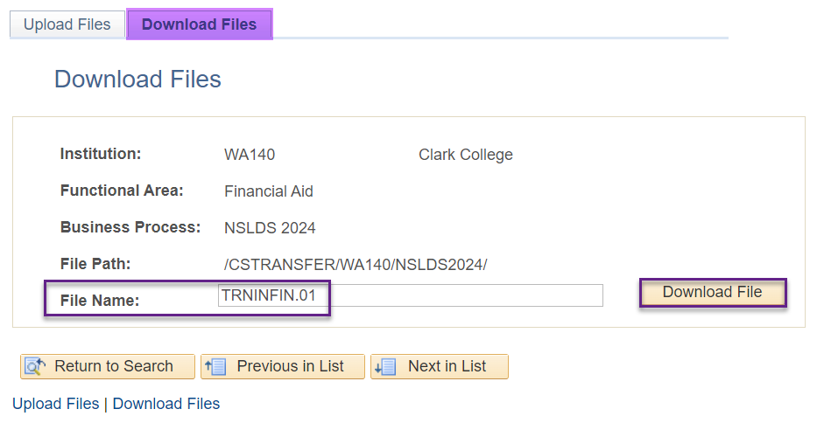
Download trninfin files/outbound
Navigation: PeopleTools > CTC Custom > Extensions > Upload/Download Files
Download both the TRNINFIN1 and TRNINFIN2 files and outbound them through EdConnect

Slide 14
DEMONSTRATION

Slide 15
UPLOAD RESPONSE FILES
FOR INBOUNDING
TO CTCLINK

Slide 16
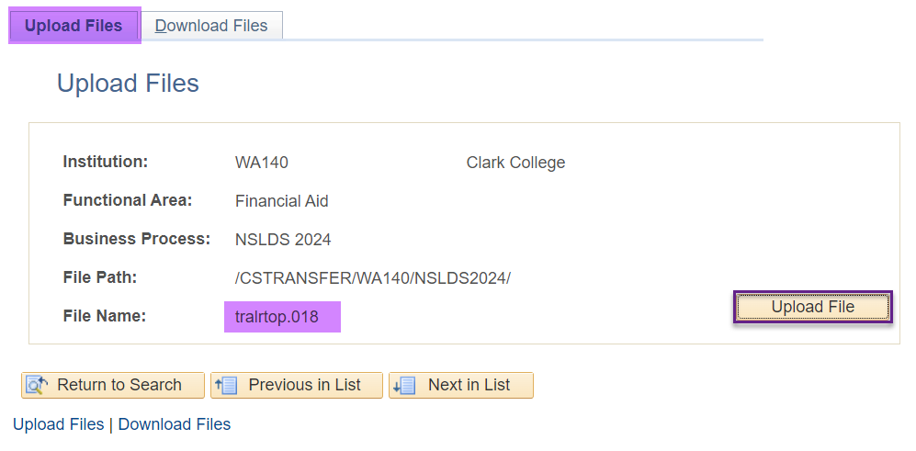
UPLOAD TRALRTOP/FAHEXTOP FILES/INBOUND
Navigation: PeopleTools > CTC Custom > Extensions > Upload/Download Files
When your file is received in EdConnect, save it to your network drive, and then upload it into ctcLink. Do this for both your TRALRTOP and FAHEXTOP file(s).

Slide 17
IMPORT FEDERAL
DATA FILES
(TRALRTOP & FAHEXTOP)

Slide 18
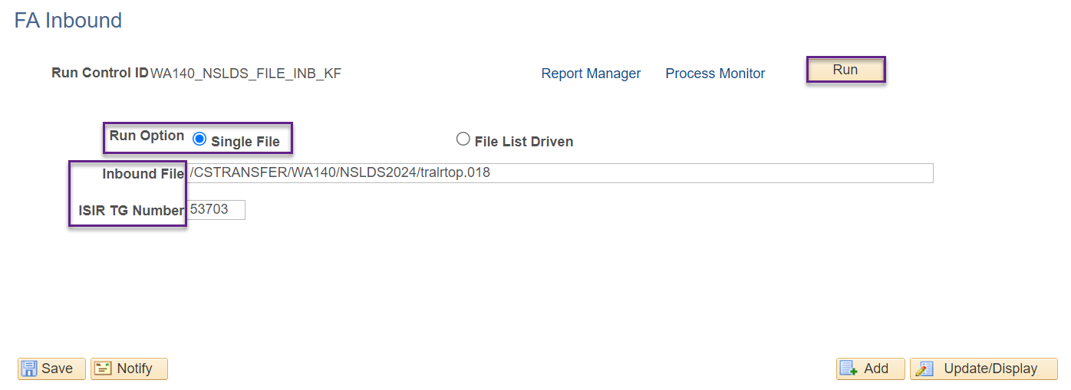
UPLOAD TRALRTOP/FAHEXTOP FILES/INBOUND
Navigation: Financial Aid > File Management > Import Federal Data Files
Remember to process both files, one at a time. Both your TRALRTOP and your FAHEXTOP files should be processed.

Slide 19
PROCESS
NSLDS FILES

Slide 20
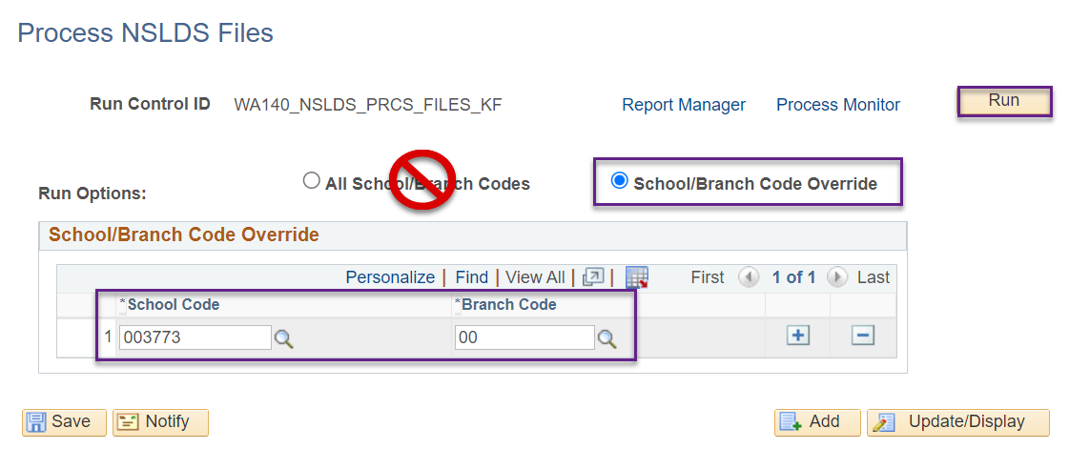
Process nslds files
Navigation: Financial Aid > File Management > NSLDS > Process NSLDS Files
Do not select the All School/Branch Code button; you will erroneously process ALL NSLDS files for ALL schools

Slide 21
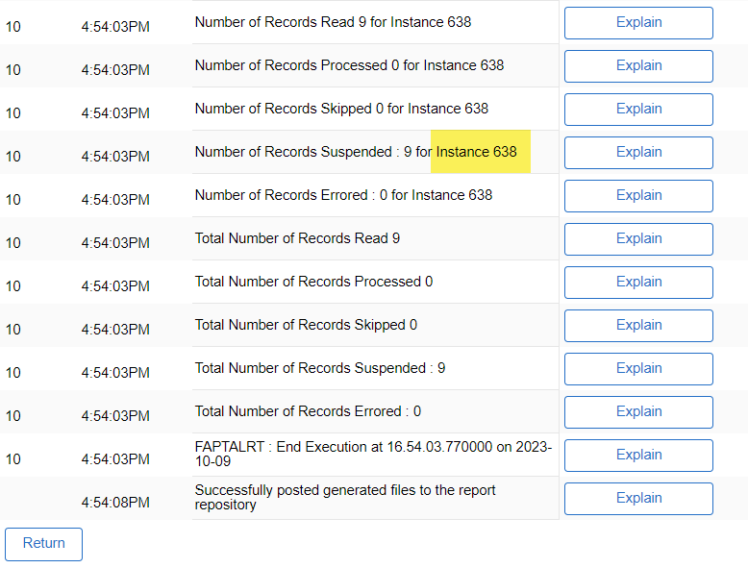
Process nslds files CONT’D
MESSAGE LOG
Find the Instance Number– you will use it for the NSLDS Suspense Process

Slide 22
RUN THE
TRANSFER
ALERT REPORT

Slide 23
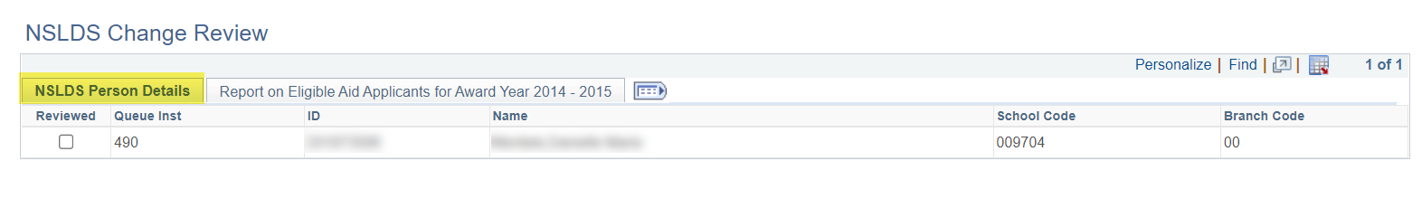
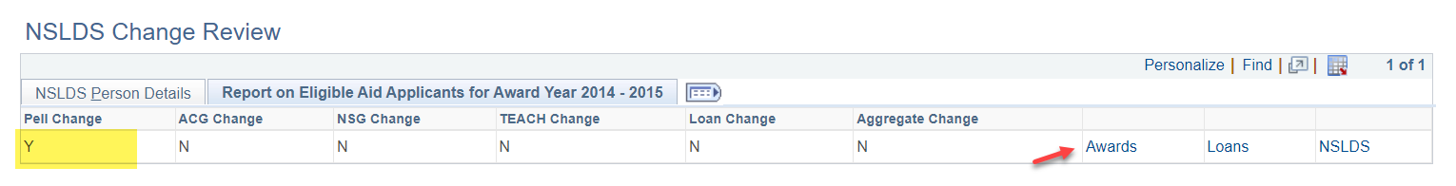
Run the transfer monitor alert report
Navigation: Financial Aid > File Management > NSLDS > Review NSLDS Flagged Students
Drill down into the Report on Eligible Aid Applicants for Award Year. The above example shows a change in Pell. Check the Award link to review the Award.
Review for all students.

Slide 24
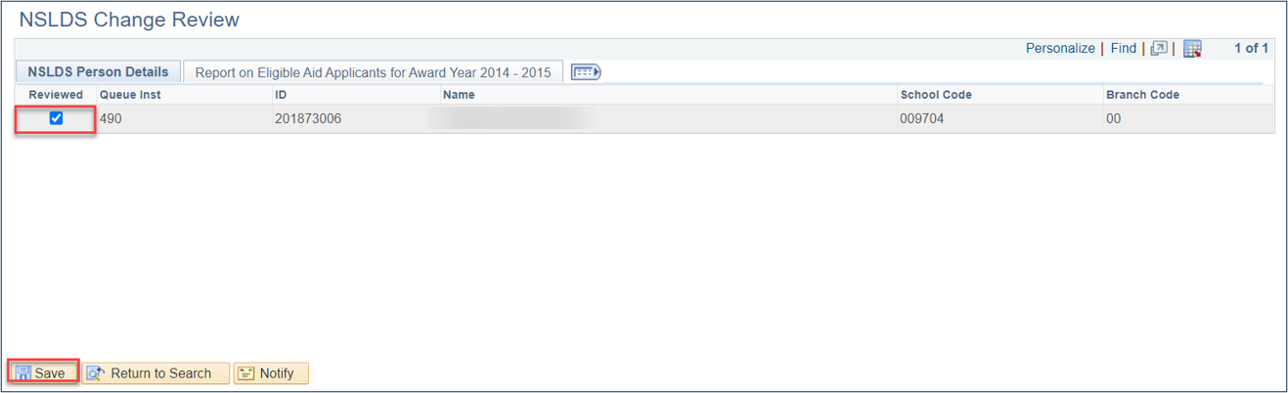
Run the transfer monitor alert report cont’d
When review is complete, and any necessary awards are adjusted, set the Reviewed checkbox to checked, and select the Save button.
You can make a comment in the View Fin Aid Status page to indicate the TSM Student has been reviewed,

Slide 25
DEMONSTRATION

Slide 26
NSLDS SUSPENSE
MANAGEMENT

Slide 27
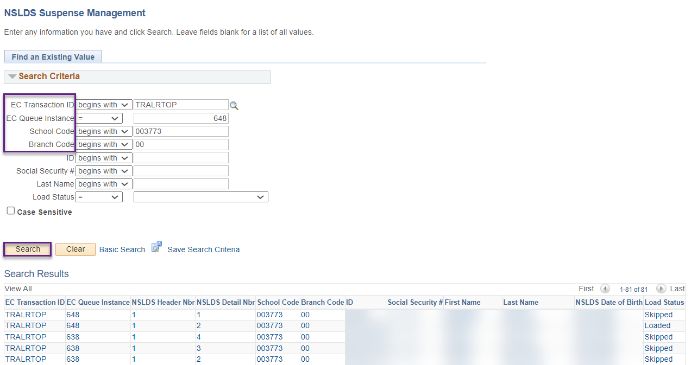
NSLDS SUSPENSE MANAGEMENT
Navigation: Financial Aid > File Management > NSLDS > NSLDS Suspense Management
Review suspense records and make the determination whether the record should be loaded.

Slide 28
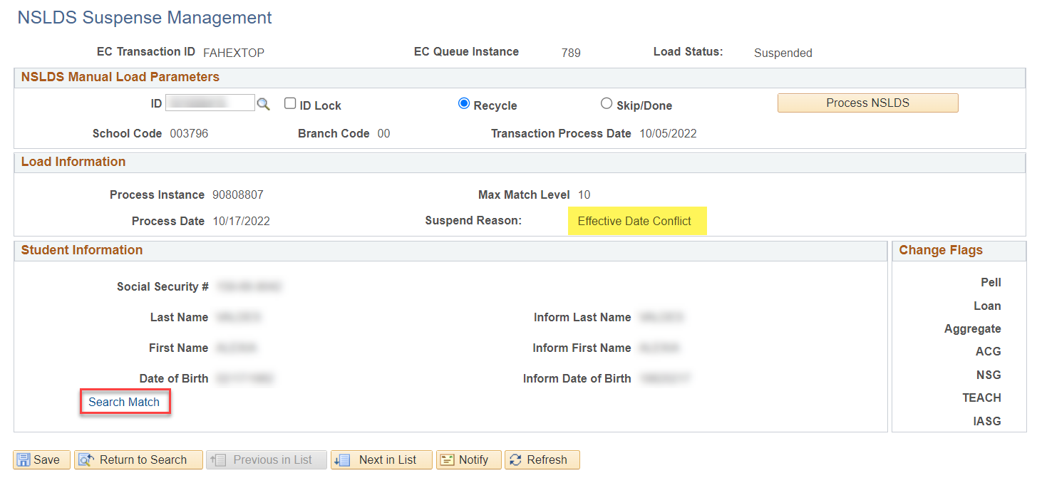
NSLDS SUSPENSE MANAGEMENT cont’d
Typically, you are looking for name mismatches, date of birth mismatches, or social security number mismatches. You will need to run Search Match before making the determination to load the record.
Check the Transfer Monitoring Business Processing Guide for an extensive list on reasons why records suspend.

Slide 29


NEXT STEPS
RESOLVE THE UEM IN BATCH
RUN NSLDS PUSH
  NSLDS Push will be run in nightly ISIR JobSet, or you can run it ad hoc to push this process

Slide 30
Outcomes
At training completion, you should be able to:
Understand the changes involved in the NSLDS TSM process
  (Checklist vs. UEM)
Understand how to assign the NSLDS TSM UEM in batch
Understand how to create the Transfer Monitoring request
Understand how to process the Financial Aid History Request
Understand how to complete the File Transfer Process - Inbound/Outbound and the steps involved to process
Understand how to run the Transfer Alert Report
Understand how to work the NSLDS Suspense Management process
Understand when to Resolve the NSLDS TSM UEM
Understand how to run NSLDS Push

Slide 31
Congratulations!
NSLDS Transfer Monitoring Processing Refresher Training Complete!
Please review the NSLDS Transfer Monitoring Alert Business Processing Guide resource as you are doing your TSM processing
Thank you for your participation today!

